Slide 1

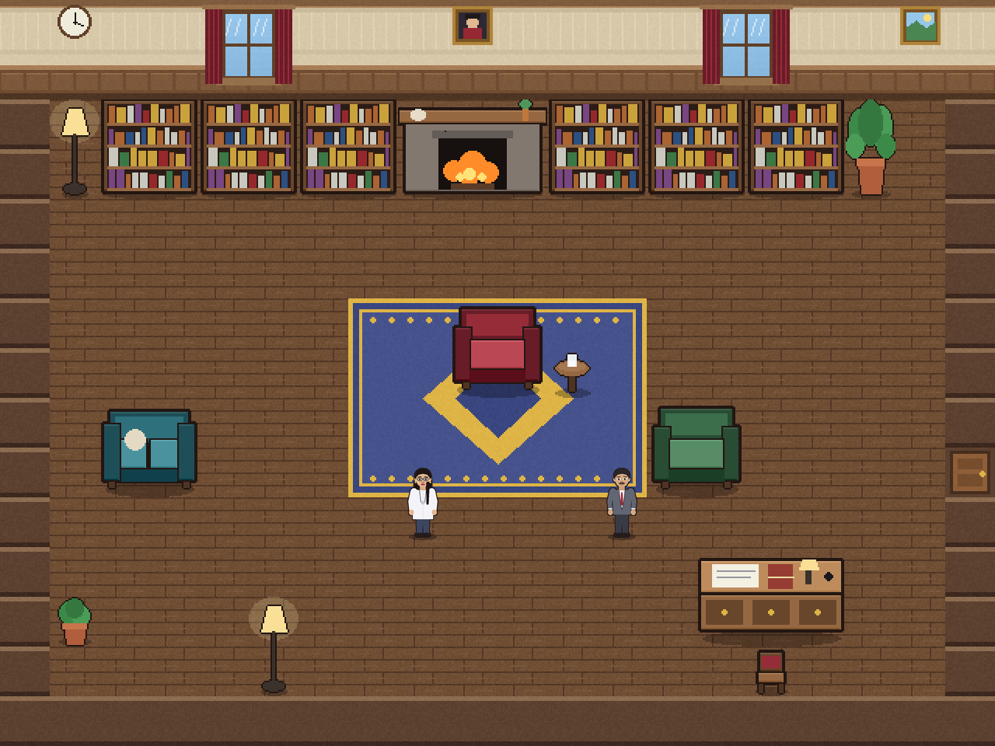
PROJECT-BASED LEARNING
PHASE-II EVALUATION
The Detective’s Dossier
A 2D murder-mystery investigation game in C++ and Qt
The library, rendered from our map files
Team Code Detektives
Team ID: DSCPP-III-2026-T027
Department of Computer Science & Engineering
Graphic Era (Deemed to be University), Dehradun
Academic Session 2026–27
Notes:
Introduce yourselves and the project in one sentence: a 2D murder-mystery game where the player must earn every clue, cross-examine suspects and use school science, built on graphs, a DAG, hash maps and a stack. Mention the team name and ID.

Slide 2
Team & Mentor Details
Team Information
Team Members
Team Name:
Code Detektives
Bahuguna, Ashutosh – 2510370440 (Team Lead)
Pundir, Snehal – 2510370590
Somraan, Vidhi – 2510380302
Team ID:
DSCPP-III-2026-T027
Semester:
3rd
Section:
ML1, ML2, ML3
Domain:
Game development
Mentor
Mr. Sujal Bindra
Interactions completed:
4
Notes:
Introduce each member and say who the mentor is. Section ML1, ML2, ML3; mentor Mr. Sujal Bindra; 4 interactions completed.

Slide 3
Phase-I Recap & Feedback Incorporated
Phase-I Status
Proposed:
a 2D murder-mystery game in C++ with Qt and SQLite, with several cases, using graphs with BFS/DFS, hashing, a stack and sorting in the investigation logic.
Achieved:
the idea, objectives, architecture plan and technology selection.
Feedback Received
Changes Incorporated
Earlier we planned multiple cases; our mentor advised a simpler scope with just one case
Focus more on Data Structures and Algorithms, since PBL is mainly about DSA, instead of showing many different things
Scope simplified: one complete, polished case (The Old Way) instead of several
DSA is now the core: graph + BFS, DAG + topological sort, hash tables and a stack drive the game logic
A validator built on those algorithms proves the case is solvable with one culprit
Notes:
Two pieces of mentor feedback: (1) make it simpler with just one case instead of several, (2) focus more on DSA because PBL is mainly about DSA. We changed the scope to a single complete case and we made the data structures and algorithms the core of the project. The repository still holds two small extra cases, but they are used only by the automated tests to show the engine is reusable; the game itself ships one case.

Slide 4
Problem Statement & Finalized Objectives
Problem Statement
Most detective games either hand the player the answer or hide the logic. We want a mystery the player must reason through: earning every clue, catching lies by cross-examination and using school science, while data structures and algorithms drive the game itself.
Finalized Objectives
1
2
3
4
Apply graphs (BFS), a DAG (topological sort), hashing and a stack inside the game logic, with complexity analysis
Prove the mystery is fair: a validator checks every clue is reachable and one culprit is provable
Deliver one complete, playable case: 7 rooms, 6 characters, 23 pieces of evidence
Add SQLite storage and measure playability with 5 to 10 playtesters (Phase-III)
Notes:
State the finalized problem and the four measurable objectives. Objectives 1 to 3 are achieved; objective 4 (SQLite and playtesting) is planned for Phase-III. Objective 1 reflects the mentor advice to focus on DSA.

Slide 5





Updated System Architecture / Workflow
Input Layer
Processing Layer
Core Logic
Database Layer
Output Layer
Keyboard: move, interact, dossier, lab, accuse
Qt game screen: game loop, state machine, collision, camera, map loader
C++ engine: Case, Game, Validator, cross-examination, forensics
SQLite planned for Phase-III. Now: case data in C++, maps in Tiled JSON
2D tile world, animated characters, dossier, lab and ending screens
Major Components
Changes Since Phase-I
Engine (Case, Game, Validator): holds every rule and data structure
Qt screen: draws the world, menus and talks to the engine
Tiled maps and an asset pipeline: rooms, tiles, sprites
Architecture: engine separated from the screen so it can be unit-tested
New components: validator, cross-examination, forensic lab
Workflow: case data → validator → game; maps checked against the case
Notes:
Walk left to right: keyboard input, the Qt screen, the engine, the (planned) database and the output. Emphasise that the engine never draws anything and the screen never decides rules. The database layer has a dashed border because it is planned, not implemented. Do not present it as done.

Slide 6



Module Design & Functional Requirements
Major Modules
Functional Requirements
Engine: Entities, Case, Game (rules, undo, credibility)
Explore 7 rooms; locked doors open only with the right clue
Collect evidence; some clues need earlier clues first
Cross-examine people and present evidence to catch lies
Run forensic tests: body cooling, ink chromatography, Samvat dial
Accuse the culprit; wrong evidence costs credibility
Save progress and log in (planned for Phase-III)
Validator and Forensics: solvability proof, science maths
Map loader: Tiled JSON, collision, map checker
Qt game screen: movement, camera, menus, dossier
Database (planned): SQLite login, progress, cases
Module Dependency
The Qt screen asks the engine for every rule decision; the engine never touches the screen. The validator and the map checker both read the case data. SQLite will later feed cases and progress into the engine.
Notes:
Explain each module in one sentence and how it depends on the others. The key idea: the engine is independent of Qt, which is why we can test it automatically.

Slide 7
Technology Stack & Development Methodology
Technology Stack
Development Methodology
Programming:
C++17
Requirement analysis: done in Phase-I
System design: engine, screen and data kept separate
Module development: one module at a time, each with tests
Integration: engine, Qt and maps joined; SQLite pending
Testing and validation: automated tests done; playtests pending
Database:
SQLite (planned, Phase-III)
Framework:
Qt 6 (Widgets)
Dev tools:
Qt Creator, CMake, Tiled map editor
Version control:
Git / GitHub
Why these choices: C++ and Qt give a fast native game with real classes; Tiled is a standard map editor; SQLite needs no server.
Notes:
Explain why each technology fits: C++ for the DSA and OOP course concepts; Qt for the 2D interface; Tiled for maps; SQLite because it needs no server. Be honest that SQLite is planned and not yet integrated.

Slide 8
Implementation of PBL Course Concepts
Concept | Where and how it is used in the game | Module / complexity
Graph + BFS | Rooms are vertices, doors are edges; locked doors open only with a clue. BFS finds the rooms the player can reach. A second BFS on the tile grid proves nothing is walled off. | Validator.h, Interact.h • O(V + E)
DAG + topological sort | Clue prerequisites form a DAG. Kahn’s algorithm detects impossible cycles. | Validator.h • O(V + E)
Hash tables | Find any clue, room or person by ID; check held clues instantly. | Case.h, Game.h • O(1) average
Stack | Undo of moves and clues (last in, first out). | Game.h • O(1) push and pop
Queue, recursion, arrays | Queue inside BFS and Kahn; recursion in the JSON map parser; vectors for tile maps. | Validator.h, JsonLite.h • O(n)
OOP with C++ | Abstract class Entity; inheritance (Location, Clue, Suspect); polymorphism (virtual functions, Qt overrides); encapsulation. | Entities.h, Case.h, Game.h
Containers come from the C++ STL; the algorithms (BFS, Kahn’s sort, the perfect-player validator) are written by us
Not claimed yet: DBMS concepts (SQLite planned for Phase-III) and operating-system concepts
Notes:
For each concept, say where it is implemented and why. Data structures: BFS is in reachableLocations in Validator.h, Kahn's sort checks the clue DAG, hash tables are unordered_map in Case.h, the stack is the undo history in Game.h. OOP: Entity is abstract, three classes inherit from it. Only claim what is implemented: DBMS is not done yet. Be ready to explain that we use STL containers rather than writing our own.

Slide 9
Development & Implementation Progress
Module | Status | Work completed
Game engine | Completed | Classes, hash-map registry, room graph with BFS, clue DAG, undo stack
Validator and forensics | Completed | Solvability proof; body-cooling and Rf calculations
Cross-examination | Completed | 15 statements, press and present evidence, credibility, accusation rule
Qt 2D interface | Completed (prototype) | Movement, collision, camera, animated characters, dossier, lab screens
Maps and art | Completed | 7 rooms in Tiled format, tileset, character sprites, map checker
SQLite database | In progress | Initial work started; not yet integrated
Sound, menus, playtesting | Pending | Planned for Phase-III
~60%
Overall project completion
Remaining: SQLite, deeper DSA work, playtesting, sound and menus
Notes:
Clearly separate completed, in-progress and pending work. The ~60% is our estimate: the logic and interface are done, the database, audio and user testing are not. Do not present planned work as completed. If asked why the Phase-II report describes an earlier stage, explain that the report was written before the engine, interface and maps were integrated, and that this deck shows the current state.

Slide 10
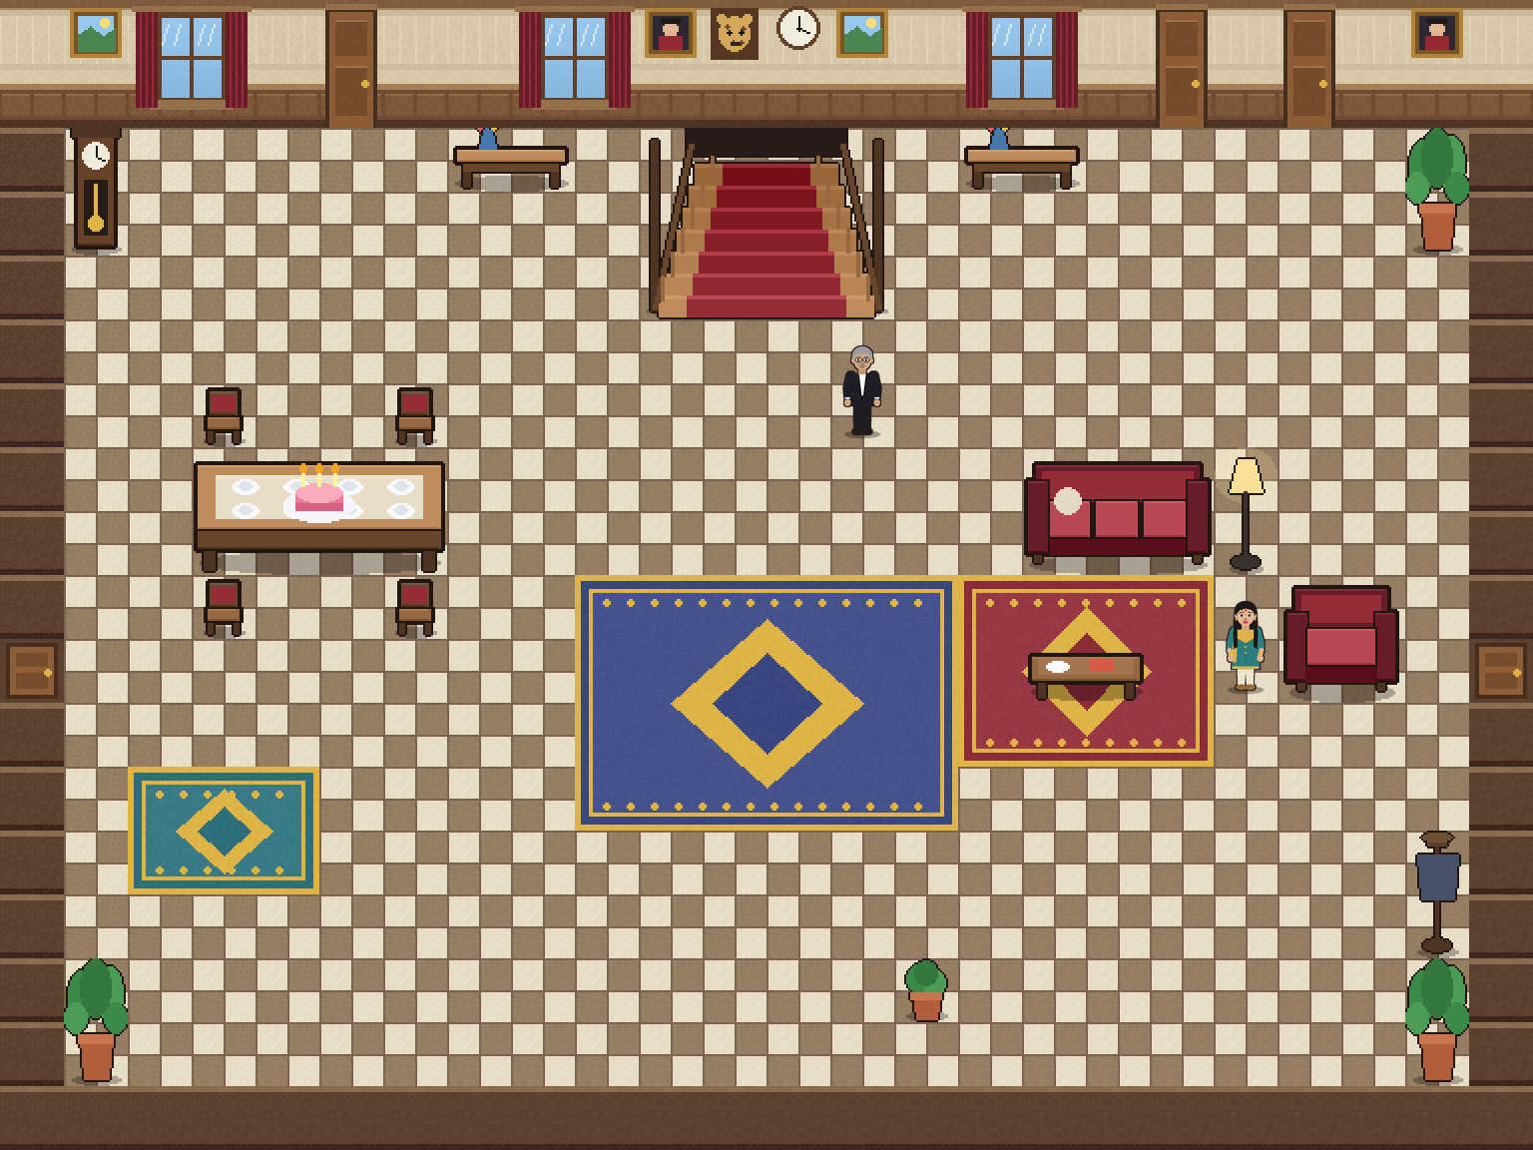


Working Prototype / Demonstration
Implemented Features
Prototype / Output
7 rooms; locked doors open with clues (graph + BFS)
Clues unlock in a fixed order (DAG + topological sort)
Instant lookup of clues, rooms and people (hash tables)
Cross-examine six people with evidence; undo history (stack)
The hall and the library, rendered from our map files. A live demonstration follows.
Forensic puzzles: body cooling and ink chromatography
Demo path: Dr. Reddy → forensic lab → cross-examine Rohit → hidden passage → accuse
Notes:
Give a live demonstration (about 3 minutes): talk to Dr. Reddy in the library and press P; press L and solve the time-of-death puzzle (37 minus 29 is 8 hours before 7:15 am, so 11:15 pm); show the papers on the side table and cross-examine Rohit with them (T); show a wrong piece of evidence costing credibility. Replace the room images on this slide with real in-game screenshots from your laptop before presenting.

Slide 11
Testing, Results & Validation
Test / Module | Expected result | Observed result | Status
Engine unit tests | Locks, undo and accusation rules behave correctly | All tests passed | Pass
Case validator | Every clue reachable; one provable culprit; broken cases rejected | Solvable with exactly one culprit; bad cases rejected | Pass
Cross-examination | Right evidence exposes a lie; wrong evidence costs credibility | Scripted playthrough solves the case | Pass
Forensic maths | Death at 23:15; ink matches Rf 0.71 | 23:15 computed; pen 3 (Rf 0.71) matched | Pass
Map checks and walking | Every door, clue and person reachable in all 7 rooms | All 7 rooms pass | Pass
Outside playtesting | Players can finish and enjoy the case | Not yet run | Pending
Results / Validation
140+ automated checks with no failures. Solvability is proven by the validator, not assumed. Outside user testing (completion rate, time to solve) is planned for Phase-III.
Notes:
Show the engine_tests window saying 'All tests passed' if possible. Explain that the tests found real bugs (for example a door that placed the player inside a wall). Re-run engine_tests on your own laptop before presenting and show it. The playtest row is honestly pending.

Slide 12
GitHub Repository & Development Activity
Repository Information
Development Activity
GitHub Link:
github.com/AshutoshBahuguna206/PBL-Sem3-DSCPP
Commits so far:
[number]
Individual commits:
[each member, own account]
README.md:
[Updated? yes / no]
Contributors:
[All 3 members added?]
Last upload:
[date]
Repo status:
[Latest code pushed?]
Documentation:
[README, report, notes]
Branches:
[main / others]
Notes:
Every team member must be a contributor and must commit individually from their own GitHub account. Before presenting: push the latest code (the dossier engine v13 project), update the README with build and run steps, add all three members as contributors, and replace every red placeholder on this slide with real facts.

Slide 13
Individual Contribution
Member | Role | Technical contribution | GitHub commits
Ashutosh Bahuguna | Team Lead | Project structure and technology planning. [Add the specific modules you built, tested or changed] | [XX]
Snehal Pundir | Game design | Game design: locations, clues, suspects and features. [Add the specific work you did in code or testing] | [XX]
Vidhi Somraan | Database | SQLite database work for user details and progress. [Add what is implemented and tested] | [XX]
Individual Evaluation
Every member should be ready to explain and demonstrate their own technical contribution. Contributions here must be specific and verifiable in the commit history.
Notes:
Replace every red placeholder with specific, truthful work that each member can explain and that is visible in their own commits. Avoid generic statements such as 'helped in coding'. Each member should be able to explain at least one module in detail, for example the validator, the cross-examination code in Game.h, the map loader or the Qt screen.

Slide 14
Challenges, Remaining Work & Phase-III Roadmap
Challenges Faced
Solutions / Learning
Phase-III Roadmap
Qt installation, and a missing-DLL error when we first ran the window
Our first version was only “collect clues” and felt boring
Making sure the mystery has exactly one fair solution
Integration bugs, such as arriving inside a wall after a door
Deployed the Qt libraries and learned clean rebuilds
Redesigned the game around cross-examination and science puzzles
Wrote a validator and automated tests that caught real bugs
Learned Qt, Tiled and sprite graphics step by step
SQLite: login, saved progress, case loading
Deepen DSA: sorting and searching in the dossier, complexity analysis
Playtesting with 5 to 10 users
Sound, menus and a tutorial
Final testing, documentation and report
Notes:
Explain genuine technical challenges and a realistic roadmap. Be honest: SQLite, audio and playtesting are still to do. The roadmap is what you will finish before Phase-III.

Slide 15
Expected Outcomes & References
Expected Final Outcomes
References
A complete single-case game with saved progress
Measurable results: completion rate and time to solve from playtests
Educational use: practise logical reasoning and school science
Runs on Windows desktops; a packaged build is possible
Documented complexity analysis of every data structure used
T. H. Cormen et al., Introduction to Algorithms, MIT Press (BFS, topological sort)
R. Lafore, Object-Oriented Programming in C++
Qt 6 documentation: doc.qt.io
Tiled map editor documentation: doc.mapeditor.org
SQLite documentation: sqlite.org/docs.html
Thank You
Questions & Suggestions
Notes:
Conclude with the final outcome expected: a complete, tested investigation game that teaches reasoning. Thank the panel and invite questions. Each of you should be ready to answer questions on the code you worked on.

