Slide 1
CSE 635 Milestone 3 Stance Detection and Rumor Verification
Team : Predict This!
Vaisshnavi Yerrapothu
Suraj Suraj
Ashutosh Bhawsar

Slide 2
Subtasks :
A - Stance Classification :
- Classify text data into 4 classes – Support, Deny, Query, Comment
B - Rumor Verification:
- Classify text data into True, False and Unverified class
C – Stance Generation :
- Generating a stance based on source tweets and consecutive replies

Slide 3
Task A
Preprocessing :
Extracting the source and reply tweets from the json file.
Removing the null values.
Processing the URLs, hashtags and mentions.
Models:
Baseline: MLP with tf-idf
Milestone3: RoBERTA

Slide 4
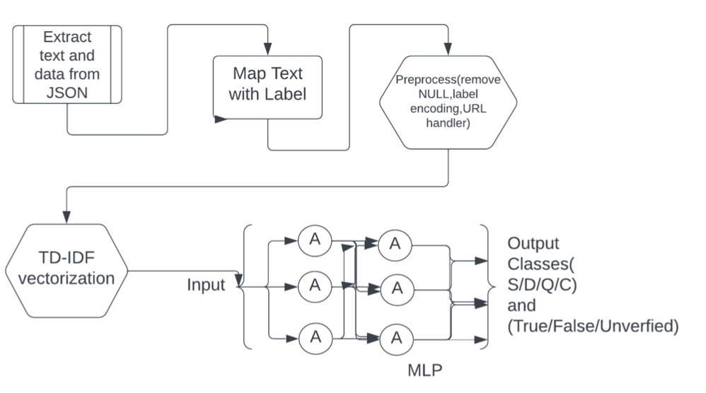
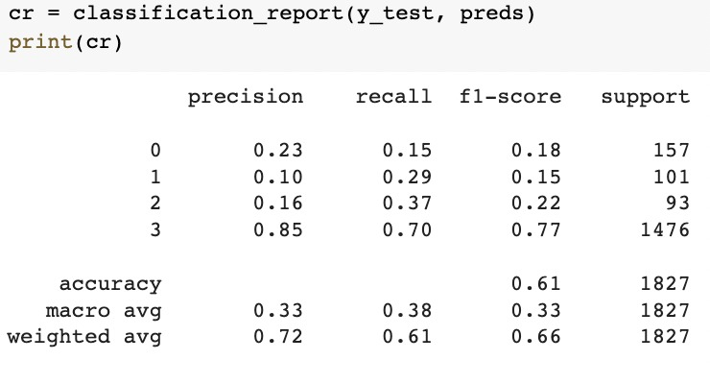
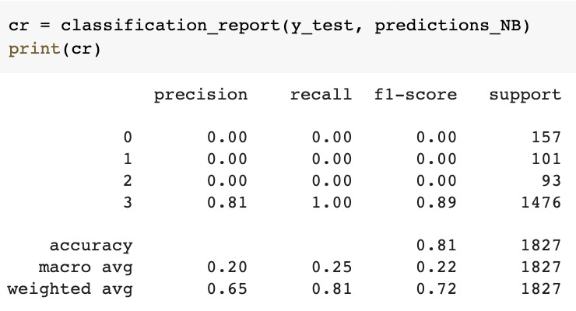
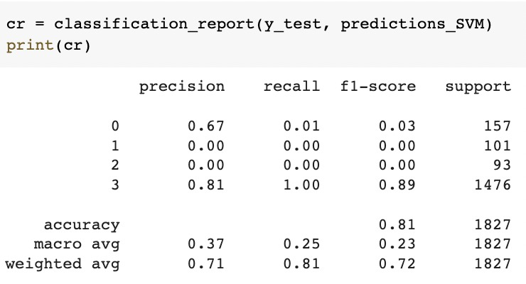
TASK A Milestone2 – Base Models
MODEL: TF-IDF and MLP
TD-IDF and Bayes Classifier
TD-IDF and SVM
MultiLayerPerceptron
Naïve Bayes
SVM

Slide 5
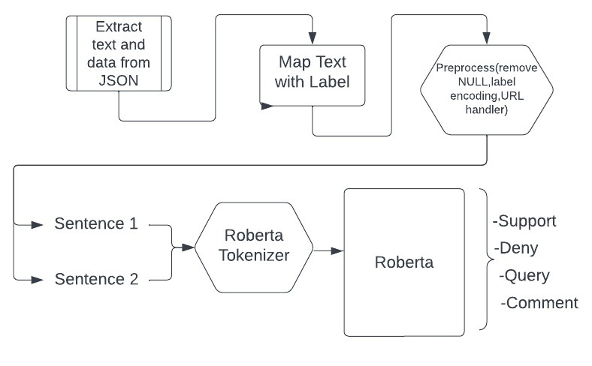
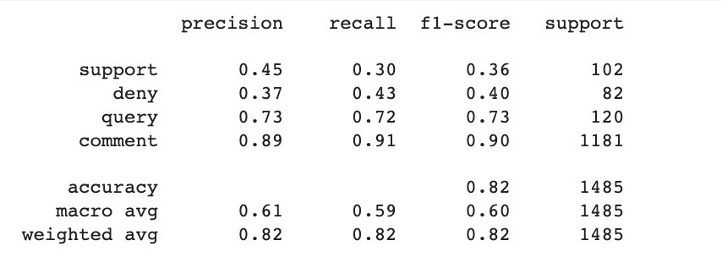
Milestone3 for TASK A
Model: RoBERTA for Sentence Pair Classification
The structure for sentence pair classification is as follows:
Source + Reply1 - label
SourceReply1 + Reply2 - label
Architecture for sentence pair classification using RoBERTA.
Results for RoBERTA sentence pair classification.

Slide 6
Task B
Preprocessing :
Extracting the source and reply tweets and additional features like "favourite_count" and "ups" from the json file.
Getting the labels of TASK A
Removing the null values.
Processing the URLs, hashtags and mentions.
Models:
Baseline: MLP with tf-idf
Milestone3: BERT, MLP with numerical features, LSTM

Slide 7
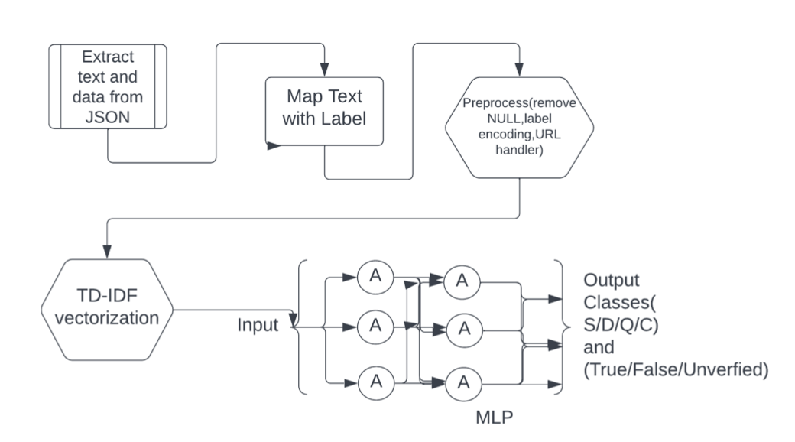
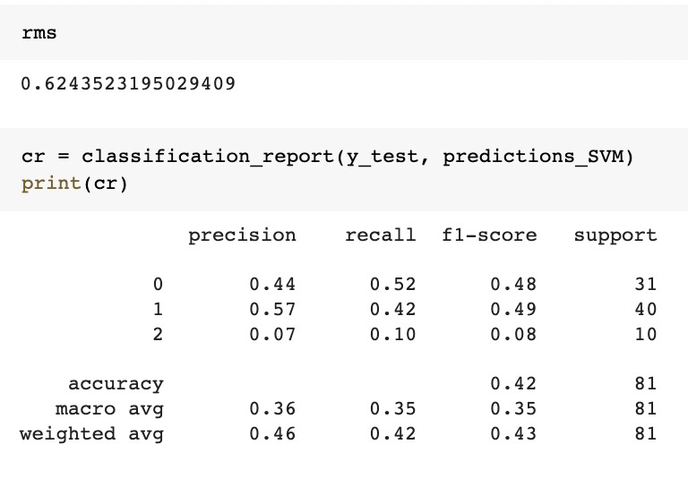
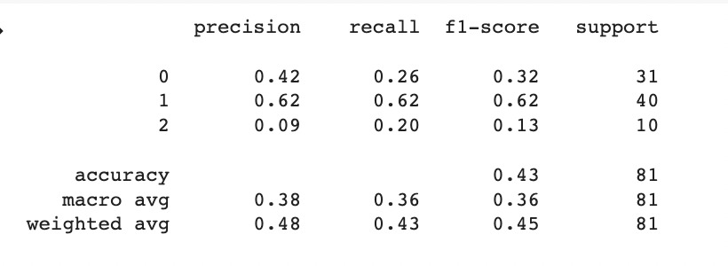
Milestone2
MODEL: TF-IDF and MLP
MODEL: TF-IDF and SVM
MultiLayerPerceptron Architecture
RMSE: 0.571
SVM
MLP

Slide 8
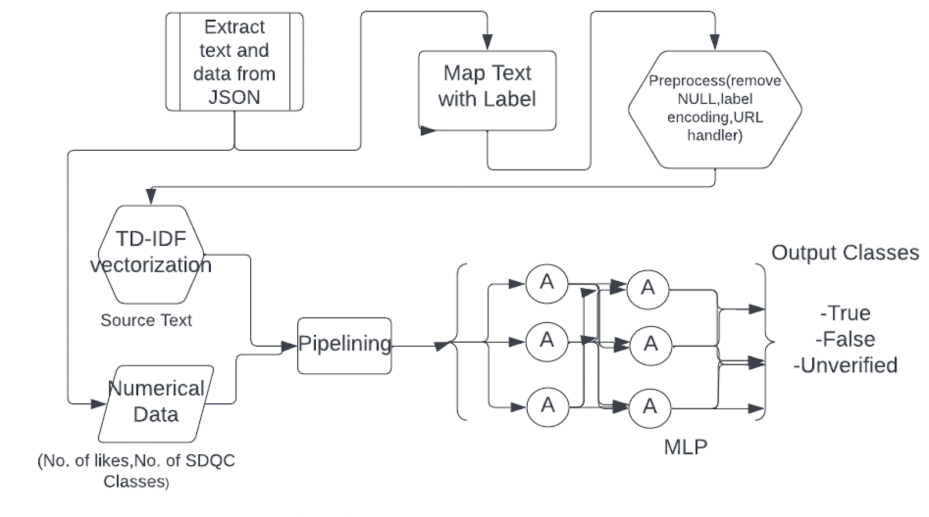
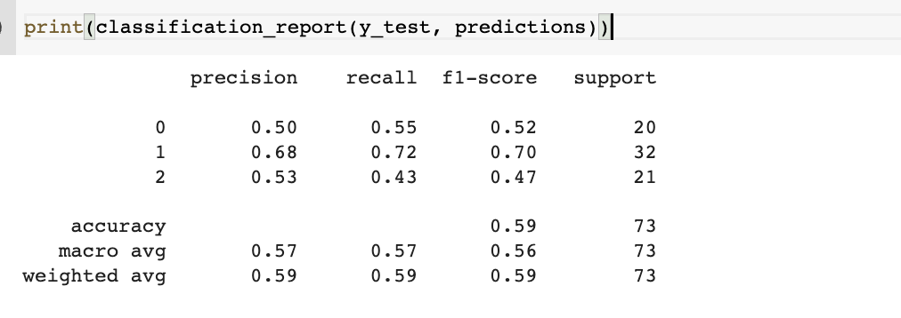
Milestone3 for TASK B
Model:
LSTM and BERT did not give the best results as the data is too small.
Tried numerical features with tf-idf vectors for MLP able to obtain good results with RMSE value of 0.32
Architecture for combing the tf-idf vectors with numerical data using pipelining.
Results for MLP with other features

Slide 9
Task C
Extra Preprocessing -
- Scraping data from generated CSV files to get source_text and target_text.
- Separate data saved for training and testing.
- Cleaning the data with obsolete characters using spacy.
Approach -
- Given source(S), generate first reply(R1), then use S and R1 to generate R2 and so on. Final text generated is golden response.
- Compare with respective golden text to get results.

Slide 10
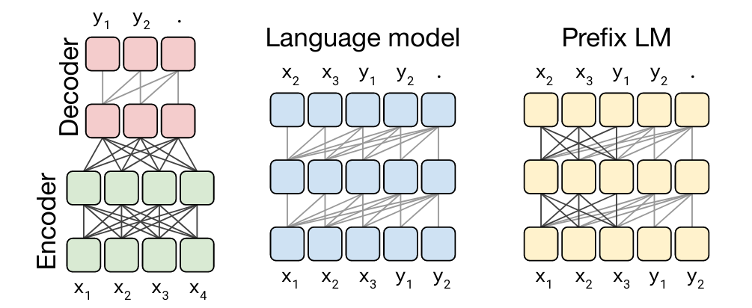
Task C
Model Used -
- t5 text to text transformers.
- simple t5 encoder-decoder model.

Slide 11
Task C
Parameters for training and fine tuning -
- Pretrained model : simplet5 – t5 base
- Max source text length : 1000
- Max target text length : 150
- Max token length for source : 128
- Max token length for target : 128
- Epochs : 5
- Training records – 5596 rows
- Testing records – 2096 rows

Slide 12
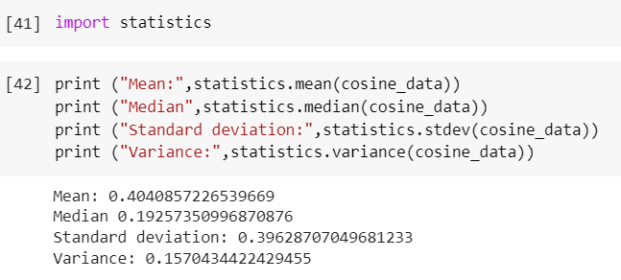
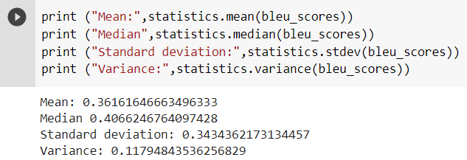
Task C
Results -
- Cosine similarity :
- BLEU Score :

Slide 13
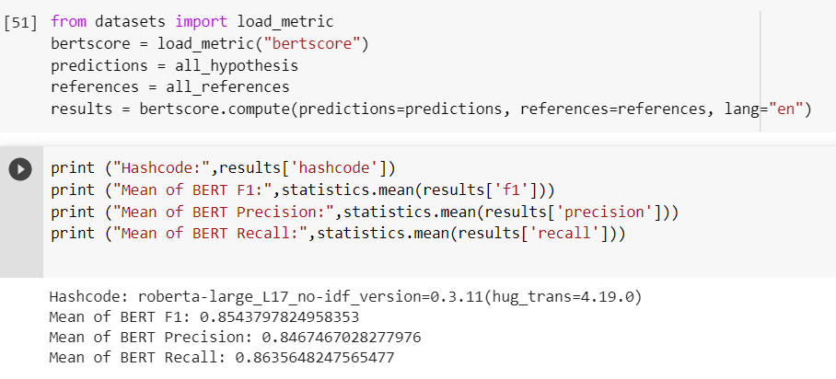
Task C
Results (cont.) -
- BERT Scores :

Slide 14
Task C
Results (cont.) -
- ROUGE Scores :
{'rouge1': AggregateScore(low=Score(precision=0.4251271271125035, recall=0.4373630994118866, fmeasure=0.4161240447328763), mid=Score(precision=0.441869178964449, recall=0.45561177213253007, fmeasure=0.43370709185583556), high=Score(precision=0.4586129726488238, recall=0.47247876916824005, fmeasure=0.45029000097689753)),
'rouge2': AggregateScore(low=Score(precision=0.3819559024919208, recall=0.3999018996642332, fmeasure=0.3807335663192744), mid=Score(precision=0.39959570841004133, recall=0.41828578882066375, fmeasure=0.39844333431819157), high=Score(precision=0.41756983963119615, recall=0.4369868128739215, fmeasure=0.4163796071175468)),

Slide 15
Task C
Results (cont.) -
- ROUGE Scores cont.:
'rougeL': AggregateScore(low=Score(precision=0.4164099911290084, recall=0.4313838334980544, fmeasure=0.4102650993319388), mid=Score(precision=0.43291338466662976, recall=0.449612498737404, fmeasure=0.42740240715039857), high=Score(precision=0.4498241332041679, recall=0.4668836699760964, fmeasure=0.4446337746276702)),
'rougeLsum': AggregateScore(low=Score(precision=0.4172381694754507, recall=0.43122815604303016, fmeasure=0.4106615766985917), mid=Score(precision=0.43434342576328455, recall=0.4503354064217186, fmeasure=0.42825460863359854), high=Score(precision=0.45088245743137784, recall=0.46864159585325754, fmeasure=0.44556725826435745))}

Slide 16
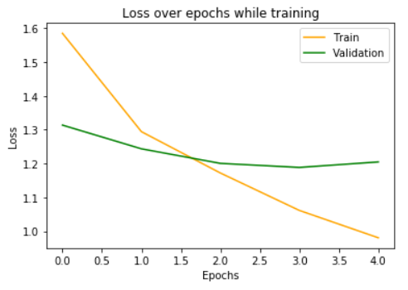
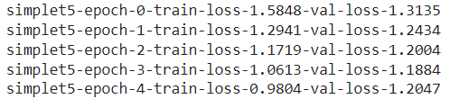
Task C
Results (cont.) -
- Training and validation loss over epochs:

Slide 17


