Slide 1
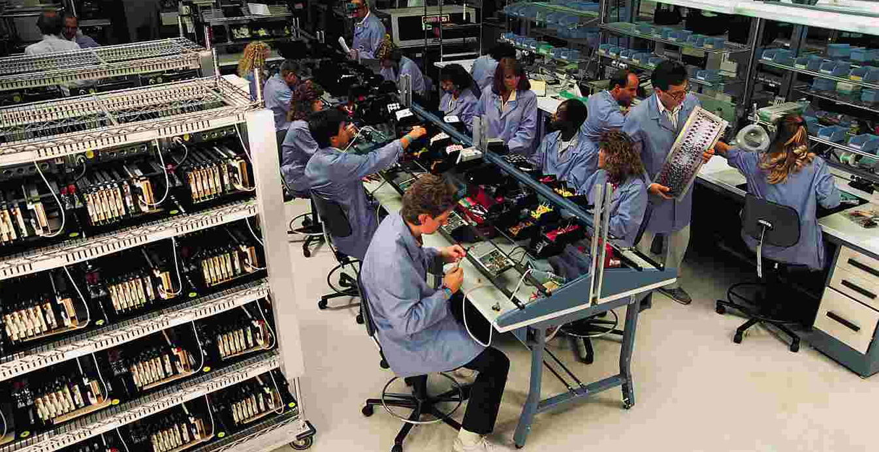


Products, Markets
and Advertising

Slide 2

Product Differentiation
The importance of non-price competition
  product differentiation
  product development
  advertising and marketing
Features of a product
  technical standards
  quality standards
  design standards
  service characteristics
  mix of attributes in different brands

Slide 3
Product Differentiation
Vertical and horizontal product differentiation
  vertical product differentiation
    importance of quality
    importance of price
  horizontal product differentiation
    importance of specific features
  market segmentation
    targeting specific parts of the market
    niche markets
Notes:
3

Slide 4
Marketing the Product
Product / market strategy
  alternative approaches
  a growth vector matrix
    market penetration
    product development
    market development
    diversification
Notes:
3

Slide 5

Growth vector components
Product
Present
New
A
B
Market
penetration
Product
development
Present
Market
C
D
Market
development
New
Diversification

Slide 6
Marketing the Product
The marketing mix
  product considerations
  pricing considerations
  place considerations
  promotion considerations
Notes:
3

Slide 7
Target market segment
Considerations when marketing a product
Product considerations
Product
line
Product
services
Brand
Package
Public
relations
Basic
price
Special
promotions
Price
alterations
Promotion considerations
Pricing considerations
Personal
promotions
Credit
terms
Transport and
handling
terms
Adverts
Channel
networks
Storage
facilities
Inventory
control
Shipping
facilities
Place considerations

Slide 8
Advertising
Background
  advertising and the state of the economy
Notes:
3

Slide 9
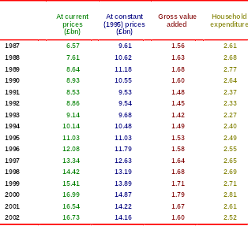
Total UK advertising expenditure

Slide 10
Advertising
Background
  advertising and the state of the economy
  distribution of advertising between media
Notes:
3

Slide 11
UK total Advertising Expenditure (% of total)
1938
1948
1958
1968
1978
1988
1998
2002
National newspapers
25.4
13.9
18.9
19.7
15.8
14.4
12.7
11.5
Regional newspapers
27.1
31.6
24.1
24.1
25.8
20.3
16.6
17.1
Consumer magazines
15.3
12.7
13.3
9.9
8.5
6.3
4.9
4.7
Business and
professional
11.9
16.5
1
0.0
9.1
10.1
9.5
8.4
6.5
Directories
0.0
0.0
1.2
1.6
2.7
4.8
5.4
5.9
Press production costs
5.1
7.6
5.2
4.6
5.1
4.7
4.3
3.8
Total press
84.7
82.3
72.7
69.0
68.0
59.7
52.2
49.6
Television
0.0
0.0
19.3
25.6
25.8
27.9
28.0
25.8
Direct mail
0.0
0.0
0.0
0.0
0.0
7.0
11.6
14.2
Outdoor and transport
8.5
13.9
6.0
4.0
3.6
3.2
4.3
4.8
Radio
3.4
0.0
0.4
0.2
1.9
1.8
3.2
3.3
Cinema
3.4
3.8
1.6
1.2
0.7
0.4
0.7
1.1
Internet
0.0
0.0
0.0
0.0
0.0
0.0
0.1
1.2
Total
100.0
100.0
100.0
100.0
100.0
100.0
100.0
100.0
Source:
Advertising Statistics Yearbook 2003
(NTC Publications Ltd).

Slide 12
Advertising
Background
  advertising and the state of the economy
  distribution of advertising between media
  advertising expenditure by product sector
Notes:
3

Slide 13
UK advertising expenditure by product sector
(% of total advertising expenditure)
1986
1990
1994
1998
2002
Retail
13.8
12.4
16.4
18.9
13.8
Industrial
8.7
7.4
7.8
8.9
12.8
Financial
10.2
10.5
10.2
8.3
10.6
Government
3.3
3.2
2.2
2.3
2.8
Services
8.
5
10.8
10.4
11.1
11.4
Durables
20.5
19.6
19.4
21.4
24.1
Consumables
35.0
36.1
33.5
29.4
24.6
Total
100.0
100.0
100.0
100.0
100.0
Source:
Advertising Statistics Yearbook 2003
(NTC Publications Ltd).

Slide 14
Advertising
Background
  advertising and the state of the economy
  distribution of advertising between media
  advertising expenditure by product sector
The intensity of advertising
Notes:
3

Slide 15
Advertising
Background
  advertising and the state of the economy
  distribution of advertising between media
  advertising expenditure by product sector
The intensity of advertising
  the advertising / sales ratio
Notes:
3

Slide 16
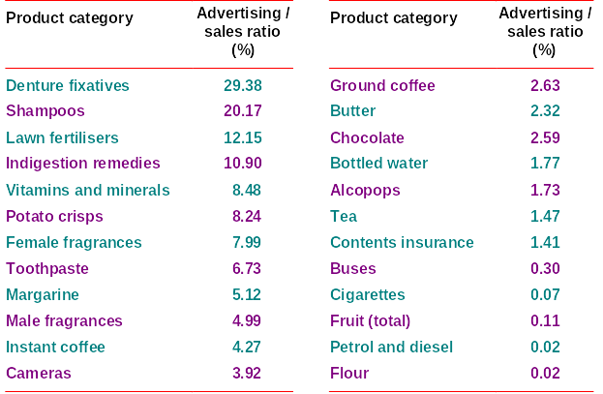
Advertising/sales ratio: 2002
(ranked by advertising/sales ratio)

Slide 17
Advertising
Background
  advertising and the state of the economy
  distribution of advertising between media
  advertising expenditure by product sector
The intensity of advertising
  the advertising / sales ratio
  causes of differences in advertising intensity between the different sectors of the economy
Notes:
3

Slide 18
Advertising
Background
  advertising and the state of the economy
  distribution of advertising between media
  advertising expenditure by product sector
The intensity of advertising
  the advertising / sales ratio
  causes of differences in advertising intensity between the different sectors of the economy
    differences in market structure
Notes:
3

Slide 19
Advertising
Background
  advertising and the state of the economy
  distribution of advertising between media
  advertising expenditure by product sector
The intensity of advertising
  the advertising / sales ratio
  causes of differences in advertising intensity between the different sectors of the economy
    differences in market structure
    differences in product characteristics
Notes:
3

Slide 20
Advertising
Aims of advertising
  shifting the demand curve
  making the demand curve less elastic
Notes:
3

Slide 21
Effect of advertising on the demand curve
P
P₁
D₁
O
Q₁
Q

Slide 22
Effect of advertising on the demand curve
P
P₁
D₂
D₁
O
Q₁
Q₂
Q

Slide 23
Effect of advertising on the demand curve
P
P₂
P₁
D₂
D₁
O
Q₁
Q₃
Q₂
Q

Slide 24
Advertising
Aims of advertising
  shifting the demand curve
  making the demand curve less elastic
Effects of advertising
Notes:
3

Slide 25
Advertising
Aims of advertising
  shifting the demand curve
  making the demand curve less elastic
Effects of advertising
  advertising and the long run
Notes:
3

Slide 26
Advertising and the long run
s₂
Habit sales
Direct effect
on sales
Sales (weekly)
Sales
s₃
Long-term
effect
Sales
s₁
Advertising
campaign
t₁
t₂
t₃
t₄
t₅
Time

Slide 27
Advertising
Aims of advertising
  shifting the demand curve
  making the demand curve less elastic
Effects of advertising
  advertising and the long run
  advertising and company growth
Notes:
3

Slide 28
Advertising, profit margins and company growth
Advertising expenditure relative to competitors
Product image and
company reputation
Relative quality of offering
Relative price
(Relative) customer value
Real market growth
Market share
Growth
Profit margins

Slide 29
Advertising
Assessing the effects of advertising
  benefits of advertising
    to firms
    to consumers
  costs of advertising
    to firms
    to consumers and society generally
Notes:
3

