Slide 1
Chapter 19 - C++ Inheritance
Outline
19.1 Introduction
19.2 Inheritance: Base Classes and Derived Classes
19.3 Protected Members
19.4 Casting Base-Class Pointers to Derived-Class Pointers
19.5 Using Member Functions
19.6 Overriding Base-Class Members in a Derived Class
19.7 Public, Protected and Private Inheritance
19.8 Direct Base Classes and Indirect Base Classes
19.9 Using Constructors and Destructors in Derived Classes
19.10 Implicit Derived-Class Object to Base-Class Object Conversion
19.11 Software Engineering with Inheritance
19.12 Composition vs. Inheritance
19.13 Uses A and Knows A Relationships
19.14 Case Study: Point, Circle, Cylinder

Slide 2
Objectives
In this chapter, you will learn:
  To be able to create new classes by inheriting from existing classes.
  To understand how inheritance promotes software reusability.
  To understand the notions of base classes and derived classes.

Slide 3
19.1 Introduction
Inheritance
  New classes created from existing classes
  Absorb attributes and behaviors.
Polymorphism
  Write programs in a general fashion
  Handle a wide variety of existing (and unspecified) related classes
Derived class
  Class that inherits data members and member functions from a previously defined base class

Slide 4
19.1 Introduction
Inheritance
  Single Inheritance
    Class inherits from one base class
  Multiple Inheritance
    Class inherits from multiple base classes
  Three types of inheritance:
    public: Derived objects are accessible by the base class objects (focus of this chapter)
    private: Derived objects are inaccessible by the base class
    protected: Derived classes and friends can access protected members of the base class

Slide 5
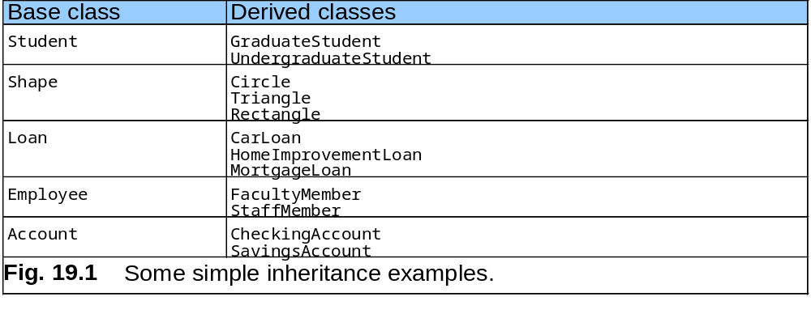
19.2 Base and Derived Classes
Often an object from a derived class (subclass) “is an” object of a base class (superclass)

Slide 6
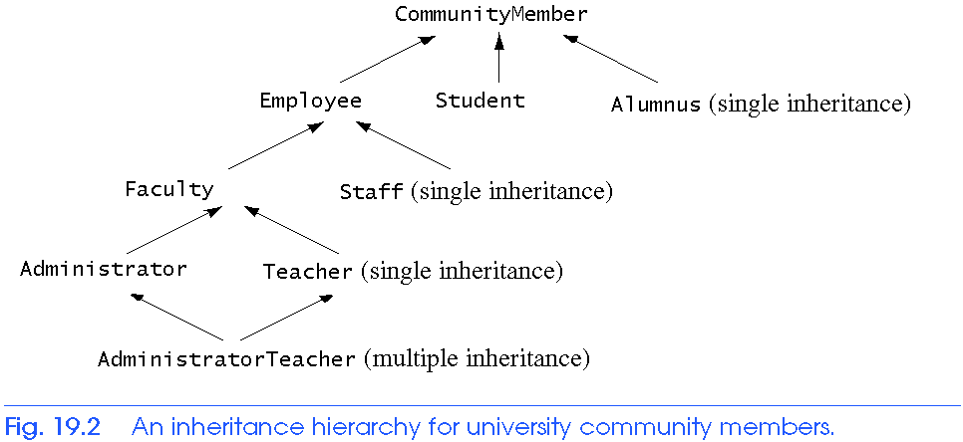
19.2 Base and Derived Classes

Slide 7
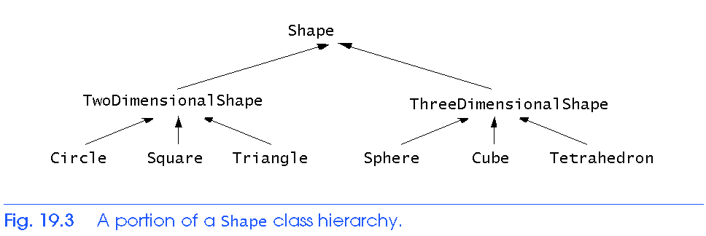
19.2 Base and Derived Classes

Slide 8
19.2 Base and Derived Classes
Implementation of public inheritance
  class CommissionWorker : public Employee {
  ...
  };
  Class CommissionWorker inherits from class Employee
  friend functions not inherited
  private members of base class not accessible from derived class

Slide 9
19.3 Protected Members
protected inheritance
  Intermediate level of protection between public and private inheritance
  Derived-class members can refer to public and protected members of the base class simply by using the member names
  Note that protected data “breaks” encapsulation

Slide 10
19.4 Casting Base Class Pointers to Derived Class Pointers
Object of a derived class
  Can be treated as an object of the base class
  Reverse not true - base class objects not a derived-class object
Downcasting a pointer
  Use an explicit cast to convert a base-class pointer to a derived-class pointer
  Be sure that the type of the pointer matches the type of object to which the pointer points
  derivedPtr = static_cast< DerivedClass * > basePtr;

Slide 11
19.4 Casting Base-Class Pointers to Derived-Class Pointers
Example
  Circle class derived from the Point base class
  We use pointer of type Point to reference a Circle object, and vice-versa

Slide 12
1 // Fig. 19.4: point.h
2 // Definition of class Point
3 #ifndef POINT_H
4 #define POINT_H
5
6 #include <iostream>
7
8 using std::ostream;
9
10 class Point {
11 friend ostream &operator<<( ostream &, const Point & );
12 public:
13 Point( int = 0, int = 0 ); // default constructor
14 void setPoint( int, int ); // set coordinates
15 int getX() const { return x; } // get x coordinate
16 int getY() const { return y; } // get y coordinate
17 protected: // accessible by derived classes
18 int x, y; // x and y coordinates of the Point
19 }; // end class Point
20
21 #endif
point.h

Slide 13
22 // Fig. 19.4: point.cpp
23 // Member functions for class Point
24 #include <iostream>
25 #include "point.h"
26
27 // Constructor for class Point
28 Point::Point( int a, int b ) { setPoint( a, b ); }
29
30 // Set x and y coordinates of Point
31 void Point::setPoint( int a, int b )
32 {
33 x = a;
34 y = b;
35 } // end function setPoint
36
37 // Output Point (with overloaded stream insertion operator)
38 ostream &operator<<( ostream &output, const Point &p )
39 {
40 output << '[' << p.x << ", " << p.y << ']';
41
42 return output; // enables cascaded calls
43 } // end operator<< function
point.cpp

Slide 14
44 // Fig. 19.4: circle.h
45 // Definition of class Circle
46 #ifndef CIRCLE_H
47 #define CIRCLE_H
48
49 #include <iostream>
50
51 using std::ostream;
52
53 #include <iomanip>
54
55 using std::ios;
56 using std::setiosflags;
57 using std::setprecision;
58
59 #include "point.h"
60
61 class Circle : public Point { // Circle inherits from Point
62 friend ostream &operator<<( ostream &, const Circle & );
63 public:
64 // default constructor
65 Circle( double r = 0.0, int x = 0, int y = 0 );
66
67 void setRadius( double ); // set radius
68 double getRadius() const; // return radius
69 double area() const; // calculate area
70 protected:
71 double radius;
72 }; // end class Circle
73
74 #endif
circle.h

Slide 15
75 // Fig. 19.4: circle.cpp
76 // Member function definitions for class Circle
77 #include "circle.h"
78
79 // Constructor for Circle calls constructor for Point
80 // with a member initializer then initializes radius.
81 Circle::Circle( double r, int a, int b )
82 : Point( a, b ) // call base-class constructor
83 { setRadius( r ); }
84
85 // Set radius of Circle
86 void Circle::setRadius( double r )
87 { radius = ( r >= 0 ? r : 0 ); }
88
89 // Get radius of Circle
90 double Circle::getRadius() const { return radius; }
91
92 // Calculate area of Circle
93 double Circle::area() const
94 { return 3.14159 * radius * radius; }
95
96 // Output a Circle in the form:
97 // Center = [x, y]; Radius = #.##
98 ostream &operator<<( ostream &output, const Circle &c )
99 {
100 output << "Center = " << static_cast< Point >( c )
101 << "; Radius = "
102 << setiosflags( ios::fixed | ios::showpoint )
103 << setprecision( 2 ) << c.radius;
104
105 return output; // enables cascaded calls
106 } // end operator<< function
circle.cpp

Slide 16
107 // Fig. 19.4: fig19_04.cpp
108 // Casting base-class pointers to derived-class pointers
109 #include <iostream>
110
111 using std::cout;
112 using std::endl;
113
114 #include <iomanip>
115
116 #include "point.h"
117 #include "circle.h"
118
119 int main()
120 {
121 Point *pointPtr = 0, p( 30, 50 );
122 Circle *circlePtr = 0, c( 2.7, 120, 89 );
123
124 cout << "Point p: " << p << "\nCircle c: " << c << '\n';
125
126 // Treat a Circle as a Point (see only the base class part)
127 pointPtr = &c; // assign address of Circle to pointPtr
128 cout << "\nCircle c (via *pointPtr): "
129 << *pointPtr << '\n';
130
fig19_04.cpp (1 of 2)

Slide 17
131 // Treat a Circle as a Circle (with some casting)
132 // cast base-class pointer to derived-class pointer
133 circlePtr = static_cast< Circle * >( pointPtr );
134 cout << "\nCircle c (via *circlePtr):\n" << *circlePtr
135 << "\nArea of c (via circlePtr): "
136 << circlePtr->area() << '\n';
137
138 // DANGEROUS: Treat a Point as a Circle
139 pointPtr = &p; // assign address of Point to pointPtr
140
141 // cast base-class pointer to derived-class pointer
142 circlePtr = static_cast< Circle * >( pointPtr );
143 cout << "\nPoint p (via *circlePtr):\n" << *circlePtr
144 << "\nArea of object circlePtr points to: "
145 << circlePtr->area() << endl;
146 return 0;
147 } // end function main
fig19_04.cpp (2 of 2)
Point p: [30, 50]
Circle c: Center = [120, 89]; Radius = 2.70
Circle c (via *pointPtr): [120, 89]
Circle c (via *circlePtr):
Center = [120, 89]; Radius = 2.70
Area of c (via circlePtr): 22.90
Point p (via *circlePtr):
Center = [30, 50]; Radius = 0.00
Area of object circlePtr points to: 0.00

Slide 18
19.5 Using Member Functions
Derived class
  Cannot directly access private members of its base class
  Hiding private members is a huge help in testing, debugging and correctly modifying systems

Slide 19
19.6 Overriding Base-Class Members in a Derived Class
To override a base-class member function
  In derived class, supply new version of that function
    Same function name, different definition
  The scope-resolution operator may be used to access the base class version from the derived class

Slide 20
1 // Fig. 19.5: employ.h
2 // Definition of class Employee
3 #ifndef EMPLOY_H
4 #define EMPLOY_H
5
6 class Employee {
7 public:
8 Employee( const char *, const char * ); // constructor
9 void print() const; // output first and last name
10 ~Employee(); // destructor
11 private:
12 char *firstName; // dynamically allocated string
13 char *lastName; // dynamically allocated string
14 }; // end class Employee
15
16 #endif
employ.h
17 // Fig. 19.5: employ.cpp
18 // Member function definitions for class Employee
19 #include <iostream>
20
21 using std::cout;
22
23 #include <cstring>
24 #include <cassert>
25 #include "employ.h"
26
employ.cpp (1 of 2)

Slide 21
27 // Constructor dynamically allocates space for the
28 // first and last name and uses strcpy to copy
29 // the first and last names into the object.
30 Employee::Employee( const char *first, const char *last )
31 {
32 firstName = new char[ strlen( first ) + 1 ];
33 assert( firstName != 0 ); // terminate if not allocated
34 strcpy( firstName, first );
35
36 lastName = new char[ strlen( last ) + 1 ];
37 assert( lastName != 0 ); // terminate if not allocated
38 strcpy( lastName, last );
39 } // end Employee constructor
40
41 // Output employee name
42 void Employee::print() const
43 { cout << firstName << ' ' << lastName; }
44
45 // Destructor deallocates dynamically allocated memory
46 Employee::~Employee()
47 {
48 delete [] firstName; // reclaim dynamic memory
49 delete [] lastName; // reclaim dynamic memory
50 } // end Employee destructor
employ.cpp (2 of 2)

Slide 22
51 // Fig. 19.5: hourly.h
52 // Definition of class HourlyWorker
53 #ifndef HOURLY_H
54 #define HOURLY_H
55
56 #include "employ.h"
57
58 class HourlyWorker : public Employee {
59 public:
60 HourlyWorker( const char*, const char*, double, double );
61 double getPay() const; // calculate and return salary
62 void print() const; // overridden base-class print
63 private:
64 double wage; // wage per hour
65 double hours; // hours worked for week
66 }; // end class HourlyWorker
67
68 #endif
hourly.h
69 // Fig. 19.5: hourly.cpp
70 // Member function definitions for class HourlyWorker
71 #include <iostream>
72
73 using std::cout;
74 using std::endl;
75
76 #include <iomanip>
77
hourly.cpp (1 of 2)

Slide 23
78 using std::ios;
79 using std::setiosflags;
80 using std::setprecision;
81
82 #include "hourly.h"
83
84 // Constructor for class HourlyWorker
85 HourlyWorker::HourlyWorker( const char *first,
86 const char *last,
87 double initHours, double initWage )
88 : Employee( first, last ) // call base-class constructor
89 {
90 hours = initHours; // should validate
91 wage = initWage; // should validate
92 } // end HourlyWorker constructor
93
94 // Get the HourlyWorker's pay
95 double HourlyWorker::getPay() const { return wage * hours; }
96
97 // Print the HourlyWorker's name and pay
98 void HourlyWorker::print() const
99 {
100 cout << "HourlyWorker::print() is executing\n\n";
101 Employee::print(); // call base-class print function
102
103 cout << " is an hourly worker with pay of $"
104 << setiosflags( ios::fixed | ios::showpoint )
105 << setprecision( 2 ) << getPay() << endl;
106 } // end function print
hourly.cpp (2 of 2)

Slide 24
107 // Fig. 19.5: fig19_05.cpp
108 // Overriding a base-class member function in a
109 // derived class.
110 #include "hourly.h"
111
112 int main()
113 {
114 HourlyWorker h( "Bob", "Smith", 40.0, 10.00 );
115 h.print();
116 return 0;
117 } // end function main
fig19_05.cpp
HourlyWorker::print() is executing
Bob Smith is an hourly worker with pay of $400.00

Slide 25
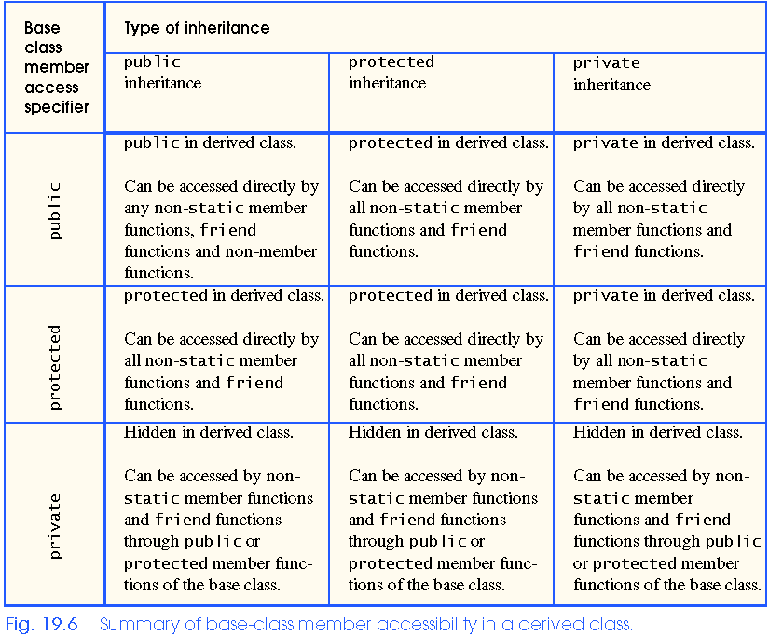
19.7 Public, Private, and Protected Inheritance

Slide 26
19.8 Direct and Indirect Base Classes
Direct base class
  Explicitly listed derived class’ header with the colon (:) notation when that derived class is declared.
  class HourlyWorker : public Employee
    Employee is a direct base class of HourlyWorker
Indirect base class
  Inherited from two or more levels up the class hierarchy
  class MinuteWorker : public HourlyWorker
    Employee is an indirect base class of MinuteWorker

Slide 27
19.9 Using Constructors and Destructors in Derived Classes
Base class initializer
  Uses member-initializer syntax
  Can be provided in the derived class constructor to call the base-class constructor explicitly
    Otherwise base class’ default constructor called implicitly
  Base-class constructors and base-class assignment operators are not inherited by derived classes
    However, derived-class constructors and assignment operators can call still them

Slide 28
19.9 Using Constructors and Destructors in Derived Classes
Derived-class constructor
  Calls the constructor for its base class first to initialize its base-class members
  If the derived-class constructor is omitted, its default constructor calls the base-class’ default constructor
Destructors are called in the reverse order of constructor calls.
  Derived-class destructor is called before its base-class destructor

Slide 29
1 // Fig. 19.7: point2.h
2 // Definition of class Point
3 #ifndef POINT2_H
4 #define POINT2_H
5
6 class Point {
7 public:
8 Point( int = 0, int = 0 ); // default constructor
9 ~Point(); // destructor
10 protected: // accessible by derived classes
11 int x, y; // x and y coordinates of Point
12 }; // end class Point
13
14 #endif
point2.h

Slide 30
15 // Fig. 19.7: point2.cpp
16 // Member function definitions for class Point
17 #include <iostream>
18
19 using std::cout;
20 using std::endl;
21
22 #include "point2.h"
23
24 // Constructor for class Point
25 Point::Point( int a, int b )
26 {
27 x = a;
28 y = b;
29
30 cout << "Point constructor: "
31 << '[' << x << ", " << y << ']' << endl;
32 } // end Point constructor
33
34 // Destructor for class Point
35 Point::~Point()
36 {
37 cout << "Point destructor: "
38 << '[' << x << ", " << y << ']' << endl;
39 } // end Point destructor
point2.cpp

Slide 31
40 // Fig. 19.7: circle2.h
41 // Definition of class Circle
42 #ifndef CIRCLE2_H
43 #define CIRCLE2_H
44
45 #include "point2.h"
46
47 class Circle : public Point {
48 public:
49 // default constructor
50 Circle( double r = 0.0, int x = 0, int y = 0 );
51
52 ~Circle();
53 private:
54 double radius;
55 }; // end class Circle
56
57 #endif
circle2.h

Slide 32
58 // Fig. 19.7: circle2.cpp
59 // Member function definitions for class Circle
60 #include <iostream>
61
62 using std::cout;
63 using std::endl;
64
65 #include "circle2.h"
66
67 // Constructor for Circle calls constructor for Point
68 Circle::Circle( double r, int a, int b )
69 : Point( a, b ) // call base-class constructor
70 {
71 radius = r; // should validate
72 cout << "Circle constructor: radius is "
73 << radius << " [" << x << ", " << y << ']' << endl;
74 } // end Circle constructor
75
76 // Destructor for class Circle
77 Circle::~Circle()
78 {
79 cout << "Circle destructor: radius is "
80 << radius << " [" << x << ", " << y << ']' << endl;
81 } // end Circle destructor
circle2.cpp

Slide 33
82 // Fig. 19.7: fig19_07.cpp
83 // Demonstrate when base-class and derived-class
84 // constructors and destructors are called.
85 #include <iostream>
86
87 using std::cout;
88 using std::endl;
89
90 #include "point2.h"
91 #include "circle2.h"
92
93 int main()
94 {
95 // Show constructor and destructor calls for Point
96 {
97 Point p( 11, 22 );
98 } // end block
99
100 cout << endl;
101 Circle circle1( 4.5, 72, 29 );
102 cout << endl;
103 Circle circle2( 10, 5, 5 );
104 cout << endl;
105 return 0;
106 } // end function main
fig19_07.cpp (1 of 2)

Slide 34
Point constructor: [11, 22]
Point destructor: [11, 22]
Point constructor: [72, 29]
Circle constructor: radius is 4.5 [72, 29]
Point constructor: [5, 5]
Circle constructor: radius is 10 [5, 5]
Circle destructor: radius is 10 [5, 5]
Point destructor: [5, 5]
Circle destructor: radius is 4.5 [72, 29]
Point destructor: [72, 29]
fig19_07.cpp (2 of 2)

Slide 35
19.10 Implicit Derived-Class Object to Base-Class Object Conversion
baseClassObject = derivedClassObject;
  This will work
    Remember, the derived class object has more members than the base class object
  Extra data is not given to the base class
derivedClassObject = baseClassObject;
  May not work properly
    Unless an assignment operator is overloaded in the derived class, data members exclusive to the derived class will be unassigned
  Base class has less data members than the derived class
    Some data members missing in the derived class object

Slide 36
19.10 Implicit Derived-Class Object to Base-Class Object Conversion
Four ways to mix base and derived class pointers and objects:
  Referring to a base-class object with a base-class pointer
    Allowed
  Referring to a derived-class object with a derived-class pointer
    Allowed
  Referring to a derived-class object with a base-class pointer
    Possible syntax error
    Code can only refer to base-class members, or syntax error
  Referring to a base-class object with a derived-class pointer
    Syntax error
    The derived-class pointer must first be cast to a base-class pointer

Slide 37
19.11 Software Engineering With Inheritance
Classes are often closely related
  “Factor out” common attributes and behaviors and place these in a base class
  Use inheritance to form derived classes
Modifications to a base class
  Derived classes do not change as long as the public and protected interfaces are the same
  Derived classes may need to be recompiled

Slide 38
19.12 Composition vs. Inheritance
"is a" relationship
  Inheritance
"has a" relationship
  Composition - class has an object from another class as a data member
Employee “is a” BirthDate; //Wrong!
Employee “has a” BirthDate;//Composition

Slide 39
19.13 Uses A And Knows A Relationships
“uses a” relationship
  One object issues a function call to a member function of another object
“knows a” relationship
  One object is aware of another
    Contains a pointer handle or reference handle to another object
  Also called an association

Slide 40
19.14 Case Study: Point, Circle, Cylinder
Define class Point
  Derive Circle
    Derive Cylinder

Slide 41
1 // Fig. 19.8: point2.h
2 // Definition of class Point
3 #ifndef POINT2_H
4 #define POINT2_H
5
6 #include <iostream>
7
8 using std::ostream;
9
10 class Point {
11 friend ostream &operator<<( ostream &, const Point & );
12 public:
13 Point( int = 0, int = 0 ); // default constructor
14 void setPoint( int, int ); // set coordinates
15 int getX() const { return x; } // get x coordinate
16 int getY() const { return y; } // get y coordinate
17 protected: // accessible to derived classes
18 int x, y; // coordinates of the point
19 }; // end class Point
20
21 #endif
point2.h

Slide 42
22 // Fig. 19.8: point2.cpp
23 // Member functions for class Point
24 #include "point2.h"
25
26 // Constructor for class Point
27 Point::Point( int a, int b ) { setPoint( a, b ); }
28
29 // Set the x and y coordinates
30 void Point::setPoint( int a, int b )
31 {
32 x = a;
33 y = b;
34 } // end function setPoint
35
36 // Output the Point
37 ostream &operator<<( ostream &output, const Point &p )
38 {
39 output << '[' << p.x << ", " << p.y << ']';
40
41 return output; // enables cascading
42 } // end operator<< function
point2.cpp

Slide 43
43 // Fig. 19.8: fig19_08.cpp
44 // Driver for class Point
45 #include <iostream>
46
47 using std::cout;
48 using std::endl;
49
50 #include "point2.h"
51
52 int main()
53 {
54 Point p( 72, 115 ); // instantiate Point object p
55
56 // protected data of Point inaccessible to main
57 cout << "X coordinate is " << p.getX()
58 << "\nY coordinate is " << p.getY();
59
60 p.setPoint( 10, 10 );
61 cout << "\n\nThe new location of p is " << p << endl;
62
63 return 0;
64 } // end function main
fig19_08.cpp
X coordinate is 72
Y coordinate is 115
The new location of p is [10, 10]

Slide 44
1 // Fig. 19.9: circle2.h
2 // Definition of class Circle
3 #ifndef CIRCLE2_H
4 #define CIRCLE2_H
5
6 #include <iostream>
7
8 using std::ostream;
9
10 #include "point2.h"
11
12 class Circle : public Point {
13 friend ostream &operator<<( ostream &, const Circle & );
14 public:
15 // default constructor
16 Circle( double r = 0.0, int x = 0, int y = 0 );
17 void setRadius( double ); // set radius
18 double getRadius() const; // return radius
19 double area() const; // calculate area
20 protected: // accessible to derived classes
21 double radius; // radius of the Circle
22 }; // end class Circle
23
24 #endif
circle2.h

Slide 45
25 // Fig. 19.9: circle2.cpp
26 // Member function definitions for class Circle
27 #include <iomanip>
28
29 using std::ios;
30 using std::setiosflags;
31 using std::setprecision;
32
33 #include "circle2.h"
34
35 // Constructor for Circle calls constructor for Point
36 // with a member initializer and initializes radius
37 Circle::Circle( double r, int a, int b )
38 : Point( a, b ) // call base-class constructor
39 { setRadius( r ); }
40
41 // Set radius
42 void Circle::setRadius( double r )
43 { radius = ( r >= 0 ? r : 0 ); }
44
45 // Get radius
46 double Circle::getRadius() const { return radius; }
47
48 // Calculate area of Circle
49 double Circle::area() const
50 { return 3.14159 * radius * radius; }
51
circle2.cpp (1 of 2)

Slide 46
52 // Output a circle in the form:
53 // Center = [x, y]; Radius = #.##
54 ostream &operator<<( ostream &output, const Circle &c )
55 {
56 output << "Center = " << static_cast< Point > ( c )
57 << "; Radius = "
58 << setiosflags( ios::fixed | ios::showpoint )
59 << setprecision( 2 ) << c.radius;
60
61 return output; // enables cascaded calls
62 } // end operator<< function
circle2.cpp (2 of 2)
63 // Fig. 19.9: fig19_09.cpp
64 // Driver for class Circle
65 #include <iostream>
66
67 using std::cout;
68 using std::endl;
69
70 #include "point2.h"
71 #include "circle2.h"
72
fig19_09.cpp (1 of 2)

Slide 47
73 int main()
74 {
75 Circle c( 2.5, 37, 43 );
76
77 cout << "X coordinate is " << c.getX()
78 << "\nY coordinate is " << c.getY()
79 << "\nRadius is " << c.getRadius();
80
81 c.setRadius( 4.25 );
82 c.setPoint( 2, 2 );
83 cout << "\n\nThe new location and radius of c are\n"
84 << c << "\nArea " << c.area() << '\n';
85
86 Point &pRef = c;
87 cout << "\nCircle printed as a Point is: " << pRef << endl;
88
89 return 0;
90 } // end function main
fig19_09.cpp (2 of 2)
X coordinate is 37
Y coordinate is 43
Radius is 2.5
The new location and radius of c are
Center = [2, 2]; Radius = 4.25
Area 56.74
Circle printed as a Point is: [2, 2]

Slide 48
1 // Fig. 19.10: cylindr2.h
2 // Definition of class Cylinder
3 #ifndef CYLINDR2_H
4 #define CYLINDR2_H
5
6 #include <iostream>
7
8 using std::ostream;
9
10 #include "circle2.h"
11
12 class Cylinder : public Circle {
13 friend ostream &operator<<( ostream &, const Cylinder & );
14
15 public:
16 // default constructor
17 Cylinder( double h = 0.0, double r = 0.0,
18 int x = 0, int y = 0 );
19
20 void setHeight( double ); // set height
21 double getHeight() const; // return height
22 double area() const; // calculate and return area
23 double volume() const; // calculate and return volume
24
25 protected:
26 double height; // height of the Cylinder
27 }; // end class Cylinder
28
29 #endif
cylindr2.h

Slide 49
30 // Fig. 19.10: cylindr2.cpp
31 // Member and friend function definitions
32 // for class Cylinder.
33 #include "cylindr2.h"
34
35 // Cylinder constructor calls Circle constructor
36 Cylinder::Cylinder( double h, double r, int x, int y )
37 : Circle( r, x, y ) // call base-class constructor
38 { setHeight( h ); }
39
40 // Set height of Cylinder
41 void Cylinder::setHeight( double h )
42 { height = ( h >= 0 ? h : 0 ); }
43
44 // Get height of Cylinder
45 double Cylinder::getHeight() const { return height; }
46
47 // Calculate area of Cylinder (i.e., surface area)
48 double Cylinder::area() const
49 {
50 return 2 * Circle::area() +
51 2 * 3.14159 * radius * height;
52 } // end function area
53
54 // Calculate volume of Cylinder
55 double Cylinder::volume() const
56 { return Circle::area() * height; }
57
cylindr2.cpp (1 of 2)

Slide 50
58 // Output Cylinder dimensions
59 ostream &operator<<( ostream &output, const Cylinder &c )
60 {
61 output << static_cast< Circle >( c )
62 << "; Height = " << c.height;
63
64 return output; // enables cascaded calls
65 } // end operator<< function
cylindr2.cpp (2 of 2)
66 // Fig. 19.10: fig19_10.cpp
67 // Driver for class Cylinder
68 #include <iostream>
69
70 using std::cout;
71 using std::endl;
72
73 #include "point2.h"
74 #include "circle2.h"
75 #include "cylindr2.h"
76
77 int main()
78 {
79 // create Cylinder object
80 Cylinder cyl( 5.7, 2.5, 12, 23 );
81
fig19_10.cpp (1 of 3)

Slide 51
82 // use get functions to display the Cylinder
83 cout << "X coordinate is " << cyl.getX()
84 << "\nY coordinate is " << cyl.getY()
85 << "\nRadius is " << cyl.getRadius()
86 << "\nHeight is " << cyl.getHeight() << "\n\n";
87
88 // use set functions to change the Cylinder's attributes
89 cyl.setHeight( 10 );
90 cyl.setRadius( 4.25 );
91 cyl.setPoint( 2, 2 );
92 cout << "The new location, radius, and height of cyl are:\n"
93 << cyl << '\n';
94
95 cout << "The area of cyl is:\n"
96 << cyl.area() << '\n';
97
98 // display the Cylinder as a Point
99 Point &pRef = cyl; // pRef "thinks" it is a Point
100 cout << "\nCylinder printed as a Point is: "
101 << pRef << "\n\n";
102
103 // display the Cylinder as a Circle
104 Circle &circleRef = cyl; // circleRef thinks it is a Circle
105 cout << "Cylinder printed as a Circle is:\n" << circleRef
106 << "\nArea: " << circleRef.area() << endl;
107
108 return 0;
109 } // end function main
fig19_10.cpp (2 of 3)

Slide 52
X coordinate is 12
Y coordinate is 23
Radius is 2.5
Height is 5.7
The new location, radius, and height of cyl are:
Center = [2, 2]; Radius = 4.25; Height = 10.00
The area of cyl is:
380.53
Cylinder printed as a Point is: [2, 2]
Cylinder printed as a Circle is:
Center = [2, 2]; Radius = 4.25
Area: 56.74
fig19_10.cpp (3 of 3)

