Slide 1
Chapter 18
Stacks and Queues

Slide 2
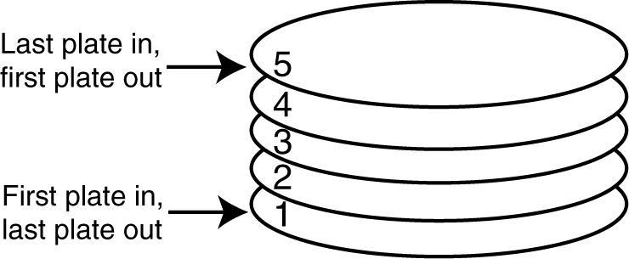
18.1 Introduction to the Stack ADT
A stack is a data structure that stores and retrieves items in a last-in-first-out (LIFO) manner.

Slide 3
Applications of Stacks
Computer systems use stacks during a program’s execution to store function return addresses, local variables, etc.
Some calculators use stacks for performing mathematical operations.

Slide 4
Static and Dynamic Stacks
Static Stacks
  Fixed size
  Can be implemented with an array
Dynamic Stacks
  Grow in size as needed
  Can be implemented with a linked list

Slide 5
Stack Operations
Push
  causes a value to be stored in (pushed onto) the stack
Pop
  retrieves and removes a value from the stack

Slide 6
The Push Operation
Suppose we have an empty integer stack that is capable of holding a maximum of three values. With that stack we execute the following push operations.
push(5);
push(10);
push(15);

Slide 7
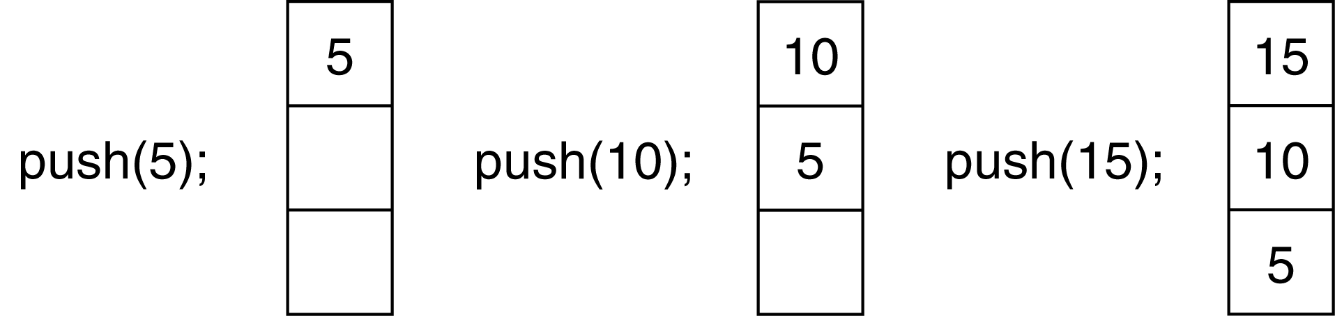
The Push Operation
The state of the stack after each of the push operations:

Slide 8
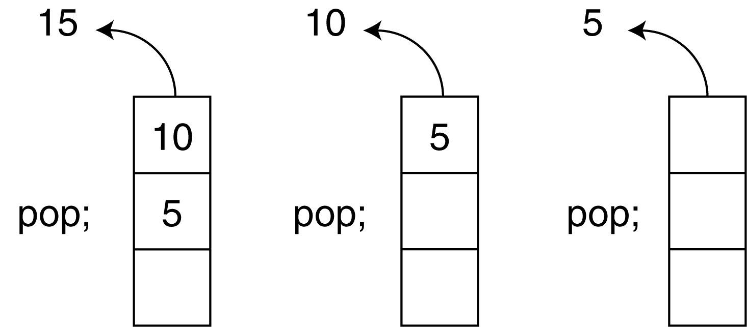
The Pop Operation
Now, suppose we execute three consecutive pop operations on the same stack:

Slide 9
Other Stack Operations
isFull: A Boolean operation needed for static stacks. Returns true if the stack is full. Otherwise, returns false.
isEmpty: A Boolean operation needed for all stacks. Returns true if the stack is empty. Otherwise, returns false.

Slide 10
The IntStack Class
Table 18-1: Member Variables
Member Variable Description
stackArray stackArray A pointer to int. When the constructor is executed, it uses
stackArray to dynamically allocate an array for storage.
stackSize An integer that holds the size of the stack.
top An integer that is used to mark the top of the stack.

Slide 11
The IntStack Class
Table 18-2: Member Functions
Member Function Description
stackArray Constructor The class constructor accepts an integer argument, which specifies the
size of the stack. An integer array of this size is dynamically
allocated, and assigned to stackArray. Also, the variable top is
initialized to –1.
push The push function accepts an integer argument, which is pushed onto
the top of the stack.
pop The pop function uses an integer reference parameter. The value at
the top of the stack is removed, and copied into the reference
parameter.

Slide 12
The IntStack Class
Table 18-2: Member Functions (continued)
Member Function Description
stackArray isFull Returns true if the stack is full and false otherwise. The stack is
full when top is equal to stackSize – 1.
isEmpty Returns true if the stack is empty, and false otherwise. The stack
is empty when top is set to –1.

Slide 13
Contents of IntStack.h
#ifndef INTSTACK_H
#define INTSTACK_H
class IntStack
{
private:
int *stackArray;
int stackSize;
int top;
public:
IntStack(int);
void push(int);
void pop(int &);
bool isFull(void);
bool isEmpty(void);
};
#endif

Slide 14
Contents of IntStack.cpp
#include <iostream.h>
#include "intstack.h“
//*******************
// Constructor *
//*******************
IntStack::IntStack(int size)
{
stackArray = new int[size];
stackSize = size;
top = -1;
}

Slide 15
Contents of IntStack.cpp
//*************************************************
// Member function push pushes the argument onto *
// the stack. *
//*************************************************
void IntStack::push(int num)
{
if (isFull())
{
cout << "The stack is full.\n";
}
else
{
top++;
stackArray[top] = num;
}
}

Slide 16
Contents of IntStack.cpp
//****************************************************
// Member function pop pops the value at the top *
// of the stack off, and copies it into the variable *
// passed as an argument. *
//****************************************************
void IntStack::pop(int &num)
{
if (isEmpty())
{
cout << "The stack is empty.\n";
}
else
{
num = stackArray[top];
top--;
}
}

Slide 17
Contents of IntStack.cpp
//***************************************************
// Member function isFull returns true if the stack *
// is full, or false otherwise. *
//***************************************************
bool IntStack::isFull(void)
{
bool status;
if (top == stackSize - 1)
status = true;
else
status = false;
return status;
}

Slide 18
Contents of IntStack.cpp
//****************************************************
// Member funciton isEmpty returns true if the stack *
// is empty, or false otherwise. *
//****************************************************
bool IntStack::isEmpty(void)
{
bool status;
if (top == -1)
status = true;
else
status = false;
return status;
}

Slide 19
Program 18-1
// This program demonstrates the IntStack class.
#include <iostream.h>
#include "intstack.h“
void main(void)
{
IntStack stack(5);
int catchVar;
cout << "Pushing 5\n";
stack.push(5);
cout << "Pushing 10\n";
stack.push(10);
cout << "Pushing 15\n";
stack.push(15);
cout << "Pushing 20\n";
stack.push(20);
cout << "Pushing 25\n";
stack.push(25);

Slide 20
Program 18-1 (continued)
cout << "Popping...\n";
stack.pop(catchVar);
cout << catchVar << endl;
stack.pop(catchVar);
cout << catchVar << endl;
stack.pop(catchVar);
cout << catchVar << endl;
stack.pop(catchVar);
cout << catchVar << endl;
stack.pop(catchVar);
cout << catchVar << endl;
}

Slide 21
Program 18-1 (continued)
Program Output
Pushing 5
Pushing 10
Pushing 15
Pushing 20
Pushing 25
Popping...
25
20
15
10
5

Slide 22
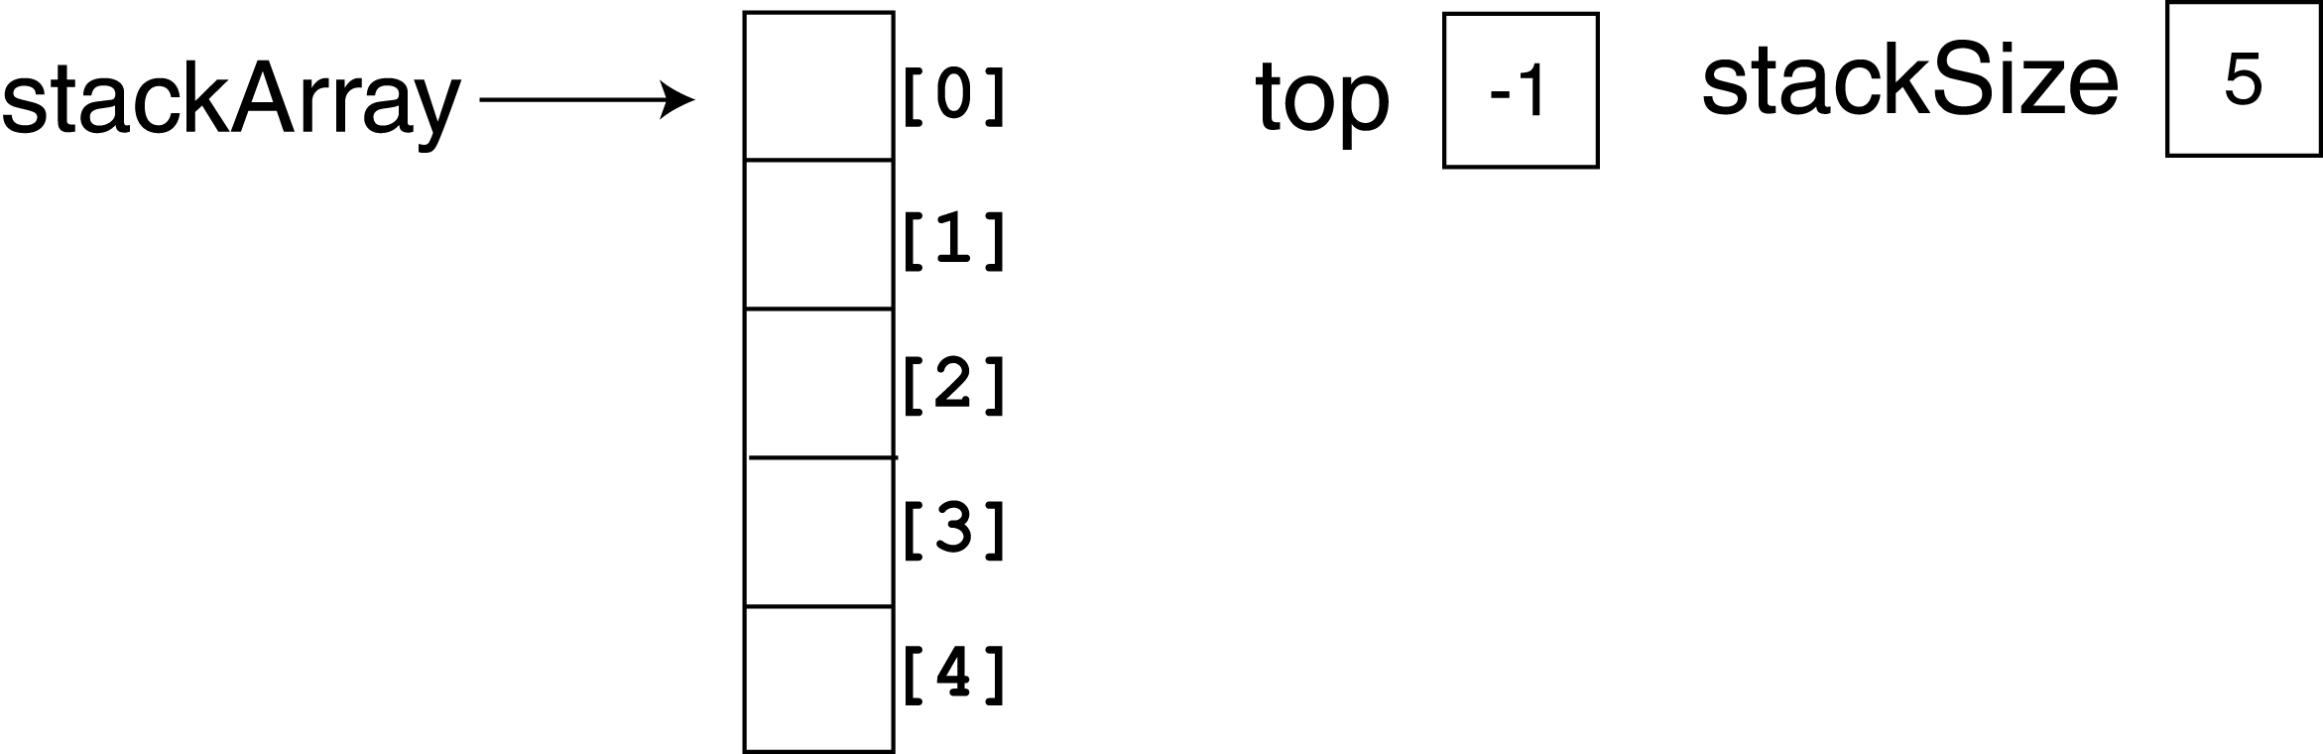
About Program 18-1
In the program, the constructor is called with the argument 5. This sets up the member variables as shown in Figure 18-4. Since top is set to –1, the stack is empty

Slide 23
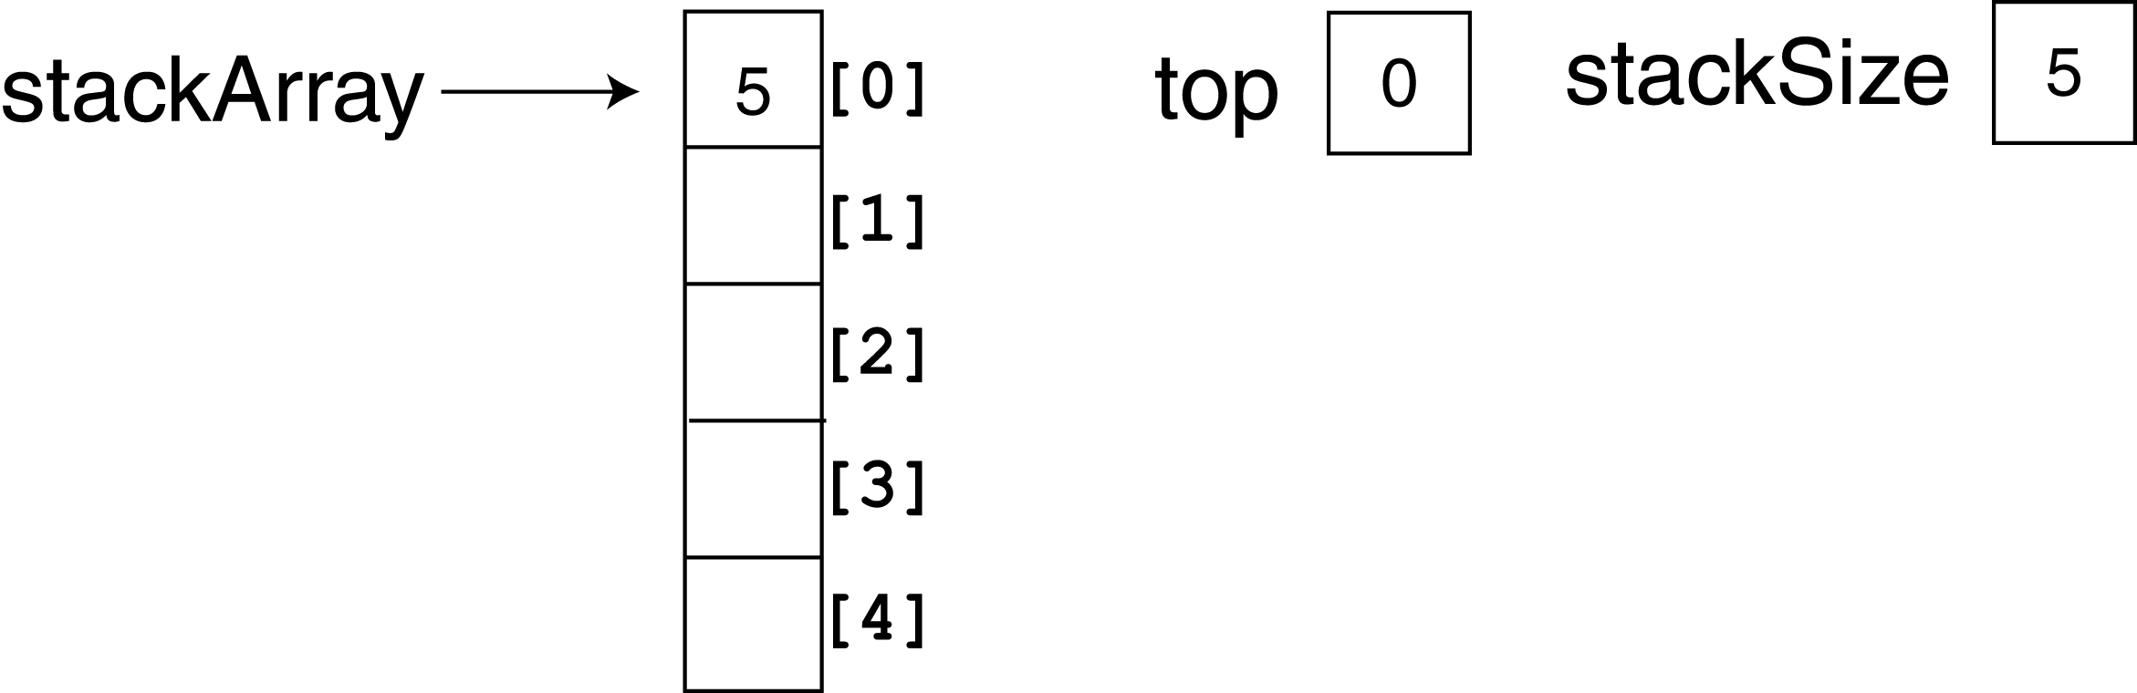
About Program 18-1
Figure 18-5 shows the state of the member variables after the push function is called the first time (with 5 as its argument). The top of the stack is now at element 0.

Slide 24
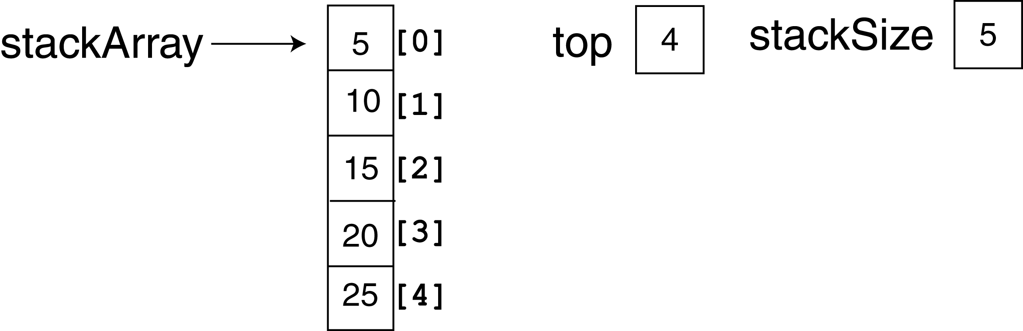
About Program 18-1
Figure 18-6 shows the state of the member variables after all five calls to the push function. Now the top of the stack is at element 4, and the stack is full.

Slide 25
About Program 18-1
Notice that the pop function uses a reference parameter, num. The value that is popped off the stack is copied into num so it can be used later in the program. Figure 18-7 (on the next slide) depicts the state of the class members, and the num parameter, just after the first value is popped off the stack.

Slide 26
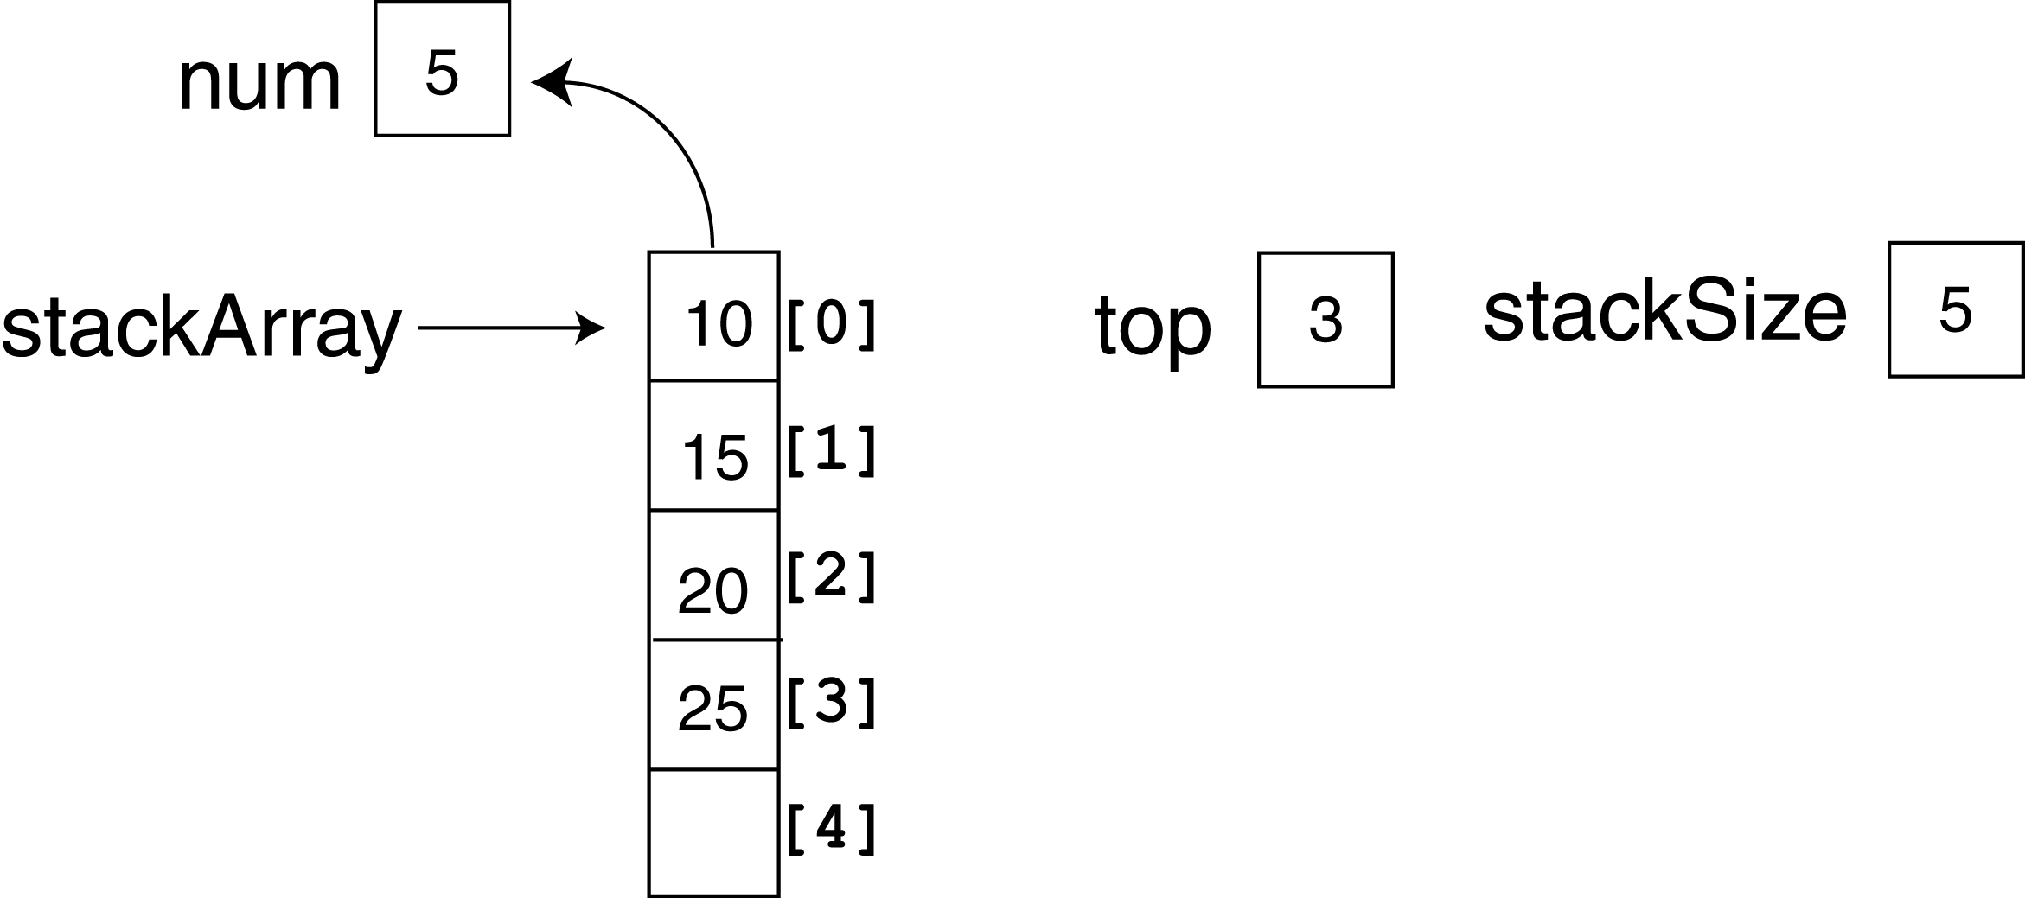
About Program 18-1

Slide 27
Implementing Other Stack Operations
The MathStack class (discussed on pages 1072 – 1075) demonstrates functions for stack-based arithmetic.

Slide 28
18.2 Dynamic Stacks
A dynamic stack is built on a linked list instead of an array.
A linked list-based stack offers two advantages over an array-based stack.
  No need to specify the starting size of the stack. A dynamic stack simply starts as an empty linked list, and then expands by one node each time a value is pushed.
  A dynamic stack will never be full, as long as the system has enough free memory.

Slide 29
Contents of DynIntStack.h
class DynIntStack
{
private:
struct StackNode
{
int value;
StackNode *next;
};
StackNode *top;
public:
DynIntStack(void)
{ top = NULL; }
void push(int);
void pop(int &);
bool isEmpty(void);
};

Slide 30
Contents of DynIntStack.cpp
#include <iostream.h>
#include "dynintstack.h“
//************************************************
// Member function push pushes the argument onto *
// the stack. *
//************************************************
void DynIntStack::push(int num)
{
stackNode *newNode;
// Allocate a new node & store Num
newNode = new stackNode;
newNode->value = num;

Slide 31
Contents of DynIntStack.cpp
// If there are no nodes in the list
// make newNode the first node
if (isEmpty())
{
top = newNode;
newNode->next = NULL;
}
else // Otherwise, insert NewNode before top
{
newNode->next = top;
top = newNode;
}
}
//****************************************************
// Member function pop pops the value at the top *
// of the stack off, and copies it into the variable *
// passed as an argument. *
//****************************************************

Slide 32
Contents of DynIntStack.cpp
void DynIntStack::pop(int &num)
{
stackNode *temp;
if (isEmpty())
{
cout << "The stack is empty.\n";
}
else // pop value off top of stack
{
num = top->value;
temp = top->next;
delete top;
top = temp;
}
}

Slide 33
Contents of DynIntStack.cpp
//****************************************************
// Member funciton isEmpty returns true if the stack *
// is empty, or false otherwise. *
//****************************************************
bool DynIntStack::isEmpty(void)
{
bool status;
if (!top)
status = true;
else
status = false;
return status;
}

Slide 34
Program 18-3
// This program demonstrates the dynamic stack
// class DynIntClass.
#include <iostream.h>
#include "dynintstack.h“
void main(void)
{
DynIntStack stack;
int catchVar;
cout << "Pushing 5\n";
stack.push(5);
cout << "Pushing 10\n";
stack.push(10);
cout << "Pushing 15\n";
stack.push(15);

Slide 35
Program 18-3 (continued)
cout << "Popping...\n";
stack.pop(catchVar);
cout << catchVar << endl;
stack.pop(catchVar);
cout << catchVar << endl;
stack.pop(catchVar);
cout << catchVar << endl;
cout << "\nAttempting to pop again... ";
stack.pop(catchVar);
}
Program Output
Pushing 5
Pushing 10
Pushing 15
Popping...
15
10
5
Attempting to pop again... The stack is empty.

Slide 36
18.3 The STL stack Container
The STL stack container may be implemented as a vector, a list, or a deque (which you will learn about later in this chapter).
Because the stack container is used to adapt these other containers, it is often referred to as a container adapter.

Slide 37
18.3 The STL stack Container
Here are examples of how to declare a stack of ints, implemented as a vector, a list, and a deque.
stack< int, vector<int> > iStack; // Vector stack
stack< int, list<int> > iStack; // List stack
stack< int > iStack; // Default – deque stack

Slide 38
18.3 The STL stack Container
Table 18-3 (pages 1080-1081) lists and describes many of the stack container’s member functions.

Slide 39
Program 18-4
// This program demonstrates the STL stack
// container adapter.
#include <iostream.h>
#include <vector>
#include <stack>
using namespace std;
void main(void)
{
int x;
stack< int, vector<int> > iStack;
for (x = 2; x < 8; x += 2)
{
cout << "Pushing " << x << endl;
iStack.push(x);
}

Slide 40
Program 18-4 (continued)
cout << "The size of the stack is ";
cout << iStack.size() << endl;
for (x = 2; x < 8; x += 2)
{
cout << "Popping " << iStack.top() << endl;
iStack.pop();
}
}
Program Output
Pushing 2
Pushing 4
Pushing 6
The size of the stack is 3
Popping 6
Popping 4
Popping 2

Slide 41
18.4 Introduction to the Queue ADT
Like a stack, a queue (pronounced "cue") is a data structure that holds a sequence of elements.
A queue, however, provides access to its elements in first-in, first-out (FIFO) order.
The elements in a queue are processed like customers standing in a grocery check-out line: the first customer in line is the first one served.

Slide 42
Example Applications of Queues
In a multi-user system, a queue is used to hold print jobs submitted by users , while the printer services those jobs one at a time.
Communications software also uses queues to hold information received over networks and dial-up connections. Sometimes information is transmitted to a system faster than it can be processed, so it is placed in a queue when it is received.

Slide 43
Static and Dynamic Queues
Just as stacks are implemented as arrays or linked lists, so are queues.
Dynamic queues offer the same advantages over static queues that dynamic stacks offer over static stacks.

Slide 44
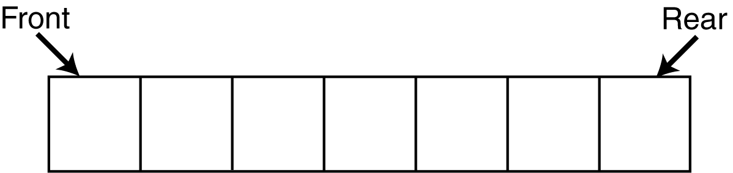
Queue Operations
Think of queues as having a front and a rear. This is illustrated in Figure 18-8.

Slide 45
Queue Operations
The two primary queue operations are enqueuing and dequeuing.
To enqueue means to insert an element at te rear of a queue.
To dequeue means to remove an element from the front of a queue.

Slide 46
Queue Operations
Suppose we have an empty static integer queue that is capable of holding a maximum of three values. With that queue we execute the following enqueue operations.
Enqueue(3);
Enqueue(6);
Enqueue(9);

Slide 47
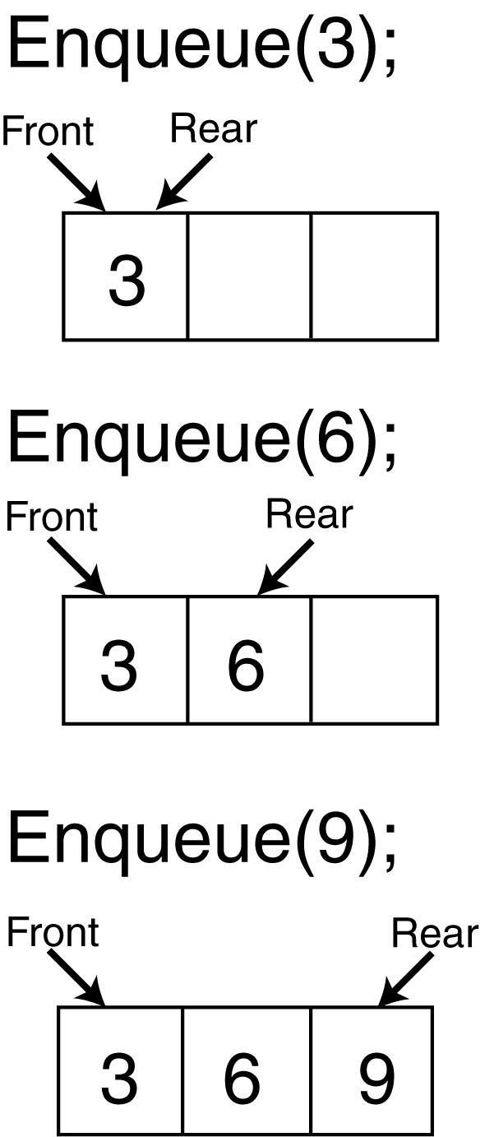
Queue Operations
Figure 18-9 illustrates the state of the queue after each of the enqueue operations.

Slide 48
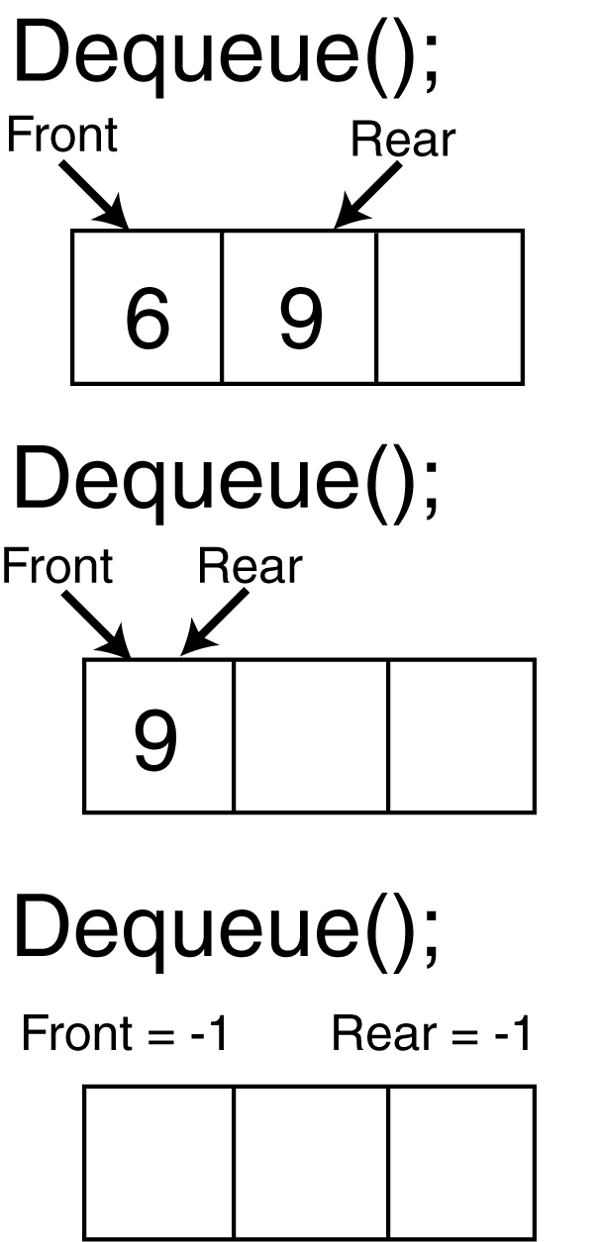
Queue Operations
Now let's see how dequeue operations are performed. Figure 18-10 illustrates the state of the queue after each of three consecutive dequeue operations

Slide 49
Queue Operations
When the last deqeue operation is performed in the illustration, the queue is empty. An empty queue can be signified by setting both front and rear indices to –1.
Pages 1084-1085 discuss the inefficiency of this algorithm, and its solution: implement the queue as a circular array.

Slide 50
Contents of IntQueue.h
class IntQueue
{
private:
int *queueArray;
int queueSize;
int front;
int rear;
int numItems;
public:
IntQueue(int);
~IntQueue(void);
void enqueue(int);
void dequeue(int &);
bool isEmpty(void);
bool isFull(void);
void clear(void);
};

Slide 51
Contents of IntQueue.cpp
#include <iostream.h>
#include "IntQueue.h“
//*************************
// Constructor *
//*************************
IntQueue::IntQueue(int s)
{
queueArray = new int[s];
queueSize = s;
front = 0;
rear = 0;
numItems = 0;
}

Slide 52
Contents of IntQueue.cpp
//*************************
// Destructor *
//*************************
IntQueue::~IntQueue(void)
{
delete [] queueArray;
}

Slide 53
Contents of IntQueue.cpp
//********************************************
// Function enqueue inserts the value in num *
// at the rear of the queue. *
//********************************************
void IntQueue::enqueue(int num)
{
if (isFull())
cout << "The queue is full.\n";
else
{
// Calculate the new rear position
rear = (rear + 1) % queueSize;
// Insert new item
queueArray[rear] = num;
// Update item count
numItems++;
}
}

Slide 54
Contents of IntQueue.cpp
//*********************************************
// Function dequeue removes the value at the *
// front of the queue, and copies t into num. *
//*********************************************
void IntQueue::dequeue(int &num)
{
if (isEmpty())
cout << "The queue is empty.\n";
else
{
// Move front
front = (front + 1) % queueSize;
// Retrieve the front item
num = queueArray[front];
// Update item count
numItems--;
}
}

Slide 55
Contents of IntQueue.cpp
//*********************************************
// Function isEmpty returns true if the queue *
// is empty, and false otherwise. *
//*********************************************
bool IntQueue::isEmpty(void)
{
bool status;
if (numItems)
status = false;
else
status = true;
return status;
}

Slide 56
Contents of IntQueue.cpp
//********************************************
// Function isFull returns true if the queue *
// is full, and false otherwise. *
//********************************************
bool IntQueue::isFull(void)
{
bool status;
if (numItems < queueSize)
status = false;
else
status = true;
return status;
}

Slide 57
Contents of IntQueue.cpp
//*******************************************
// Function clear resets the front and rear *
// indices, and sets numItems to 0. *
//*******************************************
void IntQueue::clear(void)
{
front = queueSize - 1;
rear = queueSize - 1;
numItems = 0;
}

Slide 58
Program 18-5
// This program demonstrates the IntQeue class
#include <iostream.h>
#include "intqueue.h“
void main(void)
{
IntQueue iQueue(5);
cout << "Enqueuing 5 items...\n";
// Enqueue 5 items.
for (int x = 0; x < 5; x++)
iQueue.enqueue(x);
// Attempt to enqueue a 6th item.
cout << "Now attempting to enqueue again...\n";
iQueue.enqueue(5);

Slide 59
Program 18-5 (continued)
// Deqeue and retrieve all items in the queue
cout << "The values in the queue were:\n";
while (!iQueue.isEmpty())
{
int value;
iQueue.dequeue(value);
cout << value << endl;
}
}
Program Output
Enqueuing 5 items...
Now attempting to enqueue again...
The queue is full.
The values in the queue were:
0

Slide 60
18.5 Dynamic Queues
A dynamic queue starts as an empty linked list.
With the first enqueue operation, a node is added, which is pointed to by front and rear pointers.
As each new item is added to the queue, a new node is added to the rear of the list, and the rear pointer is updated to point to the new node.
As each item is dequeued, the node pointed to by the front pointer is deleted, and front is made to point to the next node in the list.

Slide 61
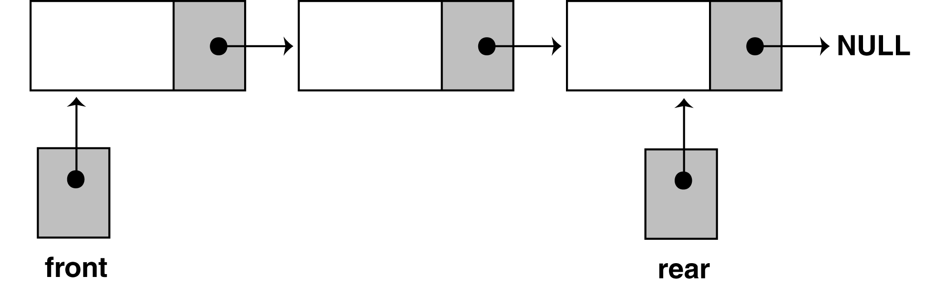
Dynamic Queues
Figure 18-14 shows the structure of a dynamic queue.

Slide 62
Contents of DynIntQueue.h
class DynIntQueue
{
private:
struct QueueNode
{
int value;
QueueNode *next;
};
QueueNode *front;
QueueNode *rear;
int numItems;
public:
DynIntQueue(void);
~DynIntQueue(void);
void enqueue(int);
void dequeue(int &);
bool isEmpty(void);
void clear(void);
};

Slide 63
Contents of DynIntQueue.cpp
#include <iostream.h>
#include "dynintqueue.h“
//************************
// Constructor *
//************************
DynIntQueue::DynIntQueue(void)
{
front = NULL;
rear = NULL;
numItems = 0;
}
//************************
// Destructor *
//************************
DynIntQueue::~DynIntQueue(void)
{
clear();
}

Slide 64
Contents of DynIntQueue.cpp
//********************************************
// Function enqueue inserts the value in num *
// at the rear of the queue. *
//********************************************
void DynIntQueue::enqueue(int num)
{
QueueNode *newNode;
newNode = new QueueNode;
newNode->value = num;
newNode->next = NULL;
if (isEmpty())
{
front = newNode;
rear = newNode;
}
else
{
rear->next = newNode;
rear = newNode;
}
numItems++;
}

Slide 65
Contents of DynIntQueue.cpp
//**********************************************
// Function dequeue removes the value at the *
// front of the queue, and copies it into num. *
//**********************************************
void DynIntQueue::dequeue(int &num)
{
QueueNode *temp;
if (isEmpty())
cout << "The queue is empty.\n";
else
{
num = front->value;
temp = front->next;
delete front;
front = temp;
numItems--;
}
}

Slide 66
Contents of DynIntQueue.cpp
//*********************************************
// Function isEmpty returns true if the queue *
// is empty, and false otherwise. *
//*********************************************
bool DynIntQueue::isEmpty(void)
{
bool status;
if (numItems)
status = false;
else
status = true;
return status;
}

Slide 67
Contents of DynIntQueue.cpp
//********************************************
// Function clear dequeues all the elements *
// in the queue. *
//********************************************
void DynIntQueue::clear(void)
{
int value; // Dummy variable for dequeue
while(!isEmpty())
dequeue(value);
}

Slide 68
Program 18-6
// This program demonstrates the DynIntQeue class
#include <iostream.h>
#include "dynintqueue.h“
void main(void)
{
DynIntQueue iQueue;
cout << "Enqueuing 5 items...\n";
// Enqueue 5 items.
for (int x = 0; x < 5; x++)
iQueue.enqueue(x);
// Deqeue and retrieve all items in the queue
cout << "The values in the queue were:\n";
while (!iQueue.isEmpty())
{
int value;
iQueue.dequeue(value);
cout << value << endl;
}
}

Slide 69
Program 18-6 (continued)
Program Ouput
Enqueuing 5 items...
The values in the queue were:
0
1
2
3
4

Slide 70
The STL deque and queue Containers
A deque (pronounced "deck" or "deek") is a double-ended queue. It similar to a vector, but allows efficient access to values at both the front and the rear.
The queue ADT is like the the stack ADT: it is actually a container adapter.

Slide 71
The deque Container
Programs that use the deque ADT must include the deque header file.
The push_back, pop_front, and front member functions are described in Table 18-4 (page 1094).

Slide 72
Program 18-7
// This program demonstrates the STL deque
// container.
#include <iostream.h>
#include <deque>
using namespace std;
void main(void)
{
int x;
deque<int> iDeque;
cout << "I will now enqueue items...\n";
for (x = 2; x < 8; x += 2)
{
cout << "Pushing " << x << endl;
iDeque.push_back(x);
}
cout << "I will now dequeue items...\n";
for (x = 2; x < 8; x += 2)
{
cout << "Popping " << iDeque.front() << endl;
iDeque.pop_front();
}
}

Slide 73
Program 18-7 (continued)
Program Output
I will now enqueue items...
Pushing 2
Pushing 4
Pushing 6
I will now dequeue items...
Popping 2
Popping 4
Popping 6

Slide 74
The queue Container Adapter
The queue container adapter can be built upon vectors, lists, or deques.
By default, it uses deque as its base.

Slide 75
The queue Container Adapter
The queue insertion and removal operations are the same as those supported by the stack ADT: push, pop, and top.
The queue version of push always inserts an element at the rear of the queue.
The queue version of pop always removes an element from the structure's front.
The top function returns the value of the element at the front of the queue.

Slide 76
Program 18-8
// This program demonstrates the STL queue
// container adapter.
#include <iostream.h>
#include <queue>
using namespace std;
void main(void)
{
int x;
queue<int> iQueue;
cout << "I will now enqueue items...\n";
for (x = 2; x < 8; x += 2)
{
cout << "Pushing " << x << endl;
iQueue.push(x);
}
cout << "I will now dequeue items...\n";
for (x = 2; x < 8; x += 2)
{
cout << "Popping " << iQueue.front() << endl;
iQueue.pop();
}
}

Slide 77
Program 18-8 (continued)
Program Output
I will now enqueue items...
Pushing 2
Pushing 4
Pushing 6
I will now dequeue items...
Popping 2
Popping 4
Popping 6

