Slide 1

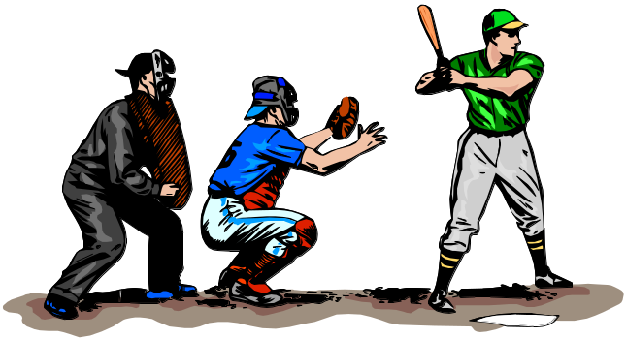

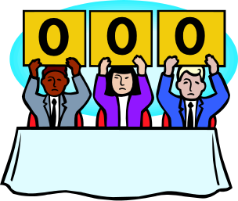
What You Will Learn
Use
try,
throw,
catch
to
watch for
indicate exceptions
handle
How to process exceptions and failures.

Slide 2
Syntax Errors, Runtime Errors, and Logic Errors
There are three categories of errors: syntax errors, runtime errors, and logic errors.
Syntax errors arise because the rules of the language have not been followed. They are detected by the compiler.
Runtime errors occur while the program is running if the environment detects an operation that is impossible to carry out.
Logic errors occur when a program doesn't perform the way it was intended to.

Slide 3
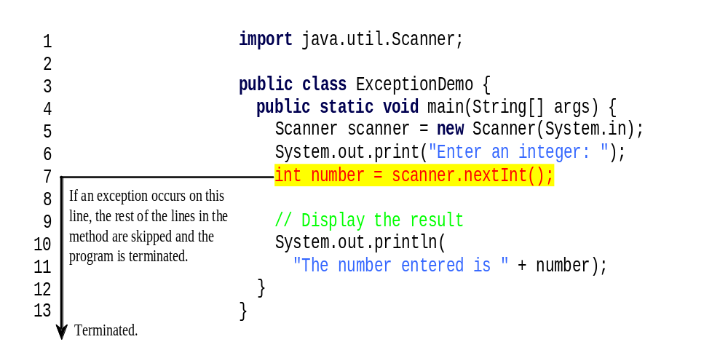
Runtime Errors

Slide 4
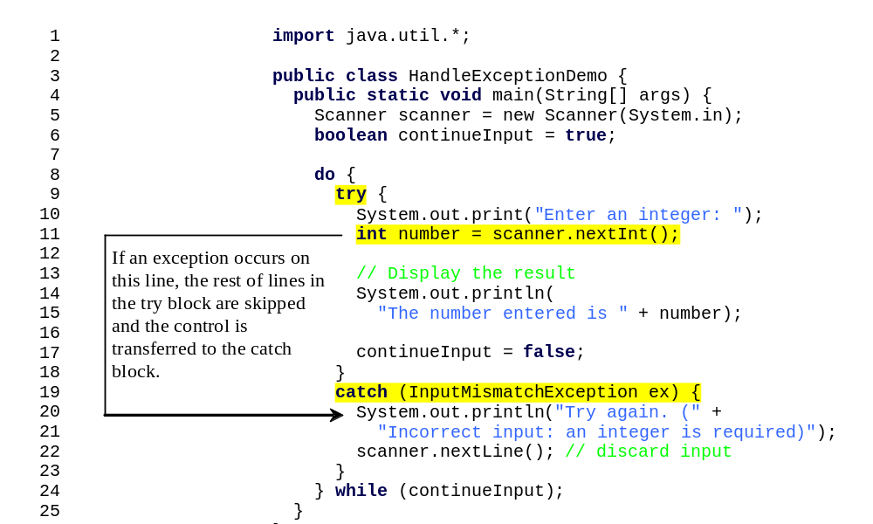
Catch Runtime Errors

Slide 5

Exception Classes

Slide 6
System Errors
System errors are thrown by JVM and represented in the Error class. The Error class describes internal system errors. Such errors rarely occur. If one does, there is little you can do beyond notifying the user and trying to terminate the program gracefully.

Slide 7
Exceptions
Exception describes errors caused by your program and external circumstances. These errors can be caught and handled by your program.

Slide 8
Runtime Exceptions
RuntimeException is caused by programming errors, such as bad casting, accessing an out-of-bounds array, and numeric errors.

Slide 9
Checked Exceptions vs. Unchecked Exceptions
RuntimeException, Error and their subclasses are known as unchecked exceptions.
All other exceptions are known as checked exceptions, meaning that the compiler forces the programmer to check and deal with the exceptions.

Slide 10
Unchecked Exceptions
In most cases, unchecked exceptions reflect programming logic errors that are not recoverable.
For example, a NullPointerException is thrown if you access an object through a reference variable before an object is assigned to it; an IndexOutOfBoundsException is thrown if you access an element in an array outside the bounds of the array.
These are the logic errors that should be corrected in the program. Unchecked exceptions can occur anywhere in the program. To avoid cumbersome overuse of try-catch blocks, Java does not mandate you to write code to catch unchecked exceptions.

Slide 11
Checked Exceptions
Inherit from class Exception but not from RuntimeException
Compiler enforces catch-or-declare requirement
Compiler checks each method call and method declaration
  determines whether method throws checked exceptions.
  If so, the compiler ensures checked exception caught or declared in throws clause.
  If not caught or declared, compiler error occurs.

Slide 12

Checked or Unchecked Exceptions
Unchecked exception.

Slide 13
Code that could generate errors put in try blocks
  Code for error handling enclosed in a catch clause
  The finally clause always executes
Termination model of exception handling
  The block in which the exception occurs expires
throws clause specifies exceptions method throws

Slide 14
Exception Handler
Exception "thrown" here
Thrown exception matched against first set of exception handlers
Exception handler
If it fails to match, it is matched against next set of handlers, etc.
Exception handler
If exception matches none of handlers, program is abandoned

Slide 15

Declaring, Throwing, and Catching Exceptions

Slide 16
Declaring Exceptions
Every method must state the types of checked exceptions it might throw. This is known as declaring exceptions.
public void myMethod()
throws IOException
public void myMethod()
throws IOException, OtherException

Slide 17
Throwing Exceptions
When the program detects an error, the program can create an instance of an appropriate exception type and throw it. This is known as throwing an exception. Here is an example,
throw new TheException();
TheException ex = new TheException();
throw ex;

Slide 18
Throwing Exceptions Example
/** Set a new radius */
public void setRadius(double newRadius)
throws IllegalArgumentException {
if (newRadius >= 0)
radius = newRadius;
else
throw new IllegalArgumentException(
"Radius cannot be negative");
}

Slide 19
Catching Exceptions
try {
statements; // Statements that may throw exceptions
}
catch (Exception1 exVar1) {
handler for exception1;
}
catch (Exception2 exVar2) {
handler for exception2;
}
...
catch (ExceptionN exVar3) {
handler for exceptionN;
}

Slide 20
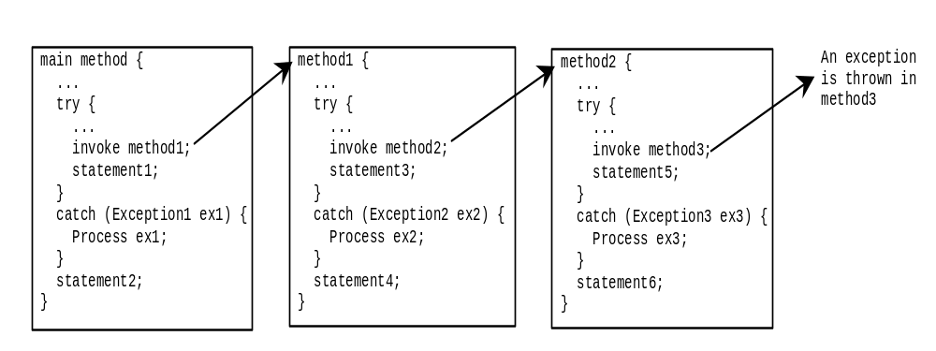
Catching Exceptions

Slide 21
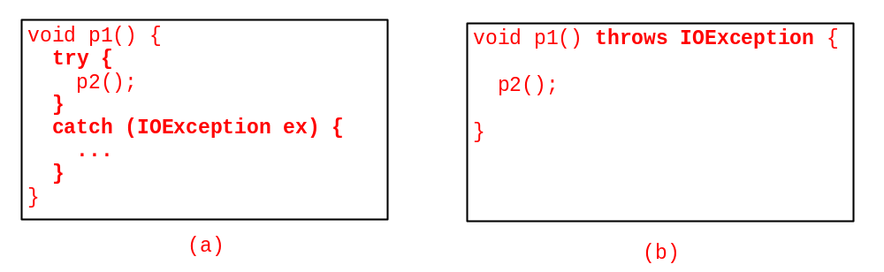
Catch or Declare Checked Exceptions
Java forces you to deal with checked exceptions. If a method declares a checked exception (i.e., an exception other than Error or RuntimeException), you must invoke it in a try-catch block or declare to throw the exception in the calling method.
For example, suppose that method p1 invokes method p2 and p2 may throw a checked exception (e.g., IOException), you have to write the code as shown in (a) or (b).

Slide 22
Rethrowing Exceptions
try {
statements;
}
catch(TheException ex) {
perform operations before exits;
throw ex;
}

Slide 23
The finally Clause
try {
statements;
}
catch(TheException ex) {
handling ex;
}
finally {
finalStatements;
}

Slide 24
Trace a Program Execution
Suppose no exceptions in the statements
try {
statements;
}
catch(TheException ex) {
handling ex;
}
finally {
finalStatements;
}
Next statement;

Slide 25
Trace a Program Execution
The final block is always executed
try {
statements;
}
catch(TheException ex) {
handling ex;
}
finally {
finalStatements;
}
Next statement;

Slide 26
Trace a Program Execution
Next statement in the method is executed
try {
statements;
}
catch(TheException ex) {
handling ex;
}
finally {
finalStatements;
}
Next statement;

Slide 27
Trace a Program Execution
try {
statement1;
statement2;
statement3;
}
catch(Exception1 ex) {
handling ex;
}
finally {
finalStatements;
}
Next statement;
Suppose an exception of type Exception1 is thrown in statement2

Slide 28
Trace a Program Execution
try {
statement1;
statement2;
statement3;
}
catch(Exception1 ex) {
handling ex;
}
finally {
finalStatements;
}
Next statement;
The exception is handled.

Slide 29
Trace a Program Execution
try {
statement1;
statement2;
statement3;
}
catch(Exception1 ex) {
handling ex;
}
finally {
finalStatements;
}
Next statement;
The final block is always executed.

Slide 30
Trace a Program Execution
try {
statement1;
statement2;
statement3;
}
catch(Exception1 ex) {
handling ex;
}
finally {
finalStatements;
}
Next statement;
The next statement in the method is now executed.

Slide 31
Trace a Program Execution
try {
statement1;
statement2;
statement3;
}
catch(Exception1 ex) {
handling ex;
}
catch(Exception2 ex) {
handling ex;
throw ex;
}
finally {
finalStatements;
}
Next statement;
statement2 throws an exception of type Exception2.

Slide 32
Trace a Program Execution
try {
statement1;
statement2;
statement3;
}
catch(Exception1 ex) {
handling ex;
}
catch(Exception2 ex) {
handling ex;
throw ex;
}
finally {
finalStatements;
}
Next statement;
Handling exception

Slide 33
Trace a Program Execution
try {
statement1;
statement2;
statement3;
}
catch(Exception1 ex) {
handling ex;
}
catch(Exception2 ex) {
handling ex;
throw ex;
}
finally {
finalStatements;
}
Next statement;
Execute the final block

Slide 34
Trace a Program Execution
try {
statement1;
statement2;
statement3;
}
catch(Exception1 ex) {
handling ex;
}
catch(Exception2 ex) {
handling ex;
throw ex;
}
finally {
finalStatements;
}
Next statement;
Rethrow the exception and control is transferred to the caller

Slide 35
Exceptions Methods:
Following is the list of important methods available in the Throwable class.
SN | Methods with Description
1 | public String getMessage() Returns a detailed message about the exception that has occurred. This message is initialized in the Throwable constructor.
2 | public Throwable getCause() Returns the cause of the exception as represented by a Throwable object.
3 | public String toString() Returns the name of the class concatenated with the result of getMessage()
4 | public void printStackTrace() Prints the result of toString() along with the stack trace to System.err, the error output stream.
5 | public StackTraceElement [] getStackTrace() Returns an array containing each element on the stack trace. The element at index 0 represents the top of the call stack, and the last element in the array represents the method at the bottom of the call stack.
6 | public Throwable fillInStackTrace() Fills the stack trace of this Throwable object with the current stack trace, adding to any previous information in the stack trace.

Slide 36
Catching Exceptions:
A method catches an exception using a combination of the try and catch keywords.
A try/catch block is placed around the code that might generate an exception. Code within a try/catch block is referred to as protected code, and the syntax for using try/catch looks like the following:
try { //Protected code }
catch(ExceptionName e1) { //Catch block }
A catch statement involves declaring the type of exception you are trying to catch. If an exception occurs in protected code, the catch block (or blocks) that follows the try is checked.
If the type of exception that occurred is listed in a catch block, the exception is passed to the catch block much as an argument is passed into a method parameter.

Slide 37
ExcepTest.java
import java.io.*;
public class ExcepTest{
public static void main(String args[]){
try{
int a[] = new int[2];
System.out.println("Access element three :" + a[3]); } catch(ArrayIndexOutOfBoundsException e){ System.out.println("Exception thrown :" + e);
}
System.out.println("Out of the block");
}
}

Slide 38
The throws/throw Keywords:
If a method does not handle a checked exception, the method must declare it using the throws keyword. The throws keyword appears at the end of a method's signature.
You can throw an exception, either a newly instantiated one or an exception that you just caught, by using the throw keyword. Try to understand the different in throws and throw keywords.

Slide 39
The following method declares that it throws a RemoteException:
import java.io.*;
public class className {
public void deposit(double amount) throws RemoteException {
// Method implementation
throw new RemoteException();
} //Remainder of class definition
}

Slide 40
A method can declare that it throws more than one exception, in which case the exceptions are declared in a list separated by commas.

Slide 41
For example, the following method declares that it throws a RemoteException and an InsufficientFundsException:
import java.io.*;
public class className {
public void withdraw(double amount) throws RemoteException, InsufficientFundsException { // Method implementation }
//Remainder of class definition
}

Slide 42
The finally Keyword
The finally keyword is used to create a block of code that follows a try block. A finally block of code always executes, whether or not an exception has occurred.
Using a finally block allows you to run any cleanup-type statements that you want to execute, no matter what happens in the protected code.

Slide 43
A finally block appears at the end of the catch blocks and has the following syntax:
try { //Protected code }
catch(ExceptionType1 e1) {
//Catch block }
catch(ExceptionType2 e2) {
//Catch block }
catch(ExceptionType3 e3)
{ //Catch block }
finally { //The finally block always executes. }

Slide 44
public class ExcepTest{
public static void main(String args[]){
  int a[] = new int[2];
  try{
  System.out.println("Access element three :" + a[3]); }catch(ArrayIndexOutOfBoundsException e){ System.out.println("Exception thrown :" + e);
  } finally{
  a[0] = 6; System.out.println("First element value: " +a[0]);
  System.out.println("The finally statement is executed");
  }
  }
  }

Slide 45
Note the following:
A catch clause cannot exist without a try statement.
It is not compulsory to have finally clauses when ever a try/catch block is present.
The try block cannot be present without either catch clause or finally clause.
Any code cannot be present in between the try, catch, finally blocks.

Slide 46
Cautions When Using Exceptions
Exception handling separates error-handling code from normal programming tasks, thus making programs easier to read and to modify.
Be aware, however, that exception handling usually requires more time and resources because it requires instantiating a new exception object, rolling back the call stack, and propagating the errors to the calling methods.

Slide 47
When to Throw Exceptions
An exception occurs in a method. If you want the exception to be processed by its caller, you should create an exception object and throw it. If you can handle the exception in the method where it occurs, there is no need to throw it.

Slide 48
When to Use Exceptions
When should you use the try-catch block in the code? You should use it to deal with unexpected error conditions. Do not use it to deal with simple, expected situations. For example, the following code
try {
System.out.println(refVar.toString());
}
catch (NullPointerException ex) {
System.out.println("refVar is null");
}

Slide 49
When to Use Exceptions
is better to be replaced by
if (refVar != null)
System.out.println(refVar.toString());
else
System.out.println("refVar is null");

