Slide 1

INTRODUCTION TO POWER QUALITY

Slide 2
CONTENTS
What is Power Quality?
Why are we concerned about it?
Power Quality Problems?

Slide 3
Major Reasons for Increased Concern
Newer generation load equipment with micro processor based control, power electronic devices is more sensitive to power quality variations than the equipments that were used in the past.
The characteristics of the electric loads have changed dramatically with the proliferation of new microelectronics and sensitive computer type equipment.

Slide 4
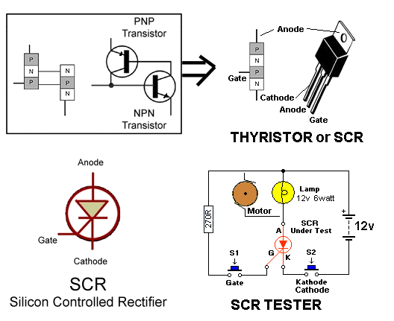
Major Reasons for Increased Concern
Power Electronic Devices

Slide 5
Major Reasons for Increased Concern
The increasing emphasis on overall power system efficiency has resulted in continued growth in the application of devices such as high-efficiency, adjustable-speed motor drives and shunt capacitors for power factor correction to reduce losses. This is resulting in increasing harmonic levels on power systems and has many people concerned about the future impact on system capabilities.
Harmonics cause equipment to fail prematurely and also decrease the efficiency of the electric distribution/utilization network.

Slide 6
Major Reasons for Increased Concern
End users have an increased awareness of power quality issues.
Utility customers are becoming better informed about such issues as interruptions, sags, and switching transients and are challenging the utilities to improve the quality of power delivered.

Slide 7
Major Reasons for Increased Concern
Electric power systems are now interconnected, integrated, and thus any system disturbance can have an extended serious economic impact particularly for large industrial type consumers due to process shutdown.

Slide 8
Power Quality
Any power problem manifested in voltage, current, or frequency deviations that results in failure or misoperation of customer equipment.
Measure of proper utilization of power by customers
For ideal electrical systems, the supplied power should have perfect current and voltage sinusoidal waveforms, being safe and reliable.

Slide 9
It is not always economical to eliminate power quality variations on the supply side.
In many cases, the optimal solution to a problem may involve making a particular piece of sensitive equipment less sensitive to power quality variations.
The level of power quality required is that level which will result in proper operation of the equipment at a particular facility.

Slide 10
Quantifying Power
The ultimate measure of power quality is determined by the performance and productivity of end-user equipment.
If the electric power is inadequate for those needs, then the “quality” is lacking.

Slide 11
Power Quality = Voltage Quality
it is actually the quality of the voltage that is being addressed in most cases.
The power supply system can only control the quality of the voltage.
It has no control over the currents that particular loads might draw. Therefore, the standards in the power quality area are devoted to maintaining the supply voltage within certain limits.

Slide 12
AC power systems are designed to operate at a sinusoidal voltage of a given frequency [typically 50 or 60 hertz (Hz)] and magnitude.
Any significant deviation in the waveform magnitude, frequency, or purity is a potential power quality problem.

Slide 13
In any practical power system there is always a close relationship between V and I.
Although the generators may provide a near-perfect sine-wave voltage, the current passing through the impedance of the system can cause a variety of disturbances to the voltage.

Slide 14
Example:
The current resulting from a short circuit causes the voltage to sag or disappear completely, as the case may be.
Distorted currents from harmonic-producing loads also distort the voltage as they pass through the system impedance. Thus a distorted voltage is presented to other end users.
Therefore, while it is the voltage with which we are ultimately concerned, we must also address phenomena in the current to understand the basis of many power quality problems.

Slide 15
Why are we concerned about it?
The ultimate reason that we are interested in power quality is economic value.
There are economic impacts on utilities, their customers, and suppliers of load equipment.

Slide 16
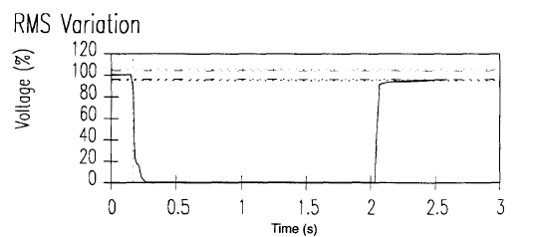
Power Quality Problems
Momentary Interruption due to fault
and breaker reclose

Slide 17
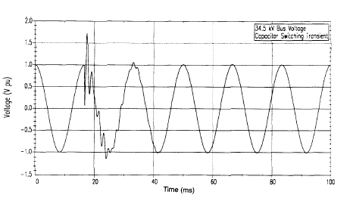
Power Quality Problems
Transient Overvoltages

Slide 18
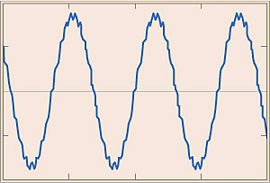
Power Quality Problems
Harmonics

Slide 19
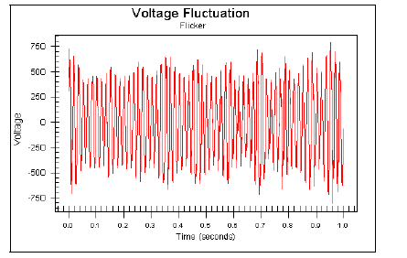
Flicker Due to Arc Furnace Operation

Slide 20
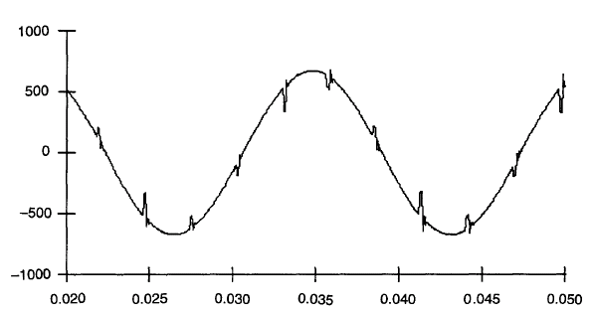
Power Quality Problems
Voltage Notching

Slide 21
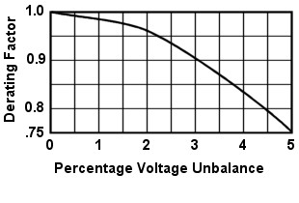
Power Quality Problems
Voltage Unbalance
Motor Derating Factor due to Unabalanced Voltage

Slide 22
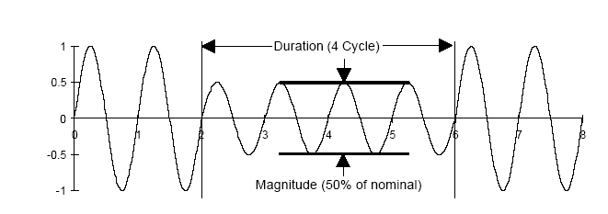
Voltage Sags
Reduction in the ac voltage, at the power frequency, for durations from a half-cycle to one minute.
Magnitude of supply falls within 90% and 10% of nominal.
Impacts Industrial Customers 7 to 8 times more likely than Outages.

Slide 23
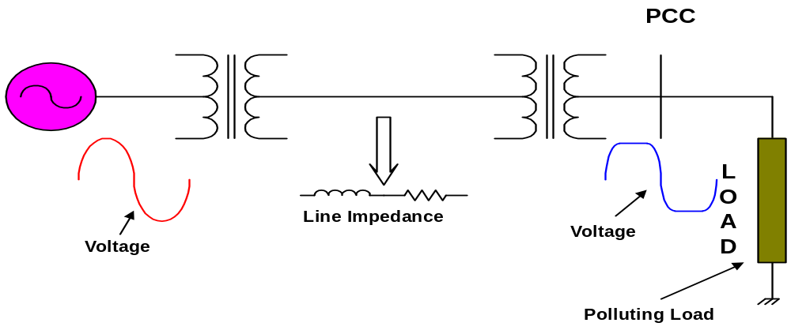
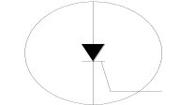
Power Quality Affected by Polluting Load
Other loads connected at the Point of Common Coupling (PCC) suffer!

Slide 24
Power Supply Authority
Clean Power Supply/ Correction Measure
Power Quality
Consumer
No Electrical Pollution
Responsibility of Both! The most important contributor to PQ problem is the customer’s use of sensitive type non-linear load in all sectors (Industrial, commercial and Residential)

