Slide 1

MODULE – 1

Slide 2
CONTENTS – Terms and Definitions
General classes of power quality problems
Transients
Long duration voltage variations
Short duration voltage variations
Voltage Imbalance
Notes:
The effect of power quality problems in industrial, commercial, and residential systems can range from a minor inconvenience to costly downtime. This course covers the fundamentals of power generation, distribution, quality, monitoring, and troubleshooting. Online and portable power monitoring and testing concepts are detailed. Power quality measurements are introduced with common applications.

Slide 3
CONTENTS – Voltage sags and Interruptions
Sources of Sags and Interruptions
Estimating Voltage Sag Performance
Fundamental Principles of Protection
Solutions at the End-User Level
Evaluating the Economics of Different Ride-Through Alternatives
Motor Starting Sags
Utility System Fault-Clearing Issues

Slide 4
Transients
Based on the waveform shape
Impulsive Transient
Oscillatory Transient

Slide 5
Transients
Transients are abnormal short duration power system phenomena. They show very high rise of voltage and current in short period of time.
They effect the performance of the power system devices as well as measuring, controlling and protective devices.

Slide 6
Impulsive Transient
It is a sudden non-power frequency change in the steady state condition of voltage, current, or both that is unidirectional in polarity (primarily either positive or negative).
These are normally characterized by their rise and decay times.
Major Cause: Lightning

Slide 7
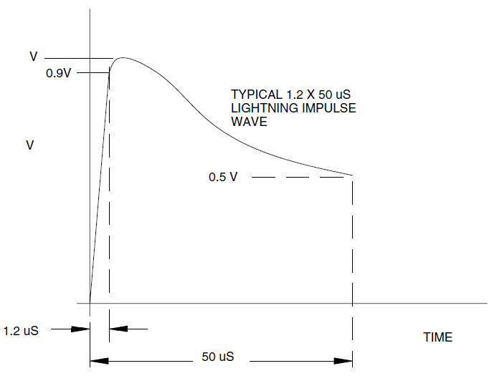
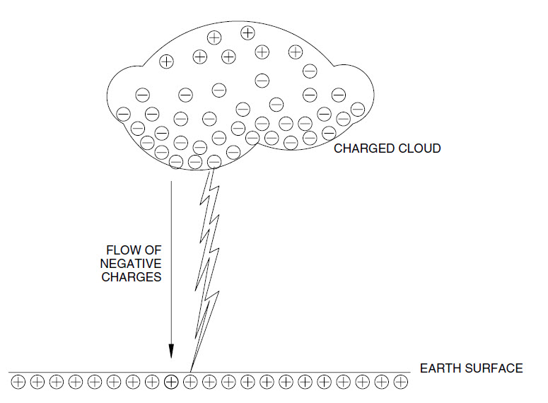
Over potential surge due to lightning discharge is the most common natural cause of electrical equipment failure. The phenomenon of lighting strike can be described as follows. A negative charge builds up on a cloud. A corresponding positive charge can build up on the surface of the earth. A voltage difference of hundreds of millions of volts can exist between the cloud and the earth due to the opposing charges. When the voltage exceeds the breakdown potential of air (about 3 × 106 V/m or 75 kV/inch), a lightning flash occurs.
Figure 1
Figure 2

Slide 8
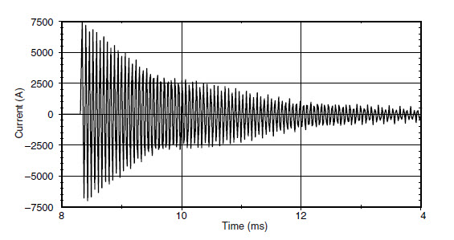
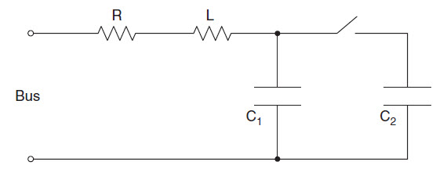
Oscillatory Transient
It is a sudden non-power frequency change in the steady state condition of voltage , current, or both, that includes both negative and positive polarity values.
Major Cause: Occur due to resonance during switching of capacitor bank for power factor improvement
Figure 3
Figure 4

Slide 9
Voltage variations (VV)
Long Duration V V (> 1 minute)
Over Voltage > 110%
Under Voltage < 90%
Sustained Interruptions
Short Duration VV
Interruption
Sags (dips) : 0.1 pu – 0.9 pu (0.5 cycle to 1 min.)
Swells

Slide 10
Overvoltage | Under voltage | Sustained Interruptions
It is an increase in the rms ac voltage greater than 110% at the power frequency for a duration longer than 1 minute. | It is a decrease in the rms ac voltage to less than 90% at the power frequency for a duration longer than 1 minute. | When the supply voltage has been zero for a period of time in excess of 1 minute.
Cause: Load switching – Switching off a large load or energizing a capacitor bank; Incorrect tap settings | Cause: Load switching on or capacitor switching off; overloaded circuits.

Slide 11
Sustained Interruptions
When the supply voltage has been zero for a period of time in excess of 1 minute.
Voltage interruptions longer than 1 min. are often permanent and require human intervention to repair the system for restoration.
It is different from the term outage (for reliability calculation purpsoses).
Outage – it refers to the state of a component in the system that has failed to function as expected

Slide 12
Short Duration Voltage Variations
Caused by
Fault Conditions
Energization of large loads which require high starting currents
Intermittent loose connections in power wiring
Depending on the fault location and system conditions, the fault can cause:
Temporary voltage drops (sags) or
Voltage rises (swells) or
Complete loss of voltage (Interruptions)

Slide 13
Interruption
An interruption occurs when the supply voltage or load current decreases to less than 0.1 pu for a period of time not exceeding 1 minute.
Causes: Power system faults, equipment failures, control malfunctions.
The duration of an interruption due to a fault on the utility system is determined by the operating time of utility protective devices.
Instantaneous reclosing generally will limit the interruption caused by a nonpermanent fault to less than 30 cycles.
Delayed reclosing – momentary or temporary interruption

Slide 14
Sags (Dip (IEC standard))
It is a decrease to between 0.1 pu and 0.9 pu in rms voltage or current at the power frequency for durations from 0.5 cycle to 1 minute.
20% sag => a sag whose magnitude is 20% => a sag to 0.8 pu
Causes: Power system faults, energization of heavy loads or starting of large motors

Slide 15
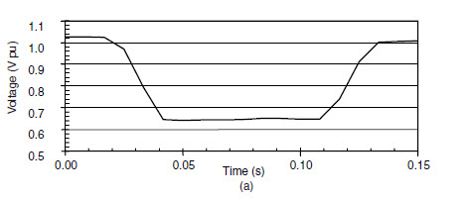
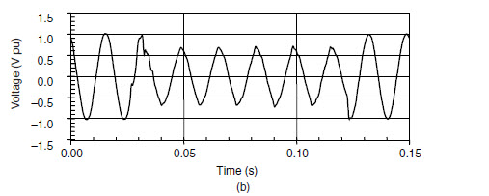
An 80% sag exists for about 3 cycles until the substation breaker is able to interrupt the fault current. Typical fault clearing times: 3-30 cycles depending on the magnitude of fault current and the type of over current protection.
Figure 5: Voltage sag caused by an SLG fault. (a) RMS waveform for voltage sag event. (b) Voltage sag waveform.

Slide 16
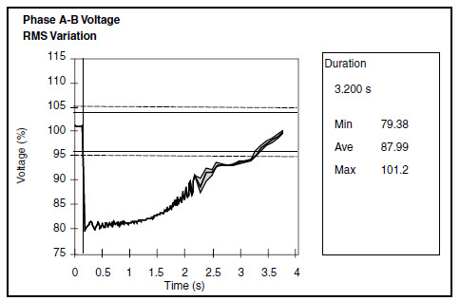
Effect of large motor starting
Induction motor – During its start-up it draws 6-10 times its full-load current.
Voltage sags to 80% and then gradually returns to normal in about 3 seconds.
Fig. 6 Temporary voltage sag caused by motor starting.

Slide 17
Swell (Momentary overvoltage)
It is defined as an increase to between 1.1 and 1.8 pu in rms voltage or current at the power frequency for durations from 0.5 cycle to 1 minute.
Swells are usually associated with system fault conditions, but not as common as voltage sags.
Causes: Switching off a large load or energizing a large capacitor bank.
The severity of a voltage swell during a fault condition is a function of the fault location, system impedance, and grounding

Slide 18
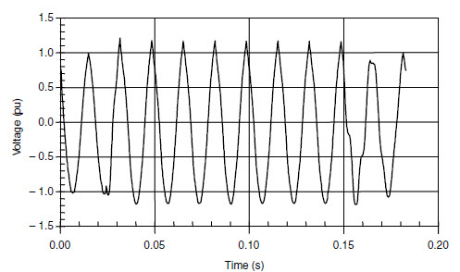
Fig. 7 Instantaneous voltage swell caused by an SLG fault
Temporary voltage rise on the unfaulted phases during an SLG fault

Slide 19
Voltage Imbalance (Voltage Unbalance)
It is defined as the maximum deviation from the average of the three phase voltages or currents, divided by the average of the three-phase voltages or currents, expressed in percent.
It is the ratio of either the negative or zero sequence component to the positive sequence component.
Source of voltage unbalance less than 2%: single phase loads on a three-phase circuit;
Voltage unbalance – result of blown fuses in one phase of a three-phase capacitor bank.

