Slide 1

MODULE – 1

Slide 2
CONTENTS – Terms and Definitions
Waveform distortion
Voltage fluctuations
Power frequency variations
Power Quality terms
Notes:
The effect of power quality problems in industrial, commercial, and residential systems can range from a minor inconvenience to costly downtime. This course covers the fundamentals of power generation, distribution, quality, monitoring, and troubleshooting. Online and portable power monitoring and testing concepts are detailed. Power quality measurements are introduced with common applications.

Slide 3
Waveform Distortion
It is defined as steady state-deviation from an ideal sine wave of power frequency principally characterized by the spectral content of the deviation.
Types of waveform distortion:
DC offset
Harmonics
Inter harmonics
Notching
Noise

Slide 4
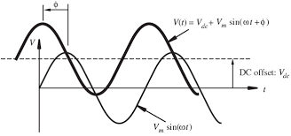
DC offset
        The presence of a dc voltage or current in an ac power system is termed as dc offset.
Sources:
This can occur as a result of a geomagnetic disturbance or asymmetry of electronic power converters.
Incandescent light bulb life extenders consist of diodes that reduce the rms voltage supplied to the light bulb by half-wave rectification
Consequences (Effects)
Direct current in an ac networks can have a damaging effect by biasing transformer cores so they saturate in normal operation.
Causes additional heating and loss of transformer life.
Direct current may also cause the electrolytic erosion of grounding electrodes and other connectors
Notes:
A geomagnetic storm is a temporary disturbance of the Earth's magnetosphere caused by a solar wind shock wave and/or cloud of magnetic field that interacts with the Earth's magnetic field.
Geomagnetic disturbances can have a serious effect on power systems. Currents induced in power lines flow to ground through substation transformers. Here they cause saturation of the transformer core which can lead to a variety of problems. Increased heating has caused transformers to burn out. Also, extra harmonics generated in the transformer produce unwanted relay operations, suddenly tripping out power lines. The stability of the whole system can also be affected as compensators switch out of service. Such a sequence of events led to the Quebec blackout of March 13, 1989, which left the whole province without power for over 9 hours.
Geomagnetically induced currents (GIC) are driven by the electric fields produced by the magnetic field variations that occur during a geomagnetic disturbance. Because of their low frequency compared to the AC frequency, the geomagnetically induced currents appear to a transformer as a slowly-varying DC current. GIC flowing through the transformer winding produces extra magnetisation which, during the half-cycles when the AC magnetisation is in the same direction, can saturate the core of the transformer. This results in a very spikey AC waveform with increased harmonic levels that can cause misoperation of relays and other equipment on the system and lead to problems ranging from trip-outs of individual lines to collapse of the whole system.
A DC current flowing through the windings generates a DC flux in the core with a magnitude depending on the magnitude of the DC current, number of turns in the windings carrying the current and reluctance of the DC flux path. This impressed DC flux shifts the operating point of the magnetizing characteristic and causes half cycle saturation in the core resulting in harmonic currents, forcing the flux to flow outside the core and increased reactive power consumption

Slide 5
Harmonics
Harmonics are sinusoidal voltages or currents having frequencies that are integer multiples of the frequency at which the supply system is designed to operate (fundamental frequency 50 or 60 Hz).
Periodically distorted waveforms can be decomposed into a sum of the fundamental frequency and the harmonics.
The harmonics are characterized/quantified by THD and TDD.
Major causes: power electronic equipment, arcing, transformer saturation (non-linear characteristics of devices and loads)
Major consequences: equipment overheating, high voltage/current, protective device operations
Notes:
Total harmonic distortion, Total demand distortion.

Slide 6
Interharmonics
Voltages or currents having frequency components that are not integer multiples of the frequency at which the supply system is designed to operate (e.g., 50 or 60 Hz) are called interharmonics.
They can appear as discrete frequencies or as a wideband spectrum.
Interharmonics can be found in networks of all voltage classes.

Slide 7
Sources:
Arcing devices
Cycloconverters
Induction furnaces
Static frequency converters
Consequences:
They have been shown to affect power-line-carrier signaling and induce visual flicker in fluorescent and other arc lighting as well as in computer display devices.

Slide 8
Notching
Notching is a periodic voltage disturbance caused by the normal operation of power electronic devices when current is commutated from one phase to another.
The frequency components associated with notching can be quite high and may not be readily characterized with measurement equipment normally used for harmonic analysis.

Slide 9
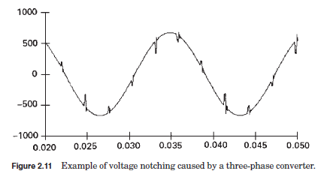
Figure shows an
example of voltage
notching from
a three-phase
converter that produces
continuous dc current.
The notches occur when the current commutates from one phase to another.
During this period, there is a momentary short circuit between two phases, pulling the voltage as close to zero as permitted by system impedances.
Fig. Example of voltage notching caused by a three phase converter

Slide 10
Noise
Noise is defined as unwanted electrical signals with broadband spectral content lower than 200 kHz superimposed upon the power system voltage or current in phase conductors, or found on neutral conductors or signal lines.
Causes:
Power electronic devices,
control circuits
arcing equipment
loads with solid-state rectifiers
switching power supplies.
Noise problems are often exacerbated by improper grounding that fails to conduct noise away from the power system.
Notes:
Exacerbated = Make worse

Slide 11
Voltage Fluctuation
Voltage fluctuations are systematic variations of the voltage envelope or a series of voltage changes, the magnitude of which does not normally exceed the voltage ranges of 0.9 to 1.1 p.u.
Loads that can exhibit continuous, rapid variations in the load current magnitude can cause voltage variations that are often referred to as flicker.
Voltage flicker is measured with respect to the sensitivity of the human eye.
Causes:
Arc Furnace-one of the most common causes of voltage fluctuations on utility transmission and distribution systems.

Slide 12
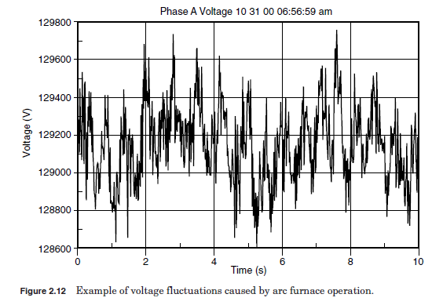
Figure. Example of voltage fluctuations caused by arc furnace operation

Slide 13
Power Frequency Variations
Power frequency variations are defined as the deviation of the power system fundamental frequency from it specified nominal value (e.g., 50 or 60 Hz).
The power system frequency is directly related to the rotational speed of the generators supplying the system.
There are slight variations in frequency as the dynamic balance between load and generation changes.
The size of the frequency shift and its duration depend on the load characteristics and the response of the generation control system to load changes.
Frequency variations that go outside of accepted limits for normal steady-state operation of the power system can be caused by faults on the bulk power transmission system, a large block of load being disconnected, or a large source of generation going off-line.

Slide 14
On modern interconnected power systems, significant frequency variations are rare.
Frequency variations of consequence are much more likely to occur for loads that are supplied by a generator isolated from the utility system.
In such cases, governor response to abrupt load changes may not be adequate to regulate within the narrow bandwidth required by frequency-sensitive equipment.

