Slide 1
ANTENNAS

Slide 2
HISTORY
The first antennas were built in 1888 by German physicist Heinrich Hertz in his pioneering experiments to prove the existence of electromagnetic waves predicted by the theory of James Clerk Maxwell.
Hertz placed dipole antennas at the focal point of parabolic reflectors for both transmitting and receiving. He published his work in Annalen der Physik und Chemie (vol. 36, 1889).

Slide 3
INTRODUCTION
An antenna is an electrical device which converts electric currents into radio waves, and vice versa. It is usually used with a radio transmitter or radio receiver.
In transmission, a radio transmitter applies an oscillating radio frequency electric current to the antenna's terminals, and the antenna radiates the energy from the current as electromagnetic waves (radio waves).

Slide 4
Transmitting Antenna: Any structure designed to efficiently radiate electromagnetic radiation in a preferred direction is called a transmitting antenna.
In reception, an antenna intercepts some of the power of an electromagnetic wave in order to produce a tiny voltage at its terminals, that is applied to a receiver to be amplified. An antenna can be used for both transmitting and receiving.
Receiving Antenna: Any structure designed to efficiently receive electromagnetic radiation is called a receiving antenna

Slide 5
BASIC STRUCTURE
It is a metallic conductor system capable of radiating and receiving em waves.
Typically an antenna consists of an arrangement of metallic conductors (“elements"), electrically connected (often through a transmission line) to the receiver or transmitter.
An oscillating current of electrons forced through the antenna by a transmitter will create an oscillating magnetic field around the antenna elements, while the charge of the electrons also creates an oscillating electric field along the elements.

Slide 6
These time-varying fields radiate away from the antenna into space as a moving electromagnetic field wave.
Conversely, during reception, the oscillating electric and magnetic fields of an incoming radio wave exert force on the electrons in the antenna elements, causing them to move back and forth, creating oscillating currents in the antenna.
Antenna reciprocity : can be used as transmitter and receiver.In two way communication same antenna can be used as transmitter and receiver.

Slide 7
Antennas may also contain reflective or directive elements or surfaces not connected to the transmitter or receiver, such as parasitic elements, parabolic reflectors or horns, which serve to direct the radio waves into a beam or other desired radiation pattern.
Antennas can be designed to transmit or receive radio waves in all directions equally (omnidirectional antennas), or transmit them in a beam in a particular direction, and receive from that one direction only ( directional or high gain antennas).

Slide 8
WHY ANTENNAS ?
Need of antenna arisen when two person wanted to communicate between them when separated by some distance and wired communication is not possible.
Antennas are required by any radio receiver or transmitter to couple its electrical connection to the electromagnetic field.
Radio waves are electromagnetic waves which carry signals through the air (or through space) at the speed of light with almost no transmission loss.

Slide 9
Radio transmitters and receivers are used to convey signals (information) in systems including broadcast (audio) radio, television, mobile telephones , point-to-point communications links (telephone, data networks), satellite links.
Radio waves are also used directly for measurements in technologies including Radar, GPS, and radio astronomy.
In each and every case, the transmitters and receivers involved require antennas, although these are sometimes hidden (such as the antenna inside an AM radio or inside a laptop computer equipped with wi-fi).

Slide 10
WHERE USED?
Antennas are used in systems such as radio and television broadcasting, point to point radio communication, wireless LAN, radar and space exploration
Antennas are most utilized in air or outer space
But can also be operated under water or even through soil and rock at certain frequencies for short distances

Slide 11
RADIATION MECHANISM
Ideally all incident energy must be reflected back when open circuit. But practically a small portion of electromagnetic energy escapes from the system that is it gets radiated.
This occurs because the line of force don’t undergo complete phase reversal and some of them escapes.
G

Slide 12
The amount of escaped energy is very small due to mismatch between transmission line and surrounding space.
Also because two wires are too close to each other, radiation from one tip will cancel radiation from other tip.( as they are of opposite polarities and distance between them is too small as compared to wavelength )
G

Slide 13
To increase amount of radiated power open circuit must be enlarged , by spreading the two wires.
Due to this arrangement, coupling between transmission line and free space is improved.
Also amount of cancellation has reduced.
The radiation efficiency will increase further if two conductors of transmission line are bent so as to bring them in same line.

Slide 14
TYPES OF ANTENNAS
According to their applications and technology available, antennas generally fall in one of two categories:
1.Omnidirectional or only weakly directional antennas which receive or radiate more or less in all directions. These are employed when the relative position of the other station is unknown or arbitrary. They are also used at lower frequencies where a directional antenna would be too large, or simply to cut costs in applications where a directional antenna isn't required.
2. Directional or beam antennas which are intended to preferentially radiate or receive in a particular direction or directional pattern.

Slide 15
According to length of transmission lines available, antennas generally fall in one of two categories:
1. Resonant Antennas – is a transmission line, the length of which is exactly equal to multiples of half wavelength and it is open at both ends.
2.Non-resonant Antennas – the length of these antennas is not equal to exact multiples of half wavelength. In these antennas standing waves are not present as antennas are terminated in correct impedance which avoid reflections. The waves travel only in forward direction .Non-resonant antenna is a unidirectional antenna.

Slide 16
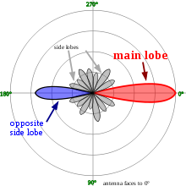
RADIATION PATTERN

Slide 17
The radiation pattern of an antenna is a plot of the relative field strength of the radio waves emitted by the antenna at different angles.
It is typically represented by a three dimensional graph, or polar plots of the horizontal and vertical cross sections. It is a plot of field strength in V/m versus the angle in degrees.
The pattern of an ideal isotropic antenna , which radiates equally in all directions, would look like a sphere.
Many non-directional antennas, such as dipoles, emit equal power in all horizontal directions, with the power dropping off at higher and lower angles; this is called an omni directional pattern and when plotted looks like a donut.

Slide 18
The radiation of many antennas shows a pattern of maxima or "lobes" at various angles, separated by “nulls", angles where the radiation falls to zero.
This is because the radio waves emitted by different parts of the antenna typically interfere, causing maxima at angles where the radio waves arrive at distant points in phase, and zero radiation at other angles where the radio waves arrive out of phase.
In a directional antenna designed to project radio waves in a particular direction, the lobe in that direction is designed larger than the others and is called the "main lobe".
The other lobes usually represent unwanted radiation and are called “sidelobes". The axis through the main lobe is called the "principle axis" or “boresight axis".

Slide 19
ANTENNA GAIN
Gain is a parameter which measures the degree of directivity of the antenna's radiation pattern. A high-gain antenna will preferentially radiate in a particular direction.
Specifically, the antenna gain, or power gain of an antenna is defined as the ratio of the intensity (power per unit surface) radiated by the antenna in the direction of its maximum output, at an arbitrary distance, divided by the intensity radiated at the same distance by a hypothetical isotropic antenna.

Slide 20
The gain of an antenna is a passive phenomenon - power is not added by the antenna, but simply redistributed to provide more radiated power in a certain direction than would be transmitted by an isotropic antenna.
High-gain antennas have the advantage of longer range and better signal quality, but must be aimed carefully in a particular direction.
Low-gain antennas have shorter range, but the orientation of the antenna is relatively inconsequential.

Slide 21
For example, a dish antenna on a spacecraft is a high-gain device that must be pointed at the planet to be effective, whereas a typical Wi-Fi antenna in a laptop computer is low-gain, and as long as the base station is within range, the antenna can be in any orientation in space.
In practice, the half-wave dipole is taken as a reference instead of the isotropic radiator. The gain is then given in dBd (decibels over dipole)

Slide 22
ANTENNA EFFICIENCY
Efficiency of a transmitting antenna is the ratio of power actually radiated (in all directions) to the power absorbed by the antenna terminals.
The power supplied to the antenna terminals which is not radiated is converted into heat. This is usually through loss resistance in the antenna's conductors, but can also be due to dielectric or magnetic core losses in antennas (or antenna systems) using such components.

Slide 23
POLARIZATION
The polarization of an antenna is the orientation of the electric field (E-plane) of the radio wave with respect to the Earth's surface and is determined by the physical structure of the antenna and by its orientation.
A simple straight wire antenna will have one polarization when mounted vertically, and a different polarization when mounted horizontally.
Reflections generally affect polarization. For radio waves the most important reflector is the ionosphere - signals which reflect from it will have their polarization changed
LF,VLF and MF antennas are vertically polarized

Slide 24
BEAM-WIDTH
Beam-width of an antenna is defined as angular separation between the two half power points on power density radiation pattern OR
Angular separation between two 3dB down points on the field strength of radiation pattern
It is expressed in degrees

Slide 25
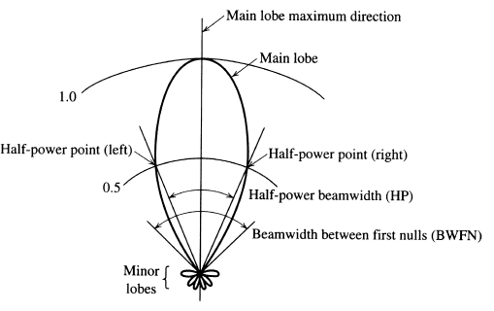

Slide 26
ISOTROPIC ANTENNA
Isotropic antenna or isotropic radiator is a hypothetical (not physically realizable) concept, used as a useful reference to describe real antennas.
Isotropic antenna radiates equally in all directions.
  Its radiation pattern is represented by a sphere whose center coincides with the location of the isotropic radiator.

Slide 27
It is considered to be a point in space with no dimensions and no mass. This antenna cannot physically exist, but is useful as a theoretical model for comparison with all other antennas.
Most antennas' gains are measured with reference to an isotropic radiator, and are rated in dBi (decibels with respect to an isotropic radiator).

Slide 28
HALF WAVE DIPOLE ANTENNA
The half-wave dipole antenna is just a special case of the dipole antenna.
Half-wave term means that the length of this dipole antenna is equal to a half-wavelength at the frequency of operation.
The dipole antenna, is the basis for most antenna designs, is a balanced component, with equal but opposite voltages and currents applied at its two terminals through a balanced transmission line.

Slide 29
To make it crystal clear, if the antenna is to radiate at 600 MHz, what size should the half-wavelength dipole be?
One wavelength at 600 MHz is = c / f = 0.5 meters. Hence, the half-wavelength dipole antenna's length is 0.25 meters.
The half-wave dipole antenna is as you may expect, a simple half-wavelength wire fed at the center as shown in Figure

Slide 30
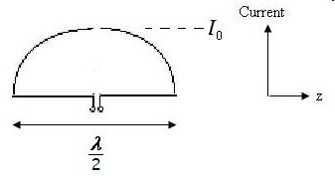
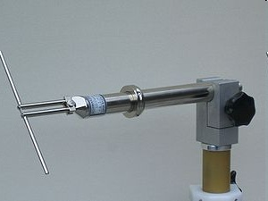

Slide 31
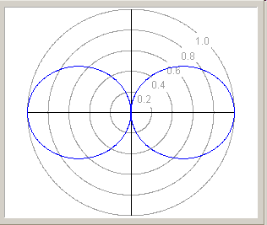
Dipoles have an radiation pattern, doughnut symmetrical about the axis of the dipole. The radiation is maximum at right angles to the dipole, dropping off to zero on the antenna's axis.

Slide 32
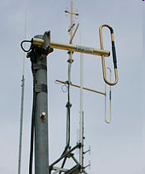
FOLDED DIPOLE
Folded antenna is a single antenna but it consists of two elements.
First element is fed directly while second one is coupled inductively at its end.
Radiation pattern of folded dipole is same as that of dipole antenna i.e figure of eight (8).

Slide 33
Advantages
Input impedance of folded dipole is four times higher than that of straight dipole.
Typically the input impedance of half wavelength folded dipole antenna is 288 ohm.
Bandwidth of folded dipole is higher than that of straight dipole.

Slide 34
HERTZ ANTENNA
The Hertzian dipole is a theoretical short dipole (significantly smaller than the wavelength) with a uniform current along its length.
A true Hertzian dipole cannot physically exist, since the assumed current distribution implies an infinite charge density at its ends, and significant radiation requires a very high current over its very short length.

Slide 35
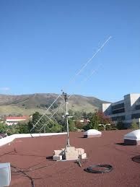

Slide 36
LOOP ANTENNA
A loop antenna is a radio antenna consisting of a loop of wire with its ends connected to a balanced transmission line
It is a single turn coil carrying RF current through it.
The dimensions of coil are smaller than the wavelength hence current flowing through the coil has same phase.
Small loops have a poor efficiency and are mainly used as receiving antennas at low frequencies. Except for car radios, almost every AM broadcast receiver sold has such an antenna built inside of it or directly attached to it.

Slide 37
A technically small loop, also known as a magnetic loop, should have a circumference of one tenth of a wavelength or less. This is necessary to ensure a constant current distribution round the loop.
As the frequency or the size are increased, a standing wave starts to develop in the current, and the antenna starts to have some of the characteristics of a folded dipole antenna or a self-resonant loop.
Self-resonant loop antennas are larger. They are typically used at higher frequencies, especially VHF and UHF, where their size is manageable. They can be viewed as a form of folded dipole and have somewhat similar characteristics. The radiation efficiency is also high and similar to that of a dipole.

Slide 38
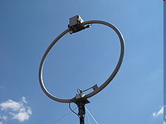
Radiation pattern of loop antenna is a doughnut pattern.
Can be circular or square loop
No radiation is received normal to the plane of loop and null is obtained in this direction.
Application: Used for direction finding applications

Slide 39
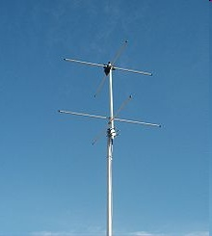
TURNSTILE ANTENNA
A turnstile antenna is a set of two dipole antennas aligned at right angles to each other and fed 90 degrees out-of-phase.
The name reflects that the antenna looks like a turnstile when mounted horizontally.
When mounted horizontally the antenna is nearly omnidirectional on the horizontal plane.

Slide 40
When mounted vertically the antenna is directional to a right angle to its plane and is circularly polarized.
The turnstile antenna is often used for communication satellites because, being circularly polarized, the polarization of the signal doesn't rotate when the satellite rotates.

Slide 41
RHOMBIC ANTENNA
Structure and construction
  4 wires are connected in rhombic shape and terminated by a resistor.
  Mounted horizontally and placed > ^/2 from ground.
Highest development of long wire antenna is rhombic antenna.

Slide 42
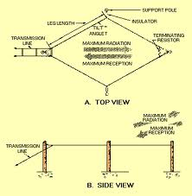

Slide 43
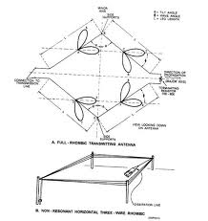

Slide 44
Advantages
  Easier to construct
  Its i/p impedance and radiation pattern are relatively constant over range of frequencies.
  Maximum efficiency
  High gain can be obtained.
Disadvantages
  Large site area and large side lobes.

Slide 45
Application
  Long distance communication, high frequency transmission and reception.
  Point to point communication.
  Radio communication.
  Short wave radio broadcasting.

Slide 46
ANTENNA ARRAYS
Antenna arrays is group of antennas or antenna elements arranged to provide desired directional characteristics.
Generally any combination of elements can form an array.
However equal elements of regualar geometry are usually used.

Slide 47
YAGI-UDA ANTENNA
It is a directional antenna consisting of a driven element (typically a dipole or folded dipole) and additional parasitic elements (usually a so-called reflector and one or more directors).
All the elements are arranged collinearly and close together.
The reflector element is slightly longer (typically 5% longer) than the driven dipole, whereas the so-called directors are a little bit shorter.
The design achieves a very substantial increase in the antenna's directionality and gain compared to a simple dipole.

Slide 48
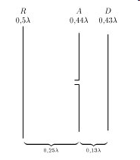
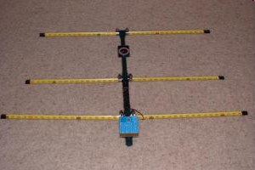

Slide 49
Typical spacing between elements vary from about 1/10 to 1/4 of a wavelength, depending on the specific design.
The elements are usually parallel in one plane.
Radiation pattern is modified figure of eight
By adjusting distance between adjacent directors it is possible to reduce back lobe
Improved front to back ratio

Slide 50
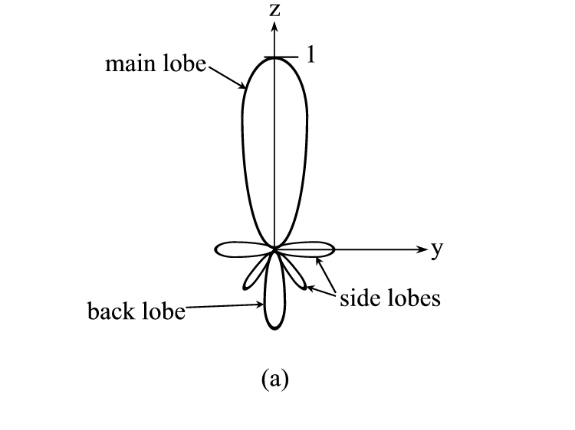

Slide 51
ANTENNA APPLICATIONS
They are used in systems such as
Radio broadcasting
Broadcast television
Two-way radio
Communication receivers
Radar
Cell phones
Satellite communications.

Slide 52
ANTENNA CONSIDERATIONS
The space available for an antenna
The proximity to neighbors
The operating frequencies
The output power
Money

Slide 53
THANKS

