Slide 1

LINK BUDGET

Slide 2
LINK BUDGET
Introduction:
A satellite link is defined as an Earth station - satellite - Earth station connection. The Earth station - satellite segment is called the uplink and the satellite - Earth station segment is called the downlink.
The Earth station design consists of the Transmission Link Design, or Link Budget, and the Transmission System Design.
The Link Budget establishes the resources needed for a given service to achieve the performance objectives.
Notes:
The Transmission System Design establishes the equipment characteristics necessary to meet the performance objectives for the services to be provided, such as the HPA rated power and the LNA noise temperature. During the analysis, tradeoffs can be made to achieve a balance between cost and performance.

Slide 3
LINK BUDGET
Performance objectives for digital links consist of:
BER for normal operating conditions
Link Availability, or percentage of time that the link has a BER better than a specified threshold level

Slide 4
LINK BUDGET
The satellite link is composed primarily of three segments:
(i) the transmitting Earth station and the uplink media;
(ii) the satellite; and
(iii) the downlink media and the receiving Earth station.
The carrier level received at the end of the link is a straightforward addition of the losses and gains in the path between transmitting and receiving Earth stations.

Slide 5
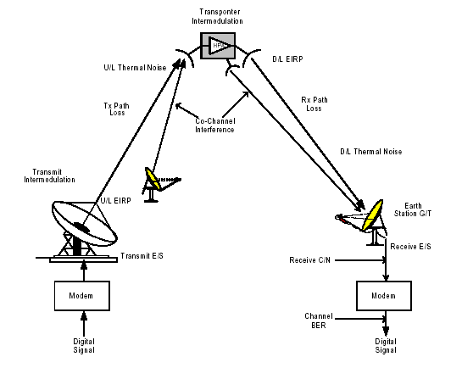
Typical Satellite Link

Slide 6
LINK BUDGET
The basic carrier-to-noise relationship in a system establishes the transmission performance of the RF portion of the system, and is defined by the receive carrier power level compared to the noise at the receiver input. For example, the downlink thermal carrier-to-noise ratio is:
C/N = C -10log(kTB) (1)
Where:
C = Received power in dBW
k = Boltzman constant, 1.38*10⁻²³ W/°K/Hz
B = Noise Bandwidth (or Occupied Bandwidth) in Hz
T = Absolute temperature of the receiving system in °K

Slide 7
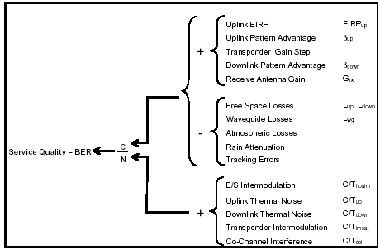
Link Parameters’ Impact on Service Quality

Slide 8
LINK BUDGET
The link equation in its general form is:
  C/N = EIRP - L + G - 10log(kTB) (2)
Where:
EIRP = Equivalent Isotropically Radiated Power (dBW)
L = Transmission Losses (dB)
G = Gain of the receive antenna (dB)
Notes:
The first three terms give the received carrier power, and the final term is the noise power of the receiving system. The link equation applies for both uplink and downlink.
Transmission losses are defined as the free space transmission loss plus
any additional path losses.

Slide 9
LINK BUDGET
Equivalent Isotropically Radiated Power:
The gain of a directive antenna results in a more economic use of the RF power supplied by the source. Thus, the EIRP is expressed as a function of the antenna transmit gain G_{T} and the transmitted power PT fed to the antenna.
EIRP_{dBW} = 10 log P_{T dBw} + G_{T} _{dBi} (3)
Where:
PT _{dBw} = antenna input power in dBW
GT _{dBi} = transmit antenna gain in dBi
Notes:
The EIRP must be accurately controlled, because an excessive EIRP will cause interference to adjacent and co-channel carriers, while a low EIRP will result in poor quality performance of the service.

Slide 10
LINK BUDGET
Equivalent Isotropically Radiated Power:
Maximum power flux density at distance r from a transmitting antenna of gain G:
Ψ_{M} = (G*Ps) / (4πr²)
An isotropic (omnidirectional) radiator would generate this flux density
EIRP is defined as G*Ps
When expressed as dBW, Ps in W, G in dB:
EIRP = Ps + G
e.g., transmit power of 6 W and antenna gain of 48.2 dB:
EIRP = 10 log 6 + 48.2 = 56 dBW
Free Space Loss: P_{R} = EIRP + G_{R} - 10 log (4πr/λ)² (dBW)

Slide 11
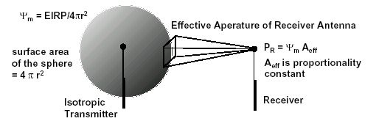

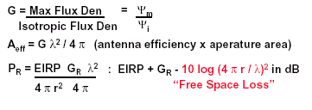
Receiver Power Equation

Slide 12
Antenna Gain.
The antenna gain, referred to an isotropic radiator, is defined by:
G_{dBi} = 10log(η)+20log(f)+20log(d)+20.4 dB (4) Where:
η = antenna efficiency (Typical values are 0.55 - 0.75)
d = antenna diameter in m
f = operating frequency in GHz

Slide 13
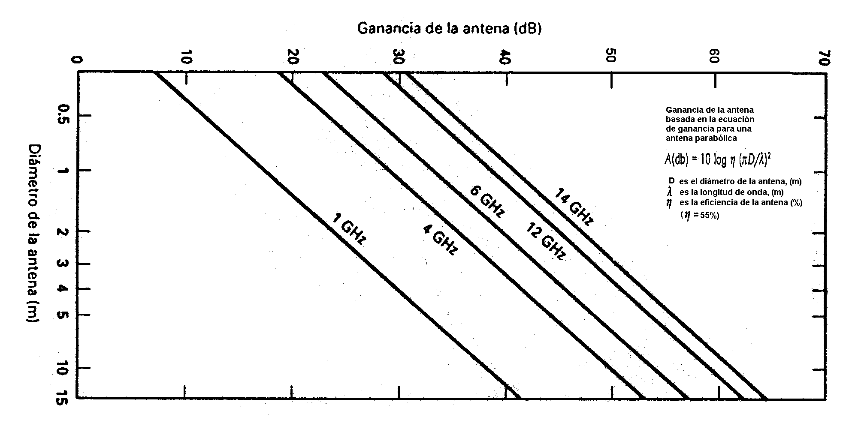

Slide 14
Transmission losses,
generally consist of four components:
L = L_{o} + L_{atm} + L_{rain} + L_{track} (5)
Where:
L_{o} = free Space Loss
L_{atm} = atmospheric losses
L_{rain} = attenuation due to rain effects
L_{track} = losses due to antenna tracking errors

Slide 15
LINK BUDGET
If an isotropic antenna radiates a power P_{T}, the beam power will spread as a sphere in which the antenna is the center. The power at a distance “D” from the transmission point is given by the next equation.
W = P_{T}/4πD². . . . . (W/m²) (6)
As the transmit antenna focuses the energy (i.e., has a gain), the equation changes to:
W = G_{T}P_{T}/4πD². . . . . (W/m²) (7)

Slide 16
LINK BUDGET
or
W_{dBW/m}² = EIRP_{dBW} - 20 log D – 71 dB (8)
Where:
G_{T}P_{T} = EIRP
W = illumination level
D = distance in km
71 dB = 10 log (4π*10⁶)

Slide 17
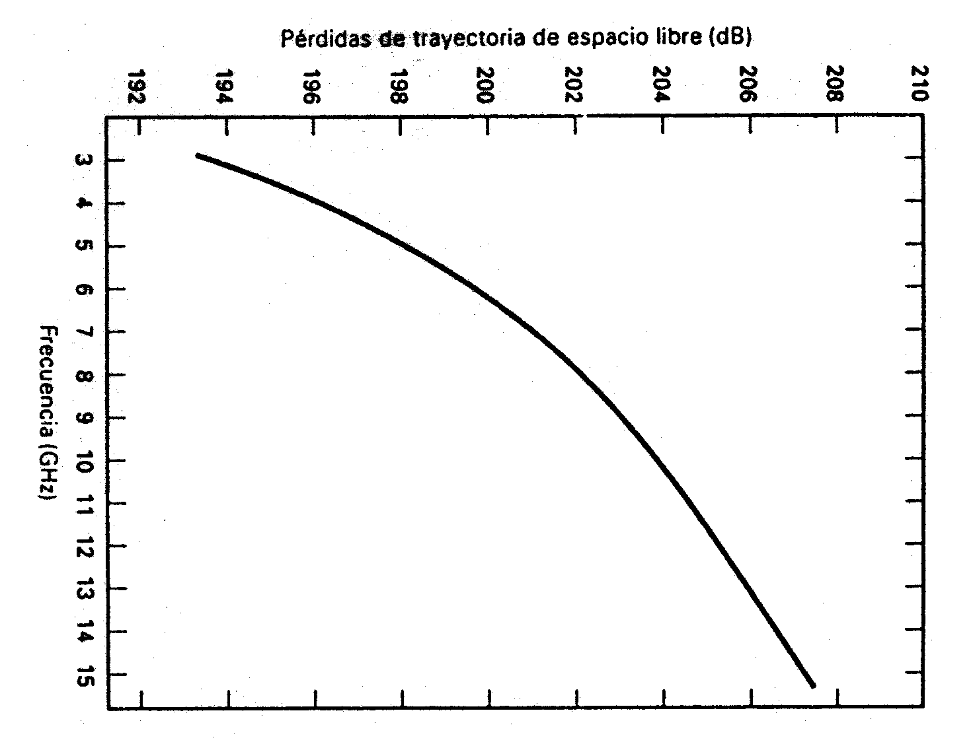

Slide 18
LINK BUDGET
As a receiver antenna 'collects' the signal, the amount of 'collected' signal will depend on the receiver antenna size. The received power P_{R} will be:
P_{R} = W*Ae (9)
Where:
Ae = effective aperture of the receive antenna
= (λ²/4π)/G_{R}
Then,
P_{R} = [G_{T}P_{T}/4πD²]*[(λ²/4π)/G_{R}] (10)
P_{R} = G_{T}P_{T}*(λ/4πD)²*G_{R} (11)

Slide 19
LINK BUDGET
The expression [4πD/λ]² is known as the basic free space loss Lo. The basic free space loss is expressed in decibels as:
Lo = 20log(D) + 20log(f) + 92.5 dB (12)
Where:
D = distance in km between transmitter and receiver, or slant range
f = frequency in GHz
92.5 dB = 20 log {(4π*10⁹*10³)/c}

Slide 20
Free Space Loss
FSL = 10 log (4πr/λ)²
in dBW , FSL = 32.4 + 20 log r + 20 log ƒ
e.g., ES to satellite is 42,000 km, ƒ is 6 GHz, what is FSL?
» FSL = 32.4 + 20 log 42000 + 20 log 6000 = 200.4 dB
» Very large loss!!
e.g., EIRP = 56 dBW, receive antenna gain 50 dB
» PR = 56 + 50 - 200.4 = -94.4 dBW = 355 pW
• Other sources of losses
– Feeder losses
– Antenna misalignment losses
– Fixed atmospheric and ionospheric losses
– Effects of rain
• PR = EIRP + GR - Losses, in dBW

Slide 21
Path Loss
Depends on:
  Distance and frequency
  About 200 dB at C-band
  About 206 dB at Ku-band

Slide 22
LINK BUDGET
Expressing equation (11) in dB:
P_{R dBW} = EIRP - Lo + G_{R} (13)
In equation (13), if GR were the gain for a 1m² antenna with 100 percent efficiency, P_{R} will become the illumination level per unit area in dBW/m²; therefore, the illumination level in equation (8) can also be expressed as:
W_{dBW/m}² = EIRP - Lo + G_{1m}² (14)

Slide 23
Atmospheric Losses
Losses in the signal can also occur through absorption by atmospheric gases such as oxygen and water vapor. This characteristic depends on the frequency, elevation angle, altitude above sea level, and absolute humidity. At frequencies below 10 GHz, the effect of atmospheric absorption is negligible.
Its importance increases with frequencies above 10 GHz, especially for low elevation angles.

Slide 24

Atmospheric Losses
Table shows an example of the mean value of atmospheric losses for a 10-degree elevation angle.

Slide 25
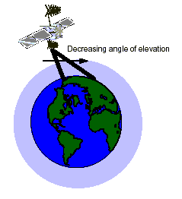
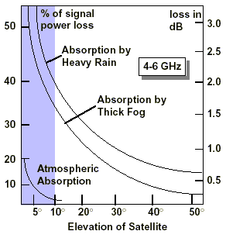
Atmospheric Attenuation

Slide 26
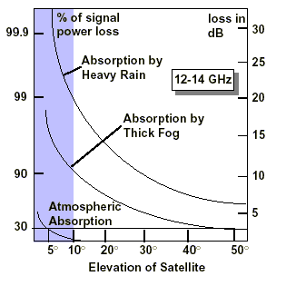
Atmospheric Attenuation

Slide 27
Atmospheric Absorption
Contributing Factors:
– Molecular oxygen Constant
– Uncondensed water vapor
– Rain
– Fog and clouds Depend on weather
– Snow and hail
• Effects are frequency dependent
– Molecular oxygen absorption peaks at 60 GHz
– Water molecules peak at 21 GHz
• Decreasing elevation angle will also increase absorption loss

Slide 28
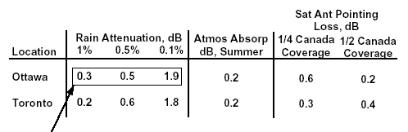
Atmospheric Absorption
1% of the time, rain attenuation exceeds 0.3 dB
(99% of the time, it is less than or equal to 0.3 dB)
0.5% of the time, it exceeds 0.5 dB
0.1% of the time, it exceeds 1.9 dB

Slide 29
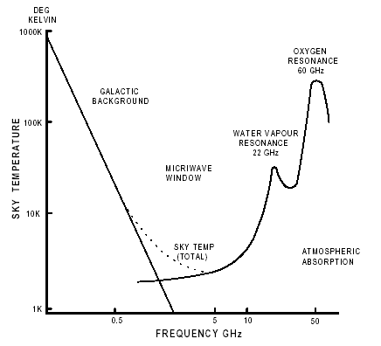
Sky-Noise and Frequency Bands

Slide 30
Transmission Losses
Up-Link (Geosync)
– Up-link ƒ = 6.175 GHz, D = 36,000 km
– Path loss is a function of frequency and distance minus transmitter and receiver antenna gain
– Loss = 132.7 - 20 log dt - 20 log dr
dt transmitter antenna: 30 m
dr satellite receiver antenna: 1.5 m
– Loss = 132.7 - 29.5 - 3.5 = 94.7 dB
Transmitted pwr/received pwr = 2.95 x 109
• Down-Link
– Down-link ƒ = 3.95 GHz
– Footprint of antenna affects its gain; wide area footprint yields a lower gain, narrow footprint a higher gain
– Loss = 136.6 - 20 log dt - 20 log dr
Loss = 136.6 - 3.5 - 29.5 = 103.6 dB

Slide 31
Rain Effects
An important climatic effect on a satellite link is the rainfall. Rain results in attenuation of radio waves by scattering and by absorption of energy from the wave.
Rain attenuation increases with the frequency, being worse for Ku-band than for C-band. Enough extra power must be transmitted to overcome the additional attenuation induced by rain to provide adequate link availability.
Notes:
The prediction of rain attenuation is a statistical process, and many models have been developed which yield results that confirm experimental observation. These models relate to operating frequency, rain rate statistics by geographic location, as well as the proposed link availability.
Typical values for rain margins can be found in IESS documents. Note that a reliable prediction of attenuation by rain is desirable to realistically determine the link availability and establish the appropriate link margin.

Slide 32
Tracking Losses
When a satellite link is established, the ideal situation is to have the Earth station antenna aligned for maximum gain, but normal operation shows that there is a small degree of misalignment which causes the gain to drop by a few tenths of a dB. The gain reduction can be estimated from the antenna size, the tracking type, and accuracy.
This loss must be considered for the uplink and downlink calculations.
Notes:
Larger antenna diameters will always require tracking, and misalignment losses can be left as 0.5 dB for uplinks and downlinks.

Slide 33
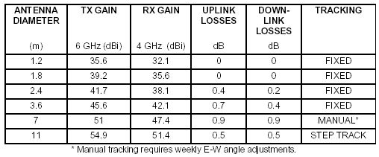
Tracking Losses
Earth Station Performance Characteristic (C-band, Antenna Efficiency 70%)

Slide 34
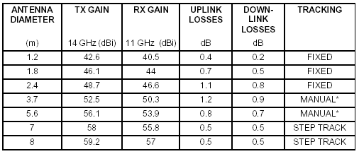
Tracking Losses
Earth Station Performance Characteristic (Ku-band, Antenna Efficiency 60%)

Slide 35
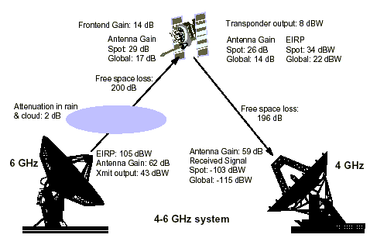
Typical Losses

Slide 36
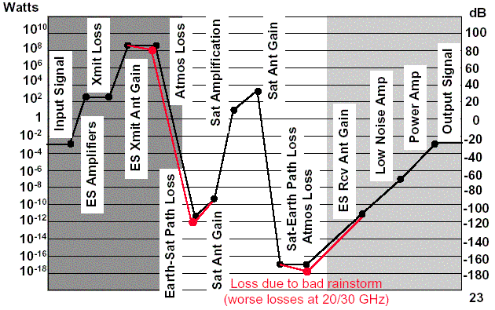
Typical Losses (4/6 GHz)

Slide 37
System Noise Temperature
The system noise temperature of an Earth station consists of the receiver noise temperature, the noise temperature of the antenna, including the feed and waveguides, and the sky noise picked up by the antenna.
T_{system} = T_{ant}/L + (1 - 1/L)To + Te (15)
Where:
L = feed loss in numerical value
Te= receiver equivalent noise temperature
To= standard temperature of 290°K
T_{ant} = antenna equivalent noise temperature as provided by the manufacturer
Notes:
Equation (15) shows that waveguide losses have a significant effect on system noise temperature.
For example, an attenuation of 0.3 dB (due to waveguide components between the antenna and the receiver pre-amplifier), contributes approximately 19°K to the system noise temperature. The feeder loss must be kept as small as possible, otherwise the benefits of a low noise antenna and LNA will be lost. This is why LNAs are mounted as close as possible to the antenna feed.
It should be noted that equation (9.15) is general and is also applicable to the spacecraft receiving system. The difference is that the spacecraft antenna "sees" the warm Earth instead of the "cold sky". Also, the spacecraft receiver has a much higher noise temperature than the Earth station receiver, so the typical noise temperature of the spacecraft receiving system is usually much higher than that of the Earth station.

Slide 38
Noise
Shannon’s Law: B = BN log2 (PR / PN + 1)
Where B = information-carrying capacity of the link (bits/unit bandwidth)
BN = usable bandwidth (hertz)
PR/PN must not get too small!
Noise power usually quoted in terms of noise temperature: PN = k TN BN
The noise temperature of a noise source is that temperature that produces the same noise power over the same frequency range: TN = PN / k BN
Noise density (noise per hertz of b/w): N0 = PN / BN = k TN
Carrier-to-Noise: C/N0 = PR / N0 = PR / k TN : EIRP + G/T - k - Losses in dB
Receiver antenna figure of merit: increases
with antenna diameter and frequency;
More powerful xmit implies cheaper receiver
Sun, Moon, Earth, Galactic
Noise, Cosmic Noise, Sky
Noise, Atmospheric Noise,
Man-made Noise

Slide 39
Noise Sources
System Noise
– Received power is very small, in picowatts
– Thermal noise from random motion of electrons
– Antenna noise: antenna losses + sky noise (background microwave radiation)
– Amplifier noise temperature: energy absorption manifests itself as heat, thus generating thermal noise
• Carrier-to-Noise Ratio
– C/N = PR - PN in dB
– PN = k TN BN
– C/N = EIRP + GR - LOSSES - k -TS - BN
where k is Boltzman’s constant, TS is system noise temperature, TN is equivalent noise temperature, BN is the equivalent noise bandwidth
– Carrier to noise power density (noise power per unit b/w):
C/N0 = EIRP + G/T - Losses - k

Slide 40
Antenna Noise Temperature
The noise power into the receiver, (in this case the LNA), due to the antenna is equivalent to that produced by a matched resistor at the LNA input at a physical temperature of T_{ant}.
If a body is capable of absorbing radiation, then the body can generate noise. Thus the atmosphere generates some noise. This also applies to the Earth surrounding a receiving ground station antenna. If the main lobe of an antenna can be brought down to illuminate the ground, the system noise temperature would increase by approximately 290°K.
Notes:
Fortunately however, synchronous satellites require vertical angles of elevation of 5° or more. If the directivity of the antenna is such that the ground absorbs 5 percent of its radiated energy illuminates, then the same antenna used for reception would contribute 5/100 x 290°K, i.e., 14.5°K of noise.
The antenna noise temperature is a complex function of antenna gain pattern, background noise, temperature of the sky, equivalent
atmospheric noise temperature, and noise temperature of the Sun.
It is usually a minimum at zenith, typically 15°K to 20°K for a low loss antenna with low sidelobes. It increases considerably as the elevation angle falls below 10°.

Slide 41
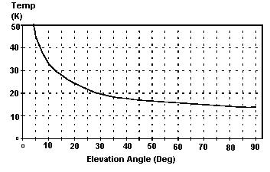
Antenna Noise Temperature
Noise Temperature of an Antenna as a Function of Elevation Angle

Slide 42
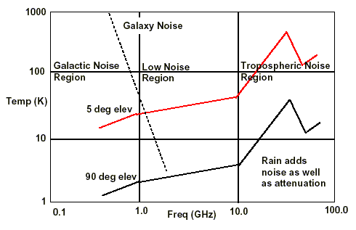
Antenna Temperature

Slide 43
Figure of Merit (G/T)
In every transmission system, noise is a factor that greatly influences the whole link quality.
The G /T_{dBK} is known as the "goodness" measurement of a receive system.
This means that providing the Earth station meets the required G/T specification, INTELSAT will provide enough power from the satellite to meet the characteristic of every service.

Slide 44
Figure of Merit (G/T)
G/T is expressed in dB relative to 1°K. The same system reference point, such as the receiver input, for both the gain and noise temperature must be used.
G/T = G_{rx} - 10log(T_{sys}) (16)
Where:
Grx = receive gain in dB
Tsys = system noise temperature in °K
Notes:
As the antenna gain is frequency-dependent, the G/T must be normalized
to a known frequency (normally either 4 or 11 GHz) by subtracting from equation (16) the factor 20 log f/fo (fo being 4 or 11) where “f” is the
frequency in GHz.

Slide 45
Carrier to Noise Ratio
In the link equation, by unfolding the kTB product under the logarithm, the link equation becomes:
C/N = EIRP - L+ G - 10log(k) - 10log(T) - 10log(B) (17)
The difference, G - 10logT, is the figure of merit:
C/N = EIRP - L+ G/T - 10log(k) - 10log(B) (18)
Where:
L = transmission losses
G/T = figure of merit of the receiver
k = Boltzmann constant
B = carrier occupied bandwidth

Slide 46
Carrier to Noise Ratio
Because the receiver bandwidth (B) is often dependent on the modulation format, isolate the link power parameters by normalizing out the bandwidth dependence. The new relation is known as Carrier-to-Noise Density ratio (C/No).
C/No = EIRP - L + G/T - 10log(k) (19)
Note that:
C/N = C/T - 10logkB (20)
Expressing C/T as a function of C/N, and replacing C/N with the right side of the link equation, results:
C/T = EIRP - L + G/T (21)
Notes:
C/T is characteristic for each carrier size and type and indicates directly the level of carrier power required for a given G/T. For example, the C/T for an acceptable TV signal might be -140 dBW/°K as compared to perhaps -150 dBW/°K for a digital carrier, although the C/N for the two carriers at the input of the demodulator may be the same.

Slide 47
Carrier to Noise Ratio
The ratio C/No allow us to compute directly the receiver Bit energy-to-noise density ratio as:
E_{b}/N_{o} = C/N_{o} - 10log(digital rate) (22)
The term "digital rate" is used here because E_{b}/N_{o} can refer to different points with different rates in the same modem.

Slide 48
Carrier-to-Noise Ratio
Example Calculation
– 12 GHz frequency, free space loss = 206 dB,
antenna pointing loss = 1 dB,
atmospheric absorption = 2 dB
– Receiver G/T = 19.5 dB/K,
receiver feeder loss = 1 dB
– EIRP = 48 dBW
• Calculation:
– C/N0 = -206 - 1 - 2 + 19.5 - 1 + 48 + 228.6 = 86.1
(Note that Boltzmann’s constant k
= 1.38x10⁻²³ J/K = -228.6 dB)

Slide 49
Link Budget
The interpretation of equation (21) is that a given C/T required by a certain type of carrier and quality of service, can be obtained for different combinations of EIRP and G/T.
EIRP represents the resource usage and finally is reflected in the operating costs because higher satellite EIRP means higher operating costs. On the other hand the G/T represents the capital expenditure, because higher G/T means larger antenna and/or better LNA, reflected in the cost of the equipment.
Notes:
For a long term usage of an Earth station facility, it may be more economical to build a larger antenna that will require a lower downlink EIRP, compared to a smaller antenna that will require higher satellite EIRP for the same quality of service.

Slide 50
Link Budget
Note that in some cases the Earth station G/T could be improved by using a better LNA. For example, an Earth station with a receive gain of 53 dBi,
antenna noise of 25°K at 25° in C-band, feeder noise temperature of 5°K and LNA noise temperature of 80°K would have:
G/T = Gant -10log(T_{ant}+T_{feed}+T_{LNA}) (23)
G/T = 53-10log(25 + 5 + 80) = 32.6 dB/°K
This antenna would be classified as a standard B antenna.

Slide 51
Link Budget
Removing the LNA and replacing it with a 30°K LNA, the G/T is:
G/T = 53 - 10log(25 + 5 + 30) = 35.2 dB/°K
This reclassifies the antenna as a standard A.
For elevation angles below 25°, the antenna noise would increase and the overall G/T would be too
low for standard A.

Slide 52
Simplified Link Equation
10 log (C/N₀) = P_{S} + G_{S} - FSL + G_{R} - T_{R} - k - L (dB) where:
– C/N₀: ratio of signal pwr to noise pwr after being received (Hz)
– P_{S}: RF pwr delivered to transmitting antenna (dBW)
– G_{S}: Gain of the transmitting antenna relative to isotropic rad (dBi)
– FSL: Free space loss (dB)
– G_{R}: Gain of the receiving antenna (dBi)
– T_{R}: Composite noise temperature of the receiver (dBK)
– k: Boltzmann’s constant (-288.6 dBW/K-Hz)
– L: Composite of propagation loss (dB)
• G = 10 log (ηπ²D²/λ²) dBi
– η: antenna efficiency, D: diameter
• FSL = 10 log [(4πr)²/λ²] dB
– r is distance
Path loss and antenna gain increase with square of radio frequency

Slide 53
Frequency vs. Losses vs. BER
Higher transmission frequency has the advantage of requiring a smaller receiver antenna BUT suffers from higher attenuation losses through atmosphere
• To achieve the same C/N0 performance, which is related to BER, actually needs a LARGER antenna than same transmission power at a lower frequency
• But still frequency allocation advantages for high frequencies solution is to use higher transmitter power at the satellite and earth station for the higher frequency transmissions

Slide 54
Time Delay
The total Earth-satellite-Earth path length may be as much as 84,000km thus giving a one-way propagation delay of 250ms. The effect of this delay on telephone conversations, where a 500ms gap can occur between one person asking a question and hearing the other person reply.
This phenomenon is minimized with the use of "Echo cancelers". With geostationary satellites, a two-hop operation is sometimes unavoidable and results in a delay of over 1 second.

Slide 55
Geographical Advantage
A station which is located near the center of a satellite beam (footprint), will have an advantage in the received signal compared to another located at the edge of the same beam of the satellite.
The satellite antenna pattern has a defined beam edge to which the values of the satellite Equivalent Isotropically Radiated Power (EIRP), Gain-to-Noise Temperature ratio (G/T), and flux density are referenced.

Slide 56
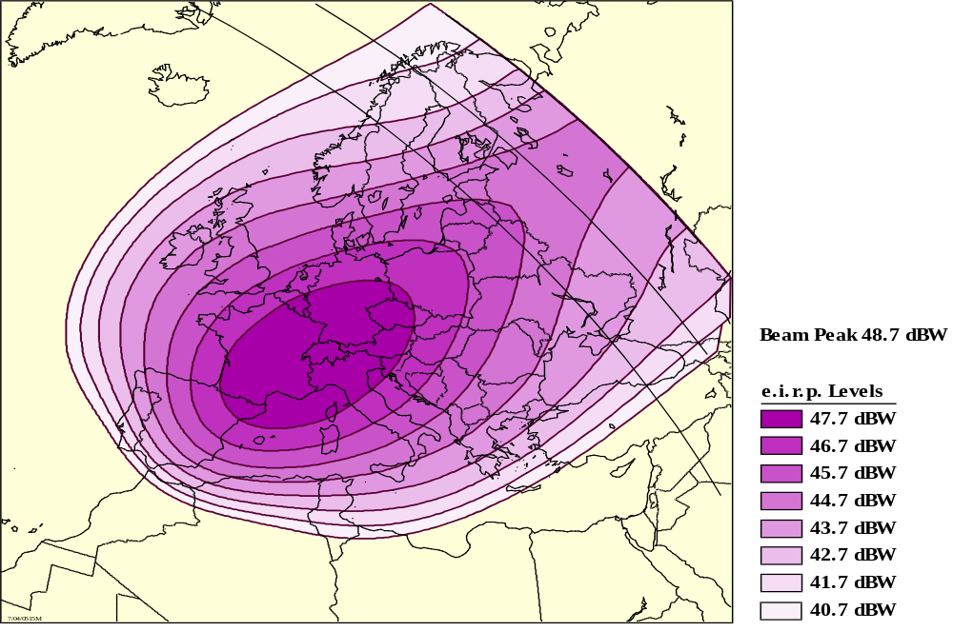
Geographical Advantage

Slide 57
Sun Interference
Sun interference is due to the satellite, the Sun, and the Earth station antenna being aligned, causing the antenna to receive solar noise.
The Sun represents a transmitter with significantly more power than the satellite, and the solar noise will overwhelm the signals coming from the satellite, causing a total loss of traffic.

Slide 58
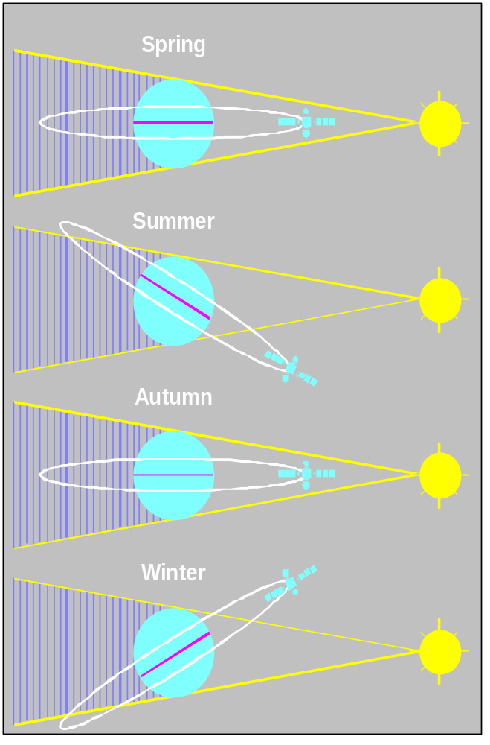
SUN INTERFERENCE

Slide 59
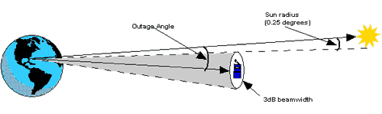
Sun Outage

Slide 60
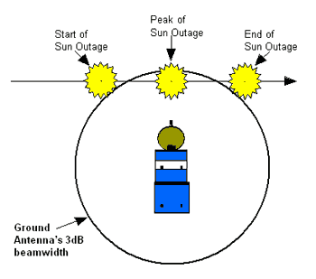
Sun Outage

Slide 61
Tropospheric Scintillation
At unpredictable times the levels of receive signals from the satellite rapidly fluctuate up and down. This is called scintillation.
Scintillation is brought about by the turbulent mixing of air mass at different temperatures and humidities, and by the random addition of particles such as rain, ice, and moisture.
Notes:
Changes of up to 12 dB have been recorded across the 500 MHz satellite band for up to 2 or 3 hours, and may be observed at one Earth station while a neighboring Earth station at a distance of 200km is not being affected.
Scintillation is caused by variations in amplitude and phase of the microwave signal as it propagates along the slant path through the atmosphere. The air masses that comprise the atmosphere are not homogenous causing the radio refractive index of the air mass to vary with time and position within the mass.
Severe scintillations can adversely affect the tracking capabilities of the Earth station and preventive action (such as program or memory tracking) may have to be taken.

