Slide 1
Satellite Communication

Slide 2
Spacecraft Subsystems Overview

Slide 3
Components of a Satellite
Payload: Satellite Main Mission Antennas & Communications System
Satellite Bus Components
Satellite Tracking, Telemetry, Command & Monitoring (TTC&M)
Satellite Power System
Satellite “Bus”, Orientation and Stabilization System

Slide 4
AOCS
AOCS is needed to get the satellite into the
correct orbit and keep it there
– Orbit insertion
– Orbit maintenance
– Fine pointing
• Major parts
– Attitude control system
– Orbit control system

Slide 5
Definition of Axes (1)
Roll axis
– Rotates around the axis tangent to the orbital
plane (N/S on the earth)
• Pitch axis
– Moves around the axis perpendicular to the
orbital plane (E/W on the earth)
• Yaw axis
– Moves around the axis of the sub-satellite point

Slide 6
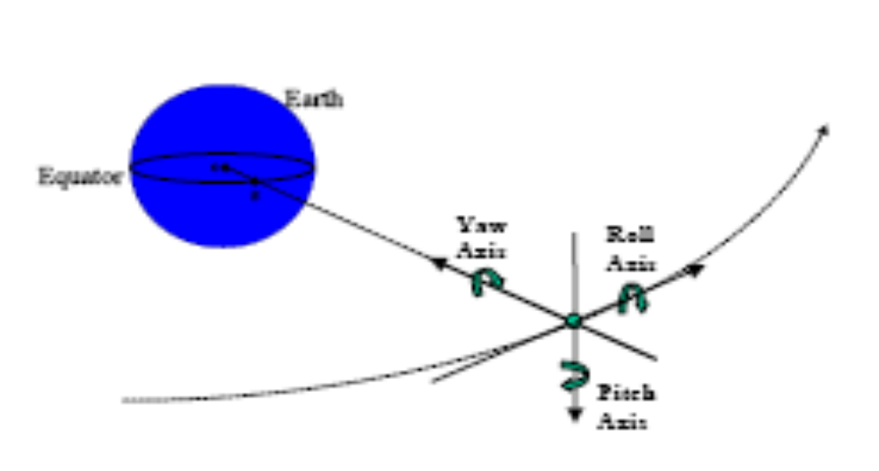
Definition of Axes (2)

Slide 7
TTC&M
Major functions
– Report spacecraft health
– Monitor command actions
– Determine orbital elements
– Launch sequence deployment
– Control of thrusters
– Control of payload (communications, etc.)
TTC&M is often a battle between Operations (who want every little thing monitored)
and Engineering who want to hold data channels to a minimum

Slide 8
Telemetry (1)
Monitor all important functions
– Temperature
– Voltages
– Currents
– Sensors
• Transmit data to earth
• Record data at TTC&M stations

Slide 9
Telemetry (2): Modes
Non-earth pointing
– During the launch phase
– During “safe mode” operations when
spacecraft loses tracking data
• Earth-pointing
– During parts of the launch phase
– During routine operations

Slide 10
Tracking
Measure range repeatedly
• Measure beacon Doppler or the
communication channel
• Compute orbital elements
• Plan station-keeping maneuvers
• Communicate with main control station and
users

Slide 11
Command
During launch sequence
– Switch on power
– Deploy antennas and solar panels
– Point antennas to desired location
• In orbit
– Maintain spacecraft thermal balance
– Control payload, thrusters, etc.

Slide 12
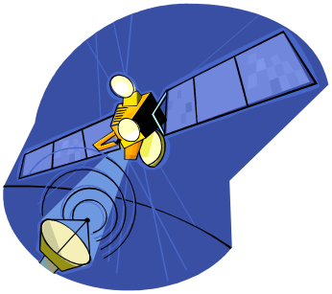
Components of a Satellite
Satellite Transmit Power (EIRP)
EIRP = Effective Isotropic Radiate Power.
The product of final amplifier power, filtering and coupling losses and antenna gain.
Specified in watts or dB (relative to 1 watt) = dBw
EIRP density, typically specified in terms of dBw/Hz is a key parameter in determining both uplink and downlink performance.

Slide 13
Components of a Satellite
Satellite Transponder & SSPAs
Transponder Traffic Loading is a Function of:
Transponder Bandwidth
Uplink and Downlink satellite and earth station parameters
Number of Carriers per transponder. This determines “back-off” which is the reduction in amplifier power from the saturated or maximum output power.
Modulation efficiency (i.e. bits/Hz)

Slide 14
Components of a Satellite:
Satellite Tracking, Telemetry, Command & Monitoring (TTC&M)
Tracking is necessary to know exactly where a satellite is and thus be able to send it commands, receive telemetry and communication with it.
Omni antenna is used to be able to track and command satellite even if orbit is disturbed.
The TTC&M system is highly automated with computer alarms to sound in case of anomalies are detected.
    Analogy: School bus represents: spacecraft bus, and passengers represents payload: telecommunications and TV traffic. TTC&M is needed to keep “bus” running and check on status of passengers.

Slide 15
Components of a Satellite:
Satellite Power System
Main source of power is solar cell panels that are constantly oriented towards the sun.
New solar cells are increasingly efficient.
The solar cell system is backed up by battery system that provides energy during solar eclipses and other periods of outages.
Typical power levels of 2 to 5 KWs for Fixed Satellite Systems and 10 to 12 KWs for Mobile and Broadcast Satellite Systems in GEO. Levels are lower for LEO & MEO Systems.

Slide 16
Components of a Satellite:
Satellite “Bus” & Stabilization System
The “bus” is the key parts of the satellite that allows its operation in space.
The early generation of satellites use gravity-gradient or spin stabilization but now 3-axis body stabilization using momentum wheels is most common because of lifetime & efficiency.
The “bus” includes the antenna mast, the thermal control, the sun & earth sensors, the batteries, momentum wheels, solar array controls & on-board computers.
Carbon-epoxy structures are used because of strength and light weight.

Slide 17
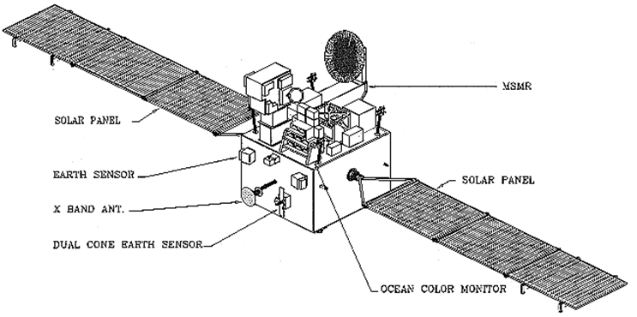
Components of a Satellite:
Satellite “Bus” & Stabilization System
Notes:
Multi-frequency Scanning Microwave Radiometer (MSMR):
The MSMR measures Sea Surface Temperature, wind magnitude, water vapor and liquid water content in the atmosphere which are used to compute geophysical parameters of the ocean and weather forecasting.
Ocean Color Monitor (OCM):
OCM detects the chlorophyll content, suspended sediment and yellow substance (degraded biomass). It is being used in ‘true’ operational sense for identification of Potential Fishery Zones (PFZ) in the sea. OCM is an 8-band multi spectral camera operating in the Visible-Near IR Spectral range. This camera provides an Instantaneous Geometric Field of View of 360 m covering a swath width of 1420 km.
Earth Sensor:
Earth sensors operate in the infrared domain. They scan a large field of view and then detect signals at the Earth/Space transitions. An optical encoder provides the four angular Earth/Space and Space/Earth transition values, which are then fed to the onboard computer to facilitate roll and
pitch angle calculations through a combination of these four transitions.
The Dual Cone Scanner (DCS) a single-head earth horizon sensor which provides altitude and two-axis attitude information with minimal sun or moon error.

Slide 18
Basic Transmission Theory:

Slide 19
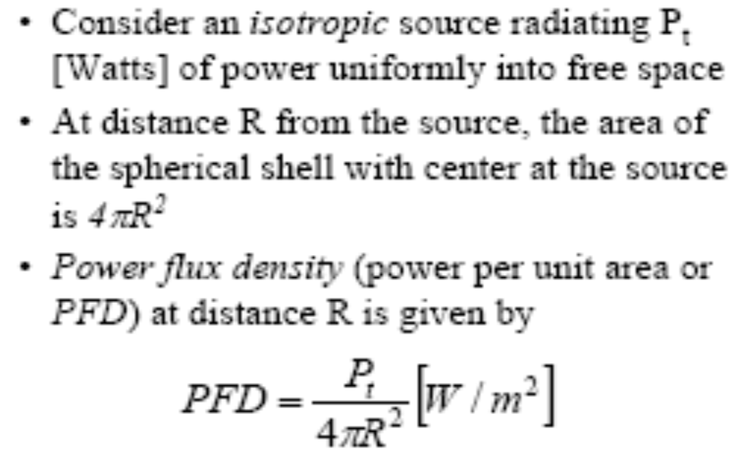
Basic Transmission Theory:
Isotropic Radiator (1)

Slide 20
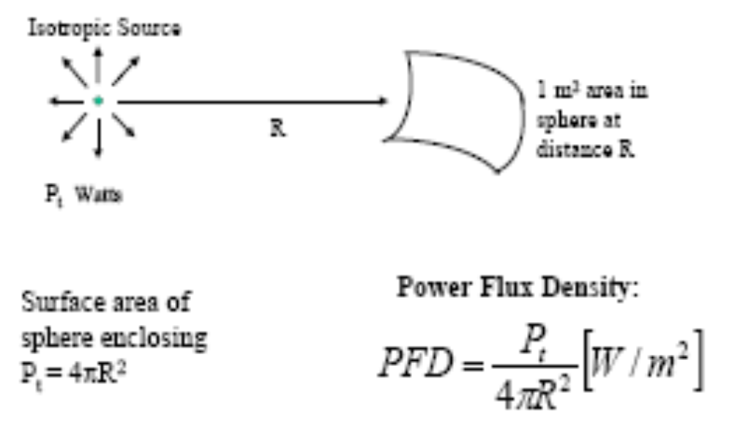
Basic Transmission Theory:
Isotropic Radiator (2)

Slide 21
Basic Transmission Theory:
Power Flux Density (PFD)
Assume medium is lossless, so power is conserved
• The power radiated from transmitter must pass
through a spherical shell (surface area = 4πR2)
• Therefore, spherical spreading loss is 1/4πR2
• PFD is a regulated parameter of the system
– All satellite systems have limit in maximum PFD
– Limitations enforced by signatory nations
– Allowable PFD varies with EL
– Allows control of interference
– Increasing importance with proliferation of LEO systems

Slide 22

Basic Transmission Theory:
Numerical Example 1 (1)
Transmit power at satellite = 10 W
• Distance to earth, d = 40,000 km
• Flux density = P/4πR2 = 4.97 • 10-16 W/m2
• Note: This is a very small amount of power

Slide 23
Basic Transmission Theory:
Numerical Example 1 (2)
• How much power is 4.97 • 10-16 W/m2 ?
• Suppose we collect all the power falling on
a 1 km2 area for 25 years
• The total power = 0.4 Joules
• This is the amount of power a flashlight
uses in one second
• But, we can send 500 phone calls through
this 10 W transponder !

Slide 24
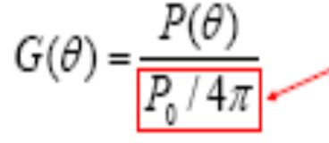
Basic Transmission Theory:
Antennas (1)
Directive antennas increase power of isotropic
radiator in specific direction
The gain of an antenna is the power increase in a particular direction relative to an isotropic antenna (no gain)
-G(θ) is gain at the direction θ
– P(θ) is power transmitted at the direction θ
– P0 is total power transmitted
– Sphere = 4π solid radians

Slide 25
Basic Transmission Theory:
Antennas (2)
Antennas have gain in every direction
• Gain is a ratio, usually expressed in decibels (dB)
G [dB] = 10 log10 G [ratio]
• Gain is a function of angle and is often used loosely
• Usually “gain” denotes maximum gain of the
antenna
• The direction of maximum gain is called boresight

Slide 26
Basic Transmission Theory:
Effective Isotropic Radiated Power (EIRP) - 1
An isotropic radiator radiates in all directions equally
• Antenna gain is relative to this standard
• Antennas are fundamentally passive
– No additional power is generated
– Gain is realized by focusing power
– Similar to the difference between a lantern and a flashlight
• Effective Isotropic Radiated Power (EIRP) is the amount of
power the transmitter would have to produce if it was
radiating equally to all directions, in order to provide
equivalent PFD at a given direction.
• Note that EIRP may vary as a function of direction because
of changes in the antenna gain vs. angle

Slide 27
Basic Transmission Theory:
Effective Isotropic Radiated Power (EIRP) -2
The output power of a transmitter HPA is Pout [W]
• Some power is lost before reaching the antenna
Pt = Pout /Lt [W]
(the power into the antenna)
• The antenna has a gain Gt relative to an isotropic
radiator
• This gives an effective isotropic radiated power
EIRP = PtGt watts relative to a 1 Watt
isotropic radiator

Slide 28

Basic Transmission Theory:
Antennas (3) – Aperture Antennas
• Aperture antennas (horns and reflectors) have
a physical collecting area that can be easily
calculated from their dimensions
• Real antennas have effective flux collecting
areas less than physical aperture area

Slide 29

Basic Transmission Theory:
Antennas (4) - Effective Aperture (1)
• Define effective aperture area as
• A physical is the physical aperture size (Ar at the receiver)
• η is the aperture efficiency
– 75% is very good
– Typically 55% - 60%

Slide 30
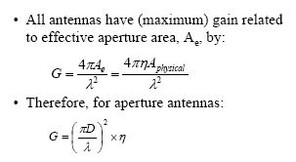
Basic Transmission Theory:
Antennas (5) - Effective Aperture (2)

Slide 31
Basic Transmission Theory:
Antennas (6) – Aperture Antenna Types
• Horn
– Low gain
– Wide beam
– Efficient: 65% – 80%
• Reflector
– High gain
– Narrow beam
– Not as efficient: 50% – 60%
– May have to be deployed in space

Slide 32
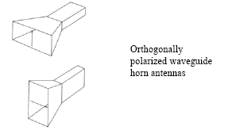
Basic Transmission Theory:
Antennas (7) – Horn Types

Slide 33
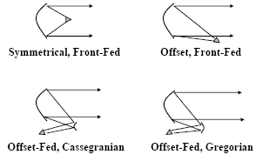
Basic Transmission Theory:
Antennas (8) – Reflector Types

Slide 34
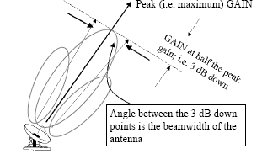
Basic Transmission Theory:
Antennas (9) – Beamwidth (1)

Slide 35



Basic Transmission Theory:
Antennas (10) – Beamwidth (2)
• A “rule of thumb” to calculate a reflector antenna beamwidth in a givenplane as a function of the antenna dimension in that plane is given by:
•The approximation above, together with the definition of gain (previous page) allow a gain approximation (for aperture antennas only):
•If η is taken to be 55%, or 0.55, then

Slide 36


Basic Transmission Theory:
Received Power (1)
Rewrite the PFD now considering the transmit
antenna gain
The total power available to a receive antenna of physical area Ar [m2] is

Slide 37
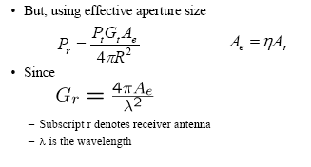
Basic Transmission Theory:
Received Power (2)

Slide 38
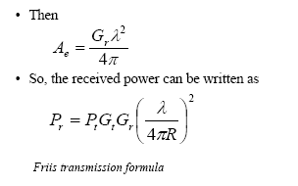
Basic Transmission Theory:
Received Power (3)

Slide 39
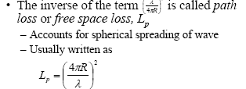

Basic Transmission Theory:
Path Loss

Slide 40
The Link Budget Equation
• The basic link budget equation is typically too
simplistic. Demonstrated formula assumes
idealized case.
• Free Space Loss (Lp) represents spherical
spreading only.
• In reality, there are several additional losses in
the link*

Slide 41

The Link Budget Equation :
Losses in the Link
• La = Due to atmospheric attenuation (e.g. rain)
• Lta = Associated with transmitting antenna
• Lra = Associated with receiving antenna
• Lpol = Due to polarization mismatch
• Lpointing = Due to antenna pointing mismatch
• Lr = Losses at receiver (after receiving antenna)
• Lother = Any other known loss

Slide 42
The Decibel
• Since Pr will probably be very small,
perhaps 10-14 W as in the example,
communications engineers use decibels to
handle link calculations
– This operation makes small numbers
manageable; e.g. 10-14 W becomes –140 dBW
– The dB allows link budgets to be calculated
using addition and subtraction
• Definition: X [dB] = 10log10(x)

Slide 43
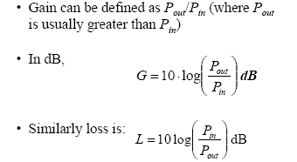
The Decibel

Slide 44
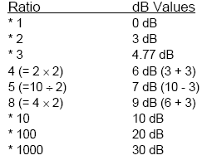
The Decibel : Common dB Values

Slide 45
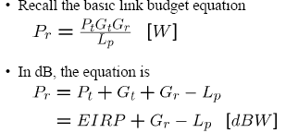
The Link Budget Equation (1)

Slide 46
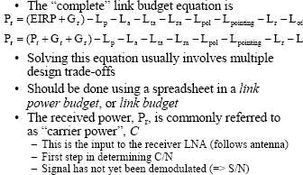
The Link Budget Equation

Slide 47
Satellite application

Slide 48
Satellite Application Types
Broadcast and Multicast of Digital Content
Voice and Telephony Networks
Data Communications and the Internet
Mobile and Personal Communications

Slide 49
Broadcast and Multicast of Digital Content
The first set of applications follow the predominant transmission mode of the GEO satellites i.e. point-to-multipoint information distribution.
Lets focus on the broadcast and multicast of content in digital form to the users.
In the past, signals were transmitted in their original analog form using frequency modulation (FM).
While some of this equipment is still in use around the world, it is being phased out.
One of the main reasons for this is that signals in digital form can be compressed appreciably without impairing their quality.

Slide 50
Broadcast and Multicast of Digital Content
A bandwidth compression factor of 10 to 20 is now common, with the primary benefit of reducing transponder occupancy per channel of transmission, thereby increasing useful capacity.
Rather than paying, say, $1.5 million per TV channel per year, transponder cost is reduced to $0.25 million or less.
Once in digital form, information can be managed in a wide variety of manners and forms.
The resulting bit stream can be expanded to include different content, addressable to subsets of users or even an individual user.
In addition to the current heavy use of satellites to transmit digital TV channels, we see new applications in digital content distribution under development.
These new applications may employ features of the Internet such as Web browsing etc.

Slide 51
Broadcast and Multicast of Digital Content:
Entertainment Television (Cable, Direct Broadcast Satellite and Network)
Commercial TV is the largest segment of the entertainment industry; it also represents the most financially rewarding user group to satellite operators.
The four fundamental ways that the satellite transfers TV signals to the ultimate consumer are:
  Point-to-multipoint distribution of TV network programming contribution from the studio to the local broadcast station;
  Point-to-point transmission of specific programming from an event location to the studio (alternatively, from one studio to another studio);
  Point-to-multipoint distribution of cable TV programming from the studio to the local cable TV system;
  Point-to-multipoint distribution of TV network and/or cable TV programming from the studio directly to the subscriber (i.e., DTH).

Slide 52
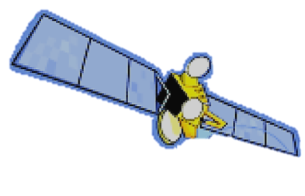








Typical VSAT System
(Very Small Aperture Terminals)
Applications
Credit Card Validation
ATM/Pay at the Pump
Inventory Control
Store Monitoring
Electronic Pricing
Training Videos
In-Store Audio
Broadband Internet Access
Distance Learning
Apartment Buildings
Corporate Offices
Gas Stations
Residential
Corporate Data Center
Branch offices
Notes:
- Very Small Aperture Antennas
- Business Television = GM send training tapes to Mr. Good Ranch for fixing carburation or fuel injection system
- TV sets with shopping carts and today’s specials
- VSATs can be found in different types of operations and buildings mostly for IP based / very large scale Voice over IP applications
- VSATs can range from 0.8 m to 1~2.8 Meters
- Digital video broadcasting VSATs are 0.8m while International Network not in a spot beam and in an area where is a lot of rain fall its about 10ft
in diameter
- Cost of the reflectors (antennas) is not much, but the electronics (ASICs) are the costly components
- USATs are Ka band terminals called Ultra Small Aperture Terminals which are called Micro Terminals
- As the volume and production of equipment goes up the Cost will continue to decline

Slide 53
Introduction
VSAT = Very Small Aperture Terminal
Early Earth Stations in commercial systems were very large and expensive (30 m).
Need to make system more affordable to end user:
  Increased transmit power from satellite.
  Higher frequencies
Result: Smaller ES antenna size required.

Slide 54
Large Antenna Systems
Breakpoint between “large” and “small” antennas is at about 100 wavelengths.
Above breakpoint, “back-fed” configurations such as Cassegrain or Gregorian are economically and technically viable (subreflectors need to be at least 10 wavelengths).
Below breakpoint, terminals called Small Aperture Terminals.
Smaller Antennas ➔ Tighter Link Budgets

Slide 55
Typical Antenna Sizes
At C-band: below 5 meters (100 wavelength at 6 GHz).
Extrapolation of terminology:
USAT = Ultra Small Aperture Terminal.
Standard VSAT antennas (Intelsat tables next)
Smaller antennas are also included in the concept of VSAT or USAT (DTH, MSS, etc). These systems will be studied separately in this course.

Slide 56
VSAT SYSTEMS
Underlying objective of VSAT Systems:
bring the service directly to the end-user
Major reasons for doing this
  Reduce hierarchical distribution network (make more efficient and faster - e.g. POS credit)
  Reduce distribution costs
  “Leapfrog” technology in developing countries (e.g. VSAT/WLL)
Point of Service

Slide 57
VSAT/WLL - 1
Telecommunications and roads are the two major economic growth requirements for developing countries
Major telecommunications infrastructure does not exist in many developing countries
SOLUTION
  Distribute links to communities by satellite/VSAT
  Use Wireless Local Loop from the VSAT

Slide 58
VSAT/WLL - 2
The geostationary satellite is used to link a large number of VSATs with the main switching center in a large city.
Each VSAT acts as the link to the local switching center in the village or rural community, with the final mile of the telephony link being carried over a Wireless Local Loop.

Slide 59
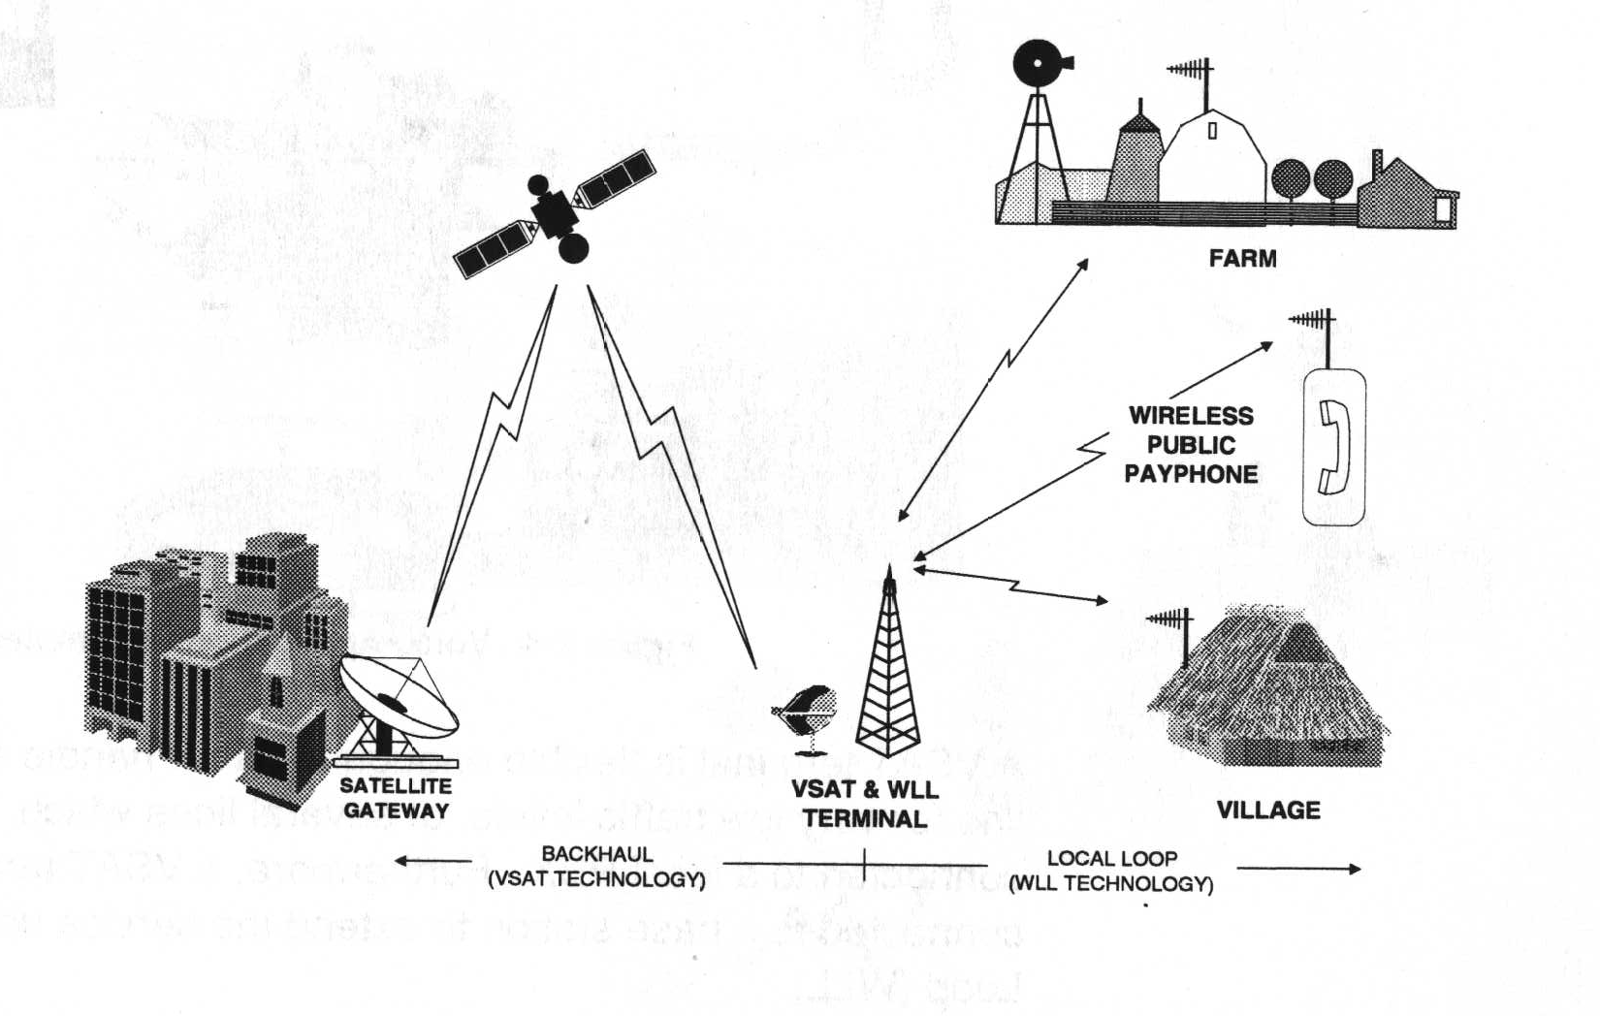
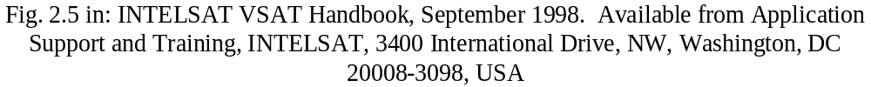
VSAT/WLL - 3

Slide 60
VSAT/WLL – 4
User density dependency
Economic advantages of VSAT/WLL solution depends primarily on user density.
Physical distances, major transportation routes, and geographic barriers, as well as the individual country’s demographics and political influences, can alter the breakpoints.

Slide 61
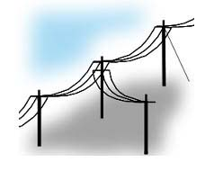
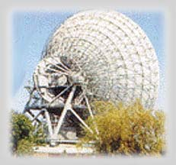
Motivation to use VSAT/WLL
VS
The last mile problem
Hard to reach areas
Reliability
Time to deploy (4-6 months vs. 4-6 weeks)
Flexibility
Cost
Source: www.bhartibt.com

Slide 62
Over-the-Air TV Broadcasting
This techniques is now standard for TV broadcasting in the VHF and UHF bands, which use local TV transmitters to cover a city or market.
The satellite is used to carry the network signal from a central studio to multiple receive Earth stations, each connected to a local TV transmitter.
This has been called TV distribution or TV rebroadcast. When equipped with uplink equipment, the remote Earth station can also transmit a signal back to the central studio to allow the station to originate programming for the entire network.
U.S. TV networks like CBS and Fox employ these reverse point-to-point links for on-location news reports.
The remote TV uplink provides a transmission point for local sporting and entertainment events in the same city.
This is popular in the United States, for example, to allow baseball and football fans to see their home team play an away from home game in a remote city.
More recently, TV networks employ fiber optic transmission between studio and broadcast station, and between stadium and studio; but the satellite continues to be the alternate flexible routing system.

Slide 63
Over-the-Air TV Broadcasting
Satellite transmissions have gone digital, as discussed previously, but broadcast stations depend heavily on the conventional analog standards: NTSC, PAL, and SECAM.
In developed countries, governments are encouraging broadcasters to digitize their signals to open up bandwidth for more TV channels and for use in other radio services such as mobile telephone.
In the United States, many local stations provide some quantity of their programming in digital form, offering high-definition television in some cases.
Revenue for local broadcast operations is available from two potential sources:
  Advertisers and
  Public taxes

Slide 64
Over-the-Air TV Broadcasting
Pay TV services from cable, satellite, and local microwave transmissions permit greater revenue when TV watchers become monthly subscribers.
In some countries, nationally sponsored broadcasters are supported directly through a tax or indirectly by government subsidy.
Since its beginnings in the United States, TV provided an excellent medium to influence consumer purchase behavior
In exchange for watching commercials for soap, airlines, and automobiles, the consumer is entertained for nothing.
This has produced a large industry in the United States as stations address local advertisers and the networks promote nationwide advertising.
The commercial model was also adopted in Latin America.

Slide 65
Over-the-Air TV Broadcasting
An alternative approach was taken in many European countries and in Japan, where government-operated networks were the first to appear.
In this case, the consumer is taxed on each TV set in operation.
These revenues are then used to operate the network and to produce the programming.
The BBC in the United Kingdom and NHK in Japan are powerhouses in terms of their programming efforts and broadcast resources.
However, with the rapid introduction of truly commercial networks, cable TV, and DTH, these tax-supported networks are experiencing funding difficulties.

Slide 66
Over-the-Air TV Broadcasting
Public TV in the United States developed after commercial TV was well established.
Originally called Educational TV, this service existed in a fragmented way until a nonprofit organization called the Public Broadcasting Service (PBS) began serving the nation by satellite in 1978.
The individual stations are supported by the local communities through various types of donations.
Some are attached to universities;
others depend on donations from individuals and corporations.
PBS itself acquires programming from the member stations and from outside sources like the BBC.
Programs are distributed to the members using satellite transponders purchased by the U.S. government. It must therefore compete with other government agencies for Congressional support.
In extreme cases where terrestrial broadcasting has been destroyed by war or conflict, or has not been constructed due to a lack of economic motivation, satellite TV represents the only effective alternative.

Slide 67
Cable TV
Begun as a way to improve local reception in rural areas, cable TV has established itself as the dominant force in many developed countries.
This was facilitated by organizations that used satellite transmission to distribute unique programming formats to cable subscribers.
The cable TV network was pioneered by HBO in the 1970s.
Other early adopters of satellite delivery include Turner Broadcasting, Warner Communications, and Viacom.
By 1980, 40% of urban homes in the United States were using cable to receive the local TV stations (because the cable provided a more reliable signal); at the same time, the first nationwide cable networks were introduced as additional revenue source.
During the 1980s, cable TV became an $8 billion industry and the prototype for this medium in Europe, Latin America, and the developed parts of Asia.

Slide 68
Cable TV
By 2002, about 80 million U.S. households were connected to cable for TV, with about 6 million benefiting from broadband Internet access through two way cable technology.
The cable industry actually benefited from the digital DTH revolution, which forced cable systems to digitize and expand services.
Cable TV Networks offer programming as a subscriber service to be paid for on a monthly basis or as an almost free service like commercial TV broadcasting.
HBO Showtime, and the Disney Channel are examples of premium (pay) services, while The Discovery Channel, CNN, and MSNBC are examples of commercial channels that receive most of their revenue from advertisers.
Cable TV became the first to offer a wide range of programming options that are under the direct control of the service provider.
The local cable system operator controls access and can therefore collect subscription fees and service charges from subscribers.
If the fees are not paid, the service is terminated.

Slide 69
Wireless Cable TV
Wireless cable, a viable alternative to wired cable, uses portions of the microwave spectrum to broadcast multiple TV channels from local towers.
It has proven effective in urban areas in developing economies where the density of paying subscribers is relatively high, such as Mexico City and Jakarta, Indonesia.
Just as in the case of DTH, wireless cable depends on some form of conditional access control that allows the operator to electronically disconnect a nonpaying user.
Theft of signals, called piracy, is a common threat to the economic viability of wired and wireless cable

Slide 70
Direct-to-Home Broadcasting
The last step in the evolution of the satellite TV network is DTH.
After a number of ill-fated ventures during the early 1980s by USCI, COMSAT, CBS, and others, DTH has established its niche in the broadcasting and cable spheres.
Sky in the United Kingdom, NHK in Japan, DIRECTV and EchoStar in the United States, Sky Latin America, and STAR TV in Asia are now established businesses, with other broadcasters following suit.
Through its wide-area broadcast capability, a GEO satellite is uniquely situated to deliver the same signal throughout a country or region at an attractive cost per user.
Notes:
USCI United Satellite Communications, Inc. was previously known as United Satellite Television Corp.
COMSAT is Short for Communications Satellite Corporation, the company that was created in 1962.
CBS is Short for Columbia Broadcasting System.
NHK is Short for Nihon Hoso Kyokai (Japan Broadcasting Corporation). The Japanese equivalent of the BBC.

Slide 71
Direct-to-Home Broadcasting
The particular economics of this delivery depend on the following factors:
  The size of the receiving antennas:
    Smaller antennas are easier to install and maintain and are cheaper to purchase in the first place.
    They are also less noticeable (something that is desirable in some cultures).
  The design of the equipment:
    This is simple to install and operate (An example Digital Satellite System (DSS) installation, needed to receive DIRECTV, takes only 2 hours—that is, 105 minutes to run the cables and 15 minutes to install and point the dish).
  Several users can share the same antenna:
    This is sensible if the antenna is relatively expensive, say, in excess of $1,000; otherwise, each user can afford his or her own.
    A separate receiver is needed for each independent TV watcher (the same now applies to digital cable service).

Slide 72
Direct-to-Home Broadcasting
  The number of transponders that can be accessed through each antenna (typically 32):
    Due to the high power required as well as concerns for single-point failure, DTH operators place more than one satellite in the same orbit position in order to achieve the desired total transponder count.
    The more channels that are available at the same slot, the more programming choices that the user will have.
  The number of TV channels that can be carried by each transponder (typically10):
    Capacity is multiplied through digital compression and statistical multiplexing techniques.
  Inclusion of local TV channels in the United States:
    This simplifies home installation and meets a government mandate that satellites “must carry” these channels to all potential markets.
The ideal satellite video network delivers its programming to the smallest practical antenna on the ground, has a large number of channels available (200 or more), and permits some means for users to interact with the source of programming.
A simple connection to the PSTN or broadband allows services to be ordered directly by the subscriber;

Slide 73
Satellite Delivered Digital Audio Radio Service
Digital Audio Radio Service (DARS) focuses on broadcasting sound programming without a visual element.
S-DARS addresses itself to networks where
  Spectral bandwidth is limited,
  Users are mobile in their cars and boats, and/or
  Users are isolated from major sources of radio and other mass media.
While DARS is a term generally reserved for terrestrial digital radio, the version we are interested in is Satellite delivered Digital Audio Radio Service (S-DARS).

Slide 74
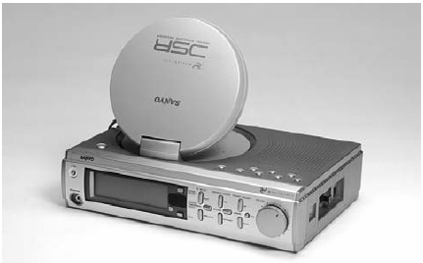
Satellite Delivered Digital Audio Radio Service
Satellite construction and launch was hardly a challenge for S-DARS; however, producing the appropriate receiving terminal proved to be more time consuming than the original business plans considered.
      Sanyo WorldSpace receiver.

Slide 75
Voice and Telephony Networks
Voice communications are fundamentally based on the interaction between two people.
It was recognized very early in the development of satellite networks that the one-way propagation delay of one-quarter second imposed by the GEO tends to degrade the quality of interactive voice communications, at least for some percentage of the population.
However, voice communications represent a significant satellite application due to the other advantages of the medium.

Slide 76
Voice and Telephony Networks
For example, many developing countries and lightly inhabited regions of developed countries continue to use satellite links in rural telephony and as an integral part of the voice network infrastructure.
Furthermore, an area where satellite links are essential for voice communications is the mobile field.
The PSTN within and between countries is primarily based on the requirements of voice communications, representing something in the range of 50% to 60% of all interactive traffic.
The remainder consists of facsimile (fax) transmissions, low- and medium-speed data (both for private networks and access to public network services such as the Internet), and various systems for monitoring and controlling remote facilities.

Slide 77
Voice and Telephony Networks
The economics of satellite voice communications are substantially different from that of the fiber-based PSTN, even given the use of digital technology with both approaches.
With low-cost VSAT technology and high-powered satellites at Ku- and Ka-bands, satellite voice is the cheapest and quickest way to reach remote areas where terrestrial facilities are not available.
It will be more attractive to install a VSAT than to extend a fiber optic cable over a distance greater than a few hundred meters.
A critical variable in this case is the cost of the VSAT, which dropped from $10,000 level in 1995 to as low as $1,500 in 2003.

Slide 78
Voice and Telephony Networks
High-speed Internet access has been introduced on wireline local loops through the class of technologies known as DSL.
Using the basic approach of frequency division multiplexing (FDM), DSL adds the baseband bandwidth needed to allow bidirectional transfer speeds of 100 Kbps to as much as 1 Mbps over copper twisted-pair.
In the absence of copper, traditional fixed wireless local loop networks cannot support DSL-like services.
More recently, some service providers have begun to offer wireless Internet access using the IEEE 802.11b standard (also called Wi-Fi).
The advantage of this approach is that the spectrum is unlicensed in the United States and most other countries and therefore freely available (although potentially crowded); furthermore, many individuals already carry Wi-Fi cards within their laptops.
Likewise, to add high-speed access to satellite telephony amounts to providing the appropriate bandwidth over the same or even another VSAT.
The notion that bandwidth is free certainly does not apply to wireless systems, whether speaking of the local or satellite varieties.

Slide 79
Voice and Telephony Networks
Fiber optic networks are attractive for intra- and intercity public networks and can offer broadband point-to-point transmission that is low in cost per user.
The economics of long-haul fiber dictate that the operator must aggregate large volumes of telephone calls, private leased lines, and other bulk uses of bandwidth in order to make the investment pay.
In 2002, the financial failure of several new fiber carriers illustrates the dilemma they face.
Yet this is easier to do with a satellite because it provides a common traffic concentration point in the sky.
The bandwidth is used more effectively (a principle of traffic engineering), and therefore the network can carry more telephone conversations and generate more revenue regardless of where the demand arises.
Satellite networks are very expandable because all points are independent and local terrain does not influence performance.
Example: Deutsche Bank, Germany, installed medium-sized Earth stations to provide banking facilities to new branches.

Slide 80
Data Communications and the Internet
Satellite networks are able to meet a wide variety of data communication needs of businesses, government agencies, and nongovernmental organizations (NGOs), which include charities and religious groups.
The wide-area coverage feature combined with the ability to deliver relatively wide bandwidths with a consistent level of service make satellite links attractive in the developing world as well as in the geographically larger developed countries and regions.
Furthermore, the point-to-multipoint feature renders GEO satellites superior to the terrestrial Internet for the distribution of IP-based multimedia content such as Web pages and movies.
The standard 36-MHz transponders, commonly used for C- and Ku-bands worldwide, can transfer up to 80 Mbps, which is suitable for wideband applications and multimedia.

Slide 81
Data Communications and the Internet
Satellite communication introduces a relatively large propagation delay, but this is only one factor in the overall response time.
There are many contributors to response time:
  The input data rate (in bits per second),
  The propagation delay through the link,
  The processing and queuing delay in data communication equipment, and
  Any contention for a terrestrial data line or computer processing element.

Slide 82
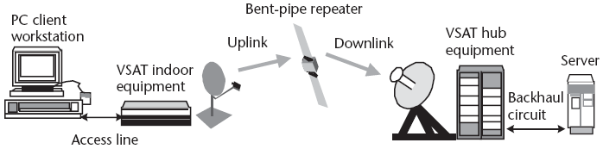
Data Communications and the Internet
The total end-to-end latency for data transfer results from several components: access lines, equipment processing, uplink and downlink propagation, and data processing in servers.

Slide 83
Mobile and Personal Communications
The world has experienced an explosion in the demand for wireless telephone and data communications, typically of a mobile nature.
The basis for this is the technology of cellular radio systems, which connect vehicular and handheld mobile phones to the public network as if they had access by wire.
Availability of cellular radio at a reasonable cost has allowed a much larger subscriber base to develop than was even possible during earlier generations of mobile phone technology.
The allure of terrestrial cellular led to the development and operation of two non-GEO MSS systems:
  Iridium and
  Globalstar

Slide 84
Mobile and Personal Communications
While both systems began operation, neither succeeded in the marketplace.
The Inmarsat GEO satellite system grew in a much more gradual and sustained manner.
As a result, Inmarsat successfully offers a range of low and medium speed digital services to user terminals on ships, aircraft, and vehicles, as well as many operated by individuals.
While the satellite industry has been working to compete with conventional cellular telephone, the telephone and mobile radio business has been working to produce a more capable wireless service.
With digital cellular and Personal Communications Network (PCN) and Personal Communications Service (PCS) having become the mainstay, existing and new operators have begun to pursue the third generation (3G) cellular market.
Thuraya and Inmarsat 4 represent the satellite response to 3G, assuming an interesting future in mobile communications.

