Slide 1
Satellite Communication

Slide 2
Overview
Satellite technology has progressed tremendously over the last 50 years since Arthur C. Clarke first proposed its idea in 1945 in his article in Wireless World.
Today, satellite systems can provide a variety of services including broadband communications, audio/video distribution networks, maritime navigation, worldwide customer service and support as well as military command and control.
Satellite systems are also expected to play an important role in the emerging 4G global infrastructure providing the wide area coverage necessary for the realization of the “Optimally Connected Anywhere, Anytime” vision that drives the growth of modern telecom industry.

Slide 3
Section 1:Introduction to state of satellite Communication.
Orbital mechanics and parameters
Look angle determination
Lunches and Lunch vehicle
Orbital effects in communication system performance.
AOCS (Attitude and Orbital control systems)
Description of spacecraft system Transponders
Satellite Link Design:
    Basic transmission Theory
    System noise temp and G/T ratio
    Uplink and downlink design
    Design of sat link for specified C/N performance.

Slide 4
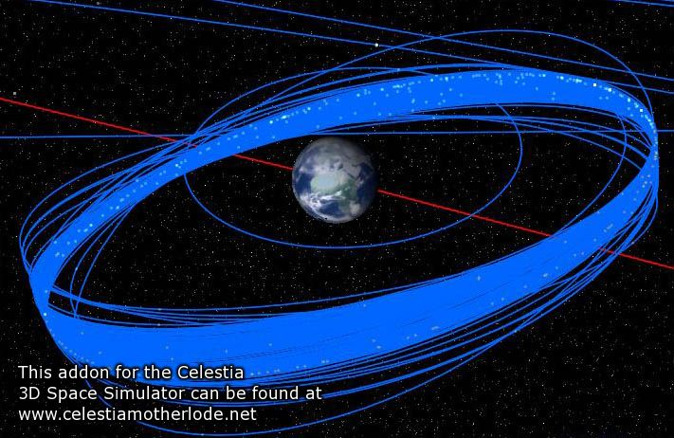
Types of Satellites
Satellite Orbits
  GEO
  LEO
  MEO
  Molniya Orbit
  HAPs
Frequency Bands

Slide 5
Satellite Transmission Bands
Frequency Band | Downlink | Uplink
C | 3,700-4,200 MHz | 5,925-6,425 MHz
Ku | 11.7-12.2 GHz | 14.0-14.5 GHz
Ka | 17.7-21.2 GHz | 27.5-31.0 GHz

Slide 6
Types of Satellite Orbits
Based on the inclination, i, over the equatorial plane:
  Equatorial Orbits above Earth’s equator (i=0°)
  Polar Orbits pass over both poles (i=90°)
  Other orbits called inclined orbits (0°<i<90°)
Based on Eccentricity
  Circular with centre at the earth’s centre
  Elliptical with one foci at earth’s centre

Slide 7

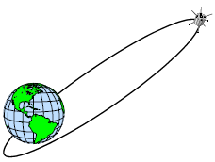
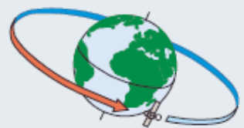

Slide 8
Types of Satellite based Networks
Based on the Satellite Altitude
  GEO – Geostationary Orbits
    36000 Km = 22300 Miles, equatorial, High latency
  MEO – Medium Earth Orbits
    High bandwidth, High power, High latency
  LEO – Low Earth Orbits
    Low power, Low latency, More Satellites, Small Footprint
  VSAT
    Very Small Aperture Satellites
      Private WANs

Slide 9
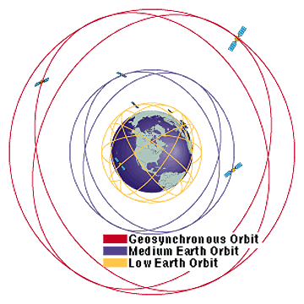
Satellite Orbits
Geosynchronous Orbit (GEO): 36,000 km above Earth, includes commercial and military communications satellites, satellites providing early warning of ballistic missile launch.
Medium Earth Orbit (MEO): from 5000 to 15000 km, they include navigation satellites (GPS, Galileo, Glonass).
Low Earth Orbit (LEO): from 500 to 1000 km above Earth, includes military intelligence satellites, weather satellites.

Slide 10
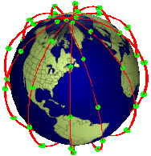
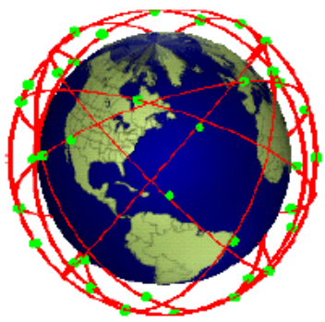
LEO - Low Earth Orbits
Circular or inclined orbit with < 1400 km altitude
  Satellite travels across sky from horizon to horizon in 5 - 15 minutes => needs handoff
  Earth stations must track satellite or have Omni directional antennas
  Large constellation of satellites is needed for continuous communication (66 satellites needed to cover earth)
  Requires complex architecture
  Requires tracking at ground

Slide 11
LEO
Advantages
  A LEO satellite’s proximity to earth compared to a GEO satellite gives it a better signal strength and less of a time delay, which makes it better for point to point communication.
  A LEO satellite’s smaller area of coverage is less of a waste of bandwidth.
Disadvantages
  A network of LEO satellites is needed, which can be costly
  LEO satellites have to compensate for Doppler shifts cause by their relative movement.
  Atmospheric drag effects LEO satellites, causing gradual orbital deterioration

Slide 12
MEO
Advantage
  A MEO satellite’s longer duration of visibility and wider footprint means fewer satellites are needed in a MEO network than a LEO network.
Disadvantage
  A MEO satellite’s distance gives it a longer time delay and weaker signal than a LEO satellite, though not as bad as a GEO satellite.

Slide 13
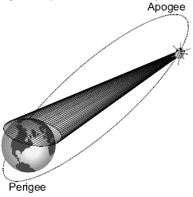
HEO - Highly Elliptical Orbits
HEOs (i = 63.4°) are suitable to provide coverage at high latitudes (including North Pole in the northern hemisphere)
Depending on selected orbit (e.g. Molniya, Tundra, etc.) two or three satellites are sufficient for continuous time coverage of the service area.
All traffic must be periodically transferred from the “setting” satellite to the “rising” satellite (Satellite Handover)

Slide 14
Other Orbits
Molniya Orbit Satellites
  Used by Russia for decades.
  Molniya Orbit is an elliptical orbit. The satellite remains in a nearly fixed position relative to earth for eight hours.
  A series of three Molniya satellites can act like a GEO satellite.
  Useful in near polar regions.
High Altitude Platform (HAP)
  One of the newest ideas in satellite communication.
  A blimp or plane around 20 km above the earth’s surface is used as a satellite.
  HAPs would have very small coverage area, but would have a comparatively strong signal.
  Cheaper to put in position, but would require a lot of them in a network.

Slide 15
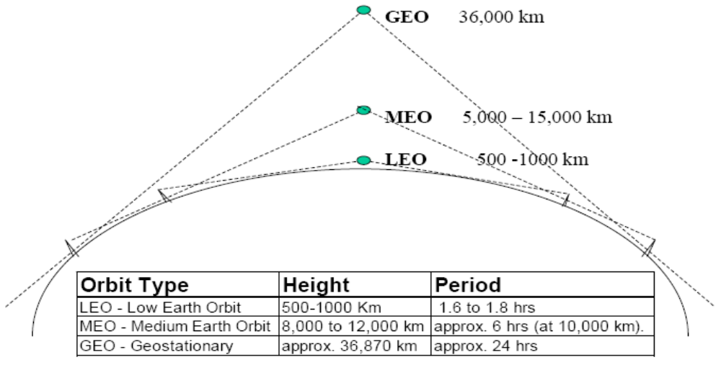
Satellite Orbits

Slide 16
GEO - Geostationary Orbit
In the equatorial plane
Orbital Period = 23 h 56 m 4.091 s
= 1 sidereal day*
Satellite appears to be stationary over any point on equator:
  Earth Rotates at same speed as Satellite
  Radius of Orbit r = Orbital Height + Radius of Earth
  Avg. Radius of Earth = 6378.14 Km
3 Satellites can cover the earth (120° apart)

Slide 17
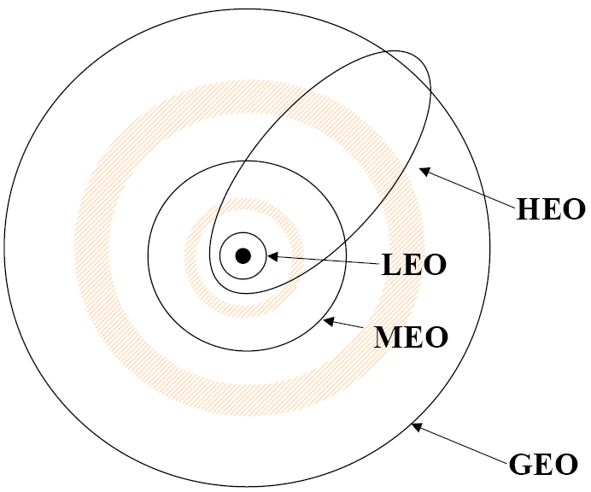

NGSO - Non Geostationary Orbits
Orbit should avoid Van Allen radiation belts:
  Region of charged particles that can cause damage to satellite
  Occur at
    ~2000-4000 km and
    ~13000-25000 km

Slide 18
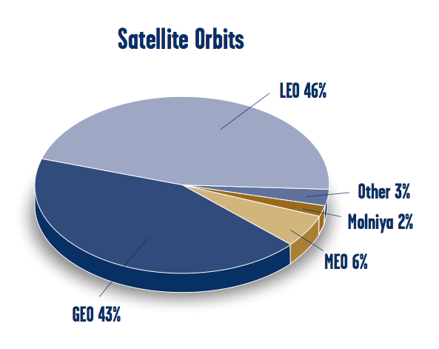
Satellite Orbits

Slide 19
Orbital mechanics and parameters

Slide 20
Orbital Mechanics
Kinematics & Newton’s Law
s = Distance traveled in time, t
u = Initial Velocity at t = 0
v = Final Velocity at time = t
a = Acceleration
F = Force acting on the object
• s = ut + (1/2)at²
• v² = u² + 2at
• v = u + at
• F = ma
Newton’s Second Law

Slide 21
FORCE ON A SATELLITE:1
Force = Mass × Acceleration
Unit of Force is a Newton
A Newton is the force required to accelerate 1 kg by 1 m/s2
Underlying units of a Newton are therefore (kg) × (m/s2)
In Imperial Units 1 Newton = 0.2248 ft lb.

Slide 22
ACCELERATION FORMULA
a = acceleration due to gravity = μ / r2 km/s2
r = radius from center of earth
μ = universal gravitational constant G multiplied by the mass of the earth ME
μ is Kepler’s constant and
= 3.9861352 × 105 km3/s2
G = 6.672 × 10-11 Nm2/kg2 or 6.672 × 10-20 km3/kg s2 in the older units

Slide 23
FORCE ON A SATELLITE : 2
Inward (i.e. centripetal force)
Since Force = Mass × Acceleration
If the Force inwards due to gravity = FIN then
FIN = m × (μ / r2)
= m × (GME / r2)

Slide 24
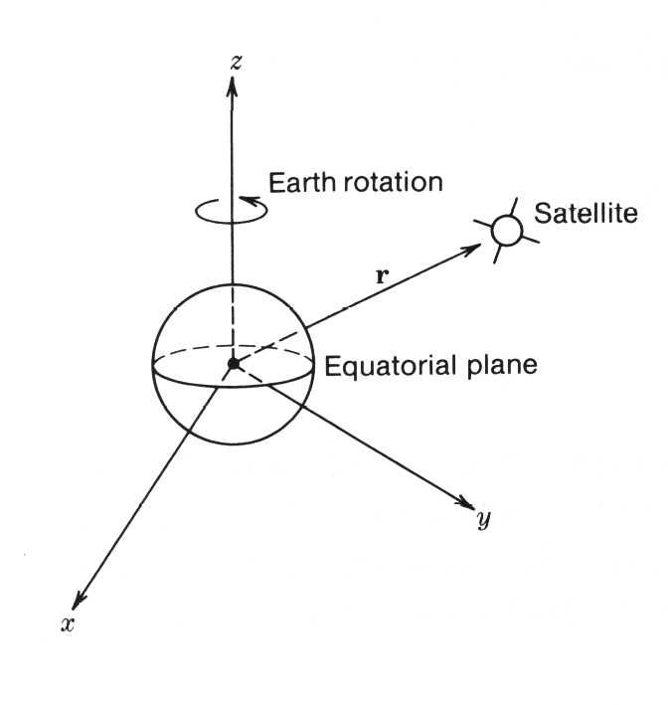
Reference Coordinate Axes 1:
Earth Centric Coordinate System
Fig. 2.2 in text
The earth is at the center of the coordinate system
Reference planes coincide with the equator and the polar axis
More usual to use this coordinate system

Slide 25
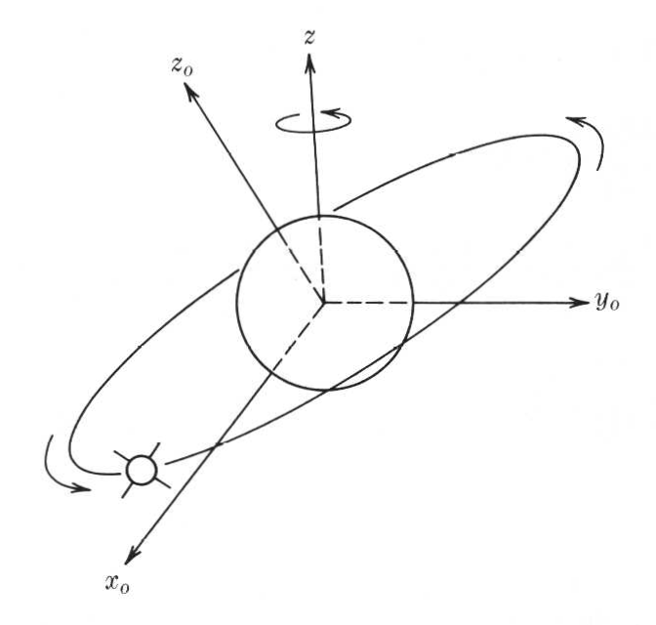
Reference Coordinate Axes 2: Satellite Coordinate System
Fig. 2.3 in text
The earth is at the center of the coordinate system and reference is the plane of the satellite’s orbit

Slide 26
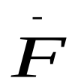
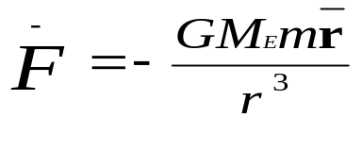

Balancing the Forces - 2
Inward Force
Equation (2.7)
G = Gravitational constant = 6.672 × 10⁻¹¹ Nm²/kg²
M_{E} = Mass of the earth (and GM_{E} = μ = Kepler’s constant)
m = mass of satellite
r = satellite orbit radius from center of earth
= unit vector in the r direction (positive r is away from earth)

Slide 27
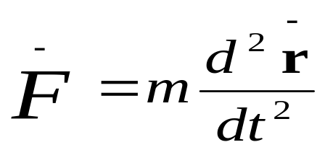
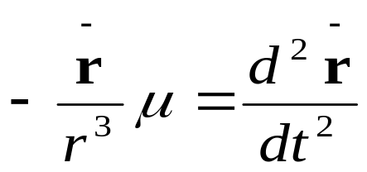
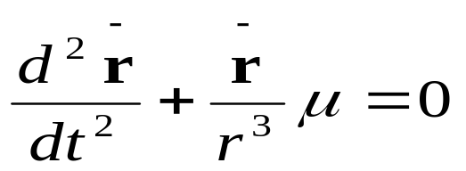
Balancing the Forces - 3
Outward Force
Equation (2.8)
Equating inward and outward forces we find
Equation (2.9), or we can write
Second order differential equation with six unknowns: the orbital elements
Equation (2.10)

Slide 28
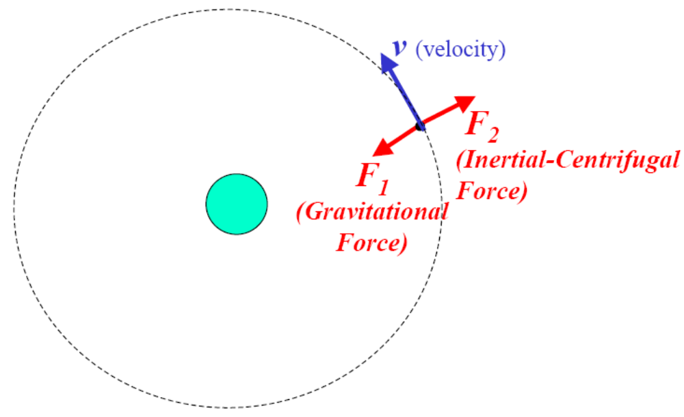
Why Satellites remain in Orbits

Slide 29
THE ORBIT - 1
We have a second order differential equation
See text p.21 for a way to find a solution
If we re-define our co-ordinate system into polar coordinates (see Fig. 2.4) we can re-write equation (2.11) as two second order differential equations in terms of r₀ and ϕ₀

Slide 30
THE ORBIT - 2
Solving the two differential equations leads to six constants (the orbital constants) which define the orbit, and three laws of orbits (Kepler’s Laws of Planetary Motion)
Johaness Kepler (1571 - 1630) a German Astronomer and Scientist

Slide 31
KEPLER’S THREE LAWS
Orbit is an ellipse with the larger body (earth) at one focus
The satellite sweeps out equal arcs (area) in equal time (NOTE: for an ellipse, this means that the orbital velocity varies around the orbit)
The square of the period of revolution equals a CONSTANT × the THIRD POWER of SEMI-MAJOR AXIS of the ellipse. law of kepler video

Slide 32

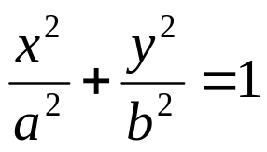

Review: Ellipse analysis
y
P(x,y)
(0,b)
V(-a,0)
F(-c,0)
x
F(c,0)
V(a,0)
(0,-b)
Points (-c,0) and (c,0) are the foci.
Points (-a,0) and (a,0) are the vertices.
Line between vertices is the major axis.
a is the length of the semimajor axis.
Line between (0,b) and (0,-b) is the minor axis.
b is the length of the semiminor axis.
Standard Equation:
Area of ellipse:

Slide 33
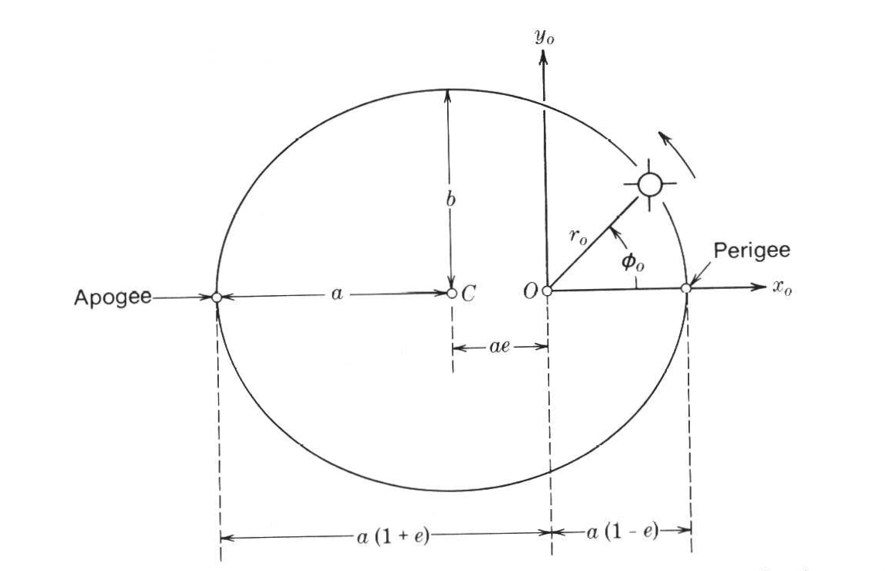
KEPLER 1: Elliptical Orbits
Figure 2.6 in text
Law 1
The orbit is an ellipse
e = ellipse’s eccentricity
O = center of the earth (one focus of the ellipse)
C = center of the ellipse
a = (Apogee + Perigee)/2

Slide 34
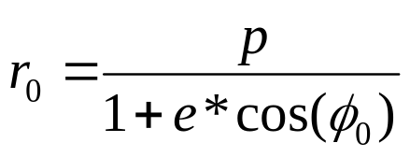
KEPLER 1: Elliptical Orbits (cont.)
Equation 2.17 in text: (describes a conic section, which is an ellipse if e < 1)
p
e = eccentricity
e<1 ⇒ ellipse
e = 0 ⇒ circle
r₀ = distance of a point in the orbit to the center of the earth
p = geometrical constant (width of the conic section at the focus)
p=a(1-e²)
ϕ₀ = angle between r₀ and the perigee

Slide 35
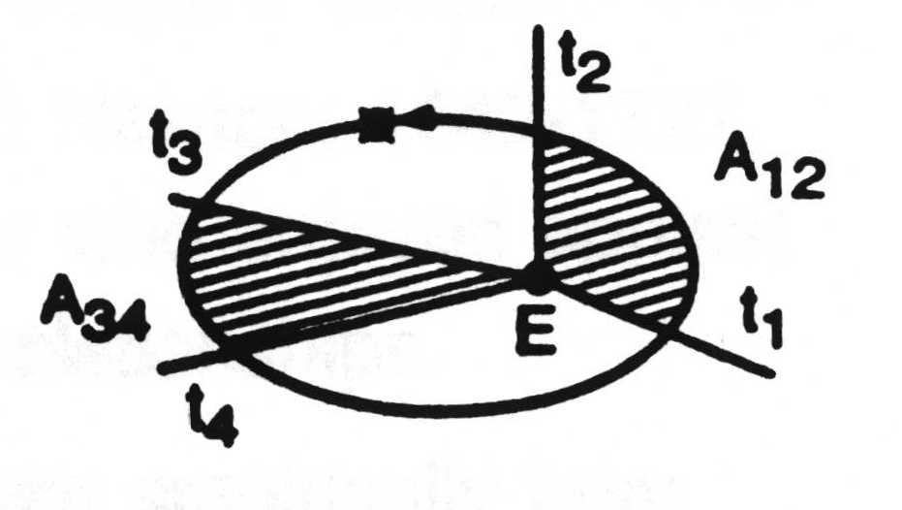
KEPLER 2: Equal Arc-Sweeps
Figure 2.5
Law 2
If t₂ - t₁ = t₄ - t₃
then A₁₂ = A₃₄
Velocity of satellite is SLOWEST at APOGEE; FASTEST at PERIGEE

Slide 36
KEPLER 3: Orbital Period
Orbital period and the Ellipse are related by
T² = (4 π² a³) / μ (Equation 2.21)
That is the square of the period of revolution is equal to a constant × the cube of the semi-major axis.
IMPORTANT: Period of revolution is referenced to inertial space, i.e., to the galactic background, NOT to an observer on the surface of one of the bodies (earth).
μ = Kepler’s Constant = GM_{E}

Slide 37
Numerical Example 1
The Geostationary Orbit:
Sidereal Day = 23 hrs 56 min 4.1 sec
Calculate radius and height of GEO orbit:
T² = (4 π² a³) / μ (eq. 2.21)
Rearrange to a³ = T² μ /(4 π²)
T = 86,164.1 sec
a³ = (86,164.1) ² x 3.986004418 x 10⁵ /(4 π²)
a = 42,164.172 km = orbit radius
h = orbit radius – earth radius = 42,164.172 – 6378.14
  = 35,786.03 km

Slide 38
Solar vs. Sidereal Day
A sidereal day is the time between consecutive crossings of any particular longitude on the earth by any star other than the sun.
A solar say is the time between consecutive crossings of any particular longitude of the earth by the sun-earth axis.
  Solar day = EXACTLY 24 hrs
  Sidereal day = 23 h 56 min. 4.091 s
Why the difference?
  By the time the Earth completes a full rotation with respect to an external point (not the sun), it has already moved its center position with respect to the sun. The extra time it takes to cross the sun-earth axis, averaged over 4 full years (because every 4 years one has 366 deays) is of about 3.93 minutes per day.

Slide 39
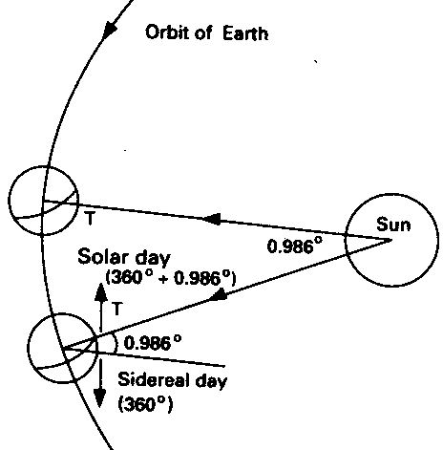
Solar vs. Sidereal Day
Numerical Calculation:
4 years = 1461 solar days (365*4 +1)
4 years : earth moves 1440 degrees (4*360) around sun.
1 solar day: earth moves 0.98 degrees (=1440/1461) around sun
1 solar day : earth moves 360.98 degress around itself (360 + 0.98)
1sidereal day = earth moves 360 degrees around itself
1 solar day = 24hrs = 1440 minutes
1 sidereal day = 1436.7 minutes (1440*360/360.98)
Difference = 3.93 minutes
  (Source: M.Richaria, Satellite Communication Systems, Fig.2.7)

Slide 40
LOCATING THE SATELLITE IN ORBIT: 1
Start with Fig. 2.6 in Text
ϕ_{o} is the True Anomaly See eq. (2.22)
C is the center of the orbit ellipse
O is the center of the earth
NOTE: Perigee and Apogee are on opposite sides of the orbit

Slide 41
LOCATING THE SATELLITE IN ORBIT: 2
Need to develop a procedure that will allow the average angular velocity to be used
If the orbit is not circular, the procedure is to use a Circumscribed Circle
A circumscribed circle is a circle that has a radius equal to the semi-major axis length of the ellipse and also has the same center

Slide 42
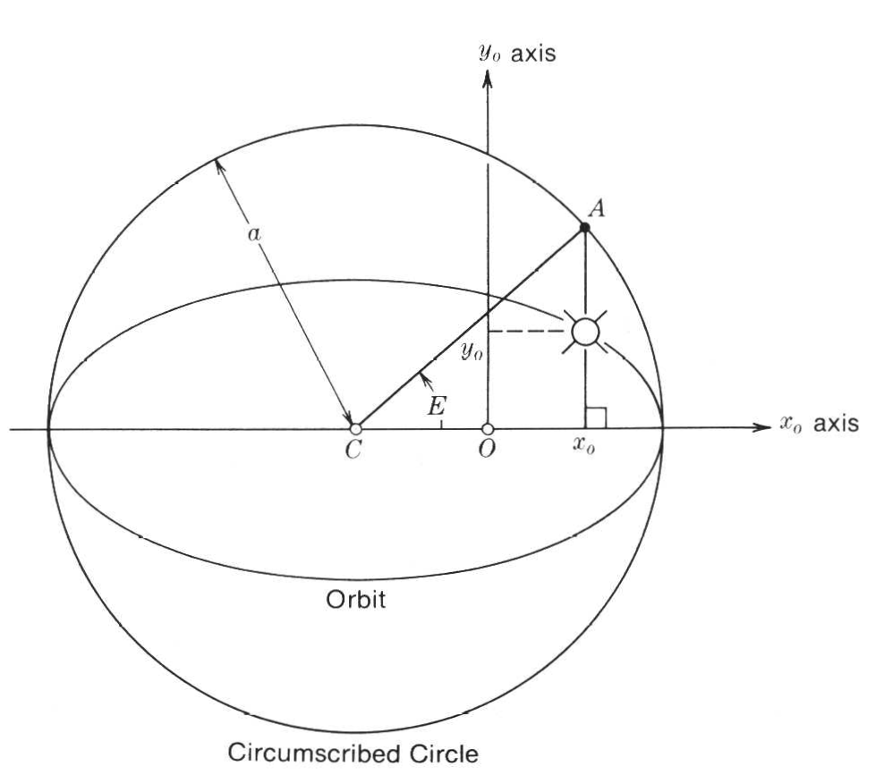
LOCATING THE SATELLITE IN ORBIT: 3
Fig. 2.7 in the text
η = Average angular velocity
E = Eccentric Anomaly
M = Mean Anomaly
M = arc length (in radians) that the satellite would have traversed since perigee passage if it were moving around the circumscribed circle with a mean angular velocity η

Slide 43
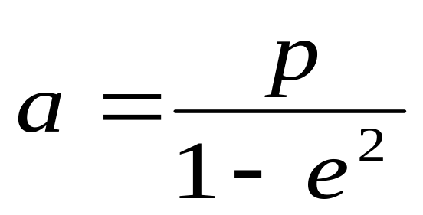
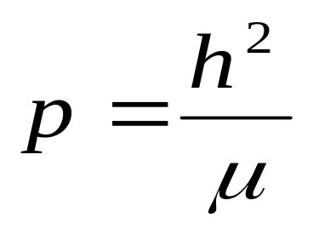
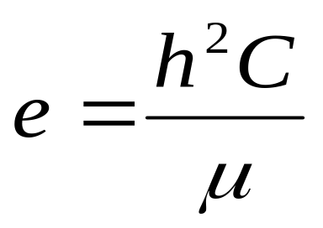
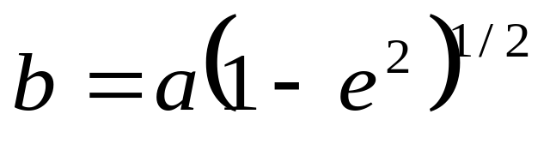
ORBIT CHARACTERISTICS
Semi-Axis Lengths of the Orbit
See eq. (2.18) and (2.16)
where
and h is the magnitude of the angular momentum
See eqn. (2.19)
where
and e is the eccentricity of the orbit

Slide 44
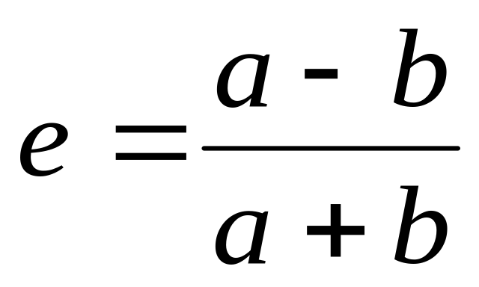
ORBIT ECCENTRICITY
If a = semi-major axis,
b = semi-minor axis, and
e = eccentricity of the orbit ellipse,
then
NOTE: For a circular orbit, a = b and e = 0

Slide 45
Time reference:
t_{p} Time of Perigee = Time of closest approach to the earth, at the same time, time the satellite is crossing the x₀ axis, according to the reference used.
t- t_{p} = time elapsed since satellite last passed the perigee.

Slide 46
ORBIT DETERMINATION 1:
Procedure:
Given the time of perigee t_{p}, the eccentricity e and the length of the semimajor axis a:
η Average Angular Velocity (eqn. 2.25)
M Mean Anomaly (eqn. 2.30)
E Eccentric Anomaly (solve eqn. 2.30)
r_{o} Radius from orbit center (eqn. 2.27)
ϕ_{o} True Anomaly (solve eq. 2.22)
x₀ and y₀ (using eqn. 2.23 and 2.24)

Slide 47
ORBIT DETERMINATION 2:
Orbital Constants allow you to determine coordinates (r_{o}, ϕ_{o}) and (x_{o}, y_{o}) in the orbital plane
Now need to locate the orbital plane with respect to the earth
More specifically: need to locate the orbital location with respect to a point on the surface of the earth

Slide 48
LOCATING THE SATELLITE WITH RESPECT TO THE EARTH
The orbital constants define the orbit of the satellite with respect to the CENTER of the earth
To know where to look for the satellite in space, we must relate the orbital plane and time of perigee to the earth’s axis
NOTE: Need a Time Reference to locate the satellite. The time reference most often used is the Time of Perigee, t_{p}

Slide 49
GEOCENTRIC EQUATORIAL COORDINATES - 1
z_{i} axis Earth’s rotational axis (N-S poles with N as positive z)
x_{i} axis In equatorial plane towards FIRST POINT OF ARIES
y_{i} axis Orthogonal to z_{i} and x_{i}
NOTE: The First Point of Aries is a line from the center of the earth through the center of the sun at the vernal equinox (spring) in the northern hemisphere

Slide 50
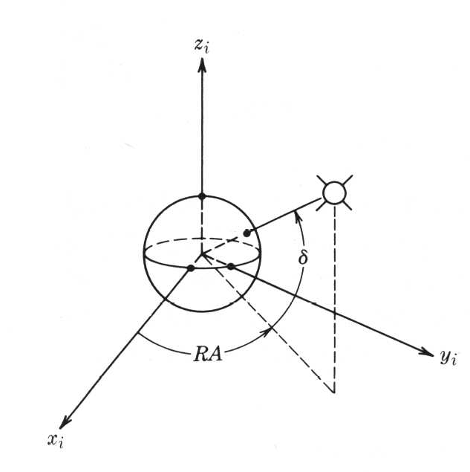
GEOCENTRIC EQUATORIAL COORDINATES - 2
Fig. 2.8 in text
RA = Right Ascension (in the x_{i},y_{i} plane)
δ = Declination (the angle from the x_{i},y_{i} plane to the satellite radius)
To First Point of Aries
NOTE: Direction to First Point of Aries does NOT rotate with earth’s motion around; the direction only translates

Slide 51
LOCATING THE SATELLITE - 1
Find the Ascending Node
  Point where the satellite crosses the equatorial plane from South to North
  Define Ω and i
  Define ω
Inclination
Right Ascension of the Ascending Node (= RA from Fig. 2.6 in text)
See next slide

Slide 52
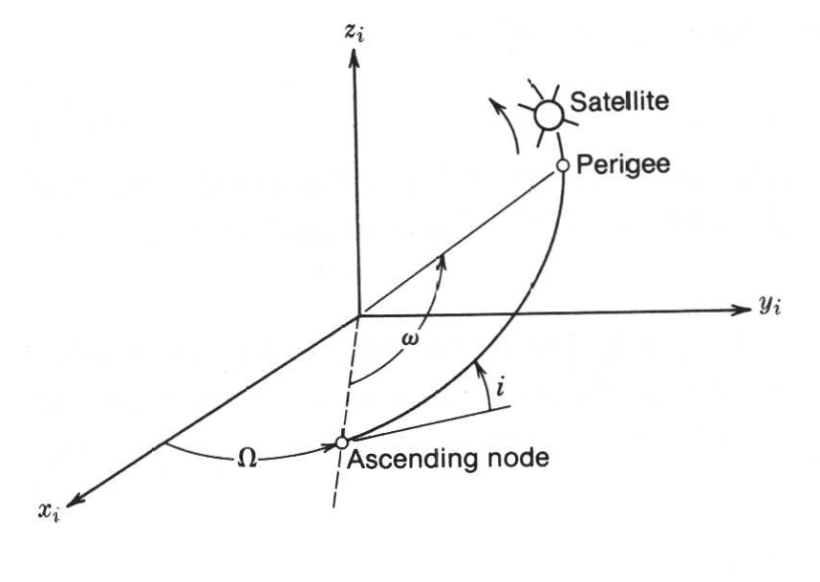
DEFINING PARAMETERS
Fig. 2.9 in text
Center of earth
Argument of Perigee
Inclination of orbit
Right Ascension
First Point of Aries
Orbit passes through equatorial plane here
Equatorial plane

Slide 53
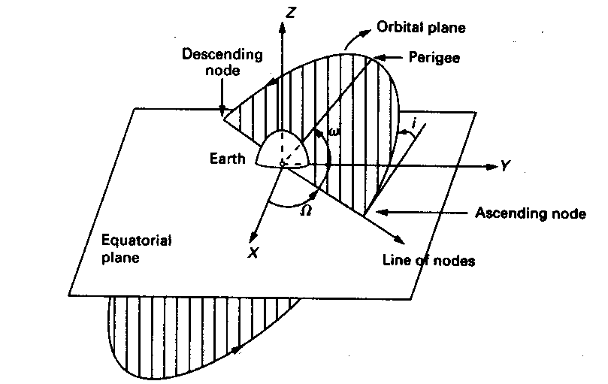
DEFINING PARAMETERS 2
  (Source: M.Richaria, Satellite Communication Systems, Fig.2.9)

Slide 54
LOCATING THE SATELLITE - 2
Ω and i together locate the Orbital plane with respect to the Equatorial plane.
ω locates the Orbital coordinate system with respect to the Equatorial coordinate system.

Slide 55
ORBITAL ELEMENTS
Ω Right Ascension of the Ascending Node
i Inclination of the orbit
ω Argument of Perigee (See Figures 2.6 & 2.7 in the text)
t_{p} Time of Perigee
e Eccentricity of the elliptical orbit
a Semi-major axis of the orbit ellipse (See Fig. 2.4 in the text)

Slide 56
Look Angle Determination

Slide 57
CALCULATING THE LOOK ANGLES 1: HISTORICAL
Need six Orbital Elements
Calculate the orbit from these Orbital Elements
Define the orbital plane
Locate satellite at time t with respect to the First Point of Aries
Find location of the Greenwich Meridian relative to the first point of Aries
Use Spherical Trigonometry to find the position of the satellite relative to a point on the earth’s surface

Slide 58
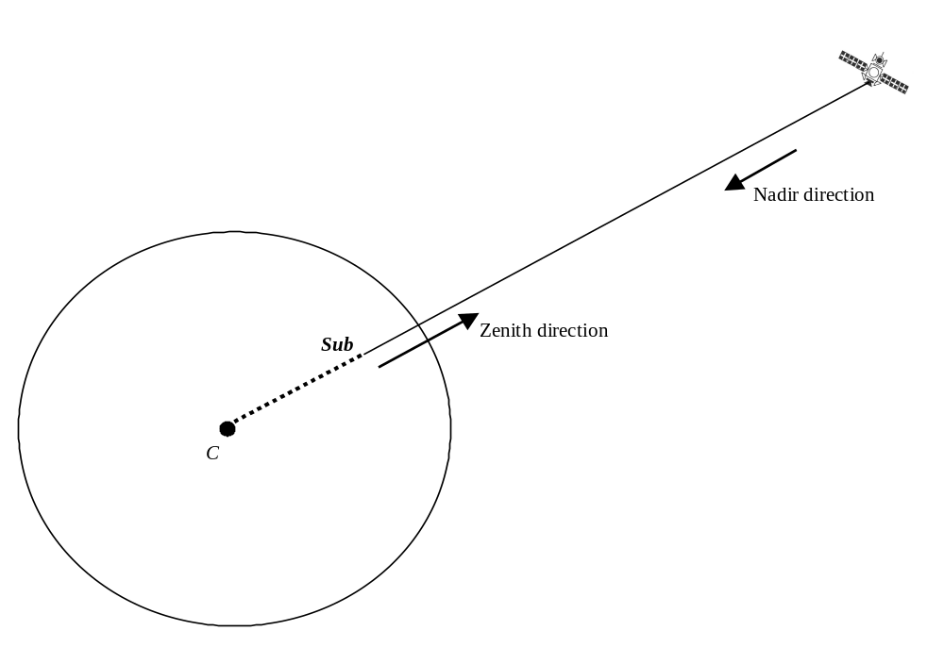
ANGLE DEFINITIONS - 1

Slide 59
Coordinate System 1
Latitude: Angular distance, measured in degrees, north or south of the equator.
  L from -90 to +90 (or from 90S to 90N)
Longitude: Angular distance, measured in degrees, from a given reference longitudinal line (Greenwich, London).
  l from 0 to 360E (or 180W to 180E)

Slide 60
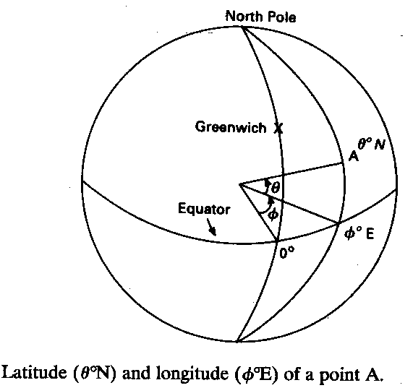
Coordinate System 2
(Source: M.Richaria, Satellite Communication Systems, Fig.2.9)

Slide 61
Satellite Coordinates
SUB-SATELLITE POINT
Latitude L_{s} Longitude l_{s}
EARTH STATION LOCATION
Latitude L_{e}
Longitude l_{e}
Calculate γ, ANGLE AT EARTH CENTER
Between the line that connects the earth-center to the satellite and the line from the earth-center to the earth station.

Slide 62
LOOK ANGLES 1
Azimuth: Measured eastward (clockwise) from geographic north to the projection of the satellite path on a (locally) horizontal plane at the earth station.
Elevation Angle: Measured upward from the local horizontal plane at the earth station to the satellite path.

Slide 63
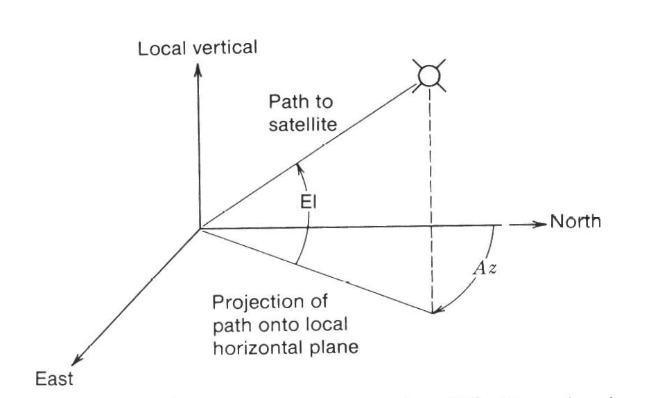
LOOK ANGLES
NOTE: This is True North (not magnetic, from compass)
Fig. 2.9 in text

Slide 64
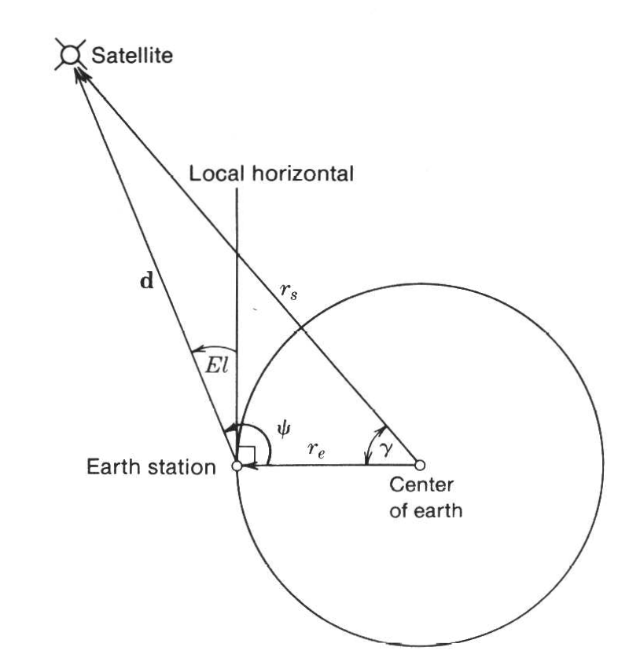
Geometry for Elevation Calculation
Fig. 2.11 in text
El = ψ - 90º
γ = central angle
r_{s} = radius to the satellite
r_{e} = radius of the earth

Slide 65
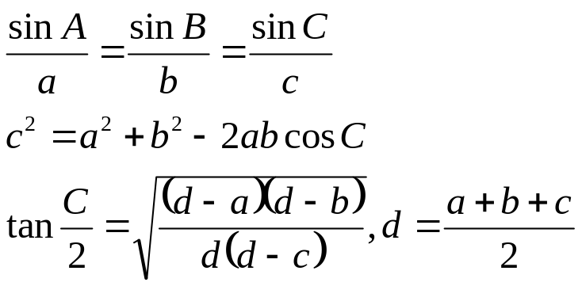
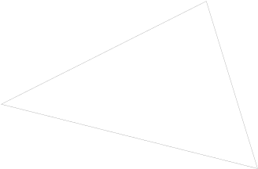
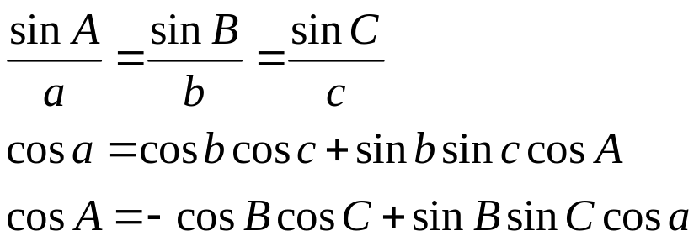

Slant path geometry
Review of plane trigonometry
  Law of Sines
  Law of Cosines
  Law of Tangents
C
a
b
B
c
A
Review of spherical trigonometry
  Law of Sines
  Law of Cosines for angles
  Law of Cosines for sides
C
b
a
A
B
c

Slide 66
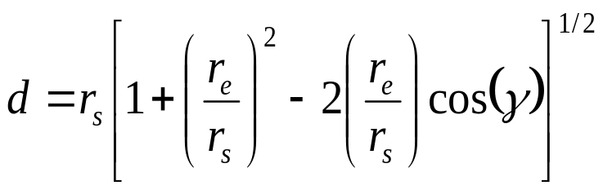
THE CENTRAL ANGLE γ
γ is defined so that it is non-negative and
cos (γ) = cos(Le) cos(L_{s}) cos(l_{s} – l_{e}) + sin(L_{e}) sin(L_{s})
The magnitude of the vectors joining the center of the earth, the satellite and the earth station are related by the law of cosine:

Slide 67
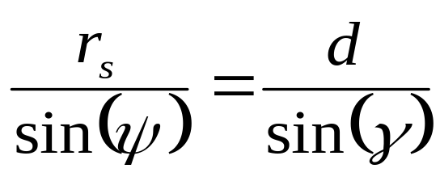
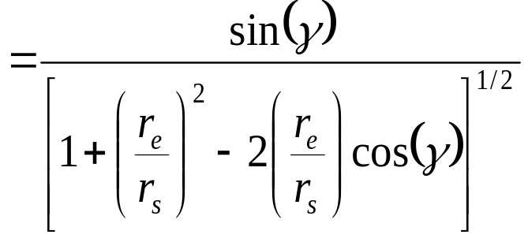
ELEVATION CALCULATION - 1
By the sine law we have
Eqn. (2.57)
Which yields
cos (El)
Eqn. (2.58)

Slide 68
GEOSTATIONARY SATELLITES
We will concentrate on the GEOSTATIONARY CASE
This will allow some simplifications in the formulas
SUB-SATELLITE POINT
(Equatorial plane, Latitude L_{s} = 0º Longitude l_{s})
EARTH STATION LOCATION
Latitude L_{e}
Longitude l_{e}

Slide 69
THE CENTRAL ANGLE γ - GEO
The original calculation previously shown:
cos (γ) = cos(Le) cos(L_{s}) cos(l_{s} – l_{e}) + sin(L_{e}) sin(L_{s})
Simplifies using L_{s} = 0º since the satellite is over the equator:
cos (γ) = cos(Le) cos(l_{s} – l_{e}) (eqn. 2.66)

Slide 70
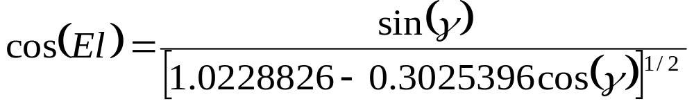
ELEVATION CALCULATION – GEO 1
Using r_{s} = 42,164 km and r_{e} = 6,378.14 km gives
d = 42,164 [1.0228826 - 0.3025396 cos(γ)]^{1/2} km
NOTE: These are slightly different numbers than those given in equations (2.67) and (2.68), respectively, due to the more precise values used for r_{s} and r_{e}

Slide 71
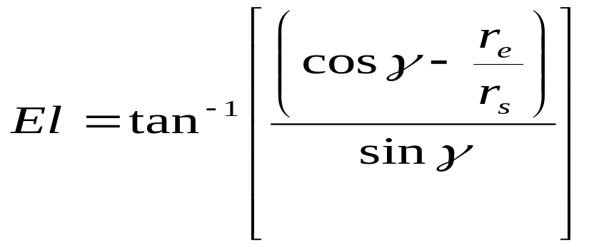
ELEVATION CALCULATION – GEO 2
A simpler expression for El (after Gordon and Walter, “Principles of Communications Satellites”) is :

Slide 72
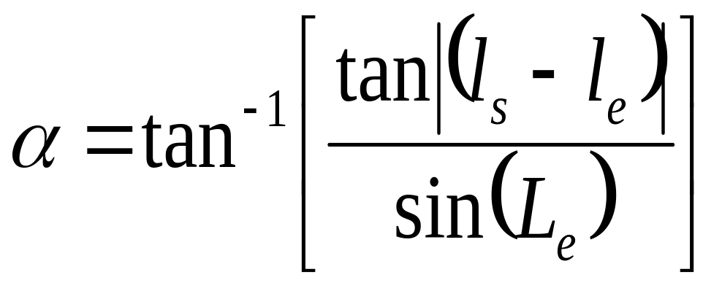
AZIMUTH CALCULATION – GEO 1
To find the azimuth angle, an intermediate angle, α, must first be found. The intermediate angle allows the correct quadrant (see Figs. 2.10 & 2.13) to be found since the azimuthal direction can lie anywhere between 0º (true North) and clockwise through 360º (back to true North again). The intermediate angle is found from
NOTE: Simpler expression than eqn. (2.73)

Slide 73
AZIMUTH CALCULATION – GEO 2
Case 1: Earth station in the Northern Hemisphere with
(a) Satellite to the SE of the earth station: Az = 180º - α (b) Satellite to the SW of the earth station: Az = 180º + α
Case 2: Earth station in the Southern Hemisphere with
(c) Satellite to the NE of the earth station: Az = α (d) Satellite to the NW of the earth station: Az = 360º - α

Slide 74
EXAMPLE OF A GEO
LOOK ANGLE ALCULATION - 1
FIND the Elevation and Azimuth Look Angles for the following case:
Earth Station Latitude 52º N
Earth Station Longitude 0º
Satellite Latitude 0º
Satellite Longitude 66º E
London, England Dockland region
Geostationary INTELSAT IOR Primary

Slide 75
EXAMPLE OF A GEO
LOOK ANGLE ALCULATION - 1
Step 1. Find the central angle γ
cos(γ) = cos(L_{e}) cos(l_{s}-l_{e})
= cos(52) cos(66)
= 0.2504
yielding γ = 75.4981º
Step 2. Find the elevation angle El

Slide 76
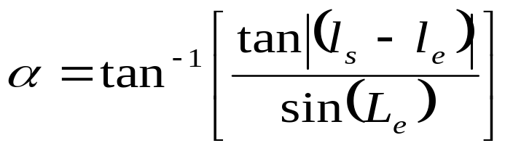
EXAMPLE OF A GEO
LOOK ANGLE ALCULATION - 1
Step 2 contd.
El = tan⁻¹[ (0.2504 – (6378.14 / 42164)) / sin (75.4981) ]
= 5.85º
Step 3. Find the intermediate angle, α
= tan⁻¹ [ (tan (66 - 0)) / sin (52) ]
= 70.6668

Slide 77
EXAMPLE OF A GEO
LOOK ANGLE ALCULATION - 1
The earth station is in the Northern hemisphere and the satellite is to the South East of the earth station. This gives
Az = 180º - α
= 180 – 70.6668 = 109.333º (clockwise from true North)
ANSWER: The look-angles to the satellite are
Elevation Angle = 5.85º
Azimuth Angle = 109.33º

Slide 78
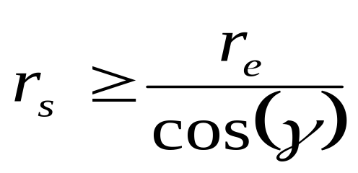
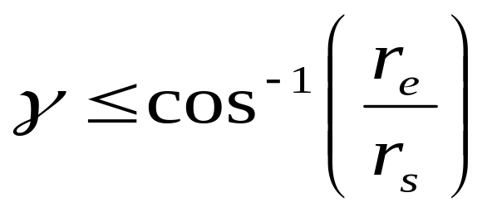
VISIBILITY TEST
A simple test, called the visibility test will quickly tell you whether you can operate a satellite into a given location.
A positive (or zero) elevation angle requires (see Fig. 2.13)
Eqns. (2.42) & (2.43)
which yields

Slide 79
OPERATIONAL LIMITATIONS
For Geostationary Satellites
γ ≤ 81.3º
This would give an elevation angle = 0º
Not normal to operate down to zero
usual limits are C-Band 5º
Ku-Band 10º
Ka- and V-Band 20º

Slide 80
Range Variations
Even with best station-keeping tolerances,
range to users will change
• Essential to know range for TDMA access
– User frames MUST arrive at the correct instant
• LEO TDMA systems (e.g. Iridium) require
large shifts in delay to compensate for range
variation

Slide 81
Solar Eclipse
Earth gets between Sun and the satellite
– For GEO systems, most prevalent in spring and
fall
– For LEO systems, varies with inclination
• Major source of power is solar panels
– Eclipse operations must be on batteries
• Thermal balance changed significantly and
rapidly
– Thermal design is key element often neglected

Slide 82
Lunches and Lunch vehicles

Slide 83
Launching Satellites (1)
LEO
– Shuttle, small-to-Large ELVs
MEO
– Medium ELVs, shuttle + booster stage
HEO
– Medium ELVs, shuttle + booster stage
GEO
– Large ELVs, shuttle + booster stage

Slide 84
Launching Satellites (2)
Key points for achieving correct orbit
– Correct velocity (vector)
– Correct altitude
Two launch approaches
– Direct insertion
– Transfer trajectory + on-board velocity
augmentation

Slide 85
Launching Satellites (3)
Direct insertion into orbit
– Launch vehicle contains all the necessary
propulsion energy to take the satellite into its
correct orbit
– Satellite only needs to take care of in-orbit
maneuvers (station-keeping, location changes,
“graveyard orbit burn”, attitude)

Slide 86
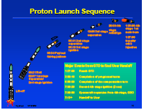
Example Launch Sequence

Slide 87
Launching Satellites (4)
• Transfer trajectory plus velocity
augmentation
– Launch vehicle only has enough propulsion
energy to place the satellite in a transfer
trajectory
– Satellite needs to have additional on-board
energy to boost it into the desired orbit
– GEO achieved in two ways

Slide 88
Launching Satellites (5)
• Transfer trajectory options
– High-energy approach to raise transfer orbit to
GEO orbit in one rocket firing (“burn”). This
approach uses an Apogee Kick Motor (AKM)
– Low-energy approach to raise transfer orbit to
GEO orbit in a number of burns

Slide 89
Multiple Launches
• Many rockets can loft more than one satellite per
launch
– Lowers cost per satellite
– Enables clusters of small satellites to be launched
• 4 GLOBALSTARS on one DELTA II
• 7 Iridiums on one PROTON
• Need payload adapters

Slide 90
Lunching of satellite
Lunching of a satellite from NASA
RISAT-1
Radar Satellite-1 (RISAT-1) is a state of the art Microwave Remote Sensing Satellite carrying a Synthetic Aperture Reader (SAR) Payload operating in C-band (5.35 GHz), which enables imaging of the surface features during both day and night under all weather conditions.

Slide 91
Satellite Vs. Lunch vehicles
Satellities
Earth Observing Satellities
Space Missions
Experimental / Small Satellite
All Satellites
Lunch vehicles
PSLV
GSLV
GSLV Mark III

Slide 92
Satellite
For the past four decades, ISRO has launched more than 65 satellites for various scientific and technological applications like mobile communications, Direct-to-Home services, meteorological observations, telemedicine, tele-education, disaster warning, radio networking, search and rescue operations, remote sensing and scientific studies of the space.

Slide 93
ISRO has established two major space systems, the Indian National Satellite System (INSAT) series for communication, television broadcasting and meteorological services which is Geo-Stationary Satellites, and Indian Remote Sensing Satellites (IRS) system for resources monitoring and management which is Earth Observation Satellites. ISRO has launched many Experimental Satellites which are generally small comparing to INSAT or IRS and Space Missions to explore the space. Geo-Stationary

Slide 94
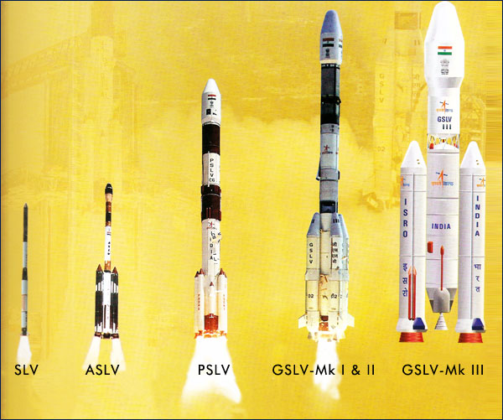

Slide 95


3D model of agni-5

Slide 96



Slide 97
PSLV
PSLV-C19 launched RISAT-1 on April 26, 2012 (Successful)
PSLV-C18 launched Megha-Tropiques, SRMSat, VesselSat-1 and Jugnu on October 12, 2011 (Successful)
PSLV-C17 launched GSAT - 12 on July 15, 2011 (Successful)
PSLV-C16 launched RESOURCESAT - 2, YOUTHSAT and X-SAT on April 20, 2011 (Successful)
PSLV-C15 launched CARTOSAT-2B, ALSAT-2A, NLS 6.1 & 6.2 and STUDSAT on July 12, 2010 (Successful)
PSLV-C14 launched Oceansat - 2 and Six Nanosatellites on September 23, 2009 (Successful)
PSLV-C12 launched RISAT-2 and ANUSAT on April 20, 2009 (Successfully)
PSLV-C11 launched CHANDRAYAAN-I, on October 22, 2008 (Successful)
PSLV-C9 launched CARTOSAT-2A, IMS-1 and Eight nano-satellites on April 28, 2008 (Successful)

Slide 98
GSLV
GSLV-F06 launched GSAT-5P on December 25, 2010 (Unsuccessful)
GSLV-D3 launched GSAT-4 on April 15, 2010 (Unsuccessful)
GSLV-F04 launched INSAT-4CR on September 2, 2007 (Successful)
GSLV-F02 launched INSAT-4C on July 10, 2006 (Unsuccessful)
GSLV-F01 launched EDUSAT(GSAT-3) on September 20, 2004 (Successful)
GSLV-D2 launched GSAT-2 on May 8, 2003 (Successful)
GSLV-D1 launched GSAT-1 on April 18, 2001 (Successful)

