Slide 1

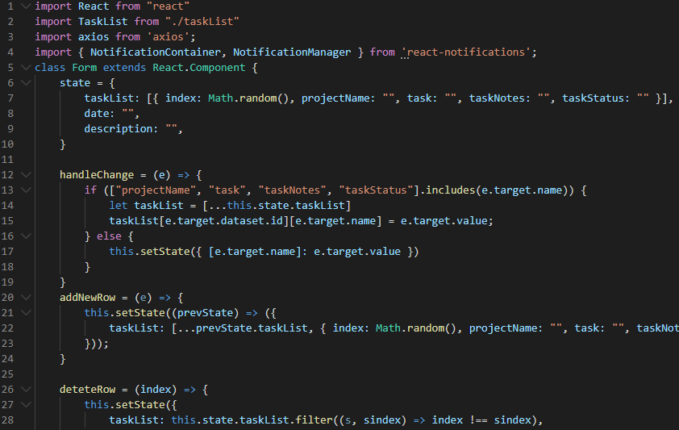

Angular Vs React in 2020

Slide 2



Angular Vs React in 2020 [Hindi]

Slide 3
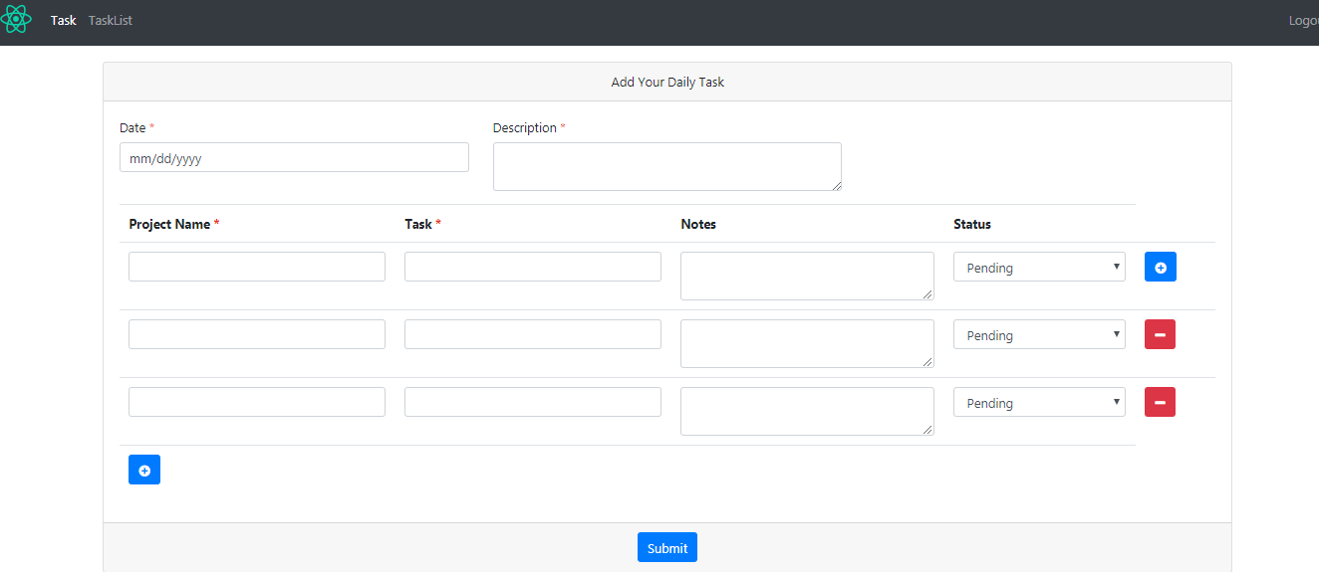

Dynamically Add / Delete Form Input Field
Angular Vs React in 2020

Slide 4
Dynamically Add / Delete Form Input Field In Hindi
Angular Vs React in 2020
Why React slice always delete the last row ?

Slide 5
Dynamically Add / Delete Form Input Field
In Hindi
Using Reactive Form
Angular Vs React in 2020

Slide 6
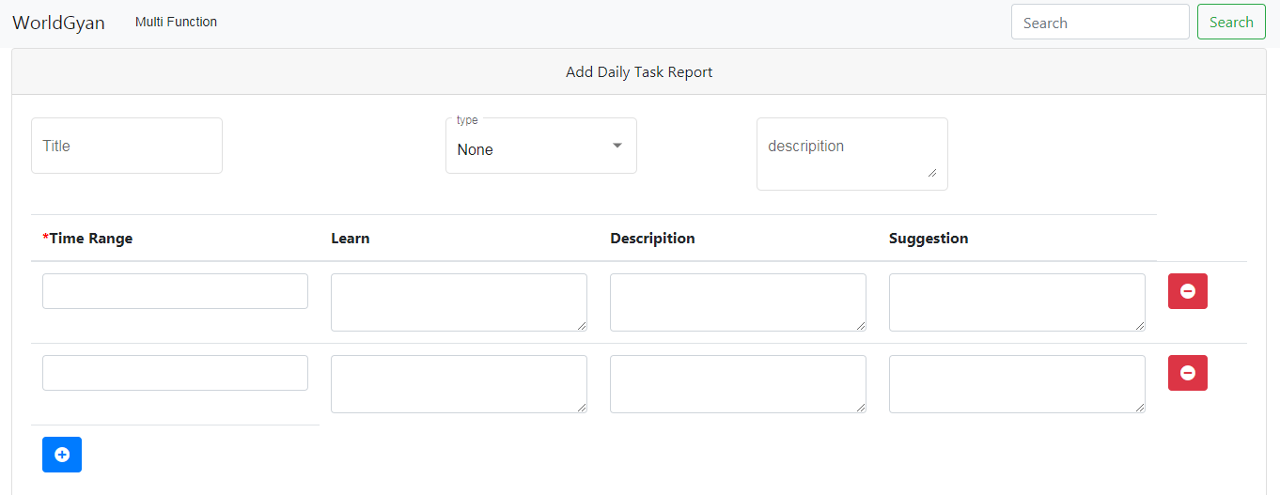
Dynamically Add / Delete
Form Input Field
Angular Vs React in 2020
Using Reactive Form
In English

Slide 7
Dynamically Add / Delete
Form Input Field
Angular Vs React in 2020
Using Reactive Form
In Hindi

Slide 8

PHP In 2020 and beyond
Is PHP A Dying Language in 2020 ??
Why should we learn PHP in 2020?
In Hindi
Angular Vs React in 2020

Slide 9
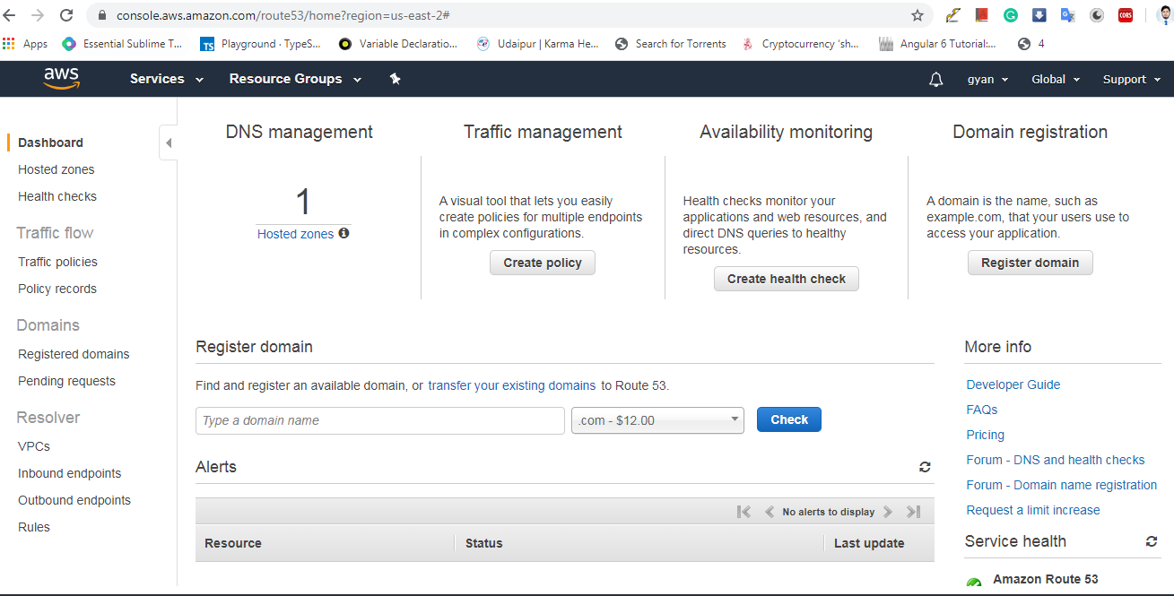
How do I publicly host my website on an EC2 Windows
Can't connect to the web server on an EC2 instance
How do I access ec2 instance from browser?
In English [Full Detail]
Angular Vs React in 2020

Slide 10

How do I publicly host my website on an EC2 Windows
Can't connect to the web server on an EC2 instance
How do I access ec2 instance from browser?
Inbound setting is allow but page is not opening outside ??
Configuring Windows Firewall and add inbound
English
Angular Vs React in 2020

Slide 11
How do I publicly host my website on an EC2 Windows
Can't connect to the web server on an EC2 instance
How do I access ec2 instance from browser?
Inbound setting is allow but page is not opening outside ??
Configuring Windows Firewall and add inbound
Hindi
Angular Vs React in 2020

Slide 12
How to connect public IP to domain name
Link domain name to ec2 instances
What is elastic IP ?
How to assign elastic IP address to ec2 instances ?
Connect worldgyan.com to ec2 instances
Hindi
Angular Vs React in 2020

Slide 13
How to connect public IP to domain name
Link domain name to ec2 instances
What is elastic IP ?
Aws elastic ip vs public ip ??
How to assign elastic IP address to ec2 instances ?
English
Connect worldgyan.com to ec2 instances
Angular Vs React in 2020

Slide 14
PHP In 2020 and beyond
Is PHP A Dying Language in 2020 ??
Why should we learn PHP in 2020?
In Hindi [Full Detail]
Angular Vs React in 2020

Slide 15
Easy ,Simple And Direct Is Our Policy
Simple and only simple
In Simple Language
Easy And Direct
Angular Vs React in 2020
WorldGyan

Slide 16

What happens if you recharge your Jio number two times ?
If you recharge 599 two times ?
What happens if recharge 399 then 599 ?
Hindi
Angular Vs React in 2020
WorldGyan

Slide 17
What should be done if you have recharged the wrong Jio number?
Reliance Jio Wrong Recharge Reversal
Hindi
Angular Vs React in 2020
WorldGyan

