Slide 1
Product Table
Fillable
Title
Tag
Category
Descripition
Image
Price
Compare price
published
Id (Primary)
created_at
deteted_at
updated_at

Slide 2
Cart Table
Id (Primary)
Product id (foreign)
Quantity (fillable)
Customer Id (foreign)
created_at
deteted_at
updated_at

Slide 3
Order
Customer Id
Order Item
Payment
Fulfillment
Id (Primary)
Price Total
Total quantity
created_at
deteted_at
updated_at

Slide 4
Order Item
Id (Primary)
Order Id(foreign)
Product id (foreign)
Quantity
Customer Id (foreign)
Price Total
created_at
deteted_at
updated_at

Slide 5
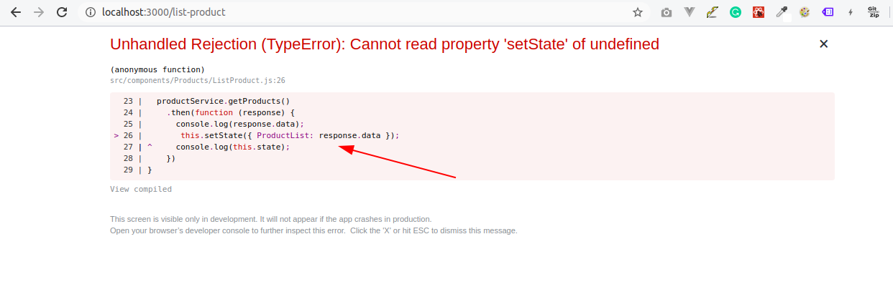
Unhandled Rejection (TypeError): Cannot read property 'setState' of undefined

Slide 6
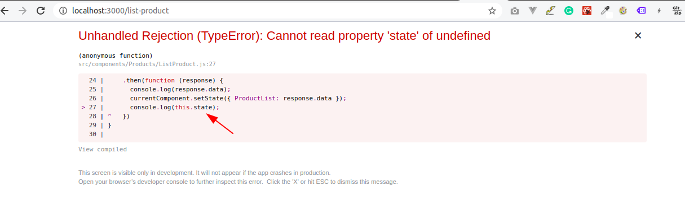
Unhandled Rejection (TypeError): Cannot read property 'state' of undefined

Slide 7
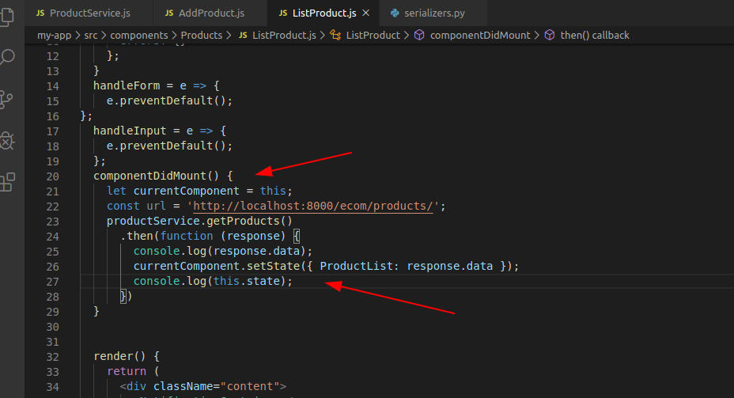
Unhandled Rejection (TypeError): Cannot read property 'state' of undefined

Slide 8
Unhandled Rejection (TypeError): Cannot read property 'state' of undefined

Slide 9
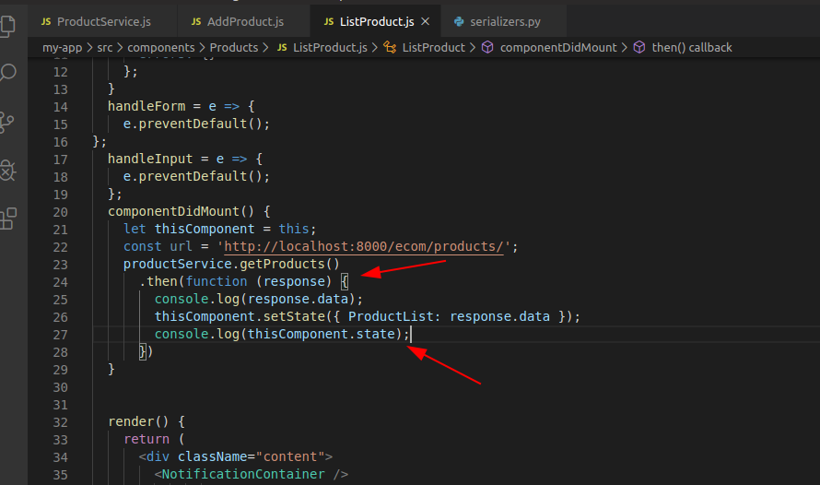
Solution

Slide 10
componentDidMount() { let thisComponent = this; const url = 'http://localhost:8000/ecom/products/'; productService.getProducts() .then(function (response) { console.log(response.data); thisComponent.setState({ ProductList: response.data }); console.log(thisComponent.state); }) }

