Slide 1
INTRODUCTION
A graph is a pictorial representation of a set of objects where
some pairs of objects are connected by links.
The interconnected objects are represented by points termed as vertices, and the links that connect the vertices are called edges.
Formally, a graph is a pair of sets (V, E), where V is the set of vertices and E is the set of edges, connecting the pairs of vertices.

Slide 2
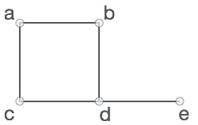
Take a look at the following graph −
In the above graph,
V = {a, b, c, d, e}
E = {ab, ac, bd, cd, de}

Slide 3
Graph Terminology
Path
A path can be defined as the sequence of nodes that are followed in order to reach some terminal node V from the initial node U.
Closed Path
A path will be called as closed path if the initial node is same as terminal node. A path will be closed path if V₀=V_{N}.
Simple Path
If all the nodes of the graph are distinct with an exception V₀=V_{N}, then such path P is called as closed simple path.
Cycle
A cycle can be defined as the path which has no repeated edges or vertices except the first and last vertices.
Connected Graph
A connected graph is the one in which some path exists between every two vertices (u, v) in V. There are no isolated nodes in connected graph.
Complete Graph
A complete graph is the one in which every node is connected with all other nodes. A complete graph contain n(n-1)/2 edges where n is the number of nodes in the graph.
.

Slide 4
Weighted Graph
In a weighted graph, each edge is assigned with some data such as length or weight. The weight of an edge e can be given as w(e) which must be a positive (+) value indicating the cost of traversing the edge.
Digraph
A digraph is a directed graph in which each edge of the graph is associated with some direction and the traversing can be done only in the specified direction.
Loop
An edge that is associated with the similar end points can be called as Loop.
Adjacent Nodes
If two nodes u and v are connected via an edge e, then the nodes u and v are called as neighbours or adjacent nodes.
Degree of the Node
A degree of a node is the number of edges that are connected with that node. A node with degree 0 is called as isolated node.

Slide 5
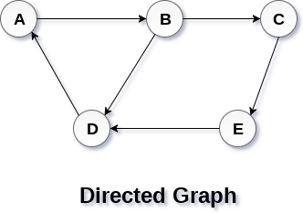
Directed and Undirected Graph :
A graph can be directed or undirected. However, in an undirected graph, edges are not associated with the directions with them. An undirected graph is shown in the above figure since its edges are not attached with any of the directions. If an edge exists between vertex A and B then the vertices can be traversed from B to A as well as A to B.
In a directed graph, edges form an ordered pair. Edges represent a specific path from some vertex A to another vertex B. Node A is called initial node while node B is called terminal node.
A directed graph is shown in the following figure.

Slide 6
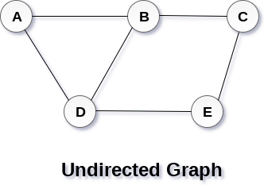
Weighted Graph
A Graph is called weighted graph when it has weighted edges which means there are some cost associated with each edge in graph.

Slide 7
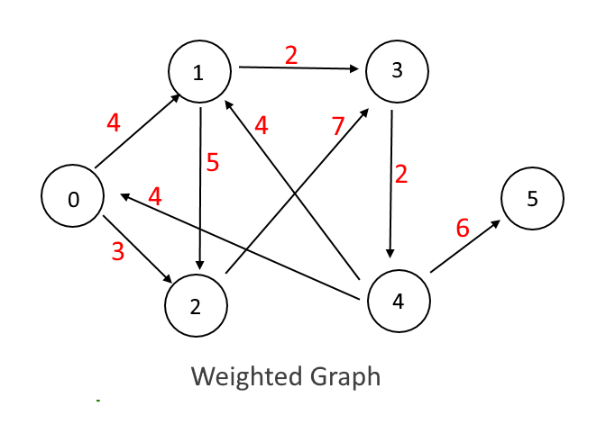
Implementation:
Each edge of a graph has an associated numerical value, called a weight.
Usually, the edge weights are nonnegative integers.
Weighted graphs may be either directed or undirected.
The weight of an edge is often referred to as the “cost” of the edge.
Will create an Edge class to put weight on each edge

Slide 8
Graph Traversal Algorithm
In this part of the tutorial we will discuss the techniques by using which, we can traverse all the vertices of the graph.
Traversing the graph means examining all the nodes and vertices of the graph. There are two standard methods by using which, we can traverse the graphs. Lets discuss each one of them in detail.
1.Breadth First Search
2.Depth First Search
Breadth First Search (BFS) Algorithm
Breadth first search is a graph traversal algorithm that starts traversing the graph from root node and explores all the neighbouring nodes. Then, it selects the nearest node and explore all the unexplored nodes.

Slide 9
Algorithm
Step 1: SET STATUS = 1 (ready state)
for each node in G
Step 2: Enqueue the starting node A
and set its STATUS = 2
(waiting state)
Step 3: Repeat Steps 4 and 5 until
QUEUE is empty
Step 4: Dequeue a node N. Process it
and set its STATUS = 3
(processed state).
Step 5: Enqueue all the neighbours of
N that are in the ready state
(whose STATUS = 1) and set
their STATUS = 2
(waiting state)
[END OF LOOP]
Step 6: EXIT

Slide 10
Depth First Search (DFS) Algorithm
Depth first search (DFS) algorithm starts with the initial node of the graph G, and then goes to deeper and deeper until we find the goal node or the node which has no children. The algorithm, then backtracks from the dead end towards the most recent node that is yet to be completely unexplored.
The data structure which is being used in DFS is stack. The process is similar to BFS algorithm. In DFS, the edges that leads to an unvisited node are called discovery edges while the edges that leads to an already visited node are called block edges.
Algorithm
Step 1: SET STATUS = 1 (ready state) for each node in G
Step 2: Push the starting node A on the stack and set its STATUS = 2 (waiting state)
Step 3: Repeat Steps 4 and 5 until STACK is empty
Step 4: Pop the top node N. Process it and set its STATUS = 3 (processed state)
Step 5: Push on the stack all the neighbours of N that are in the ready state (whose STATUS = 1) and set their
STATUS = 2 (waiting state)
[END OF LOOP]
Step 6: EXIT

