Slide 1
Feature of CPP:
General purpose programming
Middle level programming
Compiled language
Object oriented language
Generic programming
Functional programming
Procedural programming

Slide 2
Use of CPP:
Games
GUI application
Web browser->mozilla ,chrome
Compilers
Editor: Notepad, Wordpad, edit plus.
Operation system:-dos,windows,unix
Medical and engineering application
To creating some of other programming language.
It design database also: oracle,mysql.
Device driver : printer

Slide 3
Execution of source code:
C++ source file
One.cpp two.cpp
Intermediate code
One.ii two.ii
compilation
Assembly Object
code code
One.s two.s
C++ Souce code
External
Library
Output
Standard
Library
Execution
Pre processor
Loader
compiler
Executable
.exe
External
Library
Standard
Library
Assembler
Linker
One.obj
Two.obj

Slide 4
Installation G++ on ubuntu
Check version
Command: g++ --version
2. g++ is not installed
Command:
sudo apt update
sudo apt install g++
g++ --version

Slide 5
First Program:
#include<iostream> //header file for cin and cout object
Using namesapce std; //; is it compulsory bz every stat end with ;//all features and every function and classes under the namespace std.
//using statement specifying that I am using the program elements declared in std namespace
int main()
{
// write the statement you want to execute.
cout<<“hello world”;
return 0;
}

Slide 6
Compile and Run Program:
Compile :
command-
g++ filename.cpp –o name of output file
g++ filename.cpp
Run and execute:
Command-
./name of the output file
./file name

Slide 7
Constant Literals:
1.Integer literals
2.Floating point literals
3.Character literals
4.String literals
5.Boolean literals
Boolean literals represent boolean values. They are the simplest category of literals in that only two different values are allowed: true and false. Both of them evaluate to a value of type bool. bool may be converted to integer types, in which case a true yields to nonzero value, whereas false yields zero

Slide 8
Data type:
Int:
Char:
Float:
Double:
Void:
bool: It refers to a boolean/logical value. It can either be true or false.
wchar_t: It refers to a wide character whose size is either 2 or 4 bytes. It is similar to the char data type but the only difference is the space occupied in the computer memory.
string: Instead of declaring an array of characters to enter a string data type, C++ gives you the provision to declare the “string” data type.

Slide 9
Keywords: keyword means meaning already define in complier
lignas (since C++11) alignof (since C++11) and and_eq asm atomic_cancel (TM TS) atomic_commit (TM TS) atomic_noexcept (TM TS) auto(1) bitand bitor bool break case catch char char8_t (since C++20) char16_t (since C++11) char32_t (since C++11) class(1) compl concept (since C++20) const consteval (since C++20) constexpr (since C++11) constinit (since C++20) const_cast continue co_await (since C++20) co_return (since C++20) co_yield (since C++20) decltype (since C++11) | default(1) delete(1) do double dynamic_cast else enum explicit export(1)(3) extern(1) false float for friend goto if inline(1) int long mutable(1) namespace new noexcept (since C++11) not not_eq nullptr (since C++11) operator or or_eq private protected public reflexpr (reflection TS) | register(2) reinterpret_cast requires (since C++20) return short signed sizeof(1) static static_assert (since C++11) static_cast struct(1) switch synchronized (TM TS) template this thread_local (since C++11) throw true try typedef typeid typename union unsigned using(1) virtual void volatile wchar_t while xor xor_eq

Slide 10
Escape sequences:
nnn | arbitrary octal value | byte nnn
\xnn | arbitrary hexadecimal value | byte nn
\unnnn (since C++11) | universal character name (arbitrary Unicode value); may result in several characters | code point U+nnnn
\Unnnnnnnn (since C++11) | universal character name (arbitrary Unicode value); may result in several characters | code point U+nnnnnnnn

Slide 11
Const:
The const qualifier used on a declaration of a non-local, non-volatile, non-template ,non-inline variable that is not declared extern gives it internal linkage. This is different from C where const file scope variables have external linkage.
constexpr - specifies that the value of a variable or function can appear in constant expressions.
consteval - specifies that a function is an immediate function, that is, every call to the function must produce a compile-time constant
constinit - asserts that a variable has static initialization, i.e. zero initialization and constant initialization, otherwise the program is ill-formed.

Slide 12
Cout: In C we use printf()
cout is an object of the output stream that is used to show output.
cout uses the extraction operator( << ).
Cin: In C we use scanf()
cin is an object of the input stream and is used to take input from input streams like files, console.
cin uses the insertion operator( >> )
Example:
#include<iostream>
int main() {
int n;
std::cin >>n;
std::cout << n;
return 0;
}

Slide 13
Comments:
It use for program documentation for human readable.
If you want to ignore statement then used.
1.Single line //
2. Multiple line /*…..*/
We can't nested the comments

Slide 14
Preprocessor:
The preprocessor is executed at translation phase 4, before the compilation. The result of preprocessing is a single file which is then passed to the actual compiler.
Syntax:
# character
preprocessing instruction (one of define, undef, include, if, ifdef, ifndef, else, elif, endif, line, error, pragma)
arguments (depends on the instruction)
line break
Example:
#include<file.h>

Slide 15
Namespace:
Namespaces provide a method for preventing name conflicts in large projects.
Symbols declared inside a namespace block are placed in a named scope that prevents them from being mistaken for identically-named symbols in other scopes.
Multiple namespace blocks with the same name are allowed. All declarations within those blocks are declared in the named scope
Syntax:
Namespace ns-name{declarations}
Using namespace ns_name;
Using ns_name::name;
Namespace{declaration}
Ns_name::name
Example:
Using namespace std;

Slide 16
Statements
1) expression statements( assignments or function calls)
2) compound statements
3) selection statements(if,if..else, switch)
4) iteration statements(while, do..while, for, range for)
5) jump statements(break, continue, return, goto)
6) declaration statements;
7) try blocks;

Slide 17
Operators:-
Arithmetic Operator: (+,_,*,/,%)
Increment and Decrement : (++,--)
Conditional Operator: (if, if..else,nested if else and else if)
Comparison Operator: (<,>,<=,>=,==,!=)
Logical Operator: (&&,||,!)
Ternary Operator:

Slide 18
CPP Concept:
1.Object:
2.class:
3.Encapsulation
4.Abstraction
5.Inhertance:
6.Polymorphic

Slide 19
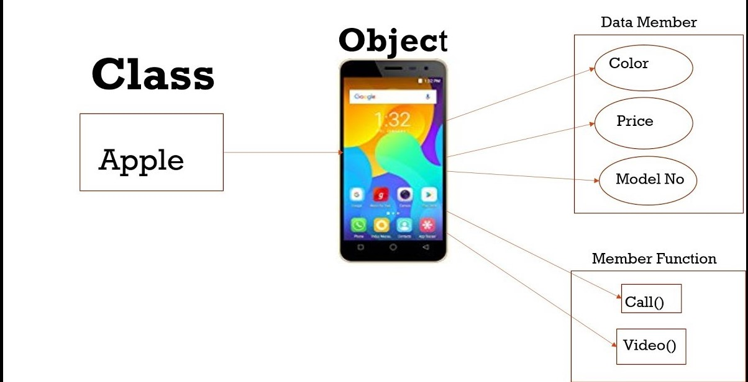
Object:-
Object is a runtime entity, it is created at runtime,
Object is an instance of a class.
Class:
class is user defined data type which is use to bind data member and member function in single unit.

Slide 20

Abstraction:
Abstraction is important feature of OOPS that shows required data and hiding unnecessary data to user.
Real life example of abstraction is ATM machine because we don’t know how does ATM functioning inside but we can withdraw money easily .
Who provides abstraction in C++
C++ access specifiers like private, protected provides
abstraction features.

Slide 21
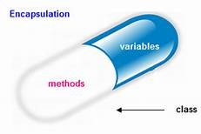
Encapsulation:
Encapsulation means binding all data members and member function in single unit.
Who providing Encapsulation in C++
class provides encapsulation facility.

Slide 22
Inheritance:
Inheritance is a mechanism where a new class is derived from an existing class. In C++, classes may inherit or acquire the properties and methods of other classes.
Example:
inherited
feature
Mother
Father
Parent
child
child

Slide 23
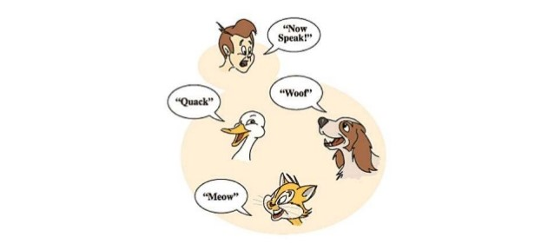
Polymorphic:
Doing same work in different way is called polymorphism in C++.
polymorphism means “having multiple forms”. if a variable can hold more than one type of value, then that’s a kind of polymorphism. If functions can process more than one type of parameter, that’s also polymorphism

Slide 24
Array:-
Array is collection of similar data type.
Ex. You have to store six subject.
All arrays consist of contiguous memory locations
Declaring Arrays:
Type arrayname[size]; arr
Int arr [5]; 0 1 2 3 4
Initializing Arrays:
Int arr[5]={10,20,30,40,50} arr
0 1 2 3 5
arr[3]=60; arr
0 1 2 3 4
G G G G G
10 20 30 40 50
0 0 0 60 0

Slide 25
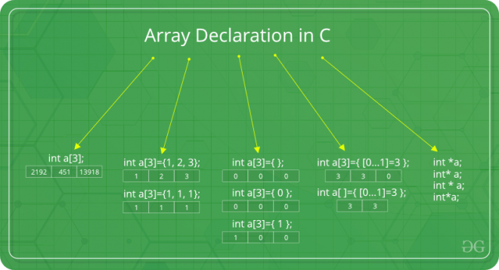
Declaration of Array:

Slide 26
Program :
#include<iostream>
using namespace std;
int main()
{
int arr[5]; //declaration of array
cout<<“Enter array elements”;
for(int i=0;i<5;i++)
{
cin>>arr[i]; //accessing element from user
}
for(int i=0;i<5;i++)
{
cout<<arr[i];} // display element
}

Slide 27
Advantages:
Random access of elements using array index.
Use of less line of code as if creates a single array of multiple elements.
Easy access to all the elements.
Traversal through the array becomes easy using a single loop.
Disadvantages:
Allows a fixed number of elements to be entered which is decided at the time of declaration.
Insertion and deletion difficult.

Slide 28
Class:
A Class is a user defined data-type which has data members and member functions.
Data members are the data variables and member functions are the functions used to manipulate these variables and together these data members and member functions defines the properties and behavior of the objects in a Class.
example of class Car, the data member will be speed limit, mileage etc and member functions can be apply brakes, increase speed etc.
How to create class
class keyword is use to create class in C++.
At the end of the braces semicolon(;)is mandatory
Syntax:
class className
{
Access specifier; //can private, public and protected
Data members; // class variables
Memberfunction(){}// class function
};

Slide 29
Accessing Data Members
The public data members are also accessed in the same way given however the private data members are not allowed to be accessed directly by the object. Accessing a data member depends solely on the access control of that data member. This access control is given by Access modifiers in C++. There are three access modifiers : public, private and protected.
Member Functions in Classes
There are 2 ways to define a member function:
Inside class definition
Outside class definition
To define a member function outside the class definition we have to use the scope resolution :: operator along with class name and function name.

Slide 30
Program:
Inside class definition
#include<iostream>
Using namespace std;
class student //class name
{
Private: ///access modifier
Int rollno; //data member
Float marks;
Public:
Void display(){ //inside class definition member function
Cout<<“rollno=”<<rollno;
Cout<<“marks=”<<marks;
};
Outside class definition
#include<iostream>
Using namespace std;
class student //class name
{
Private: ///access modifier
Int rollno; //data member
Float marks;
Public:
Void display();
}
Void student:: display(){ //outside class definition member function
Cout<<“rollno=”<<rollno;
Cout<<“marks=”<<marks;
}

Slide 31
Object:-
An Object is an instance of a Class. When a class is defined, no memory is allocated but when it is instantiated (i.e. an object is created) memory is allocated.
Declaring Objects:-
Syntax:
ClassName ObjectName;
Student stud;

Slide 32
Getter and Setter Functions:
If you want others to read or modify the value of a private member, you can provide public get and set methods.
Set Method:
If you want to set value of particular variable then use setMethod.
Get Method:
If you want to take value of particular variable then use GetMethod
Example:
Class A
{
private : int nVal;
Public:
Void setNval(int n)
{
nVal=n;
}
Int getNval()
{
Return nVal;
}
};
Int main()
{
A obj;
Obj.setNval(10);
Cout<<obj.getNval();
}

Slide 33
Constructors:
Constructors are special class members which are called by the compiler every time an object of that class is instantiated. Constructors have the same name as the class and may be defined inside or outside the class definition.
Syntax:
class-name ( parameter-list(optional) ) except-spec(optional) attr(optional There are 3 types of constructors:
Default constructors:
A default constructor is a constructor which can be called with no arguments (either defined with an empty parameter list, or with default arguments provided for every parameter). A type with a public default constructor is DefaultConstructible
Syntax:
1. class-name();
2. Class-name::classname(){}
3.class-name()=delete;
4. class-name()=defulat;
Class-name::class-name()=default;

Slide 34
Parametrized constructors:
Copy constructors:
creates a new object, which is exact copy of the existing object. The compiler provides a default Copy Constructor to all the classes.
Syntax:
class-name(class name&)
{
}
class_name ( const class_name & ) = default;
class_name ( const class_name & ) = delete;

Slide 35
Example of constructor:
class Complex
{
int real;
int img;
public:
Complex()
{
real=0; //default constructor
img=0;
}
Complex (int r,int i)
{
real=r; //parameterized constructor
img=I;
}
Complex(complex& c)
{
this->real=c.real;
this->img=c.img; // copy constructor
}
};
int main()
{
Complex c;
Complex c2(10,20); //main method
Complex c3(c2);
Complex c4=c3;
}

Slide 36
Destructors:
Destructor is another special member function that is called by the compiler when the scope of the object ends.
Syntax:
~class-name()
{
// delete statements;
}

Slide 37
Function overloading:
Function overloading means more than one function have same name but different parameters list, when I say parameter list, it means the data type and sequence of the parameters.
Function overloading is a compile-time polymorphism.
Example:
Myfun(int ,int);
Myfun(int,int,int);
Myfun(int,float);
Myfun(float,int);

Slide 38
Operator overloading:
Customize the C++operators for operand of user-defined type.
In C++, we can make operators to work for user defined classes
Syntax:
return_type class_name : : operator op(argument_list)
{
// body of the function.
}

Slide 39
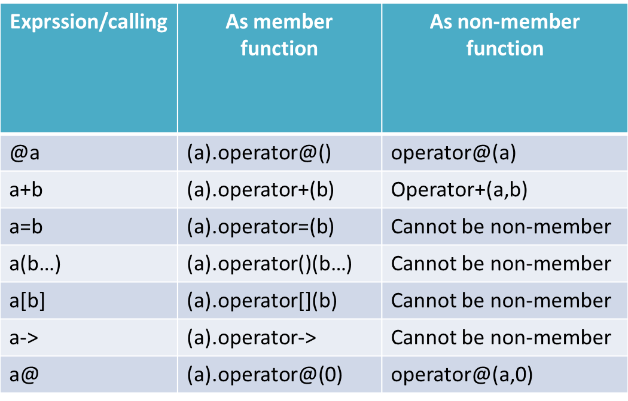

Slide 40
Restrictions of operator overloading
The operators :: (scope resolution), . (member access), .* (member access through pointer to member), and ?: (ternary conditional) cannot be overloaded.
New operators such as **, <>, or &| cannot be created.
The overloads of operators && and || lose short-circuit evaluation.
The overload of operator -> must either return a raw pointer, or return an object (by reference or by value) for which operator -> is in turn overloaded.
It is not possible to change the precedence, grouping, or number of operands of operators.

Slide 41
Example of unary operator
#include<iostream>
Using namespace std;
class Complex
{
int real;
int img;
public:
Complex()
{
real=0;img=0;
}
Complex(int r,int i)
{
real=r;
img=I;
}
Operator ++()
{
}
}
int main()
{
Complex c(10,20)
Complex c2(30,40);
C1++ //c1.operator()
++c1 //c1.operator(int)
return 0;
}

Slide 42
Example of unary operator:
#include<iostream>
Using namespace std;
class Complex
{
int real;
int img;
public:
Complex()
{
real=0;img=0;
}
Complex(int r,int i)
{
real=r;
img=I;
}
Complex Operator- (complex c2)
{
Complex temp;
temp.real=this->real-c2.real;
temp.img=this->img-c2.img;
return temp;
}
Complex Operator+ (complex c2)
{
Complex temp;
temp.real=this->real+c2.real;
temp.img=this->img+c2.img;
return temp;
}
Void operator =(const Complex&c2)
{
this->real=c2.real;
this->img=c2.img;
}
}
int main()
{
Complex c(10,20)
Complex c2(30,40);
Complex c3;
C3=c1+c2; //c1.operator+(c2)
C3=c1-c2 //c1.operator-(c2)
return 0;
}

Slide 43
Friend Function:-
The friend declaration appears in a class body and grants a function or another class access to private and protected members of the class where the friend declaration appears.
Syntax
Friend fuction-declartaion
Friend function definition
Example
Friend complex operator+(complex c1,complex c2);

Slide 44
In C++, stream insertion operator << is used for output and stream extraction operator >> is used for input.
cout is an object of ostream class which is a compiler defined class.
When we do cout<<obj where obj is an object of our class, the compiler first looks for an operator function in ostream, then it looks for a global function.
#include <iostream> using namespace std; class Complex { private: int real, imag; public: Complex(int r = 0, int i =0) { real = r; imag = i; } friend ostream & operator << (ostream &out, const Complex &c); friend istream & operator >> (istream &in, Complex &c); }; ostream & operator << (ostream &out, const Complex &c) { out << c.real; out << "+i" << c.imag << endl; return out; } istream & operator >> (istream &in, Complex &c) { cout << "Enter Real Part "; in >> c.real; cout << "Enter Imagenory Part "; in >> c.imag; return in; }

Slide 45
Inheritance
In C++, it is possible to inherit attributes and methods from one class to another. We group the "inheritance concept" into two categories:
derived class (child) - the class that inherits from another class
base class (parent) - the class being inherited from
To inherit from a class, use the : symbol.
Advantage:
It is useful for code reusability: reuse attributes and methods of an existing class when you create a new class.
Syntax
class subclass_name : access_mode base_class_name
{ //body of subclass
};

Slide 46
Example:
/ Base class class Vehicle { public: string brand = "Ford"; void honk() { cout << "Tuut, tuut! \n" ; } }; // Derived class class Car: public Vehicle { public: string model = "Mustang"; }; int main() { Car myCar; myCar.honk(); cout << myCar.brand + " " + myCar.model; return 0; }

Slide 47
Modes of Inheritance:
Public mode: If we derive a sub class from a public base class. Then the public member of the base class will become public in the derived class and protected members of the base class will become protected in derived class.
Protected mode: If we derive a sub class from a Protected base class. Then both public member and protected members of the base class will become protected in derived class.
Private mode: If we derive a sub class from a Private base class. Then both public member and protected members of the base class will become Private in derived class.
Base class member access specifier | Public | Protected | Private
public | public | protected | private
protected | protected | Protected | private
private | not accessible | not accessible | not accessible

Slide 48
Type of Inheritance:
1.Single Inheritance
2.Multilevel Inheritance
3.Multiple Inheritance
4. Hierarchical Inheritance
5.Hybrid Inheritance
1.Single inheritance:
In single inheritance, a class is allowed to inherit from only one class.
Base class
Derived class
Syntax:
class subclass_name : access_mode base_class {
//body of subclass
};
A class
B class

Slide 49
Multilevel Inheritance: In this type of inheritance, a derived class is created from another derived class.
(Base Class 2)
(Base Class 1)
(Derived class)
Class C
Class B
Class A

Slide 50
3.Multiple inheritance:
Multiple Inheritance is a feature of C++ where a class can inherit from more than one classes
(BaseClass1) (BaseClass2)
(Derived Class)
Syntax:
class subclass_name : access_mode base_class1, access_mode base_class2, .... {
//body of subclass };
Class B
Class C
Class A

Slide 51
Hierarchical Inheritance: In this type of inheritance, more than one sub class is inherited from a single base class.
A Class
B Class
C class
D class
E Class

Slide 52
Hybrid Inheritance:
Class A
Class F
Class B
Class E
Class G
Class C
Class D

Slide 53
Examples:
Single Inheritance
Class ParentClass
{
Private:
Char pname[10];
Public:
void setPname(int name)
{
strcpy(pname,name);
}
char* getPname()
{
return pname;
}
};
Class ChildClass: public ParentClass
{
private : cname
public:
void setCname(int name)
{
strcpy(cname,name);
}
Char* getCname()
{
Return cname;
}
};
Int main()
{
ChildClass c;
C.setCname(“shubhangi”);
C.setPname(“Kailas”);
Return 0;
}

Slide 54
Example of Multilevel Inheritance:

Slide 55
Example of Multiple Inheritance:

Slide 56
Example of Hierarchical Inheritance:

Slide 59
Friend Class:
A friend class is a class that can access the private and protected members of a class in which it is declared as friend. This is needed when we want to allow a particular class to access the private and protected members of a class.
Example
#include <iostream>
using namespace std;
class XYZ {
private: char ch='A';
int num = 11; public:
/* This statement would make class ABC * a friend class of XYZ, this means that * ABC can access the private and protected * members of XYZ class. */
friend class ABC;
};
class ABC {
public:
void display(XYZ obj){
cout<<obj.ch<<endl;
cout<<obj.num<<endl;
}
};
int main() {
ABC obj1;
XYZ obj2;
obj1.display(obj2);
return 0; }

Slide 60
Polymorphism:
Polymorphism
Compile time polymorphism
run time polymorphism
Function overloading
operator overloading
Function overloading

Slide 61
Virtual Function:
A virtual function is a member function which is declared within a base class and is re-defined(Overriden) by a derived class. When you refer to a derived class object using a pointer or a reference to the base class, you can call a virtual function for that object and execute the derived class’s version of the function.
Virtual functions ensure that the correct function is called for an object, regardless of the type of reference (or pointer) used for function call.
They are mainly used to achieve Runtime polymorphism
Functions are declared with a virtual keyword in base class.

Slide 62
Rules for Virtual Functions:
Virtual functions cannot be static and also cannot be a friend function of another class.
Virtual functions should be accessed using pointer or reference of base class type to achieve run time polymorphism.
The prototype of virtual functions should be same in base as well as derived class.
They are always defined in base class and overridden in derived class. It is not mandatory for derived class to override (or re-define the virtual function), in that case base class version of function is used.
A class may have virtual destructor but it cannot have a virtual constructor.

Slide 63
Example of Virtual Function:
#include <iostream>
using namespace std;
class Shape {
public:
virtual void print()
{
cout << "print base class" << endl;
}
void show()
{
cout << "show base class" << endl;
}
};
class Circle: public Shape{
public:
void print()
{
cout << "print derived class" << endl;
}
void show()
{
cout << "show derived class" << endl;
}
};
Output:
print derived class
show base class

Slide 64
Pure Virtual Function:
A pure virtual function is a virtual function in C++ for which we need not to write any function definition and only we have to declare it. It is declared by assigning 0 in the declaration.
An abstract class is a class in C++ which have at least one pure virtual function.
Abstract class can have normal functions and variables along with a pure virtual function.
Abstract class cannot be instantiated, but pointers and references of Abstract class type can be created.
Abstract classes are mainly used for Upcasting, so that its derived classes can use its interface.
If an Abstract Class has derived class, they must implement all pure virtual functions, or else they will become Abstract too.
We can’t create object of abstract class as we reserve a slot for a pure virtual function in Vtable, but we don’t put any address, so Vtable will remain incomplete.

Slide 65
Example of Pure Virtual Function:
#include <iostream>
using namespace std;
class Shape {
public:
virtual void print()
{
cout << "print base class" << endl;
}
virtual void area()=0
};
class Circle: public Shape{
Private :int radios;
public:
Circle()
{
Radios=0;
}
Circle(int r)
{
this-> radios=r;
}
void print()
{
cout << "print derived class" << endl;
}
void area()
{
cout << “Area is=“<<p3.14* radios * radios << endl;
}
};

Slide 66
Static Keyword:
Static elements are allocated storage only once in a program lifetime in static storage area. And they have a scope till the program lifetime. Static Keyword can be used with following,
Static variable in functions
Static Class Objects
Static member Variable in class
Static Methods in class

Slide 67
Static Variables inside Functions
Static variables when used inside function are initialized only once, and then they hold there value even through function calls.
Example:
Void counter()
{
static int count=0;
cout<<count++;
}
int main()
{
for(int i=0;i<5;i++)
{
counter();
}
}
Output:
01234

Slide 68
Example: without static variable
Void counter()
{
int count=0;
cout<<count++;
}
int main()
{
for(int i=0;i<5;i++)
{
counter();
}
}
Output:
00000

Slide 69
Static Data Member in class:
Static data members of class are those members which are shared by all the objects. Static data member has a single piece of storage, and is not available as separate copy with each object, like other non-static data members.
Static data members of class are those members which are shared by all the objects. Static data member has a single piece of storage, and is not available as separate copy with each object, like other non-static data members.
Example:
class ABC {
public:
static int i;
ABC() {
// construtor
}
};
int ABC::i=1;
int main() {
ABC obj; cout << obj.i; // prints value of I
}

Slide 70
Static Member Functions
These functions work for the class as whole rather than for a particular object of a class.
It can be called using an object and the direct member access . operator. But, its more typical to call a static member function by itself, using class name and scope resolution :: operator.
class ABC
{
public:
static void fun()
{ // statement
}
};
int main() {
ABC::fun();
// calling member function directly with class name
}

Slide 71
Inline Functions:
All the member functions defined inside the class definition are by default declared as Inline. Let us have some background knowledge about these functions.
You must remember Preprocessors from C language. Inline functions in C++ do the same thing what Macros did in C language. Preprocessors/Macros were not used in C++ because they had some drawbacks.
1.Problem with spacing
2.Complex Argument Problem
3.No way to access Private Members of Class
Inline functions are actual functions, which are copied everywhere during compilation, like preprocessor macro, so the overhead of function calling is reduced.
Example
inline void fun(int a) { return a++; }

Slide 72
Standard library header <iostream>:
This header is part of the Input/output library.
Including <iostream> behaves as if it defines a static storage duration object of type std::ios_base::Init, whose constructor initializes the standard stream objects if it is the first std::ios_base::Init object to be constructed, and whose destructor flushes those objects (except for cin and wcin) if it is the last std::ios_base::Init object to be destroyed.
Includes:
<ios>
<streambuf>
<istream>
<ostream>

Slide 73
Object of Std:
Std::cin – standard input.
Std::cout-standard output
Std::cerr- standard error
Std::clog standard log
Std::wcin standart input

Slide 74
RTTI (Run-time type Information):
RTTI (Run-time type information) is a mechanism that exposes information about an object’s data type at runtime and is available only for the classes which have at least one virtual function. It allows the type of an object to be determined during program execution.

