Slide 1


Pctriks&key Youtube ----------------------
Er. Ashutosh SIR
Library Management
System
Submitted To
Submitted by

Slide 2
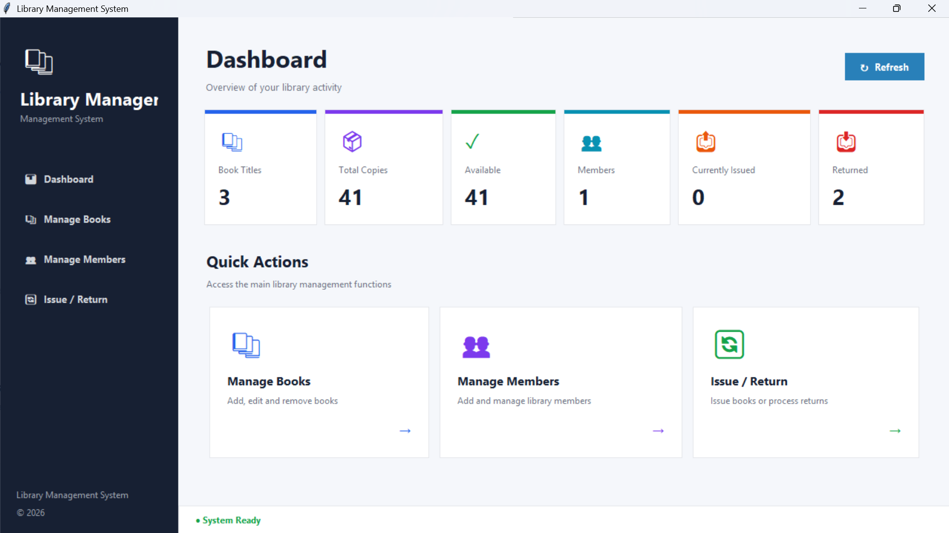
DASHBOARD_OVERVIEW
Library Management System
A desktop application for managing books, members, and the issue / return workflow.
Dashboard · Manage Books · Manage Members · Issue / Return
Notes:
Introduce the Library Management System UI: four main screens built as a desktop app.

Slide 3




One system, four focused screens
Each screen maps to one librarian task, reachable from the sidebar or the dashboard's Quick Actions.
Dashboard
Manage Books
Manage Members
Issue / Return
At-a-glance stats on titles, copies, availability, members, and loans.
Add, edit, delete, and search the book collection with live availability.
Register and maintain library members with contact details.
Lend a book to a member, return it, and review transaction history.

Slide 4
Design Color user In python
COLOUR PALETTE (approximate, sampled from the screens)
CONSISTENT PATTERNS
Deep Navy
Midnight
Form → search → table
Every management screen stacks input, search, and results in the same order.
#1A3F8B
#141B3A
Page headers, table headers
Dashboard sidebar
Colour by intent
Green adds, blue updates, red removes, grey clears, purple searches.
Success Green
Action Blue
#1E9E63
#1F7AE0
Add actions, availability
Update, Refresh
Icon + label headings
Section titles pair a small icon with bold navy text for quick scanning.
Alert Red
Violet
#E5483B
#7B3FBF
Click a row to edit
Delete, Return
Search
Selecting a table row loads it into the form or the return action.

Slide 5
Dashboard: library at a glance
1
Six KPI cards
Book titles, total copies, available, members, currently issued, and returned, each with its own icon and colour.
2
Quick Actions
Large cards jump straight to Manage Books, Manage Members, or Issue / Return.
3
Persistent sidebar
A dark navigation rail keeps all four screens one click away.
4
Refresh + status bar
A Refresh button updates the numbers; “System Ready” confirms the app state.
Notes:
Dashboard screen walkthrough.

Slide 6
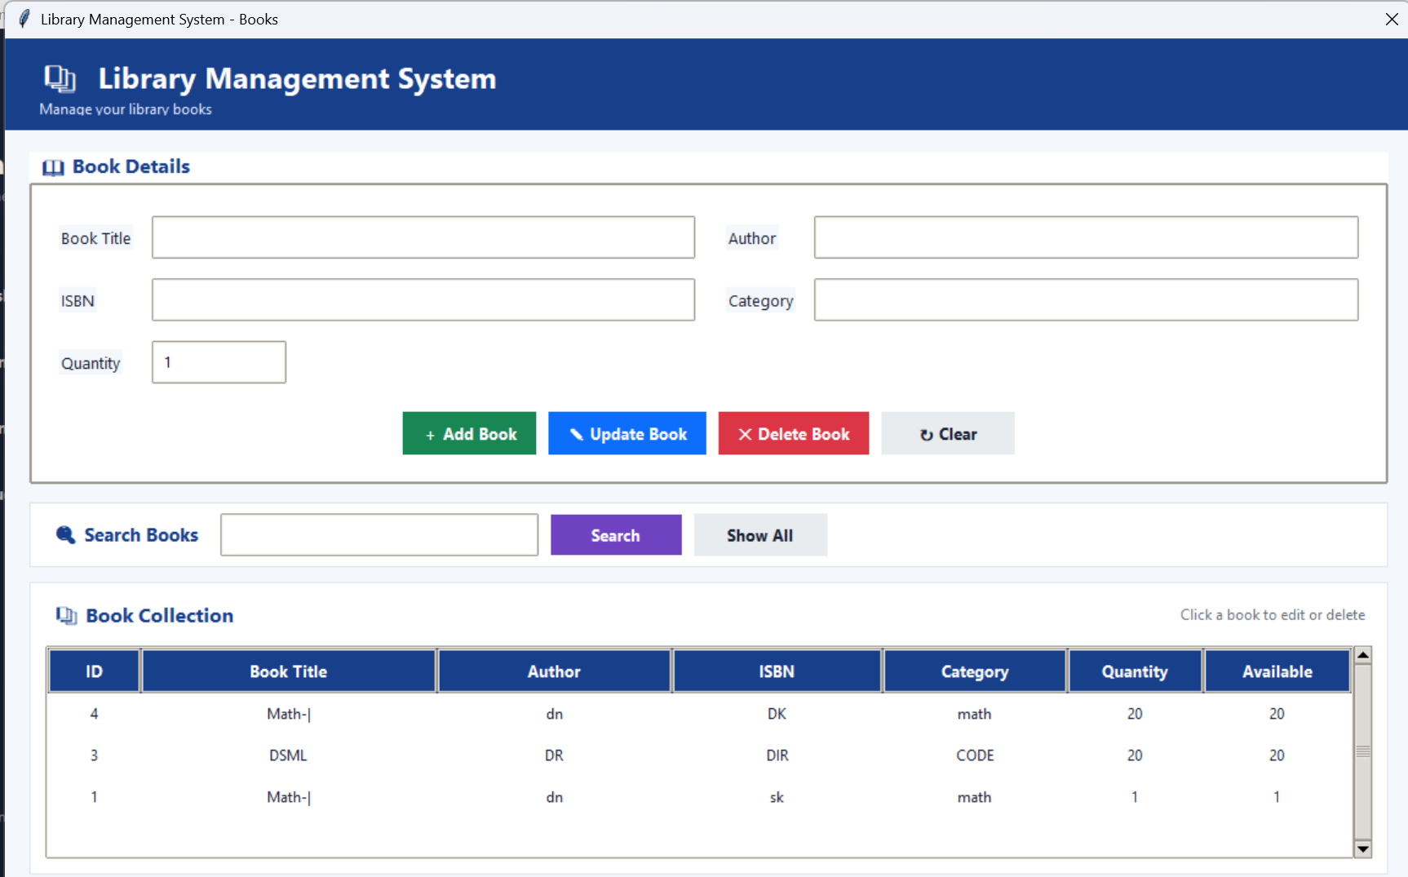
Manage Books: the catalogue
1
Book Details form
Title, Author, ISBN, Category, and Quantity in a compact two-column grid.
2
Colour-coded actions
Add (green), Update (blue), Delete (red), and Clear (grey) are easy to tell apart.
3
Search + Show All
A single search box filters the collection; Show All resets the view.
4
Book Collection table
Shows ID, title, author, ISBN, category, quantity, and available copies. Click a row to edit.
Notes:
Manage Books screen walkthrough.

Slide 7
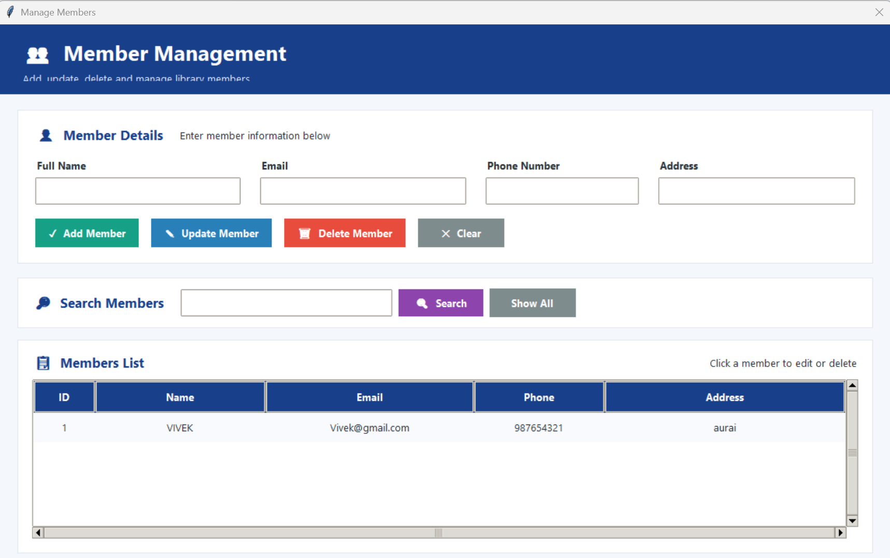
Manage Members: the people
1
Member Details form
Full name, email, phone number, and address laid out in one row of four fields.
2
Same action pattern
Add, Update, Delete, and Clear reuse the colours and order from the Books screen.
3
Search Members
Quick lookup with a Show All button to restore the full list.
4
Members List
A scrollable table (ID, name, email, phone, address). Click a member to edit or delete.
Notes:
Manage Members screen walkthrough.

Slide 8
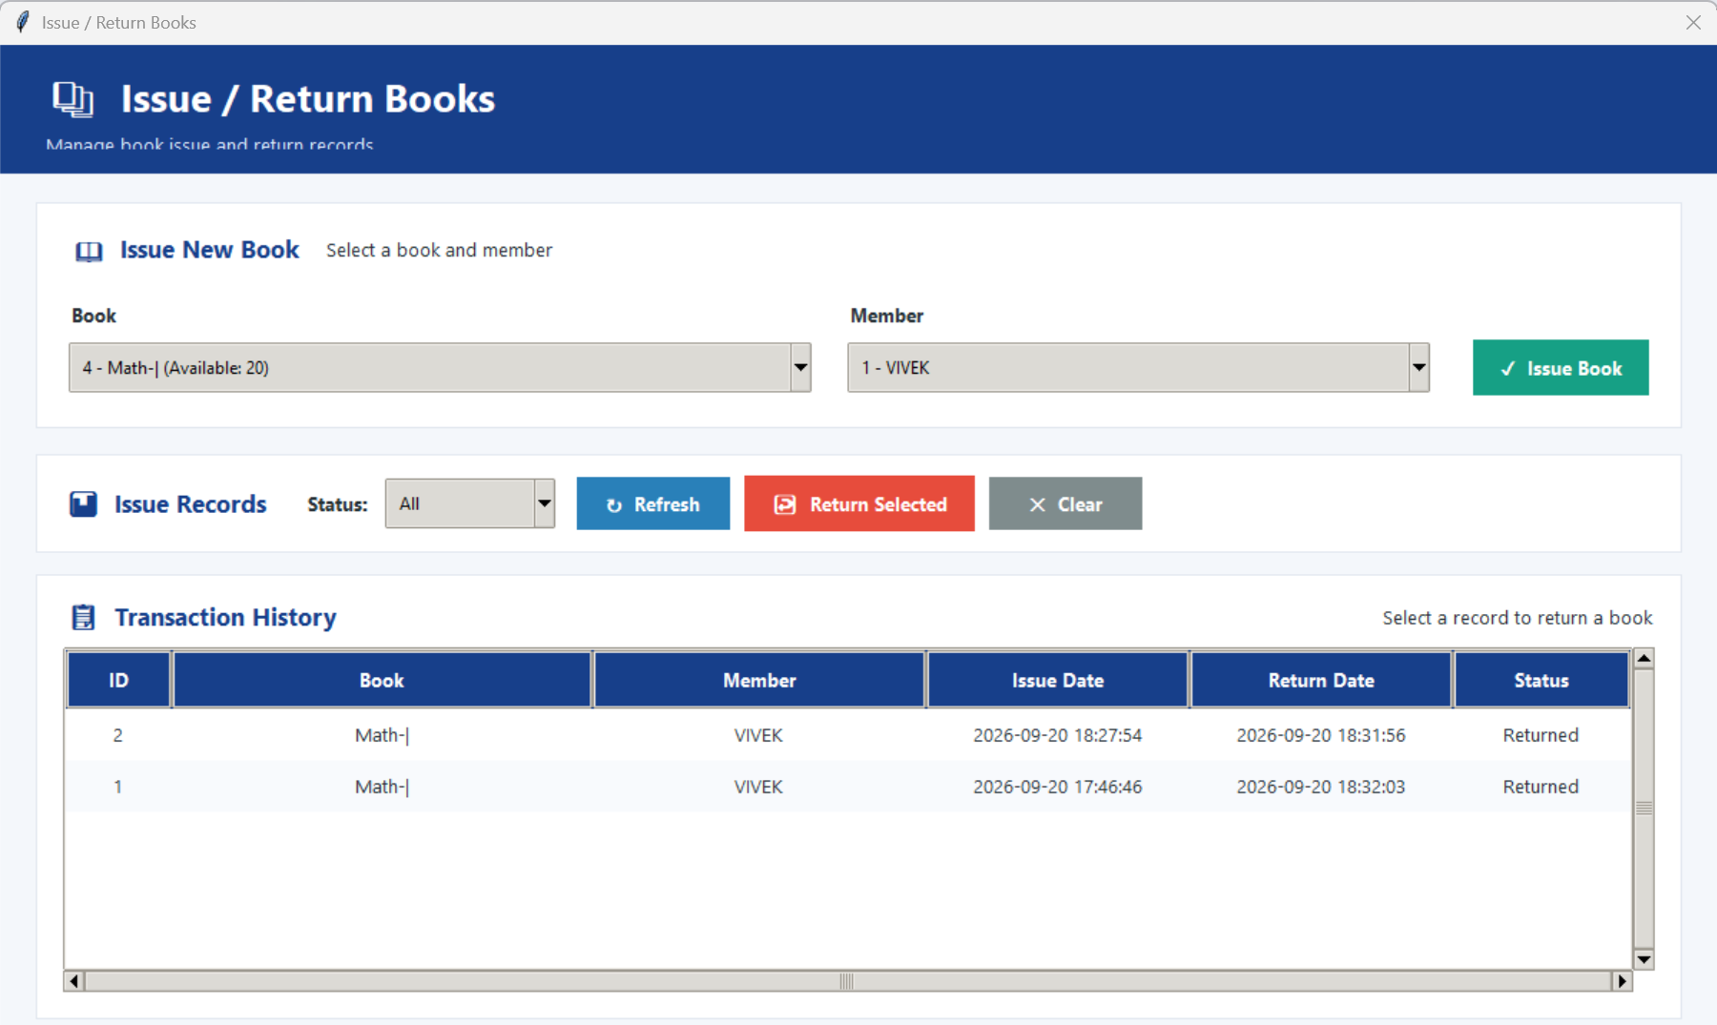
Issue / Return: the circulation desk
1
Issue New Book
Pick a book (its available count is shown) and a member from dropdowns, then click Issue Book.
2
Issue Records toolbar
Filter by status, Refresh the list, or Return Selected for the highlighted record.
3
Transaction History
ID, book, member, issue date, return date, and status for every loan.
4
Timestamped records
Issue and return times are stored to the second, giving a clear audit trail.
Notes:
Issue / Return screen walkthrough.

Slide 9
A typical librarian workflow
From an empty catalogue to a completed loan in five steps.
1
2
3
4
5
Add books
Register members
Issue a book
Return the book
Check the numbers
›
›
›
›
MANAGE BOOKS
MANAGE MEMBERS
ISSUE / RETURN
ISSUE / RETURN
DASHBOARD
Enter title, author, ISBN, category, and quantity.
Save name, email, phone, and address.
Choose a book and a member, then Issue Book.
Select the record and click Return Selected.
Refresh to see issued, returned, and available counts.

Slide 10


What works, and what to refine next
Strengths
Opportunities
Consistent layout and colours across all screens
Clear visual hierarchy: navy headers, white cards, bold labels
Colour-coded actions reduce mistakes
Availability shown right where books are selected
Dashboard gives instant feedback on library activity
Header subtitles are slightly clipped on the Members and Issue screens
Window titles differ between screens; unify the naming
Add due dates and overdue highlighting for loans
Add confirmation prompts and validation for delete and issue
Filter the Issue dropdowns with type-ahead search

Slide 11


