Slide 1
Amazon Customer Review Analysis
- Ashutosh Mahala

Slide 2
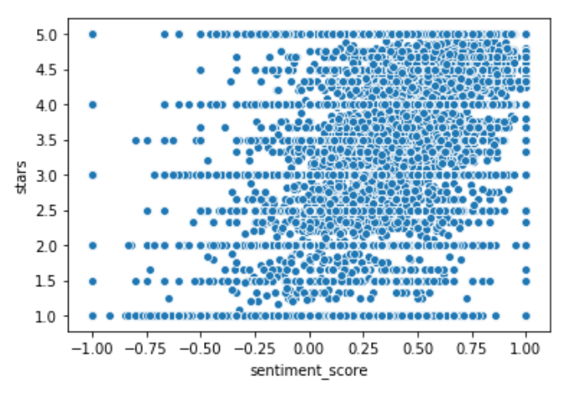
About Dataset
Dataset contains reviews of multiple products
Multiple languages
For analysis only English has been used

Slide 3
Analysis In Hadoop
Sentiment Analysis on the comment
If the comments are good or bad
Scoring sentiments
Averaging comments and sentiment scores for a product
Top N analysis on sentiment score and votes

Slide 4
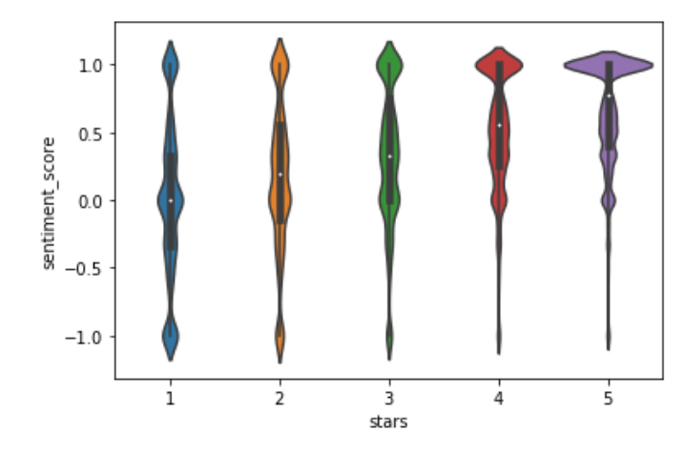
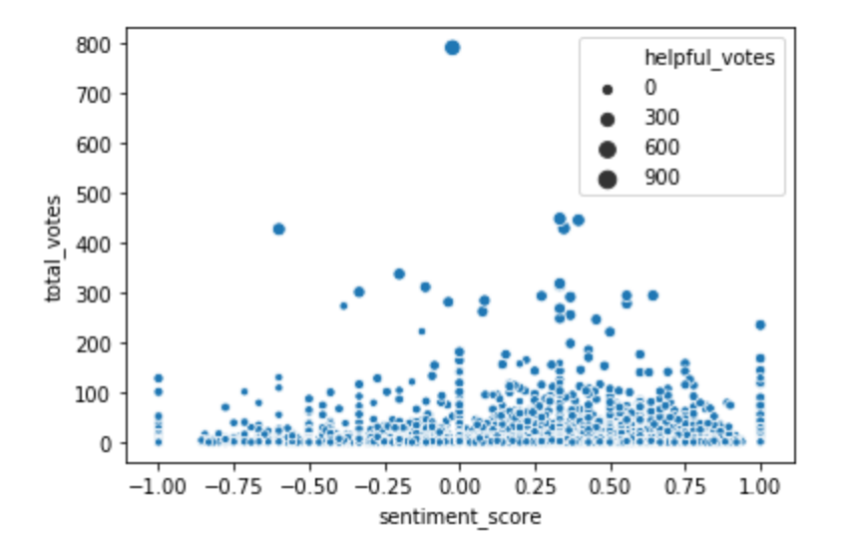
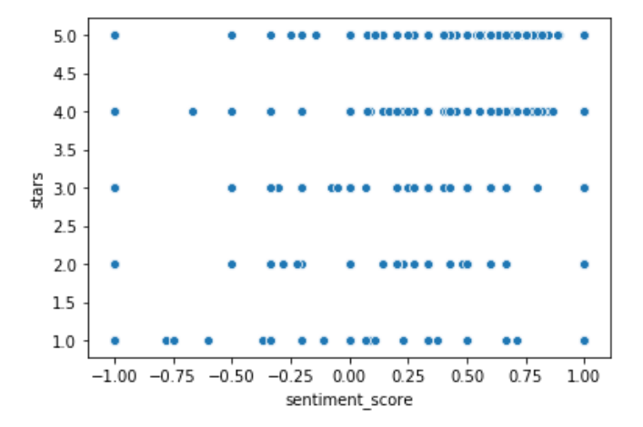
Relation with Sentiment Score

Slide 5
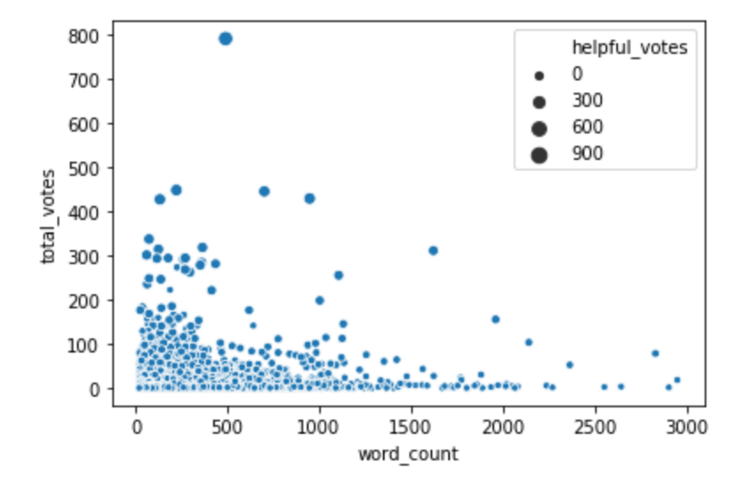
Word Count and helpful score

