Slide 1
Secure Data Hiding in Images using Steganography
CAPSTONE PROJECT
Presented By :
Student Name : Ashutosh Mitra
College Name & Department : Udayanath Autonomous College of Science and Technology – ITM Department

Slide 2
OUTLINE
Problem Statement -------------------------------------------------------------------------------------------- 1
Technology used ----------------------------------------------------------------------------------------------- 2
Wow factor -------------------------------------------------------------------------------------------------------- 3
End users --------------------------------------------------------------------------------------------------------- 4
Result --------------------------------------------------------------------------------------------------------------- 5
Conclusion ------------------------------------------------------------------------------------------------------- 6
Git-hub Link ------------------------------------------------------------------------------------------------------ 7
Future scope ----------------------------------------------------------------------------------------------------- 8

Slide 3
Problem Statement
With the rapid advancement of digital communication, the need for secure data transmission has become more crucial than ever. Traditional encryption methods, while effective in securing data, are often detectable, drawing unwanted attention from cyber adversaries. In scenarios where secrecy is paramount, an alternative approach like steganography—which conceals information within digital media—becomes highly effective. This project aims to implement a steganographic system for hiding and retrieving data securely within digital images. By embedding text within an image in a way that does not alter its visible quality, the project provides a covert communication channel that ensures data confidentiality, integrity, and access control. Additionally, encryption is integrated to provide an additional layer of security, preventing unauthorized extraction even if the hidden data is detected.
Key Objectives:
✔ Develop a tool that allows users to embed and extract hidden text from images.
✔ Maintain the original visual integrity of the image after embedding data.
✔ Implement encryption to enhance the security of hidden data.
✔ Ensure user authentication for retrieving sensitive information.

Slide 4
Technology used
The project is implemented using cutting-edge technologies that enhance the accuracy, security, and efficiency of the steganographic process:
Programming Languages:
Python – for its simplicity.
Java – for its security and robust library support.
Image Processing: OpenCV – to handle image manipulation efficiently.
Data Handling & Computation: NumPy – for pixel-level computations.
Encryption: Python/Java Cryptography Library – to ensure secure data transmission.
Data Storage & Retrieval: File I/O – to read/write hidden messages from images.
Version Control & Hosting: GitHub – for collaborative development and open-source sharing.

Slide 5
Wow factors
This project is distinguished by the following unique features:
Dual-Layer Security:
The message is first encrypted before being embedded into the image, ensuring that even if data is extracted, it cannot be understood without the correct passcode.
Lossless Image Quality:
The Least Significant Bit (LSB) steganography technique is used to embed data in such a way that it remains invisible to the human eye, maintaining the original image appearance.
Key-Based Access Control:
Users must enter a passcode to retrieve the hidden message, adding an authentication layer.
Multi-Format Support:
The tool can encode and decode messages in various image formats, including PNG, JPEG, and BMP.
Fast & Efficient Processing:
Optimized algorithms allow for quick embedding and retrieval of hidden messages with minimal computational overhead.

Slide 6
End users
This tool can be useful for various domains where secure and hidden communication is required:
Government & Defense: Secure transmission of classified data and sensitive intelligence.
Journalists & Whistleblowers: Protect sources and safely share confidential reports.
Corporate Sector: Secure communication of trade secrets and sensitive business documents.
Cybersecurity Professionals: Enhance research on steganographic security measures.
General Users: Keep personal data and private messages hidden from unauthorized access.

Slide 7
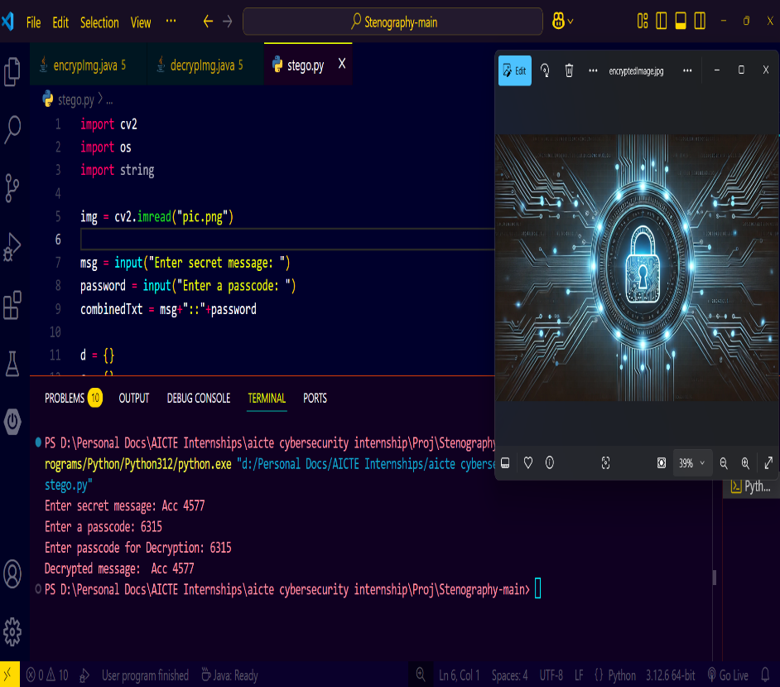
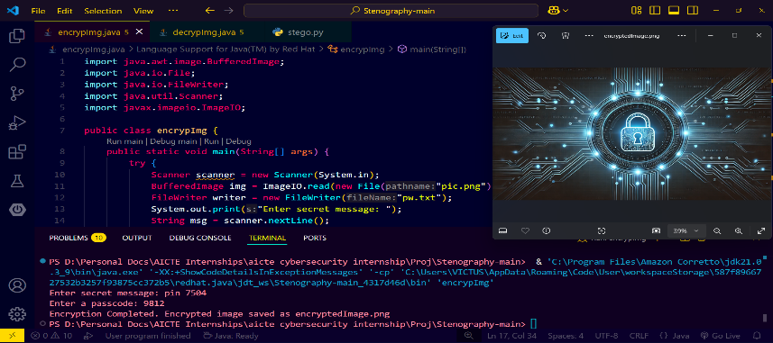
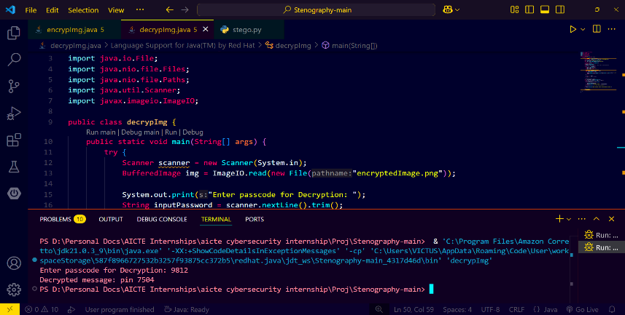
Results

Slide 8

Conclusion
This project successfully provides a secure, covert communication channel by implementing image-based steganography with encryption. Unlike traditional encryption techniques that may attract attention, this method ensures data confidentiality without raising suspicion. By integrating encryption, access control, and a user-friendly interface, this tool is practical, efficient, and suitable for real-world applications in cybersecurity, data privacy, and confidential communication.

Slide 9
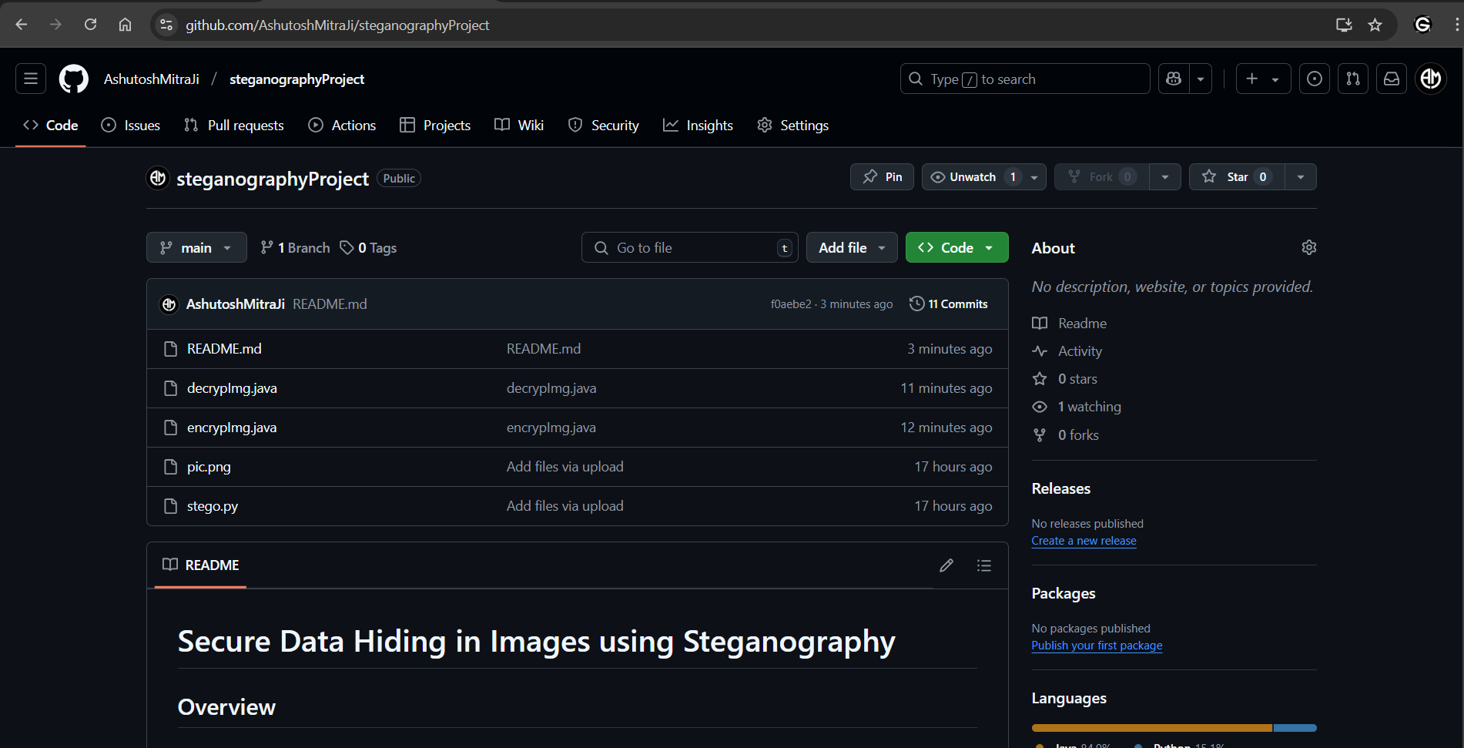
GitHub Link
GitHub repository: Steganography Project - Ashutosh Mitra

Slide 10
Future scope
To make the project more advanced and adaptable, the following enhancements can be implemented in future iterations:
Adaptive AI-Based Steganography – Implementing AI models to dynamically adjust data embedding patterns, making detection even more difficult.
Support for Additional File Types – Expanding functionality to hide audio, video, and document files within images.
Cloud Integration for Secure Storage – Enabling secure cloud storage of steganographic images with end-to-end encryption.
Mobile & Web-Based Version – Developing a cross-platform application to make secure steganography more accessible.
Blockchain Integration for Authenticity – Leveraging blockchain technology to verify the authenticity and integrity of hidden data.

Slide 11
THANK YOU

