Slide 1

Performance Evaluation of NLP Driven ML Models for Spam Classification in SMS
Group-8
Ashutosh – 28
Shishir Pathak – 32
Hieu Ho – 17

Slide 2
Presentation Outline
Problem Statement
Dataset Information
Evaluate Data
Feature Engineering

Slide 3
Model Lifecycle
Problem Statement
Understanding Data
Feature Engineering
Evaluate Data
Evaluate Model
Tunning Model

Slide 4
Problem Statement
The rise in SMS communication has led to an increase in spam, posing risks like fraud and phishing. This study evaluates the performance of NLP-driven machine learning models for effective spam classification, aiming to identify the most accurate and efficient approach.

Slide 5
Dataset Information
Source: https://archive.ics.uci.edu/dataset/228/sms+spam+collection
The dataset contains a total of 5,574 instances, with 747 labeled as spam messages and 4,825 labeled as ham messages.
Dataset Structure:
Attributes: The message content (text of the message).
Target Class: The label indicating whether the message is "ham" (non-spam) or "spam."

Slide 6
Evaluate Data
Understand Data:
Explored the structure of the dataset to identify key attributes (Class, Message).
Handling Data Issues:
Duplicated Values: Identified and removed duplicate entries to avoid redundancy.
Missing Values: Checked for and addressed any missing data points to maintain consistency.
Outliers: Identified and analyzed outliers that could impact model accuracy and reliability.
Refining Data:
Measured the length of each message to understand text patterns.
Removed outliers to ensure the dataset reflects realistic patterns.
Visualizing Insights:
Created word clouds to visualize frequently used words in spam and ham messages and used bar charts and box plots for a clear and intuitive understanding of the dataset.

Slide 7
Feature Engineering
Transforming Raw Data into Meaningful Insights To enhance the model's ability to classify messages effectively, we engineered features that capture key characteristics of the text:
Pattern Detection:
Identified messages containing URLs, contact numbers, and currency symbols, which are common indicators of spam.
Insights Through Visuals:
Plotted the distribution of messages with:
URLs, Contact numbers, and Currency symbol

Slide 8
Text Preprocessing
Cleaning data
Tokenization
Removing stop words
Lemmatization

Slide 9
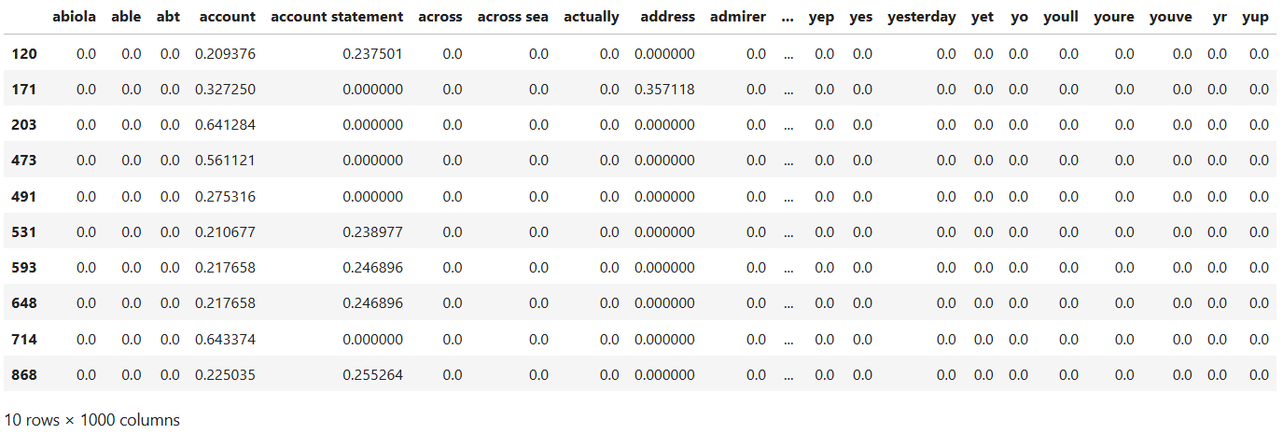
Vectorization
TF-IDF

Slide 10
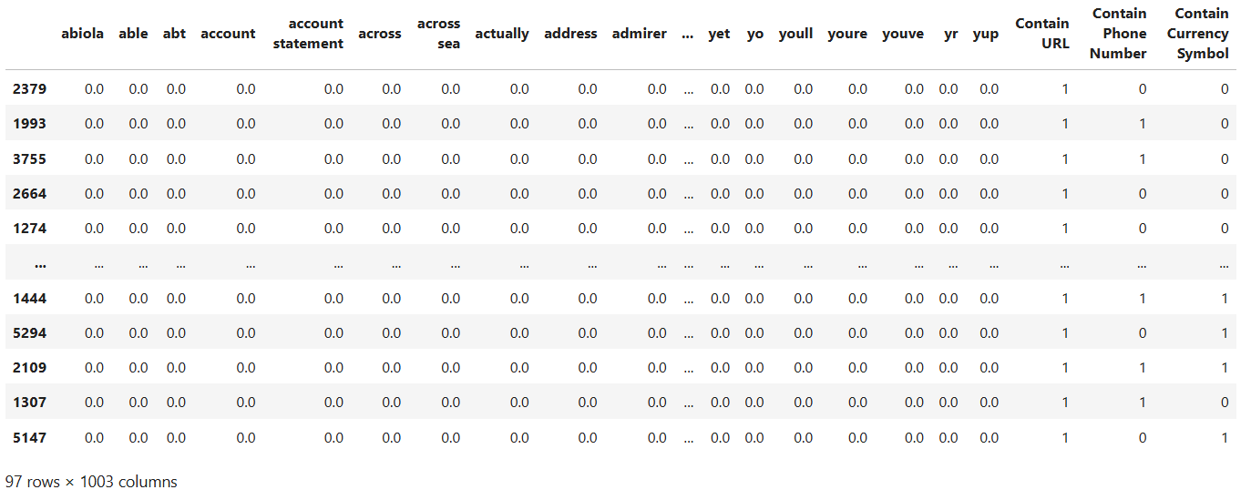
Vectorization

Slide 11
Vectorization
You won $400, call XXX-XXX-XXX1 to claim your price!!!
Text XXX-XXX-XXX2 to get a free trip to Miami
Get your free Iphone here freephone123.org
Need help with job opportunities? Go to newjobs.net
xxx1 | xxx2 | freephone123.org | newjobs.net
0.1 | 0.0 | 0.0 | 0.0
0.0 | 0.1 | 0.0 | 0.0
0.0 | 0.0 | 0.2 | 0.0
0.0 | 0.0 | 0.0 | 0.3
call | free | text | won
0.2 | 0.0 | 0.0 | 0.1
0.0 | 0.4 | 0.2 | 0.0
0.0 | 0.3 | 0.0 | 0.0
0.0 | 0.0 | 0.0 | 0.0
1
2
3
4

Slide 12
Vectorization Binary Encoding
You won $400, call XXX-XXX-XXX1 to claim your price!!!
Text XXX-XXX-XXX2 to get a free trip to Miami
Get your free Iphone here freephone123.org
Need help with job opportunities? Go to newjobs.net
call | free | text | won
0.2 | 0.0 | 0.0 | 0.1
0.0 | 0.4 | 0.2 | 0.0
0.0 | 0.3 | 0.0 | 0.0
0.0 | 0.0 | 0.0 | 0.0
URL | PHONE | CURRENCY
0 | 1 | 1
0 | 1 | 0
1 | 0 | 0
1 | 0 | 0
1
2
3
4

Slide 13
Vectorization Presentation Comparison
xxx1 | xxx2 | freephone123.org | newjobs.net
0.1 | 0.0 | 0.0 | 0.0
0.0 | 0.1 | 0.0 | 0.0
0.0 | 0.0 | 0.2 | 0.0
0.0 | 0.0 | 0.0 | 0.3
call | free | text | won
0.2 | 0.0 | 0.0 | 0.1
0.0 | 0.4 | 0.2 | 0.0
0.0 | 0.3 | 0.0 | 0.0
0.0 | 0.0 | 0.0 | 0.0
1
2
3
4
call | free | text | won
0.2 | 0.0 | 0.0 | 0.1
0.0 | 0.4 | 0.2 | 0.0
0.0 | 0.3 | 0.0 | 0.0
0.0 | 0.0 | 0.0 | 0.0
URL | PHONE | CURRENCY
0 | 1 | 1
0 | 1 | 0
1 | 0 | 0
1 | 0 | 0
1
2
3
4

Slide 14
Vectorization Performance Comparison
 | LR | MNB | CNB
Accuracy | 0.974282 | 0.983254 | 0.956938
Precision | 0.985437 | 0.946058 | 0.780328
Recall | 0.835391 | 0.938272 | 0.979424
F1 | 0.904232 | 0.942149 | 0.868613
ROC-AUC | 0.990325 | 0.992240 | 0.992240
PR-AUC | 0.979033 | 0.980921 | 0.980921
 | LR | MNB | CNB
Accuracy | 0.961124 | 0.976675 | 0.944378
Precision | 0.971098 | 0.984615 | 0.724252
Recall | 0.736842 | 0.842105 | 0.956140
F1 | 0.837905 | 0.907801 | 0.824197
ROC-AUC | 0.990323 | 0.985797 | 0.985797
PR-AUC | 0.955256 | 0.962550 | 0.962550
With binary encoding
Without binary encoding

Slide 15
Vectorization Performance Comparison
 | LR |  |  | MNB |  |  | CNB
 | W/O | W/ | % | W/O | W/ | % | W/O | W/ | %
Accuracy | 0.9611 | 0.9743 | 1.32 | 0.9767 | 0.9833 | 0.66 | 0.9444 | 0.9569 | 1.26
Precision | 0.9711 | 0.9854 | 1.43 | 0.9846 | 0.9461 | -3.86 | 0.7243 | 0.7803 | 5.61
Recall | 0.7368 | 0.8354 | 9.85 | 0.8421 | 0.9383 | 9.62 | 0.9561 | 0.9794 | 2.33
F1 | 0.8379 | 0.9042 | 6.63 | 0.9078 | 0.9421 | 3.43 | 0.8242 | 0.8686 | 4.44
ROC-AUC | 0.9903 | 0.9903 | 0.00 | 0.9858 | 0.9922 | 0.64 | 0.9858 | 0.9922 | 0.64
PR-AUC | 0.9553 | 0.9790 | 2.38 | 0.9626 | 0.9809 | 1.84 | 0.9626 | 0.9809 | 1.84

Slide 16
Initial Performance
 | Logistic Regression | Multinomial Naive Bayes | Complement Naive Bayes
Accuracy | 0.9663 | 0.9818 | 0.9565
Precision | 0.9722 | 0.9494 | 0.7553
Recall | 0.7447 | 0.8989 | 0.9521
F1 | 0.8434 | 0.9235 | 0.8424
ROC-AUC | 0.9875 | 0.9857 | 0.9857
PR-AUC | 0.9554 | 0.9614 | 0.9614

Slide 17
Tuned Performance
 | Logistic Regression | Multinomial Naive Bayes | Complement Naive Bayes
Accuracy | 0.9799 | 0.9838 | 0.9650
Precision | 0.9243 | 0.9503 | 0.8045
Recall | 0.9096 | 0.9149 | 0.9415
F1 | 0.9169 | 0.9322 | 0.8676
ROC-AUC | 0.9857 | 0.9879 | 0.9879
PR-AUC | 0.9603 | 0.9651 | 0.9650

Slide 18
Performance Comparison
 | LR |  |  | MNB |  |  | CNB
 | Initial | Tuned | % | Initial | Tuned | % | Initial | Tuned | %
Accuracy | 0.9663 | 0.9799 | 1.36 | 0.9818 | 0.9838 | 0.19 | 0.9565 | 0.9650 | 0.84
Precision | 0.9722 | 0.9243 | -4.79 | 0.9494 | 0.9503 | 0.08 | 0.7553 | 0.8045 | 4.93
Recall | 0.7447 | 0.9096 | 16.49 | 0.8989 | 0.9149 | 1.60 | 0.9521 | 0.9415 | -1.06
F1 | 0.8434 | 0.9169 | 7.35 | 0.9235 | 0.9322 | 0.88 | 0.8424 | 0.8676 | 2.53
ROC-AUC | 0.9875 | 0.9857 | -0.19 | 0.9857 | 0.9879 | 0.22 | 0.9857 | 0.9879 | 0.23
PR-AUC | 0.9554 | 0.9603 | 0.49 | 0.9614 | 0.9651 | 0.37 | 0.9614 | 0.9650 | 0.35

Slide 19
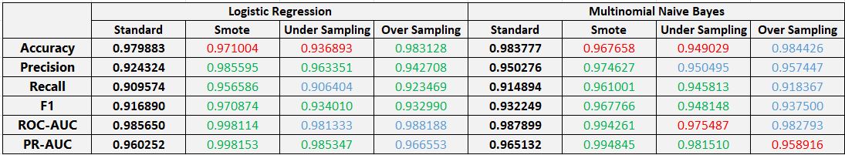
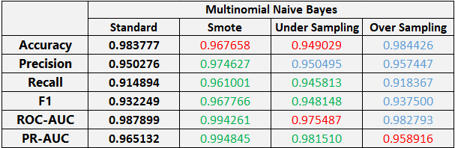
Comparison of classification algorithms vs imbalance data technique

Slide 20
THANK YOU

