Slide 1


SERVICE ROBOT
- based on Wi-Fi module
Department: Diploma In Computer Engineering (Third Year)
ASHUTOSH PANDEY
HIMESH SUTAR
DHRUV MULAY
SAGAR BISWAS
Guided by : Prof. PranavKumar Bhadane

Slide 2



Introduction
Existing System
Proposed System
Components
Architecture
Circuitry of a Developed System
Actual Image of the Circuit
Advantages
Conclusion
Contents :

Slide 3




Introduction :
The robot tray machine is based on Node MCU Esp8266 Wi-Fi Module.
This is the prototype based on Wi-Fi module which can carry up to 2-3 kgs. The weight can vary based on purpose it can be used as well as the size of the Robot.
Discarding human contact on various purposes, these types of machines are very useful.

Slide 4
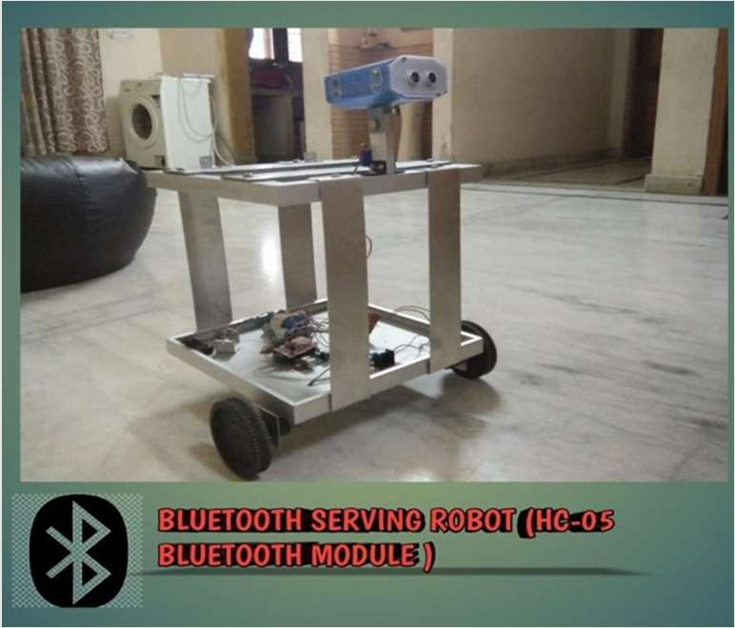
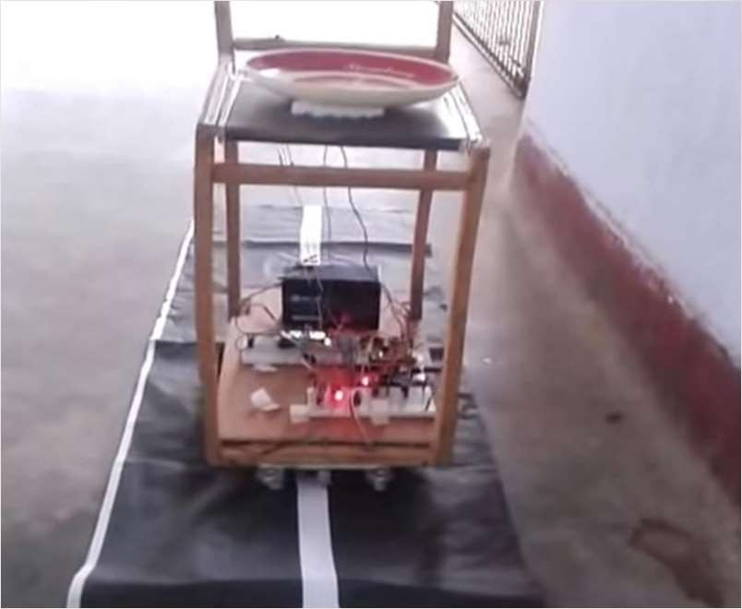

Existing System:
Bluetooth Robot
Line Following Robot

Slide 5


A 11.1-12.6 Volt DC
Power Supply has been applied to Motor Driver.
The input voltage for microcontroller can be defined with 5V intake.
Proposed System :
The Microcontroller text input and gives output to the Wi-Fi module.
Here four 150 rpm BO- motors are connected to L298N Motor Driver which is connected to Wi-Fi module.
Motor Driver takes instructions as per the code, which is installed in Wi-Fi module

Slide 6


Node MCU ESP8266 (Amica CP2102)
L298N Motor Driver
11.1-12.6V (2500MaH) Lithium-ion Battery 4 BO Motors
Female DC Jack (For Battery) Voltmeter (3V-30V)
12V (01aH) Battery Charge Adapter
Jumper Wires (Female-Female/Male-Female) Robotic Wheels
Breadboard (840 points) Wooden Ply
Glue Gun Soldering Iron
Motor Holder Clamps
Components :

Slide 7


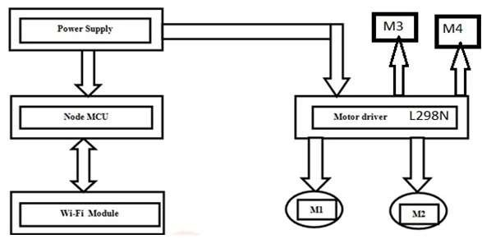

Architecture :

Slide 8

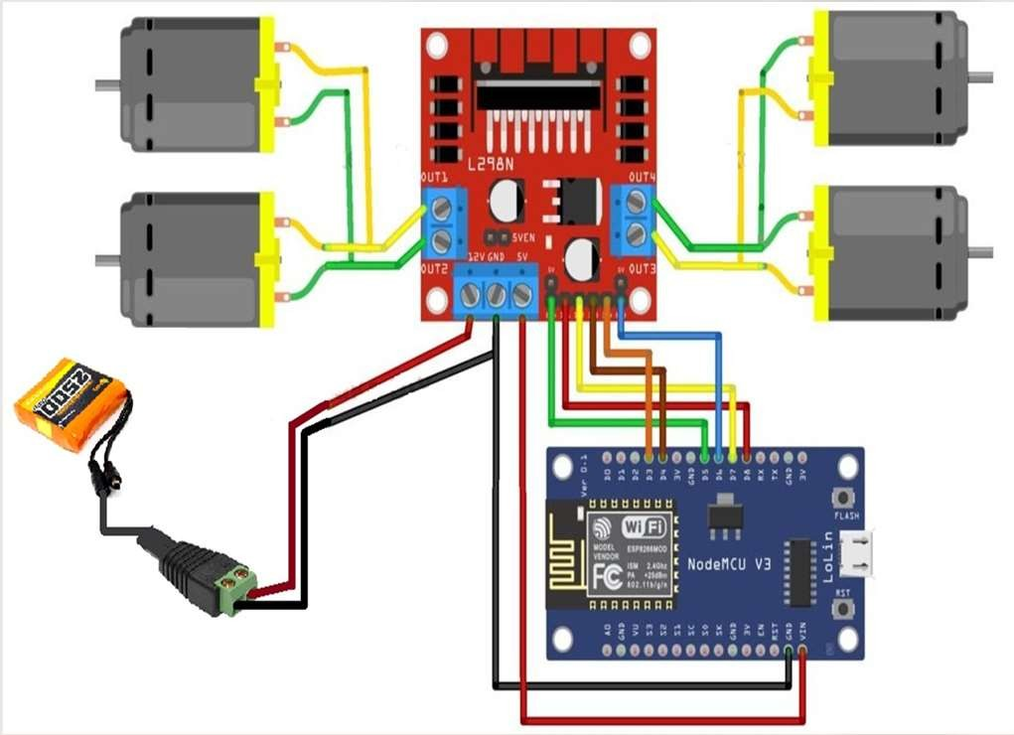

Circuitry of Developed System:
We developed the Model by considering the Proposed System, where we used the Circuit reference mentioned in the slide before.
Here in this circuitry, we used the Female DC Jack for the powering of this project where the jack is connected to the Battery (Male Switch) on one end and another part to the Motor Driver.
Then the Motor Driver has a 12V input pin with Grounding and 5V output pin on it with the Control Pins (with ENA & ENB) and the Motor activation pins.
By the input of Battery with the help of 12V, we powered the Motor Driver for the further activation and the powering of Motors & Node MCU ESP8266.
To power the Node MCU in the Circuit, we used the 5V pin of the Motor Driver connected to the Vin pin of the Node MCU Board and shorting of the Grounding pin of Motor Driver and Node MCU.
Then after the Node MCU is been Powered, the code is been injected in it on which the commands are to be executed.
Then as per the code injected the 6 Control Pins are to be connected between the Motor Driver and Node MCU, those pins are 4 movement/control pins with Enable-A (ENA) and Enable-B (ENB).
Hence the Robotic circuitry is ready for the Movement given by the User whether it can be used in a Hospital or in Hotel to prevent Human-to-Human contact.

Slide 9
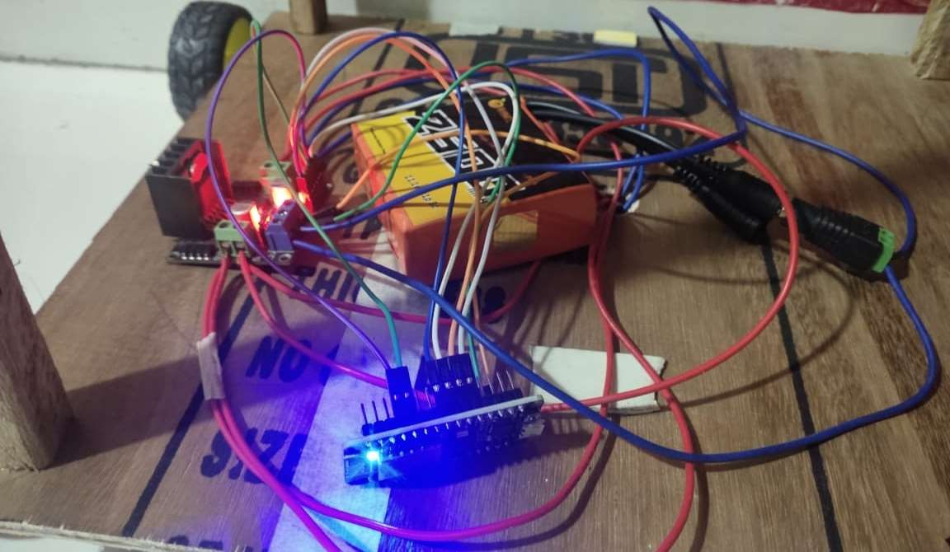

Actual Image of the Circuit:

Slide 10

This Robotic tray machine can be used in hotels and hospitals discarding Human- to Human contact.
Next advantage is, here in this robotic machine we are using wi-fi module, which is better then using Bluetooth or wired system based on connectivity.
Advantages:
This is one time investment robot which reduces the cost of labor and consume less time than human.

Slide 11



Conclusion:
It is designed keeping in mind about the need for industry, hospital and restaurant, it can extend for other purposes such as commercial and research application.
The command coding will be entered in robot it is very easy to understand.
As the technology grows day by day, we can imagine about the future in which these things may occupy every place.

Slide 12

Reference:
Waiter Robot for Restaurants - Arduino Project Hub
WiFi Controlled Robot Using Esp8266 : 6 Steps (with Pictures) – Instructables
Configuring Your Mobile Robot | Build an ESP8266 Mobile Robot | Adafruit Learning System
WiFi Controlled Robot using ESP8266 and Arduino (electronicshub.org)

Slide 13



