Slide 1
Sports Scheduling Optimization
Worldwide Softball League (WSL) • MILP + Gurobi • Travel + Fairness + Broadcast
Background: Multi million-dollar international leagues use these techniques to solve scheduling problem
Key idea: Convert Vague league rules into a solvable MILP and quantify impact. Output: validated 9-week schedule + travel / fairness KPIs
Ashutosh Srivastava
Feb 2026
Notes:
[Sources] - Gurobi overview of MIP solution approach (branch-and-bound/branch-and-cut): https://www.gurobi.com/resources/mixed-integer-programming-mip-a-primer-on-the-basics/ (accessed 2026-02-18) [/Sources]

Slide 2
1) Business problem
Global travel is expensive, schedule quality affects cost, fairness, and TV revenue
What the league wants
Lower travel spend
Balanced schedules
Maximize TV weeks
Teams spread worldwide
Minimize away-trip miles
Avoid long road stretches
No “easy” vs “brutal” travel
Keep travel distribution tight
Prevent bad start/end patterns
4 marquee matchups
No two in the same week
Keeps weekly headline game
WSL setup
• 12 teams, split into 2 divisions (North/South)
• 9-week season: each team plays 8 games (4 home, 4 away) + 1 bye
• Play everyone in-division once (5 games) + 3 cross-division opponents
• Hard pattern rules: limit back-to-back away games to 0 or 1 and avoid bad start/end
WSL Scheduling • Slide 2

Slide 3
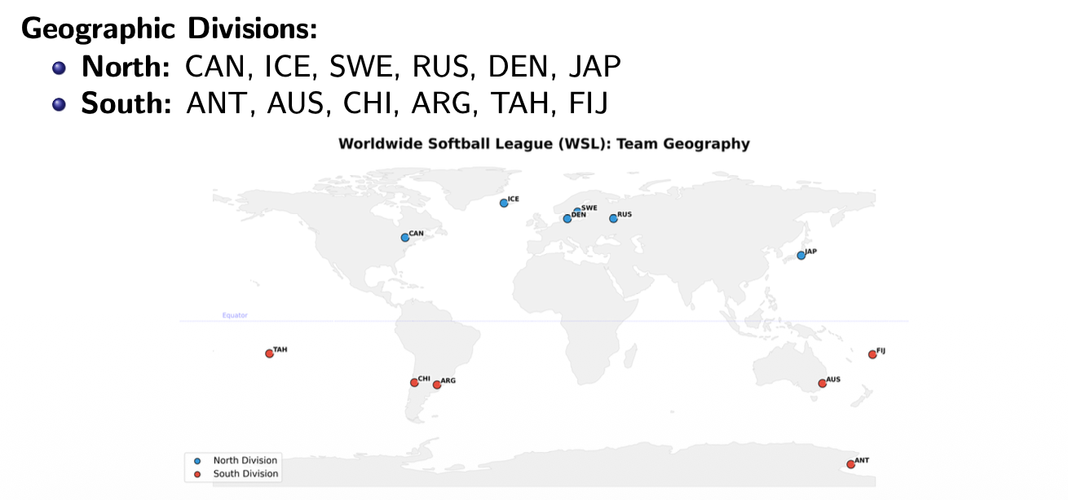
Goal: Minimize total travel while ensuring fairness and broadcast requirements.

Slide 4
2) Inputs and output
Distance matrix + league rules → validated schedule file
Inputs
Output (submission format)
• Team list + division membership
• 9 weeks, one game max per team per week
• Distance matrix between home cities (miles)
• “Marquee” games that must be in different weeks
• Soft preferences: travel-friendly cross-division picks + fairness
Each line: HOME AWAY WEEK
CAN DEN 5
FIJ CHI 8
DEN SWE 7
...
Preprocessing
• Convert distances data → full symmetric dist(i,j)
• Build quick validation checks (counts, opponent coverage, patterns)
• Encode soft rules as objective penalties (not brittle hard rules)
Primary deliverables
• Feasible schedule (all hard rules)
• KPI report: travel, fairness, away patterns
• Re-runnable code + sanity checks
WSL Scheduling • Slide 3

Slide 5
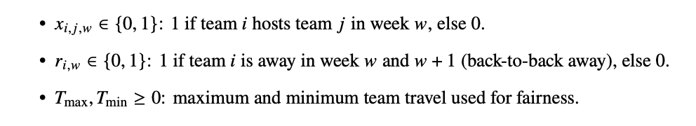
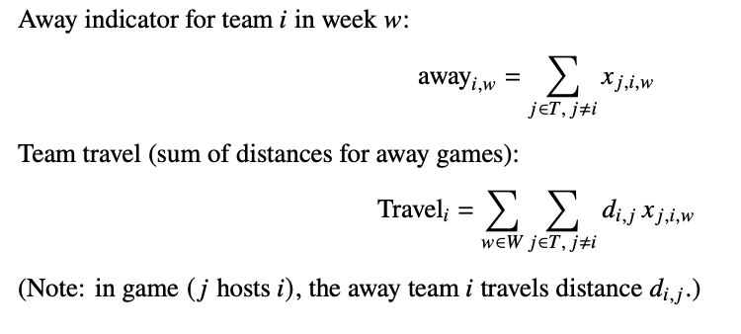
3) Model structure
Binary decision variables capture opponent, venue, and week
Decision variables
Helper Expressions
Why this structure works • One variable encodes opponent + venue + week
• All hard rules become linear constraints
• Travel cost is a simple weighted sum over away assignments
WSL Scheduling • Slide 4

Slide 6
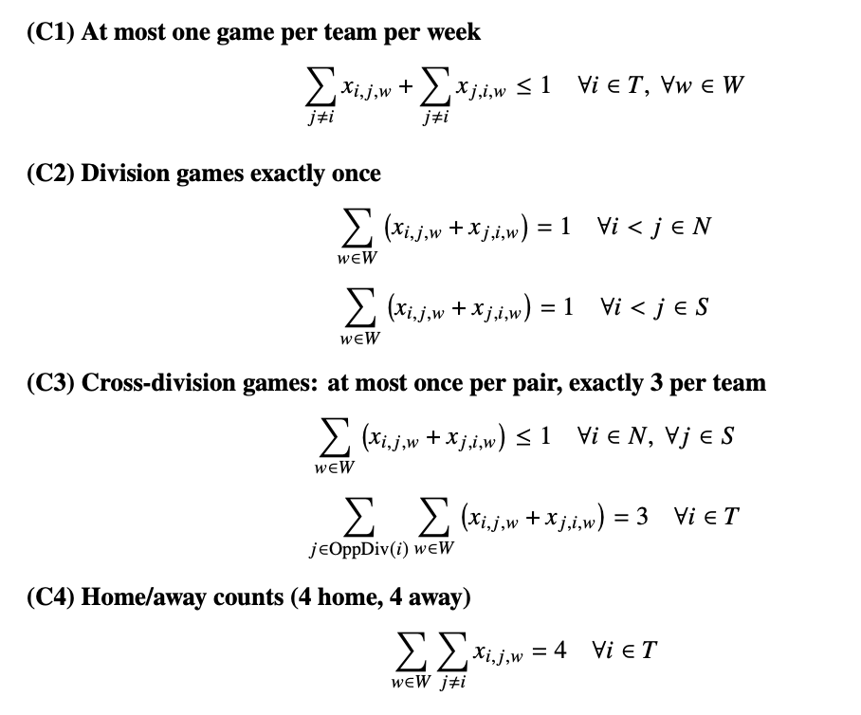
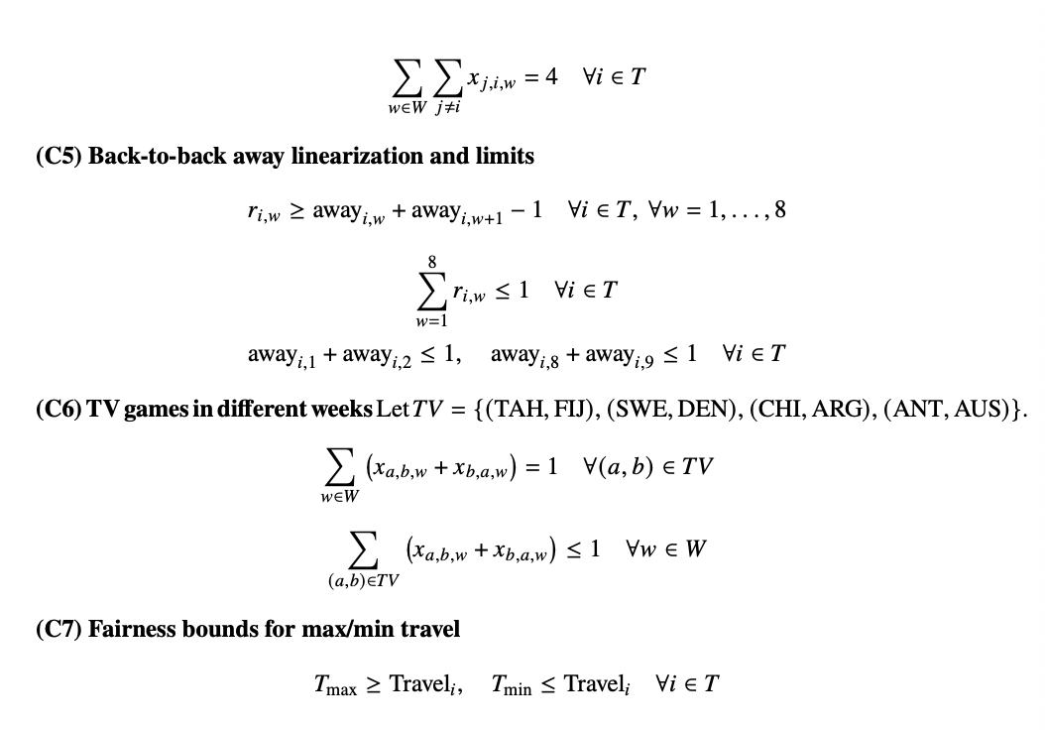
Constraints:
(at most one back-to-back away)

Slide 7
4) Hard constraints
Rules that must always hold (feasibility)
Season structure
Broadcast constraint
• ≤ 1 game per team per week (byes allowed)
• 4 home + 4 away per team (8 games)
• In-division: play all 5 opponents exactly once
• Cross-division: pick 3 opponents (exactly 3 games)
Marquee matchups must be in different weeks:
• Tahiti–Fiji
• Sweden–Denmark
• Chile–Argentina
• Antarctica–Australia
Key linearizations
Road-trip rules
away[i,w] = Σ_j x[j,i,w]
r[i,w] ≥ away[i,w] + away[i,w+1] − 1
Σ_w r[i,w] ≤ 1
TV in different weeks:
Σ_(a,b)∈TV (x[a,b,w]+x[b,a,w]) ≤ 1
• At most 1 back-to-back away segment per team
• Cannot start season with away-away (weeks 1–2)
• Cannot end season with away-away (weeks 8–9)
WSL Scheduling • Slide 5

Slide 8
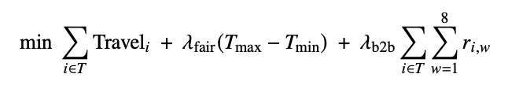
5) Objective: travel + fairness
Soft constraints handled via penalties (stable + tunable)
Primary objective
Minimize total away-team travel miles:
TotalTravel = Σ_w Σ_i Σ_j dist(i,j) · x[j,i,w]
Fairness: avoid a “brutal” schedule for any single team
Let travel[i] be total away miles for team i.
Introduce T_max and T_min:
T_max ≥ travel[i] for all i
T_min ≤ travel[i] for all i
Penalty term: (T_max − T_min)
Why a penalty (vs hard caps)?
• Keeps model feasible
• Smooth trade-offs
• Easy weight tuning
Final objective (weighted sum)
Minimize: TotalTravel + λ_fair·(T_max−T_min) + λ_b2b·Σ r[i,w]
WSL Scheduling • Slide 6
Notes:
[Sources] - Gurobi primer describing LP-based branch-and-bound approach for MIP: https://www.gurobi.com/resources/mixed-integer-programming-mip-a-primer-on-the-basics/ (accessed 2026-02-18) [/Sources]

Slide 9
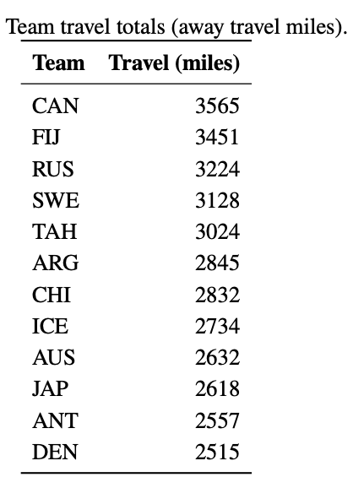
6) Results (validated schedule)
Hard constraints satisfied; strong travel + fairness KPIs
Total away travel
Avg miles / away trip
Fairness spread
B2B away
35,125 mi
731.8 mi
1050 mi
0
DEN (2515 miles)
CAN (3565 miles)
48 away trips
baseline ~828 mi
max − min
all teams
Constraint Satisfied
Travel by team (away miles)
• 4 home / 4 away / 1 bye each
• In-division opponents: exactly once
• Cross-division: exactly 3 opponents
• TV games in distinct weeks
• No start/end with away-away
1.
2.
3.
4.
5.
6.
7.
8.
9.
10.
11.
12.
Marquee weeks
• Week 2: TAH–FIJ
• Week 3: CHI–ARG
• Week 7: SWE–DEN
• Week 8: ANT–AUS
WSL Scheduling • Slide 8

Slide 10
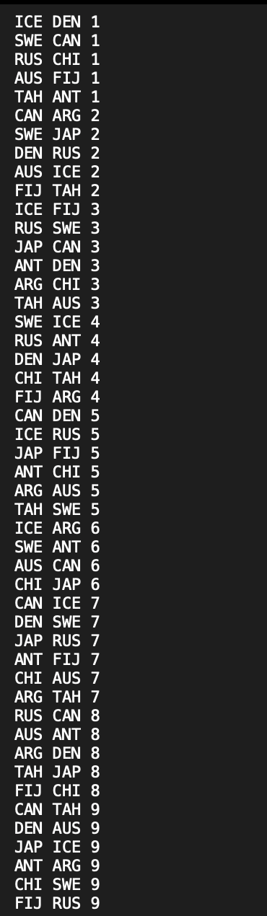
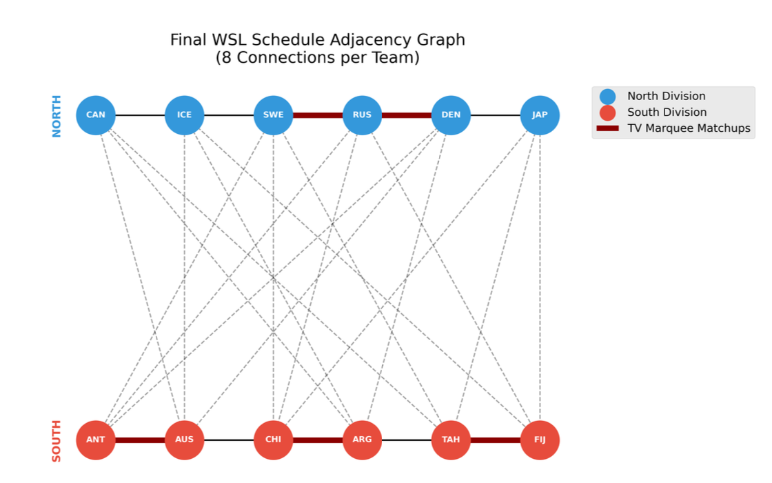
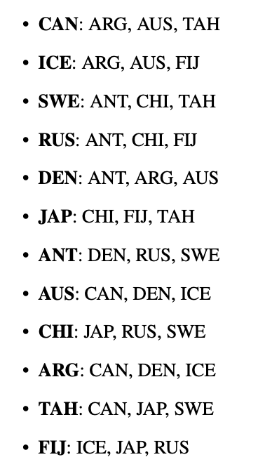
Week 7 (DEN - SWE)
Week 8 Week 3 Week 2

Slide 11
7) Schedule snapshot
How the season flows (byes + marquee games)
Weekly notes
Byes are inferred (not printed). Marquee games are separated to maximize weekly TV value.
Week
Byes
Headline / notes
1
JAP, ARG
—
2
ANT, CHI
Marquee: TAH–FIJ
3
—
Marquee: CHI–ARG
4
CAN, AUS
—
5
—
—
6
RUS, DEN, TAH, FIJ
More byes this week to satisfy home/away + opponent coverage
7
—
Marquee: SWE–DEN
8
ICE, SWE
Marquee: ANT–AUS
9
—
—
Quality check: no team has consecutive away games anywhere in the season (0 back-to-back road segments).
WSL Scheduling • Slide 9

Slide 12
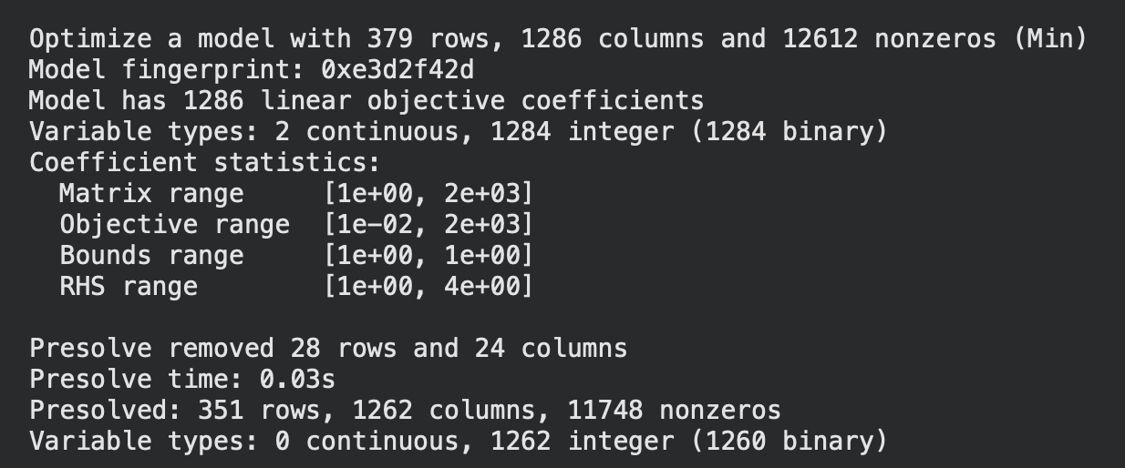
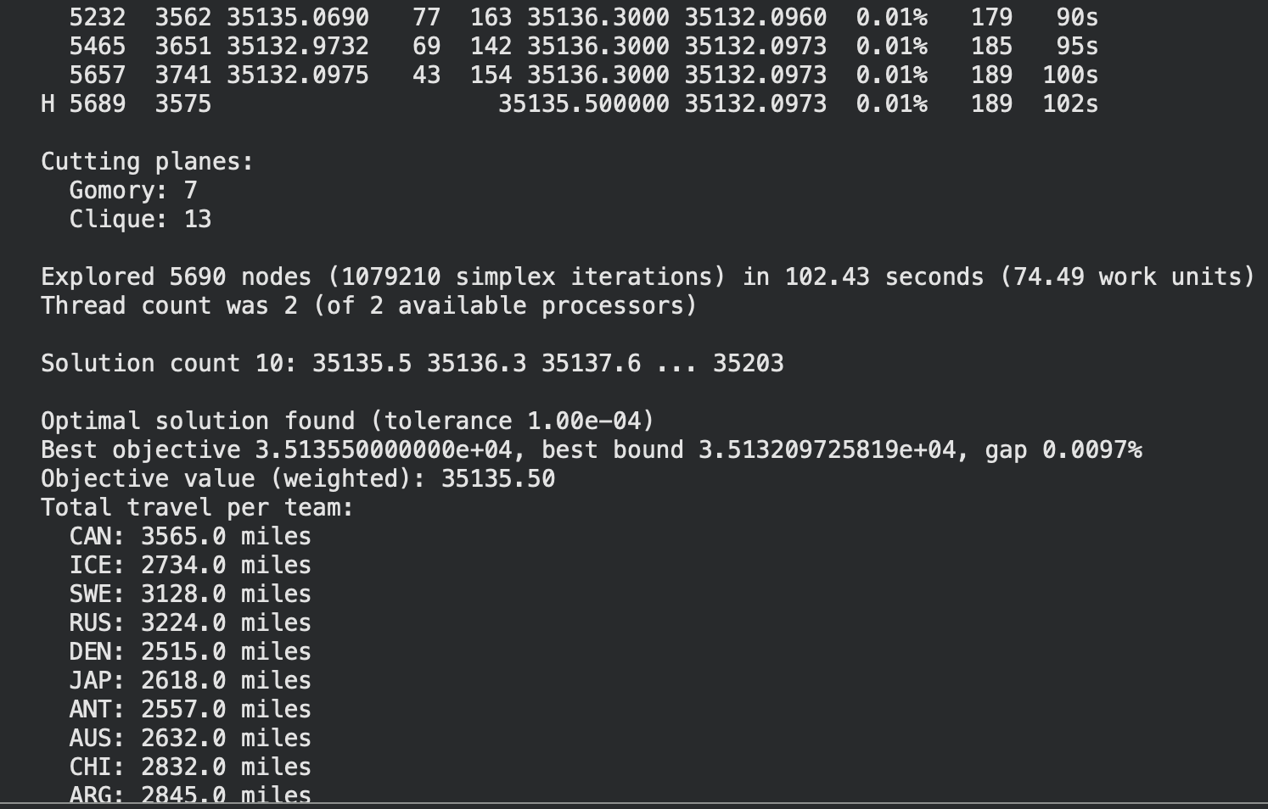
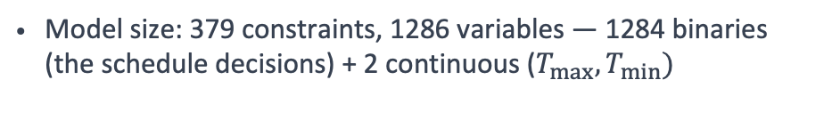
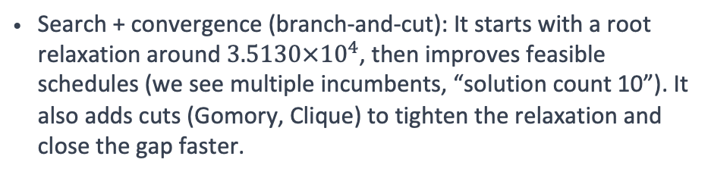
8) Solver Log
Solver Performance: Optimal Schedule in ~102 Seconds
Model size: 379 constraints, 1286 variables — 1284 binaries (the schedule decisions) + 2 continuous ($T_{max},T_{min})$
Presolve (solver simplification before branching): Gurobi removed 28 rows and 24 columns, reducing it to 351 rows, 1262 integer vars.
Search + convergence (branch-and-cut): It starts with a root relaxation around $3.5130×{10}^{4}$, then improves feasible schedules (we see multiple incumbents, “solution count 10”). It also adds cuts (Gomory, Clique) to tighten the relaxation and close the gap faster.
Quality + runtime: It explored 5690 nodes in ~102 seconds and finished with an optimal solution: best objective 35135.5 with 0.0097% gap. That objective is the weighted one: 35125 travel miles + 0.01×(1050 fairness spread) = 35135.5, and 0 back-to-back away game penalties.
Notes:
Presolve (solver simplification before branching): Gurobi removed 28 rows and 24 columns, reducing it to 351 rows, 1262 integer vars. This means it found redundancies/fixed variables early, which speeds up the solve.

Slide 13
9) Travel spend & savings (estimate)
Translate miles into dollars with transparent assumptions
Assumptions
Estimated travel spend (range)
• Fully-loaded cost per mile (team travel party): $200–$400 (flights/charter, lodging, meals, ground transport)
• Baseline(average pairwise distance * away games): travel-blind schedule expectation ≈ league-wide avg → 39,729 miles (vs 35,125 optimized)
• Savings shown are directional and depend on vendor rates
Bars show total spend; labels show savings vs baseline.
Headline impact
• Miles reduced: 4,604 (11.6% vs baseline)
• Avg away trip: 731.8 mi (48 trips)
• Fairness: spread 1050 mi (max − min)
• Pattern quality: 0 back-to-back away segments
Savings vs baseline (39,729 mi):
$200/mi → $0.92M | $300/mi → $1.38M | $400/mi → $1.84M
WSL Scheduling • Slide 10

Slide 14
10) Engineering & what broke
Debugging infeasibility and making results reproducible
Data pitfalls
Model pitfalls
Hardening
Distance table was upper-triangular.
Early versions hit missing-key errors
Fix: build symmetric dist(i,j) once
Easy to create infeasible combos
Fix: add constraints incrementally
Use conflict checks when infeasible
Wrote a validator: counts + opponents + patterns
Unit checks for TV games and byes
Exported clean “HOME AWAY WEEK” file
Future Work?
What if ICE plays back-to-back away games at DEN and SWE?
WSL Scheduling • Slide 7
Notes:
[Sources] - Gurobi FAQ noting MIP solvers typically use branch-and-cut: https://www.gurobi.com/faqs/mip-solvers/ (accessed 2026-02-18) [/Sources]

Slide 15
THANK YOU QUESTIONS?
WSL Scheduling • Slide 7
Notes:
[Sources] - Gurobi FAQ noting MIP solvers typically use branch-and-cut: https://www.gurobi.com/faqs/mip-solvers/ (accessed 2026-02-18) [/Sources]

