Slide 1
Advance Database Management Systems

Slide 2
EXPERIMETN 02: JOINS
Organizational Hierarchy Explorer (medium)
You are a Database Engineer at TalentTree Inc., an enterprise HR analytics platform that stores employee data, including their reporting relationships. The company maintains a centralized Employee relation that holds: Each employee’s ID, name, department, and manager ID (who is also an employee in the same table).
Your task is to generate a report that maps employees to their respective managers, showing:
The employee’s name and department
Their manager’s name and department (if applicable)
This will help the HR department visualize the internal reporting hierarchy.

Slide 3
Input Table: Employee
OUTPUT
EmpID | Ename | Department | ManagerID
1 | Alice | HR | NULL
2 | Bob | Finance | 1
3 | Charlie | IT | 1
4 | David | Finance | 2
5 | Eve | IT | 3
6 | Frank | HR | 1
EmployeeName | EmployeeDept | ManagerName | ManagerDept
Alice | HR | NULL | NULL
Bob | Finance | Alice | HR
Charlie | IT | Alice | HR
David | Finance | Bob | Finance
Eve | IT | Charlie | IT
Frank | HR | Alice | HR

Slide 4
Financial Forecast Matching with Fallback Strategy (hard)
You are a Data Engineer at FinSight Corp, a company that models Net Present Value (NPV) projections for investment decisions. Your system maintains two key datasets:
Year_tbl: Actual recorded NPV’s of various financial instruments over different years:
ID: Unique Financial instrument identifier.
YEAR: Year of record
NPV: Net Present Value in that year
Queries_tbl: A list of instrument-year pairs for which stakeholders are requesting NPV values:
ID: Financial instrument identifier
YEAR: Year of interest.
Find the NPV of each query from the Queries table. Return the output order by ID and Year in the sorted form.
However, not all ID-YEAR combinations in the Queries table are present in the Year_tbl. If an NPV is missing for a requested combination, assume it to be 0 to maintain a consistent financial report.

Slide 5
Year_tbl
ID | YEAR | NPV
1 | 2018 | 100
7 | 2020 | 30
13 | 2019 | 40
1 | 2019 | 113
2 | 2008 | 121
3 | 2009 | 12
11 | 2020 | 99
7 | 2019 | 0
OUTPUT:
ID | YEAR | NPV
1 | 2019 | 113
2 | 2008 | 121
3 | 2009 | 12
7 | 2018 | 0
7 | 2019 | 0
7 | 2020 | 30
13 | 2019 | 40
ID | YEAR
1 | 2019
2 | 2008
3 | 2009
7 | 2018
7 | 2019
7 | 2020
13 | 2019
Queries_tbl

Slide 6
EXPERIMENT 03: SUB-QUERIES
Department Salary Champions
In a bustling corporate organization, each department strives to retain the most talented (and well-compensated) employees. You have access to two key records: one lists every employee along with their salary and department, while the other details the names of each department. Your task is to identify the top earners in every department.
If multiple employees share the same highest salary within a department, all of them should be celebrated equally. The final result should present the department name, employee name, and salary of these top-tier professionals arranged by department.

Slide 7
Input Table: Employee
Department
ID | NAME | SALARY | DEPT_ID
1 | JOE | 70000 | 1
2 | JIM | 90000 | 1
3 | HENRY | 80000 | 2
4 | SAM | 60000 | 2
4 | MAX | 90000 | 1
ID | DEPT_NAME
1 | IT
2 | SALES
OUTPUT
DEPT_NAME | NAME | SALARY
IT | MAX | 90000
IT | JIM | 90000
SALES | HENRY | 80000

Slide 8
Merging Employee Histories: Who Earned Least? (Hard)
Two legacy HR systems (A and B) have separate records of employee salaries. These records may overlap. Management wants to merge these datasets and identify each unique employee (by EmpID) along with their lowest recorded salary across both systems. Objective 1. Combine two tables A and B.
2. Return each EmpID with their lowest salary, and the corresponding Ename.
Table A
Table B
EmpID | Ename | Salary
1 | AA | 1000
2 | BB | 300
EmpID | Ename | Salary
2 | BB | 400
3 | CC | 100

Slide 9
OUTPUT:
EmpID | Ename | Salary
1 | AA | 1000
2 | BB | 300
3 | CC | 100

Slide 10
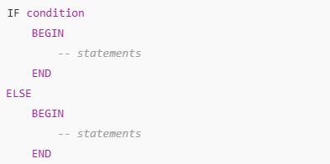
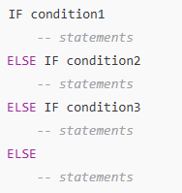
IF-ELSE & ELSE-IF LADDER (SQL SERVER)

Slide 11
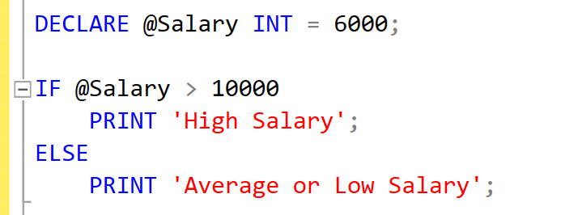
Examples:

Slide 12
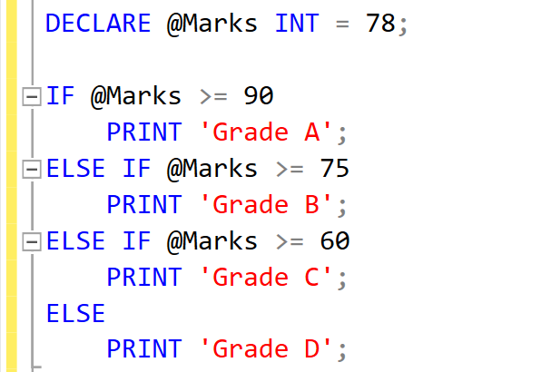
Examples:

Slide 13
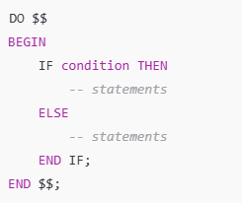
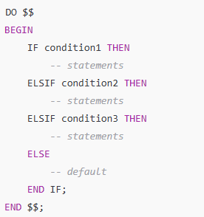
IF-ELSE & ELSE-IF LADDER (POSTGRES)

Slide 14
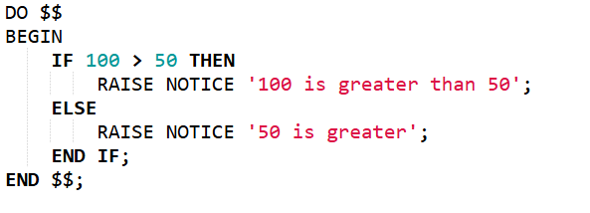
Examples:

Slide 15
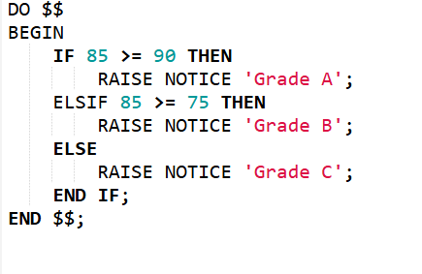
Examples:

Slide 16
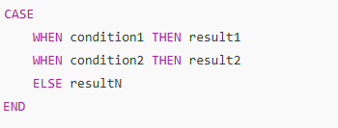
CASE STATEMENTS (SQL SERVER)

Slide 17
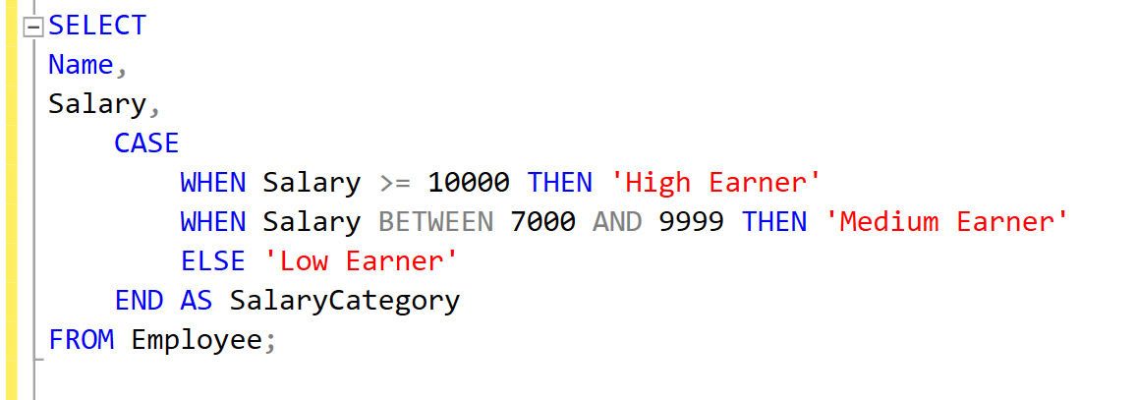
Example:

Slide 18
Practice Set:
CREATE TABLE Department (
DeptID INT PRIMARY KEY,
DeptName VARCHAR(50)
);
CREATE TABLE Employee (
EmpID INT PRIMARY KEY,
Name VARCHAR(50),
DeptID INT,
Salary INT,
Marks INT
);
INSERT INTO Department VALUES
(1, 'IT'), (2, 'HR'), (3, 'Finance');
INSERT INTO Employee VALUES
(1, 'John', 1, 12000, 88),
(2, 'Alice', 2, 9000, 72),
(3, 'Bob', 1, 6000, 55),
(4, 'Sarah', 3, 15000, 95),
(5, 'David', 2, 7000, 65),
(6, 'Tom', 1, 8000, 45);

Slide 19
Practice Set:
Sno | Problem Statement
1 | Write an IF-ELSE block to check if the average salary of all the employees is greater than 1000. (SQL SERVER + POSTGRES) If yes, print ‘Highest Salary Company’, else ‘Average Salary Company’
2 | Use IF-ELSE Ladder to classify marks of a given employee (second class => 50/ first class >= 70/ distinction > 85)
3 | Write a query to classify employees based on salary using CASE statements: 1. >=12000 – Platinum 2. 8000 – 11999 – Gold 3. Else Silver

