Slide 1

Open3d
A python library for 3D data

Slide 2
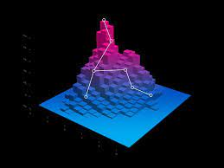

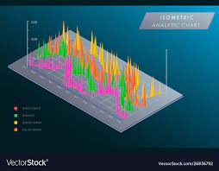
Agenda
Introduction
Why Open3d?
Features
Sample codes and snippets
Conclusion

Slide 3
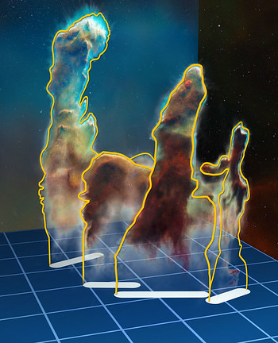

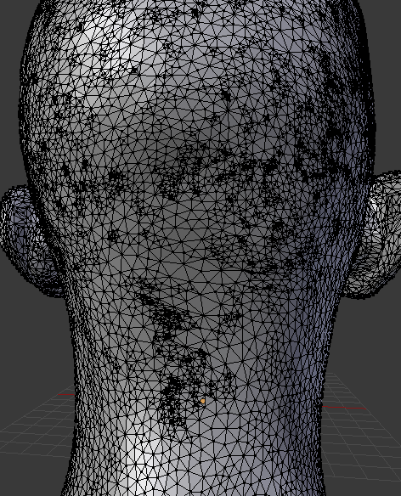

Introduction
Open3d is an open-source library that supports rapid development of software that deals with 3D data. The Open 3D frontend exposes a set of carefully selected data structures and algorithms in both C++ & Python. The backend is highly optimized and is set up for parallelization. Open3D was developed from a clean slate with a small and carefully considered set of dependencies. It can be setup on different platform and compiled from source with minimal effort.

Slide 4

Why Open3d?

Slide 5
Open3D is mainly used for dealing with 3D data. It is available in both Python and C++.
Latest updates have also made performing Machine learning and Deep learning to be performed on 3D data.
Open3D has its own software “Open3D Engine” which is backed by The Linux Foundation, Adobe, AWS etc. , and the engine is open-source too.
Other competitors of Open3d are:
Pytorch3D (created by Facebook AI)
PCL
Kaolin
Panda3D
Mayavi
Pi3D

Slide 6
Features

Slide 7
Features of Open3d
3D Data Structures
3D Data processing algorithms
Scene Reconstruction
Surface alignment
3D visualization
Physically based rendering (PBR)
3D machine learning supported by TensorFlow and Pytorch
GPU acceleration for core 3D operations
Available for Speedy operations in C++
Applications
3D Algorithms
3D Data structures

Slide 8
3D Data Structures
Point Cloud
Triangle Mesh
Voxel Grid
A point cloud is a set of Data points in space. The points may represent a 3D shape or object. The points have co-ordinates as (X,Y,Z) axis.
Triangle mesh is a type of polygon mesh in computer graphics. It comprises a set of triangles that are connected by their common edges
A voxel grid is another geometry type in 3D that is defined on a regular 3D grid, whereas a voxel can be thought of as the 3D counterpart to the pixel in 2D.
Octree
Camera
RGBD Images
An octree is a tree data structure where each internal node has eight children. Octrees are commonly used for spatial partitioning of 3D point clouds
Camera is also taken as a data structure in Open3d. It has several inbuild functions for the same.
RGB-D stands for Red, Blue, Green and Depth images. Normal images are of RGB type, but due the addition of 3D data structures, depth can also be measured in images.

Slide 9
Sample codes and Snippets
Check Github repository for implementations:-
https://github.com/Ashutosharma08/Open3d_work

Slide 10

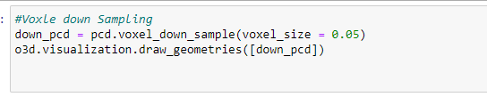

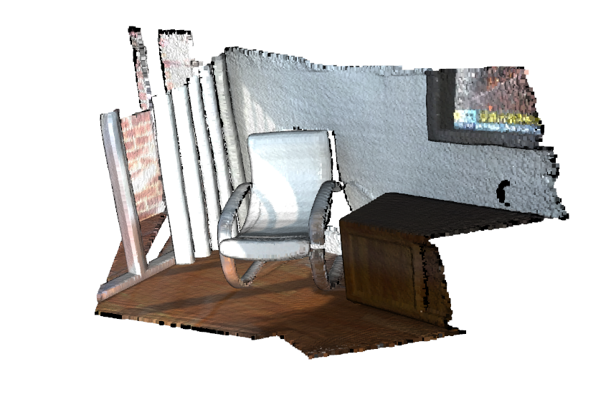
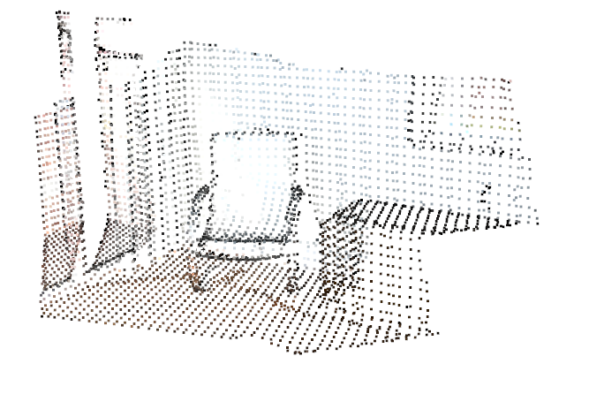
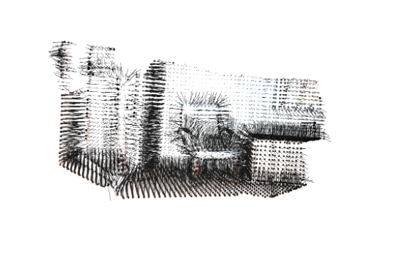
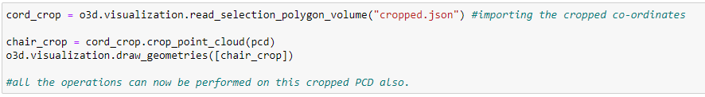
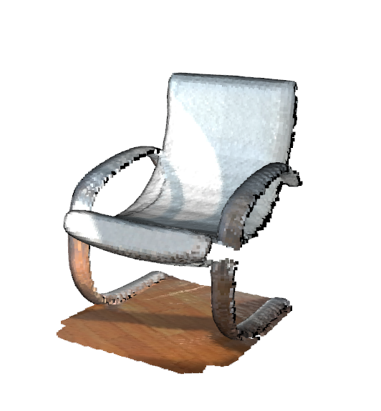
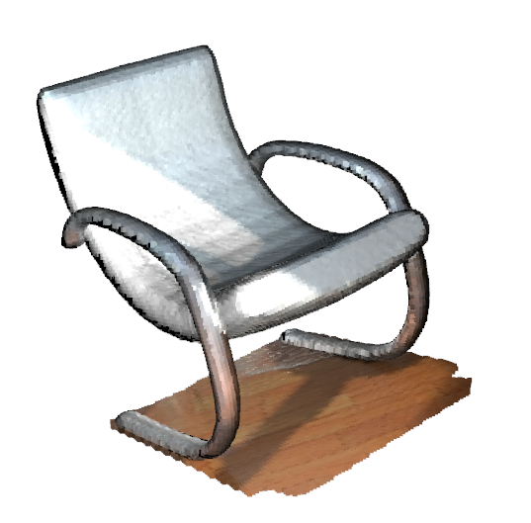
Reading .ply file and visualizing a point cloud:-
Down-sampling by creating Voxels
Drawing normal points on each point for better understanding of the nature of image.
Cropping individual point structures from the main PCD

Slide 11
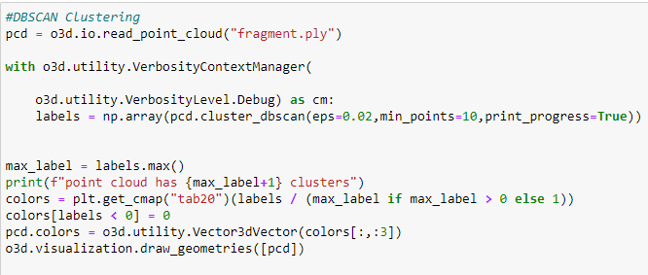
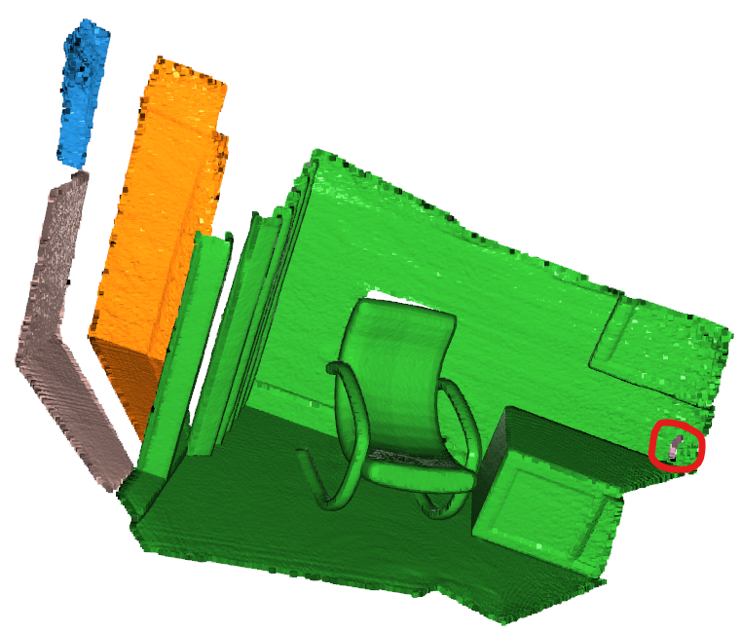
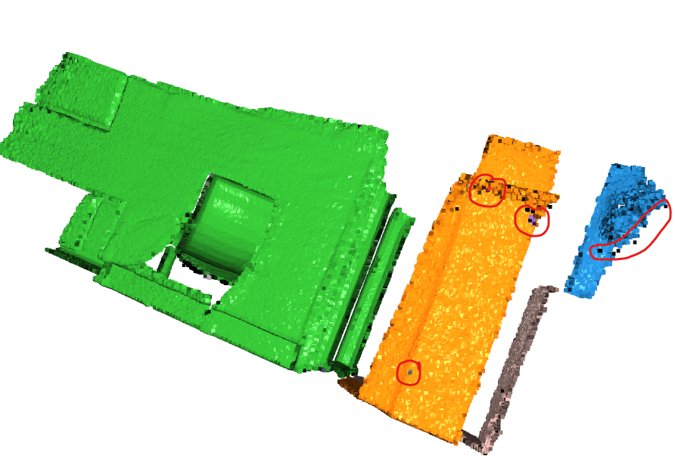
Creating Clusters based on distance between each point

Slide 12
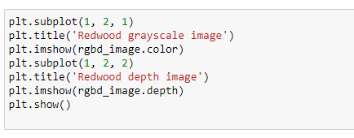
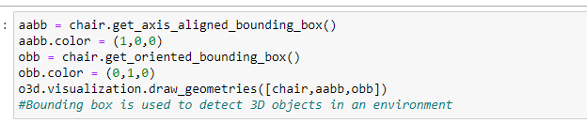
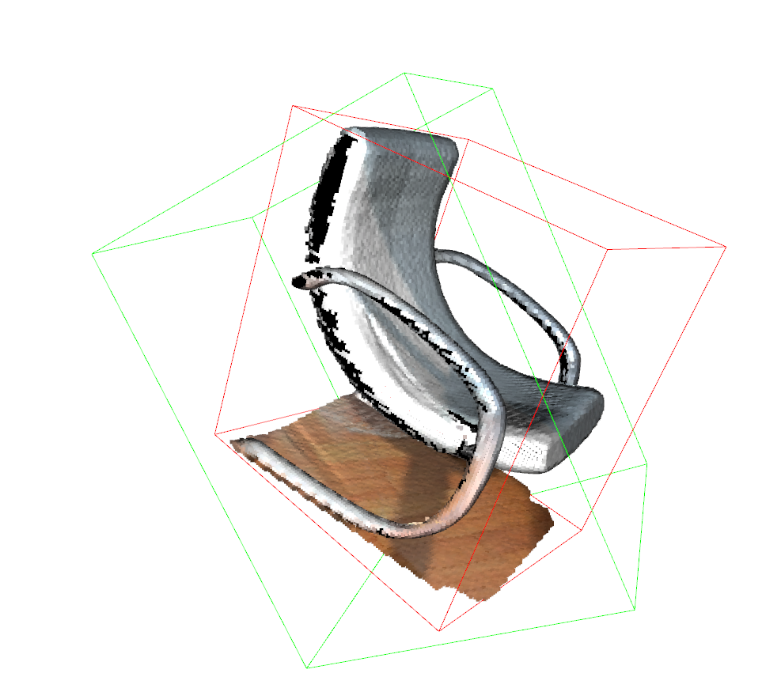

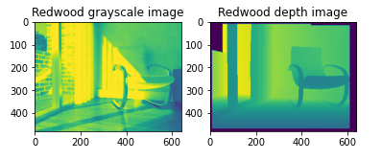
Creating Surrounding boxes on the chair- axis and the chair itself.
Merging images to create RGBD Images

Slide 13

Conclusion
Open3d is extensively used for 3D data manipulation, Scene reconstruction, Implementing machine learning on 3D Data and many more operations based on 3D data. It has API for both Python and C++. The code is clean and simple to understand.

Slide 14


Thank You
Presenter name: Ashutosh Sharma

