Slide 1
Mint
MEDIFLOW
Cutting No-Show Losses with a Smarter Booking & Reminder Workflow
Sunrise Medical Clinic · Business Process Improvement Project
Build-to-Learn 2026 · Department of Professional Management Studies
Presented by Ashutosh · Roll No. 25BBAI18 · BBA (AI & Data Science)
Notes:
Introduce the MediFlow project: a business process improvement case study built on a real 71,959-record medical appointment dataset, redesigning the patient reminder and waitlist workflow at a fictional Sunrise Medical Clinic to cut no-shows.

Slide 2





What We'll Cover
From the problem on the ground to a redesigned, data-driven process
01
The Problem
Why patients miss appointments and what it costs the clinic
02
The Data
Key metrics from 71,959 real appointment records
03
Root Causes
Three insights driving no-shows
04
The Solution
MediFlow's risk-tiered booking & reminder workflow
05
The Impact
Before vs after, projected savings & recommendations
MediFlow · Business Process Improvement · Sunrise Medical Clinic
2
Notes:
Roadmap slide — five sections: problem, data, root causes, solution, impact.

Slide 3






The Problem: A Broken Reminder Loop
Sunrise Medical Clinic's current, manual booking process
→
→
→
→
→
Patient calls clinic
Manual paper register
1 generic SMS reminder
Patient no-shows
Staff calls paper waitlist
No one available
Slot empty — ₹350 lost per no-show. Result: 30% no-show rate · ₹5,250 lost/day · 45 min patient wait · 40 min staff time wasted
The core issue: every patient gets the same generic message, regardless of how likely they are to miss the appointment — and when they no-show, there's no fast way to refill the slot.
MediFlow · Business Process Improvement · Sunrise Medical Clinic
3
Notes:
Walk through the six-step manual process end to end, then land on the cost: 30% no-show rate, Rs 5,250/day lost, long waits, wasted staff time. Emphasize the root cause box: one-size-fits-all reminders plus no fast re-fill mechanism.

Slide 4
What the Data Shows
Analysis of 71,959 real medical appointment records (Kaggle)
TOTAL APPOINTMENTS
NO-SHOW RATE
Risk Level Split
71,959
28.5%
Patients grouped by no-show risk score
records analysed
20,522 missed appts
REVENUE LOST / DAY
PROJECTED FILL RATE
₹4,200
87%
at ₹350 per consult
with MediFlow waitlist
No-Show Rate by Risk Factor (%)
MediFlow · Business Process Improvement · Sunrise Medical Clinic
4
Notes:
Present the four headline KPIs, then the risk-tier donut (roughly low/medium/high split) and the risk-factor bar chart: long lead time, younger patients, Mondays, and SMS-only reminders all correlate with higher no-show rates.

Slide 5
Three Insights Behind the No-Shows
What the appointment data tells us about who misses, and why
1
2
3
SMS Alone Isn't Enough
Lead Time Matters
Younger Patients Are Riskiest
27.6%
33% vs 21.4%
34.2%
no-show with SMS
30+ days vs same-day
no-show rate, ages 19-35
Patients who received a generic SMS reminder still missed appointments at 27.6%, barely below the 29.5% no-show rate for patients with no reminder at all.
Same-day bookings had a 21.4% no-show rate. Appointments booked 30+ days out jumped to 33% — the longer the wait, the easier it is to forget or deprioritize.
Patients aged 19-35 had the highest no-show rate of any group, making age one of the strongest predictors flagged automatically by MediFlow's risk model.
MediFlow · Business Process Improvement · Sunrise Medical Clinic
5
Notes:
Three data-backed insights: generic SMS reminders barely move the needle; longer lead times raise no-show risk; and patients aged 19-35 are the highest-risk group. These three findings directly shape MediFlow's risk-tiered design.

Slide 6





The Solution: MediFlow's Risk-Tiered Workflow
Every patient is scored, then routed to the reminder intensity that fits their risk
Digital booking (Google Form)
Risk score assigned (Excel)
Urgent double confirmation call + SMS
HIGH RISK
→
→
Highest-touch outreach for patients most likely to miss
MEDIUM RISK
Personalized reminder + confirmation request
Balanced follow-up, 1 reminder + confirm-back
LOW RISK
Standard single reminder
Low-touch — most likely to attend as booked
Confirmed cancellations trigger an automatic waitlist broadcast — the next eligible patient accepts instantly and the slot is filled instead of sitting empty.
MediFlow · Business Process Improvement · Sunrise Medical Clinic
6
Notes:
Explain the flow: digital booking feeds an Excel-based risk score; patients are split into three tiers with matched reminder intensity; confirmed cancellations auto-broadcast to a waitlist so slots refill immediately instead of going empty.

Slide 7
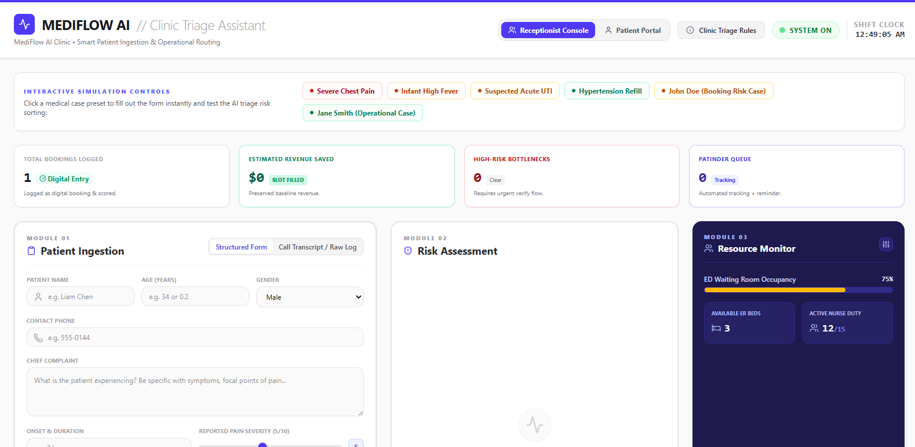

Bringing It to Life: The MediFlow AI Console
A working prototype that scores patients and routes staff attention in real time
Patient Ingestion
Structured intake form or raw call-transcript capture at first contact.
Risk Assessment
Auto-scores each case (e.g. severe chest pain vs. routine refill) to set urgency.
Resource Monitor
Live ED occupancy, available beds, and nurse duty status alongside the queue.
Operational KPIs
Bookings logged, revenue saved, high-risk bottlenecks, and waitlist tracking at a glance.
MediFlow · Business Process Improvement · Sunrise Medical Clinic
7
Notes:
Show the receptionist-facing console: staff log a patient (structured form or raw transcript), the risk-assessment module scores urgency, and a resource monitor tracks ED occupancy and staffing side by side with operational KPIs like revenue saved and high-risk bottlenecks.

Slide 8
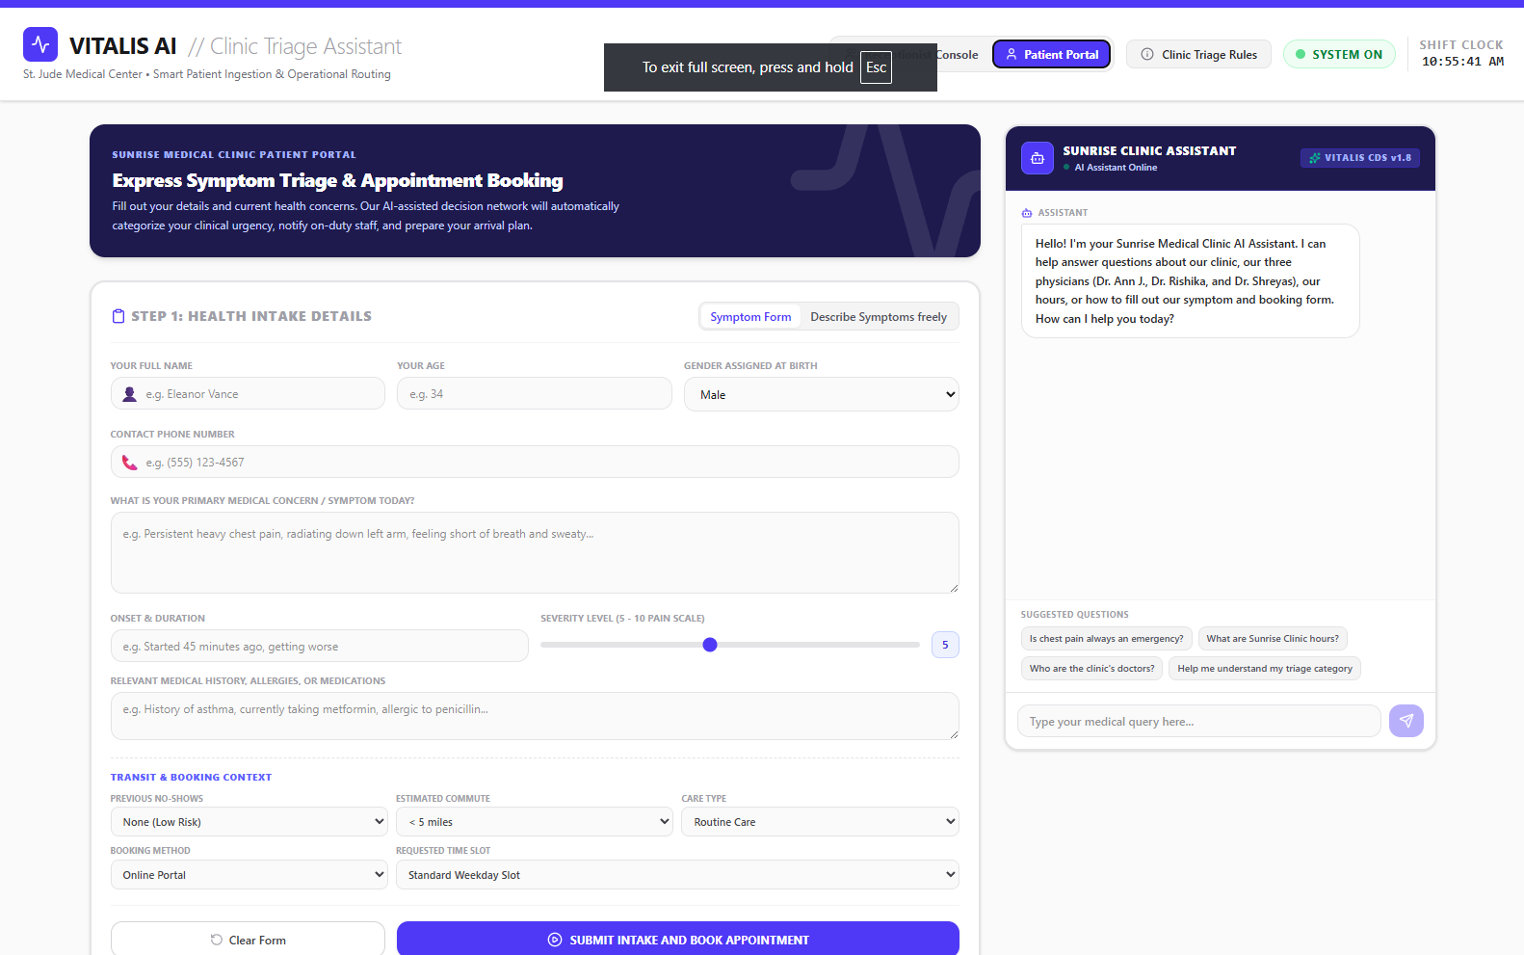
The Patient Side: Self-Service Booking + AI Assistant
Patients triage themselves and get instant answers before they even arrive
MediFlow · Business Process Improvement · Sunrise Medical Clinic
8
Notes:
The patient-facing portal lets patients submit symptoms and booking context themselves — including prior no-show history and estimated commute, which feed the risk score — while a built-in AI assistant answers common questions like clinic hours, doctors on staff, and what their triage category means.

Slide 9
Before vs After: MediFlow Impact
Projected change across four key operational metrics
MediFlow · Business Process Improvement · Sunrise Medical Clinic
9
Notes:
Side-by-side comparison: no-show rate drops from 30% to 8%, slot fill rate rises from roughly 12% to 87%, patient wait time falls from 45 to 15 minutes, and staff time per no-show drops from 40 to 5 minutes.

Slide 10



The MediFlow Impact
Projected annual results if implemented at Sunrise Medical Clinic
30% → 8%
₹9.8L
45 → 15 min
580 hrs
NO-SHOW RATE
ANNUAL REVENUE RECOVERED
PATIENT WAIT TIME
STAFF TIME SAVED / YEAR
Based on Rs 350 average consultation value and observed no-show patterns across 71,959 appointment records.
MediFlow · Business Process Improvement · Sunrise Medical Clinic
10
Notes:
Headline the four biggest wins: no-show rate cut from 30% to 8%, roughly Rs 9.8 lakh in annual revenue recovered, patient wait time down from 45 to 15 minutes, and about 580 staff hours saved per year.

Slide 11
Conclusion & Recommendations
Turning a manual, reactive process into a proactive, data-driven one
Score every booking
Match effort to risk
Assign a no-show risk score at the point of booking using lead time, age group, and reminder history.
Reserve urgent, high-touch confirmation calls for high-risk patients instead of treating everyone the same.
Automate the waitlist
Track and iterate
Broadcast confirmed cancellations instantly so open slots are refilled in minutes, not left empty.
Monitor no-show rate, fill rate, and staff time monthly to keep refining the risk model.
MediFlow · Business Process Improvement · Sunrise Medical Clinic
11
Notes:
Close with four actionable recommendations: risk-score every booking, match reminder intensity to risk tier, automate waitlist broadcasting, and keep tracking metrics to refine the model over time.

