Slide 1

Time Series Forecasting Tesla Stock Price Prediction Using ARIMA/SARIMA Model
Presented by:
Ashutosh kumar
2205016
CSEDS
Group I
Session: 2022-2026
Om kumar Mishra
2205039
CSEDS
Group II
Session: 2022-2026

Slide 2
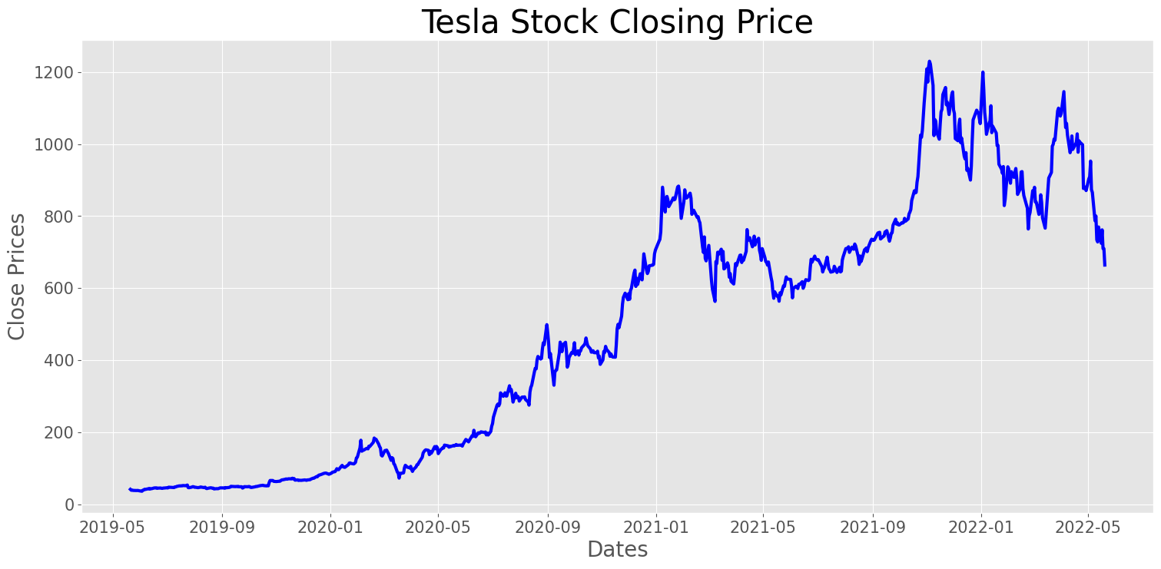
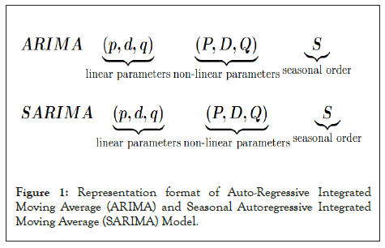
Introduction
This presentation introduces time series forecasting, focusing on the analysis of Tesla's stock price using ARIMA and SARIMA models. The objective is to provide insights into stock price prediction techniques and demonstrate the effectiveness of these models.
Literature Review
This study focuses on the Auto-Regressive Integrated Moving Average (ARIMA) and Seasonal Auto-Regressive Integrated Moving Average (SARIMA) machine learning algorithms to create a machine learning model which is capable of forecasting future Tesla stock prices based on historical time series data with high accuracy and reliability.

Slide 3

Time Series Forecasting :
01
Time series forecasting is a technique for the prediction of events through a sequence of time.
Time series data refers to an ordered sequence or a set of data points that a variable takes at equal time intervals.
In time series, time acts as an independent variable to estimate the dependent variable.

Slide 4
Time Series Components:
The components by which a time series is composed are called the components of a time series.
◆ Trend component (T): (upward, downward, flat)
It is the general tendency of data to grow or decline over a long period
◆ Seasonal component (S): (hour , day , month , year)
- The Component responsible for the regular rise or fall during a period not more than 1 year
◆ Cyclic component (C): (season + Noise )
These are the recurrent variations in time series
◆ Irregular component (I):( Noise, randomness, white noise, error )
- These components don't repeat in a definite pattern

Slide 5
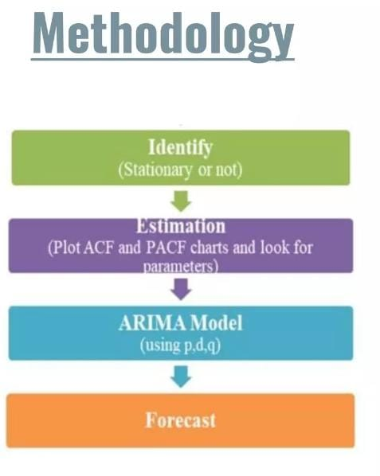
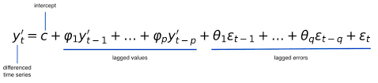
Forecasting Model –ARIMA
ARIMA stands for Auto Regressive Integrated Moving Average
It is an integrated model of Auto Regressive(AR) and Moving Average(MV)
In this model past values of the time series alone used to predict the future values
The common form of an ARIMA model
This model is called as "ARIMA (p, d, q) model
where,
p- order of the auto-regressive part
d - degree of differencing
q- order of the moving average part
↓

Slide 6
Methodology:
Identify:
In order to design an ARIMA model, the primary time series has to be a Stationary one
- If the series is non-stationary, then the series has to be differenced so as to make it stationary.
Estimation:
An important step while selecting the model is the determination of ideal parameters for the model
Plotting the ACF(Auto-Correlation Function) and PACF (Partial Auto-Correlation Function)against the consecutive time lags for the series is a simple approach to choose the parameters of the model
The general form of ACF is as:
• Covariance (Xt, Xt-h)/ Variance(Xt)
The common form is of PACF is as:
• Covariance (y, X3|X1, X2)/ variance(y|X1|X2)variance(X3|X1, X2)

Slide 7
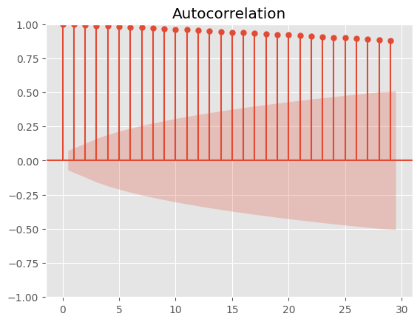
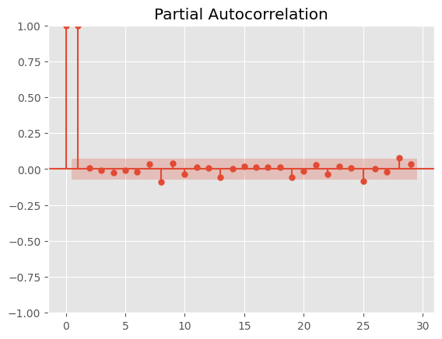
ACF and PACF plot for Tesla Stock
ACF Plot Insight: Shows a slow decay, indicating the Tesla stock time series is non-stationary and needs differencing to stabilize it.
PACF Plot Insight: Cuts off sharply after lag 1, suggesting that an AR(1) component may be appropriate for the model.
These patterns support starting with an ARIMA(1,1,0) model configuration.

Slide 8

Model Selection
We use the "ARIMA (0, 1, 0) model" for predicting the next values in the time series
We use the auto.arima () function in R to get the results.
Auto.arima() function chooses the best parameters of ARIMA(p,d,q).
↓

Slide 9
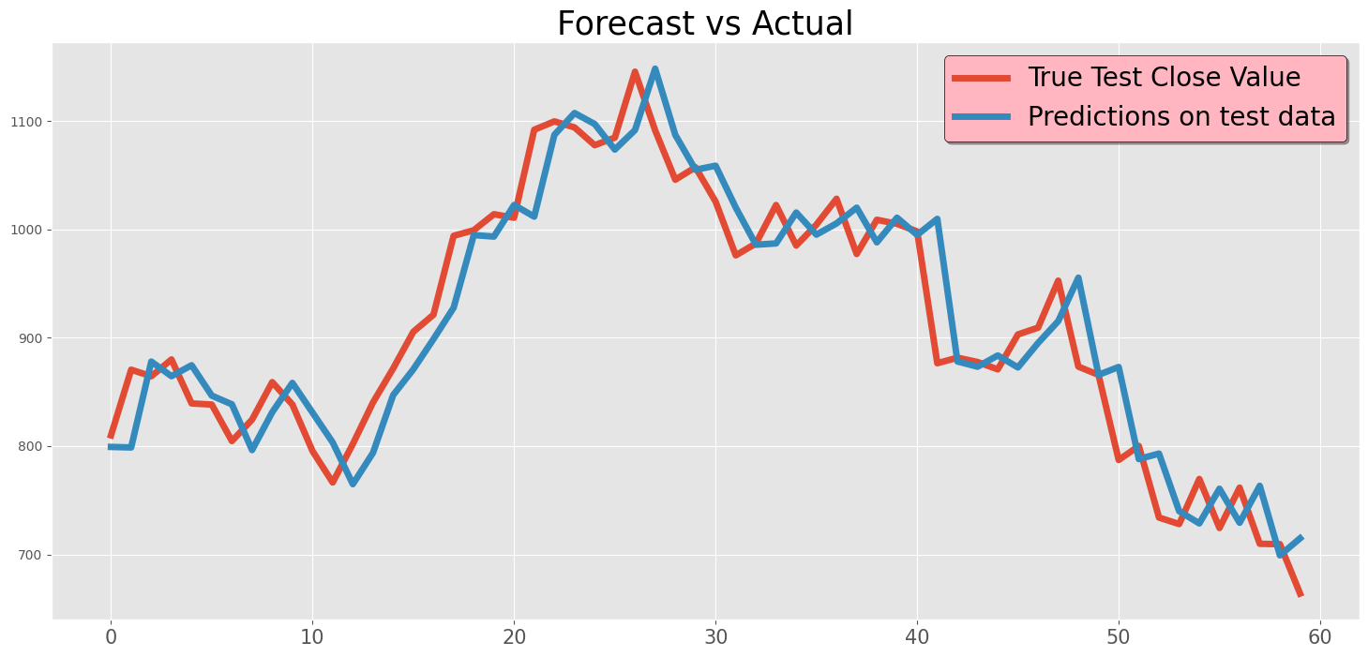
RESULT
- Forecast refers to the model's prediction of future values based on past observed data.
- The best model selected was:
ARIMA(2, 0, 0)
- This model provided the lowest RMSE (39.44) compared to the SARIMA model (RMSE: 39.74), indicating a better balance between accuracy and simplicity.

Slide 10
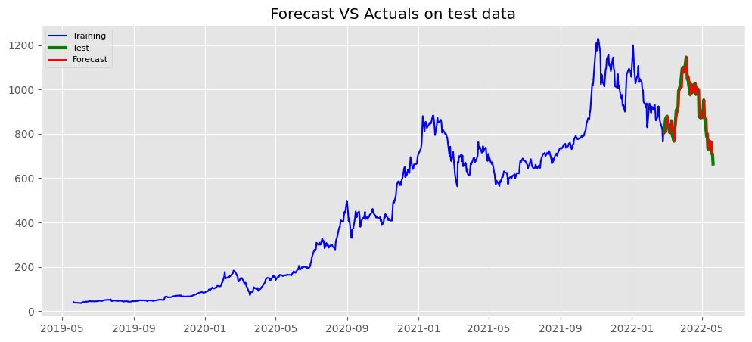
Conclusions
In conclusion, time series forecasting using ARIMA and SARIMA models provides powerful tools for predicting future values in various applications, especially within financial markets. Understanding the components of time series data, ensuring stationarity, and accurately building models are essential steps to yield reliable forecasts. The insights gained from these forecasts can significantly aid in decision-making processes for businesses, investors, and policymakers.
→

Slide 11
Thank you!
References
References:
1. Hyndman, R. J., & Athanasopoulos, G. (2021). *Forecasting: Principles and Practice* (3rd ed.). Retrieved from https://otexts.com/fpp3/
2. Statsmodels - Time Series Analysis in Python. (n.d.). Retrieved from https://www.statsmodels.org/stable/tsa.html
3. Tesla Stock Data from 2010 to 2020. (n.d.). Kaggle. Retrieved from https://www.kaggle.com/datasets/timoboz/tesla-stock-data-from-2010-to-2020 /datasets/timoboz/tesla-stock-data-from-2010-to-2020
Do you have any questions?
↓
CREDITS: This presentation template was created by Slidesgo, and includes icons, infographics & images by Freepik
+91 620 421 838

