Slide 1

SMART INDIA HACKATHON 2026
TITLE PAGE
SANYOG संयोग — from problem, to pilot, to procurement
PROBLEM STATEMENT ID
PS CATEGORY
THEME
SIH26136
Software
Miscellaneous
TEAM ID
TEAM NAME
ORGANISATION
PRODHUB
Govt of Maharashtra · MSInS
PROBLEM STATEMENT TITLE
Startup friendly public procurement mechanism that enables government departments to identify, pilot, procure, and scale innovative solutions from eligible startups
● LIVE sanyog.ashutosh-palai2005.workers.dev

Slide 2
IDEA TITLE
PRODHUB
Proposed Solution (Describe your Idea/Solution/Prototype)
SANYOG (संयोग) — an end-to-end digital pathway that takes a government department from a written problem to a scaled, procured startup solution — in eight governed stages, on one platform.
1 · CHALLENGE
2 · SCREEN
3 · EVALUATE
4 · SANDBOX
5 · CONTRACT
6 · MILESTONES
7 · VALIDATE
8 · SCALE
Detailed explanation of the proposed solution
How it addresses the problem
Innovation and uniqueness of the solution
▪ Departments publish outcome-based challenges — a measured baseline → target is mandatory, so every pilot is verifiable by construction.
▪ DPIIT-recognised startups are auto-screened on application; pilots run in a governed sandbox with security clearance and a fixed exit date.
▪ Payments release 30/40/30 against verified milestones; independent validators record results against pre-locked KPIs.
▪ Removes turnover, prior-experience and EMD barriers (GFR 173(i) & 170(i) as defaults) — quality criteria never waived.
▪ The three mandated documents — Problem Statement, Pilot MOU, Scale-Up Scorecard — are working digital forms, not PDFs.
▪ Demand becomes visible, payments timed, evaluations accountable, every decision evidence-based and audit-traceable.
▪ Compliance is computed, not promised — the database refuses payment without verification, sandboxes without clearance, rejection without reason.
▪ KPIs are locked before measurement begins; deemed-approval clocks; attributable panel scores with mandatory written rationale.
▪ Three satisfactory departmental validations unlock scale-up — the evidence pack exports directly to GeM. No fresh tender.

Slide 3
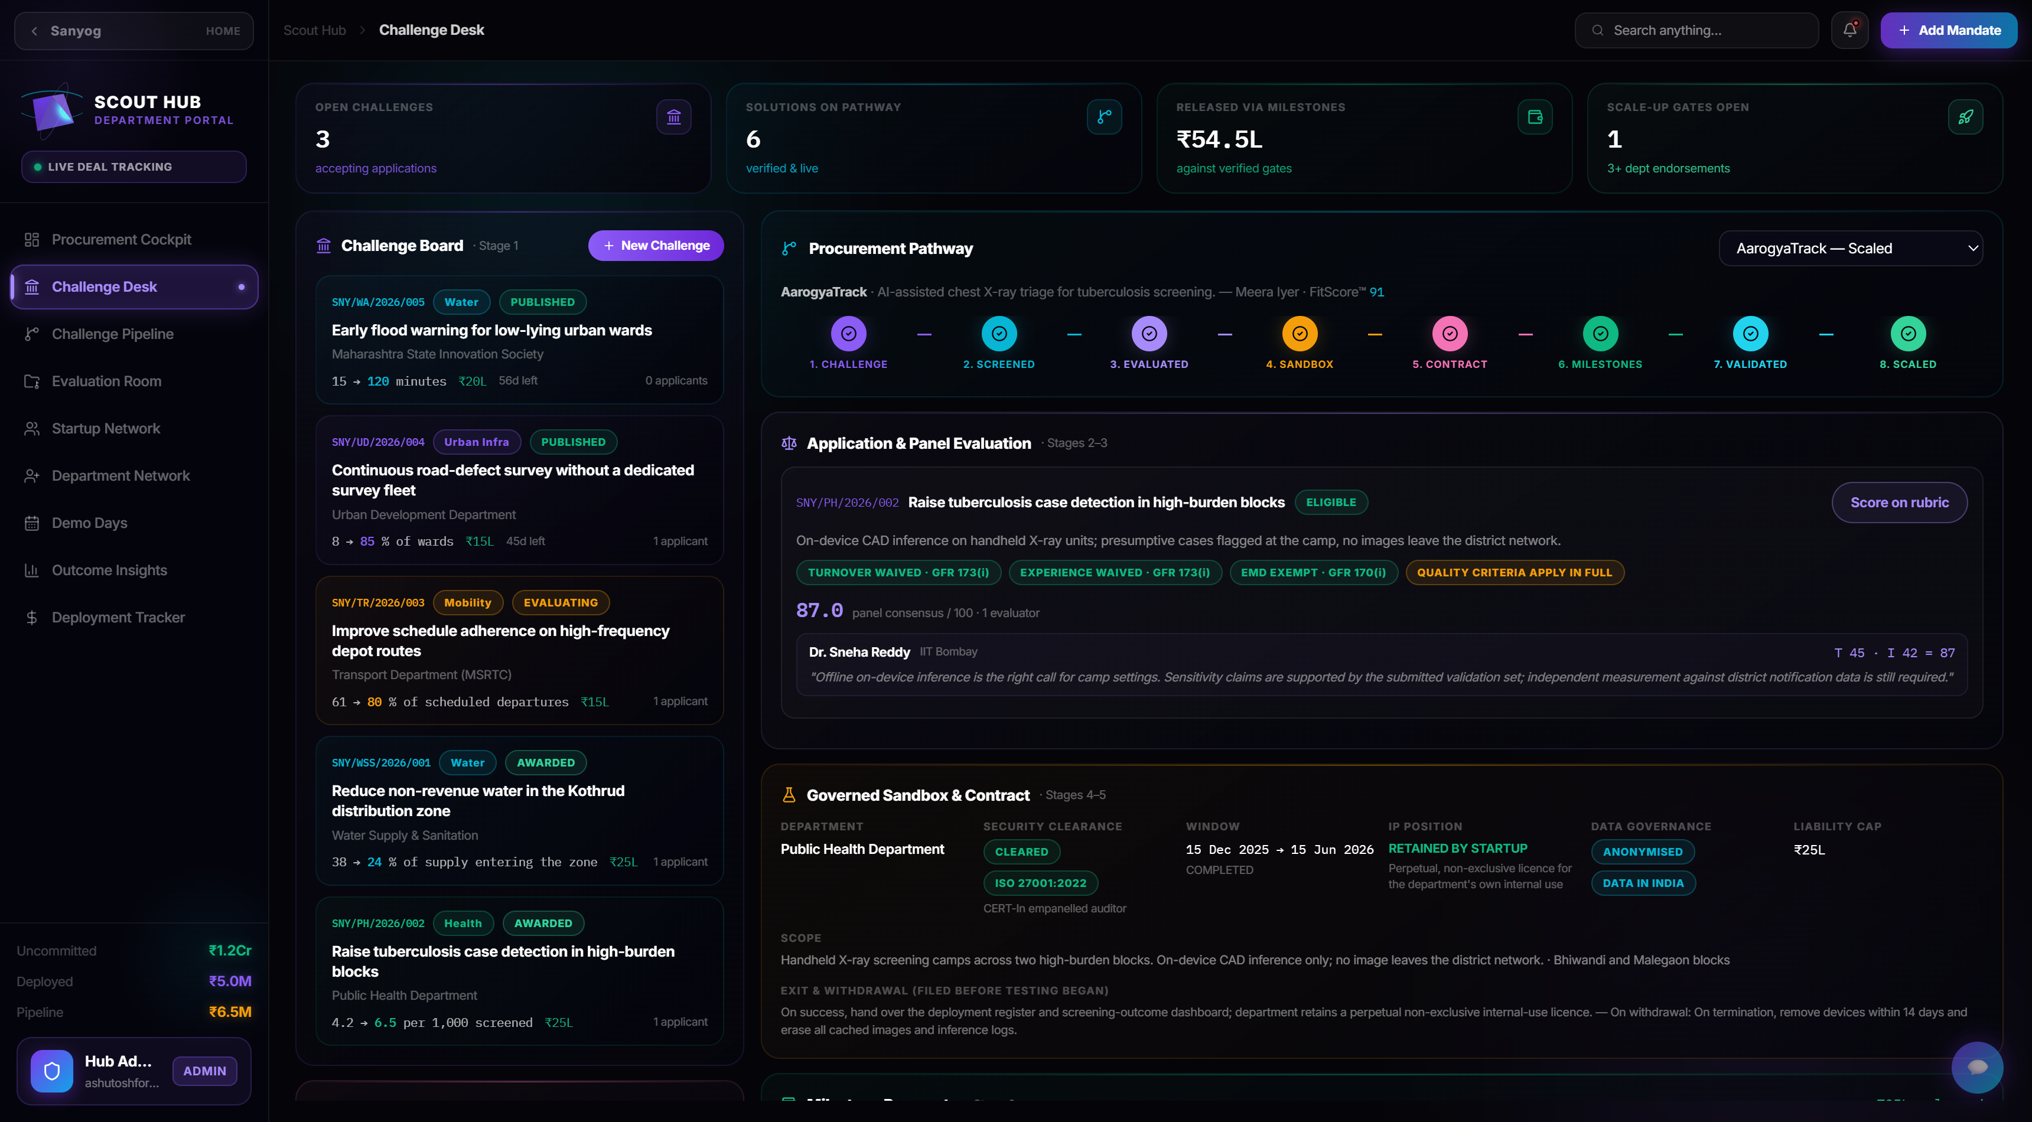
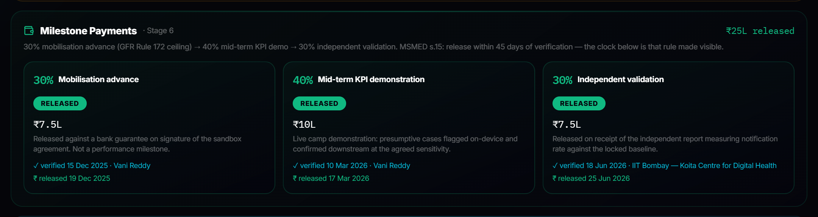
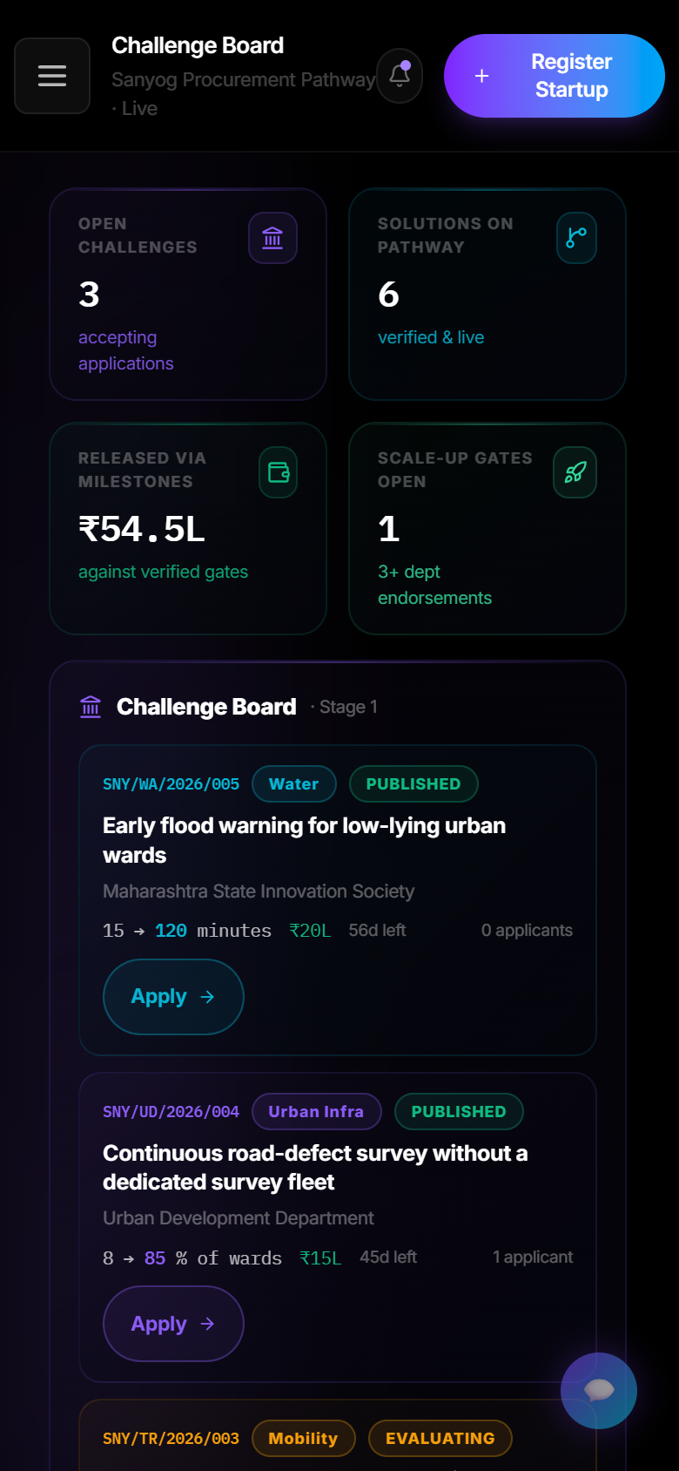
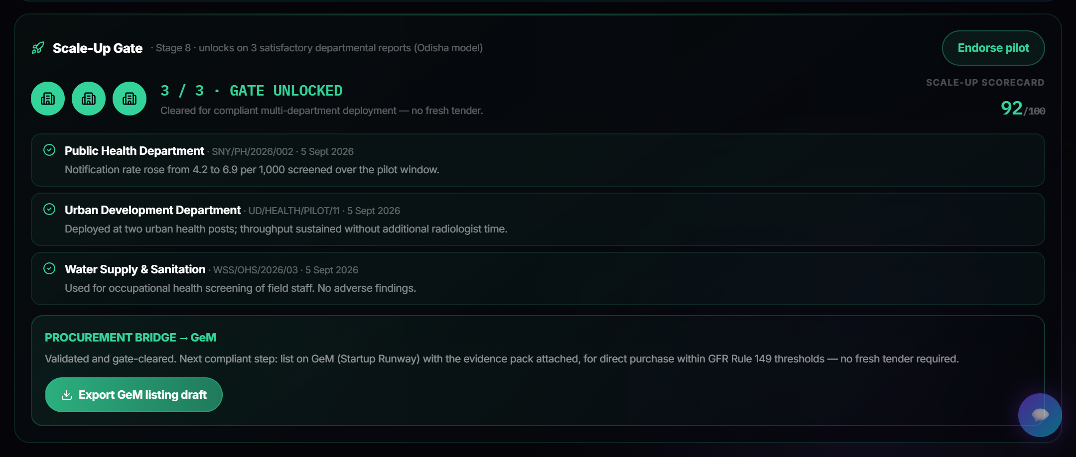
TECHNICAL APPROACH
PRODHUB
Technologies to be used (e.g. programming languages, frameworks, hardware)
React 19 + TanStack Start
Cloudflare Workers · edge SSR
Supabase PostgreSQL · RLS
Groq LLM · FitScore™
JWT + Google OAuth
DPIIT auto-screening
GeM · Startup Runway export
Rules enforced in the DB
Methodology and process for implementation (Flow Charts/Images/ working prototype)
1
Challenge published
→
2
Eligibility screen
→
3
Panel evaluation
→
4
Sandbox clearance
→
5
Milestone payments
→
6
Independent validation
→
7
Three-dept gate
→
8
GeM scale-up
CHALLENGE DESK · LIVE
MILESTONE ENGINE
MOBILE
SCALE-UP GATE · 3/3
Working prototype — live at sanyog.ashutosh-palai2005.workers.dev · Challenge Desk · milestone engine · 3-department scale-up gate · mobile

Slide 4
FEASIBILITY AND VIABILITY
PRODHUB
Analysis of the feasibility of the idea
Potential challenges and risks → Strategies for overcoming these challenges
▪ Needs no new law — GFR 2017 already permits every relaxation applied — Rule 173(i) turnover & experience, Rule 170(i) EMD, Rule 172 capping the 30% advance; MSMED s.15/16 supplies the payment clock.
▪ Policy demand exists — Maharashtra Innovation Policy 2025, Section 13.7, commits to exactly these guidelines — Sanyog is the working mechanism, ready to adopt.
▪ Precedents in force — Telangana G.O. Ms. 08 (deemed approval) · Odisha’s 3-client scale gate · Kerala GO(Ms) 2/2022 (₹50L direct route).
▪ Prototype, not concept — Fully built and LIVE — both portals, all 8 stages, the 3 mandated templates, screening, payments, validation and the scale gate.
⚠ Subjective, opaque evaluation
→ Dual-axis 0–50 scores stored per evaluator with mandatory written rationale and conflict declaration — defensible on audit.
⚠ Late payments starve startups
→ A 45-day clock on every tranche; overdue MSMED interest (3x bank rate) on the department’s own screen; release blocked until verification.
⚠ Citizen-data & security exposure
→ CERT-In-empanelled audit before go-live; ISO/IEC 27001:2022 only; data anonymised and localised in India; fixed sandbox exit dates.
⚠ Pilots that never scale (iDEX: ~8%)
→ The 3-department gate converts pilot evidence into a GeM listing within GFR Rule 149 thresholds — no fresh tender.

Slide 5
IMPACT AND BENEFITS
PRODHUB
Potential impact on the target audience
45 days
16 weeks
3 validations
100%
hard payment ceiling on every milestone (MSMED s.15)
from published challenge to a running pilot
unlock multi-department scale — no fresh tender
of decisions attributable and audit-traceable
STARTUPS
DEPARTMENTS
CITIZENS
Paid in 45 days, not months · no turnover / experience / EMD walls · demand finally visible · one validated pilot opens every department and district.
Risk bounded by design (exit dates, liability caps, IP clarity) · decisions carry evidence · standard templates replace months of drafting.
Water, health and mobility fixes reach the field in ~16 weeks · outcomes measured against locked baselines, not claimed in reports.
Benefits of the solution (social, economic, environmental, etc.)
ECONOMIC
SOCIAL
Startup cashflow survives government sales — 30% mobilisation advance + clocked tranches; wider MSME participation in public procurement.
Transparent, reasoned public decisions — arbitrariness engineered out; successful pilots scale to every district, not just the pilot ward.
ENVIRONMENTAL
GOVERNANCE
Pilots target measurable resource loss — non-revenue water 38% → 24% in the demo arc; transformer failures pre-empted before outages.
Every decision attributable and audit-traceable; scale-up rests on independently validated outcomes, not vendor claims.

Slide 6
RESEARCH AND REFERENCES
PRODHUB
Details / Links of the reference and research work
General Financial Rules 2017 — Dept of Expenditure
MSMED Act 2006 — s.15, s.16
Rules 149 (GeM thresholds), 170(i) EMD exemption, 172 (30% advance cap), 173(i) turnover & experience relaxation · doe.gov.in
45-day payment ceiling that cannot be contracted around; default interest at 3x the RBI bank rate, compounded monthly
Maharashtra Innovation & Startup Policy 2025 — s.13.7
State precedents in force
State commitment to startup-procurement guidelines and pilot support · msins.in
Telangana G.O. Ms. No. 08 (deemed approval) · Odisha 3-client scale gate · Kerala GO(Ms) 2/2022/SPD (₹50L direct purchase)
CERT-In — Directions 2022 & Guidelines for Govt Entities 2023
DPDP Act 2023 · ISO/IEC 27001:2022
Empanelled pre-hosting audit · 6-hour incident reporting · 180-day logs within India · cert-in.org.in
Data-protection safeguards for sandbox pilots; the 2013 ISO edition expired 31 Oct 2025 — the platform accepts :2022 only
iDEX / DISC outcome data — Ministry of Defence
US SBIR 15 U.S.C. 638(r)(4) · UK SBRI Condition 27
~548 challenges → ~45 procurement contracts (≈8%): the pilot-to-purchase gap Stage 8 is designed to close
Competitive entry + verified pilot supports a lawful non-competed follow-on; arising IP retained by the supplier
NHS England KPI framework · HM Treasury Magenta Book
Working prototype — Team PRODHUB · LIVE
Baseline–target–threshold KPI schema and pre-registered evaluation design, adopted in Stages 1 and 7
sanyog.ashutosh-palai2005.workers.dev · full 8-stage platform, 3 mandated templates · code: github.com/Ashutoshpalai3073/PRODHUB

