Slide 1
C Programming and Data Structures

Slide 2
Agenda
1
Introduction to C
2
Operators & Control Structures
3
Arrays and Pointers
4
Functions and Recursion
5
User-Defined Data Types
6
File Input / Output

Slide 3
Introduction to C Module 1

Slide 4
Objectives
At the end of this module, you will be able to:
Explain genesis of C programming language
List features of C programming language
State the data types in C
Perform basic Input and output operations
Duration: 3 hrs

Slide 5
Computer Languages
Machine Language: A Binary Language composed of 0s and 1s – that is specific to each computer.
Assembly Language: Binary instructions are given abbreviated names called mnemonics which form the Assembly Language. Assembly Language is specific to a given machine.
High Level Language: Programming language intended to be machine-independent is called High level language. Instructions are called as statements.
Eg:FORTRON,PASCAL,C ..etc.

Slide 6
Assemblers and Compilers
Assembler is a program that translates the mnemonics into the corresponding binary machine codes of the microprocessor
Eg: KEIL’s a51
Compiler is a program that translates the source code (statements) into the machine language (object code) compatible with the microprocessor used in the system
Eg: TURBO C,
BORLAND C
GCC ..etc.

Slide 7
The C Language
C is a robust language whose rich set of built-in functions and operators can be used to write any complex program.
C compiler combines the capabilities of an assembly language with features of high-level language and therefore it is well suited for writing both system software and business packages.
Programs written in C are efficient and fast .This is due to its variety of data types and powerful operators.
Notes:
Currently, the most commonly-used language for embedded systems
Very portable: compilers exist for virtually every processor
Several built-in functions are available which can be used for developing programs.
C programs are highly portable ,programs written for one computer can be run on another with little or no modification.
C language is well suited for structured programming.The modular structure makes program debugging,testing and maintenance easier.

Slide 8
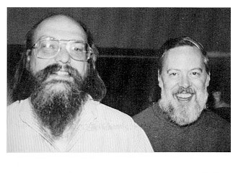
C History
Developed between 1969 and 1973 along with Unix
Ken Thompson created the B language in 1969 from Martin Richard's BCPL
Dennis Ritchie of Bell Laboratories later converted B into C by retaining most of B's syntax in 1972 and wrote the first compiler.
Designed for systems programming
Operating systems
Utility programs
Compilers
Filters
Ken Thompson & Dennis Ritchie

Slide 9
Welcome to C Programming
#include <stdio.h>
void main()
{
printf(“Welcome to C Programming!\n”);
}
Preprocessor used to share information among source files
Program mostly a collection of functions
“main” function special: the entry point
“void” qualifier indicates function does not return anything
I/O performed by a library function: not included in the language

Slide 10
Pieces of C
Types and Variables
Definitions of data in memory
Expressions
Arithmetic, logical, and assignment operators in an infix notation
Statements
Sequences of conditional, iteration, and branching instructions
Functions
Groups of statements and variables invoked recursively

Slide 11
Constants, Variables keywords and Identifiers
Constants are the quantities which do not change during the execution of a program.
Variables are the quantities which may vary during the execution of a program
Keywords are the words whose meaning has already been explained to the C compiler.
Identifiers are the user defined names given to variables,functions and arrays.

Slide 12
Rules for constructing Constants
Rules for constructing Integer Constants
Rules for Constructing Real Constants
Rules for Constructing Character Constants
Notes:
Rules for constructing Integer Constants
It must not have a decimal point.
It could be either positive or negative.
If no sign precedes it is assumed to be positive.
No commas or blanks are allowed within the no.
An Integer constant must have at least one digit.
The allowable range is –32768 to +32767.
Rules for Constructing Real Constants
A real constant must have at least one digit.
It must have a decimal point.
It could be either positive or negative.
Default sign is positive.
No commas and blanks are allowed within the no.
Eg: 426.0 ,-32.76,-48.5879
Rules for Constructing Character Constants
A character constant is either a single alphabet, a single digit or a single symbol within single inverted (both left)commas.
The max length of the of a char constant can be 1 character.
Eg: ’A’

Slide 13
C variables
Variable names are names given to the memory locations of a computer where different constants are stored.
These locations can contain integer,real or character constants.
The rules of constructing variable names of all types are same.
A variable name is any combination of 1 to 8 alphabets, digits or underscores.
The first character must be alphabet.
No commas and blanks are allowed within the variable name.
No special symbol other than an underscore can be used in a variable name.
Eg: si_int, pop_e_89
Notes:
How C compiler distinguish b\n the variable names.
It makes it compulsory to declare the type of any variable to use in a program.
This type of declaration is done at the beginning of the program(global) or beginning of the function(local).
Eg: int si,m_hra;
char code;
float bass;

Slide 14
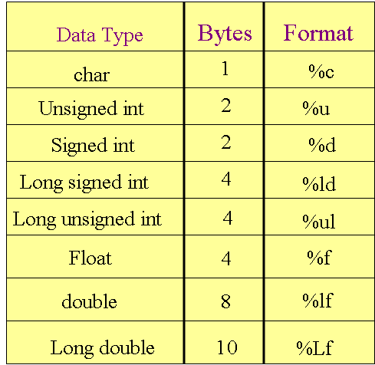
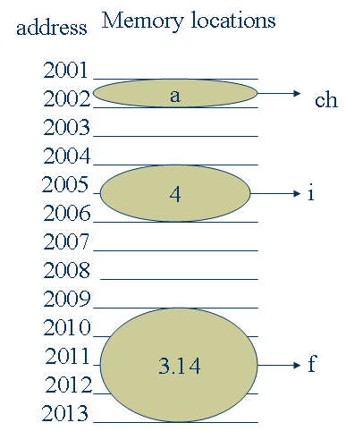
C Data Type
Memory allocation is done by OS.
int i=4;
float f=3.14;
char ch=‘a’;
Notes:
Basic types: char, int, float, and double
Meant to match the processor’s native types
Natural translation into assembly
Fundamentally non-portable
Declaration syntax: string of specifiers followed by a declarator
Declarator’s notation matches that in an expression
Access a symbol using its declarator and get the basic type back

Slide 15
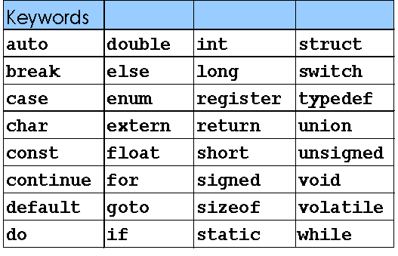
C Keywords
Keywords are the words whose meaning has already been explained to the C compiler. The keywords cannot be used as variable names .
Doing so is trying to assign a new name to the keyword which is not allowed by the compiler. Keywords are also called as Reserved words.
There are only 32 keywords available in C.

Slide 16
C Instructions
Type declaration :To declare the type of variables used in the program.
Input/Output instructions: To perform the function of supplying input data to a program and obtaining the output results from it.
Arithmetic instructions: To perform arithmetic operations b/n constants and variables.
Control instructions: To control the sequence of execution of various statements.

Slide 17
C program
Any C program is basically a collection of functions that are supported by the C library.User defined functions can be added to the C library.
The main( ) is a special function used by the C system to tell the computer where the program starts.
The set of statements belonging to a function are enclosed within a pair of braces,{ }.
Any Variable used in the program must be declared before using it.
C program statements are written in lowercase letters and end with semicolon.
Uppercase letters are used only for symbolic constants.

Slide 18
Basic Structure of C program
Link Section
Definition Section
Global Declaration Section
main( )
{
Declaration Part(local)
Execution Part
function call
}
function()
{
Declaration Part(local)
Execution Part
}

Slide 19
printf() statement
printf( ) is predefined ,standard C function for printing output.
The general form of printf() is,
printf(“<format string>”,<list of variables>);
<format string> could be,
%f for printing real values.
%d for printing integer values.
%c for printing character values.
Eg: printf(“%f”,si);
printf(“%d”,i);

Slide 20
scanf() statement
scanf( ) is a predefined,standard C function used to input data from keyboard.
The general form of scanf() is
scanf(“<format string>”,<address of variables>);
Eg: scanf(“%d”,&n);
scanf(“%f”,&interest);
& is pointer operator which specifies the address of that variable.

Slide 21
Example Program
1 /* - - -- - - -*/
2 Addition program */
Outline
Initialize variables
Input
2.1 Sum
Print
Program Output
3 #include <stdio.h>
4
5 int main()
6 {
7 int integer1, integer2, sum; /* declaration */
8
9 printf( "Enter first integer\n" ); /* prompt */
10 scanf( "%d", &integer1 ); /* read an integer */
11 printf( "Enter second integer\n" ); /* prompt */
12 scanf( "%d", &integer2 ); /* read an integer */
13 sum = integer1 + integer2; /* assignment of sum */
14 printf( "Sum is %d\n", sum ); /* print sum */
15
16 return 0; /* indicate that program ended successfully */
17 }
Enter first integer
45
Enter second integer
72
Sum is 117

Slide 22
Hands-on: 1hour
Purpose
Exposure to Program development environment, compilation, debugging and running a “Welcome program” program
Working with printf & scanf function for integer data type.

Slide 23
Summary
In this module, we discussed:
Features of C programming language
Data types in C
Basic Input and output operations

Slide 24
Operators & Control Structures Module 2

Slide 25
Objectives
At the end of this module, you will be able to:
Classify and use operators
Apply the unary, binary, ternary, compound assignment operators, increment/decrement operators
Use character arithmetic and understand the rules of conversion between different data types
Write simple programs with conditional constructs and iterative constructs
Duration: 4hrs

Slide 26
C Expressions & Operators
Traditional mathematical expressions
y = a*x*x + b*x + c;
An Operator is a symbol that tells the computer to perform certain mathematical or logic manipulations. Operators are used in programs to manipulate data and variables.
C Operators can be classified as
Arithmetic Operators. + – * / %
Logical Operators. && || !
Relational Operators. == != < <= > >=
Bit wise Operators & | ^ ~
Assignment Operators. = += -=
Increment & Decrement Operators. ++ --
Conditional Operators. ? :

Slide 27
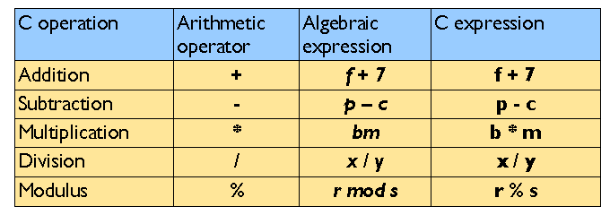
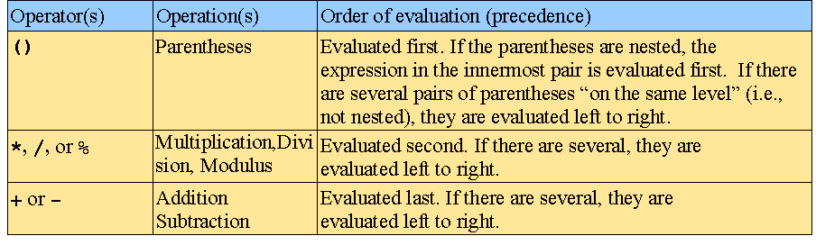
Arithmetic Operators
Arithmetic operators:
Rules of operator precedence:

Slide 28
Equality and Relational Operators
Decision Making operators

Slide 29
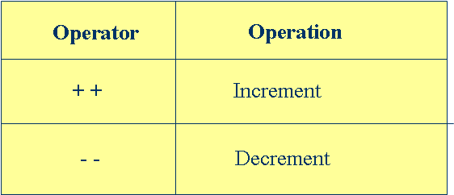
Increment & Decrement Operators
The increment and decrement operators are unary operators.
The operator ++ adds 1 to the operand while - -subtracts 1.They take the following form:
++m(pre increment); or m++(post increment);
--m(pre decrement); or m--(post decrement);
Prefix operator first does the operation and then result is assigned to the variable.
Postfix operator first assigns the value to the variable and then does the operation.
Notes:
++m and m++ mean the same thing when they form statements independently .
They behave differently when they are used in expressions on the right hand side of the assignment.
Unary operators, as the name suggests, works on one operand or variable.
Incrementing and decrementing by 1 is such a ubiquitous operation that C offers the prefix and postfix implementations of the ++ and the -- operators.
The expression i = i + 1; can also be written as i++.
When used as a standalone statement, writing i++, or ++i does not make any difference at all.
It is only when they are used as part of an expression that the prefix and the postfix operators can have totally different results.

Slide 30
Conditional/ Ternary Operator
A Ternary operator pair “ ? :”is available in C to construct conditional expression of the form
expression1 ? expression2 : expression3
Eg:
a=10;
b=15;
x=(a>b) ? a : b;
x will be assigned to the value of b.

Slide 31
Ternary Operator: Example
Write a program to display the greatest of two numbers.
#include <stdio.h>
main()
{
int number1, number2, greater;
printf(“\nEnter the first number “);
scanf(“%d”,&number1);
printf(“\nEnter the second number”);
scanf(“%d”,&number2);
greater=number1 > number2?number1 : number2;
printf(“\nThe greater number is %d”,greater);

Slide 32
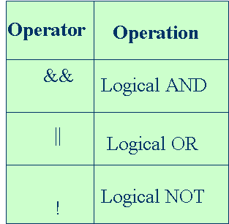
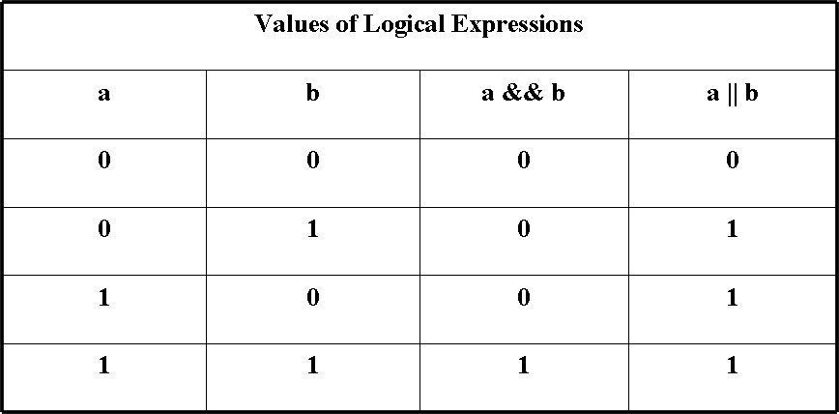
Logical Operators
The Logical AND Operator
a && b;
(a < b) && (c < d)
The Logical OR Operator
a || b
(a < b) || (c < d)
The Logical NOT Operator
!a
!(x + 7)
Notes:
The logical operators act on operands which are themselves logical expressions. They seek to combine the individual logical expressions into more complex expressions that are either true or false.
The result of a logical AND operation is true if both operands are true.
It has the general form: expression1 && expression2
Which evaluates to 1 (true) if both expression1 and expression2 are 1 (true); otherwise evaluates to false even if one of them evaluates to 0 (false).

Slide 33
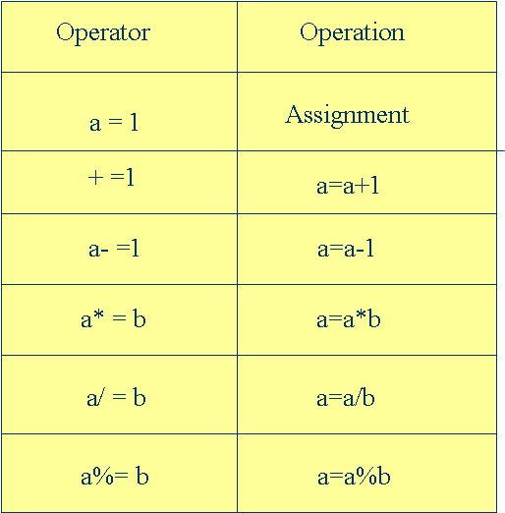
Assignment Operators
Notes:
Compound assignment statements help in simplifying, and writing simple code.
So far, we have been writing statements such as:
sum = sum + num
The same could be simplified as
sum += num;
The same applies to the other binary operators.

Slide 34
Type Conversions
When an operator has operands of different types, they are converted to a common type according to a small number of rules.
The following informal set of rules will suffice:
If either operand is long double, convert the other to long double.
Otherwise, if either operand is double, convert the other to double.
Otherwise, if either operand is float, convert the other to float.
Otherwise, convert char and short to int.
Then, if either operand is long, convert the other to long.
Conversions take place across assignments; the value of the right side is converted to the type of the left, which is the type of the result.
Notes:
In general, the only automatic conversions are those that convert a ``narrower'‘ operand into a ``wider'' one without losing information, such as converting an integer into floating point
Expressions that might lose information, like assigning a longer integer type to a shorter, or a floating-point type to an integer, may draw a warning, but they are not illegal.
A char is just a small integer, so chars may be freely used in arithmetic expressions. This permits considerable flexibility in certain kinds of character transformations.
Implicit arithmetic conversions work much as expected. In general, if an operator like + or * that takes two operands (a binary operator) has operands of different types, the “lower'' type is promoted to the ``higher'' type before the operation proceeds.

Slide 35
Type Conversions (Contd.).
Consider the following assignments:
int i;
char c;
i = c;
In the aforesaid assignment, the data type on the right (char) is converted to the data type on the left (int) which is the type of the result.
If x is float and i is int, then x = i and i = x both cause conversions; float to int causes truncation of any fractional part. When a double is converted to float, whether the value is rounded or truncated is implementation dependent.

Slide 36
Explicit Type Conversion
In the construction (type name) expression, the expression is converted to the named type by the conversion rules above.
Consider the following example:
int i, j;
double d;
d = i / j; /* double assigned the result of the division of two integers */
The problem with the above assignment is that the fractional portion of the above division is lost, and d is effectively assigned the integer quotient of the two integers i and j.
Notes:
36
For example, the library routine sqrt expects a double argument, and will produce nonsense if inadvertently handled something else. (sqrt is declared in <math.h>.) So if n is an integer, we can use sqrt((double) n)
to convert the value of n to double before passing it to sqrt. Note that the cast produces the value of n in the proper type; n itself is not altered.
Finally, explicit type conversions can be forced (``coerced'') in any expression, with a unary operator called a cast.

Slide 37
Explicit Type Conversion (Contd.).
To resolve this, the variable i can be type cast into a double as in:
d = (double)i / j;
int i is converted to a double using the explicit cast operator. Since one of the operands is a double, the other operand (j) is also converted to a double, and the result is a double.
The result is assigned to a double with no side effects. The cast operator can be done only on the right-hand side of an assignment.

Slide 38
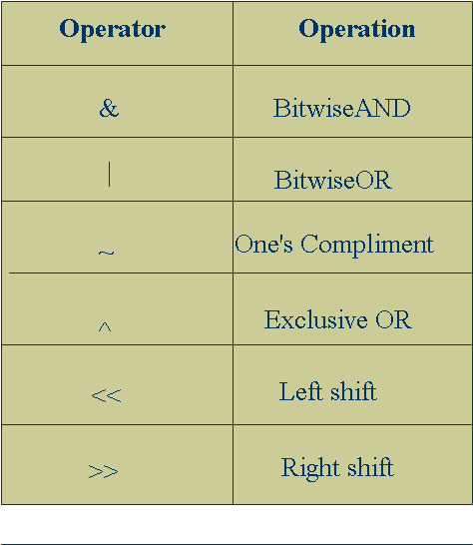
Bit-wise Operators
Bit-wise operators allow direct manipulation of individual bits within a word.
These Bit-manipulations are used in setting a particular bit or group of bits to 1 or 0.
All these operators work only on integer type operands.
Bit-Wise logical operators:
Bit-Wise AND (&)
Bit-Wise OR ( | )
Bit-Wise exclusive OR (^)
These are binary operators and require two integer-type operands.
These operators work on their operands bit by bit starting from the least significant bit
Notes:
Bit-Wise AND is often used to test whether a particular bit is 1 or 0.
#define TEST 8 /*(00…01000)*/
main()
{ int flag;
. . . . .
. . . . .
if((flag & TEST)!=0)
printf(“Fourth bit is set”);
else printf(Fourth bit is not set);
}
Bit-Wise Shift Operators:
Left shift : op<<n;
Right shift: op>>n;
The left shift operation causes all the bits in the operand op to be shifted to the left by n positions.
** The left most n bits in the original bit pattern will be lost and the rightmost n bit positions that are vacated will be filled with 0s.
The right shift operation causes all the bits in the operand op to be shifted to the right by n positions.
** The right most n bits in the original bit pattern will be lost and the leftmost n bit positions that are vacated will be filled with 0s.

Slide 39
Size of operator
The sizeof is a compile time operator and,when used with an operator, it returns the number of bytes the operand occupies
The operand may be a variable,a constant or a data type qualifier
Eg: int m,n, sum;
m=sizeof(sum);
n=sizeof(long int);
The sizeof operator is normally used to determine the lengths of arrays and structures
It is also used to allocate memory space dynamically to variables during execution of a program

Slide 40
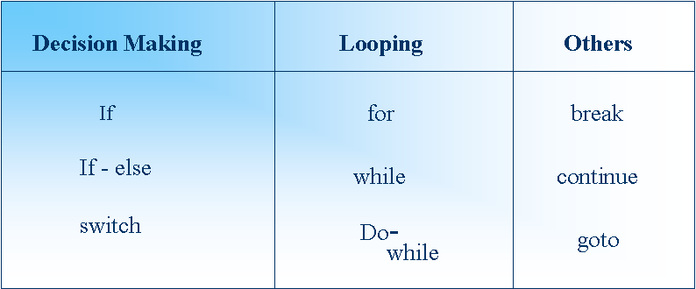
Control Structures
These are the statements which alter the normal (sequential)execution flow of a program.
There are three types of Control Statements in C

Slide 41
if statement
The general form :
if(test expression)
{
statement–block;
}
statement-x;
Entry
test expression ?
True
statement–block
False
Statement-x

Slide 42
if….else statement
The if….else statement is an extension of simple if statement. The general form is,
if(test expression)
{
true-block statements;
}
else
{
False-block statements;
}
statement-x;
Entry
Test expression?
False
True
True-block
False-block
Statement-x

Slide 43
Example - if- else Construct
The following function checks whether the character entered by the user is a star (*) character.
#include <stdio.h>
main( )
{
char ch;
ch = getchar( );
fflush(stdin);
if (ch = = ‘*’)
puts (“You have entered the star character”);
else
puts (“You have not entered the star character”);
}
start
ch = ‘ ‘
Input ch
is ch = ‘*’
true
Print *
false
Not a *
stop
Notes:
43
It is important here to distinguish between the comparison operator (= = ) and the assignment operator ( = ). If the assignment operator ( = ) was used in the conditional construct, the statement would be treated as an assignment. That is the statement if (ch = ‘*) would be treated as an assignment. That is, the ch would have got the character ‘*’, and ASCII value of the character ‘*’ being non-zero, it would be evaluated as true.
It is important to remember that a non-zero expression always evaluates to true in C.

Slide 44
Example - if- else Construct (Contd.).
The earlier function can also be alternately written as:
#include <stdio.h>
main( )
{
char ch;
ch = getchar( );
fflush(stdin);
if (ch ! = ‘*’)
puts (“You have not entered the star character”);
else
puts (“You have entered the star character”);
}
Notes:
44

Slide 45
Cascading if- else Construct
The cascading if-else construct is also known as the multiple if-else construct.
On the first condition evaluating to false, the else part of the first condition consists of another if statement that is evaluated for a condition.
If this condition evaluates to false, the else part of this if condition consists of another if statement that is evaluated for a condition, and so on.

Slide 46
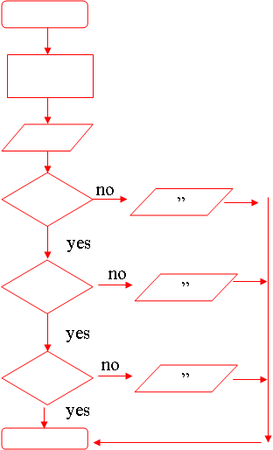
Example - Cascading if - else
/* Function to determine for input of numbers 0 through 9 */
#include <stdio.h>
main( )
{ char chr;
chr = getchar( );
if (chr = = ‘0’)
puts(“You entered the number 0”);
else if (chr = = ‘1’)
puts(“You entered the number 1”);
else if (chr = = ‘2’)
puts(“You entered the number 2”);
..
else if (chr = = ‘9’)
puts(“You entered the number 9”);
else
puts(“You did not enter a number”);
}

Slide 47
Nested if Construct
A nested if statement is encountered if the statement to be executed after a condition evaluates to true is another if statement.
Both the outer if statement and the inner if statement have to evaluate to true for the statement following the inner if condition to be executed.
no
yes
”
yes
no

Slide 48
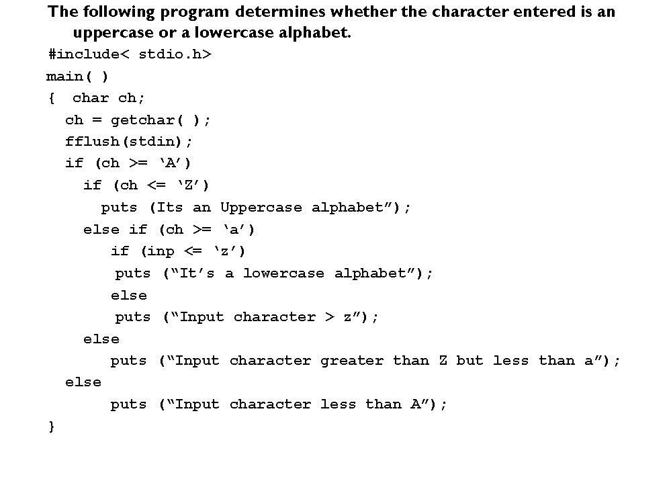
Nested if Construct: Example
Notes:
Braces are mandatory when, corresponding to an if or an else statement, there are multiple steps to be executed.

Slide 49
switch statement
The switch statement tests the value of a given variable(or expression) against a list of case values and when a match is found, a block of statements associated with that case is executed.
The break statement at the end of each block signals the end of particular case and causes an exit from the switch statement, transferring the control to the statement-x.
The default is an optional case. When present, it will be executed if the value of the expression does not match any of the case values.
If default not present, no action takes place if all matches fail and control goes to statement-x.
switch (expression)
{
case value-1 : case-1 block
break;
case value-2 : case-2 block
break;
default : default block
break;
}
statement-x;
Notes:
The switch-case conditional construct is a more structured way of testing for multiple conditions rather than resorting to a cascading, or a multiple if statement.
A switch-case statement makes for better readability, and hence makes code better understandable.
The switch-case statement is used in situations where based on the value of a variable, certain actions need to be taken.
switch ( ) specifies the variable name which has to be compared with the specified cases. The variable may be an integer or a character variable.
The case statements specify values which may be integer or character constants. They also specify the action to be taken if the value specified in the case statement matches with the value of the switch variable.
After the action for a particular case value is specified, the break statement is used to bring control out of the switch block of statements, and to the statement immediately following the switch block.
If the break statement is not specified after the statements associated with each case statement, then all the statements associated with the other case statements will be executed.
This will be in addition to the statements associated with the case statement whose value evaluated to the value of the variable specified in the switch statement.
This is because when one of the case statements is evaluated as true, the action statements are executed until a break statement sends control out of the switch block of statements, or the switch block comes to an end.

Slide 50
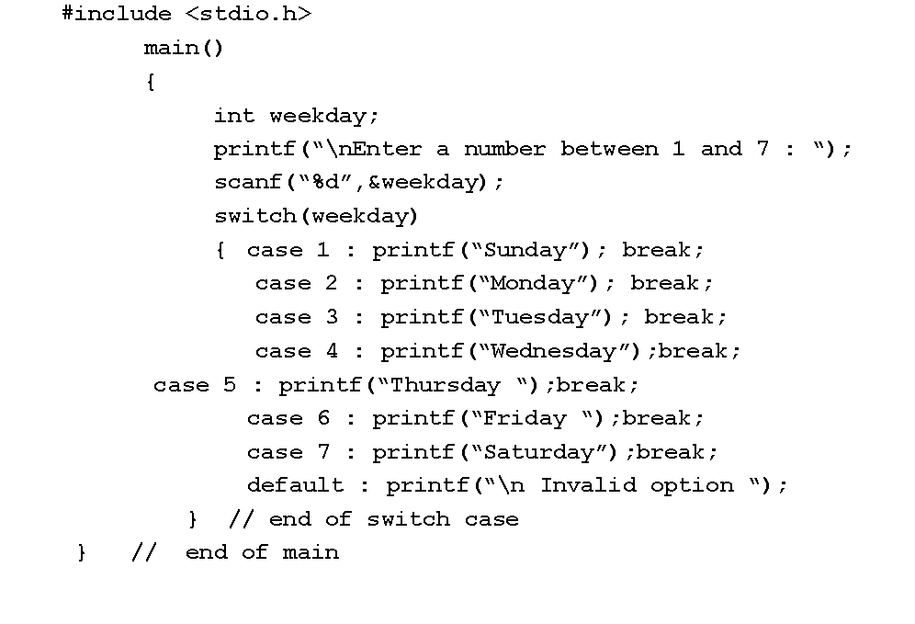
Example – switch statement
Example : Write a program to accept a number from 1 to 7 and display the appropriate week day with 1 for Sunday.

Slide 51
Iterative Constructs - The while Loop
In a while loop, the loop condition is written at the top followed by the body of the loop.
Therefore, the loop condition is evaluated first, and if it is true, the loop body is executed.
After the execution of the loop body, the condition in the while statement is evaluated again. This repeats until the condition becomes false.
General form
while(test-condition)
{
body of the loop
}
Evaluate Condition
false
true
Execute body of loop
Notes:
51

Slide 52
Example - The while Loop
#include <stdio.h>
/* function to accept a string and display it 10 times
main( )
{
int counter=0;
char message[10];
gets( message);
fflush( stdin);
while (counter <= 9)
{
puts( message);
counter = counter + 1;
gets( message);
fflush (stdin)
}
}

Slide 53
do…while loop
The general form of do..while loop is
do
{
body of the loop
} while (test-condition) ;
The do..while construct provides an exit-controlled loop as the test-condition is evaluated at the bottom of the loop and therefore the body of the loop is always executed at least once.
Execute body of loop
Evaluate Condition
false
true
Notes:
In this loop construct, the body of the loop comes first followed by the loop condition at the end.
Therefore, when this loop construct is used, the body of the loop is guaranteed to execute at least once.
The loop is entered into straightaway, and after the first execution of the loop body, the loop condition is evaluated.
Subsequent executions of the loop body would be subject to the loop condition evaluating to true.

Slide 54
Example – do…while loop
/* This is an example of a do-while loop */
main()
{
int i;
i = 0;
do {
printf("The value of i is now %d\n",i);
i = i + 1;
} while (i < 5);
}

Slide 55
for loop
The for loop is another entry-controlled loop that provides a more concise loop structure
for(initialization;test-condition;increment)
{
body of the loop
}
Initialization of the control variable is done first,using assignment statements
Notes:
The for loop construct is by far the most powerful and compact of all the loop constructs provided by C.
This loop keeps all loop control statements on top of the loop, thus making it visible to the programmer.
The for loop works well where the number of iterations of the loop is known before the loop is entered into.
The header of the loop consists of three parts separated by semicolons:
The first part is executed before the loop is entered. This is usually the initialization of the loop variable.
The second is a test. The loop is terminated when this test returns a false.
The third part is a statement to be run every time the loop body is completed. This is usually an increment of the loop counter.

Slide 56
Example – for loop
#include <stdio.h>
/* this function displays a message 10 times */
main( )
{
int i;
for( i = 0; i <= 9; i = i + 1)
{
puts( “message”);
}
}

Slide 57
Features of for loop
Initializing, testing and incrementing are placed in the for loop itself, thus making them visible to the programmers and users, in one place.
The for statement allows for negative increments. More than one variable can be initialized at a time.
for (p=1,n=0;n<17;++n)
The increment section can also have more than one part.
for (n=1,m=50;n<=m;m++,n--)
One or more sections can be omitted, if necessary.
for(;m!=0;)
** The semicolons separating the sections must remain.
If the test-condition is not present, the for statement sets up an infinite loop.
for(i=0; ;i++)
Notes:
Time delay loops can be set up using the null statements.
for(j=1000;j>0;j--);

Slide 58
Control of Loop Execution
A loop construct, whether while, or do-while, or a for loop continues to iteratively execute until the loop condition evaluates to false.
The break statement is used to exit early from all loop constructs (while, do-while, and for)
The continue statement used in a loop causes all subsequent instructions in the loop body (coming after the continue statement) to be skipped.
Notes:
But there may be situations where it may be necessary to exit from a loop even before the loop condition is reevaluated after an iteration.
Control passes back to the top of the loop where the loop condition is evaluated again.
In case of a continue statement in a for loop construct, control passes to the reinitialization part of the loop, after which the loop condition is evaluated again.

Slide 59
break and continue statements
When a break statement is encountered in a loop,the loop is exited and the program continues with the statements immediately following the loop.
When the loops are nested,the break would only exit from the loop containing it.
continue statement causes the loop to be continued with the next iteration after skipping any statements in between.
In while and do loops,continue causes the control to go directly to the test-condition and then continue the iteration process.
In case of for loop, the increment section of the loop is executed before the test-condition is evaluated

Slide 60
goto statement
C supports goto statement to branch unconditionally from one point to another in a program.
The goto requires a label in order to identify the place where the branch is to be made.
A label is any valid variable name , and must be followed by a colon.
int no,sqroot;
read:scanf(“%d”,&no);
if(no<0)
goto read;
sqroot=sqrt(no);

Slide 61
C Statements
Expression
Conditional
if (expr) { … } else {…}
switch (expr) { case c1: case c2: … }
Iteration
while (expr) { … } zero or more iterations
do … while (expr) at least one iteration
for ( init ; valid ; next ) { … }
Jump
goto label
continue; go to start of loop
break; exit loop or switch
return expr; return from function

Slide 62
Hands-on: 2 hours
Purpose
Using all types operators
Implementing various data types
Using all types of conditional & iterative constructs
Using control statement
Performing data type conversions
Notes:
Hands-on for 2 hours to be taken up to understand constructing various expressions using operators and implementing constructs
Refer to hand-out in the supporting document (Module 2: Operators & control structures)

Slide 63
Summary
In this module, we discussed:
Classifying and using operators
Unary, binary, ternary, compound assignment operators, increment/ decrement operators
Rules of conversion between different data types
Conditional constructs and iterative constructs
in this module

Slide 64
Arrays and Pointers Module 3

Slide 65
Objectives
At the end of this module, you will be able to:
Declare, initialize, manipulate, and address one-dimensional arrays
Declare, initialize, manipulate and print from a two-dimensional array
Declare, initialize, and manipulate pointers
Use pointers for manipulating one-dimensional and two-dimensional arrays
Distinguish between arrays and pointers
Use pointer arithmetic
a
Duration: 4 hrs

Slide 66
Arrays
An array is a group of related data items that share a common name.
int a[10];
The individual values are called elements.
The elements are a[0] ,a[1] , a[2]……a[9].
The elements are stored in continuous memory locations during compilation.
The name of the array(a)contains the address of the first location i.e a[0].
The elements of the array are physically and logically adjacent.
When an array is passed as an argument to a function,its address is actually passed.
Data type
Index(size)
Notes:
Array: sequence of identical objects in memory
int a[10]; means space for ten integers
By itself, a is the address of the first integer
*a and a[0] mean the same thing
The address of a is not stored in memory: the compiler inserts code to compute it when it appears
Each array element shares the same name as the array name, but distinguishes itself from other elements in the array using a subscript, or an index.
The subscript or the index of each array element is determined based on the number of offset positions it has.

Slide 67
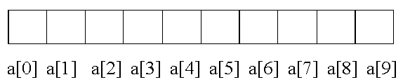
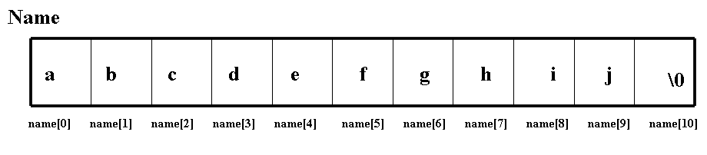
Array Representation
int a[10];
/*defines an array a of size 10, as a block of 10 contiguous elements in memory */
Character Arrays
Char name[11];
To define a character array, need to define a array of size n+1 characters.This is because all character arrays are terminated by a NULL character (‘\0’)
where name[0] through name[9] will contain the characters comprising the name, and name[10] will store the NULL character

Slide 68
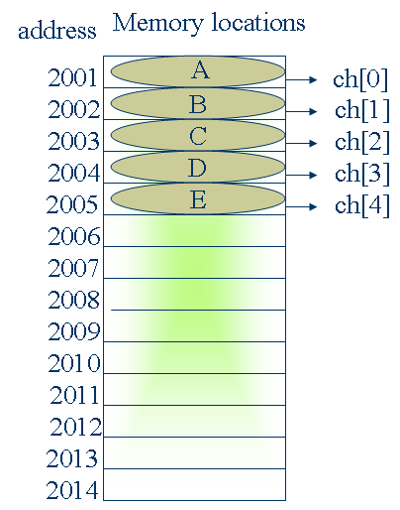
Array - Memory allocation
char ch[5]={ ‘A’,’B’,’C’,’D’,’E’};
or
ch[0]=‘A’;
ch[1]=‘B’;
ch[2]=‘C’;
ch[3]=‘D’;
ch[4]=‘E’;
Note: Memory allocation is done by OS.

Slide 69
Array Initialization
Since an array is a set of elements located at contiguous memory locations, its initialization involves moving element by element, or one data at a time into the array.
#include<stdio.h>
main( )
{
char array1[ ] = {‘A’, ‘R’, ‘R’, ‘A’, ‘Y’, ‘\0’};
char array2[ ] = {“ARRAY”};
char dayofweek[ ] = {‘M’, ‘T’, ‘W’, ‘T’, ‘F’, ‘S’, ‘S’, ‘\0’};
float values[ ] = {100.56, 200.33, 220.44,0};
}
Notes:
An array is initialized by specifying each element in an initialization list separated by commas.
The size of the array, in this case, may or may not be specified. The number of elements stored in the array determines its size.
A character array needs a string terminator, the NULL character (‘\0’) as the last character, whereas integer and float arrays do not need a terminator.
Array Initialization Using a for loop
#include<stdio.h>
main( )
{
int i, num[50];
for (i = 0; i < 50; i = i + 1)
{
num[i] = 0;
num[i] = i + 1;
}
}
If you wish to declare an array, and then to initialize it in a subsequent step, you will have to initialize them element by element through an iterative construct.

Slide 70
Array Processing
#include<stdio.h>
main( )
{ char array1[ ] = {‘A’, ‘R’, ‘R’, ‘A’, ‘Y’, ‘\0’};
char array2[ ] = {“ARRAY”};
char dayofweek[ ] = {‘M’, ‘T’, ‘W’, ‘T’, ‘F’, ‘S’, ‘S’, ‘\0’};
float values[ ] = {100.56, 200.33, 220.44, 400.22, 0};
int i = 0;
printf( “String 1 is %s\n”, array1);
printf( “String 2 is %s\n”, array2);
for( i = 0; dayofweek[i] != ‘\0’; i = i +1)
printf ( “The Day %d in a week is %c\n”, i + 1, dayofweek[i];
for( i = 0; values[i] != 0; i = i +1)
printf ( “The amount %d in a week is %f\n”, i + 1, values[i];
}
Notes:
70
It is important to know that array initialization using an initialization list can only be possible at the time of declaration of the array. That is, declaration and initialization have to be done in a single step. They cannot be broken down into two steps as in:
char array1[6 ];
char array1[ ] = {“ARRAY”};

Slide 71
Array Manipulation Using Subscripts
/* this function finds the length of a character string */
#include <stdio.h>
main( )
{
int i = 0;
char string[11];
printf(“Enter a string of maximum ten characters\n”);
gets(string);
fflush( stdin);
for(i =0; string[i] != ‘\0’; i = i + 1);
printf(“The length of the string is %d \n”, i);
}

Slide 72
Example - Array Manipulation Using Subscripts
/* this function converts a string to upper case */
main( )
{
char string[51];
int i = 0;
printf(“Enter a string of maximum 50 characters\n”);
gets(string);
fflush(stdin);
while (string[i] != ‘\0’)
{
if(string[i] >= ‘a’ && string[i] <= ‘z’)
{
string[i] = string[i] – 32;
i = i + 1;
}
printf(“The converted string is %s\n”, string)
}
Notes:
72
The C programming language facilitates arithmetic with characters. It is significant to note that characters are enclosed in single quotes. On the other hand, strings are enclosed in double characters. Consider the following assignment statements:
Char x;
x = ‘v’; // x is a character variable that takes up a single byte of storage.
On the other hand, character “v” within double quotes would entail that it is a string requiring a minimum of two bytes of storage (one for the character v and the other for the NULL character ‘\0’).

Slide 73
Example - Array Manipulation Using Subscripts (Contd.).
/* function to extract a substring from a main string starting at a specified position, and containing a specified number of characters */
main( )
{
int i, start_pos, no_of_chars;
char string[101], substring[101];
printf(“Enter a string of upto 100 characters\n”);
gets(string);
fflush( stdin);
printf(“Enter start position, and no. of characters to extract\n”);
scanf(“%d,%d”, &start_pos, &no_of_chars);
fflush(stdin);
start_pos = start_pos -1;
for (i = 0; i < no_of_chars; i = i + 1, start_pos = start_pos + 1)
{
substring[i] = string[sp];
}
substring[i] = ‘\0’;
printf(“The substring is %s\n”, substring);
}

Slide 74
Example - Array Manipulation Using Subscripts
/* the following function accepts numbers as long as 0 is not entered as an array element, and displays the sum of the numbers in the array along with the array elements */
main( )
{
int total, int_array[20], i = -1;
do
{
i = i + 1;
printf(“Enter number %d (0 to terminate)\n”);
scanf(“%d”, &int_array[i]);
}while (int_array[i] != 0);
i = 0;
while (int_array != 0)
{
printf(“Element number %d is %d\n”, i + 1, int_array[i]);
total = total + int_array[i];
}
printf(“The sum of the numbers in the array is %d \n”, total);
}

Slide 75
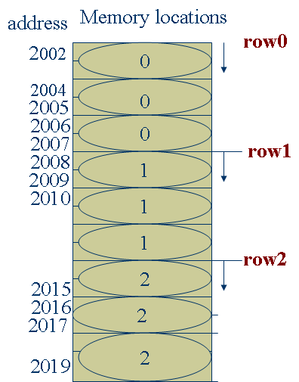
Two-Dimensional Arrays
Declaration:
type array_name[rowsize][columnsize];
Eg:
int m[3][3]={0,0,0,1,1,1,2,2,2};
m[0][0] m[0][1] m[0][2]
m[1][0] m[1][1] m[1][2]
m[2][0] m[2][1] m[2][2]
In multi-dimensional arrays,elements are stored sequentially row wise in memory.
Notes:
While a one-dimensional array can be visualized in one-dimension as either a row of elements, or a column of elements, a two-dimensional array needs to be visualized along two dimensions, i.e., along rows and columns.
To be precise, a two-dimensional array can be represented as an array of m rows by n columns.
A general way of representing or visualizing a two-dimensional array is in the form of a two-dimensional grid. But, in memory, even a two-dimensional array is arranged contiguously as an array of elements.

Slide 76
Two-dimensional Arrays (Contd.).
col 0
col 1
col 2
row 0
row 1
row 2
r0,c0
r0,c1
r0,c2
r1,c0
r1,c1
r1,c0
r2,c0
r2,c1
r2,c2
Notes:
The Scenario: Consider a situation where you want to record the region-wise, product-wise figures of sales. The regions are A, B and C. The products are X, Y and Z
Sales data for the region-wise, product-wise breakup should be shown as follows:

Slide 77
Two-Dimensional Array – Declaration, Initialization
Declaring a two-dimensional array involves two indices, or two subscripts. There will be an extra set of [ ] to indicate the second subscript, or the second index.
int rp_array[3][3] = { 0,0,0,
0,0,0,
0,0,0
};
To improve the legibility of the initialization, it can be written as:
int rp_array[3][3] = { {0,0, 0},
{0, 0, 0},
{0, 0, 0}
};
Notes:
To declare a two-dimensional array for accommodating sales data for three regions and three products, we would come out with an array declaration as in:
int rp_array[3][3];
/* this array would have nine elements starting at rp_array[0][0], rp_array[1][1]…….and going on till rp_array[2,2] */

Slide 78
Processing Two-Dimensional Arrays
/* Program for converting these sales figures into percentages of total sales. */
main( )
{ int r_counter, p_counter, rp_array[3][3], total_sales = 0;
float rp_array_perc[3][3];
/* input sales into rp_array using the for loop */
for (r_counter = 0; r_counter < 3; r_counter ++)
{ for (p_counter = 0; p_counter < 3; p_counter ++)
{printf( “\nEnter sales data for Region %d and Product %d, r_counter + 1, p_counter + 1);
scanf(“%d”, &rp_array[r_counter][p_counter]);
fflush( stdin);
}
}
/* Determine total sales using the for loop */
for (r_counter = 0; r_counter < 3; r_counter ++)
{ for (p_counter = 0; p_counter < 3; p_counter ++)
total_sales += rp_array[r_counter][p_counter];
}
Notes:
78

Slide 79
Processing Two-Dimensional Arrays (Contd.).
/* Determine percentage of individual sales data against total sales */
for (r_counter = 0; r_counter < 3; r_counter ++)
{ for (p_counter = 0; p_counter < 3; p_counter ++)
rp_array_perc[r_counter][p_counter] =
(( float)100 * rp_array[r_counter][p_counter] ) / total_sales ;
}
} /* end of main( ) */

Slide 80
The Preprocessor Phase
The measure of the flexibility of any program is the ease with which changes can be implemented.
The preceding exercises involving two-dimensional arrays is inflexible because the number of regions and products is hard coded into the program, causing the size of the array to be also hard coded.
If changes in terms of the number of regions and products were to be incorporated with the least amount of code maintenance, the best solution would be the use of macros referred to in C as #define.

Slide 81
The Preprocessor Phase (Contd.).
The #define constitutes the preprocessor phase, wherein the value/s specified as part of the macro or #define is substituted into the code prior to compilation. This is also known as macro substitution.
#include <stdio.h>
#define RG 3
#define PR 3
main( )
{ int r_counter, p_counter, rp_array[RG][PR], total_sales = 0;
float rp_array_perc[RG][PR];
/* initialization of rp_array using the for loop */
for (r_counter = 0; r_counter < RG; r_counter ++)
{ for (p_counter = 0; p_counter < PR; p_counter ++)
rp_array[r_counter][p_counter] = 0;
}

Slide 82
Two-Dimensional Character Arrays
If you were to store an array of 11 names, with each name containing up to a maximum of 30 characters, you would declare it as a two-dimensional character array such as: char name[11][31];
Here, name[0] through name[9] would store character strings representing names of 30 characters each.
The first index represents the number of names, and the second index represents the maximum size of each name.
main( )
{ char team_india [11][30] = {
“Akash Chopra”,
“Virendra Sehwag”,
“Rahul Dravid”
“Sachin Tendulkar”,
“V.V.S. Laxman”,
“Yuvraj Singh”,
“Ajit Agarkar”,
“Parthiv Patel”,
“Anil Kumble”,
“L. Balaji”,
“Irfan Pathan”
};
int i;
for( i = 0; i < 11; i ++)
printf(“%s”, team_india[i]);
}
Notes:
Particular elements can also be printed from a two dimensional array by using the second subscript.
Printf(“%c”, team_india[10][6] would print the character ‘P’ from the string “Pathan”

Slide 83
Pointers
A pointer is a variable which holds the address of another variable in memory.The actual location of a variable in the memory is system dependent.
Since pointer is a variable ,its value is also stored in the memory in another location.
& operator(address of) is used to assign the address of a variable to a pointer variable.
The declaration of a pointer takes the following form:
data type *ptr;
Eg: int *pa;
int a;
pa=&a;
The asterisk(*)tells that pa is a pointer variable.
pa needs a memory location.
pa points to a variable a of type int
Notes:
When a variable is declared (such as int i = 22) in a program, space is reserved in memory for the variable i.
To be precise, each variable is assigned a particular memory location referenced by its address.
In our case, the integer i would be stored at a specific memory location having the address, say, 1000 (addresses are typically hexadecimal values).
The declaration of i can be conceptualized as follows:

Slide 84
Accessing a variable through its pointer
A pointer contains garbage until it is initialized
The value of a variable can be accessed using pointer by *(asterisk) known as indirection operator.
Eg: int a,n;
int *pa;
a=4;
n=*pa;
The value of a i.e 4 is assigned to n through its pointer pa.
When the operator * is placed before a pointer variable in an expression,the pointer returns the value of the variable of which the pointer value is the address.
Notes:
In C, it is possible to manipulate a variable either by its name, or by its address. The address of a variable can be stored in another variable (called a pointer variable), and access can be had to the variable through this pointer variable.
A pointer can therefore be defined as a variable that holds the address of another variable.
If you want to define a pointer to hold the address of an integer variable, then you must define the pointer as a pointer to an integer.
The ‘*’ operator precedes a pointer operand. In the preceding declaration, int *pointer_to_an_integer; the ‘*’ operator preceding the variable name marks it out as a pointer declaration, and the data type of the pointer variable begins the pointer declaration.
It is obvious from the preceding code snippet that the ‘&’ operator is used to return the address of a variable. The returned address is stored into a pointer variable of the appropriate type.
It is critical, as a good C programmer, to initialize a pointer as soon as it is declared.

Slide 85
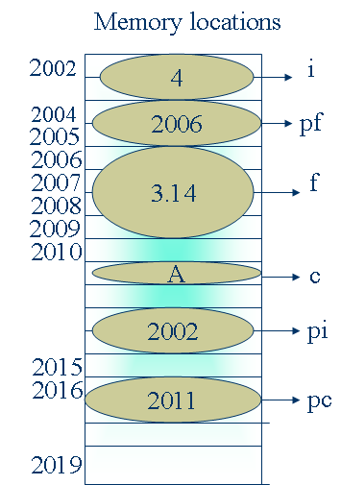
Pointer - Memory Allocation
int i,*pi;
float f,*pf ;
char c,*pc;
i=4;
f=3.14;
c=‘A’
pi=&i;
pf=&f;
pc=&c;
The actual location of a variable in the memory is OS dependent.
Two bytes(in DOS )of memory is allocated to any type of pointer.

Slide 86
Pointer – Declaration & Initialization
It is in this sense that a pointer is referred to as a derived data type, as the type of the pointer is based on the type of the data type it is pointing to.
For the earlier declaration of the integer variable i, its pointer can be declared as follows:
int i, *pointer_to_an_integer;
i = 22;
pointer_to_an_integer = &i;
/* initialize pointer variable (pointer_to_an_integer) with address of the integer variable i. */
i
variable name
pointer_to_an_integer
22
variable value
1000
1000
variable address
Notes:
86
Note the declaration of the

Slide 87
Dereferencing a Pointer
Returning the value pointed to by a pointer is known as pointer dereferencing. To deference the contents of a pointer, the * operator is used.
#include<stdio.h>
main( )
{ int x, y, *pointer;
x = 22;
pointer = &x;
y = *pointer; /* obtain whatever pointer is pointing to */
}
Notes:
Pointers - Variations on a theme
pointer = &x; /* make pointer point to x */
y = *ptr + 1; /* return the value of the variable pointed to by pointer, add 1 to it, and store the result in y */
*ptr = 0; /* set the value of the variable pointed to by pointer to 0. In this case, the variable x is set to 0 through its pointer */

Slide 88
Pointers - Variations on a Theme
Consider the following code snippet:
int x, y, *pointer1, *pointer2;
pointer1 = &x /* return the address of x into pointer1 */
pointer2 = pointer1;
/* assign the address in pointer1 to pointer2. Hence, both the pointer variables, pointer1 and pointer2, point to the variable x. */
i
variable name
pointer1
22
variable value
1000
1000
variable address
pointer2
1000

Slide 89
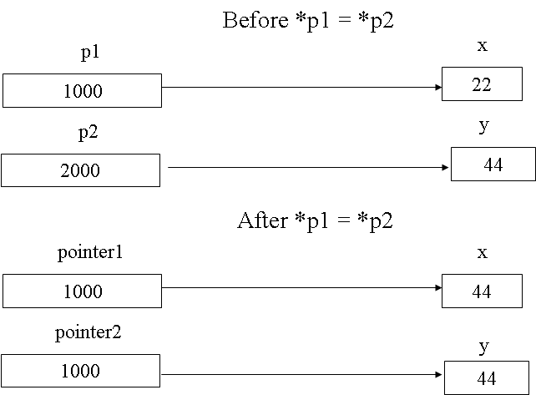
Pointers - Variations on a Theme (Contd.).
Consider the following code snippet:
int x, y, *p1, *p2;
x = 22;
y = 44;
p1 = &x; /* p1 points to x */
p2 = &y ; /* p2 points to y */
*p1 = *p2 ;
/* make whatever p1 was pointing to (variable x and hence the value 22) equivalent to whatever p2 is pointing to. */
Hence, both x and y will now have the value 44.

Slide 90
Printing Using Pointers
Consider the following code snippet:
#include <stdio.h>
main( )
{
int x, *p;
x = 26;
p = &x;
printf(“The value of x is %d\n”, x);
printf(“The value of x is %d\n”, *p);
}

Slide 91
Pointer increments and scale factor
int *pa;
float *pf;
char *pc;
pi++;
pf++;
pc++;
When a pointer is incremented ,its value is increased by the length of the data type that its points to.This length is called scale factor.
The no of bytes used to store various data types can be found by using sizeof operator.

Slide 92
Pointers and Arrays
Consider the following declaration:
char string[10], *p;
Both string and p are pointers to char
However, string[10] has 10 bytes of contiguous storage allocated for it.
Thus, during execution, string is effectively a pointer with a constant address, namely, the address &string[0]; and this address cannot be changed during the life of the program
Notes:
However, p is a pointer variable that can point to one string at one point of time during the running of the program, and can also point to another string at another point of time during the running of the same program.
p is a variable, and a variable by its very definition can hold different values at different points of time during one run of the program.
Therefore, we can conclude that a string is a pointer constant, whereas an explicit character pointer declaration is a character pointer variable.

Slide 93
Character Arrays Using Pointers
One-dimensional
The one-dimensional character array declared earlier (char string[11]) can be alternately declared as:
char *string; /* string is now a explicit pointer variable that can point to a character */
char *string = “Hello”;
printf(“%s”, string);
Two-dimensional
Since a pointer to a character can be a pointer to a string, it follows that a two-dimensional character array can be declared as an array of character pointers.
This could be alternately declared as:
char *team_india[11];
Notes:
team_india is now an array of 11 character pointers, each of which in turn can point to a string. A pointer to a character can be a pointer to a string as well.
Recall the declaration of the two dimensional character array that you used earlier to store 11 names, each of which could be a maximum of 30 characters. It was written as: char team_india [11][30];
The flexibility with a declaration of an array of character pointers is that each of the character pointers may point to an array of unequal length, as against the declaration of a two-dimensional character array in which each string is of a fixed size.

Slide 94
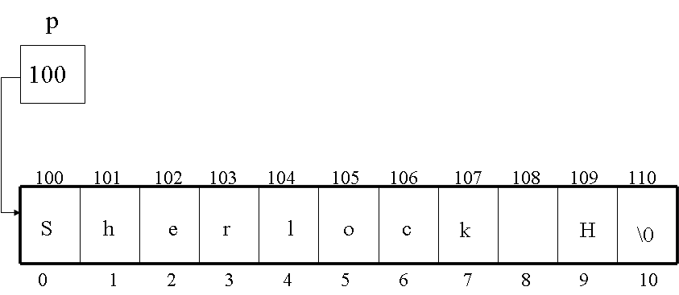
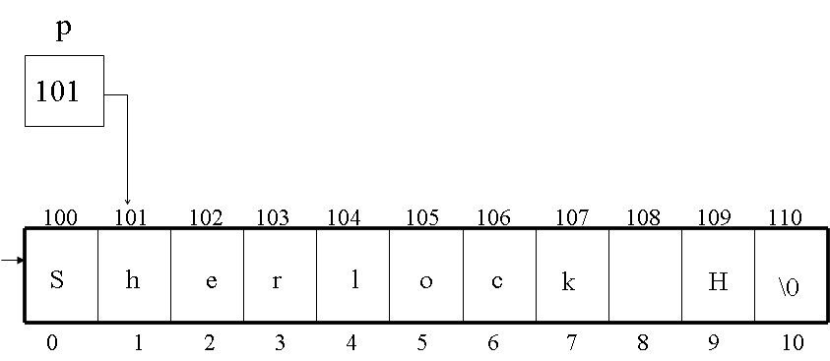
Pointer Arithmetic
char *p = “Sherlock H”;
printf(“%s\n”, p);
The initialization of the character pointer with the string “Sherlock H” can be visualized as shown in the following slide.
After incrementing the pointer p by 1, it points to the next element in the string or the character array, i.e., character ‘h’ after ‘S’. p now contains the address of the element ‘h’, i.e., 101
Notes:
Now, let us increment the pointer p by 1, as in:
p++;

Slide 95
Pointer Arithmetic (Contd.).
Consider the following declaration of a two-dimensional integer array:
int p[3][5] = {{ 2, 4, 6, 8, 10},
{ 3, 6, 9, 12, 15},
{ 5, 10, 15, 20, 25}
};
The aforesaid declaration declares an array of three integer pointers, each pointing to the first element of an array of 5 integers. This can be visualized as follows:

Slide 96
Pointer Arithmetic (Contd.).
p
100
200
204
208
212
216
100
200
2
4
6
8
10
300
304
308
312
316
104
300
3
6
9
12
15
400
404
408
412
416
108
400
5
10
15
20
25
Notes:
Here, p points to the first element of the array of pointers.
*p equals p[0], i.e., it returns the address 200. This address points to the element at offset [0,0], i.e., element 2.
Therefore, *(*p) returns the value 2.
Since p is a pointer to another pointer, incrementing p by 1 makes it point to the next element in the array of pointers, i.e., it now points to the element containing the address 300.

Slide 97
Pointer Arithmetic (Contd.).
Hence, *(p + 1) returns the address 300.
Therefore, * (*(p + 1)) returns the value at this address, i.e., the element with the value 3. In other words, the element at the offset [1,0].
The following table gives various pointer expressions, and their values:
Pointer Expression | Resulting Address | Variable | Value
*(*p) | 200 | p[0][0] | 2
*(*p+1) | 204 | p[0][1] | 4
*(*(p + 1)) | 300 | p[1][0] | 3
*(*(p+1)+1) | 304 | p[1][1] | 6
*(*(p+1)+1)+1 | 304 | p[1][1] + 1 | 6 + 1 = 7

Slide 98
String Handling Functions Using Pointers
/* The following function determines the length of a string */
#include <stdio.h>
main( )
{
char *message = “Virtue Alone Ennobles”;
char *p;
int count;
for (p = message, count = 0, p != ‘\0’, p++)
count++;
printf(The length of the string is %d\n”, count);
}

Slide 99
String Handling Functions Using Pointers (Contd.).
/* The following functions compares two strings */
#include<stdio.h>
main( )
{
char *message1 = “This is a test”;
char *message2 = “This is not a test”;
char *p1, *p2;
for(p1=message1, p2=message2; (*p1 = = *p2) && (*p1 != ‘\0’) && (*p2 != ‘\0’); p1++, p2++)
if ((*p1 = = ‘\0’) && (*p2 = = ‘\0’))
printf(“The two strings are identical\n”);
else
printf(“The two strings are not identical\n”);
}

Slide 100
Hands-on: 2 hours
Purpose
Construct single and 2 dimensional Arrays
Access & computing array elements
Use pointers for any variable
Notes:
Hands-on for 2 hours to be taken up to construct Arrays (single & 2) and hence to access elements and performing computation
Refer to hand-out in the supporting document (Module 3: Arrays and Pointers)

Slide 101
Summary
In this module, we discussed:
One-dimensional arrays - Declare, initialize and manipulate
Two-dimensional array - - Declare, initialize and manipulate
Pointers - Declare, initialize, and manipulate
pointers for manipulating one-dimensional and two-dimensional arrays
Use pointer arithmetic

Slide 102
Functions & Recursion Module 4

Slide 103
Objectives
At the end of this module, you will be able to:
Write programs that invoke functions through a:
Call by value
Call by reference
Define function prototypes
Describe the function call mechanism
Use the Auto, Static, and Extern storage qualifiers
Use string handling functions, conversion functions, and functions for formatting strings in memory
Describe how to write a recursive function
Describe recursive calls to a function using the runtime stack
Define, Declare, and Use Function Pointers
Duration: 4 hrs

Slide 104
Function - Introduction
Functions facilitate the factoring of code.
Functions facilitate:
Reusability
Procedural abstraction
Function Parameters
Function parameters are defined as part of a function header, and are specified inside the parentheses of the function.
The reason that functions are designed to accept parameters is that you can embody generic code inside the function.
All that would be required by the function would be the values that it would need to apply the generic code on the values received by it through its parameters
Notes:
Every C program consists of one main( ) function typically invoking other functions, each having a well-defined functionality.
By procedural abstraction, we mean that once a function is written, it serves as a black box. All that a programmer would have to know to invoke a function would be to know its name, and the parameters that it expects.

Slide 105
Function Parameters
Consider the following printf( ) statement:
printf(“%d”, i);
This is actually a call to the printf( ) function with two pieces of information passed to it, namely, the format string that controls the output of the data, and the variable that is to be output.
The format string, and the variable name can be called the parameters to the function printf( ) in this example.
Notes:
Function parameters are therefore a mechanism wherein values can be passed down to a function for necessary processing, and the processed value returned back from the function, as the case may be.
It is important to remember that not all function need be defined to accept parameters, though most functions do.
This brings us now to the important concept of a function returning a value, and also the return type of a function.

Slide 106
Invoking Functions
In C, functions that have parameters are invoked in one of two ways:
Call by value
Call by reference
Call by Value
Call by reference
void swap(int,int );
main()
{ int a=10, b=20;
swap(a, b);
printf(“ %d %d \n”,a,b);
}
void swap (int x, int y)
{ int temp = x;
x= y;
y=temp;
}
void swap( int *, int *);
main()
{ int a=10, b=20;
swap(&a, &b);
printf(“ %d %d \n”,a,b);
}
void swap (int *x, int *y)
{ int temp=*x;
*x=*y;
*y=temp;
}
Notes:
The call by value mechanism is the default mechanism of function call employed by C. This means that whenever you pass a variable/s to a function, they are implicitly passed by value. The call by value mechanism is useful when it is critical that the called function does need to directly modify the argument in the calling function. The call by value mechanism acts as a safeguard against accidental change to the arguments in the calling function, for it ensures that the called function works on only the copy of the arguments through its parameters.
In the preceding example, the function main( ) declared and initialized two integers a and b, and then invoked the function swap( ) by passing a and b as arguments to the function swap( ).
The function swap( ) receives the arguments a and b into its parameters x and y. In fact, the function swap( ) receives a copy of the values of a and b into its parameters.
The parameters of a function are local to that function, and hence, any changes made by the called function to its parameters affect only the copy received by the called function, and do not affect the value of the variables in the called function. This is the call by value mechanism.
Call by reference means that the called function should be able to refer to the variables of the calling function directly, and not create its own copy of the values in different variables.
This would be possible only if the addresses of the variables of the calling function are passed down as parameters to the called function.
In a call by reference, therefore, the called function directly makes changes to the variables of the calling function.

Slide 107
Passing Arrays to Functions
Arrays are inherently passed to functions through a call by reference
For example, if an integer array named int_array of 10 elements is to be passed to a function called fn( ), then it would be passed as:
fn( int_array);
Recall that int_array is actually the address of the first element of the array, i.e., &int_array[0]. Therefore, this would be a call by reference.
The parameter of the called function fn( ) would can be defined in one of three ways:
fn( int num_list[ ]); or
fn(int num_list[10]); or
fn(int *num_list)

Slide 108
Returning a Value From a Function
Just as data can be passed to a function through the function’s parameters at the time of call, the function can return a value back to the caller of the function.
In C, functions can return a value through the return statement.
#include<stdio.h>
main( )
{ int i,j, value;
scanf(“%d %d”, &i, &j);
fflush(stdin);
value = add(i, j);
printf( “the total is %d\n”, value);
}
add( int a, int b)
{ return (a + b);
}
Notes:
In the aforesaid example, the function add( ) sends back the value of the expression (a + b) to the function main( ). The value returned to main( ) from add( ) is stored in the variable value which appears on the left hand side of the statement in which the function add( ) is called.
The return statement not only returns a value back to the calling function, it also returns control back to the calling function.
A function can return only one value, though it can return one of several values based on the evaluation of certain conditions.

Slide 109
Function Prototype
C assumes that a function returns a default value of int if the function does not specify a return type
In case a function has to return a value that is not an integer, then the function itself has to be defined of the specific data type it returns.
Functions should be declared before they are used.
Consider the situation where you want to use the pow( ) function, called the power function, one of many functions in the mathematics library available for use by the programmer.
A function call such as pow(x, y) returns the value of x raised to the power y.

Slide 110
Function Prototype (Contd.).
To elucidate further, pow(2.0, 3.0) yields the value 8.0
The declaration of the function is given by:
double pow( double x, double y);
Function declarations of this type are called function prototypes.
An equal function prototype is given by:
double pow( double, double);
A function prototype tells the compiler the number and data types of arguments to be passed to the function and the data type of the value that is to be returned by the function.
ANSI C has added the concept of function prototypes to the C language.
Notes:
Identifiers such as x and y that appear in parameter lists in function prototypes are not used by the compiler. Their purpose is to provide documentation to the programmers and readers of the code.

Slide 111
Function Prototype (Contd.).
#include <stdio.h>
float add(float a, float b);
main()
{ float i, j, value;
scanf(“%f %f”, &i, &j);
fflush(stdin);
value = add(i, j);
printf( “the total is %d\n”, value);
}
float add(float a, float b)
{
return (a + b);
}
#include <stdio.h>
main( )
{ void add( float, float);
float i, j, value;
scanf(“%f %f”, &i, &j);
fflush(stdin);
add(i, j);
printf( “the total is %d\n”, value);
}
void add(float a, float b)
{
printf(“%f”, a + b);
return;
}
Notes:
111
In this example, the function add( ) has been declared of type float at the start of the program, and also where it has been defined. The calling function, main( ) in our case, should declare what type of data it is expecting from the called function. The called function should also declare what type of data it is returning to the calling function. In case a function does not return any value to the calling function, but simply returns control to it, then it can be declared to be of type void.

Slide 112
Function Calls
It is important for us to know what happens under the hood when a function executes.
A logical extension of the aforesaid point is the situation that arises when a function calls another function.
It is important to know how the CPU manages all this, i.e., knowing where to look for when a function call is encountered, and having executed the function, to also know where it has to return to.
In short, we need to know the call mechanism, and the return mechanism.
Notes:
Function Calls – A Top Level Overview
When a function call is encountered, it involves the following steps:
Each expression in the argument list is evaluated.
The value of the expression is converted, if necessary, to the type of the formal parameter, and that value is assigned to the corresponding formal parameter at the beginning of the body of the function.
The body of the function is executed.
If the return statement includes an expression, then the value of the expression is converted, if necessary, to the type specified by the type specifier of the function, and that value is passed back to the calling function.
If no return statement is present, the control is passed back to the calling function when the end of the body of the function is reached. No useful value is returned.

Slide 113
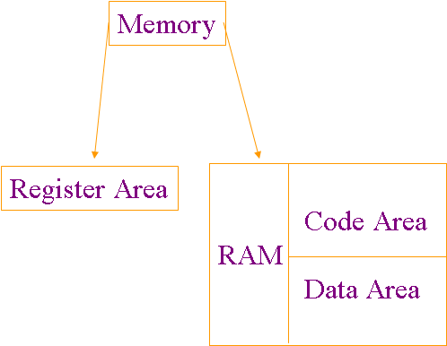
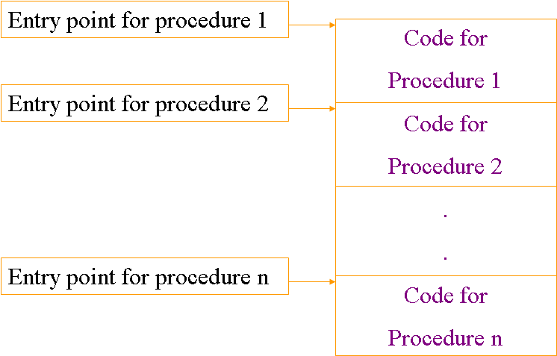
Function Calls & The Runtime Stack
Runtime Environment: Runtime Environment is the structure of the target computer’s registers and memory that serves to manage memory and maintain the information needed to guide the execution process.
The C language uses a stack-based runtime environment, which is also referred to as a runtime stack, or a call stack.
Let us begin by understanding the internal memory organization that comes into the picture whenever a program needs to be executed.
Code Area
Notes:
In most compiled languages, it is not possible to make changes to the code area during execution. The code area is fixed prior to the execution, and all code addresses are computable at compile time.
Entry point of each procedure and function is known at compile time.

Slide 114
Data Area
small part of data can be assigned fixed locations before execution begins
Global and/or static data
Compile-time constants
Large integer values
Floating-point values
Literal strings

Slide 115
Dynamic Memory
The memory area for the allocation of dynamic data can be organized in many different ways.
A typical organization divides the dynamic memory into
stack area (LIFO protocol)
heap area

Slide 116
Memory Organization
code area
global/static area
stack
free space
heap
free space

Slide 117
Procedure Activation Record
Procedure activation record contains memory allocated for the local data of a procedure or function when it is called, or activated.
When activation records are kept on stack, they are called stack frames. Details depend on the architecture of target machine and properties of the language.
A Procedure Activation Record or a Stack Frame
arguments
bookkeeping information (return address)
local data
local temporaries

Slide 118
Registers
Registers may be used to store temporaries, local variables, or even global variables.
When a processor has many registers, the entire static area and whole activation records may be kept in the registers.
Special purpose registers:
Program counter (PC)
Stack pointer (SP)

Slide 119
Calling Sequence
The calling sequence is the sequence of operations that must occur when a procedure or function is called.
Allocation of memory for the activation record
The computation and storing the arguments
Storing and setting registers
Compute the arguments and store them in their correct positions in the new activation record (pushing them in order onto the runtime stack)
Store (push) the fp as the control link in the new activation record.
Change the fp so that it points to the beginning of the new activation record (fp=sp)
Store the return address in the new activation record.
Jump to the code of the procedure to be called

Slide 120
Return Sequence
The return sequence is the sequence of operations needed when a procedure or function returns.
The placing of the return value where it can be accessed by the caller
Readjustment of registers
Releasing of activation record memory
Copy the fp to the sp
Load the control link into the fp
Jump to the return address
Change the sp to pop the arguments.

Slide 121
Fully Static Runtime Environment
The simplest kind of a runtime environment.
All data are static, remaining in memory for the duration of the program.
All variables can be accessed directly via fixed addresses
Each procedure has only a single activation record, which is allocated statically prior to execution.
Such environment can be used to implement a language in which:
There are no pointers or dynamic allocation,
Procedures cannot be called recursively.
Example: COBOL & FORTRAN

Slide 122
Stack-based Runtime Environment
In a language in which recursive calls are allowed, activation records cannot be allocated statically.
Activation records are allocated in a stack-based fashion.
This stack is called the stack of activation records (runtime stack, call stack).
Each procedure may have several different activation records at one time.

Slide 123
Global Procedures
In a language where all procedures are global (the C language), a stack-based environment requires two things:
A pointer to the current activation record to allow access to local variables.
This pointer is called the frame pointer (fp) and is usually kept in a register.
The position or size of the caller’s activation record
This information is commonly kept in the current activation record as a pointer to the previous activation record and referred as the control link or dynamic link.
Sometimes, the pointer is called the old fp
Additionally, there may be a stack pointer (sp)
It always points to the top of the stack

Slide 124
Tracing Function Calls
int z;
main( )
{
int x;
fn_a( );
….. .
.
.
.
}
fn_a( int m )
{
int y;
fn_b( );
…..
.
.
.
}
fn_b( int n )
{
int b;
…..
.
.
.
}
return instruction
return instruction

Slide 125
A View of the Runtime Stack
Stack
Growth
z
x
m y control link return address
n control link return address b
Free Store (Heap)
Global static area
Activation record of main
Activation record of call to fn_a( )
Activation record of call to fn_b( )
fp
sp

Slide 126
Access to Variables
In static environment, parameters and local variables can be accessed by fixed addresses.
In a stack-based environment, they must be found by offset from the current frame pointer.
In most languages, the offset for each local variable is still statically computable by compiler.
The declarations of a procedure are fixed at compile time and the memory size to be allocated for each declaration is fixed by its data type.

Slide 127
Variable Length-Data
There is a possibility that data may vary, both in the number of data objects and the size of each object.
Two examples:
The number of arguments in a call may vary from call to call.
The size of an array parameter or a local array variable may vary from call to call.
The printf( ) function in C, where the number of arguments is determined from the format string that is passed as the first argument.
printf(“%d%s%c”, n, prompt, ch);
printf(“Hello, world!”);
Notes:
C compilers push arguments onto the stack in reverse order.
The first parameter (which tells how many more parameters are) is always located at the fixed offset from fp.

Slide 128
Local Temporaries
Local temporaries are partial results of computations that must be saved across procedure calls.
Example:
x[i]=(i+j)*(i/k+f(i));
Three partial results need to be saved: the address of x[i], the sum i+j, and the quotient i/k.
They can be stored
In the registers
As temporaries on the runtime stack prior the call to f.

Slide 129
Nested Declarations
Nested declarations can be treated in a similar way to temporary expressions, allocating them on the stack as the block is entered and deleting them on exit.
void p (int x, double y)
{ char a;
int i;
{ double x; // block A
int y;
…
}
{ double x; // block B
int j;
…
}
{ char *a; // block C
int k;
…
}
}

Slide 130
Passing Arguments to main( )
Arguments are generally passed to a function at the time of call. And function calls are initiated by main( ).
Since main( ) is the first function to be executed, there is no question of main( ) being called from any other function.
So, if main( ) is not going to be invoked by any other function, is it possible to pass arguments to main( ) given the fact that arguments are generally passed to a function at the time of invocation.
The answer lies in understanding command-line arguments.

Slide 131
Command-Line Arguments
The function main( ) can receive arguments from the command line.
Information can be passed to the function main( ) from the operating system prompt as command line arguments.
The command line arguments are accepted into special parameters to main( ), namely, argc and argv. Their declarations are as follows:
main(int argc, char * argv[ ])

Slide 132
Command-Line Arguments (Contd.).
argc provides a count of the number of command line arguments.
argv is an array of character pointers of undefined size that can be thought of as an array of pointers to strings.
The strings are the words that make up the command line arguments.
Since the element argv[0] contains the command itself, the value of argc is at least 1.
Notes:
Consider a program called uppercase which converts a string to uppercase. The program expects the string to be entered at the command prompt.
It should be noted that if the string accepted as a command line argument has embedded spaces, it should be enclosed in quotation marks.
Assume the program is run by entering the following command at the operating system prompt:
Uppercase “Sherlock Holmes”

Slide 133
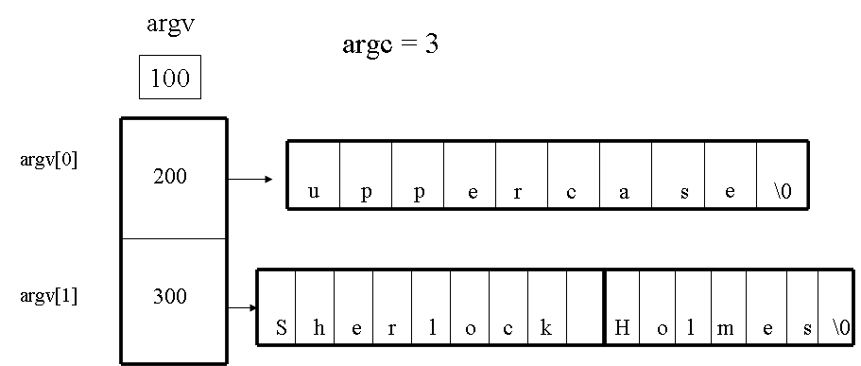
Command-Line Arguments (Contd.).
The program uppercase.c can be coded as follows:
#include <stdio.h>
main(int argc, char * argv[ ])
{ int i;
for (i = 0; argv[1][i] != ‘\0’, i++)
{ if ((argv[1][i] >= ‘a’) && (argv[1][i] <= ‘z’))
argv[1][i] = argv[1][i] – 32;
}
printf( “%s”, argv[1]);
}
Notes:
It is to be noted that numbers passed to main( ) from the command line as arguments are treated as strings. If, therefore, numeric operations are to be performed on them, they have to be converted into their appropriate numeric representation using appropriate conversion functions before venturing to perform arithmetic operations on them.

Slide 134
Storage Qualifiers
The storage qualifier determines the lifetime of the storage
associated with the identified variable.
A variable also has a scope, which is the region of the program in which it is known.
The storage qualifiers in C are:
auto
static
extern
register

Slide 135
automatic Variables
automatic variables are local to a block, and are discarded on exit from the block.
Block implies a function block, a conditional block, or an iterative block.
Declarations within a block create automatic variables if no storage class specification is mentioned, or if the auto specifier is used.
Variable declarations, therefore, are by default, auto.
#include<stdio.h>
main( )
{ char var;
while ((var = getchar( )) != ‘*’)
{ if ((var >= ‘A’) && (var <= ‘Z’))
uppercase_count( );
}
}
uppercase_count( )
{ auto int counter = 0;
counter ++;
}
Notes:
In the aforesaid program, each time the function uppercase_count( ) is invoked, the variable counter is created and initialized. Therefore, every time the function uppercase_count( ) is invoked from the while block in main( ), the variable is created, initialized to 0, and incremented by 1. Therefore even if the while loop is made to execute 10 times, the value of the variable counter in the function uppercase_count( ) will continue to be 1 even after the tenth iteration of the while loop in main( ). It is therefore clear that the life of the auto variable counter is governed by the scope of the function uppercase_count( ). The moment the function uppercase_count( ) terminates, the auto variable counter ceases to exist.

Slide 136
Global Variables
Global variable is defined outside all functions.
A typical convention of defining global variables is before the main( ) function.
A variable declared as global is visible to the function main( ) as well as to any other functions called from main( ).
A variable defined as global has file scope, that is, it is visible to all the functions written within the scope of a program file.
/* A sample C program */
# include <stdio.h>
/* function prototype */
int sum( );
/* a and b are global variables, visible to main( ) as well as to sum( ) */
int a=10, b=20;
main()
{ int c;
c = sum();
printf(“%d+%d = %d \n”,a,b,c);
}
int sum()
{ return(a+b);
}

Slide 137
Static Variables
Static variables may be local to a block or external to all blocks, but in either case retain their values across exit from, and reentry to functions and blocks.
Within a block, including a block that provides the code for a function, static variables are declared with the keyword static.
Let us rewrite the code for the example involving auto variables to incorporate the declaration of static variables.
#include<stdio.h>
main( )
{
char var;
while ((var = getchar( )) != ‘*’)
{ if ((var >= ‘A’) && (var <= ‘Z’))
uppercase_count( );
}
}
uppercase_count( )
{
static int counter = 0;
counter ++;
}
Notes:
The declaration of the variable counter as static within the function uppercase_count( ) ensures that the variable counter does not lose its current value upon exit from the function uppercase_count( ). Therefore, if the while loop in main( ) were allowed to iterate ten times, it would involve ten calls to the function uppercase_count( ). Each time the function uppercase_count( ) is exited, and control returns to main( ), the static qualifier for the variable counter ensures that the variable counter retains its current value even after exiting the function uppercase_count( ).
Therefore, after ten executions of the while loop in main( ), the value of the static variable counter will be 10.

Slide 138
Static and Global Variables – A Comparison
From the preceding example, it seems that static variables are functionally similar to global variables in that they retain their value even after exiting from a function in which it has been defined as static.
But an important difference is that while a global variable has file scope, and is therefore visible to all functions defined within that program file, a static variable is visible only to the function in which it has been defined as static.

Slide 139
Extern Variables
Variables declared as extern are useful especially when building libraries of functions.
This means that functions required to run a program can be saved in separate program files, which can be compiled separately, and linked up with the file containing the function main( ) prior to running the program.
In such a case, if the functions use the same global variables, then their declarations would involve the use of the extern qualifier

Slide 140
Extern Variables (Contd.).
Program a.c
int val /* global */
main( )
{
printf(“Enter value”);
scanf(“%d”, &val);
compute( ); /* function call */
}
Program b.c
compute( )
{
extern int val; /* implies that val is defined in another program containing a function to which the current function will be linked to at the time of compilation */
}
Notes:
From the preceding example, it is clear that though val is declared global in the function main( ) in program a.c, it has been declared again within the function compute( ), which is defined in its own program file, b.c.
However, the qualifier extern has been added to its declaration.
The extern qualifier in the function compute( ) in b.c indicates to the compiler (when a.c and b.c are compiled together) that the variable used in this program file has been declared in another program file.

Slide 141
Standard String Handling Functions
strcmp( ) – compares two strings (that are passed to it as parameters) character by character using their ASCII values, and returns any of the following integer values.
Return Value | Implication | Example
Less than 0 | ASCII value of the character of the first string is less than the ASCII value of the corresponding character of the second string | i = strcmp(“XYZ”, “xyz”)
Greater than 0 | ASCII value of the character of the first string is less than the ASCII value of the corresponding character of the second string | i = strcmp(“xyz”, “XYZ”)
Equal to 0 | If the strings are identical | i = strcmp(“XYZ”, “XYZ”)

Slide 142
Standard String Handling Functions (Contd.).
strcpy( ) – copies the second string to the first string, both of which are passed to it as arguments.
Example: strcpy( string1, “XYZ”) will copy the string “XYZ” to the string string1.
If string1 were to contain any value, it is overwritten with the value of the second string.

Slide 143
Standard String Handling Functions (Contd.).
strcat( ) – appends the second string to the first string, both of which are passed to it as arguments.
Example
strcat(“Edson Arantes Do Nascimento”, “Pele”);
will give the string “Edson Arantes Do Nascimento Pele”
strlen( ) – This function returns the length of a string passed to it as an argument. The string terminator, i.e., the null character is not taken into consideration.
Example:
i = strlen(“Johann Cryuff”);
will return the value value 13 into i.

Slide 144
String to Numeric Conversion Functions
atoi( ) – This function accepts a string representation of an integer, and returns its integer equivalent
Example:
i = atoi(“22”)
will return the integer value 22 into the integer i.
This function is especially useful in cases where main is designed to accept numeric values as command line arguments.
It may be recalled that an integer passed as a command line argument to main( ) is treated as a string, and therefore needs to be converted to its numeric equivalent.
Notes:
144
The atoi( ) function returns 0 if the string does not begin with a digit.

Slide 145
String to Numeric Conversion Functions (Contd.).
atof( ) - This function accepts a string representation of a number, and returns its double equivalent
For example, if the string str contains the value “1234”, then the following statement:
i = atoi(str);
will cause i to have the value 1234.000000
To use the function atof( ) in any function, its prototype must be declared at the beginning of the function where it is used: double atof( )
Notes:
145
The function atof( ) returns 0 if the string does not begin with a digit or the decimal point.

Slide 146
Functions for Formatting Data in Memory
sprintf( ) – this function writes to a variable in memory specified as its first argument.
The syntax of the function sprintf( ) is as follows:
sprintf( string, format specification, data)
Example:
sprintf( str, “%02d-%02d-%02d”, 28, 8, 71)
will return the string 28-08-71 into str.

Slide 147
Functions for Formatting Data in Memory (Contd.).
sscanf( ) – this function reads from a variable in memory, and stores the data in different memory variables specified.
The syntax of the function sscanf( ) is:
Sscanf( string, format specification, variable list);
Example:
sscanf(str, “%2d%2s%s%d”, &day, suffix, mnth, &year)
printf(“The day is : %d, suffix is %s, month is %s, year is %d\n”, day, suffix, mnth, year);
If the data in str is “29th July 1971”, the output will be:
The day is 29, suffix is th, month is July, year is 1971

Slide 148
Recursion: Factorial Function
You may therefore write the definition of this function as follows:
0! = 1
1! = 1
2! = 2 * 1
3! = 3 * 2 * 1
4! = 4 * 3 * 2 * 1
n! = 1 if n = = 0
n! = n * (n-1) * (n-2) * ….. * 1 if n > 0.
You may therefore define:
0! = 1
1! = 1 * 0!
2! = 2 * 1!
3! = 3 * 2!
4! = 4 * 3!
prod = 1
for (x = n; x > 0; x--)
{
prod *= x;
return (prod)
}
Notes:
The dots are really a shorthand notation for all the numbers between (n – 3) and (n – 2) multiplied together.
To avoid the shorthand in the definition of n!, we would have to list a formula for n! for each value of n separately, as follows:
It is cumbersome for you to list the formula for the factorial of each integer.
To avoid any shorthand, and to avoid an infinite set of definitions, but yet to define the function precisely, you may present an algorithm that accepts an integer n and returns the value of n!.
Such an algorithm is iterative because it calls for the explicit repetition of some process until a certain condition is met.
This function can be translated readily into a C function that returns n! when n is input as a parameter.
Pay closer attention to the definition of n! that lists a separate formula for each value of n.
You may note, for example, that 4! equals 4 * 3 * 2 * 1, which equals 4 * 3!.
In fact, for any n > 0, you see that n! equals n * (n – 1)!.
Multiplying n by the product of all integers from n – 1 to 1 yields the product of all integers from n to 1.
Using the mathematical notation used earlier, you can write the factorial of any number as:
n! = 1 if n = = 0
n! = n * (n – 1)! If n > 0
This definition is interesting since it defines the factorial function in terms of itself.
This seems to be a circular definition and totally unacceptable until you realize that the mathematical notation is only a concise way of writing out the infinite number of equations necessary to define n! for each n. 0! is defined directly as 1.
Once 0! has been defined, defining 1! As 1* 0! is not circular at all.
Similarly once 1! factorial has been defined, defining 2! as 2 * 1! is equally straightforward.
It may be argued that the latter notation is more precise than the definition of n! as n * (n-1) * (n-2) * ….. * 1 for n > 0 because it does not resort to dots to be filled in by the logical intuition of the reader.
Such a definition, which defines a problem in terms of a simpler case of itself, is called a recursive definition.
Let us see how the recursive definition of the factorial function may be used to evaluate 5!.
The definition states that 5! Equals 5 * 4!.
Thus, before you can evaluate 5!, you must first evaluate 4!. Using the definition once more, you find that 4! = 4 * 3!. Therefore, you must evaluate 3!.

Slide 149
Evolving a Recursive Definition for the Factorial
You will now attempt to incorporate this process into an algorithm. You want the algorithm to accept a non-negative integer, and to compute in a variable fact the non-negative integer that is n factorial.
if (n == 0)
fact = 1;
else
{
x = n – 1;
find the value of x!. call it y;
fact = n * y;
}
Notes:
This algorithm exhibits the process used to compute n! by the recursive definition.
The key to the algorithm is of course line 5 , where you are told to find the value of x!.
This requires re-executing the algorithm with input x, since the method for computing the factorial is the algorithm itself.
To see that the algorithm eventually halts, note that at the start of line 5, x equals n – 1.
Each time the algorithm is executed, its input is one less than the preceding time, so that 0 is eventually input to the algorithm. At that point, the algorithm simply returns 1.
This value is returned to line 5, which asks for the evaluation of 0!.
The multiplication of y (which equals 1) by n (which equals 1) is then executed and the result is returned. This sequence of multiplications and returns continues until the original n! has been evaluated.
Properties of Recursive Definitions
It is important to summarize what is involved in a recursive definition or algorithm.
One important requirement for a recursive algorithm to be correct is that it does not generate an infinite sequence of calls to itself.
Clearly, any algorithm that does generate such a sequence can never terminate.
For at least one argument or group of arguments, a recursive function f must be defined in terms that do not involve f.
There must be a way out of the sequence of recursive calls.
For example, the non-recursive portion of the n! was 0! that is equal to 1 and did not involve another recursive definition.

Slide 150
Mechanics of Recursion
In the statement y = fact(x), the function fact( ) makes a recursive call to itself.
This is the essential ingredient of a recursive routine.
The programmer assumes that the function being computed has already been written, and uses it in its own definition.
However, the programmer must ensure that this does not lead to an endless series of calls.
int fact(n)
int n;
{
int x, y;
if ( n == 0)
return (1);
else
{
x = n-1;
y = fact(x);
return ( n * y);
}
}
Notes:
It is important to examine the execution of this function when it is called by another program.
For example, the calling program (main( )) contains the statement: printf(“%d”, fact(4));
When the calling function calls fact( ), the parameter n is set equal to 4. Since n is not 0, x is set equal to 3.
At that point, fact( ) is called a second time with an argument of 3.
Therefore, the function fact( ) is reentered and the local variables (x and y) and parameter (n) of the block are reallocated.
Since execution has not yet left the first call of fact( ), the first allocation of these variables remains.
Thus, there are two generations of each of these variables in existence simultaneously in the stack for the first call, and the second recursive call to the function fact( ) respectively.
From any point within the second execution of fact( ), only the most recent copy of these variables can be referenced.
In general, each time the function fact( ) is entered recursively, a new set of local variables and parameters is allocated on the stack, and only this new set may be referenced within that call of fact( ).
When a return from fact( ) to a point in a previous call takes place, the most recent allocation of these variables is freed from the stack when the function returns, and the previous copy is reactivated (belonging to the previous recursive call to the function fact( )).
This previous copy is the one that was allocated upon the original entry to the previous call and is local to that call.
This description suggests the use of a stack to keep the successive generations of local variables and parameters.
This stack is maintained by the C system and is invisible to the programmer.

Slide 151
Mechanics of Recursion (Contd.).
The recursive call to fact(3) returns to the assignment of the result to y within fact(4), but the call to fact(4) returns to the printf( ) statement in the calling function.
(a) initially
(b) fact(4)
(b) fact(4)
(c) fact(3)
(c) fact(2)
2
*
*
3
*
*
3
2
*
4
*
*
4
3
*
4
3
*
n x y
n x y
n x y
n x y
Notes:
Each time that a recursive function is entered, a new allocation of its variables is pushed on top of the stack.
Any reference to a local variable or parameter is through the current top of the stack.
When the function returns, the stack is popped, the top allocation is freed, and the previous allocation becomes the current top of the stack to be used for referencing local variables and parameters.
You will now see how this mechanism is applied in computing the factorial function.
The following figure contains a series of snapshots of the stack for the variables n, x, and y as execution of the fact( ) function proceeds.
Initially, the stacks are empty, as illustrated in (a).
After the first call on fact( ) by the calling procedure, the situation is as shown in (b) with n equal to 4. The variables x and y are allocated but not initialized.
Since n does not equal 0, x is set to 3 and fact(3) is called as shown in (c).
The new value of n does not equal 0; therefore, x is set to 2 and fact(2) is called as shown in (d).
This continues until n equals 0 as shown in(f).
At that point, the value 1 is returned from the call to fact(0).
Execution resumes from the point at which fact(0) was called, which is the assignment of the returned value to the copy of y declared in fact(1).
This is shown by the status of the stack shown in figure (g), where the variables allocated for fact(0) have been freed and y is set to 1.
The statement return (n * y) is then executed, multiplying the top values of n and y to obtain 1, and returning the value to fact(2) as shown in (h).
This process is repeated twice more, until finally the value of y in fact(4) equals 6.
The statement return (n * y) is executed one more time.
The product 24 is returned to the calling function where it is printed by the statement printf(“%d”, fact(4));
Note that each time that a recursive routine returns, it returns to the point immediately following the point from which it was called.

Slide 152
Mechanics of Recursion (Contd.).
(e) fact(1)
(f) fact(0)
(g) y = fact(0)
(h) y = fact(1)
0
*
*
1
*
*
1
0
*
1
1
0
2
1
*
2
1
*
2
*
2
1
1
1
3
2
*
3
2
*
3
2
*
3
2
*
4
3
*
4
3
*
3
*
3
*
4
4
n x y
n x y
n x y
n x y

Slide 153
Mechanics of Recursion (Contd.).
(i) y = fact(2)
(j) y = fact(3)
Pritnf(“%d”, fact(4))
3
2
2
4
3
*
4
3
6
n x y
n x y
n x y
The stack at various times during execution. An asterisk indicates an uninitialized value.

Slide 154
Function Pointers
Function Pointers are pointers, i.e. variables, which point to the address of a function.
Thus a function in the program code is, like e.g. a character field, nothing else than an address.
When you want to call a function fn() at a certain point in your program, you just put the call of the function fn() at that point in your source code.
Then you compile your code, and every time your program comes to that point, your function is called.
But what can you do, if you don't know at build-time which function has got to be called? Or, invoke functions at runtime.
Notes:
Note that a running program gets a certain space in the main-memory.
Both, the executable compiled program code and the used variables, are put inside this memory.
It is only important how you, or better, your compiler/processor, interpret the memory a pointer points to.

Slide 155
Function Pointers (Contd.).
You want to select one function out of a pool of possible functions.
However you can also solve the latter problem using a switch-statement, where you call the functions just like you want it, in the different branches.
Consider the example : How are function pointers used? As stated above they are typically used so one function can take in other functions as a parameter.
Notes:
But there's still another way: Use a function pointer!

Slide 156
Declaring and Using Function Pointers
#include <stdio.h>
int compute(int,int (*comp)(int) );
int doubleIt( int );
int tripleIt( int );
int main()
{ int x;
x = compute( 5, &doubleIt );
printf(“The result is: %i\n", x );
x = compute( 5, &tripleIt );
printf("The result is: %i\n", x );
return 0;
}
int compute( int y, int (*comp)(int) )
{ return comp( y );
}
int doubleIt( int y )
{ return y*2;
}
int tripleIt( int y )
{ return y*3;
}
Notes:
Aside from main( ), this program has 3 functions.
The functions doubleIt( ) and tripleIt( ) are just run of mill functions that take in an integer, either double or triple the value of the argument received, and return the value.
The function of interest here is compute( ). It starts off normal. It returns an int, and the first parameter is an int.
But the second parameter is pretty strange looking. The whole "int (comp*)(int)" is one parameter, which, in fact, is the format of a function pointer.
Basically it says compute( ) wants a pointer to a function that takes one integer parameter, and returns an integer. And it is going to refer to this function through the parameter name comp.
When compute( ) is called, it uses its parameter comp just like a normal function. When a function pointer is passed to a function, it can be used like a normal function.
When compute( ) is called in main( ), the second parameter is given the name of another function with an ampersand.
The ampersand is of course, the "address of" operator. So this is passing the address of doubleIt( ) (and pointers are really just addresses). So this is how compute( ) gets the pointer to doubleIt( )
It is important to note however, that if the return type of the function doubleIt( ) and it's parameter list did not match the ones for the function pointer comp, it could not be used.
When you pass a function pointer, the functions header must match the header of the function pointer definition exactly, or it cannot be used.
We read the second parameter as comp is a pointer to a function that takes a single argument of type integer, and returns an integer. The parentheses are necessary because ( ) binds tighter than *. In contrast, consider the declaration:
Int * comp(int)
This declares comp to be a function that takes an argument of type integer, and returns a pointer to an integer. In the body of the function definition for comp( ), we can either treat the pointer comp as if it were a function, or we can explicitly dereference the pointer.
It is helpful to think of the construct (*f)(k) as follows:
f the pointer to the function
*f the function itself
(*f) (k) the call to the function

Slide 157
Hands-on: 2 hours
Functions, Pointers and storage taypes
Notes:
Hands-on for 2 hours to be taken up to work on implementing functions with storage types. Also using pointers for variables/functions
Refer to hand-out in the supporting document (Module 4 : Functions & Recursion)

Slide 158
Summary
In this module, we discussed:
Programs that invoke functions through a:
Call by value
Call by reference
Function prototypes
Function call mechanism
Command-line arguments
Using the Auto, Static, and Extern storage qualifiers
Using string handling functions, conversion functions, and functions for formatting strings in memory
Recursive function
Recursive calls to a function using the runtime stack
Function Pointers

Slide 159
User – Defined Data Types
Module 5

Slide 160
Objectives
At the end of this module, you will be able to:
Trace down the genesis of user-defined data types
Declare user-defined data types, namely
Structures
Unions
Enumerations
Use pointers to structures and unions
Declare arrays of structures
Pass structures to functions
Use the typedef declaration for easier and compact coding
Use the functions fread( ) and fwrite( ) to read and write structures to and from files
Duration: 4 hrs

Slide 161
User-Defined Data Types – The Genesis
Consider a situation where your application needs to read records from a file for processing.
The general approach would be to read the various fields of a record into corresponding memory variables.
Computations can then be performed on these memory variables, the contents of which can then be updated to the file.
But, this approach would involve manipulating the current file offset for the relevant fields that need to be updated.

Slide 162
User-Defined Data Types – The Genesis (Contd.).
Processing would become a lot more simpler if it were possible to read an entire record into an extended variable declaration, the structure of which would be the same as the record in the file.
This extended variable declaration in turn would be a collection of variables of different data types, each variable matching the data type of the fields in the record.
The flexibility with such an arrangement is that the collection of variables making up the extended variable declaration can be referred to in the program using a single name.

Slide 163
Structures – The Definition
A structure is a collection of one or more variables, possibly of different types, grouped together under a single name for convenient handling.
Structures help to organize complicated data, particularly in large programs, because they permit a group of related variables to be treated as a unit instead of as separate entities.
An example of a structure is the payroll record: an employee is described by a set of attributes such as name, address, social security number, salary, etc.

Slide 164
Structures – The Definition (Contd.).
Some of these in turn could be structures: a name has several components, as does an address.
Other examples of structures are: a point is a pair of coordinates, a rectangle is a pair of points, and so on.
The main change made by the ANSI standard is to define structure assignment - structures may be copied and assigned to, passed to functions, and returned by functions
Automatic structures and arrays may now also be initialized.

Slide 165
Structures – Defining a Type
When we declare a structure, we are defining a type.
A structure declaration results in the definition of a template or a blueprint for a user-defined data type.
Upon declaring a structure, the compiler identifies the structure declaration as a user-defined data type over and above the fundamental data types, or primitive data types built into the compiler.
A structure therefore is a mechanism for the extension of the type mechanism in the C language.

Slide 166
Declaring a Structure
The C language provides the struct keyword for declaring a structure. The following is a structure declaration for employee attributes.
struct empdata {
int empno;
char name[10];
char job[10];
float salary;
};
Notes:
The keyword struct introduces a structure declaration, which is a list of declarations enclosed in braces.
An optional name called a structure tag may follow the word struct, as with employee in the previous example.
The tag names this kind of structure, and can be used subsequently as a shorthand for the part of the declaration in braces.
A struct declaration defines a type.

Slide 167
Declaring a Structure - Conventions
The variables named in a structure are called members. A structure member or tag, and an ordinary (i.e., non-member) variable can have the same name without conflict, since they can always be distinguished by context.
Furthermore, the same member names may occur in different structures, although as a matter of style one would normally use the same names only for closely related structure variables.
Variables of a structure type may immediately follow the structure declaration, or may be defined separately as follows:

Slide 168
Declaring a Structure Variable
struct empdata {
int empno;
char name[10];
char job[10];
float salary;
} emprec; /* emprec is a variable of structure type empdata */
Or a structure can be declared separately as:
struct empdata emprec;/* emprec is a variable of structure type empdata */
Notes:
Declaring a structure only defines a template or a blueprint for a data type. It does not therefore result in the allocation of memory.
Memory is allocated only when a variable of a structure type is declared in the program.
Till a variable of a structure type is created, a structure declaration is only identified as a type, and no memory is allocated.
Even for fundamental data types, the compiler does not allocate memory for types. Rather, it allocates memory for implementations of fundamental data types, in short, memory is allocated only for a variable declaration.

Slide 169
Accessing Elements of a Structure
Once a structure variable has been declared, the individual members of the structure can be accessed by prefixing the structure variable to the element of the structure.
struct empdata {
int empno;
char name[10];
char job[10];
float salary;
}
struct empdata emprec;
emprec.empno /* referring to the element of the structure variable emprec */

Slide 170
Passing Structures to Functions
#include<stdio.h>
struct salesdata
{ int transaction_number, salesman_number, product_number;
int units_sold;
float value_of_sale;
};
main( )
{ struct salesdata salesvar;
printf(“enter transaction number :”);
scanf(“%d”, &salesvar.transaction_number); fflush(stdin);
printf(“enter salesman number :”);
scanf(“%d”, &salesvar.salesman_number); fflush(stdin);
printf(“enter product number :”);
scanf(“%d”, &salesvar.product_number); fflush(stdin);
printf(“enter units sold :”);
scanf(“%d”, &salesvar.units_sold); fflush(stdin);
compute(&salesvar);
.
.
}

Slide 171
Passing Structures to Functions (Contd.).
compute( salesdata *salesptr)
{
static float product_unit_price = {10.0, 20.0, 30.0, 40.0};
/*product unit price for products numbered 1 through 4 */
salesptr-> value_of_sale = (float)salesptr-> units_sold *
product_unit_price[salesptr->product_number – 1]
}
Notes:
171
Since the address of the structure variable salesvar is passed to the function compute( ) from main( ), the parameter of the function compute( ) has appropriately defined to be a pointer to a structure of type salesdata.
When accessing elements of a structure variable using a pointer to the structure, the arrow operator is used. This is evident from the references to the elements value_of_sale, units_sold, and product_unit_price in the function compute. They are referred to using the structure pointer salesptr followed by the arrow operator (->)
Since the function compute( ) receives the address of the structure variable salesvar from main( ), it does not need to pass the structure variable back to main( ), as the function main( ) would have accessed and computed the values of the elements of the structure variable salesvar in the calling function itself.

Slide 172
Array of Structures
Just as it is possible to declare arrays of primitive data types, it should also be possible to declare arrays of structures as well.
If one were to define an array of structure variables, one would do so as follows:
struct empdata employee_array[4];
The rationale for declaring an array of structures becomes clear when one wants to improve I/O efficiency in a program.
Once an array of structures is defined, it is possible to read in a block of records from a file using an appropriate function (fread( )), the details of which you will see shortly.
struct empdata {
int empno;
char name[10];
char job[10];
float salary;
};

Slide 173
Writing Records On To a File
The fwrite( ) function allows a structure variable to be written on to a file.
The following statement writes the structure variable salesvar on to a file “SALES.DAT, which is pointed to by the FILE type pointer fp:
fwrite( &salesvar, sizeof(struct salesdata), 1, fp);
The arguments to the function fwrite( ) are explained as follows:

Slide 174
Writing Structures To a File
Here &salesrec is the address of the structure variable to be written to the file.
The second parameter is the size of the data to be written, i.e., size of the structure salesdata. The parameter to the sizeof( ) operator is the structure label, or the structure type itself, and not a variable of the structure type. The sizeof( ) operator can be used to determine the size of any data type in C (fundamental as well as user-defined data types.
The third parameter of fwrite( ) is the number of structure variables to be written to the file. In our statement, it is 1, since only one structure variable is written to the file. In case, an array of 4 structure variables is to be written to a file using fwrite( ), the third parameter to fwrite( ) should be 4.
The last parameter is the pointer to the file.
Notes:
Using the sizeof( ) operator makes for portable code. This is especially so when the size of an integer depends upon different hardware architectures. It may be 2 bytes for lower-end platforms, and 4 bytes for higher-end platforms. The sizeof( ) operator determines the implementation of a data type on any hardware platform.

Slide 175
Reading Records from a File
Records can be read from a file using fread( ). The corresponding read statement using fread( ) for the earlier fwrite( ) statement would be:
fread(&salesvar, sizeof(struct salesdata), 1, fp);
Here, the first parameter &salesvar is the address of the structure variable salesvar into which 1 record is to be read from the file pointed to by the FILE type pointer fp.
The second parameter specifies the size of the data to be read into the structure variable.

Slide 176
Reading Records from a File (Contd.).
fread( ) will return the actual number of records read from the file. This feature can be checked for a successful read.
if ((fread( &salesvar, sizeof(struct salesdata), 1, fp)) != 1)
error code;
An odd feature of the fread( ) function is that it does not return any special character on encountering end of file.
Therefore, after every read using fread( ), care must be taken to check for end of file, for which the standard C library provides the feof( ) function. It can be used thus:
if(feof(fp))

Slide 177
Union
Can hold objects of different types and sizes at different times
Syntax similar to structure but meaning is different
All members of union share same storage space
Only the last data member defined can be accessed
Means of conserving memory
union declaration similar to struct declaration
union u_type {
int i;
char ch;
};
union u_type cnvt;

Slide 178
Unions
In cnvt, both integer i and character ch share the same memory location. Of course, i occupies 2 bytes (assuming 2-byte integers, and ch uses only one byte.
i
Byte 0 Byte 1
ch
Notes:
To access a member of a union, use the same syntax that you would use for structures: the dot and arrow operators.
If you are operating on the union directly, use the dot operator. If the union is accessed through a pointer, use the arrow operator.
For example, to assign the integer 10 to element i of cnvt, write cnvt.i = 10;

Slide 179
Unions (Contd.).
In the following code snippet, a pointer to cnvt is passed to a function:
void func1( union u_type *un)
{
un->i = 10; /* assign 10 to cnvt using function */
}
Using a union can aid in the production of machine-independent (portable) code. Because the compiler keeps track of the actual size of the union members, no unnecessary machine dependencies are produced.
Notes:
Unions are used frequently when specialized type conversions are needed because you can refer to the data held in the union in fundamentally different ways.
Consider the problem of writing a short integer to a disk file. The C standard library defines no function specifically designed to write a short integer to a file.
While you can write any type of data to a file using fwrite( ), using fwrite( ) incurs excessive overhead for such a simple operation.
However, using a union, you can easily create a function called putw( ), which represents the binary representation of a short integer to a file one byte at a time.
The following example assumes that short integers are 2 bytes long. First, create a union consisting of one short integer and a 2-byte character array:
Now, you can use pw to create the version of putw( ) shown in the following program:
int putw( short int num, FILE *fp);

Slide 180
Unions - Example
union pw
{ short int i;
char ch[2];
};
int main (void)
{ FILE *fp;
fp = fopen( “test.tmp”, “wb+”);
putw(1000, fp); /* write the value 1000 as an integer */
fclose( fp );
return 0;
}
int putw( short int num, FILE *fp)
{ union pw word;
word.i = num;
fputc( word.ch[0], fp); /* write first half */
fputc( word.ch[1], fp); /* write second half */
}
Notes:
Although putw( ) is called with a short integer, it can still use the standard function fputc( ) to write each byte in the integer to a disk file one byte at a time.

Slide 181
Enumeration
Is a set of named integer constants that specify all the legal values a variable of that type can have.
The keyword enum signals the start of an enumeration type.
The general form for enumeration is
enum enum-type-name { enumeration list } variable_list;
enum coin { penny, nickel, dime, quarter, half_dollar, dollar};
enum coin money;
Notes:
Given these declarations, the following types of statements are perfectly valid:
money = dime;
if (money = = quarter)
printf( “Money is a quarter. \n”);
The key point to understand about an enumeration is that each of the symbols stands for an integer value.
As such, they may be used anywhere that an integer may be used.
Each symbol is given a value one greater than the symbol that precedes it. The value of the first enumeration symbol is 0. Therefore,
printf( “%d %d”, penny, dime);
displays 0 2 on the screen.
You can specify the value of one or more of the symbols by using an initializer.
Do this by following the symbol with an equal sign and an integer value.

Slide 182
Enumeration (Contd.).
For example, the following code assigns the value of 100 to quarter:
enum coin { penny, nickel, dime, quarter=100, half_dollar, dollar};
Now, the values of these symbols are:
penny 0
nickel 1
dime 2
quarter 100
half_dollar 101
dollar 102
Notes:
One common but erroneous assumption about enumerations is that the symbols can be input and output directly. This is not the case.
For example, the following code fragment will not perform as desired:
money = dollar;
printf( “%s”, money);
Dollar is simply a name for an integer; it is not a string.
For the same reason, you cannot use this code to achieve the desired results:
/* this code is wrong */
strcpy (money, “dime”);
That is, a string that contains the name of a symbol is not automatically converted to that symbol.
Actually creating code to input and output enumeration symbols is quite tedious (unless you are willing to settle for their integer values).

Slide 183
Enumeration - Example
switch (money)
{
case penny : printf( “penny”); break;
case nickel : printf( “nickel”); break;
case dime : printf( “dime”); break;
case quarter : printf( “quarter”); break;
case half_dollar : printf( “half_dollar”); break;
case dollar : printf( “dollar”); break;
}
Notes:
For example, you need the following code to display, in words, the kind of coins that money contains:

Slide 184
Typedef Statements
Creates synonyms (aliases) for previously defined datatypes
Used to create shorter type names
Format: typedef type new-type;
Example: typedef struct Card * CardPtr;
defines a new type name CardPtr as a synonym for type struct Card *
typedef does not create a new datatype
Only creates an alias

Slide 185
Hands-on: 2 hours
Purpose
construct Structures, Unions & Enumeration and performing computation
Notes:
Hands-on for 2 hours to be taken up to construct Structures, Unions & Enumeration and performing computation
Refer to hand-out in the supporting document (Module 5: User defined data types )

Slide 186
Summary
In this module, we discussed:
The genesis of user-defined data types
User-defined data types, namely Structures, Unions, and Enumerations
Pointers to structures and unions
Arrays of structures
Passing structures to functions
The typedef declaration for easier and compact coding
Functions fread( ) and fwrite( ) to read and write structures to and from files

Slide 187
File Input / Output Module 6

Slide 188
Objectives
At the end of this module, you will be able to:
Use pointers of type FILE when performing file I/O
Perform Input/Output with files
Use character-based file input/output functions
Use string-based file input/output functions
Perform random access on files using the functions
fseek( )
ftell( )
rewind( )
feof( )
Duration: 3 hrs

Slide 189
Formatted I/O
C provides standard functions for performing formatted input and output. These functions accept as parameters a format string and a list of variables.
The format string consists of a specification for each of the variables in terms of its data type, called the conversion character, and width of input or output.
The format string, along with the data to be output, are the parameters to the printf( ) function.
Format string is a string containing the format specification introduced by the character %, and ended by a conversion character.
Notes:
The function printf( ) is used for formatted output to standard output based on a format string.
The syntax of the printf( ) function is: printf( “format string”, var1,var2…..)

Slide 190
Formatted Output
An example:
printf(“%c\n”, var);
The conversion characters and their meanings are:
Conversion character | Meaning
d | The data is converted to decimal
c | The data is treated as a character
s | The data is a string and characters from the string are printed until a null character is reached, or until the specified number of characters has been exhausted
f | The data is output as float or double with a default precision of 6
Notes:
190
Other characters permitted in the format string are:
\n for new line
\t for tab (equivalent to eight spaces)

Slide 191
Formatted Output (Contd.).
Between the % character and the conversion character, there may be:
A minus sign | Implying left adjustment of data
A digit | Implying the minimum in which the data is to be output. If the data has larger number of characters than the specified width, the width occupied by the output is larger. If the data consists of fewer characters than the specified width, it is padded to the right (if minus sign is specified), or to the left (if no minus sign is specified). If the digit is prefixed with a zero, the padding is done with zeroes instead of blanks
A period | Separates the width from the next digit.
A digit | Specifying the precision, or the maximum number of characters to be output
l | To signify that the data item is a long integer, and not an integer.

Slide 192
Formatted Output (Contd.).
Format String | Data | Output
%2d | 4 | |4|
%2d | 224 | |224|
%03d | 8 | |008|
%-2d | 4 | |4 |
%5s | Sherlock Holmes | | Sherlock Holmes|
%15s | Sherlock Holmes | | Sherlock Holmes |
%-15s | Sherlock Holmes | | Sherlock Holmes |
%f | 22.44 | |22.440000|

Slide 193
Data Conversion Using Format String
A variable of a data type can be output as another data type using the conversion character.
#include<stdio.h>
main( )
{
int number = 97;
printf(“Value of num is %d\n”, number);
printf(“The Character equivalent of %d is %c\n”, number, number);
}

Slide 194
Formatted Input
The function scanf( ) is used for formatted input, and provides many of the conversion facilities of printf( ).
The scanf( ) function reads and converts characters from standard input according to the format string, and stores the input in memory locations specified by the other arguments.
#include<stdio.h>
main( )
{
char name[10];
int age;
char gender;
scanf (“%s%c%d”, name, &gender, &age);
fflush(stdin);
printf( “% s %c %d”, name, gender, age);
}
Notes:
The syntax of the function scanf( ) is: scanf( format string, var1, var2….)
Note that the names of the character and numeric variables (gender and age) have been preceded with the ‘&’ character when inputting into variables using the scanf( ) function, whereas the same is not necessary when inputting into a string using the scanf( ) function.

Slide 195
String Input Using scanf( )
Remember that while accepting strings using scanf( ), a space is considered as a string terminator. Hence, scanf( ) cannot be used to accept strings with embedded spaces.
#include<stdio.h>
main( )
{
char string[40];
printf(“Enter a string of maximum 39 characters”);
scanf(“%s”, string);
fflush(stdin);
printf(“%s”, string);
}
Notes:
195
If the input string is “My name is Nobody”, the output would be “My”. The space after “My” causes the string to be terminated. Hence, to input strings that might have embedded spaces, the gets( ) function should be used.

Slide 196
Files
A collection of logically related information
Examples:
An employee file with employee names, designation, salary etc.
A product file containing product name, make, batch, price etc.
A census file containing house number, names of the members, age, sex, employment status, children etc.
Two types:
Sequential file: All records are arranged in a particular order
Random Access file: Files are accessed at random

Slide 197
File Access
The simplicity of file input/output in C lies in the fact that it essentially treats a file as a stream of characters, and accordingly facilitates input/output in streams of characters.
Functions are available for character-based input/output, as well as string-based input/output from/to files.
In C, there is no concept of a sequential or an indexed file. This simplicity has the advantage that the programmer can read and write to a file at any arbitrary position.
Notes:
The examples so far have involved reading from standard input, and writing to standard output, which is the standard environment provided by the operating system for all applications.
You will now look at the process that a program needs to follow in order to access a file that is not already connected to the program.
Before a file can be read from, or written into, a file has to be opened using the library function fopen( )
The function fopen( ) takes a file name as an argument, and interacts with the operating system for accessing the necessary file, and returns a pointer of type FILE to be used in subsequent input/output operations on that file.
This pointer, called the file pointer, points to a structure that contains information about the file, such as the location of a buffer, the current character position in the buffer, whether the file is being read or written, and whether errors, or end of file have occurred.

Slide 198
File Access
This structure to which the file pointer point to, is of type FILE, defined in the header file <stdio.h>.
The only declaration needed for a file pointer is exemplified by:
FILE *fp;
FILE *fopen(char *name, char *mode);
fp = fopen( “file name”, “mode”);
Once the function fopen( ) returns a FILE type pointer stored in a pointer of type FILE, this pointer becomes the medium through which all subsequent I/O can be performed.

Slide 199
File Access Modes (Contd.).
When opening a file using fopen( ), one also needs to mention the mode in which the file is to be operated on. C allows a number of modes in which a file can be opened.
Mode | Access | Explanation
“r” | Read only mode | Opening a file in “r” mode only allows data to be read from the file
“w” | Write only mode | The “w” mode creates an empty file for output. If a file by the name already exists, it is deleted. Data can only be written to the file, and not read from it

Slide 200
File Access Modes
Mode | Access | Explanation
“a” | Append mode | Allows data to be appended to the end of the file, without erasing the existing contents. It is therefore useful for adding data to existing data files.
“r+” | Read + Write mode | This mode allows data to be updated in a file
“w+” | Write + Read mode | This mode works similarly to the “w” mode, except that it allows data to be read back after it is written.
“a+” | Read + Append mode | This mode allows existing data to be read, and new data to be added to the end of the file.

Slide 201
Character-based File I/O
In C, character-based input/output from and to files is facilitated through the functions fgetc( ) and fputc( ).
These functions are simple extensions of the corresponding functions for input/output from/to the terminal.
The only additional argument for both functions is the appropriate file pointer, through which these functions perform input/output from/to these files.

Slide 202
A File Copy Program
#include<stdio.h>
main( )
{
FILE *fp1, *fp2;
fp1 = fopen( “source.dat”, “r”);
fp2 = fopen( “target.dat”, “w”);
char ch;
while ( (ch = fgetc( fp1)) != EOF)
{
fputc (ch, fp2);
}
fclose(fp1);
fclose(fp2);
}

Slide 203
Variation to Console-Based I/O
#include<stdio.h>
main( )
{
char ch;
while ( (ch = fgetc( stdin)) != EOF)
{
fputc (ch, stdout);
}
}
Notes:
203

Slide 204
Nuggets on FILE Type Pointers
The important point to note is that in C, devices are also treated as files. So, the keyboard and the VDU are also treated as files.
It would be interesting here to know what stdin, stdout, and stderr actually are.
stdin, stdout, and stderr are pointers of type FILE defined in stdio.h. stdin is a FILE type pointer to standard input, stdout is a FILE type pointer to standard output, and stderr is a FILE type pointer to the standard error device.

Slide 205
Nuggets on FILE Type Pointers (Contd.).
In case fopen( ) is unsuccessful in opening a file (file may not exist, or has become corrupt), it returns a null (zero) value called NULL.
NULL is defined in the header file stdio.h
The NULL return value of fopen( ) can be used for error checking as in the following line of code:
if ((fp = fopen(“a.dat”, “r”)) = = NULL)
printf(“Error Message”);

Slide 206
The exit( ) function
The exit( ) function is generally used in conjunction with checking the return value of the fopen( ) statement.
If fopen( ) returns a NULL, a corresponding error message can be printed, and program execution can be terminated gracefully using the exit( ) function.
if ((fp = fopen(“a.dat”, “r”)) = = NULL)
{
printf(“Error Message”);
exit( );
}

Slide 207
Line Input/ Output With Files
C provides the functions fgets( ) and fputs( ) for performing line input/output from/to files.
The prototype declaration for fgets( ) is given below:
char* fgets(char *line, int maxline, FILE *fp);
The explanations to the parameters of fgets( ) is:
char* line – the string into which data from the file is to be read
int maxline – the maximum length of the line in the file from which data is being read
FILE *fp – is the file pointer to the file from which data is being read

Slide 208
Line Input/ Output With Files (Contd.).
fgets( ) reads the next input line (including the newline) from file fp into the character array line;
At most maxline-1 characters will be read. The resulting line is terminated with '\0'.
Normally fgets( ) returns line; on end of file, or error it returns NULL.

Slide 209
Line Input/ Output With Files (Contd.).
For output, the function fputs( ) writes a string (which need not contain a newline) to a file:
int fputs(char *line, FILE *fp)
It returns EOF if an error occurs, and non-negative otherwise.

Slide 210
File Copy Program Using Line I/O
#define MAX 81;
#include<stdio.h>
main( )
{
FILE *fp1, *fp2;
fp1 = fopen( “source.dat”, “r”);
fp2 = fopen( “target.dat”, “w”);
char string[MAX];
while ( (fgets(string, MAX, fp1)) != NULL)
{
fputs (string, fp2);
}
fclose(fp1);
fclose(fp2);
}
Notes:
210
In the fgets( ) statement, the number of characters to be read has been specified by the macro MAX, which is 81. This is based on the assumption that the maximum line length in the file is 80 (i.e., one more than the maximum line length in the file). This is because fgets( ) reads one character less than the number specified, and adds a ‘\0’ at the end of the string. If however, a newline character is encountered before the specified number of characters, fgets( ) puts the ‘\0’ there. fgets( ) returns a NULL if an attempt is made to read beyond the last character in the file, i.e., end of file.

Slide 211
Formatted File Input/ Output
C facilitates data to be stored in a file in a format of your choice. You can read and write data from/to a file in a formatted manner using fscanf( ) and fprintf( ).
Apart from receiving as the first argument the format specification (which governs the way data is read/written to/from a file), these functions also need the file pointer as a second argument.
fscanf( ) returns the value EOF upon encountering end-of-file.

Slide 212
Formatted File Input/ Output (Contd.).
fscanf( ) assumes the field separator to be any white space character, i.e., a space, a tab, or a newline character.
The statement printf(“The test value is %d”, i); can be rewritten using the function fprintf( ) as:
fprintf( stdout, “The test value is %d”, x);
The statement scanf( “%6s%d, string, &i) can be rewritten using the function fscanf( ) as:
fscanf(stdin, “%6s%d”, string, &i);

Slide 213
Random Access
Input from, or output to a file is effective relative to a position in the file known as the current position in the file.
For example, when a file is opened for input, the current position in the file from which input takes place is the beginning of the file.
If, after opening the file, the first input operation results in ten bytes being read from the file, the current position in the file from which the next input operation will take place is from the eleventh byte position.

Slide 214
Random Access (Contd.).
It is therefore clear that input or output from a file results in a shift in the current position in the file.
The current position in a file is the next byte position from where data will be read from in an input operation, or written to in an output operation.
The current position advances by the number of bytes read or written.
A current position beyond the last byte in the file indicates end of file.
Notes:
For example, when a file is opened for input, the current position in the file from which input takes place is the beginning of the file.
If, after opening the file, the first input operation results in ten bytes being read from the file, the current position in the file from which the next input operation will take place is from the eleventh byte position.
This is sequential access, in which a file is opened, and you start reading bytes from the file sequentially till end of file. The same argument cab be extended to sequential write.
In sharp contrast to sequential access is random access that involves reading from any arbitrary position in the file, or writing to any arbitrary position in the file.
Random access therefore mandates that we must have a mechanism for positioning the current position in the file to any arbitrary position in the file for performing input or output.
To facilitate this, C provides the fseek( ) function, the prototype of which is as follows:

Slide 215
The fseek( ) Function
The function fseek( ) is used for repositioning the current position in a file opened by the function fopen( ).
int rtn = fseek(file pointer, offset, from where)
where,
int rtn is the value returned by the function fseek( ). fseek( ) returns the value 0 if successful, and 1 if unsuccessful.
FILE file-pointer is the pointer to the file
long offset is the number of bytes that the current position will shift on a file
int from-where can have one of three values:
from beginning of file (represented as 0)
from current position (represented as 1)
from end of file (represented as 2)

Slide 216
The fseek( ) function (Contd.).
Consider the following schematic representation of a file in terms of a string of 30 bytes. The file contains records and fields that are not delimited by any special character.
fp = fopen(“employee.dat”, r)
employee.dat
1 | 2 | 3 | 4 | 5 | 6 | 7 | 8 | 9 | 0 | 1 | 2 | 3 | 4 | 5 | 6 | 7 | 8 | 9 | 0 | 1 | 2 | 3 | 4 | 5 | 6 | 7 | 8 | 9 | 0
current offset

Slide 217
The fseek( ) function (Contd.).
Consider the following schematic representation of a file in terms of a string of 30 bytes. The file contains records and fields that are not delimited by any special character.
fseek(fp, 10L, 0);
employee.dat
1 | 2 | 3 | 4 | 5 | 6 | 7 | 8 | 9 | 0 | 1 | 2 | 3 | 4 | 5 | 6 | 7 | 8 | 9 | 0 | 1 | 2 | 3 | 4 | 5 | 6 | 7 | 8 | 9 | 0
current offset

Slide 218
The fseek( ) function (Contd.).
Consider the following schematic representation of a file in terms of a string of 30 bytes. The file contains records and fields that are not delimited by any special character.
fgets(string, 7, fp);
employee.dat
1 | 2 | 3 | 4 | 5 | 6 | 7 | 8 | 9 | 0 | 1 | 2 | 3 | 4 | 5 | 6 | 7 | 8 | 9 | 0 | 1 | 2 | 3 | 4 | 5 | 6 | 7 | 8 | 9 | 0
current offset

Slide 219
The fseek( ) function
Consider the following schematic representation of a file in terms of a string of 30 bytes. The file contains records and fields that are not delimited by any special character.
fseek(fp, -10L, 2)
employee.dat
1 | 2 | 3 | 4 | 5 | 6 | 7 | 8 | 9 | 0 | 1 | 2 | 3 | 4 | 5 | 6 | 7 | 8 | 9 | 0 | 1 | 2 | 3 | 4 | 5 | 6 | 7 | 8 | 9 | 0
current offset

Slide 220
The rewind( ) Function
The function, rewind( ) is used to reposition the current position in the file (wherever it may be) to the beginning of the file.
The syntax of the function rewind( ) is:
rewind (file-pointer);
where file-pointer is the FILE type pointer returned by the function fopen( ).
After invoking rewind( ), the current position in the file is always the first byte position, i.e., at the beginning of the file.

Slide 221
Updating Data in a File
A file that needs to be updated should be opened using fopen( ) in the “r+” mode, i.e., opening a file for read and write.
The “r+” mode is useful for operations on files that need to be updated.
Consider a file, “SALARY.DAT” which contains the following structure:

Slide 222
Updating Data in a File (Contd.).
Structure of SALARY.DAT
employee number
salary
Notes:
222
The salary is a numeric string with two digits after the decimal. It has been stored as characters using the fputs( ) function.

Slide 223
Updating Data in a File (Contd.).
/* function to read the salary field (beginning at byte no. 5 and ending at byte 10) for each record in the file, and increase it by 100 */
#include<stdio.h>
main( )
{
FILE *fp;
char empno[5], salary[7];
double fsalary, atof( );
long int pos = 4L, offset = 4L;
/* open the file SALARY.DAT in read-write mode */
if ((fp = fopen( “SALARY.DAT”, “r+”)) = = NULL)
{
printf(“Error opening file SALARY.DAT”);
exit( );
}

Slide 224
Updating Data in a File (Contd.).
while(( fseek( fp, offset, 1)) = = 0)
{
fgets(salary, 7, fp);
f_salary = atof(salary) + 100;
sprintf(salary, “%6.2f”, f_salary); /*convert f_salary to a string */
fseek(fp, pos, 0); /* reposition at start of salary field */
fputs(salary, fp); /* update salary field
pos += 10; /* increment pos to starting byte of salary field for the next record */
}
printf(“The file SALARY.DAT has been updated”);
fclose(fp);
}

Slide 225
The ftell( ) and feof( ) Function
The prototype declaration for the function ftell( ) is:
long ftell(FILE *fp)
ftell returns the current file position for stream, or -1 on error.
The prototype declaration for the function feof( ) is:
int feof(FILE *fp)
feof returns non-zero if the end of file indicator for stream is set.

Slide 226
Hands-on: 2 hours
Purpose
Performing file related i/o operations
Notes:
Hands-on for 2 hours to be taken up to implement file i/o operations
Refer to hand-out in the supporting document (Module 6 : File Input/Output)

Slide 227
Summary
In this module, we discussed:
Using pointers of type FILE when performing file I/O
Perform Input/Output with files
Using character-based file input/output functions
Using string-based file input/output functions
Performing random access on files using the functions
fseek( )
ftell( )
rewind( )
feof( )

Slide 228
Introduction to Data Structures
Module 7

Slide 229
Objectives
At the end of this module, you will be able to:
Define and Data Structure
Classify Data Structures
List significance of Data Structures
Describe the operations on Data Structures
State the need for dynamic memory allocation
Use the malloc() function to allocate memory
Define self-referential structures and their advantages
Duration: 3 hrs

Slide 230
Introduction
Goal of Data Types and Data Structures is to organize data
Data Structure is a way of organizing of data element(s) in computer memory in a manner that is convenient to perform operations on it
Criteria: to facilitate efficient
storage of data
retrieval of data
manipulation of data
Design Issue:
select and design appropriate data types
Notes:
Data Structure is a way of organizing of data element(s) in computer memory in a manner that is convenient to perform operations on it.
Example
Int emp_number; int arr_emp_no[10];
Each Data Structure mainly specifies the following:
Representation of data element(s)
Relationship among data elements
Access Methods
A data structure may have a single value or a group of related values.

Slide 231
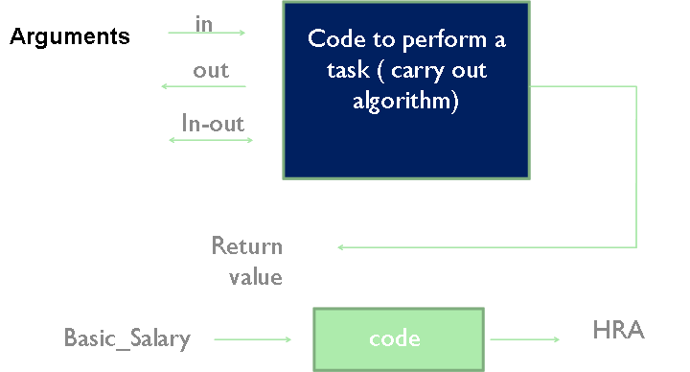
What is Program
A Set of Instructions
Data Structures + Algorithms
Algorithm = Logic + Control
Notes:
Data Structures are building blocks of a program
Hence, the selection of a particular Data Structure that best suits the requirement is most important step in the program design

Slide 232
Functions of Data Structures
Add / create Allocation of Memory
Index
Key
Position
Priority
Delete / Destroy De-Allocation of Memory
Get / Selection Accessing the data elements
Change / Updation Modify and Store

Slide 233
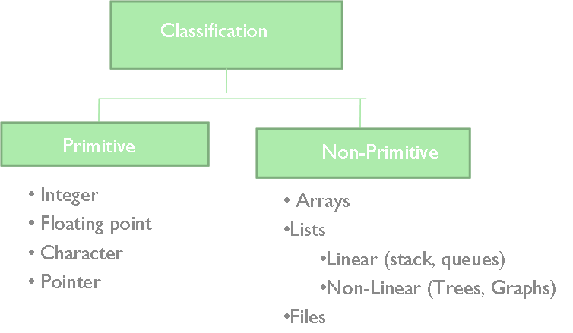
Common Data Structures
Array
Stack
Queue
Linked List
Tree
Heap
Hash Table
Priority Queue
How many Algorithms?
Countless
Notes:
An algorithm is a finite set of instructions that accomplishes a particular task.
Criteria
input: zero or more quantities that are externally supplied
output: at least one quantity is produced
definiteness: clear and unambiguous
finiteness: terminate after a finite number of steps
effectiveness: instruction is basic enough to be carried out
A program does not have to satisfy the finiteness criteria.
Data Structures can be classified into primitive and non-primitive data structures. Primitive data structures are also called as basic or primitive or scalar data types. Non-primitive data structures are also called as composite data structures having multiple values

Slide 234
Which Data Structure or Algorithm is better?
Must Meet Requirement
High Performance
Low RAM footprint
Easy to implement
Encapsulated

Slide 235
Dynamic Storage Allocation
Three issues:
How to maintain information about free memory
Linked list
The algorithm for locating a suitable block
First-fit
The algorithm for freeing an allocated block
Coalesce adjacent free blocks
The C language provides the malloc() function which a program can use to declare variables dynamically.
Notes:
Rather than pre-define array on the stack at compile time, the alternative should be to define a structure type, and dynamically declare at runtime as many instances of the structure variables as needed by the application.
When the code containing the structure type is compiled, what the compiler sees is only a structure type declaration. It therefore, does not allocate memory for the structure type since no variable has been defined based on the structure type.
The size of the stack cannot grow to accommodate these runtime variables as the stack size is determined at the time of compilation. Therefore, dynamically created variables are accommodated into another area of memory called the heap or free store.
When the program begins execution, it will need to create variables of the structure type. Therefore, the language must support runtime declaration of variables.
The problem with these variables is that they cannot be accommodated into the stack, as they were not declared at the time of compilation, and the stack would have been sized based on the stack variables already declared at compile-time.

Slide 236
Dynamic Storage Allocation (Contd.).
What are malloc() and free() actually doing?
Pool of memory segments:
Free
malloc(
)

Slide 237
Dynamic Storage Allocation (Contd.).
Rules:
Each segment contiguous in memory (no holes)
Segments do not move once allocated
malloc()
Find memory area large enough for segment
Mark that memory is allocated
free()
Mark the segment as unallocated

Slide 238
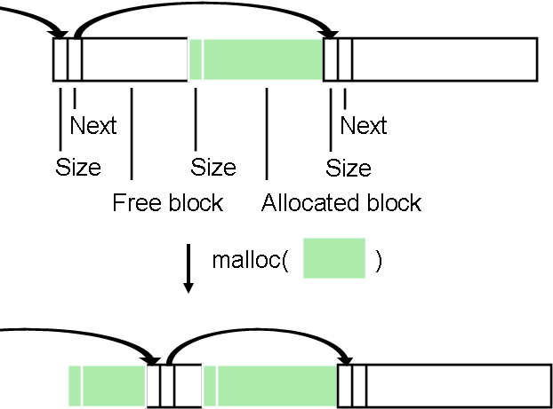
Simple Dynamic Storage Allocation
First large-enough free block selected
Free block divided into two
Previous next pointer updated
Newly-allocated region begins with a size value

Slide 239
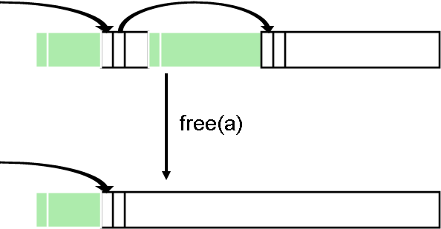
Simple Dynamic Storage Allocation (Contd.).
Appropriate position in free list identified
Newly-freed region added to adjacent free regions

Slide 240
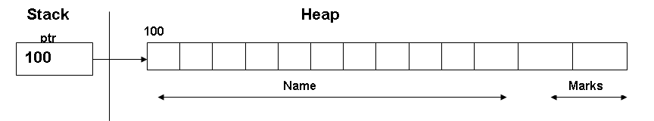
malloc() and free()
The parameter to malloc( ) is an unsigned integer which represents the number of bytes that the programmer has requested malloc( ) to allocate on the heap.
int *a;
a = (int *) malloc(sizeof(int) * k);
a[5] = 3;
free(a);
The sizeof( ) operator can be used to determine the size of any data type in C, instead of manually determining the size and using that value. Therefore, the benefit of using sizeof( ) operator in any program makes it portable.
Notes:
Library routines for managing the heap
Allocate and free arbitrary-sized chunks of memory in any order
A more effective way of passing the number of bytes to malloc( ) would be to pass the structure type along with the sizeof( ) operator to malloc( ).

Slide 241
malloc() and free() (Contd.).
More flexible than automatic variables (stacked)
More costly in time and space
malloc() and free() use complicated non-constant-time algorithms
Each block generally consumes two additional words of memory
Pointer to next empty block
Size of this block
Common source of errors
Using uninitialized memory
Using freed memory
Not allocating enough
Neglecting to free disused blocks (memory leaks)
Notes:
Memory usage errors so pervasive, entire successful company (Pure Software) founded to sell tool to track them down
Purify tool inserts code that verifies each memory access
Reports accesses of uninitialized memory, unallocated memory, etc.
Publicly-available Electric Fence tool does something similar

Slide 242
The malloc( ) Function
The malloc( ) function also returns the starting address to the marks_data structure variable on the heap.
However, malloc( ) returns this not as a pointer to a structure variable of type marks_data , but as a void pointer.
Therefore, the cast operator was used on the return value of malloc( ) to cast it as a pointer to a structure of type marks_data before being assigned to ptr, which has accordingly been defined to be a pointer to a structure of type marks_data.

Slide 243
The malloc( ) Function – Example
#include<stdio.h>
main()
{
struct marks_data
{
char name[11];
int marks;
};
struct marks_data *ptr;
/* declaration of a stack variable */
ptr = (struct marks_data *)
malloc(sizeof(struct marks_data));
/* declaration of a block of memory on the heap and the block in turn being referenced by ptr */
}
Notes:
One way of determining the size of the structure marks_data and pass it as an argument to malloc() is to determine the size of the element name (11 bytes) and marks (2 bytes or 4 bytes) depending on the platform. Therefore, the size argument to be passed to malloc() can be 13 bytes or 15 bytes. Rather than count the number of bytes constituting the structure marks_data that is platform dependent, a better way should be for the program to determine the size of the elements constituting the structure marks_data based on the platform. This is where the sizeof( ) operator comes into the picture. What we had requested malloc() in the aforesaid example is a block on the Heap representing the structure marks_data and accordingly this structure on the heap was allocated.
Confidential © 2009 Wipro Ltd
243

Slide 244
Self-Referential Structures
Suppose, you have been given a task to store a list of marks. The size of the list is not known.
If it were known, then it would have facilitated the creation of an array of the said number of elements and have the marks entered into it.
Elements of an array are contiguously located, and therefore, array manipulation is easy using an integer variable as a subscript, or using pointer arithmetic.

Slide 245
Self-Referential Structures (Contd.).
However, when runtime variables of a particular type are declared on the heap, let's say a structure type in which we are going to store the marks, each variable of the structure type marks will be located at a different memory location on the heap, and not contiguously located.
Therefore, these variables cannot be processed the way arrays are processed, i.e., using a subscript, or using pointer arithmetic.
An answer to this is a self-referential structure.

Slide 246
Self-Referential Structures (Contd.).
A self-referential structure is so defined that one of the elements of the structure variable is able to reference another subsequent structure variable of the same type, wherever it may be located on the heap.
In other words, each variable maintains a link to another variable of the same type, thus forming a non-contiguous, loosely linked data structure.
This self-referential data structure is also called a linked list.

Slide 247
Summary
In this module, we discussed:
Classification of Data Structures
Significance of Data Structures
Operations on Data Structures
Dynamic memory allocation
Using the malloc function and free function
Self-referential structures and their advantages

Slide 248
Linked Lists
Module 8

Slide 249
Objectives
At the end of this module, you will be able to:
Define Linked lists
Classify Linked Lists
Compare Array with Linked List
Write code to:
Create a sorted linked list,
Insert nodes into a sorted linked list
Traverse a linked list
Delete nodes from a linked list
Duration: 6 hrs

Slide 250
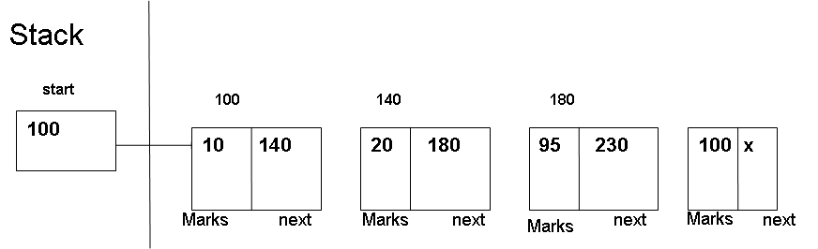
Linked Lists
A linked List is a collection of structures ordered not by their physical placement in memory but by logical links that are stored as part of the data in the structure itself.
The link is in the form of a pointer to another structure of the same time.
Each structure of the list is called a node and consists of two fields, one containing the item,and the other containing the address of the next item.
Such structures are called Self-referential.
struct node
{
type item;
struct node *next;
};
Notes:
The first node at address 100 (fictitious memory addresses) is referenced by a pointer called start (declared on the stack). Once you are able to access the first node through start, you would be able to access all subsequent nodes through next. The pointer next of the last node points to no node in particular, and therefore contains the value NULL.

Slide 251
Arrays & Linked Lists
Arrays
The sequential organization is provided implicitly by its index.
The memory allocation is static.
Elements are physically and logically adjacent.
Binary and Linear search applicable. Searching is fast
Insertion and deletion of elements takes more time.
Arrays take less memory than linked lists.
Linked Lists
The order of the list is given by links from one item to another.
Memory allocation is dynamic
Elements are logically adjacent
Only linear search applicable. Searching is slow
Insertion and deletion of elements is fast.
Linked Lists take more memory than arrays (address of the next node is to be stored)

Slide 252
Creating a Linked List..
Struct node
{
int marks;
struct node *next;
};
The struct declaration merely describes the format of the nodes and does not allocate storage.
Storage space for a node is created only when the function malloc is called.
struct node *head;
head=(struct node *)malloc(sizeof(node));
Notes:
Let us define a self-referential structure to store a list of marks the size of which may not be known.
struct marks_list
{ int marks;
struct marks_list *next;
};
We have defined a structure of type marks_list. It consists of two elements, one integer element marks and the other element, a pointer next, which is a pointer to a structure of the same type, i.e., of type marks_list itself.
Therefore, a part of the structure is referencing a structure type of itself, and hence the name self-referential structure.
Such data structures are also popularly known as linked lists, since each structure variable contains a link to other structure variables of the same type.
One can visualize a linked list as shown in the following slide:

Slide 253
Creating a Linked List. (Contd.).
malloc allocates a piece of memory that is sufficient to store a node and assigns its address to the pointer variable head
The following statements store values in the member fields
head->no=10;
head->NULL;
node
marks
next
node
10
X
marks
next

Slide 254
Creating a Linked List. (Contd.).
The second node can be added as follows:
second=(struct node *)malloc(sizeof(struct node));
second->marks=20;
second->next=NULL;
head->next=second;
This process can be easily implemented using iteration techniques.
The pointer can be moved from current node to the next by a self-replacement statement:
head=head->next;
head
second
10
second
20
X
Marks
next
Marks
next

Slide 255
Inserting an element
The process of insertion precedes a search for the place of insertion.A search involves in locating a node after which the new item is to be inserted.
The general algorithm for insertion is as follows:
Begin
if list is empty or the new node comes before the head node then,
insert the new node as the head node.
else if the new node comes after the last node ,then,
insert the new node as the end node.
else insert the new node in the body of the list.
End

Slide 256
Deleting an element
To delete a node ,only one pointer value needs to be changed.
The general algorithm for deletion :
Begin
if the list is empty, then, node cannot be deleted.
else if node to be deleted is the first node,then,make the head to point
to the second node.
else delete the node from the body of the list.
End
The memory space of deleted node may be replaced for re-use.The process of deletion also involves search for the item to be deleted.

Slide 257
Creating a Sorted Linked List
#include<stdio.h>
#include<malloc.h>
struct marks_list *start, *prev;
/* variables declared outside main() are global in nature and can be accessed by other functions called from main() */
struct marks_list
{
int marks;
struct marks_list *next;
};
main()
{ struct marks_list * makenode();
struct marks_list *new;
start = NULL;
char menu = ‘0 ‘;
while (menu != ‘4’)
{
printf( “Add Nodes :\n”);
printf( “Delete Nodes :\n”);
printf( “Traverse a list :\n”);
printf( “Exit :\n”);
menu = getchar( );
switch (menu)
{
case ‘1’ : addnode( ); break;
case ‘2’ : deletenode( ); break;
case ‘3’ : traverse( ); break;
case ‘4’: exit( ); break;
} /* end of switch */
} /* end of main( ) */

Slide 258
Creating a Sorted Linked List (Contd.).
addnode( )
{ char ch = 'y';
while ( ch = = 'y' )
{ new = makenode();
/* creation of a list is treated as a special case of insertion */
if ( start == NULL)
{ start = new; }
else { insert();
traverse( ); }
printf("%s","Want to add more nodes\n");
scanf( "%c", &ch );
fflush( stdin );
} /* end of while */
} /* end of addnode( )
struct marks_list * makenode()
{
struct marks_list *new;
new=(struct marks_list *) malloc(sizeof(struct(marks_list));
scanf("%d",&new->marks);
new->next = NULL;
return(new);
}

Slide 259
Creating a Sorted Linked List (Contd.).
insert(struct marks_list *start)
{ struct marks_list *ptr, *prev;
for(ptr=start,prev=start;(ptr);prev=ptr,ptr=ptr->next)
{ if (new->marks < start->marks)
{ /* insertion at the beginning of a list */
new->next = start;
start = new;
}
/* insertion in the middle of a list */
if(new->marks > ptr->marks)
{ continue; }
else { prev->next = new;
new->next = ptr; }
} /* end of for loop */
/* insertion at the end of the list */
if (ptr == null)
{ prev->next = new;
new->next = null;
}
} /* end of insert */

Slide 260
Linked List – Search, Delete
struct marks_list *search( int val)
{
for( ptr = start; (ptr); ptr = ptr->next)
{
if (val = = ptr-> marks)
return ptr;
}
/* this code would hold true for deletion in the middle and at the end of a linked list */
if (score = = ptr-> marks)
{
prev-> next = ptr-> next;
free(ptr);
}
}/* end of for loop */
} /* end of delete */

Slide 261
Types of Linked lists
There are 4 types of Linked lists.
Linear singly Linked list.
Circular Linked list.
Two-way or doubly Linked list.
Circular doubly Linked list.
The circular linked lists have no beginning and no end.The last item
points back to the first item.It allows to traverse to any node.
The doubly linked lists uses double set of pointers, one pointing to the
next and other pointing to the preceding item.This allows us to traverse
the list in either direction
Circular doubly linked lists employ both the forward pointer and
backward pointer in circular form.

Slide 262
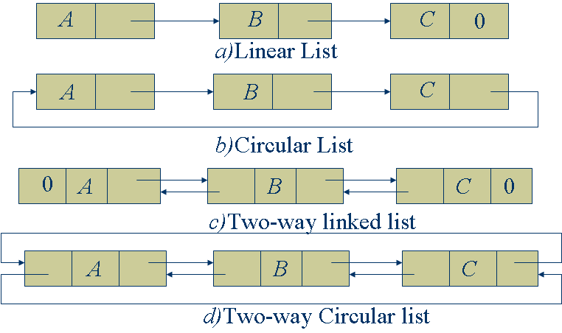
Different types of Linked lists

Slide 263
Advantages and Disadvantages of Linked lists
A linked list is a dynamic data structure. Linked lists can grow or shrink in size during the execution of a program.
Linked list uses the memory that is just needed for the list at any point of time.(It is not necessary to specify the no of nodes to be used in the list).
The linked lists provide flexibility in allowing the items to be rearranged efficiently.
The major limitation is that the access to any arbitrary item is little cumbersome and time consuming.
Linked list use more storage than an array with the same no of items.

Slide 264
Doubly Linked List
The disadvantage with a singly linked list is that traversal is possible in only direction, i.e., from the beginning of the list till the end.
If the value to be searched in a linked list is toward the end of the list, the search time would be higher in the case of a singly linked list.
It would have been efficient had it been possible to search for a value in a linked list from the end of the list.

Slide 265
Properties of a Doubly Linked List
This would be possible only if we have a doubly linked list.
In a doubly linked list, each node has two pointers, one say, next pointing to the next node in the list, and another say, prior pointing to the previous node in the list.
Therefore, traversing a doubly linked list in either direction is possible, from the start to the end using next, and from the end of the list to the beginning of the list using prior.

Slide 266
Properties of a Doubly Linked List (Contd.).
In a doubly linked list, the prior pointer of the first node will be null, as there is no node before the first node.
In a doubly linked list, the next pointer of the last node will be null, as there is no node after this list.
Bidirectional traversal of a doubly linked list is useful for implementing page up, and page down functionality when using doubly linked lists to create editors.
A doubly linked list would have two pointers, start and last to facilitate traversal from the beginning and end of the list respectively.

Slide 267
Declaration of a Doubly Linked List
struct marks_list
{
struct double_list *prior;
int info;
struct marks_list *next;
}

Slide 268
Visualizing a Doubly Linked List
last
start
100
140
100
120
140
null
1
120
100
2
140
120
3
null
prior
marks
next
prior
marks
next
prior
marks
next

Slide 269
Creating a Sorted Doubly Linked List
#include<stdio.h>
#include<malloc.h>
struct marks_list *start, *last;
/* variables declared outside main() are global in nature and can be accessed by other functions called from main() */
struct marks_list
{
struct marks_list *prior;
int marks;
struct marks_list *next;
};
main()
{
struct marks_list * makenode();
/* function prototype declaration */

Slide 270
Creating a Sorted Doubly Linked List (Contd.).
struct marks_list *new;
start = NULL;
char menu = ‘0 ‘;
while (menu != ‘5’)
{
printf( “Add Nodes :\n”);
printf( “Delete Nodes :\n”);
printf( “Forward Traverse a list :\n”);
printf( “Reverse Traverse a list :\n”);
printf( “Exit :\n”);
menu = getchar( );
switch (menu)
{
case ‘1’ : addnode( );
break;
case ‘2’ : deletenode( )
break;
case ‘3’ : forward_traverse( );
break;
case ‘4’ : reverse_traverse( );
break;
case ‘5’: exit( );
break;
} /* end of switch */
} /* end of main( ) */

Slide 271
Creating a Sorted Doubly Linked List (Contd.).
addnode( )
{
char ch = 'y';
while ( ch = = 'y' )
{ new = makenode();
/* creation of a list is treated as a special case of insertion */
if ( start = = NULL)
{ start = new;
start->prior = null;
}
else
{ insert();
traverse( );
}
printf("%s","Want to add more nodes\n");
scanf( "%c", &ch );
fflush( stdin );
} /* end of while */
} /* end of addnode( )
struct marks_list * makenode()
{ struct marks_list *new;
new=(struct marks_list *) malloc(sizeof(struct(marks_list));
scanf("%d",&new->marks);
new->prior = NULL;
new->next = NULL;
return(new);
}
insert( )
{ struct marks_list *ptr, *prev;
for(ptr=start,prev=start;(ptr);prev=ptr,ptr=ptr->next)
{ if (new->marks < start->marks)
{ /* insertion at the beginning of a list */
new->next = start;
new->prior = NULL;
start->prior = new;
last = start;
start = new;
}

Slide 272
Creating a Sorted Doubly Linked List (Contd.).
/* insertion in the middle of a list */
if(new->marks > ptr->marks)
continue;
else
{ prev->next = new;
new->prior = prev;
new->next = ptr;
ptr->prior = new;
}
} /* end of for loop */
/* insertion at the end of the list */
if (ptr = = null)
{ prev->next = new;
new->prior = prev;
new->next = null;
last = new;
}
} /* end of insert */

Slide 273
Searching a Value in a Doubly Linked List
struct marks_list *search( int val)
{
for( ptr = start; (ptr); ptr = ptr->next)
{
if (val = = ptr-> marks)
return ptr;
}
struct marks_list *search( int val)
{
for( ptr = last; (ptr); ptr = ptr->prior)
{
if (val = = ptr-> marks)
return ptr;
}

Slide 274
Deleting a Node From a Doubly Linked List
delete ( )
{
struct marks_list *ptr, *prev, *temp;
int score;
/* search the linked list for the value to be deleted */
scanf(“%d”, &score);
fflush(stdin);
for (ptr = start, prev = start; (ptr); prev = ptr, ptr = ptr->next)
{
/* deletion of the first node in the list */
if (score = = start-> marks)
{
temp =start;
start = start-> next;
start->prior = null;
free(temp);
}

Slide 275
Deleting a Node From a Linked List
/* deletion in the middle of a linked list */
if (score = = ptr-> marks)
{
prev-> next = ptr-> next;
ptr->next->prior = ptr->prior;
free(ptr);
}
/* deletion at the end of the list */
if (ptr->next = = null)
{
temp = ptr;
prev->next = null;
last = ptr->prior;
}
} }

Slide 276
Traversal of a Doubly Linked List
/* forward traversal of a doubly linked list */
for( ptr = start; (ptr); ptr = ptr->next)
{
printf(“%d”, ptr->marks);
}
/* reverse traversal of a doubly linked list */
for( ptr = last; (ptr); ptr = ptr->prior)
{
printf(“%d”, ptr->marks);
}

Slide 277
Hands-on: 2 hours
Purpose
construct single and doubly linked list and perform insertion, deletion and append operations
Notes:
Hands-on for 2 hours to be taken up to construct single and doubly linked list and perform insertion, deletion and append operations
Refer to hand-out in the supporting document (Module 4 : Functions & Recursion)

Slide 278
Summary
In this module, we discussed:
Limitations of using a data structure such as an array
Stack and heap variables
Characteristics of stack and heap variables
Creating a sorted linked list with the following operations
Insertion
Traversing
Deletion

Slide 279
Stacks & Queues
Module 9

Slide 280
Objectives
At the end of this module, you will be able to:
Explain the design, use, and operation of a stack
Implement a stack using a linked list structure
Describe applications of stacks
Discuss reversing data, parsing, postponing and backtracking
Define a queue
Describe the operations on a queue
Implement a queue as a special case of a linked list
Describe applications of queues
Duration: 4 hrs

Slide 281
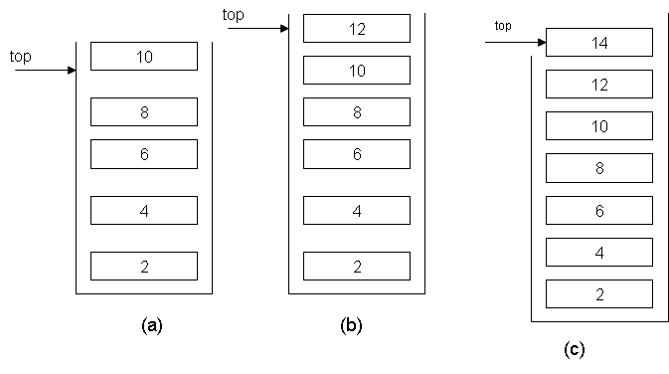
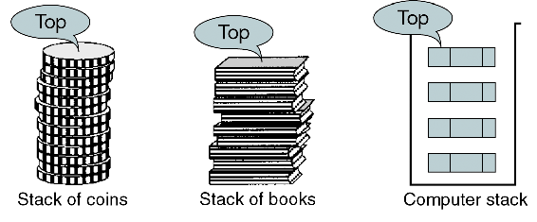
What is a Stack?
A stack is a linear list in which all additions and deletions are restricted to one end, called the top.
Last in – first out (LIFO)
Notes:
A common example of a stack, which permits the selection of only its end elements, is a stack of books.
A person desiring a book can pick up only the book at the top, and if one wants to place a plate on the pile of plates, one has to place it on the top.
You would have noticed that whenever a book is placed on top of the stack, the top of the stack moves upward to correspond to the new element (the stack grows).
And, whenever a book is picked, or removed from the top of the stack, the top of the stack moves downward to correspond to the new highest element (the stack shrinks).
Characteristics of a Stack
In diagram (a), 10 is the current top element of the stack. If we add any element in the stack, it will be placed on top of 10, and if we delete an element, it will be 10 that is on top of the stack.
Since the definition of the stack provides for the insertion and deletion of nodes into it, a stack can grow and shrink dynamically at runtime.
An ideal implementation of a stack would be a special kind of linked list in which insertions and deletions can only be done at the top of the list.

Slide 282
Operations on Stacks
Some of the typical operations performed on stacks are:
create (s)
to create s an empty stack
push (s, i)
to insert element i on top of the stack
pop (s)
to remove top element of the stack
top (s)
to return top element of stack
empty(s)
to check whether the stack is empty or not
Others
Full stack, Stack count, Destroy stack
Notes:
282
If a stack is empty, and it contains no element, it is not possible to pop the stack. Therefore, before popping an element, you must ensure that the stack is not empty. As the definition of a stack does not presuppose the number of elements in it, there is no upper limit on the number of elements in the stack, memory constraints notwithstanding.

Slide 283
Implementation of Stacks
An array can be used to implement a stack.
An ideal implementation for a stack is a linked list that can dynamically grow and shrink at runtime.
A stack, by definition, is a data structure that cannot be full since it can dynamically grow and shrink at runtime.
Notes:
283
Therefore, implementing a stack as an array prohibits the growth of the stack beyond the finite number of elements that the declared array can contain.
But since array size is defined at compile time, it cannot grow dynamically at runtime, and therefore, an attempt to insert an element into a array implementation of a stack that is already full causes a stack overflow.
Since you are going to employ a variation of a linked list that functions as a stack, you need to employ an additional pointer (top) that always points to the first node in the stack, or the top of the stack.
It is using top that a node will either be inserted at the beginning or top of the stack (push a node into the stack), or deleted from the top of the stack (popping a node at the top or beginning of the stack).

Slide 284
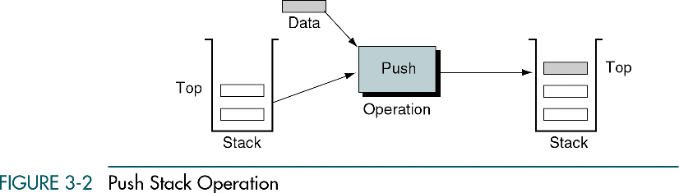
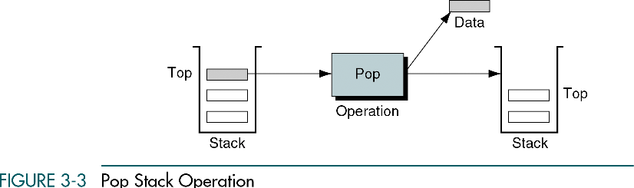
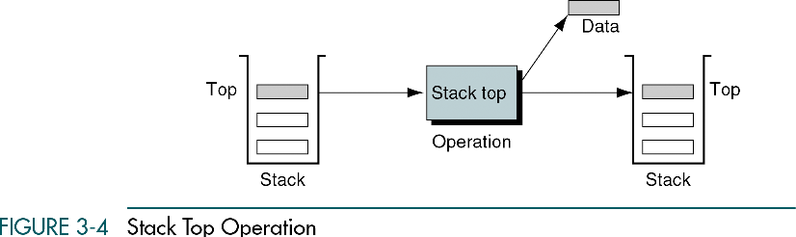
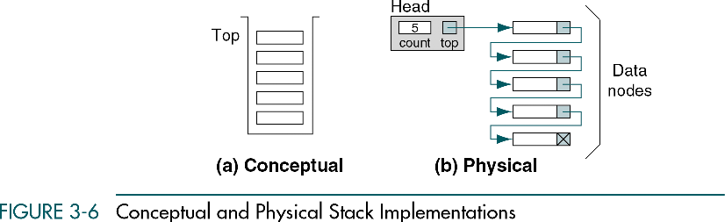
Push, Pop, Stack top

Slide 285
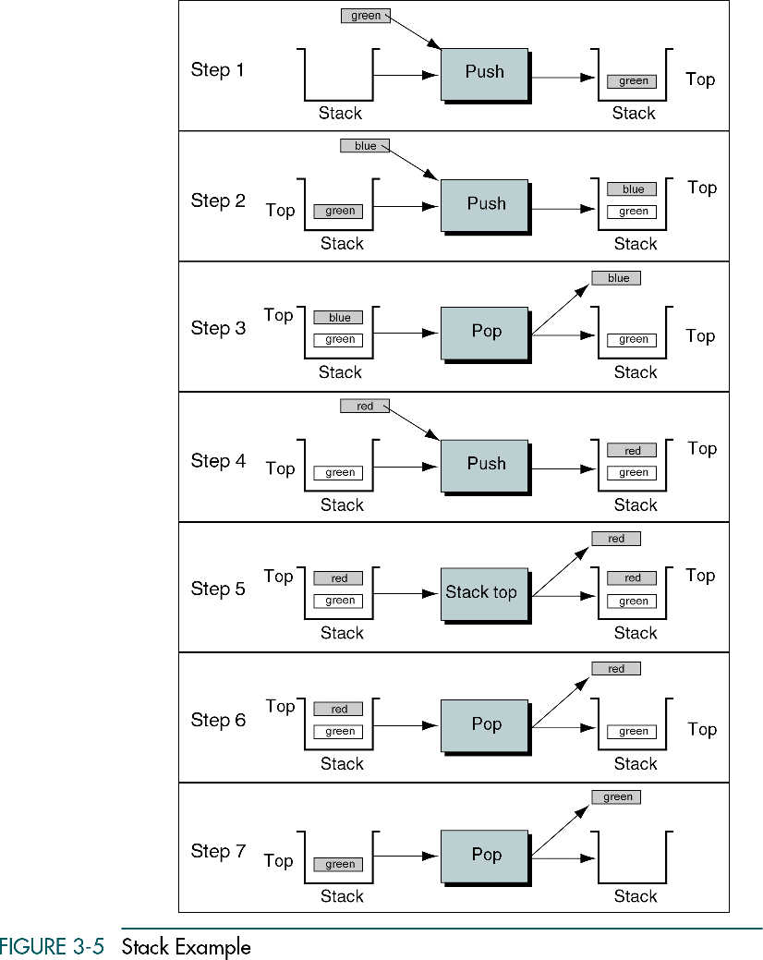
Example

Slide 286
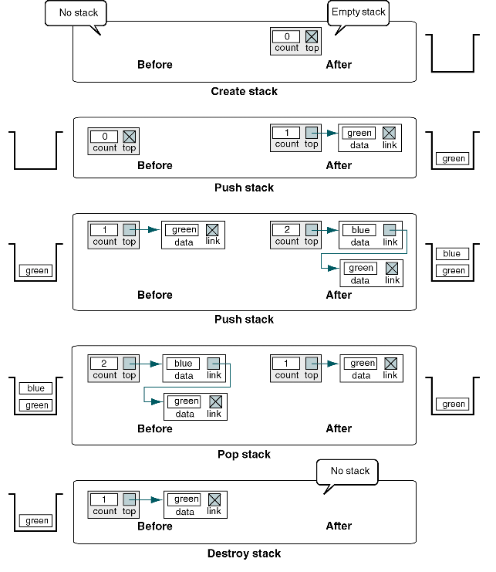
Example (Contd.).

Slide 287
Code Implementing for a Stack
The push( ) and the pop( ) operations on a stack are analogous to insert-first-node and delete-first-node operations on a linked list that functions as a stack.
struct stack
{ int info;
struct stack *next;
};
/* pointer declaration to point to the top of the stack */
struct stack *top;
main( )
{
top = NULL;
char menu = ‘0 ‘;
while (menu != ‘3’)
{
printf( “Add Nodes :\n”);
printf( “Delete Nodes :\n”);
printf( “Exit :\n”);
menu = getchar( );
switch (menu)
{ case ‘1’ : push( ); break;
case ‘2’ : pop( ) ; break;
case ‘3’: exit( ); break;
} /* end of switch */
} /*

Slide 288
Implementing push( )
push( )
{ struct stack * new;
char ch;
ch = ‘y’;
while (ch = = ‘y’)
{ new = getnode( )
/* checking for an empty stack */
if ( top = = null)
top = new;
else { new->next = top;
top = new;
}
printf("%s","Want to add more nodes\n");
scanf( "%c", &ch );
fflush( stdin );
} /* end of while */
} /* end of push( )

Slide 289
A View of the Stack After Insertion
new
1
info
next
top
2
3
info
next

Slide 290
Creating a Node on a Stack
struct stack * makenode()
{
struct stack *new;
new=(struct stack *) malloc(sizeof(struct(stack));
scanf("%d",&new->info);
new->next = NULL;
return(new);
}

Slide 291
Implementing pop( )
pop( )
{ struct stack * temp;
int x;
/* check for an empty stack */
if (top = = null)
{
printf (“Cannot remove nodes from an empty stack */
exit( );
}
else
{ temp = top;
x = top->info;
top = top->next;
free( temp);
return x;
}

Slide 292
A View of the Stack After Deletion
temp
top
A
B
next

Slide 293
Applications of Stacks
As a stack is a LIFO structure, it is an appropriate data structure for applications in which information must be saved and later retrieved in reverse order.
Consider what happens within a computer when function main( ) calls another function.
How does a program remember where to resume execution from after returning from a function call?
From where does it pick up the values of the local variables in the function main( ) after returning from the subprogram?

Slide 294
Applications of Stacks (Contd.).
As an example, let main( ) call a( ). Function a( ), in turn, calls function b( ), and function b( ) in turn invokes function c( ).
main( ) is the first one to execute, but it is the last one to finish, after a( ) has finished and returned.
a( ) cannot finish its work until b( ) has finished and returned. b( ) cannot finish its work until c( ) has finished and returned.

Slide 295
Applications of Stacks (Contd.).
When a( ) is called, its calling information is pushed on to the stack (calling information consists of the address of the return instruction in main( ) after a( ) was called, and the local variables and parameter declarations in main( ).
When b( ) is called from a( ), b( )’s calling information is pushed onto the stack (calling information consists of the address of the return instruction in a( ) after b( ) was called, and the local variables and parameter declarations in a( )).

Slide 296
Applications of Stacks (Contd.).
Then, when b( ) calls c( ), c( )’s calling information is pushed onto the stack (calling information consists of the address of the return instruction in b( ) after c( ) was called, and the local variables and parameter declarations in b( )).
When c( ) finishes execution, the information needed to return to b( ) is retrieved by popping the stack.
Then, when b( ) finishes execution, its return address is popped from the stack to return to a( )

Slide 297
Applications of Stacks (Contd.).
Finally, when a( ) completes, the stack is again popped to get back to main( ).
When main( ) finishes, the stack becomes empty.
Thus, a stack plays an important role in function calls.
The same technique is used in recursion when a function invokes itself.

Slide 298
Defining a Queue
A Queue is a data structure in which elements are added at one end (called the rear), and elements are removed from the other end (called the front).
You come across a number of examples of a queue in real life situations.
For example, consider a line of students at a fee counter. Whenever a student enters the queue, he stands at the end of the queue (analogous to the addition of nodes to the queue)

Slide 299
Defining a Queue (Contd.).
Every time the student at the front of the queue deposits the fee, he leaves the queue (analogous to deleting nodes from a queue).
The student who comes first in the queue is the one who leaves the queue first.
Therefore, a queue is commonly called a first-in-first-out or a FIFO data structure.

Slide 300
Queue Insertions and Deletions
1 2 3
1 2 3 4
front
rear
front
rear
(a)
(b)
2 3 4
front
rear
(c)
Notes:
To understand queues in a better way, consider a queue containing three elements as shown if figure (a). If you want to add element 4 to this queue, you can do so only at the rear end of the queue as shown in figure (b). Now, if you remove an element from this queue, it should be element 1 that is to be deleted because this is the element that has come first in the queue and is at the front. After deleting 1, element 2 will be at the front as shown in figure (c).
Confidential © 2009 Wipro Ltd
300

Slide 301
Queue Operations
To complete this definition of a queue, you must specify all the operations that it permits.
The first step you must perform in working with any queue is to initialize the queue for further use. Other important operations are to add an element, and to delete an element from a queue.
Adding an element is popularly known as ENQ and deleting an element is know as DEQ. The following slide lists operations typically performed on a queue.

Slide 302
Queue Operations (Contd.).
create(q) – which creates q as an empty queue
enq(i) – adds the element i to the rear of the queue and returns the new queue
deq(q) – removes the element at the front end of the queue (q) and returns the resulting queue as well as the removed element
empty (q) – it checks the queue (q) whether it is empty or not. It returns true if the queue is empty and returns false otherwise
front(q) – returns the front element of the queue without changing the queue
queuesize (q) – returns the number of entries in the queue

Slide 303
Implementing Queues
Linked lists offer a flexible implementation of a queue since insertion and deletion of elements into a list are simple, and a linked list has the advantage of dynamically growing or shrinking at runtime.
Having a list that has the functionality of a queue implies that insertions to the list can only be done at the rear of the list, and deletions to the list can only be done at front of the list.

Slide 304
Implementing Queues (Contd.).
Queue functionality of a linked list can be achieved by having two pointers front and rear, pointing to the first element, and the last element of the queue respectively.
The following figure gives a visual depiction of linked list implementation of a queue.
rear
front
2
4
7

Slide 305
Queue Declaration & Operations
struct queue
{
int info;
struct queue *next;
};
struct queue *front, *rear;
An empty queue is represented by q->front = q->rear = null. Therefore, clearq( ) can be implemented as follows:
void clearq(struct queue * queue_pointer)
{
queue_pointer->front = queue_pointer ->rear = null;
}

Slide 306
Queue Operations
You can determine whether a queue is empty or not by checking its front pointer. The front pointer of a queue can be passed as an argument to emptyq( ) to determine whether it is empty or not.
int emptyq (queue_pointer)
{
if (queue_pointer = = null)
return (1);
else
return(0);
}

Slide 307
Insertion into a Queue
struct queue
{ int info;
struct queue *next;
};
/* pointer declarations to point to the front, and rear of the queue */
struct queue *front, *rear;
main( )
{
front = NULL;
rear = NULL;

Slide 308
Insertion into a Queue (Contd.).
char menu = ‘0 ‘;
while (menu != ‘3’)
{
printf( “Add Nodes :\n”);
printf( “Delete Nodes :\n”);
printf( “Exit :\n”);
menu = getchar( );
switch (menu)
{
case ‘1’ : enq( );
break;
case ‘2’ : deq( )
break;
case ‘3’: exit( );
break;
} /* end of switch */
} /* end of main( ) */

Slide 309
Insertion into a Queue (Contd.).
void enq( )
{
struct queue *new;
new = getnode( );
if(queue_pointer->front= =queue_pointer->rear = = null)
{
queue_pointer->front = new;
queue_pointer->rear = new;
}
else
{
rear->next = new;
rear = new;
}
}
Notes:
You can insert a new node at the end of the list after the last node that is pointed to by pointer rear. You must take care when you insert an element into an empty queue as in this case you need to adjust the front pointer as well to point to this element.
Confidential © 2009 Wipro Ltd
309

Slide 310
Creating a Node on a Queue
struct queue * makenode()
{
struct queue *new;
new=(struct queue *) malloc(sizeof(struct(queue));
scanf("%d",&new->info);
new->next = NULL;
return(new);
}

Slide 311
Insertion into a Queue
New node inserted at rear of queue
rear
front
2
4
7
8
next
next
next
New

Slide 312
Deletion from a Queue
int deq( )
{
struct queue *temp;
int x;
if(queue_pointer->front= =queue_pointer->rear = = null)
{
printf( “Queue Underflow\n”);
exit (1);
}
temp = front;
x=temp->info;
front = front->next;
free(temp);
if(front = = null) /* check for queue becoming empty after node deletion */
rear = null;
return(x);
}
Notes:
Whenever you remove an element from a queue, you must ensure that the queue is not empty. If you are deleting the last element, you must ensure that q->rear = null to indicate that the queue is now empty.
Confidential © 2009 Wipro Ltd
312

Slide 313
Deletion of a Node From a Queue
rear
front
2
4
7
Node being deleted at the front of the queue

Slide 314
Applications of Queues
Queues are also very useful in a time-sharing multi-user operating system where many users share the CPU simultaneously.
Whenever a user requests the CPU to run a particular program, the operating system adds the request ( by first of all converting the program into a process that is a running instance of the program, and assigning the process an ID).
This process ID is then added at the end of the queue of jobs waiting to be executed.

Slide 315
Applications of Queues (Contd.).
Whenever the CPU is free, it executes the job that is at the front of the job queue.
Similarly, there are queues for shared I/O devices. Each device maintains its own queue of requests.
An example is a print queue on a network printer, which queues up print jobs issued by various users on the network.
The first print request is the first one to be processed. New print requests are added at the end of the queue.

Slide 316
Hands-on: 2 hours
Purpose
construct stack and queue so that to perform related operations
Notes:
Hands-on for 2 hours to be taken up to construct stack and queue so that to perform related operations
Refer to hand-out in the supporting document (Module 4 : Functions & Recursion)

Slide 317
Summary
In this module, we discussed:
Stack and operations on stack
Stack as a special case of a linked list
Applications of stacks
Queue and operations on queue
Queue as a special case of a linked list
Applications of queues

Slide 318
Binary Trees
Module 10

Slide 319
Objectives
At the end of this module, you will be able to:
Define a binary tree
Describe the terminologies associated with a binary tree
Use a dynamically allocated data structure to represent a binary tree
Traverse a binary tree
Add nodes to a binary tree
Remove nodes from a binary tree
Search a binary tree
Duration: 5 hrs

Slide 320
Eliminative or a Binary Search
The mode of accessing data in a linked list is linear. Therefore, search through a linked list is always linear.
A linear search is fine, if the nodes to be searched in a linked list are small in number.
The linear search becomes ineffective as the number of nodes in a linked list increase.
The search time increases in direct proportion with the size of the linked list.
Notes:
Therefore, in the worst case scenario of the data in question being stored at the extremes of the list, it would involve starting with the first node, and traversing through all the nodes till one reaches the last node of the list to access the data.
The linear search becomes imperative to have better searching mechanisms than a linear search
You will now be exposed to a game that will highlight a new mechanism of searching.

Slide 321
Example - Binary Search
Game that will highlight a new mechanism of searching
A coin is with one of the members in the audience divided into the two sections on the left and the right respectively as shown in the diagram.
The challenge facing X, the protagonist, is to find the person with the coin in the least number of searches.
Coin Search in a Group
X
YES
NO
J
K
L
A
B
C
M
N
O
D
E
F
P
Q
R
G
H
I
Notes:
X, familiar with a linear search, starts using it to search for the coin among the group.
Let us assume the worst-case scenario of the coin being with R.
If X was to start the search with A and progress linearly through B, C, ….M and finally to R, he would have taken a minimum of 18 searches (R being the 18th person searched in sequence to find the coin.
As you can see, this kind of search is not very efficient especially when the number of elements to be searched is high.
An eliminative search, also called a binary search, provides a far better searching mechanism.
Assume that X can pose intelligent questions to the audience to cut down on the number of searches.
A valid question that he could pose is “Which side of the audience has the coin?”
‘A’ in the audience to the left of him says that his side of the audience does not have the coin.
So X can completely do away with searching the audience to his left. That saves him 9 searches.
X has now got to search the audience to the right of him for searching out the coin.
Here too, he can split the audience into half by standing adjacent to the middle row, and posing the same question that he asked earlier “Which side of the audience has the coin?”
‘M’ in the middle row replies that the coin is with the audience to the left of him.

Slide 322
Example - Binary Search (Contd.).
X has in the process now eliminated 6 more searches, that is, the middle row and the row to the left of the middle as shown in the diagram below.
J
K
L
6 searches saved
X
NO
M
N
O
YES
P
Q
R

Slide 323
Example - Binary Search (Contd.).
X is now left with row to the right of the middle row containing P, Q, and R that has to be searched.
Here too, he can position himself right at the middle of the row adjacent to Q and pose the same question,
“Which side of the audience has the coin?” ‘Q’ replies that the coin is to his left.
P
Q
R
NO
YES
X
Notes:
That completes our eliminative or binary search.
It is called a binary search because at each stage of the search, the search is cut by more than half.
This kind of search forms the basis for the searching mechanism employed in a data structure wherein the data is represented in a hierarchal manner unlike the linear mechanism of storage employed in a linked list.

Slide 324
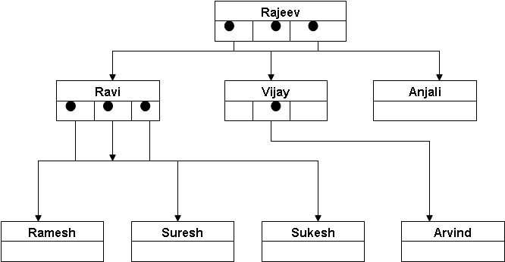
Trees
Trees are non-linear data structures.
In a tree structure, each node may point to several nodes
Tree are very flexible and a powerful data structure
Used for a wide variety of applications.
A tree is a collection of nodes that are connected to each other.
contains a unique first element known as the root, which is shown at the top of the tree structure.
A node which points to other nodes is said to be the parent of the nodes
the nodes that the parent node points to are called the children, or child nodes of the parent node.
Notes:
The root is the only node in the tree that does not have a parent.
All other nodes in the tree have exactly one parent.
There are nodes in the tree that do not have any children. Such nodes are called leaf nodes.
Nodes are siblings if they have the same parent.
A node is an ancestor of another node if it is the parent of that node, or the parent of some other ancestor of that node.
The root is an ancestor of every other node in the tree.
Similarly, we can define a node to be a descendant of another node if it is the child of the node, or the child of some other descendant of that node.
You may note that all the nodes in the tree are descendants of the root node.
above For example, we wish to use a data structure to represent a person, and all of his or her descendants. Assume that the person’s name is Rajeev and that he has three children, Ravi, Vijay and Anjali. Ravi has three children Ramesh, Suresh and Sukesh. And Vijay has Arvind.

Slide 325
Tree (Contd.).
An important feature of a tree is that there is a single unique path from the root to any particular node.
The length of the longest path from the root to any node is known as the depth of the tree.
The root is at level 0 and the level of any node in the tree is one more than the level of its parent.
In a tree, any node can be considered to be a root of the tree formed by considering only the descendants of that node. Such a tree is called the subtree that itself is a tree.

Slide 326
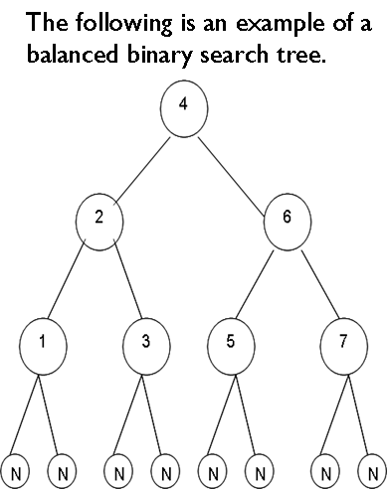
Binary Tree
A complete binary tree can be defined as one whose non-leaf nodes have non-empty left and right subtrees and all leaves are at the same level.
Each node will have a maximum of two children or two child nodes.
If a binary tree has the property that
all elements in the left subtree of a node n are less than the contents of n, and
all elements in the right subtree are greater than the contents of n
Notes:
You can give a formal definition of a binary tree as a tree which is either empty or consists of a root node together with two nodes, each of which in turn forms a subtree.
You therefore have a left subtree and a right subtree under the root node.

Slide 327
Binary Vs. Linear Search
As the name suggests, balanced binary search trees are very useful for searching an element just as with a binary search.
If we use linked lists for searching, we have to move through the list linearly, one node at a time.
If we search an element in a binary search tree, we move to the left subtree for smaller values, and to the right subtree for larger values, every time reducing the search list by half approximately.

Slide 328
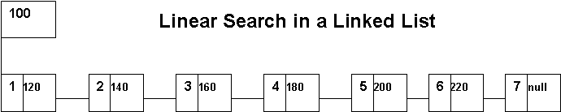
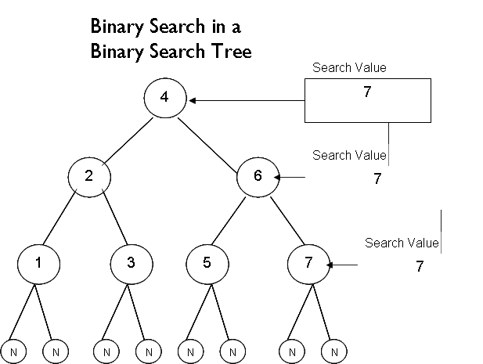
Binary Vs. Linear Search (Contd.).
Notes:
Consider the worst-case scenario of searching for the value 7 in the linked list. This would entail starting with the first node in the list and progressing linearly through the subsequent nodes till one comes to the value being searched for, which is 7. This would involve a maximum of 7 searches.
Consider the scenario of searching for the same value 7 in a balanced binary search tree. The search begins at the root node. Since the value being searched for is greater than the value in the root node, you need to search from the top of the right subtree to locate 7.
Since the value being searched is also greater than the value at the top of the right subtree, you move to the top of the next right subtree of the current subtree where the search value 7 is located.

Slide 329
The Essence of a Binary Search
To summarize, you have completely done away with searching with the entire left subtree of the root node and its descendant subtrees, in the process doing away with searching one-half of the binary search tree.
Even while searching the right subtree of the root node and its descendant subtrees, we keep searching only one-half of the right subtree and its descendants.
This is more because of the search value in particular, which is 7. The left subtree of the right subtree of the root could have been searched in case the value being searched for was say 5.

Slide 330
The Essence of a Binary Search (Contd.).
Thus we can conclude that while searching for a value in a balanced binary search tree, the number of searches is cut by more than half (3 searches in a balanced binary search tree) compared to searching in a linked list (7 searches).
Thus a search that is hierarchical, eliminative and binary in nature is far efficient when compared to a linear search.

Slide 331
Data Structure Representation of a Binary Trees
A tree node may be implemented through a structure declaration whose elements consist of a variable for holding the information and also consist of two pointers, one pointing to the left subtree and the other pointing to the right subtree.
A binary tree can also be looked at as a special case of a doubly linked list that is traversed hierarchically.
The following is the structure declaration for a tree node:
struct btreenode
{
int info;
struct btreenode *left;
struct btreenode *right;
};

Slide 332
Traversing a Binary Tree
Traversing a binary tree entails visiting each node in the tree exactly once.
Binary tree traversal is useful in many applications, especially those involving an indexed search.
Nodes of a binary search tree are traversed hierarchically.
The methods of traversing a binary search tree differ primarily in the order in which they visit the nodes.

Slide 333
Traversing a Binary Tree (Contd.).
At a given node, there are three things to do in some order. They are:
To visit the node itself
To traverse its left subtree
To traverse its right subtree
If we designate the task of visiting the root as R’, traversing the left subtree as L and traversing the right subtree as R, then the three modes of tree traversal discussed earlier would be represented as:
R’LR – Preorder
LRR’ – Postorder
LR’R – Inorder
Notes:
We can traverse the node before traversing either subtree.
Or, we can traverse the node between the subtrees.
Or, we can traverse the node after traversing both subtrees
The functions used to traverse a binary tree using these methods can be kept quite short if we understand the recursive nature of the binary tree.
Recall that a binary tree is recursive in that each subtree is really a binary tree itself.
Thus traversing a binary tree involves visiting the root node, and traversing its left and right subtrees.
The only difference among the methods is the order in which these three operations are performed.

Slide 334
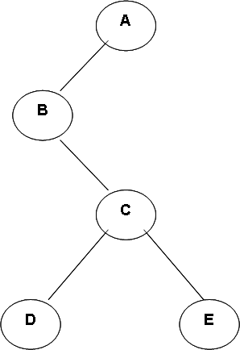
Traversing a Binary Tree (Contd.).
Depending on the position at which the given node or the root is visited, the name is given.
If the root is visited before traversing the subtree, it is called the preorder traversal.
If the root is visited after traversing the subtrees, it is called postorder traversal.
If the root is visited in between the subtrees, it is called the inorder traversal.

Slide 335
Preorder Traversal
When we traverse the tree in preorder, the root node is visited first.
i.e., the node containing A is traversed first.
Next, we traverse the left subtree.
This subtree must again be traversed using the preorder method.
Therefore, we visit the root of the subtree containing B and then traverse its left subtree.
The left subtree of B is empty
so its traversal does nothing.
Next we traverse the right subtree that has root labeled C.

Slide 336
Preorder Traversal (Contd.).
Then, we traverse the left and right subtrees of C getting D and E as a result.
Now, we have traversed the left subtree of the root containing A completely, so we move to traverse the right subtree of A.
The right subtree of A is empty, so its traversal does nothing. Thus the preorder traversal of the binary tree results in the values ABCDE.

Slide 337
Inorder Traversal
For inorder traversal, we begin with the left subtree rooted at B of the root.
Before we visit the root of the left subtree, we must visit its left subtree, which is empty.
Hence the root of the left subtree rooted at B is visited first. Next, the right subtree of this node is traversed inorder.

Slide 338
Inorder Traversal (Contd.).
Again, first its left subtree containing only one node D is visited, then its root C is visited, and finally the right subtree of C that contains only one node E is visited.
After completing the left subtree of root A, we must visit the root A, and then traverse its right subtree, which is empty.
Thus, the complete inorder traversal of the binary tree results in values BDCEA.

Slide 339
Postorder Traversal
For postorder traversal, we must traverse both the left and the right subtrees of each node before visiting the node itself.
Hence, we traverse the left subtree in postorder yielding values D, E, C and B.
Then we traverse the empty right subtree of root A, and finally we visit the root which is always the last node to be visited in a postorder traversal.
Thus, the complete postorder traversal of the tree results in DECBA.

Slide 340
Code - Preorder Traversal
void preorder (p)
struct btreenode *p;
{
/* Checking for an empty tree */
if ( p != null)
{
/* print the value of the root node */
printf(“%d”, p->info);
/* traverse its left subtree */
preorder(p->left);
/* traverse its right subtree */
preorder(p->right);
}
}

Slide 341
Code – Inorder Traversal
void inorder(p)
struct btreenode *p;
{
/* checking for an empty tree */
if (p != null)
{
/* traverse the left subtree inorder */
inorder(p->left);
/* print the value of the root node */
printf(“%d”, p->info);
/*traverse the right subtree inorder */
inorder(p->right);
}
}

Slide 342
Code – Postorder Traversal
void postorder(p)
struct btreenode *p;
{
/* checking for an empty tree */
if (p != null)
{
/* traverse the left subtree */
postorder(p->left);
/* traverse the right subtree */
postorder(p->right);
/* print the value of the root node */
printf(“%d”, p->info);
}
}

Slide 343
Accessing Values From a Binary Search Tree Using Inorder Traversal
You may note that when you traverse a binary search tree inorder, the keys will be in sorted order because all the keys in the left subtree are less than the key in the root, and all the keys in the right subtree are greater than that in the root.
The same rule applies to all the subtrees until they have only one key.
Therefore, given the entries, we can build them into a binary search tree and use inorder traversal to get them in sorted order.

Slide 344
Insertion into a Tree
Another important operation is to create and maintain a binary search tree.
While inserting any node, we have to take care the resulting tree satisfies the properties of a binary search tree.
A new node will always be inserted at its proper position in the binary search tree as a leaf.
Before writing a routine for inserting a node, consider how a binary tree may be created for the following input: 10, 15, 12, 7, 8, 18, 6, 20.

Slide 345
Insertion into a Tree (Contd.).
First of all, you must initialize the tree.
To create an empty tree, you must initialize the root to null. The first node will be inserted into the tree as a root node as shown in the following figure.
Since 15 is greater than 10, it must be inserted as the right child of the root as shown in the following figure.
10
Root
Root
10
15

Slide 346
Insertion into a Tree (Contd.).
Now 12 is larger than the root; it must go to the right subtree of the root.
Further, since it is smaller than 15, it must be inserted as the left child of the root as shown below.
Next, 7 is smaller than the root. Therefore, it must be inserted as the left child of the root as shown in the following figure.
Root
10
15
12
10
7
15
12

Slide 347
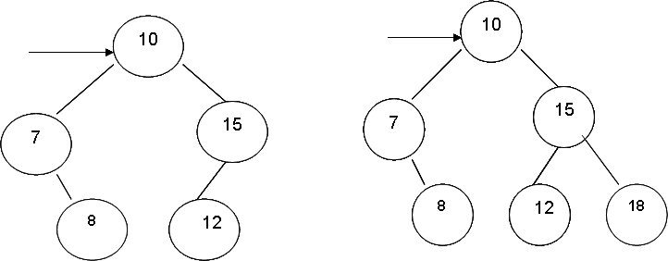
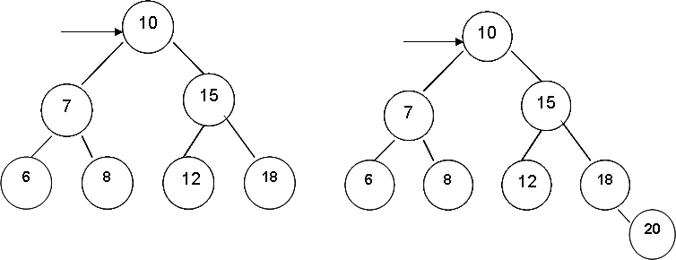
Insertion into a Tree (Contd.).
Similarly, 8, 18, 6 and 20 are inserted at the proper place as shown in the following figures.

Slide 348
Insertion into a Tree (Contd.).
This example clearly illustrates that given the root of a binary search tree and a value to be added to the tree, we must search for the proper place where the new value can be inserted.
We must also create a node for the new value and finally, we have to adjust the left and right pointers to insert the new node.
To find the insertion place for the new value, say 17, we initialize a temporary pointer p, which points to the root node.

Slide 349
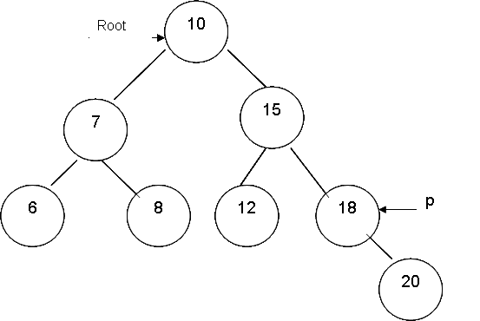
Insertion into a Tree (Contd.).
We can change the contents of p to either move left or right through the tree depending on the value to be inserted.
When p becomes null, we know that we have found the insertion place as in the following figure.

Slide 350
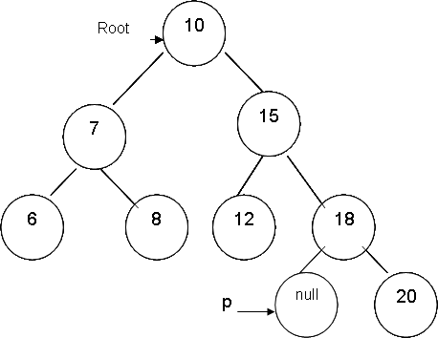
Insertion into a Tree (Contd.).
But once p becomes null, it is not possible to link the new node at this position because there is no access to the node that p was pointing to (node with value 18) just before it became null.
From the following figure, p becomes null when we have found that 17 will be inserted at the left of 18.

Slide 351
Insertion into a Tree (Contd.).
You therefore need a way to climb back into the tree so that you can access the node containing 18, in order to make its left pointer point to the new node with the value 17.
For this, you need a pointer that points to the node containing 18 when p becomes null.
To achieve this, you need to have another pointer (trail) that must follow p as p moves through the tree.
When p becomes null, this pointer will point to the leaf node (the node with value 18) to which you must link the new node (node with value 17).

Slide 352
Insertion into a Tree (Contd.).
Once you know the insertion place, you must adjust the pointers of the new node.
At this point, you only have a pointer to the leaf node to which the new node is to be linked.
You must determine whether the insertion is to be done at the left subtree or the right subtree of the leaf node.
To do that, you must compare the value to be inserted with the value in the leaf node.
If the value in the leaf node is greater, we insert the new node as its left child; otherwise we insert the new node as its right child.

Slide 353
Creating a Tree – A Special Case of Insertion
A special case of insertion that you need to watch out for arises when the tree in which you are inserting a node is an empty tree.
You must treat it as a special case because when p equals null, the second pointer (trail) trailing p will also be null, and any reference to info of trail like trail->info will be illegal.
You can check for an empty tree by determining if trail is equal to null. If that is so, we can initialize root to point to the new node.

Slide 354
Code Implementation For Insertion into a Tree
The C function for insertion into a binary tree takes two parameters; one is the pointer to the root node (root), and the other is the value to be inserted (x).
You will implement this algorithm by allocating the nodes dynamically and by linking them using pointer variables. The following is the code implementation of the insert algorithm.

Slide 355
Code Implementation For Insertion into a Tree (Contd.).
tree insert(s,x)
int x;
tree *s;
{ tree *trail, *p, *q;
q = (struct tree *) malloc (sizeof(tree));
q->info = x;
q->left = null;
q->right = null;
p = s;
trail = null;
while (p != null)
{ trail = p;
if (x < p->info) p = p->left;
else p = p->right;
}
/*insertion into an empty tree; a special case of insertion */
if (trail == null)
{ s = q;
return (s);
}
if(x < trail->info)
trail->left = q;
else
trail->right = q;
return (s);
}

Slide 356
Code Implementation For Insertion into a Tree using Recursion
You have seen that to insert a node, you must compare x with root->info.
If x is less than root->info, then x must be inserted into the left subtree.
Otherwise, x must be inserted into the right subtree.
This description suggests a recursive method where you compare the new value (x) with the one in the root and you use exactly the same insertion method either on the left subtree or on the right subtree.

Slide 357
Code Implementation For Insertion into a Tree using Recursion (Contd.).
The base case is inserting a node into an empty tree. You can write a recursive routine (rinsert) to insert a node recursively as follows:
tree rinsert (s,x)
tree *s;
int x;
{ /* insertion into an empty tree; a special case of insertion */
if (!s)
{ s=(struct tree*) malloc (sizeof(struct tree));
s->info = x;
s->left = null;
s->right = null;
return (s);
}
if (x < s->info) s->left = rinsert(x, s->left);
else if (x > s->info) s->right = rinsert(x, s->right);
return (s);
}

Slide 358

Circumstances When a Binary Tree Degenerates into a Linked List
The shape of a binary tree is determined by the order in which the nodes are inserted.
Given the following input, their insertion into the tree in the same order would more or less produce a balanced binary search tree as shown below:
Input values: 10, 15, 12, 7, 8, 18, 6, 20

Slide 359

Circumstances When a Binary Tree Degenerates into a Linked List (Contd.).
If the same input is given in the sorted order as
6, 7, 8, 10, 12, 15, 18, 20, you will construct a lopsided tree with only right subtrees starting from the root.
Such a tree will be conspicuous by the absence of its left subtree from the top.

Slide 360

Circumstances When a Binary Tree Degenerates into a Linked List (Contd.).
However if you reverse the input as
20, 18, 15, 12, 10, 8, 7, 6, and insert them into a tree in the same sequence, you will construct a lopsided tree with only the left subtrees starting from the root.
Such a tree will be conspicuous by the absence of its right subtree from the top.
Notes:
A search in such lopsided trees would degenerate into a linear search, and such a tree bears the functionality of a linked list. Such lopsided trees are not efficient from the perspective of search efficiency

Slide 361
Deletion from a Binary Search Tree
An important function for maintaining a binary search tree is to delete a specific node from the tree.
The method to delete a node depends on the specific position of the node in the tree.
The algorithm to delete a node can be subdivided into different cases.

Slide 362

Case I – Deletion Of The Leaf Node
If the node to be deleted is a leaf, you only need to set appropriate link of its parent to null, and do away with the node that is to be deleted.
For example, to delete a node containing 1 in the following figure, we have to set the left pointer of its parent (pointing to 1) to null.
The following diagram illustrates this.

Slide 363

Case II – Deletion Of a Node With a Single Child
If the node to be deleted has only one child, you cannot simply make the link of the parent to nil as you did in the case of a leaf node.
Because if you do so, you will lose all of the descendants of the node that you are deleting from the tree.
So, you need to adjust the link from the parent of deleted node to point to the child of the node you intend to delete. You can subsequently dispose of the deleted node.
To delete node containing the value 3, where the right subtree of 3 is empty, we simply make the link of the parent of the node with the value 3 (node with value 5) point to the child of 3 (node with the value 2).

Slide 364
Case III – Deletion Of a Node With Two Child Nodes
Complications arise when you have to delete a node with two children.
There is no way you can make the parent of the deleted node to point to both of the children of the deleted node.
So, you attach one of the subtrees of the node to be deleted to the parent, and then link the other subtree onto the appropriate node of the first subtree.
You can attach the right subtree to the parent node and then link the left subtree on to the appropriate node of the right subtree.

Slide 365

Case III – Deletion Of a Node With Two Child Nodes (Contd.).
Therefore, you must attach the left subtree as far to the left as possible. This proper place can be found by going left until an empty left subtree is found.
For example, if you delete the node containing x as shown in the following figure, you make the parent of x (node with the value r) point to the right subtree of x (node containing y) and then go as far left as possible (to the left of the node containing y) and attach the left subtree there.

Slide 366
Code Implementation for Node Deletion for Cases I, II & III
void delete (p)
Struct tree *p
{
struct tree *temp
if (p == null)
printf(“Trying to delete a non-existent node”);
else if (p->left == null)
{
temp = p;
p = p->right;
free(temp);
}
else if (p->right == null)
{
temp = p;
p = p->left;
free (temp);
}

Slide 367
Code Implementation for Node Deletion for Cases I, II & III (Contd.).
else if(p->left != null && p->right!= null)
{
temp = p->right;
while (temp->left != null)
{
temp = temp->left;
}
temp->left = p->left;
temp = p;
p = p->right;
free (Temp);
}
}

Slide 368
Code Implementation for Node Deletion for Cases I, II & III (Contd.).
Note that the while loop stops when it finds a node with an empty left subtree so that the left subtree of the node to be deleted can be attached here.
Also, note that you first attach the left subtree at the proper place and then attach the right subtree to the parent node of the node to be deleted.
Notes:
368
You should also note that this type of deletion maintains the binary search tree but increases the height of the tree. Thus, it increases the time required for a search. Hence, to optimize searching through a binary search tree, you need methods that make the left and the right subtrees as balanced as possible.

Slide 369
Search The Tree (Contd.).
To search a tree, you employ a traversal pointer p, and set it equal to the root of the tree.
Then you compare the information field of p with the given value x. If the information is equal to x, you exit the routine and return the current value of p.
If x is less than p->info, you search in the left subtree of p.
Otherwise, you search in the right subtree of p by making p equal to p->right.

Slide 370
Search the Tree (Contd.).
You continue searching until you have found the desired value or reach the end of the tree. You can write the code implementation for a tree search as follows:
search (p,x)
int x;
struct tree *p;
{
p = root;
while (p != null && p->info != x)
{
if (p->info > x)
p = p->left;
else
p = p->right;
} return (p);
}
Notes:
370
In the calling routine, you can check whether the returned value of p is null or not. If it is null, the calling routine can give a message that the searched value is not there in the tree. The maximum number of comparisons in a binary search tree is equal to the depth of the tree whereas in the case of a linear linked list, the maximum number of comparisons is equal to the number of nodes in the list.

Slide 371
Hands-on: 2 hours
Purpose
construct binary tree and perform search operations
Notes:
Hands-on for 2 hours to be taken up to construct binary tree and perform search operations
Refer to hand-out in the supporting document (Module 10: Binary Trees)

Slide 372
Summary
In this module, we discussed:
Binary tree and terminologies associated with a binary tree
Dynamic allocated data structure to represent a binary tree
Traversing a binary tree
Adding nodes to a binary tree
Removing nodes from a binary tree
Searching a binary tree

Slide 373
Thank You

