Slide 1


ARTIFICIAL INTELLIGENCE AIDED FORECASTING OF AIR QUALITY INDEX
Om Patra¹, Ashutosh Satpathy¹, Dinesh Darshan¹, Abba Elizabeth Joseph (PhD)², Bhaskar Mondal (PhD)¹
1. Xavier School of Computer Science and Engineering, Xavier University Bhubaneswar.
2. Xavier School of Sustainability, Xavier University Bhubaneswar.
ARCS 4.0 - Fourth Annual Research on Cities Summit International Conference on Cities for People – Plans, Programs and Policies
Xavier School of Human Settlements, Xavier University Bhubaneswar

Slide 2
INDEXUALITY SOURCES
Introduction
Air Quality Sources
Particulate Matter: What is it?
Effects
Effect on Health
Effect on Business
Motivation
Contribution
Data
Methodology
Experimental Setup
Result
Measures to Control
Conclusion and Future Work
Reference
Feedback

Slide 3
INTRODUCTION
The health effects of air pollution imperil human lives. This fact is well-documented.
Air pollution is a serious challenge for human health and annually millions of tons toxic pollutants due to human activities are released into the atmosphere .
As the largest growing industrial nation, India is producing record amount of pollutants specifically CO₂, PM_{2.5} etc. and other harmful aerial contaminants.
The alarming rise in the air pollution level can be defined as one of the most threatening problem in urban settlements in the current scenario. The different pollutants present in the atmosphere can be observed dispersed or concentrated during varied time periods. As per the previous studies the data of ambient air quality can be framed as stochastic time series, thereby helpful in estimating a short-term forecast on the basis of previously collected historical data.

Slide 4
AIR QUALITY SOURCES
What contributes to air pollution:
Motor vehicles
Power plants
Factories
Consumer & commercial products
Fuel combustion processes
Primary air pollutants which pose health risks:
Carbon monoxide
Volatile organic compounds
Particulate matter
Sulfur dioxide
Nitrogen oxides
Secondary air pollutants mix together and react with sunlight to form new compounds
Ozone

Slide 5
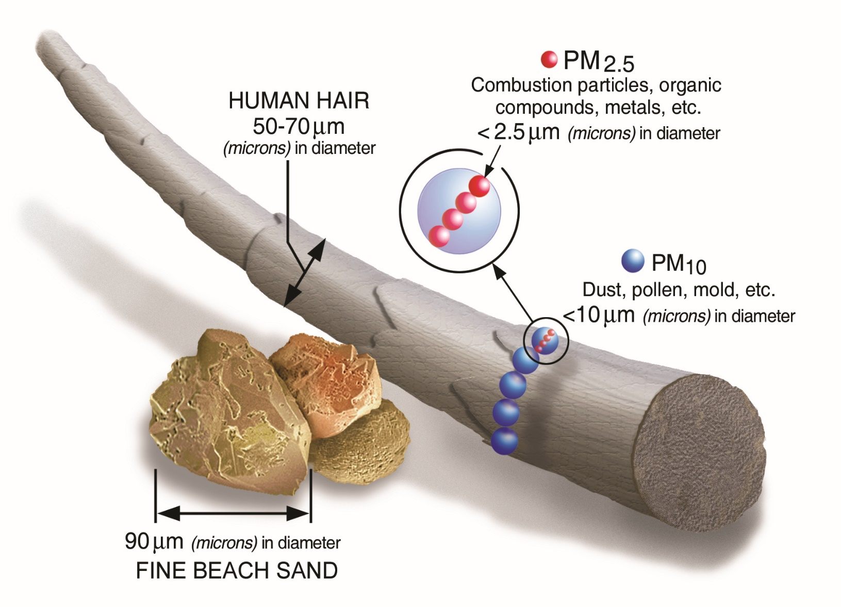
PARTICULATE MATTER: WHAT IS IT?
Particulate matter is the sum of all solid and liquid particles suspended in air many of which are hazardous. This complex mixture includes both organic and inorganic particles, such as dust, pollen, soot, smoke, and liquid droplets. These particles vary greatly in size, composition, and origin.
Particles in air are either:
directly emitted, for instance when fuel is burnt and when dust is carried by wind,
or indirectly formed, when gaseous pollutants previously emitted to air turn into particulate matter.
.

Slide 6
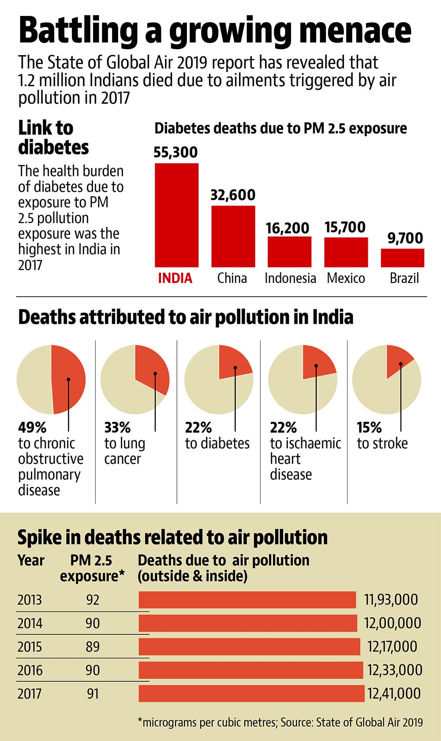
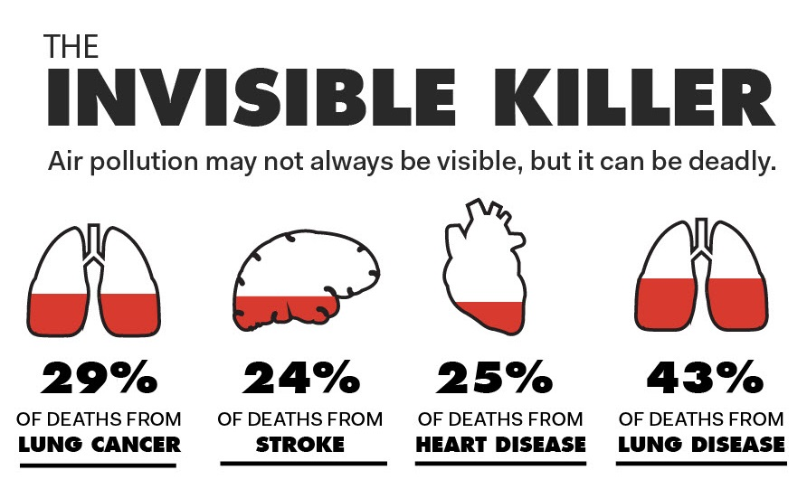
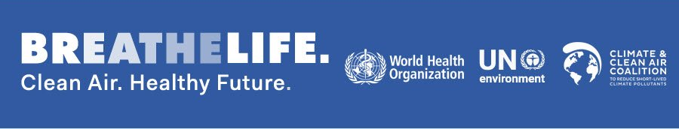
EFFECTS
Health Hazards :
Ambient air pollution health effects:
In children and adults, both short- and long-term exposure to ambient air pollution can lead to reduced lung function, respiratory infections and aggravated asthma
Maternal exposure to ambient air pollution is associated with adverse birth outcomes, such as low birth weight, pre-term birth and small gestational age births

Slide 7
Effect on Business:
Some industries might benefit from generating pollution but others might be hurt by employing sicker workers who are less productive.
Pollution has a negative effect in industries accounting for 61% of India’s output with some industries particularly sensitive to pollution.
The effects of pollution and other environmental changes can vary by industry, income and location.

Slide 8
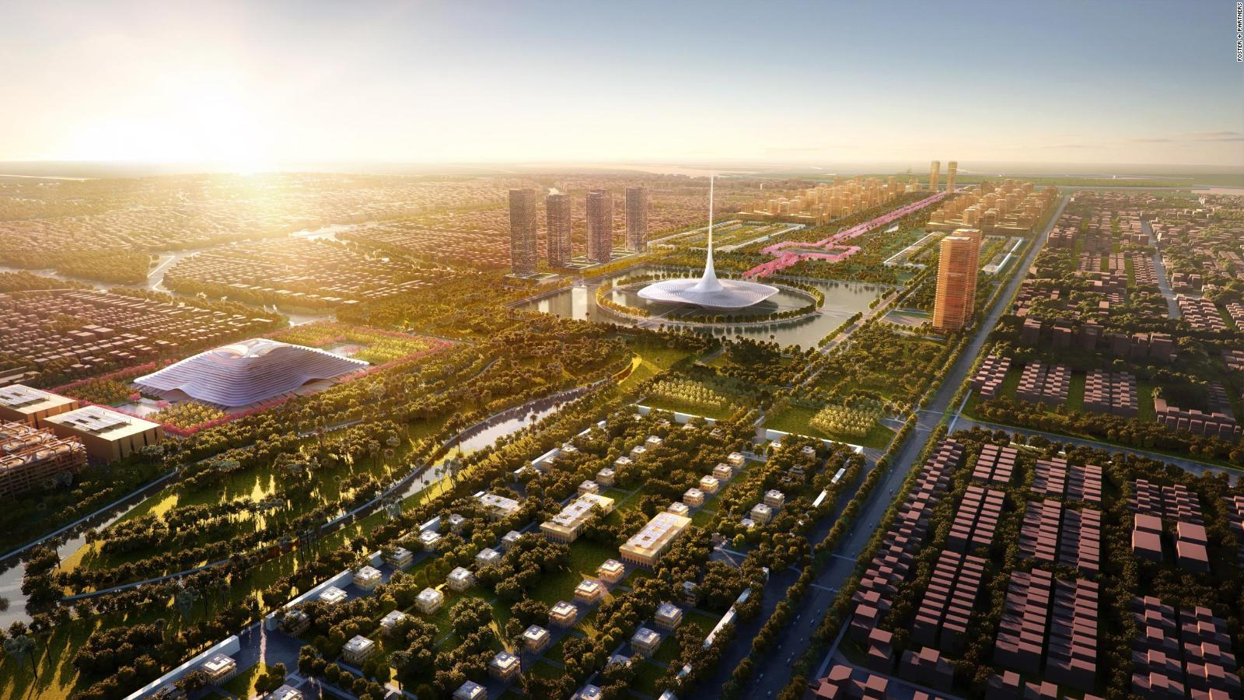
MOTIVATION
In recent years cities like Delhi, Mumbai and Hyderabad are facing dreadful situations due to massive air pollution and due to lack of proper measures not been taken in the past to control or avoid these situations.
The reason which motivated to work on this paper is the popularity of the city Amravati, an emerging future city might face the same situation in near future which will lead to numerous problems being faced by metropolitan cities such as Delhi, Mumbai and Hyderabad if the pollutants are not governed properly.

Slide 9

CONTRIBUTION
Predicting the AQI of different cities using Deep Learning (Long Short Term Memory (LSTM)) based on different environmental pollutants.
Proposing measures to avoid or control the massive air pollution for the city of Amravati.

Slide 10

DATA
We have collected the data for different cities from Central Pollution Control Board(CPCB) for prediction from 01 January 2017 to 31 January 2020. CPCB is a statutory organization, was constituted in September, 1974 under the Water (Prevention and Control of Pollution) Act, 1974.
It serves as a field formation and also provides technical services to the Ministry of Environment and Forests of the provisions of the Environment (Protection) Act, 1986.
https://app.cpcbccr.com/ccr/#/caaqm-dashboard-all/caaqm-landing/caaqm-comparison-data
Criteria pollutants that we have considered for our prediction :
Ozone
Nitrogen Dioxide
Sulfur dioxide
Carbon monoxide
Nitrogen dioxide
Particulate Matter
Date | PM10 | PM2.5 | NO2 | Ozone | SO2 | CO
13-06-2017 00:00 | 20.25 | 7.83 | 13.02 | 34.24 | 2.26 | 0.77
14-06-2017 00:00 | 40.21 | 18.94 | 13.61 | 43.56 | 13.66 | 0.87
15-06-2017 00:00 | 30.21 | 11.81 | 15.52 | 36.35 | 12.95 | 0.75

Slide 11
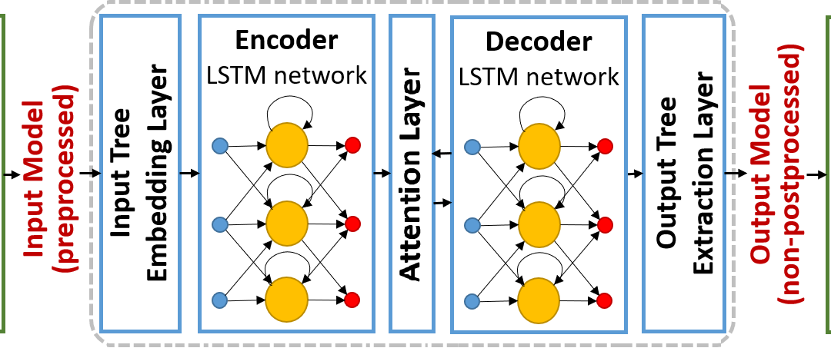
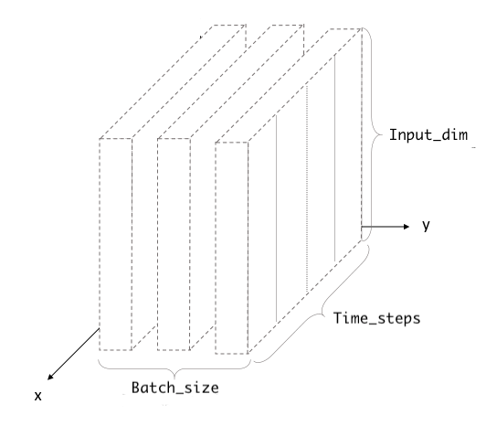
METHODOLOGY
Long short-term memory (LSTM) is an artificial recurrent neural network (RNN) architecture used in the field of deep learning. It can not only process single data points (such as images), but also entire sequences of data (such as speech or video).
We are using PM_{2.5} as our primary parameter and representing it using 6 layers by taking 6 environmental pollutants such as PM₁₀ , CO, O₃, SO₂, NO₂ and PM_{2.5}

Slide 12
EXPERIMENTAL SETUP
We have taken 684 samples for training our algorithm and 417 samples for testing purposes
For First Iteration:
684/684 [==============================] - 4s 6ms/step - loss: 0.0407
Epoch 1/200
For Last Iteration:
Epoch 200/200
684/684 [==============================] - 2s 3ms/step - loss: 0.0023
We have reduced the mean squared error by ~6% from the first iteration to the last iteration.

Slide 13
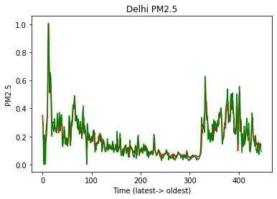
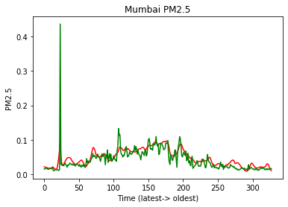
RESULT
Predicted
Actual

Slide 14
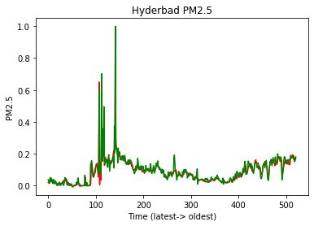
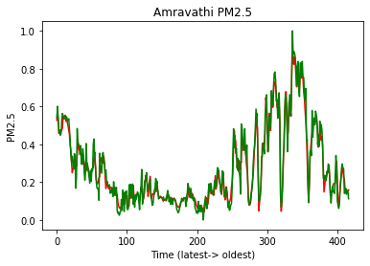
Predicted
Actual

Slide 15
MEASURES TO CONTROL
Measures to check vehicular emission
Increase distribution of electric and hybrid vehicles.
Switch to Ultra Low Sulphur Diesel(ULSD) and implement Bharat VI standards for engine emission.
Reduce emission by optimizing power sector.
Regulatory framework for industrial Air pollution.
Cleaner construction practice.
Business models to reduce crop residue.
Integrated waste management policy.

Slide 16
CONCLUSION AND FUTURE WORK
Since our model is capable of predicting the current data with high accuracy it will successfully predict the upcoming air quality index of any particular data within a given region.
With this model we can forecast the AQI and alert the respected region of the country also it a progressive learning model it is capable of tracing back to the particular location needed attention provided the time series data of every possible region needed attention.
There is also a possibility of further refinement in the results if additional metrological parameters are also included in the daily experimental data.

Slide 17
REFERENCE
H. Wang, et al., “Air Quality Index Forecast Based on Fuzzy Time Series Models”, Journal of Residuals Science & Technology, Vol. 13, No. 5, 2016
C. Zhang, et al., “Understanding deep learning requires rethinking generalization”, ICLR, 2017
Q. Feng, “Improving Neural Network Prediction Accuracy for PM10 Individual Air Quality Index Pollution Levels”, Environmental Engineering Science, 30(12): 725–732, 2013
Gokhale Sharad and Namita Raokhande, “Performance evaluation of air quality models for predicting PM10 and PM2.5 concentrations at urban traffic intersection during winter period”, Science of the total environment 394.1(2008): 9-24.
Air Pollution – Monitoring, Modelling and Health, Edited by Mukesh Khare p. cm. ISBN 978-953-51-0424-7, InTech Janeza Trdine 9, 51000 Rijeka, Croatia
Finardi, S.; de Maria, R.; D’Allura, A.; Cascone, C.; Calori, G.; Lollobrigida, F. A deterministic air quality forecasting system for Torino urban area, Italy. Environ. Model. Softw. 2008, 23, 344–355.
Grivas, G.; Chaloulakou, A. Artificial neural network models for prediction of PM10 hourly concentrations, in the Greater Area of Athens, Greece. Atmos. Environ. 2006, 40, 1216–1229.

Slide 18
FEEDBACK

