Slide 1
Quick analysis of quality of cereals, oilseeds and pulses using AI
Team name: kogarasu_maru

Slide 2
INTRODUCTION
Grading and classification of cereals, oilseeds and pulses is based on observations and through experiences. The system utilizes image-processing techniques to classify and grade quality of cereals, oilseeds and pulses .
Two dimensional cereals, oilseeds and pulses images are classified on shape and colour based analysis methods. However, different cereals, oilseeds and pulses images may have similar or identical colour and shape values. Hence, using colour or shape features analysis methods are still not effective enough to identify and distinguish fruits images.
Therefore, we used a method to increase the accuracy of the fruit quality detection by using colour, shape, and size based method with combination of convolutionary neural network (CNN).

Slide 3
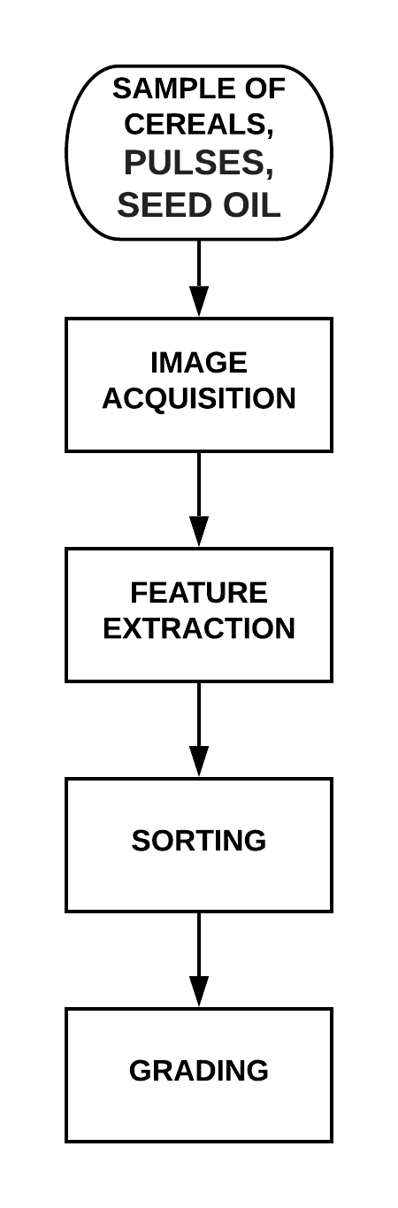
Proposed Method For Pulses, Oil Seed and Cereals Quality Detection
This proposed automated system is designed to overcome the problems of manual techniques. The system consists of several steps like feature extraction, sorting and grading.
It is designed to combine three processes as shown in a flow chart. Features like color ,shape and size of pulses, cereals and oilseeds are extracted.
Size features are extracted in height and width. Extracting the size of pulses, cereals and oilseeds is called grading. The flow chart of sorting and grading process is given in the following.

Slide 4
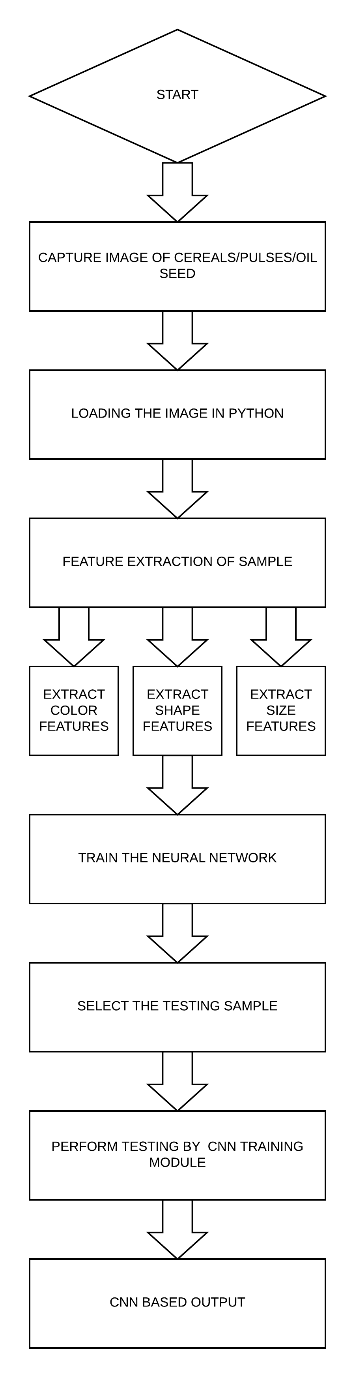
APPROCH TO THE PROBLEM STATEMENT:
There are seven Steps for the pulses, cereals and oilseeds quality detection in proposed methodology. These steps are as following:
Step 1: Get image of pulses, cereals and oilseeds with help of Raspberry Pi
Step 2: This image is loaded into the python library.
Step 3: Extract the features of fruit sample.
Step 4: Train the neural network.
Step 5: Select the fruit sample for testing.
Step 6: Perform testing by using artificial neural network training module button.
Step 7: Convolutional Neural Network (ConvNet/CNN) based output

Slide 5
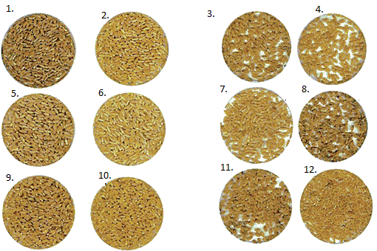
These are the samples of wheat grains from our database.

Slide 6
PROCEDURE:
We installed a camera in the raspberry pie hardware and captured the image and stored it in the database.
We extracted the features of the image on the basis of color, shape and size.
After extracting the features the image is labelled according to it (Training set).
Next we went to the nearby stores and showed them our samples. Then, we labelled the samples according to the features as per there knowledge and added a new column.
After collecting the training and testing sets we train our neural network module for further implementation.
These are the samples of wheat grains from our database.

Slide 7
CONCLUSION
The project presents a new technique for quality detection of pulses, cereals and oilseeds . The technique is started by capturing the image of pulses, cereals and oilseeds using regular digital camera attached in Raspberry Pi
The features are efficiently extracted from the sampled image. The extracted features are based on the parameters color, shape and size. The ConvNet technique is used for checking the quality.
The quality is determined by using pulses, cereals and oilseeds features obtained with the help of ConvNet. The proposed technique accurately detects the quality of pulses, cereals and oilseeds. The results are good for the three chosen wheat grains of different color, shape and size. This kind of system can further more be employed in juice plants, fruit and vegetable farms, packaging etc. In future the quality detection based on ConvNet should be compared with other mechanical and automated techniques.
This will enable the farmer to get better price and share for better quality. Presently, all produce is treated as having the same composition.

Slide 8
FEEDBACK

