Slide 1
Virtual classroom using lifi
[ study and application ]
Li-Fi or Light Fidelity is a high-speed wireless communication technology that uses visible light to transmit data. Unlike Wi-Fi, which uses radio waves, Li-Fi uses light waves to transmit information. This means that Li-Fi can be used in areas where radio waves are restricted, such as hospitals and airplanes.

Slide 2
BRACT’s Vishwakarma Institute of Information Technology An Autonomous Institute affiliated to Savitribai Phule Pune University
PROJECT BASED LEARNING REPORT
F.Y.B.Tech
ACADAMIC YEAR – 2023-2024
Faculty Mentor: Dr. Mrs. Rohini S. Bhalerao-Panajkar
Professor in Physics
Dept: Engineering & Applied Sciences

Slide 3
Study and application based on Li-Fi
Team member : presented by
Name | Roll No. | PRN . No. | Branch
Anurag Maske | 3 | 22310033 | CSE(AI)
Ashutosh Shinde | 8 | 22310120 | CSE(AI)
Pandharinath Maske | 13 | 22310246 | CSE(AI)
Aayush Bokde | 18 | 22310316 | CSE(AI)
Sakshi Lokhande | 23 | 22310541 | CSE(AI)

Slide 4
Index
Introduction
Literature Survey
Objectives
Methodology (adopted from literature Survey)
Work Plan (weekly schedule of work)
Distribution of tasks
Motivation (Technological/Scientific significance)
Principle of Physics on which the topic is based.

Slide 5
Index
9. Theoretical & Mathematical Formulation
10. Calculations using realistic parameters
11. Simulation/Demonstration of Principle
12. Results of the experiment carried out & Discussion (if
applicable)
13. Conclusions
14. Future Scope
15. References
16. Details of meetings held with contributions by

Slide 6
Introduction
We have developed an small project that utilizes a LED to transmit data from one PC to another PC , it is executed with the help of Arduinos. An idea 💡 behind the project is in today's world, effective and efficient data transmission is becoming increasingly crucial, especially in the Era of Technology. The accuracy and efficiency in transmitting data play a pivotal role in optimizing the work environment. So this model is useful for upcoming new gen technology.

Slide 7
Motivation ( Technological/ scientific significance)
Offers incredibly high-speed data transfer rates, surpassing traditional Wi-Fi.
Utilizes light waves, providing enhanced data security due to its inability to pass through walls.
Minimizes interference as it operates on the light spectrum, ideal for sensitive environments.
Holds potential for seamless integration with IoT and smart technology due to its high-speed connectivity.
Its reliance on light limits coverage range, suitable for specific, confined environments.

Slide 8
LITERATURE SURVEY
Roll No. | Title | Author | Abstract | Work Carried Out | Result | Conclusion
3 | INTRODUCTION TO INDOOR NETWORKING CONCEPTS 2017 | Cheng Chen, Stefan Videv, Damian Parol | This paper provides the motivation behind why LiFi is a very timely technology, especially for 6th generation (6G) cellular communications. It discusses and reviews essential networking technologies, such as interference mitigation and hybrid LiFi/Wi-Fi networking topologies. | The testbed platform generates data relating to users, network, traffic flows, and supported services. As the testbed supports vertical handover between the heterogeneous LiFi and Wi-Fi networks, it is possible to trace the data flows of users during transitions from LiFi to LiFi and LiFi to Wi-Fi. | The results also demonstrate that frequency reuse gains are achievable within a small area—in this case a classroom. Our future work will aim to adopt the SDN-based dynamic load-balancing algorithms developed in the lab testbed such as the LiFi network in a classroom. | The study highlights the substantial data density improvement achievable by combining LiFi with Wi-Fi. LiFi enables significant advancements in cell densification, enabling efficient reuse of transmission resources, crucial for the rising number of connected devices.
13 | IMPLEMENTATION OF LI-FI TECHNOLOGY IN CLASSROOMS 2019 | Shubhendu Apoorv, Sudharshan Kumar Bhowmick, E.Annadevi | The traditional methods like Wi-Fi or wired connections are not much efficient due to the speed limitation and other factors. Light fidelity, also known as Li-Fi is a type of data transmission technology which uses light rays to transmit data. | LED array will be installed on the ceiling of the class. The information will be fed by the server to LED driver circuit which will transmit data. The LED will send the data by blinking at a very high speed and thus, binary data in form of 0s and 1s will be sent to the receiver. The LED driver circuit controls the working of the LED thus controlling the data flow. | It provides a wireless means of communication hence no need of installing extra wires that clutters the workplace. • The mobility of the devices is increased since it can be accessed all over the room. | An efficient data transmission technology can easily accomplish a difficult task of transmitting heavy data. There is a continuous development happening in communication method in many areas, so to keep it up with the time we also need to implement these new methods in education field as well.

Slide 9
Roll No. | Title | Author | Abstract | Work Carried Out | Result | Conclusion
8 | LIFI (LIGHT FIDELITY) & ITS APPLICATIONS 2018 | Mir Mutahar Ali, Muhammad Imran | Li-Fi stands for Light Fidelity. The technology is very new and was proposed by the German physicist Harald Haas in 2011 TED (Technology, Entertainment, Design) Global Talk on Visible Light Communication (VLC). | Applications of Li-Fi can extend in areas where the Wi-Fi technology lacks its presence like aircrafts and hospitals (operation theatres), power plants and various other areas, where electromagnetic (Radio) interference is of great concern for safety and security of equipments and people. Since Li-Fi uses just the light, it can be used safely in such locations or areas. | As light is everywhere and free to use, there is a great scope for the use and evolution of LiFi technology. If this technology becomes mature, each Li-Fi bulb can be used to transmit wireless data. As the Li-Fi technology becomes popular, it will lead to a cleaner, greener, safer communications and have a bright future and environment. | By deployment of this technology, we can migrate to greener, cleaner, safer communication networks. The very concept of Li-Fi promises to solve issues such as, shortage of radio-frequency bandwidth and eliminates the disadvantages of Radio communication technologies.
18 | KEYWORDS-LIGHT FIDELITY, TRANSMISSION, WI-FI 2016 | ESHA JULKA , DEEPAK KUMAR | This is the latest technology in present day communication system which makes the use of LEDs, Light Emitting Diodes that helps in the transmission of data much more faster and flexible than the data that can be transmitted through Wi-Fi. | A very high speed of data access can be achieved from Li-Fi as it is free from interference and also is having a very large bandwidth . | With a wide use of data transmission these days, Li-Fi has proved to be more advantageous than the present day technology of Wi-Fi. | With the use of LEDs the information can be transmitted at very high rates with just the simple turning on and off of the LEDs. This technology is not only free to use but also provides a safe and secure access
23 | DESIGN AND CONSTRUCTION OF A DATA TRANSMISSION SYSTEM USING LI–FI TECHNOLOGY 2018 | OWOLABI YUSSUF KEHINDE | This project involves use of LED to transmit data at very high speed .The project implemented the Li-Fi system using off the shelf electronic components. | Constructed a data transmission system (made up of the receiver and the transmitter) that transmits text data effectively using Li-Fi technology. | Message from one PC was displayed to another . | The Data Transmission system constructed when tested showed satisfactory performances. The Li-Fi data transmission system constructed was very cheap making it satisfy the major aim of the project – incorporation of a Li-Fi medium using off the shelf electronic devices.

Slide 10
Objectives of Li-fi
High-Speed Data Transmission: Enable faster data transfer rates compared to traditional Wi-Fi, meeting the increasing demand for high-bandwidth applications.
Technological Innovation: Drive innovation in wireless communication technologies, exploring new possibilities for faster, more secure, and efficient data transmission using light.
Efficient Spectrum Utilization: Optimize the utilization of the light spectrum for communication, reducing congestion in radio frequencies and improving overall network efficiency.
Enhanced Security: Provide a secure means of data communication by utilizing light waves, minimizing the risk of external interference and unauthorized access.
Improved Connectivity in Specific Environments: Offer reliable connectivity in areas where traditional wireless technologies face limitations, such as hospitals, industrial settings, and secure facilities.

Slide 11
DISTRIBUTION OF TASK
Objectives | Tasks | Distribution
1. Study of LIFI | Study of therotical and mathematical formulation of LIFI. | Anurag Mhaske Pandhari Maske
2. Study of Application of LIFI | 1) Learning about objectives of Li-fi | 1) Sakshi Lokhande
3. Designing and building prototype. | Gathering components | Ashutosh Shinde Aayush Bokde
 | 2) Coding and decoding the message | Ashutosh Shinde Aayush Bokde
 | 3) Making prototype | All members

Slide 12
Datasheet of Components
Sr. No. | Component Info. | Quantity
1 | Arduino Uno -Microchip ATmega328P | 2
2 | IR receiver - IC LM358 | 1
3 | IR transmitter | 1
4 | Connecting wires and Resistors – 820 Ω | Wires -10, Resistor - 2

Slide 13
PRINCIPLE OF PHYSICS IN LI-FI
EM Spectrum Usage: Li-Fi uses the visible light spectrum within the electromagnetic spectrum to transmit data.
Modulation for Data Encoding: Similar to traditional wireless methods, Li-Fi encodes data onto light waves through techniques like intensity modulation.
Light's Dual Nature: Leveraging light's dual nature wave like and particle like Li-Fi utilizes properties like frequency and amplitude to convey information.
Total Internal Reflection: Li-Fi employs total internal reflection to confine and direct light signals, heightening security and reducing interference by bouncing light within specific boundaries.
Optical Data Transmission: Operating on optical wireless communication principles, Li-Fi transmits data via light waves, utilizing concepts like light propagation, diffraction, and interference for its functionality.

Slide 14
THEORITICAL AND MATHEMATICAL FORMULATION
Optical Modulation Techniques: Li-Fi utilizes mathematical models for encoding data onto light waves, mainly through intensity modulation.
Channel Capacity and Bandwidth: Mathematical formulations assess the maximum data rate and bandwidth efficiency, factoring in noise and available bandwidth.
Propagation Models: Theoretical models predict light propagation characteristics, optimizing signal strength in diverse environments.
Interference Mitigation: Mathematical approaches mitigate multipath interference, ensuring reliable data transmission despite reflections and scattering.
Security Protocol Modeling: Theoretical frameworks and algorithms create secure communication protocols for data integrity and confidentiality within Li-Fi networks.

Slide 15
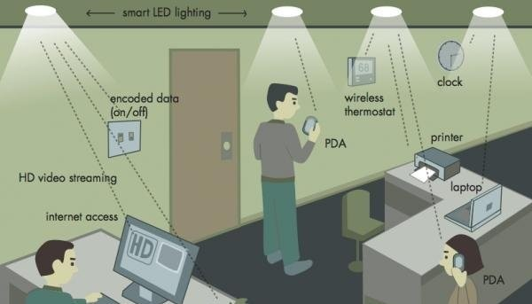
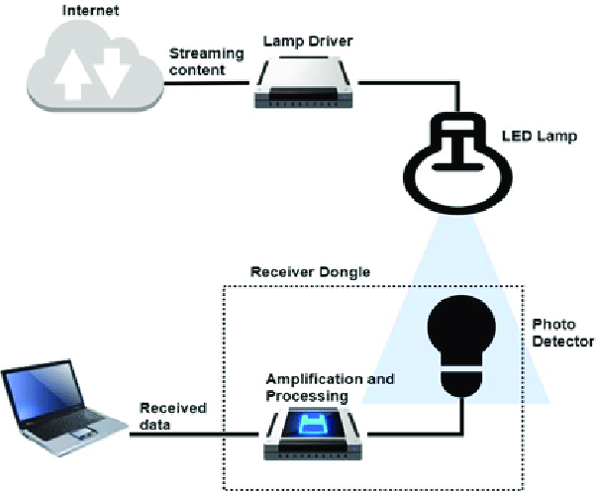
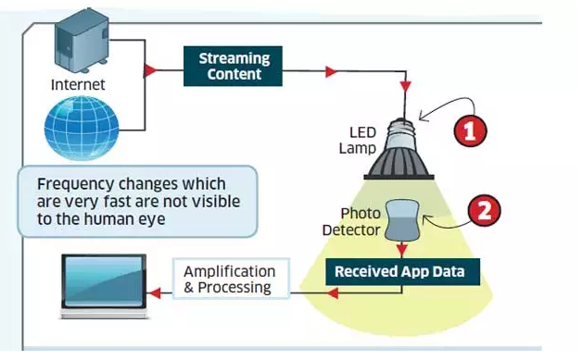
DEMONSTRATION OF PRINCIPLE
Applications of Humidity Moisture Sensor
Agriculture
Industrial
HVAC
Humidity sensors are used in heating, ventilation, and air conditioning systems to regulate moisture levels.

Slide 16
RESULT OF THE EXPERIMENT CARRIED OUT
Advantages and Limitations of Li-Fi
Advantages
Speed-The speed of the Li-Fi is very high, and we can watch the videos without buffering.Fast response time
Security- The light of the Li-Fi doesn’t run through the partition, therefore, it is more protected and hacking is not possible
Limitations
The main problem is how the receiver will send the data back to the transmitter section.
It doesn’t work In the dim areas.

Slide 17
Recent Developments in Li-Fi
Speed Enhancement: Advancements focus on boosting Li-Fi's data transmission rates and spectral efficiency.
Integration with 5G: Research aims to merge Li-Fi with 5G networks, creating hybrid systems for improved connectivity.
Hardware Improvements: Developments target more efficient and affordable Li-Fi transmitters and receivers for wider accessibility.
Standardization and Commercialization: Efforts concentrate on establishing protocols, standards, and commercial products for broader adoption.
Diverse Applications: Exploring new applications in smart cities, healthcare, and industries for Li-Fi's high-speed, secure communication.

Slide 18
CONCLUSION
Technology Potential: Li-Fi utilizes light waves for data transfer, promising high-speed connectivity and enhanced security in wireless communication.\
Transformative Advantages: Its speed, security features, and compatibility with IoT signal a revolutionary shift in connectivity solutions.
Challenges: Li-Fi faces hurdles like limited coverage and the need for line-of-sight communication.
Technological Progress: Ongoing advancements in modulation techniques and security protocols address these challenges, making Li-Fi more feasible for various applications.
Future Impact: Li-Fi holds promise to transform data transmission, offering faster, secure, and efficient wireless communication across diverse domains, from homes to industries.

Slide 19
FUTURE SCOPE
The future scope of this project,is promising and extends to various areas of high speed data transmission.
Here are some potential avenues for future development and application like reducing costs, and expanding its feasibility for broader implementation.
As technology continues to advance and environmental concerns become more pressing, the future of this project holds significant potential for contributing to more sustainable and efficient data transmission while being adaptable to a wide range of applications beyond data.

Slide 20

Thank You

