Slide 1
Capstone Project: Automated Testing on Demoblaze
Tools: Eclipse, Selenium, Java, TestNG, GitHub, Jenkins, JIRA, Zephyr
Name – Ashutosh Email – ash11022003@gmail.com

Slide 2
Project Overview
Objective: Automate testing workflow for Demoblaze website.
Scope: Signup, login, product selection, cart, checkout, confirmation.
Tech Stack: Selenium + TestNG with Java.

Slide 3
Tools & Technologies
Eclipse IDE - Development environment
Selenium WebDriver - Automation
TestNG - Test execution & reporting
Git/GitHub - Version control
Jenkins - CI/CD pipeline
JIRA + Zephyr - Agile management & test tracking

Slide 4
Test Workflow
1. User Registration
2. User Login
3. Navigate Categories
4. Select Product
5. Add Product to Cart
6. Place Order & Verify Confirmation

Slide 5
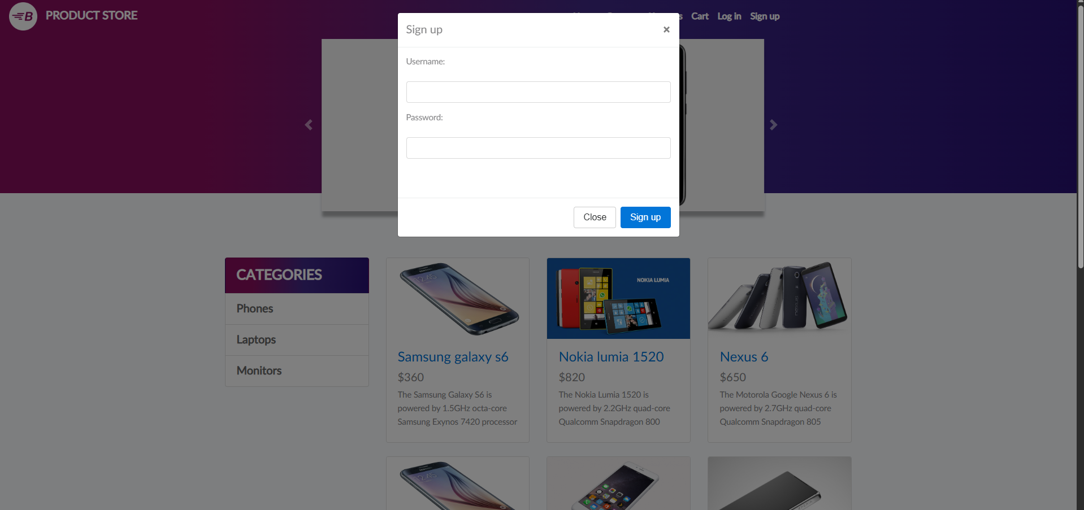
Test Case: User Registration
Objective: Verify account creation functionality.
Steps: Navigate → Sign up → Enter details → Submit.
Expected: Account created successfully.
Screenshot Here

Slide 6
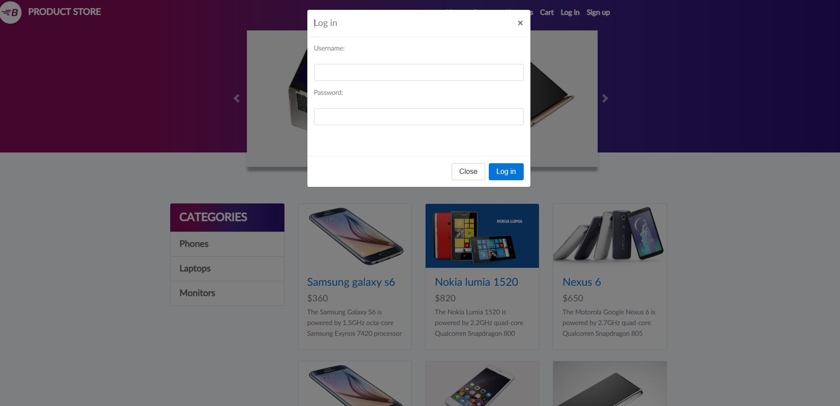
Test Case: Login
Objective: Verify login with valid credentials.
Steps: Navigate → Login → Enter details → Submit.
Expected: User logged in successfully.
Screenshot Here

Slide 7
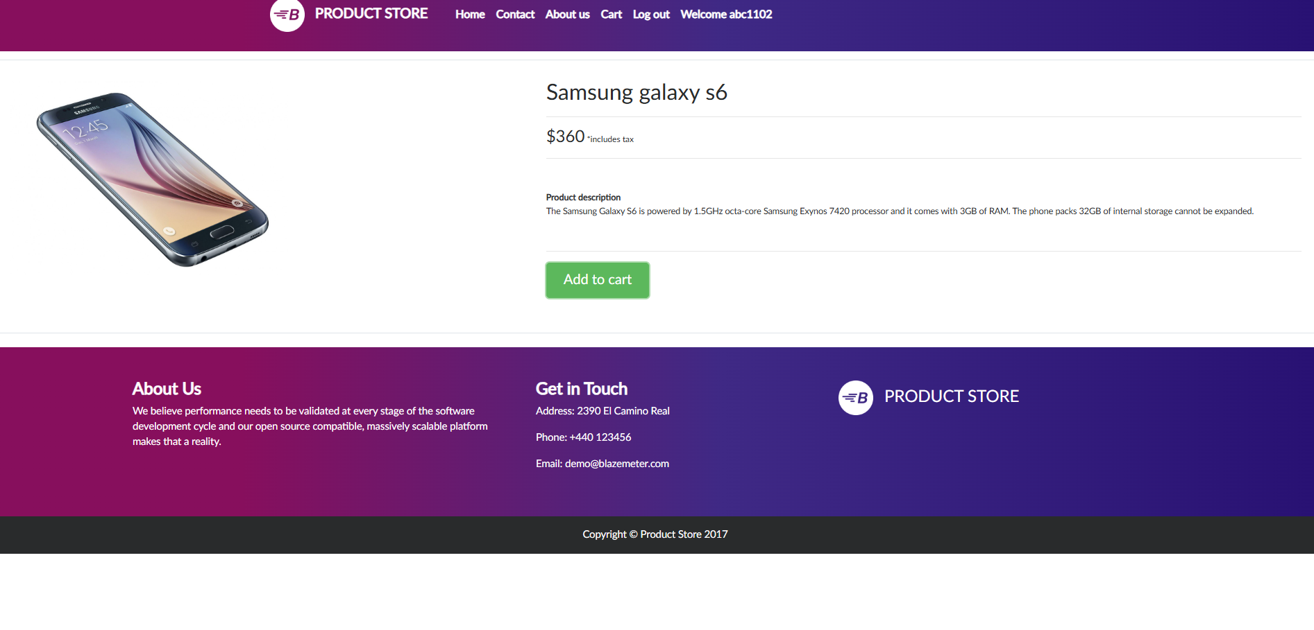
Test Case: Product Selection & Cart
Objective: Verify product selection & add to cart.
Steps: Browse categories → Select product → Add to cart.
Expected: Product added to cart.
Screenshot Here

Slide 8
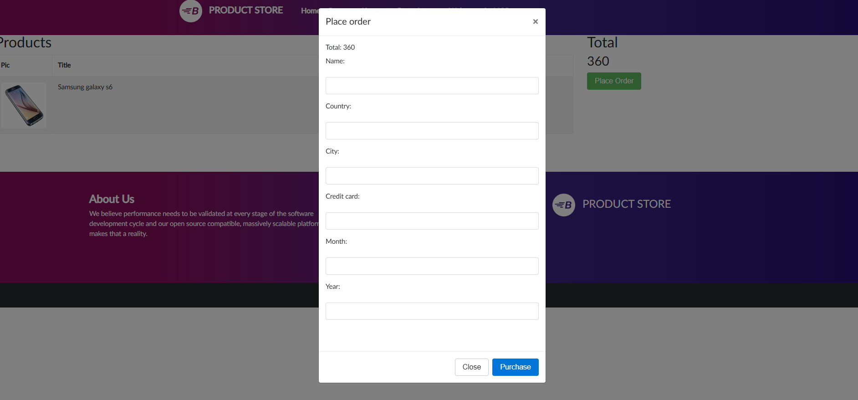
Test Case: Place Order
Objective: Verify checkout and order placement.
Steps: Go to cart → Place order → Enter details → Confirm.
Expected: Order confirmation message displayed.
Screenshot Here

Slide 9
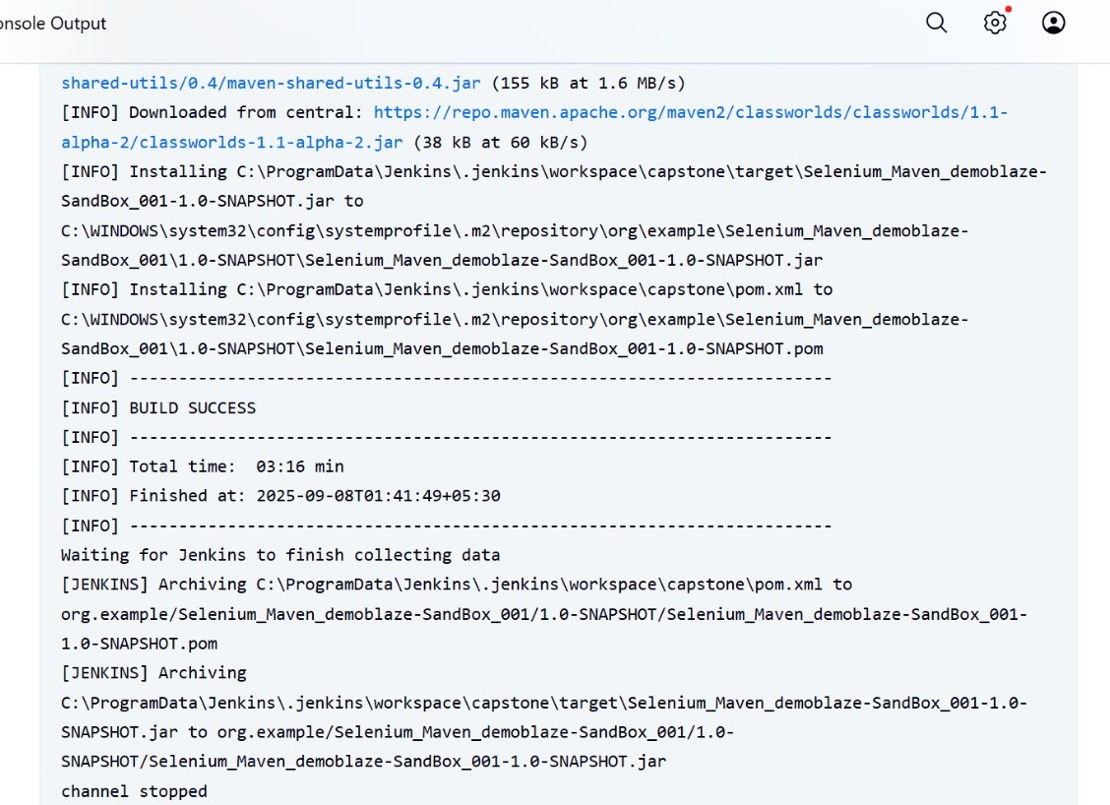
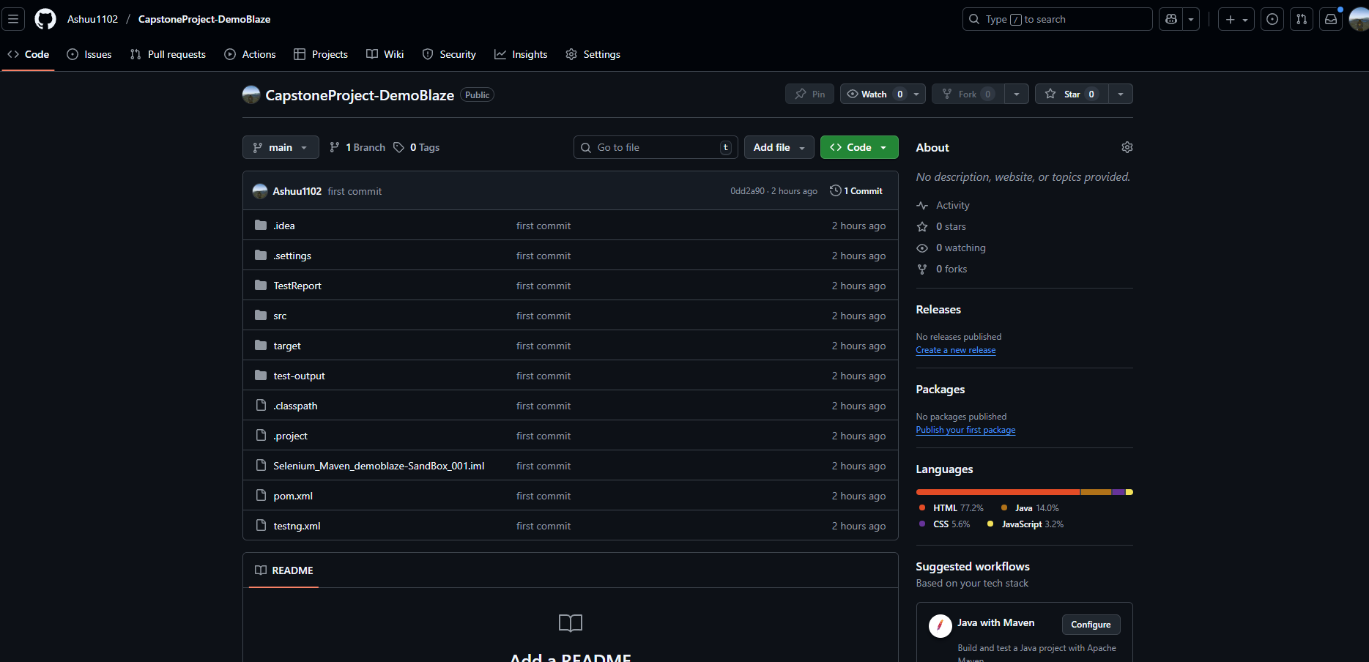
Test Management & CI/CD
JIRA + Zephyr: Scrum boards, tracked test cases & execution.
Jenkins: Automated build & execution pipeline.
Git/GitHub: Source code management and collaboration.
Screenshot Here

Slide 10
Conclusion
Successfully automated the testing process for Demoblaze website.
Covered signup, login, product selection, cart, checkout, and confirmation.
Used Selenium + TestNG with CI/CD integration.
Managed testing lifecycle with JIRA, Zephyr, Jenkins, and GitHub.

