Slide 1
KIVULINGUA AI
Language technology
rooted in community
MASHI
FIRST
Preserving Mashi and building practical speech tools for Eastern Congo
Community voice
Community ownership
Useful local tools
kivulinguaai.org
KivuLingua AI
1

Slide 2
WHY KIVULINGUA
The initiative and its goal
The challenge
Our response
Long term goal
Mashi and many Eastern Congo languages have little high quality digital speech data. This limits access to voice technology, education tools, and local digital services.
Build ethical, community governed speech resources and practical tools for automatic speech recognition and text to speech.
Create reusable language infrastructure that communities can own, validate, and expand across Eastern Congo.
Website and domain: kivulinguaai.org
KivuLingua AI
2

Slide 3
FIRST TARGET LANGUAGE
Mashi, also called Shi
Why start with Mashi?
Expansion path
• A major language of the Bushi region
• Native speaker and cultural community support already exists
• Local validation and transcription capacity is available
• A practical starting point for ASR and TTS development
Mashi provides the method, governance model, and technical foundation that can later support other Kivu languages.
Start focused. Learn locally. Scale responsibly.
KivuLingua AI
3

Slide 4
INFRASTRUCTURE BEFORE ANNOTATION
Our approach: datafication
We build tools that communities use in real life. As people use the tools, they help generate useful language data themselves.
Useful tools
Continuous data
Community control
Education, culture, health, and communication tools designed around community needs.
Speech and text data grows through normal use instead of one expensive collection campaign.
Consent, validation, access rules, and benefits are governed with the language community.
Based on Jean Louis Fendji Kedieng Ebongue, Beyond Dataset Creation: The Datafication Blind Spot in African AI Policy and a Framework for Addressing It, 2026.
KivuLingua AI
4

Slide 5
NEW COMMONS INCUBATOR
Community governance and validation
New Commons Incubator for Indigenous Languages and Cultures: Governance and Protocol
Community partners
Validation
Protocol
MASHI RHWAGANIRA
Ndaro Culture
Native speakers and cultural custodians
Communities review pronunciation, spelling, meaning, cultural context, and speaker representation.
Clear consent, representation, governance, access, attribution, and benefit sharing before wider release.
The community is not only a data source. It is a decision maker and beneficiary.
KivuLingua AI
5

Slide 6
PROGRESS
What we already have
10 hours
1.5 hours
First TTS model
Mashi speech curated and organized as a starting corpus.
Speech transcribed and prepared for the first experiment.
A Coqui TTS model was fine tuned as an early technical proof of concept.
Mashi TTS Bootstrap
ashuza11.github.io/mashi-tts-bootstrap/docs/
Also available: the KivuLingua website, domain, project narrative, language priorities, team, and public roadmap.
KivuLingua AI
6

Slide 7
PEOPLE AND PARTNERS
A multidisciplinary team
Consortium
Core team
• African STEM Resources Hub
• Kwetu Best Technologies SARL
• Muhigiri Ashuza Albin: AI, partnerships, grants, project management
• David Krame: research and model optimization
• Victoria Chasi: data governance and policy
• Ciruza Alain: AI architecture and ML infrastructure
• Marius Nshombo: Mashi language validation
• Prof. Gervais Chirhalwirwha Nkunzimwami: linguistic and community advice
• Aristide Chiza: project operations
• Dr. Abednego Wamuhindo Kambale: edge AI
• Dr. Joaquim Mbasa: data architecture
KivuLingua AI
7

Slide 8
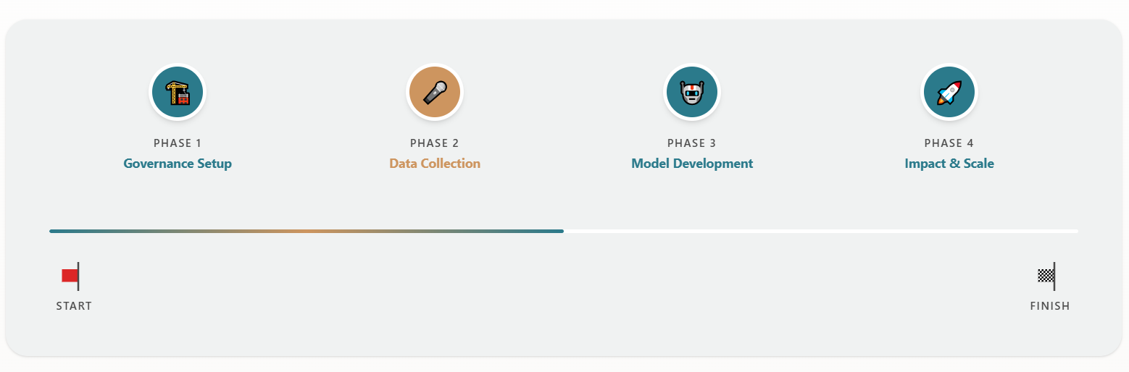
FOUR CONNECTED PHASES
Roadmap
Governance setup
Data collection
Model development
Impact and scale
KivuLingua AI
8

Slide 9
NOW
The next milestone
Expand to 8 to 10 hours of well transcribed and annotated Mashi speech
The dataset will be prepared for both TTS and ASR fine tuning.
• Complete transcription and annotation quality checks
• Validate language and representation with community partners
• Fine tune and evaluate Mashi TTS and ASR models
KivuLingua AI
9

