Slide 1

Ntina
A code-switched voice agent that helps children learn to read in their own language
SUPPORTED PAIRS
Swahili – English
Yoruba – English
Team Ntina
Final project · African Computational Linguistics Summer School
Adding a pair is a config file, not a code change.
GitHub: github.com/Ashuza11/ntina-tarl
Notes:
Ntina is one build serving two goals: our summer school final project (the dataset and the linguistic analysis) and our entry to the Sahara CodeSwitch Africa Challenge in the Agriculture and Education track. Final language pairs depend on what Sahara v2.5 bilingual beta actually exposes.

Slide 2
The problem
Children are in school. They are not learning to read. The fix is known, and too expensive to run at scale.
50%+
1-on-1
0
of Grade 2 students in resource-limited countries cannot read a single word of a short text
how every child must be assessed to find their reading level, repeated every few weeks
of that assessment works if the child does not speak the language of instruction
Teaching at the Right Level works. It groups children by measured level rather than age, and the evidence is strong. But the assessment is slow, needs trained staff, must be rebuilt for every local language, and has to be redone again and again. That labour is the cost.
!
Notes:
TaRL: assess each child one-on-one, group by level not grade, teach at that level. Randomised evaluations back it. The bottleneck is trained human time on repeated oral assessment, in a language the child actually speaks.

Slide 3
Our solution: Ntina
A voice agent that takes over the assessment and drilling, in the child's own language, offline, on a cheap phone. The teacher is freed to teach.
01
02
03
04
05
Listen
Assess
Group
Drill
Report
The child reads aloud. We already know the target text, so this is verification, not open transcription.
Score against the five TaRL levels: beginner, letter, word, paragraph, story.
Assign a learning level. The human facilitator confirms it before it takes effect.
Run level-appropriate practice while the facilitator works with another group.
Emit the monitoring record automatically. Sync when there is signal.
Code-switching is the point
Offline by design
Real classrooms mix the local language with English or French, especially for numbers and school words. Ntina speaks that way.
One shared Android device per learning camp. No stable internet required.
Notes:
Key technical insight on step 01: in a reading assessment the target text is known in advance, so we use constrained decoding rather than open ASR. That matters because child read-aloud speech is the hardest case for any speech model.

Slide 4
What we build: two datasets
This is the linguistic core of the project and the part that satisfies both the summer school and the challenge.
A
Text dataset
B
Audio dataset
powers the agent
powers the benchmark
The reading test itself: syllables, words, paragraphs, short stories with human characters and comprehension questions
Everything the agent says: instructions, praise, hints, correction, level transitions, all written as a real teacher speaks, code-switched
Annotated for language tag, switch type, borrowing vs switch, TaRL level and teaching function
Adapted from one language into a close relative, so we can measure what each extra language really costs
Recorded code-switched speech across our language pairs, with metadata: pair, accent, country, device, noise
Benchmarked across at least three speech models, including Sahara, groc, assemplyAI, Deepgram, and whisper.
Reported on word error rate and, more importantly, on whether the agent lands on the same level a human assessor would
Consent, privacy and data use documented from day one
Target: 5,000+ annotated tokens of text, plus a benchmark audio set. Both are reusable artefacts, not throwaway demo data.
Notes:
The text dataset is authored, not scraped, because the TaRL reading test must be rebuilt for each language and the choices involved are genuinely linguistic. The audio dataset is what we submit for the challenge benchmark.

Slide 5
Adapting across dialects, not just languages
Low-resourceness compounds. It is not just Swahili vs Yoruba, it is which Swahili.
1
Coastal Swahili
2
Swahili
3
Kingwana
Kenya
Tanzania
DR Congo, Bukavu and Goma
The baseline instrument.
Syllables, words and stories
authored against standard,
coastal-influenced Swahili as
taught in Kenyan schools.
Validated and re-recorded
against Tanzanian Swahili
pronunciation and everyday
vocabulary, which diverges
from the Kenyan baseline.
Recorded directly from a
native speaker of Kingwana,
the Swahili-based variety
spoken in eastern DR Congo,
the least resourced of the three.
This is the low-resourceness the challenge asks for: not one underrepresented language, but a chain of underrepresented varieties within it. planning to do the same for Yoruba.

Slide 6
How Ntina answers the challenge criteria
1
Low-resourceness
2
Creativity
Adapting an underrepresented pair
Africa-centred linguistic properties
Two full language pairs, Swahili-English and Yoruba-English, each spanning real regional varieties rather than one clean reference dialect (see the adaptation slide).
Yoruba's three-way tone contrast and subdot phonemes, Swahili's noun-class-driven syllable frequency, and code-switching kept monolingual inside the reading test but alive in everything the tutor says around it.
3
Linguistic insights
4
Technicality
How much linguistics is really in it
Everything actually working, end to end
Two linguists author every instrument item natively, not by translation, and review every scaffolding line by hand. Every reused string in the product traces back to a reviewed row, never an untracked guess.
A real pipeline: live Sahara STT integration, a fuzzy edit-distance scoring engine, a dual-language server, and a facilitator-confirmed session UI, demoed on real audio, not mockups.

Slide 7
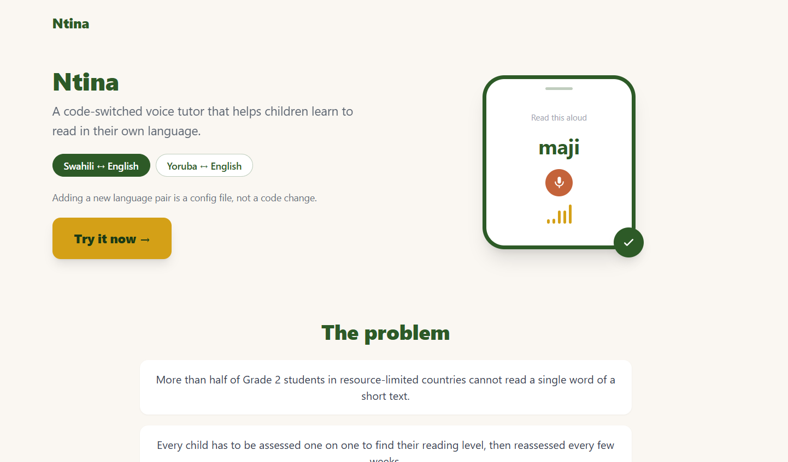
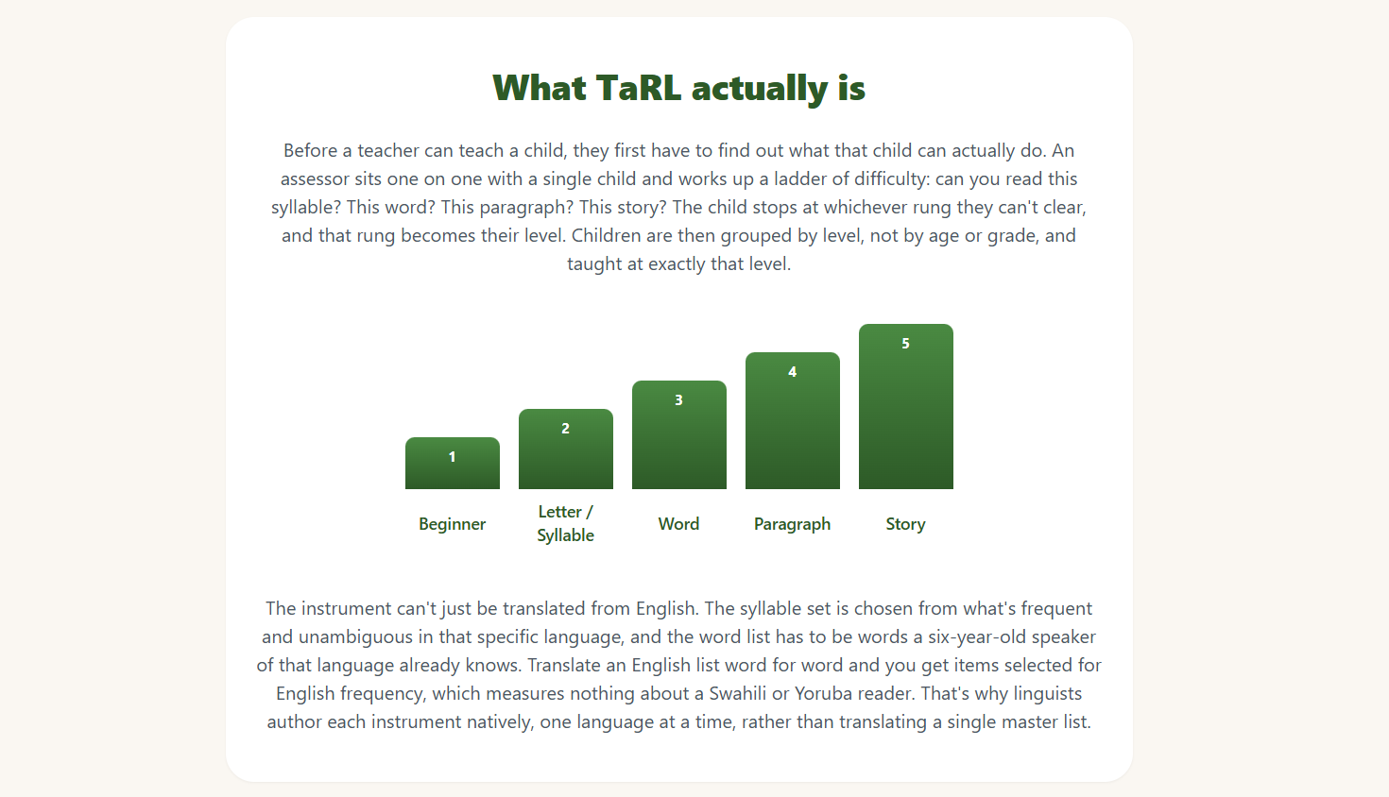
What it actually looks like

Slide 8
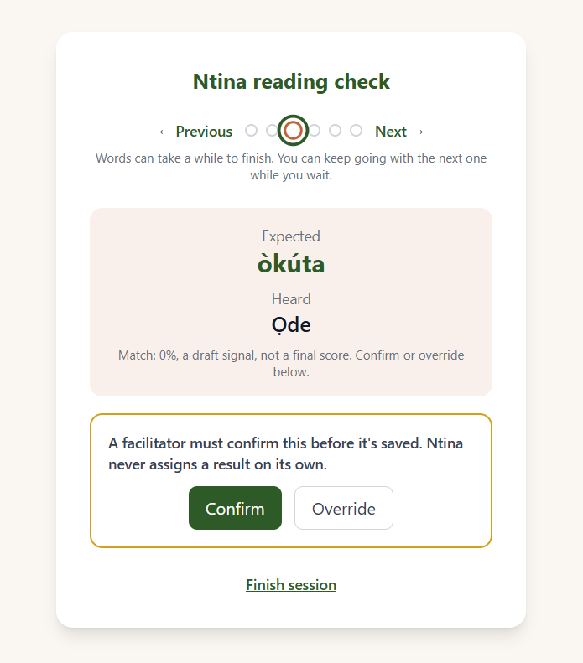
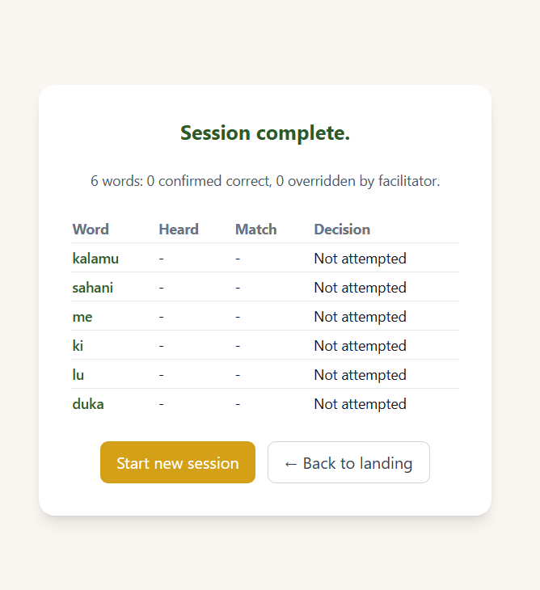
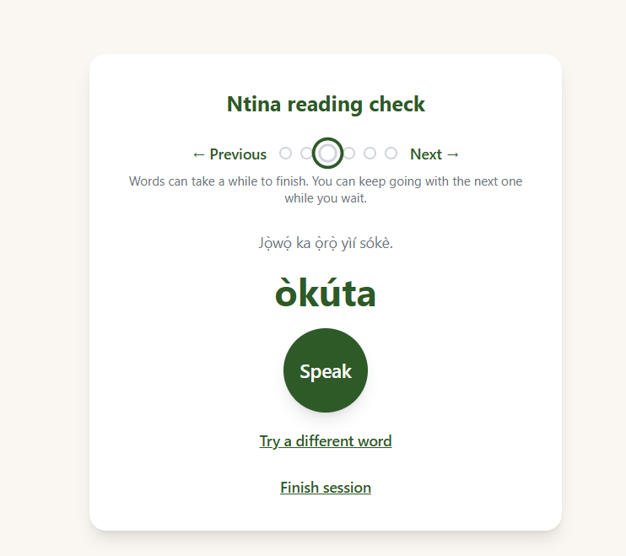
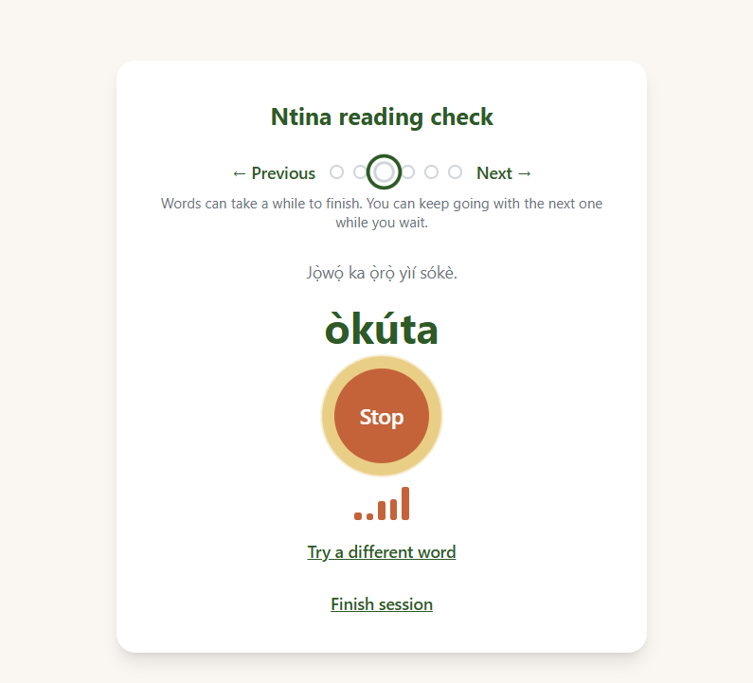
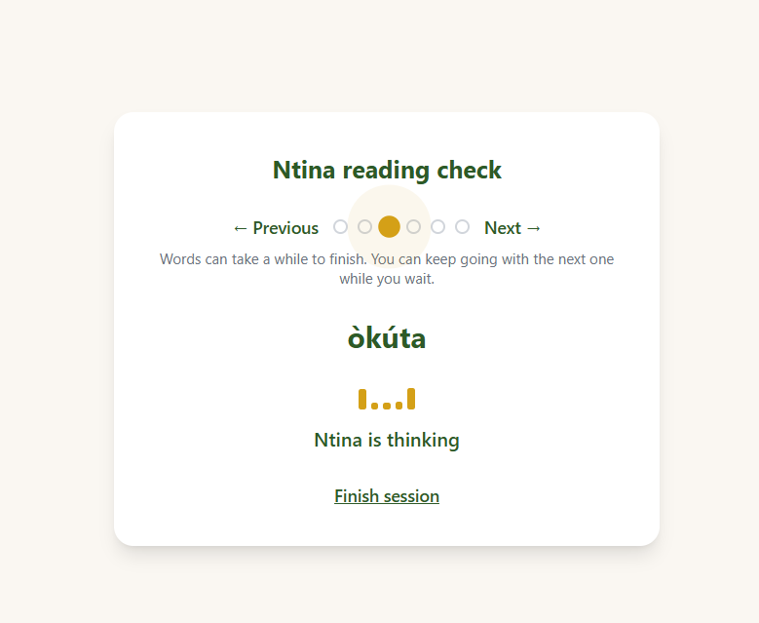
What it actually looks like: one reading check, start to finish
1. Ready
2. Recording
3. Ntina is thinking
4. Facilitator confirms
5. Session complete

Slide 9
How we work as a team
Three people, one build, two deliverables.
github.com/Ashuza11/ntina-tarl
Muhigiri Ashuza
Olufemi Oyelade
Oladejo Zainab
Developer · Team lead
Linguist · reading test
Linguist · agent speech
Sahara v2.5 integration and the agent loop
Constrained decoding for read-aloud scoring
Benchmark harness across three speech models
Offline Android build and sync
Config-per-language architecture
Syllable and word inventories per language
Defines what counts as a word for scoring
Authors paragraphs and short stories
Validates items with local speakers
Leads the adaptation into a related language
Writes what the agent says, in register
Designs the code-switching annotation scheme
Recruits speakers and runs recordings
Consent forms and data handling
Double-annotates for agreement scoring
Notes:
One build, two deliverables: the annotated dataset and linguistic write-up is the summer school final project; the working agent plus the three-model benchmark is the challenge submission. Start consent paperwork in week one, it is the long pole.

