Slide 1
THE SOLAR SYSTEM
NAME: YOUR NAME DATE: NOVEMBER - 2024

Slide 2
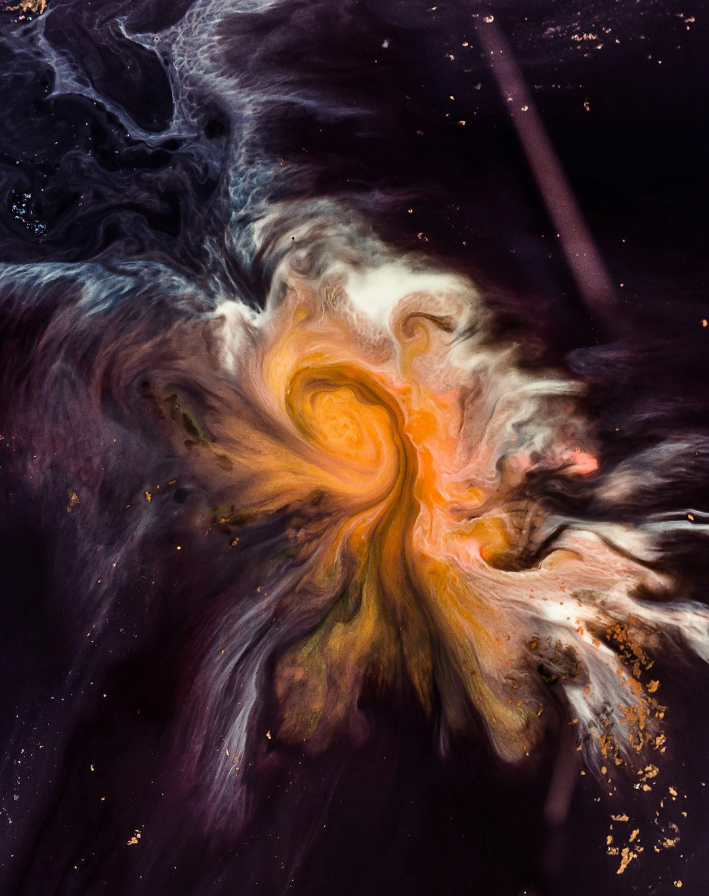
SOLAR SYSTEM OVERVIEW
KEY FEATURES OF THE SOLAR SYSTEM
The Solar System consists of the Sun and various celestial objects that orbit it, including eight major planets, dwarf planets, asteroids, comets, and the heliosphere. The terrestrial planets are Mercury, Venus, Earth, and Mars, while Jupiter and Saturn are gas giants. Uranus and Neptune are classified as ice giants. Each object plays a crucial role in understanding the dynamics and history of the Solar System.

Slide 3
COSMOLOGY
This table summarises critical concepts in cosmology, outlining their definitions and significance. Understanding these helps explain the universe's origins and structure.
CONCEPT | DESCRIPTION | SIGNIFICANCE
The Big Bang | Universe began from a hot, dense state. | Explains the origin of the universe.
Dark Energy | Energy causing cosmic acceleration. | Makes up about 68% of the universe.
Dark Matter | Invisible matter affecting gravity. | Comprises approximately 27% of the universe.
Cosmological Redshift | Phenomenon indicating universe expansion. | Supports the Big Bang theory.

