Slide 1
Applied Machine Learning
Mr. Shrikrishna Anand Narvekar
Assitant Professor
Computer Engineering Department
Agnel Institute of Technology and Design

Slide 2
Content
Introduction
Well Posed Machine Learning problems
Data representation
Diversity of data

Slide 3
Importance of the course
Why are we here ?
Machine Learning isn't magic; it's a process of improving performance (P) at some task (T) with experience (E).
Mention how data representation (Unit 1) transforms raw "noise" into the intelligence behind Netflix recommendations, medical diagnoses, or self-driving cars.

Slide 4
Syllabus Roadmap
Phase | Focus | Key Concept
Foundations (Unit 1) | The "Rules" of Learning | Bias-Variance tradeoff & how to avoid overfitting.
Statistical Rigor (Unit 2) | The "Math" of Prediction | Moving from Bayesian reasoning to k-NN and SVMs.
Uncovering Patterns (Unit 3) | The "Structure" of Data | Clustering and Data Transformations (finding hidden groups).
Tree-Based Logic (Unit 4) | The "Decision" Making | How ID3, C4.5, and Random Forests mimic human logic.

Slide 5
Relevance of the course
The Bridge from Theory to Reality
Learning to "Talk" to Data
Mastering the "Smart" Toolbox
Avoiding the "Overfitting" Trap
Notes:
1. The Bridge from Theory to Reality
In your first year, you learned the "What" (Calculus, Linear Algebra, and Stats). This year, we learn the "How." We take those abstract equations and turn them into logic that allows a computer to make decisions, predict trends, and solve problems that are too complex for a human to hard-code.
2. Learning to "Talk" to Data
Modern engineering isn't just about writing code; it's about Data Literacy. You will learn how to clean, transform, and represent messy, real-world information so that a machine can actually understand it. This is the #1 skill sought after in internships today—being the person who knows how to make data useful.
3. Mastering the "Smart" Toolbox
Think of this course as building your professional toolkit. You’ll learn specific "hammers" and "saws" like Support Vector Machines (SVMs) and Decision Trees. By the end of the semester, you won’t just know these names; you’ll know exactly which tool to pick to solve a specific problem efficiently.
4. Avoiding the "Overfitting" Trap
A bad engineer builds a solution that only works in the lab; a great engineer builds one that works in the real world. We will focus on Generalization—the art of making sure your model doesn't just "memorize" the past, but actually "understands" how to handle new, unseen situations.

Slide 6
Introduction
Human being have always dreamt of creating machines with human like traits.
In today’s world of technology machines have match several functions or even outdone them with several human function.
In some cases, machines have performed even much better than humans with extraordinary capacities and abilities.
Robots in manufacturing, mining , agriculture, space ocean exploration, and health sciences are only few examples.

Slide 7
Conventional robots and early AI systems are enslaved by commands.
They are solely based on predefined set of instructions given by human programmer.
They lack the capacity to reason, learn, adapt, or make truly independent decisions outside the boundaries of their code.
This makes them powerful tool but not truly intelligent.
Intelligent can be cast into machines
Computational Hypothesis: Cognitive processes—like learning, problem-solving, perception, and reasoning—are fundamentally a form of computation.
Rise of learning models: In ML and DL you don’t need to give explicit commands for every action
Notes:
Pre-programmed/Rule-Based: Most machines, including conventional robots and early AI systems, operate solely based on explicit, pre-defined instructions (algorithms) given by a human programmer.
The Computational Hypothesis: This is the belief that cognitive processes—like learning, problem-solving, perception, and reasoning—are fundamentally a form of computation. If they are computational, they can theoretically be replicated and executed by a machine.
The Rise of Learning Models: Recent research, particularly in Machine Learning (ML) and Deep Learning (DL), focuses on creating systems that don't need explicit commands for every action. Instead, they are given data and algorithms to learn patterns and rules on their own. This allows the intelligence to be "cast" into the system through training, rather than hard-coded command by command.

Slide 8
Well Posed Machine learning Problems
ML is about constructing computer programs that improve their performance at a task through experience.
A well-defined learning problem must clearly identify the learning task, the measure of performance, and the task experience.
The "learning from experience" behaviour embedded in ML, similar to animal learning, includes remembering, adapting, and generalizing.

Slide 9
Remembering and adapting: : Recognizing that last time in a similar situation, a certain action (that resulted in this output) was attempted and had worked; therefore, it should be tried again or this same action failed in the last attempt in a similar situation, and so something different should be tried.
Example: Imagine you are trying to open a door.
Last time you pushed the door, but it did not open.
You then pulled the door, and it opened.
Next time you reach the same door:
You remember that pulling worked.
You adapt your action and pull the door immediately.
This is how a robot or machine learns too: If an action works in a situation, store that experience. If it fails, try something else next time.

Slide 10
Generalizing: This aspect is regarding recognizing similarity between different situations. This makes learning useful because we can use our knowledge in situations unseen earlier.
Suppose you learned that:
Pulling opens the library door.
Later you see a new door at the cafeteria. It looks similar:
It has the same type of handle.
The signboard is in the same place.
You try pulling even though you never used this cafeteria door before.
Generalization: Using your earlier experience with a different but similar door.

Slide 11
Types of learning tasks
There are four primary types of learning tasks
Classification: Learning a technique to assign observations to a discrete class (e.g., classifying an email as 'Spam' or 'Not Spam').
Regression: Predicting a continuous numeric quantity (e.g., predicting house price).
Association: Finding any relationship between observations (e.g., market basket analysis).
Clustering: Grouping observations that belong together based on similarity.

Slide 12
Two major types of learning
Supervised learning | Unsupervised learning
Models are trained using labelled data | Models are trained using unlabelled data
The goal of supervised learning is to train the model so that it can predict the output when new data is given to it. | The goal of unsupervised learning is to find the hidden patterns and useful insights from the unknown dataset
It is typically used for regression (predicting continuous values) and Classification (predicting categorical values) | used for clustering (grouping similar items), association (finding relationships between variables), and dimensionality reduction (reducing the number of variables).
The output is typically a specific prediction or classification based on the labelled data. | The results are generally more exploratory and descriptive.

Slide 13
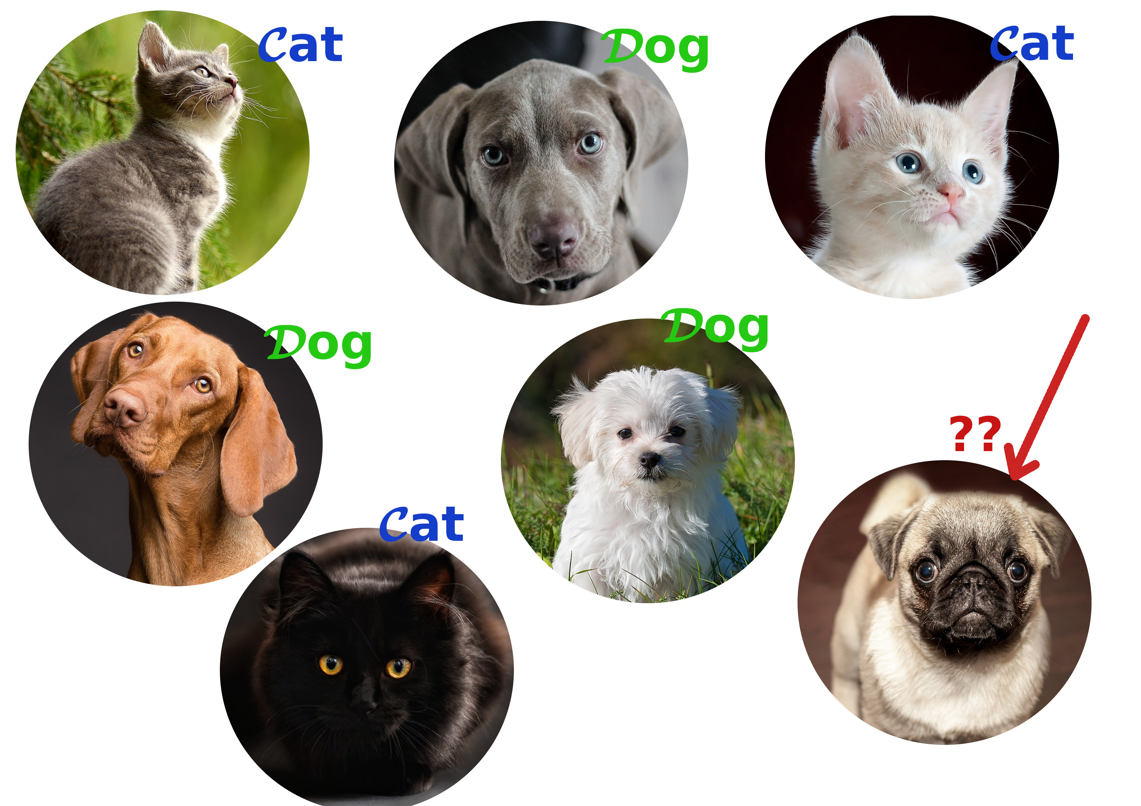

Classification

Slide 14
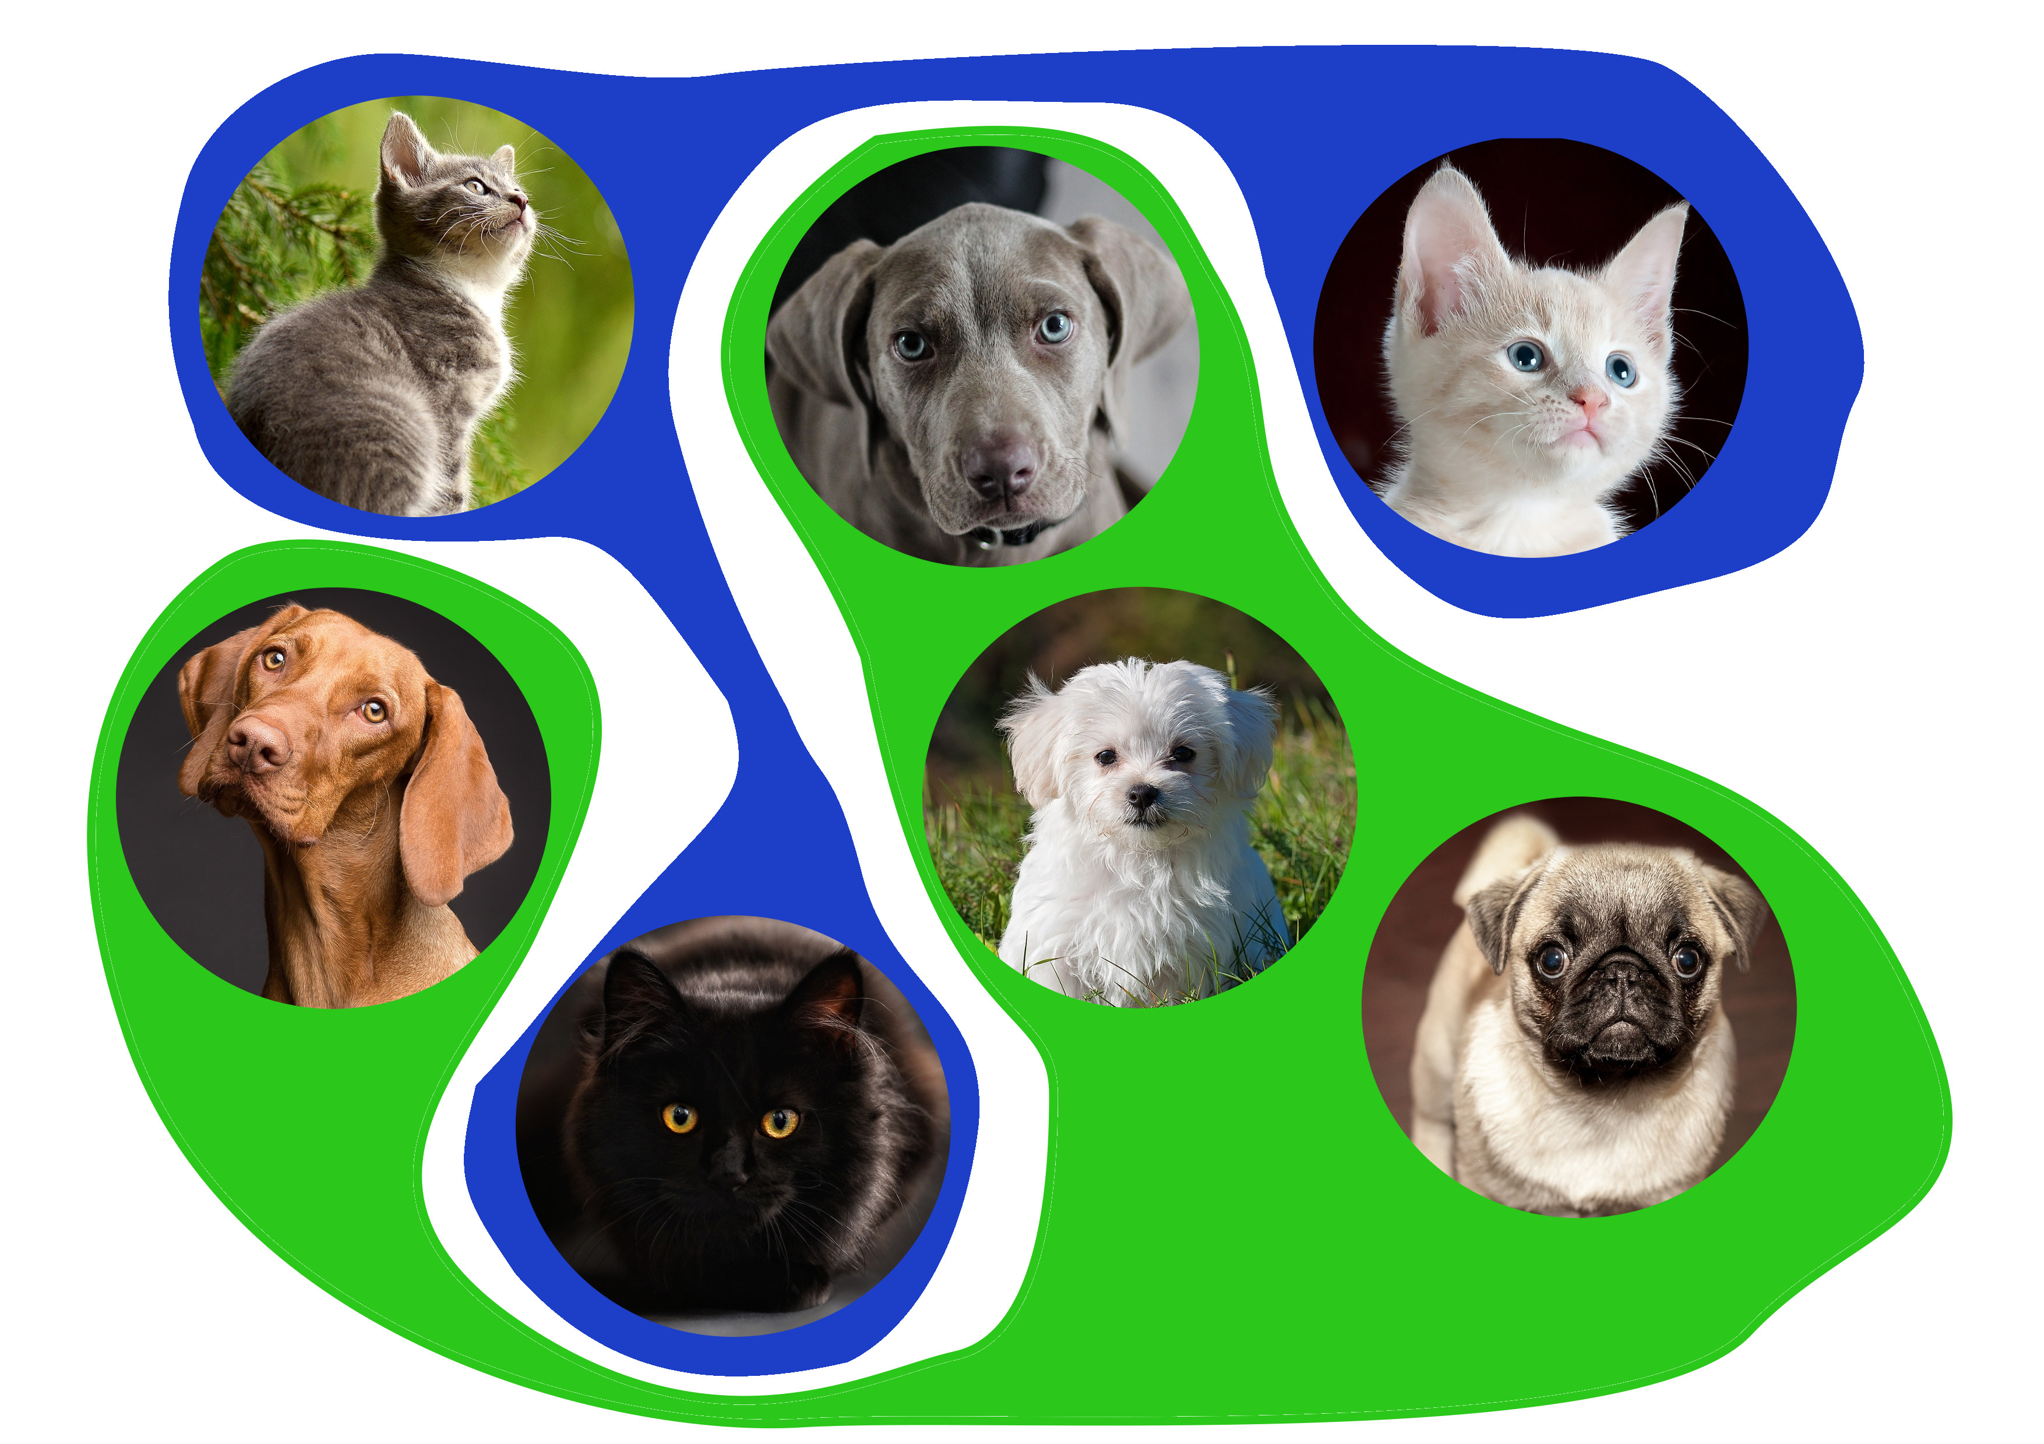

Unsupervised learning
The training data does not include the desired output (y). The goal is to uncover the inherent underlying similarities, patterns, or structure within the input data, $x^{(i)}$

Slide 15
How Machine Learns(Input)
Machine learns from experience, which is the data you give it
Data formats: Number is best format. Most data, whether it's simple measurements or complex things like images and audio, is converted into a fixed-length vector of numerical values (a list of numbers).
Why Numerical Data? Using numbers lets the machine use geometry and algebra to "see" patterns in the data (like plotting points in a space).
Measuring Similarity: When data is numerical, the similarity between two pieces of data is measured by the distance between their vectors (e.g., using Euclidean distance).
The Trade-off: Converting complex data (like an image) into simple vectors causes a loss of information, but it's necessary for the learning process.

Slide 16
Alternative data inputs:
Nominal/Categorical Data: This is non-numerical data described using words (e.g., color: 'Red', 'Blue’). Since there are no numbers, similarity is found using nonmetric methods.
Human Knowledge (IF-THEN Rules): Sometimes, the machine is trained not on data, but on human expertise given as structured knowledge, such as a list of IF-THEN rules. This can be used instead of, or in addition to, a dataset.

Slide 17
What machine Produces(Output)
1. The Output: The Model
The output is the learned knowledge, which is called a Model.
The model captures the structural patterns hidden within the training data.
2. The Model's Purpose (Prediction/Decision)
The user uses this model for decision-making.
When you feed the model a piece of new data (an observation not seen during training), the model provides a prediction or decision based on what it learned.

Slide 18
3. The Goal: Generalization
A good model must be able to generalize well—meaning it can make accurate predictions for new, unseen data, not just the data it was trained on.

Slide 19
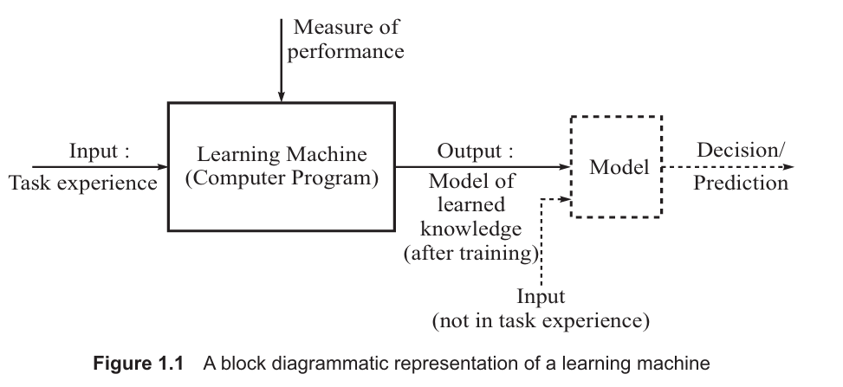
Diagrammatic representation

Slide 20
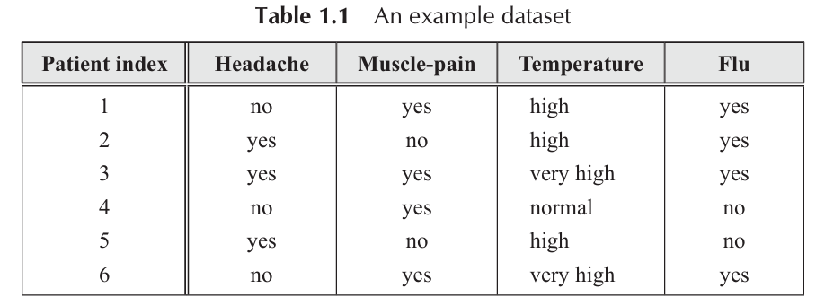
Data Representation
We will learn here how raw data is processed to create an information system,
1. Information System: The Data Table Structure
An information system is primarily represented as a data table (like a spreadsheet), often called D.

Slide 21
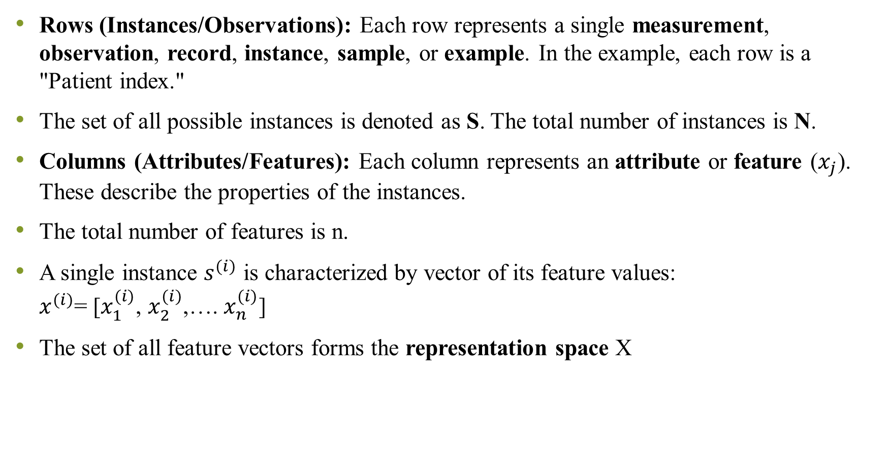
Rows (Instances/Observations): Each row represents a single measurement, observation, record, instance, sample, or example. In the example, each row is a "Patient index."
The set of all possible instances is denoted as S. The total number of instances is N.
Columns (Attributes/Features): Each column represents an attribute or feature ($x_{j}$). These describe the properties of the instances.
The total number of features is n.
A single instance $s^{(i)}$ is characterized by vector of its feature values: $x^{(i)}$= [$x_{1}^{(i)}$, $x_{2}^{(i)}$,…. $x_{n}^{(i)}$]
The set of all feature vectors forms the representation space X

Slide 22
2. Types of Attributes
Nominal attribute
Attributes (features) are classified based on the nature of the values they can hold:
These take values from a prespecified finite set of possibilities (a finite set of discrete values).
Examples from Table 1.1: "Headache" (no, yes), "Muscle-pain" (yes, no), "Temperature" (high, very high, normal), and "Flu" (yes, no).
This is often the linguistic form of knowledge representation.
Numeric Attributes (Continuous/Integer):
These adopt values that are real numbers or integer values.
Note for Class: The term 'continuous' is often used but is technically only correct for real-valued attributes, not integer-valued ones.

Slide 23
The table given below represents continuous real value attributes as well as integer values
Height and Attendance % → Continuous (real-valued)
There are infinitely many possible values between two numbers.
Age and Number_of_Projects → Integer-valued numeric
Values are numeric but discrete.
Student_ID | Age (Integer) | Height_cm (Real) | Attendance (%) (Real) | Number_of_Projects (Integer)
1 | 19 | 160.5 | 85.75 | 2
2 | 18 | 158.2 | 92.50 | 1
3 | 20 | 172.8 | 78.00 | 3
4 | 19 | 165.0 | 88.25 | 2

Slide 24
3. Decision System: Supervised Learning Input
A Decision System is a special type of Information System used for directed or supervised learning problems.
Key Feature: It includes a distinguished attribute called the Decision Attribute (or output, y).
Purpose: The decision attribute holds the known outcome or class label for each observation.
Example from Table 1.1: The column "Flu" is the Decision Attribute. The other columns (Headache, Muscle-pain, Temperature) are the Condition Attributes. The task is to learn the relationship between the condition attributes and the decision attribute.
The system is a tuple (S, X, Y) where X is the set of condition features and Y is the decision attribute.

Slide 25
The values which decision attribute take defines the machine learning tasks.
Classification problem (Two class classification)
Example: Predicting if a patient has flu (Yes/No
Here, the decision attribute (Y) takes finite discrete values.
Here,
Vy​={Yes,No}
Finite classes (M = 2)
Task = Classification
Patient_ID | Temperature | Cough | Flu (Y)
1 | 101.2 | Yes | Yes
2 | 98.4 | No | No
3 | 100.5 | Yes | Yes
4 | 97.8 | No | No

Slide 26
Classification Problem (Multi-class classification Problem)
Example: Predicting type of fruit
Here,
Vy={Apple,Mango,Orange}
Finite set with M = 3 classes
Task = Multi-class classification
Sample_ID | Weight | Color_Intensity | Fruit_Type (Y)
1 | 120 | 0.8 | Apple
2 | 150 | 0.9 | Mango
3 | 100 | 0.7 | Orange
4 | 130 | 0.5 | Apple

Slide 27
Regression (Y= Real Number)
Example: Predict house price
Here,
Vy=R
Price can be any real number
Task = Regression (numeric prediction)
Students immediately see that Y is numeric, continuous, unlike labels in classification
House_ID | Area_sqft | Bedrooms | Price (Y)
1 | 1200 | 2 | 45.6
2 | 1500 | 3 | 60.2
3 | 900 | 2 | 30.8
4 | 1800 | 3 | 75.1

Slide 28
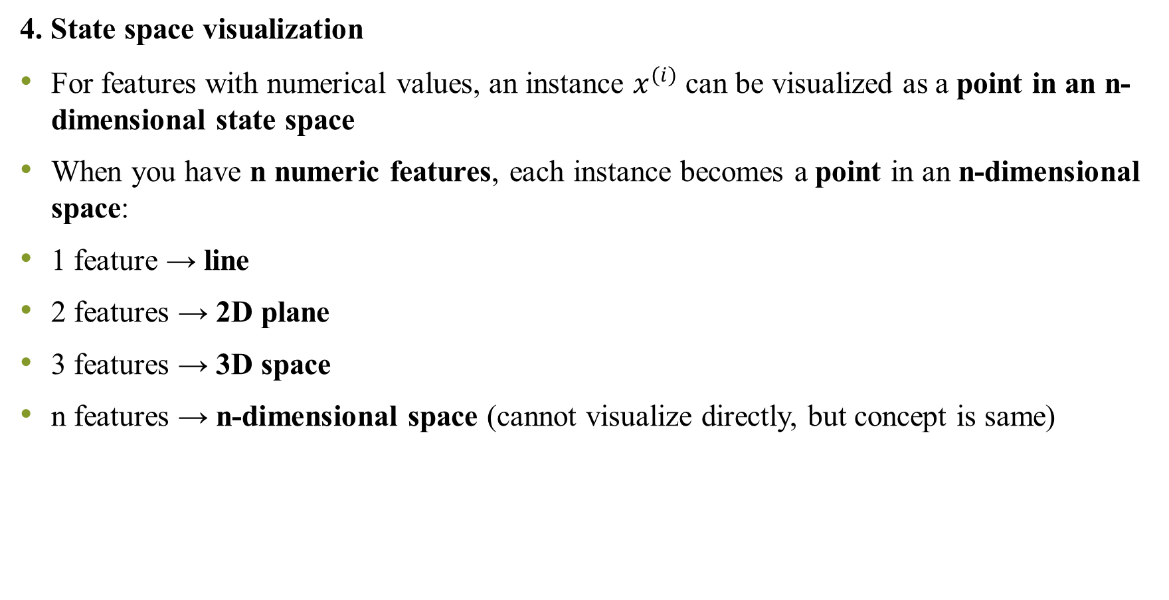
4. State space visualization
For features with numerical values, an instance $x^{(i)}$ can be visualized as a point in an n-dimensional state space
When you have n numeric features, each instance becomes a point in an n-dimensional space:
1 feature → line
2 features → 2D plane
3 features → 3D space
n features → n-dimensional space (cannot visualize directly, but concept is same)

Slide 29

Example 1: 2 Features (2D State Space)
Dataset:
Each instance becomes a point:
$x^{(i)}$=($x_{1}$, $x_{2}$)=(Height, weight)
Points in 2D space:
Student 1 → (160, 55)
Student 2 → (165, 60)
Student 3 → (170, 62)
Student 4 → (172, 65)
Student_ID | Height (cm) | Weight (kg)
1 | 160 | 55
2 | 165 | 60
3 | 170 | 62
4 | 172 | 65

Slide 30
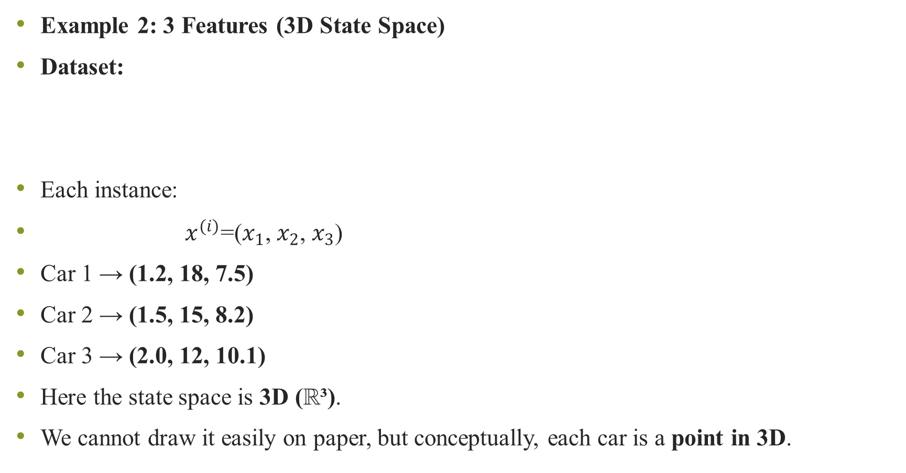
Example 2: 3 Features (3D State Space)
Dataset:
Each instance:
$x^{(i)}$=($x_{1}$, $x_{2}$, $x_{3}$)
Car 1 → (1.2, 18, 7.5)
Car 2 → (1.5, 15, 8.2)
Car 3 → (2.0, 12, 10.1)
Here the state space is 3D (ℝ³).
We cannot draw it easily on paper, but conceptually, each car is a point in 3D.
Car_ID | Engine_Size | Mileage | Price
1 | 1.2 | 18 | 7.5
2 | 1.5 | 15 | 8.2
3 | 2.0 | 12 | 10.1

Slide 31
Diversity of data
Structured data
This is the traditional data that most initial machine learning algorithms are designed to handle.
Data that has a predefined format and fits neatly into a fixed schema
Think of a meticulously organized library catalog where every book has a title, author, and ISBN in the exact same format.
Predefined Format: Follows a strict order and data type (e.g., date in MM/DD/YYYY, account number as a 12-digit integer).
Fixed Fields: Every piece of information has a designated, labelled column.

Slide 32
Examples of structured data
Relational Databases (SQL): Customer records with distinct columns for Name, Address, Age, Order_ID.
Example: Customer Records
Customer_ID | Name | Address | Age | Order_ID
101 | Amit Sharma | Panaji, Goa | 25 | ORD1001
102 | Neha Verma | Mapusa, Goa | 30 | ORD1002
103 | Ravi Kumar | Margao, Goa | 22 | ORD1003
Stock_Symbol | Closing_Price (₹) | Volume
TCS | 3520.50 | 120000
INFY | 1495.75 | 98000
RELIANCE | 2450.00 | 150000
Spreadsheets: Financial data where each column is clearly defined (e.g., Stock Symbol, Closing Price, Volume).

Slide 33
Unstructured data
Data is dominant in the digital world and presents the core challenge for "next-generation" machine learning.
Data that does not have a predefined format or schema. We have very little control over its organization.
Think of a large collection of notes, letters, and random photos thrown into a box—there is no fixed structure or order.
Characteristics:
No Fixed Format: Users or systems don't follow specific grammar, ordering, or vocabulary standards (e.g., social media text).
"Capture Everything" Approach: Data is collected as-is, and structure/meaning must be extracted later.
Notes:
Examples:
Text: Emails, social media posts, news articles, open-ended survey responses.
Media: Images, audio files, videos.
Web Data: Content from websites.

Slide 34
Big Data challenge
The combination of massive volume and the high proportion of unstructured data is what defines Big Data problems.
Research Focus: A major research challenge is how to process and mine complex unstructured data, including:
Mining sequence data (e.g., time series, gene sequences).
Mining graphs and networks (e.g., social connections).
Mining multimedia data (text, image, audio combined).

Slide 35
Machine Learning Evolution:
First-Generation ML: Works well on structured data (or structured patterns extracted from unstructured data).
Next-Generation ML: Required to effectively analyse and derive insights from the full complexity of unstructured Big Data.
Strategic Importance
Even though unstructured data is difficult, organizations cannot ignore it because of its strategic value when combined with their traditional, structured data.
Cohesive Strategy: Successful organizations must have a cohesive data strategy that integrates both structured and unstructured data, rather than treating Big Data as a separate "stand-alone" concept.

