Slide 1
Bayesian Reasoning to Inference
Shrikrishna Anand Narvekar
Assistant Professor
Agnel Institute of Technology and Design

Slide 2
Content
Introduction
Bayesian Model
Core assumptions in Bayesian learning
Bayes Theorem
Naïve bayes classifier
Bayesian belief network

Slide 3
Introduction
Earlier, prediction problems assumed:
Output is either Correct or Incorrect
No uncertainty considered
Focus only on maximizing success rate (accuracy)
Suppose a model predicts whether an email is Spam or Not Spam:
Here, prediction is binary —
no probability attached.
Email | Actual | Predicted | Result
1 | Spam | Spam | Correct
2 | Not Spam | Spam | Incorrect

Slide 4
Bayesian Model
Instead of saying:
“This email is Spam”
Bayesian classification says:
“There is a 92% probability that this email is Spam.”
So, Bayesian learning:
Assigns probabilities to predictions
Makes decisions using probability reasoning
Works based on Bayes Theorem

Slide 5
Core Assumption in Bayesian Learning
Bayesian approach assumes:
Variables follow probability distributions
We can compute probabilities using:
Prior knowledge
Observed data
Likelihood

Slide 6
Importance of Bayesian Learning in Machine Learning
Practical Algorithms – Naive Bayes
Computes explicit probabilities
Works extremely well on large datasets
Commonly used for text classification
Conceptual Importance of Bayesian Thinking
Even if some algorithms do not directly compute probabilities (like Decision Trees or SVM), understanding Bayesian reasoning helps: Interpret model behavior, Understand uncertainty, Frame ML problems probabilistically
Notes:
Real-World Example
Google uses Naive Bayes for:
Spell correction
Spam filtering
Text classification
It performs competitively with:
Decision Trees
Neural Networks
In many large dataset cases, it even outperforms them.

Slide 7
Why Not Always Use Pure Bayesian Optimal Solution?
Challenge 1: Need Prior Probabilities
Bayesian methods require:
Prior probability P(Class)
Likelihood P(Data | Class)
But in real life:
We rarely know the true probability distribution
We often assume parametric forms (like Normal distribution)
Challenge 2: High Computational Cost
Computing the Bayes Optimal Hypothesis requires:
Considering all possible hypotheses
Heavy computation
Large memory requirements
Notes:
Problem with Assumptions
Most classical distributions:
Are Unimodal (one peak)
But real-world data:
Often Multimodal (multiple peaks)
So assumptions may be unrealistic.

Slide 8
We Use Approximate Methods
Because of: Unknown distributions & Computational complexity
Naive Bayes (Approximate Bayesian Method)
It:
Assumes feature independence
Reduces complexity
Works well for large datasets
But may give suboptimal decisions

Slide 9
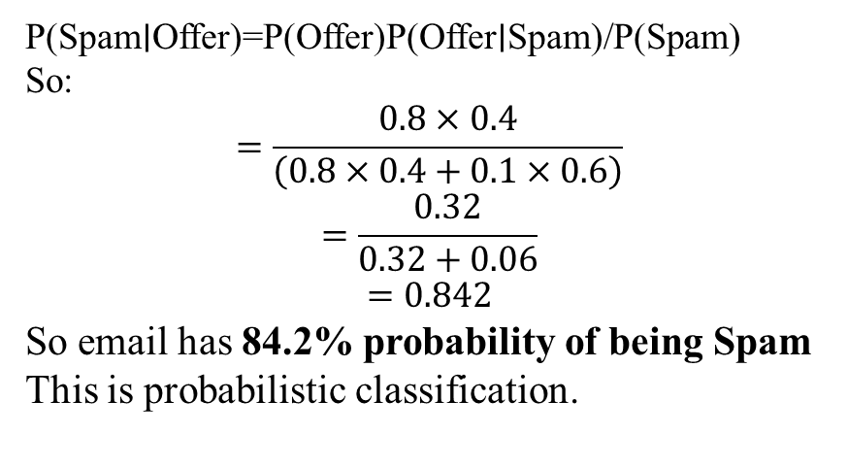
Simple Numerical Example (Bayesian Thinking)
Suppose:
40% emails are Spam
60% are Not Spam
Word “Offer” appears:
80% in Spam emails
10% in Not Spam emails
Using Bayes Theorem:
P(Spam∣Offer)=P(Offer)P(Offer∣Spam)/P(Spam)​
So:
$$=\frac{0.8×0.4}{\left(0.8×0.4+0.1×0.6\right)}$$
$$=\frac{0.32}{0.32+0.06}$$
$$=0.842$$
So email has 84.2% probability of being Spam
This is probabilistic classification.

Slide 10
Bayes Theorem
It is named after Thomas Bayes
It is one of the fundamental concept in probability theory and statistical decision theory.
Widely used in Machine Learning, especially in classification problems.

Slide 11
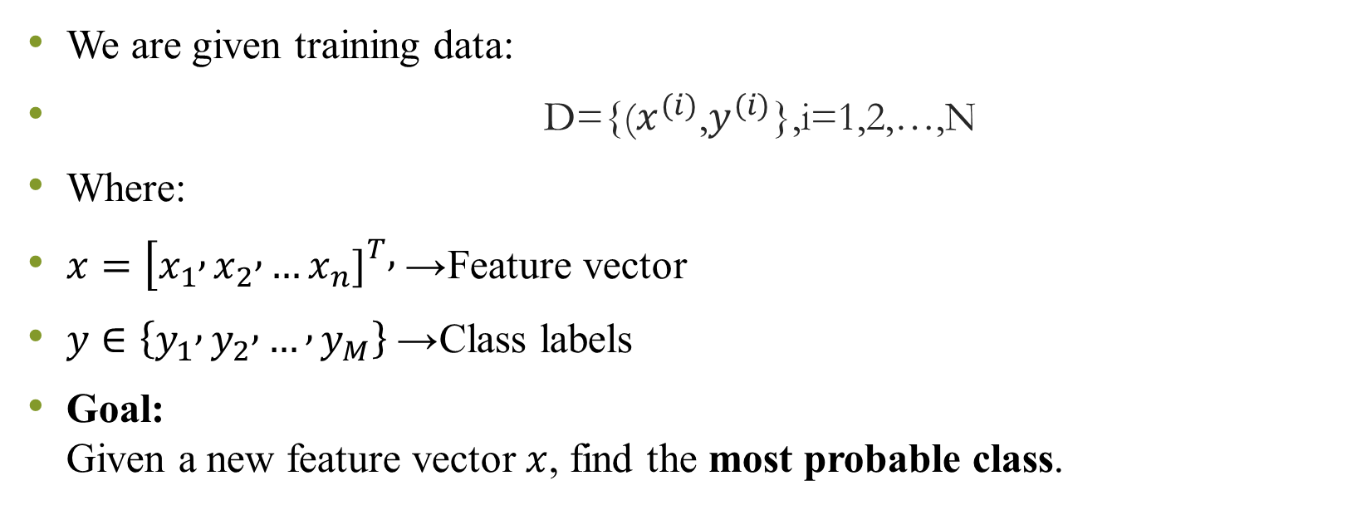
Problem setting in machine learning
We are given training data:
D={($x^{(i)}$,$y^{(i)}$},i=1,2,…,N
Where:
$x=[x_{1} , x_{2} , …x_{n}{\left.]\right.}^{T},$→ Feature vector
$y∈\left\{y_{1} , y_{2} , … , y_{M}\right\}$→ Class labels
Goal: Given a new feature vector $x$, find the most probable class.

Slide 12
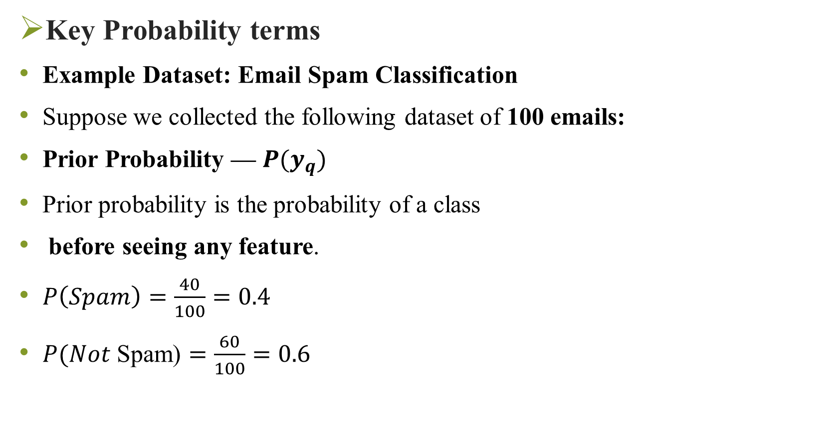
Key Probability terms
Example Dataset: Email Spam Classification
Suppose we collected the following dataset of 100 emails:
Prior Probability — $P(y_{q})$
Prior probability is the probability of a class
before seeing any feature.
$P\left(Spam\right)=\frac{40}{100}=0.4$
$P(Not \text{Spam}\text{)}=\frac{60}{100}=0.6$
Class | Total Emails | Emails Containing Word “Offer”
Spam | 40 | 32
Not Spam | 60 | 6
Total | 100 | 38
Notes:
Interpretation: Before looking at the word “Offer”, we believe:
40% emails are Spam
60% emails are Not Spam
This is our initial belief.

Slide 13
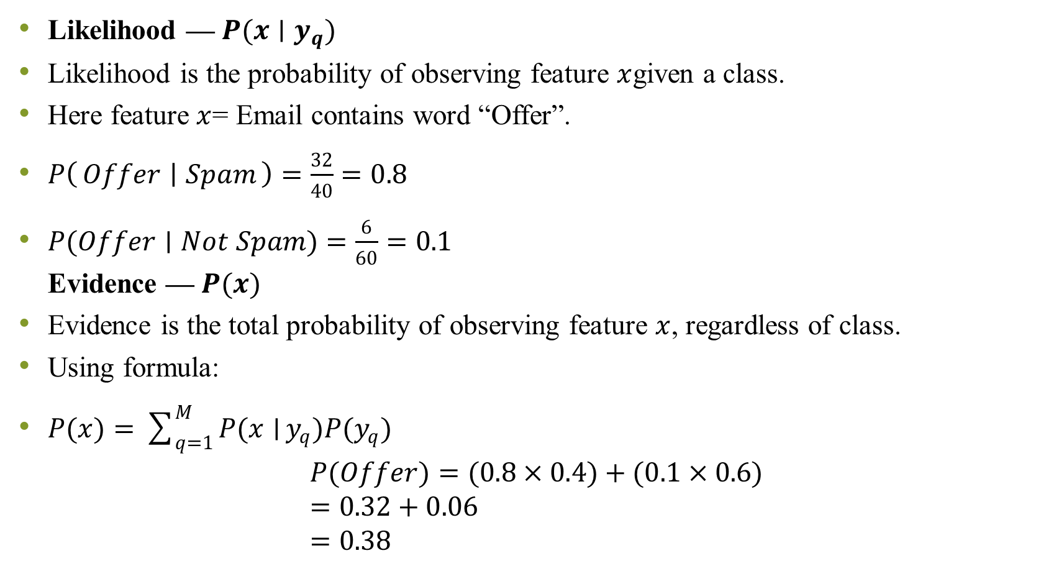
Likelihood — $P(x∣y_{q})$
Likelihood is the probability of observing feature $x$given a class.
Here feature $x$= Email contains word “Offer”.
$P\left(Offer ∣ Spam\right)=\frac{32}{40}=0.8$
$P(Offer∣Not Spam)=\frac{6}{60}=0.1$ Evidence — $P(x)$
Evidence is the total probability of observing feature $x$, regardless of class.
Using formula:
$P(x)=\sum_{q=1}^{M}{P(x∣}y_{q})P(y_{q})$ $P(Offer)=(0.8×0.4)+(0.1×0.6)$ $=0.32+0.06$ $=0.38$
Notes:
Interpretation:
If email is Spam → 80% chance it contains “Offer”
If email is Not Spam → 10% chance it contains “Offer
Interpretation: 38% of all emails contain the word “Offer”.
Evidence acts as a normalization factor

Slide 14
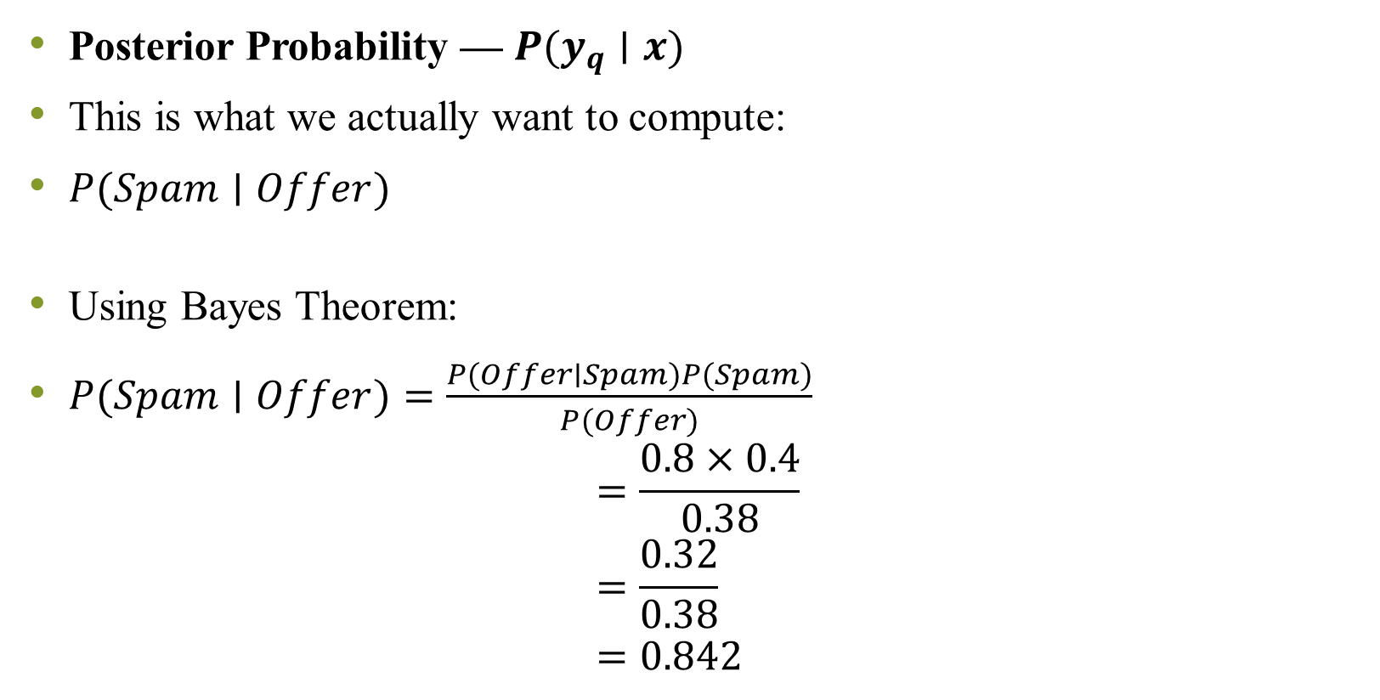
Posterior Probability — $P(y_{q}∣x)$
This is what we actually want to compute:
$P(Spam∣Offer)$
Using Bayes Theorem:
$P(Spam∣Offer)=\frac{P(Offer∣Spam)P(Spam)}{P(Offer)}$ $=\frac{0.8×0.4}{0.38}$ $=\frac{0.32}{0.38}$ $=0.842$
Notes:
Final Interpretation
$$P(Spam∣Offer)=84.2\%$$
If an email contains the word “Offer”, there is 84.2% probability that it is Spam.
This is called posterior probability, meaning:
Complete Understanding in One Line
Posterior=$​\frac{Prior × Likelihood}{Evidence}$

Slide 15
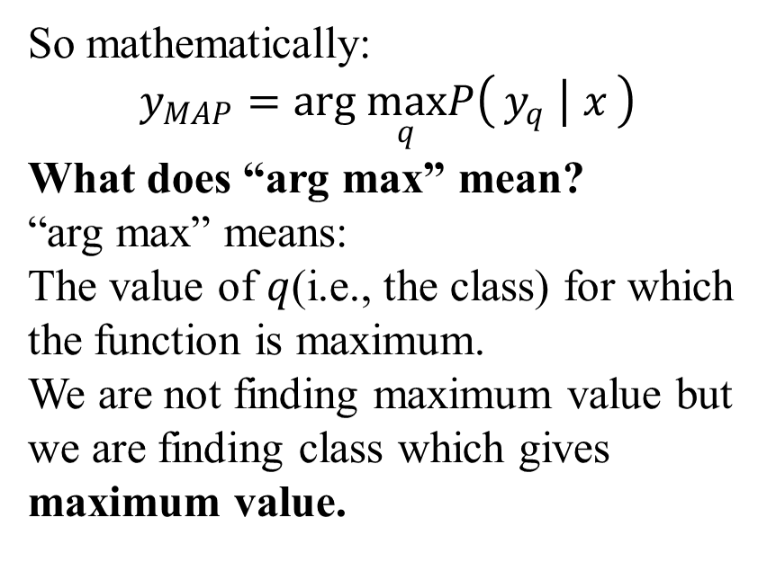
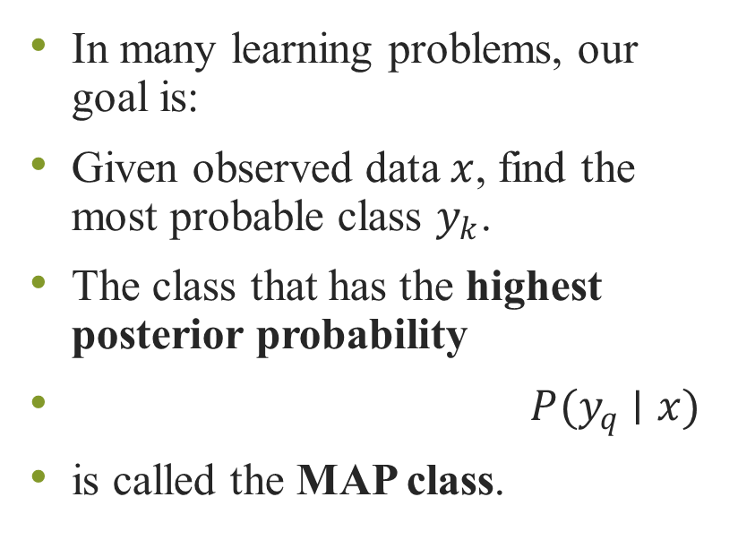
What is MAP (Maximum A Posteriori)
In many learning problems, our goal is:
Given observed data $x$, find the most probable class $y_{k}$.
The class that has the highest posterior probability
$P(y_{q}∣x)$
is called the MAP class.
So mathematically:
$$y_{MAP}=arg \max_{q}P\left(y_{q} ∣ x\right)$$
What does “arg max” mean?
“arg max” means:
The value of $q$(i.e., the class) for which the function is maximum.
We are not finding maximum value but we are finding class which gives maximum value.

Slide 16
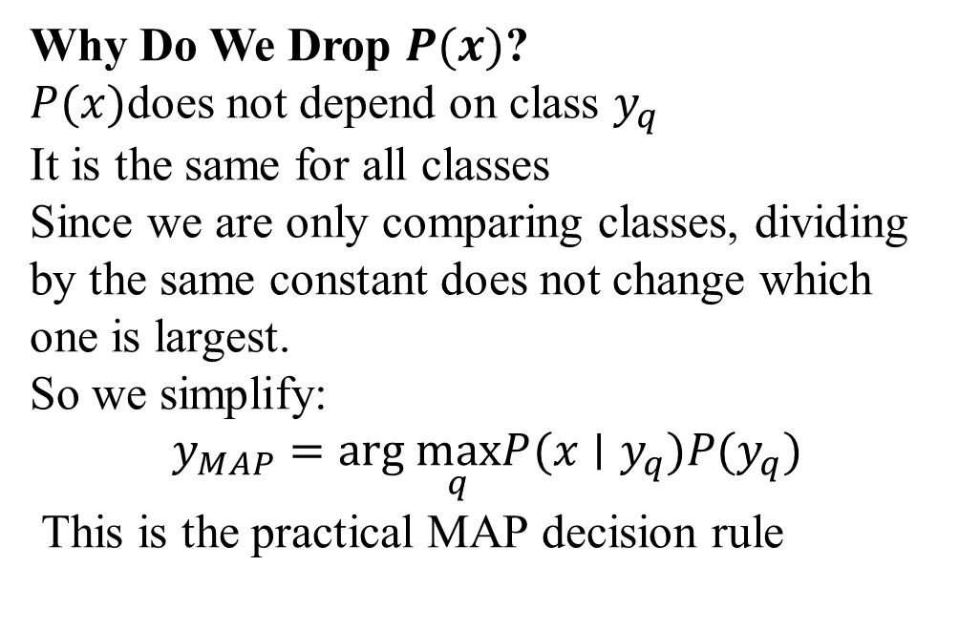
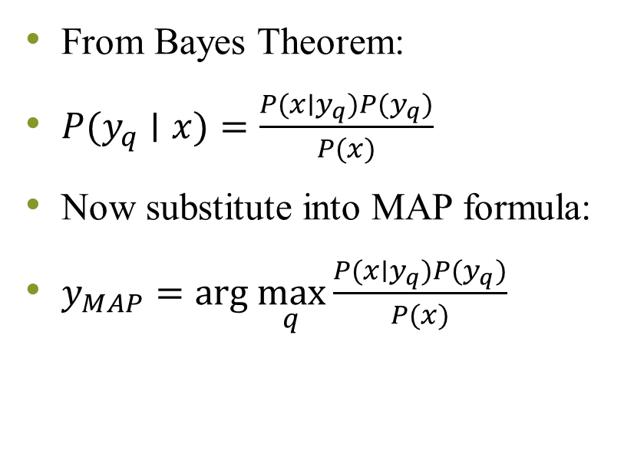
Expanding MAP using bayes theorem
From Bayes Theorem:
$P(y_{q}∣x)=\frac{P(x∣y_{q})P(y_{q})}{P(x)}$
Now substitute into MAP formula:
$y_{MAP}=arg \max_{q}\frac{P(x∣y_{q})P(y_{q})}{P(x)}$
Why Do We Drop $P(x)$?
$P(x)$does not depend on class $y_{q}$
It is the same for all classes
Since we are only comparing classes, dividing by the same constant does not change which one is largest.
So we simplify:
$$y_{MAP}=arg \max_{q}P(x∣y_{q})P(y_{q})$$
This is the practical MAP decision rule

Slide 17
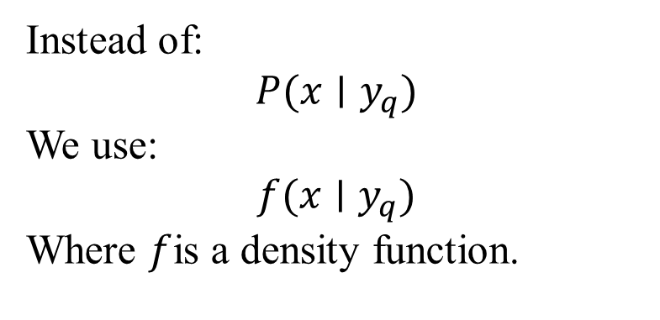
Continuous data case
Earlier examples assumed categorical data (like Spam / Not Spam).
But Bayes theorem is more general.
When data is continuous:
We do not use simple probabilities
We use probability density functions (PDFs)
Instead of:
$$P(x∣y_{q})$$
We use:
$$f(x∣y_{q})$$
Where $f$is a density function.

Slide 18
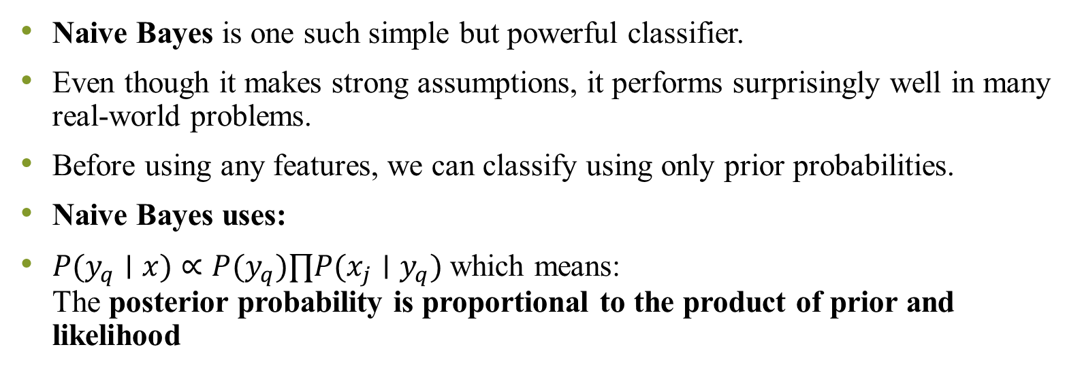
Naïve bayes classifier
Naive Bayes is one such simple but powerful classifier.
Even though it makes strong assumptions, it performs surprisingly well in many real-world problems.
Before using any features, we can classify using only prior probabilities.
Naive Bayes uses:
$P(y_{q}∣x)∝P(y_{q})∏P(x_{j}∣y_{q})$ which means: The posterior probability is proportional to the product of prior and likelihood
Notes:
Example: Flight Delay
Suppose:
82% flights are On Time
18% flights are Delayed
A very simple rule:
Predict all flights as "On Time"
Accuracy = 82%
This is called the majority class rule.
But it ignores all features like:
Day
Weather
Carrier
Departure time
Origin
Destination
A good classifier should do better than this baseline.

Slide 19
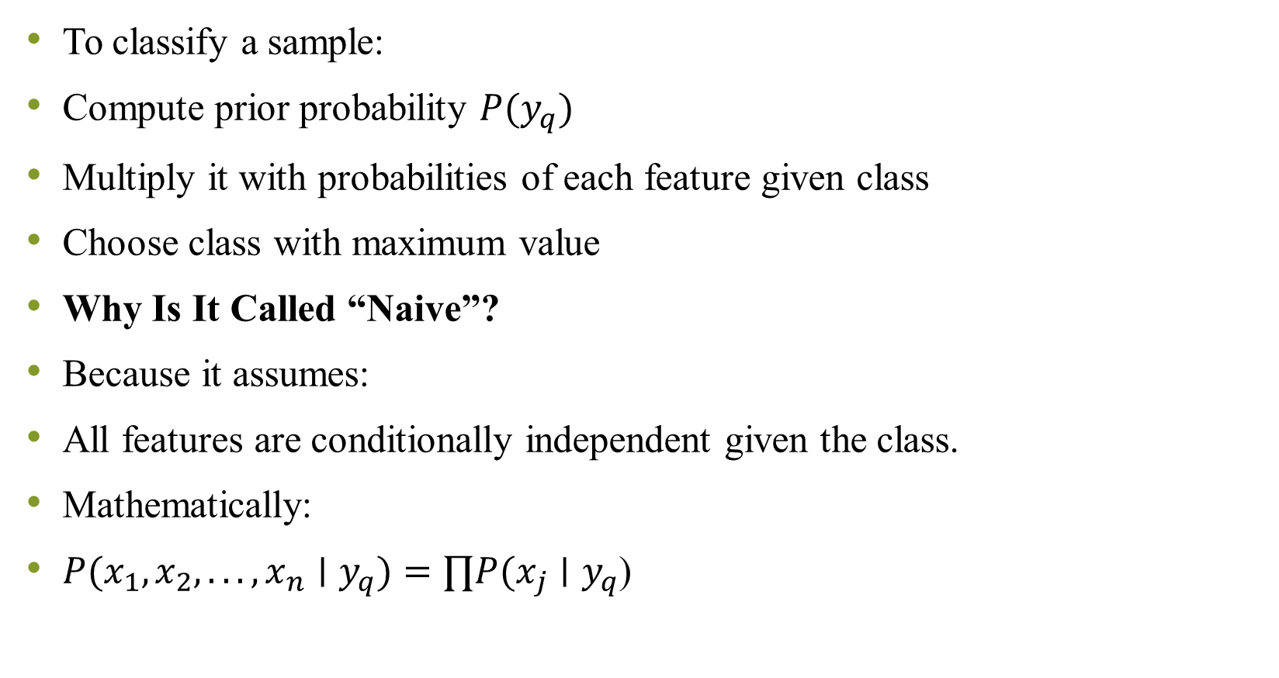
To classify a sample:
Compute prior probability $P(y_{q})$
Multiply it with probabilities of each feature given class
Choose class with maximum value
Why Is It Called “Naive”?
Because it assumes:
All features are conditionally independent given the class.
Mathematically:
$P(x_{1},x_{2},...,x_{n}∣y_{q})=∏P(x_{j}∣y_{q}$)
Notes:
In real life:
Features are NOT truly independent.
But this assumption simplifies computation greatly

Slide 20
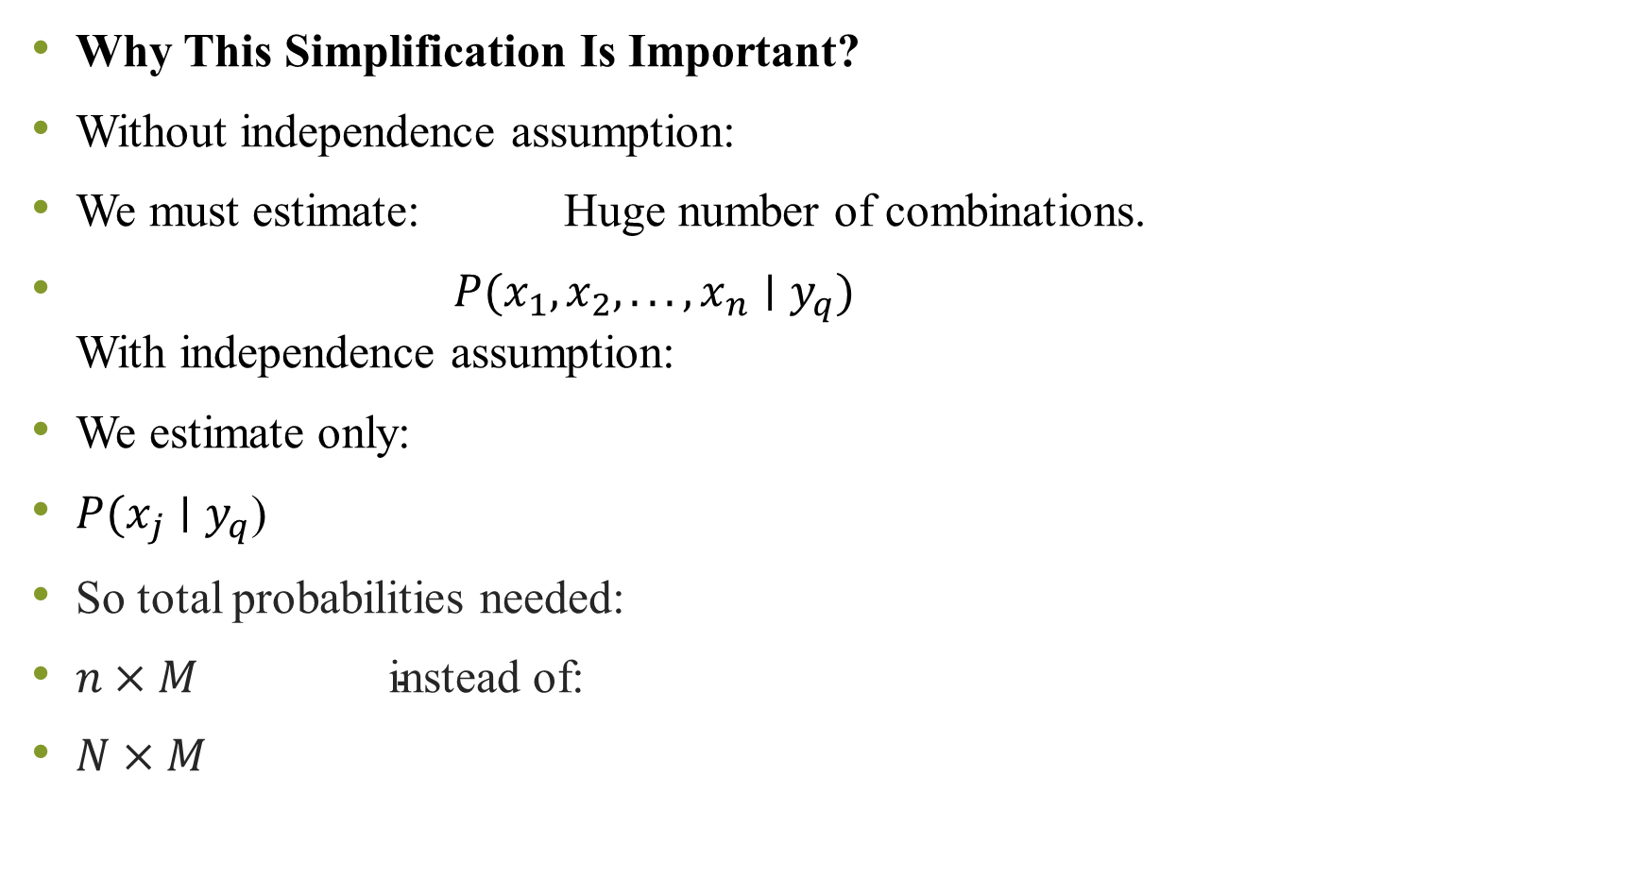
Why This Simplification Is Important?
Without independence assumption:
We must estimate: Huge number of combinations.
$P(x_{1},x_{2},...,x_{n}∣y_{q})$ With independence assumption:
We estimate only:
$P(x_{j}∣y_{q}$)
So total probabilities needed:
$n×M \text{instead} \text{of}\text{:}$
$N×M$

Slide 21
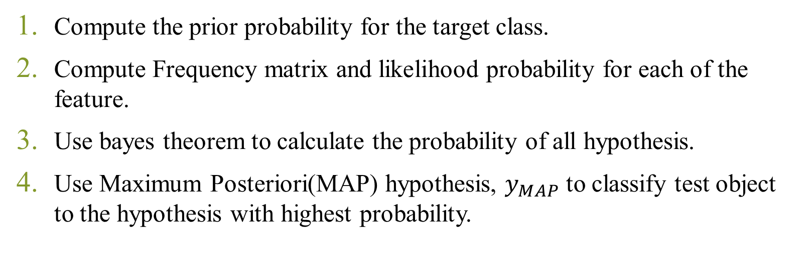
Algorithm Naïve bayes
Compute the prior probability for the target class.
Compute Frequency matrix and likelihood probability for each of the feature.
Use bayes theorem to calculate the probability of all hypothesis.
Use Maximum Posteriori(MAP) hypothesis, $y_{MAP}$ to classify test object to the hypothesis with highest probability.

Slide 22
Numerical: Assess a students performance using Naïve bayes algorithm with the dataset provided in table. Predict whether student gets a job offer or not in his final year of course
S.No | CGPA | Interactiveness | Practical Knowledge | Communication Skills | Job Offer
1 | ≥9 | Yes | Very good | Good | Yes
2 | ≥8 | No | Good | Moderate | Yes
3 | ≥9 | No | Average | Poor | No
4 | <8 | No | Average | Good | No
5 | ≥8 | Yes | Good | Moderate | Yes
6 | ≥9 | Yes | Good | Moderate | Yes
7 | <8 | Yes | Good | Poor | No
8 | ≥9 | No | Very good | Good | Yes
9 | ≥8 | Yes | Good | Good | Yes
10 | ≥8 | Yes | Average | Good | Yes
Test Data= (CGPA≥9 ,Interactiveness =Yes, Practical Knowledge=Average, Communication Skills=Good

Slide 23
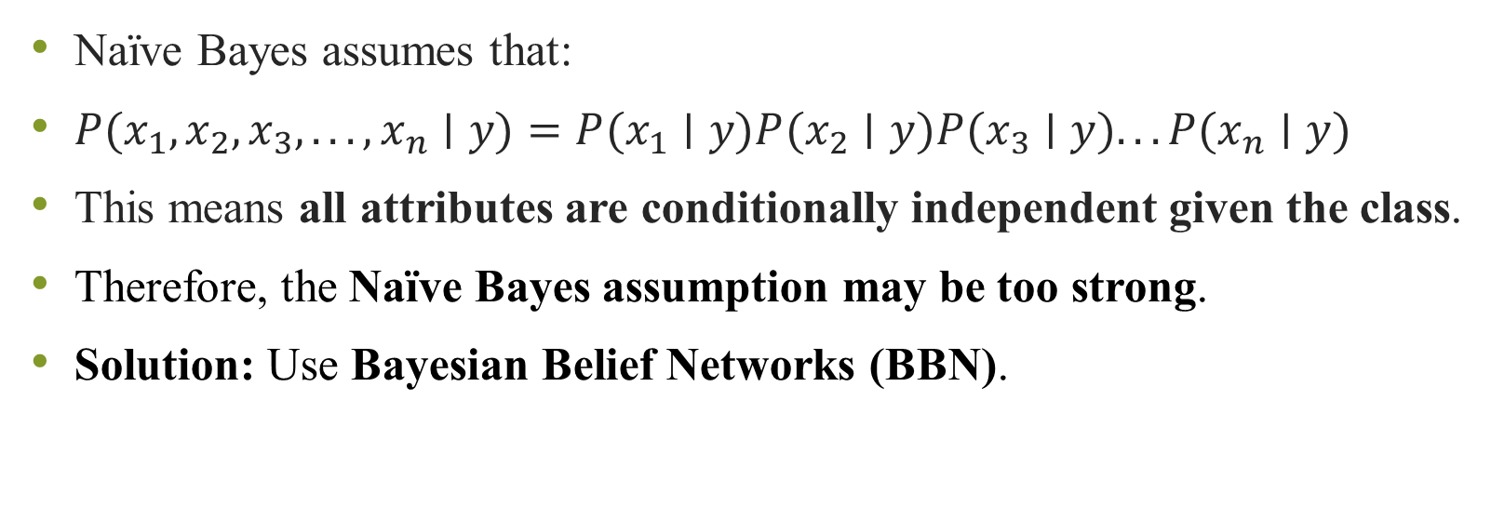
Limitations of Naïve Bayes
Naïve Bayes assumes that:
$P(x_{1},x_{2},x_{3},...,x_{n}∣y)=P(x_{1}∣y)P(x_{2}∣y)P(x_{3}∣y)...P(x_{n}∣y)$
This means all attributes are conditionally independent given the class.
Therefore, the Naïve Bayes assumption may be too strong.
Solution: Use Bayesian Belief Networks (BBN).
Notes:
Problem
In real life, attributes are often dependent.
Example
Suppose we predict Lung Cancer using:
Smoking
Family History
Pollution
In reality:
Smoking and Pollution may be related.
Family history and cancer risk may also be related.

Slide 24
What is a Bayesian Belief Network?
A Bayesian Belief Network is a probabilistic graphical model.
It contains:
Nodes → Random variables
Directed edges → Dependency relationships
Conditional Probability Tables (CPT)
It represents how variables influence each other

Slide 25
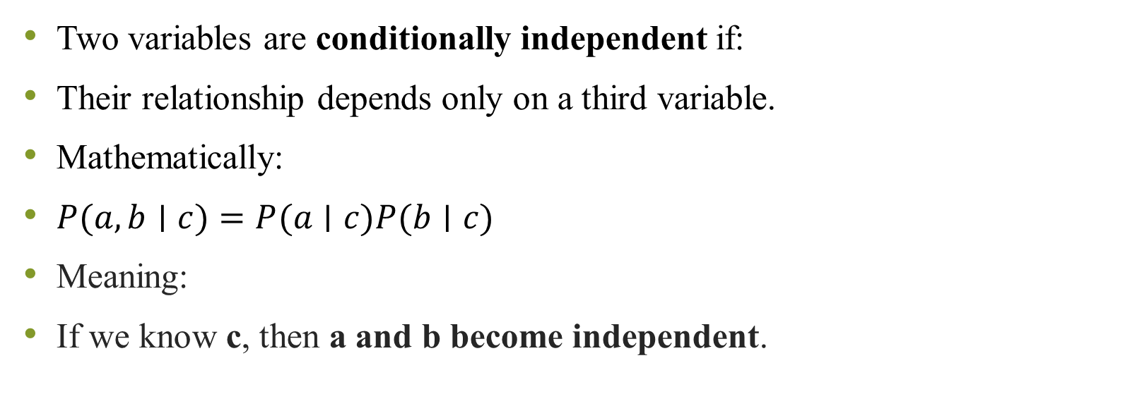
Conditional Independence in BBN
Two variables are conditionally independent if:
Their relationship depends only on a third variable.
Mathematically:
$P(a,b∣c)=P(a∣c)P(b∣c)$
Meaning:
If we know c, then a and b become independent.
Notes:
Simple Example
Suppose:
Rain (R)
Wet Ground (W)
Sprinkler (S)
Rain and sprinkler both cause wet ground.
If we know the ground is wet, Rain and Sprinkler are not independent.
But if we know whether rain occurred, sprinkler and wet ground become conditionally independent.

Slide 26
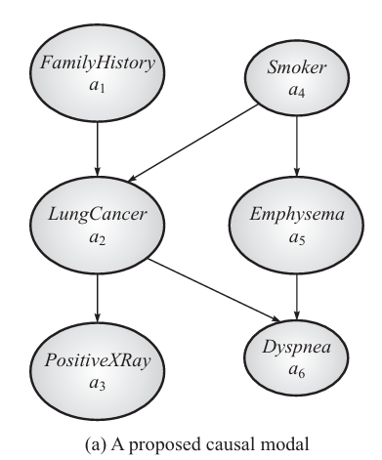
Graph Representation
In BBN:
Each node = variable
Each arrow = causal influence
Example network from the page:
Diagram contain 6 variables (nodes):FamilyHistory, LungCancer
PositiveXRay , Smoker, Emphysema, Dyspnea
Causes of Lung Cancer
FamilyHistory → LungCancer Smoker → LungCancer
Notes:
Meaning:
If a person has family history, risk of lung cancer increases.
If a person smokes, risk of lung cancer increases.

Slide 27
Symbol | Variable | Meaning
a₁ | FamilyHistory | Genetic risk
a₂ | LungCancer | Disease
a₃ | PositiveXRay | X-ray result
a₄ | Smoker | Person smokes or not
a₅ | Emphysema | Lung disease caused by smoking
a₆ | Dyspnea | Breathing difficulty

Slide 28
Smoking also causes Emphysema
Smoker → Emphysema
Smoking may lead to emphysema, another lung disease.
Symptoms
LungCancer → PositiveXRay LungCancer → Dyspnea Emphysema → Dyspnea
Meaning:
Lung cancer may cause positive X-ray
Lung cancer may cause breathing difficulty
Emphysema may also cause breathing difficulty

Slide 29
Interpretation (Very Important Concept)
Dyspnea (breathing difficulty) can occur because of two reasons:
Lung Cancer
Emphysema
This is why two arrows point to Dyspnea.
LungCancer → Dyspnea Emphysema → Dyspnea

Slide 30
Apply Naïve Bayes algorithm for following dataset and class news instance as M/H
No | Color | Legs | Height | Smelly | Species
1 | White | 3 | Short | Yes | M
2 | Green | 2 | Tall | No | M
3 | Green | 3 | Short | Yes | M
4 | White | 3 | Short | Yes | M
5 | Green | 2 | Short | No | H
6 | White | 2 | Tall | No | H
7 | White | 2 | Tall | No | H
8 | White | 2 | Short | Yes | H
9 | Green | 2 | Tall | No | ?

Slide 31
Apply Naïve Bayes algorithm for following dataset
Sr. No | Color | Type | Origin | Stolen
1 | Red | Sports | Domestic | Yes
2 | Red | Sports | Domestic | No
3 | Red | Sports | Domestic | Yes
4 | Yellow | Sports | Domestic | No
5 | Yellow | Sports | Imported | Yes
6 | Yellow | SUV | Imported | No
7 | Yellow | SUV | Imported | Yes
8 | Yellow | SUV | Domestic | No
9 | Red | SUV | Imported | No
10 | Red | Sports | Imported | Yes
11 | Red | SUV | Domestic | ?

Slide 32
Gaussian Naïve bayes
Person | Height (ft) | Weight(lbs) | Foot size (inches)
Male | 6.00 | 180 | 12
Male | 5.92 | 190 | 11
Male | 5.58 | 170 | 12
Male | 5.92 | 165 | 10
Female | 5.00 | 100 | 6
Female | 5.50 | 150 | 8
Female | 5.42 | 130 | 7
Female | 5.75 | 150 | 9
Based on the following data determine the gender of a person having height 6ft, weight 130lbs and foot size 8 inches. Use Gaussian Naïve bayes classifier

Slide 33
Assess student’s performance using naïve bayes algorithm for continuous attribute. Predict whether student gets a job in his final year of course. The training dataset T consist of 10 data instances with attributes such as ‘CGPA’ and ‘Interactiveness’ as shown in the table. The target variable is Job Offer which is classified as Yes or No for a candidate student
Test data
CGPA=9,
Interactiveness=Yes,
Job Offer=?
Sr. No | CGPA | Interactiveness | Job Offer
1 | 9.5 | Yes | Yes
2 | 8.2 | No | Yes
3 | 9.3 | No | No
4 | 7.6 | No | No
5 | 8.4 | Yes | Yes
6 | 9.1 | Yes | Yes
7 | 7.5 | Yes | No
8 | 9.6 | No | Yes
9 | 8.6 | Yes | Yes
10 | 8.3 | Yes | Yes

