Slide 1
Clustering

Slide 2
What is clustering?
Cluster analysis groups data objects based only on information found in the data that describes the objects and their relationships.
The goal is that the objects within a group be similar (or related) to one another and different from (or unrelated to) the objects in other groups.
The greater the similarity (or homogeneity) within a group and the greater the difference between groups, the better or more distinct the clustering.

Slide 3
Because a cluster is a collection of data objects that are similar to one another within the cluster and dissimilar to objects in other clusters, a cluster of data objects can be treated as an implicit class.
In this sense, clustering is sometimes called automatic classification. This is a distinct advantage of cluster analysis.
Clustering is also called data segmentation in some applications because clustering partitions large data sets into groups according to their similarity.
Clustering can also be used for outlier detection, where outliers are values that are “far away” from any cluster

Slide 4
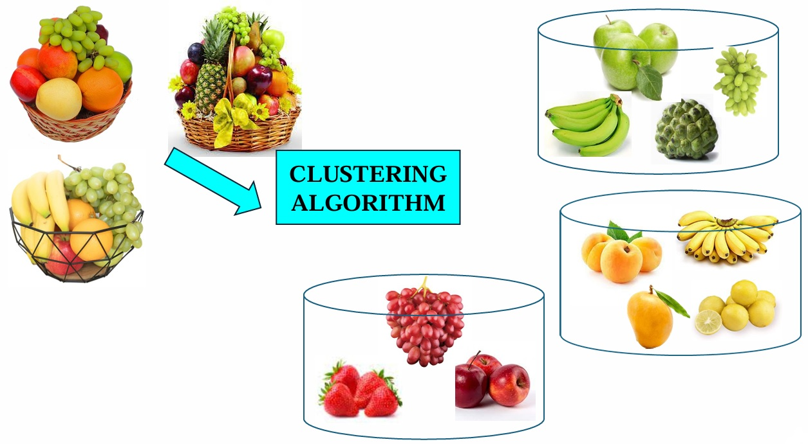

Slide 5
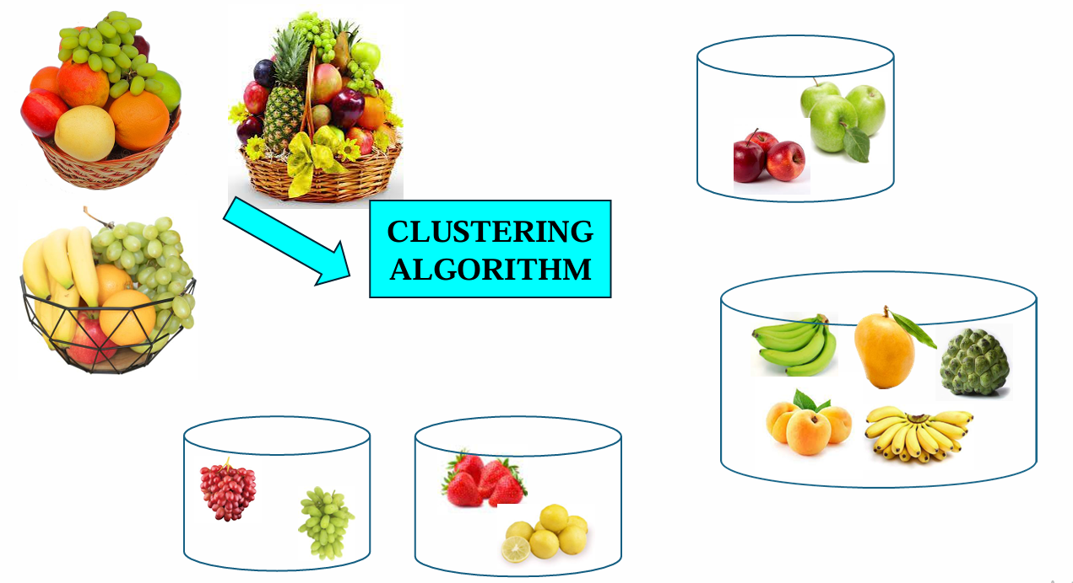
Notes:
Cluster 1 (Top Right)
Contains: Green apples + Red apples
👉 Grouped because they are the same type of fruit (apples)
Cluster 2 (Bottom Left)
Contains: Red grapes + Green grapes
👉 Grouped based on same fruit type (grapes) despite color difference
Cluster 3 (Bottom Center)
Contains: Strawberries + Lemons
👉 Likely grouped due to small size and similar texture/category (soft/small fruits)
Cluster 4 (Bottom Right - Large Cluster)
Contains: Banana, Mango, Custard apple, Peach, etc.
👉 Grouped as larger tropical fruits / similar shape or usage

Slide 6
Key characteristics
No predefined labels (unlike classification/regression)
Based on similarity or distance measures
A type of unsupervised learning
Helps in discovering hidden patterns in data
How Similarity is Measured
Based on features/attributes of data
Commonly uses distance measures (e.g., Euclidean distance)

Slide 7
Applications of clustering
1. Data exploration
Helps analyze and understand complex datasets
2. Image compression
Groups similar colors → reduces storage space
3. Document Clustering
Groups documents into categories like:
Politics
Sports
Entertainment

Slide 8
4. Bioinformatics
Identifies patterns in protein sequences
5. Customer Segmentation
Groups customers based on:
Demographics
Purchase behavior
6. Customer Relationship Management (CRM)
Helps businesses design targeted strategies for each segment
7. Outlier Detection (Anomaly Detection)
Identifies unusual data points:
Fraud detection (credit cards)
Medical anomalies (tumors)
Data errors

Slide 9
Engineering the data
Data Engineering means preparing raw data so that machine learning algorithms can work properly.
Real-world data is:
Incomplete (missing values)
Noisy (errors, incorrect entries)
Inconsistent (different formats)
If we directly apply ML algorithms to the raw data then we will get:
Wrong predictions
Poor model performance

Slide 10
Example: Raw Dataset
After Engineering data
Customer | Age | Income
A | 25 | 30000
B | ? | 40000
C | 200 | 50000
Customer | Age | Income
A | 25 | 30000
B | 30 | 40000
C | 40 | 50000
Problems:
Missing value (Age = ?)
Incorrect value (Age = 200)
✔ Clean and usable data

Slide 11
Types of learning
Classification: Predict class (Yes/No)
Regression: Predict Numeric value
Clustering: grouping similar data
Association: Find relationship between variables
Why data preparation is important?
Real world data comes from multiple sources & poor quality data leads to wrong prediction so we need data preparation

Slide 12
Exploratory data analysis
Exploring data is an opportunity to learn about what is in the data
EDA is simply:
“Looking at your data before applying any machine learning model.”
It helps you answer questions like:
What does the data look like?
Are there errors or missing values?
Which features are important?
Are there patterns or relationships?

Slide 13
Example dataset : Dataset of students
Step By step EDA
Measures of Central Tendency (Mean, Median)
“What is the average performance?”
Find Mean of marks
Insight
Dispersion (Spread of Data)
“Are values close or very spread out?”
Find Range
Student | Hours_Studied | Attendance (%) | Marks
A | 2 | 60 | 50
B | 3 | 65 | 55
C | 5 | 80 | 65
D | 7 | 85 | 80
E | 8 | 90 | 85
F | 1 | 50 | 40
G | 6 | 75 | 70
H | 9 | 95 | 90
Notes:
“What is the average performance?”
Mean Marks:
$$\text{Mean}=\frac{50+55+65+80+85+40+70+90}{8}=66.875$$
👉 Result: Average marks ≈ 67
Insight:
Most students score around 65–70
Data is fairly balanced
Range:
$$\text{Range}=90−40=50$$
👉 Result: Marks vary widely (40 to 90)
Insight:
Some students perform very low, some very high
Possible variation in effort or ability

Slide 14
Find outliers
Check if any value is too extreme
Lowest = 40 (Student F)
Highest = 90 (Student H)
Not extreme → No strong outliers
Correlation Analysis
“Do variables move together?
Relationship:
Hours studies increases marks also increases
Visualization (Understanding Patterns)
Scatter Plot (Concept)
If we plot:
X-axis → Hours Studied
Y-axis → Marks
You would see:
Points forming an upward trend
Result:
Clear linear relationship
Discover Patterns (Most Important Part)
From EDA, we found:
Students with:
>6 hours study → Marks >70
<3 hours study → Marks <60
Pattern discovered!

Slide 15
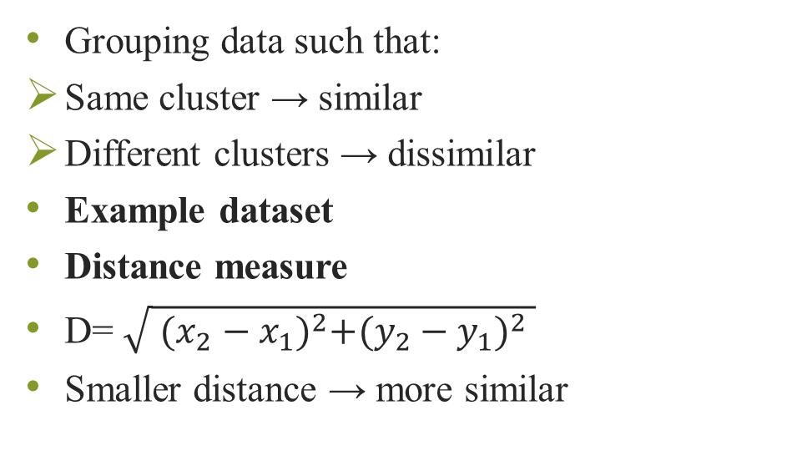
Cluster Analysis
Grouping data such that:
Same cluster → similar
Different clusters → dissimilar
Example dataset
Distance measure
D= $\sqrt{ {(x_{2}−x_{1})}^{2}+{(y_{2}−y_{1})}^{2} }$
Smaller distance → more similar
Customer | Income | Spending
A | 20000 | 80
B | 25000 | 75
C | 60000 | 40
D | 65000 | 35
Notes:
Resulting Clusters
Cluster 1:
A, B → Low income, high spending
Cluster 2:
C, D → High income, low spending

Slide 16
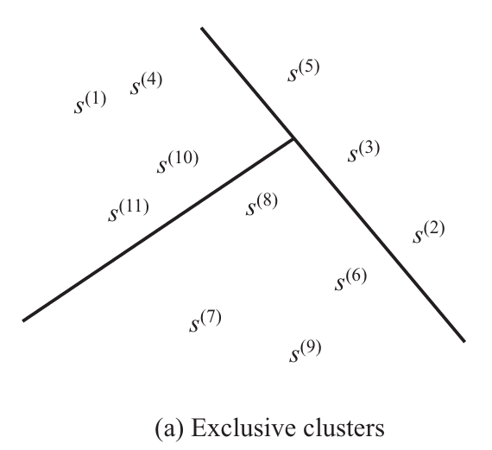
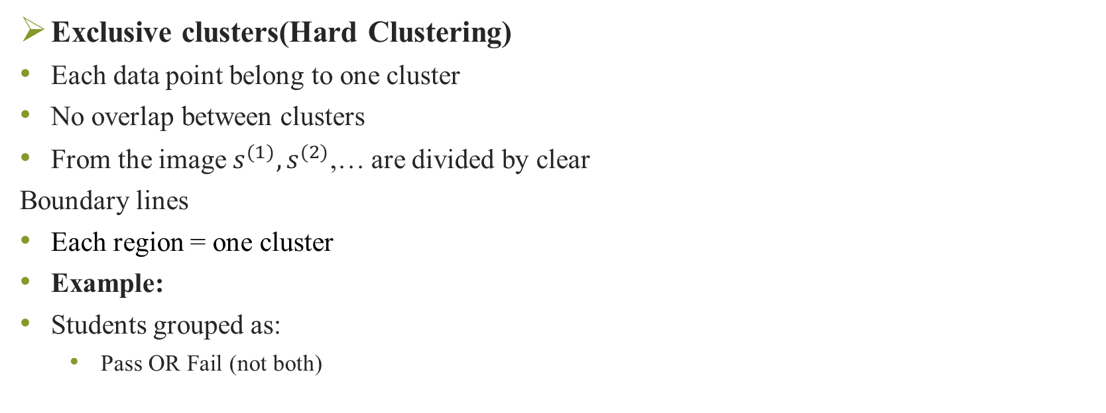
Representing cluster results
Exclusive clusters(Hard Clustering)
Each data point belong to one cluster
No overlap between clusters
From the image $s^{(1)},s^{(2)}$,… are divided by clear
Boundary lines
Each region = one cluster
Example:
Students grouped as:
Pass OR Fail (not both)
Notes:
Strict separation 👉 Used in algorithms like:
K-Means

Slide 17
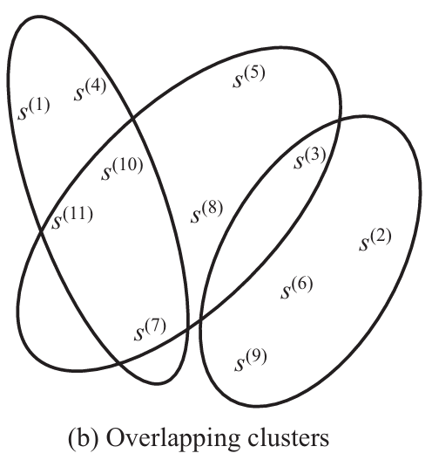
Overlapping clusters
A data point can belong to multiple clusters at the same time.
The oval shapes overlap
Some points lie in intersection areas
Example:
A person can be:
Tech-savvy AND Creative
Not strictly one category
Notes:
Soft boundaries 👉 Used in:
Fuzzy C-Means

Slide 18
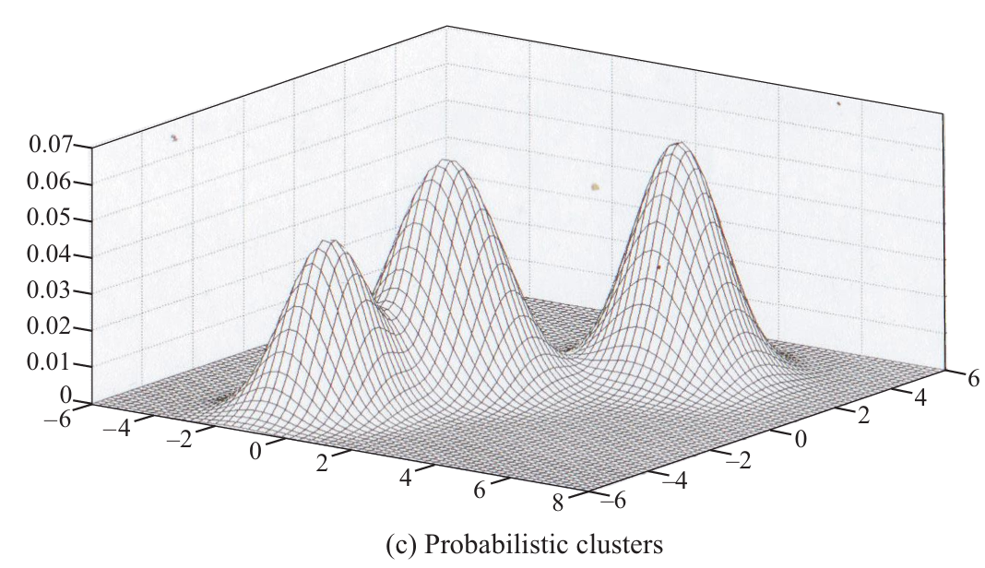
Probabilistic clusters
Each point has a probability of belonging to each cluster.
The 3D graph shows peaks (hills)
Each peak = one cluster
Height = probability density
Example:
A data point may belong:
70% to Cluster A
30% to Cluster B
Notes:
Uncertainty handled mathematically 👉 Used in:
Gaussian Mixture Models (GMM)

Slide 19
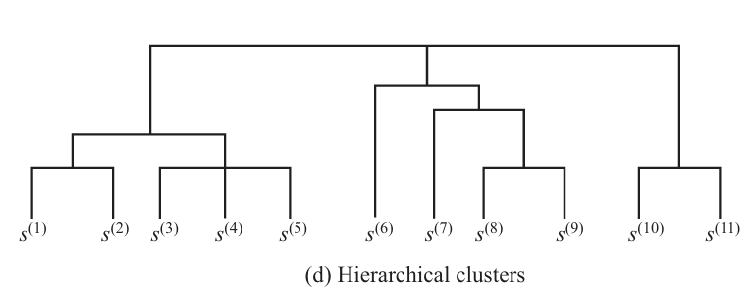
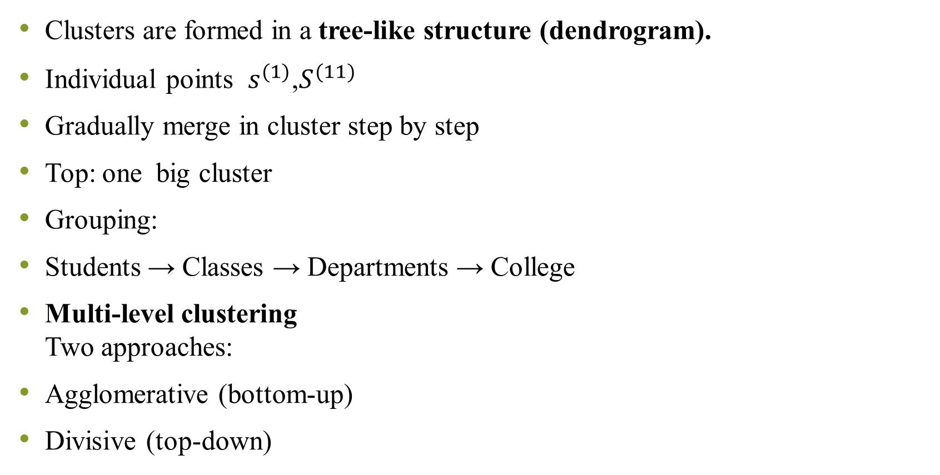
Clusters are formed in a tree-like structure (dendrogram).
Individual points $s^{(1)}$,$S^{(11)}$
Gradually merge in cluster step by step
Top: one big cluster
Grouping:
Students → Classes → Departments → College
Multi-level clustering Two approaches:
Agglomerative (bottom-up)
Divisive (top-down)
Notes:
Multi-level clustering 👉 Two approaches:
Agglomerative (bottom-up)
Divisive (top-down)

Slide 20
Measuring cluster quality
After applying a clustering algorithm (like K-Means), we must ask:
“Are these clusters actually good?”
We evaluate this using Cluster Validity Measures.
Two main criteria
Compactness(Intra- cluster similarity)
Separation(Inter-cluster distance)

Slide 21
Compactness (Intra-cluster similarity)
Points inside a cluster should be close to each other
📊 Example Dataset
Cluster 1: (2,3), (3,4), (2,4)
Cluster 2: (8,9), (9,10), (10,9)
👉 Observation:
Points in each cluster are very close → Good compactness
❌ Bad Example:
Cluster: (2,3), (10,15), (25,30)
👉 Points are far → Poor compactness
Mathematical Idea (Variance)
Lower variance = better cluster

Slide 22
2) Separation (Inter-cluster distance)
👉 Idea: Clusters should be far from each other
📊 Example
Cluster 1 center: (3,3) Cluster 2 center: (9,9)
👉 Distance is large → Good separation
❌ Bad Case:
Cluster centers: (3,3) and (4,4)
👉 Very close → Poor separation
Good clustering means:
✔ High compactness
✔ High separation

Slide 23
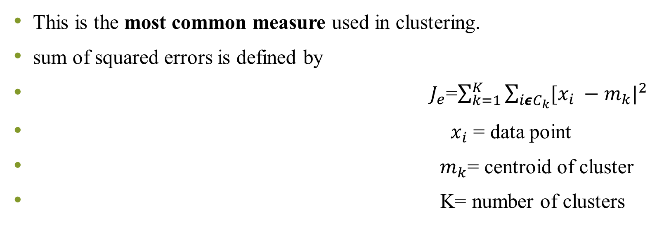
Sum of Squared Error (SSE)
This is the most common measure used in clustering.
sum of squared errors is defined by
$J_{e}$=$\sum_{k=1}^{K}{\sum_{iεC_{k}}{{[x_{i} −m_{k}|}^{2}}}$
$x_{i}$ = data point
${ m}_{k}$= centroid of cluster
K= number of clusters
Notes:
It calculates: ➡ Distance of each point from its cluster center
Example
Cluster center = (3,3)
Points: (2,3), (3,4)
Distances:
(2,3) → distance = 1 → square = 1
(3,4) → distance = 1 → square = 1
👉 SSE = 1 + 1 = 2
➡ Then squares and sums them

Slide 24
Finding Optimal Number of Clusters
We don’t know how many clusters (K) to choose.
After K=4 → improvement slows
Choose K = 4 (Elbow Method)
K | SSE
2 | 500
3 | 300
4 | 200
5 | 190

Slide 25
Cluster Interpretability
After forming clusters, we must understand them.
Step 1: Summary Statistics
Example:
Cluster A:
Avg Age = 25
Avg Income = 20K
Cluster B:
Avg Age = 45
Avg Income = 80K
Step 2: Check Meaningfulness
👉 Are clusters logical?
Yes → Young vs Experienced customers
Step 3: Assign Labels
👉 Label clusters:
Cluster A → “Students”
Cluster B → “Professionals”

Slide 26
Cluster Stability
If we slightly change data, do clusters change drastically?
Example
Original: Cluster A → (2,3), (3,4)
After adding (2.1,3.2): Still same cluster → Stable
❌ Unstable Case:
Small change → completely different clusters
👉 Bad clustering

Slide 27
Applications of clustering
1. Data Summarization
Instead of 1000 points → represent using 5 clusters
2. Outlier Detection
Example: Cluster near (2,3)
One point at (50,60)
This is an outlier
3. Faster Processing
Instead of full dataset → use cluster centers
Saves time in ML models
4. Nearest Neighbor Optimization
👉 Only check nearby clusters 👉 Avoid unnecessary comparisons

Slide 28
Data Transformation techniques
1. Data Cleansing
Purpose
Fix errors in data
🔍 Problems:
Missing values
Duplicate records
Noise
Age | Income
25 | 30000
? | 40000
Fix:
Replace with mean (e.g., 30)

Slide 29
Derived Attributes
Create new features
✔ New Feature: Savings = 20000
Discretization
Convert numbers → categories
✔ Convert to:
Young (20–30)
Middle (30–50)
Some algorithms work only with categories so in that case we need to do discretization
Income | Expenses
50000 | 30000
Age
22
45

Slide 30
Attributes reduction
Age and DOB gives same info so remove DOB so remove DOB
Final Example (End-to-End)
Step 1: Cleaning
Replace missing Age
Step 2: Transformation
Income → Low/Medium/High
Step 3: Clustering
👉 Result:
Cluster 1 → High spenders
Cluster 2 → Low spenders
ID | Age | Income | Spending
1 | 22 | 25000 | 80
2 | ? | 60000 | 40

