Slide 1
Decision tree remaining part followed by Random Forest

Slide 2
Overfitting in decision tree
Overfitting in decision trees occurs when the model fits the training data too perfectly, including noise and random patterns, and therefore does not perform well on new (unseen) data.
A fully grown decision tree continues splitting nodes until all leaf nodes become pure, which minimizes training error.
However, such a tree may capture coincidental regularities or patterns that are not actually related to the target function.

Slide 3
Overfitting can happen due to:
Presence of noise in the data (which exists in real-world datasets)
Small number of training samples at leaf nodes
Splits based on irrelevant attributes that accidentally classify data correctly
A decision tree is said to overfit when a simpler tree, which may not perfectly fit the training data, performs better on the overall data distribution.
How Pruning Helps to Avoid Overfitting
Pruning is the process of reducing the size of a decision tree by removing unnecessary branches, thereby improving its performance on new data.

Slide 4
There are two main branches
1. Prepruning
Stops the tree from growing before it perfectly fits the training data
Uses conditions such as thresholds on measures like Information Gain, Gain Ratio, or Gini Index
However, it is difficult to determine the correct stopping point
2. Postpruning
First allows the tree to grow fully (even if it overfits)
Then removes branches that add little predictive value
More effective than prepruning in practice

Slide 5
Suppose we want to predict whether a student will Pass or Fail based on study-related factors.
Student | Hours_Studied | Attendance | Assignment_Submitted | Result
S1 | 8 | High | Yes | Pass
S2 | 7 | High | Yes | Pass
S3 | 6 | Medium | Yes | Pass
S4 | 5 | Medium | No | Fail
S5 | 4 | Low | No | Fail
S6 | 3 | Low | No | Fail
S7 | 9 | High | Yes | Pass
S8 | 2 | Medium | No | Fail
S9 | 8 | High | No | Pass
S10 | 1 | Low | Yes | Fail

Slide 6
A good decision tree may create rules like:
If Attendance = High → Pass
If Attendance = Low → Fail
If Attendance = Medium and Assignments = Yes → Pass
This tree is simple and generalizes well.

Slide 7
Overfitted decision Tree
Suppose the tree continues splitting until every training record is perfectly classified.
It may create rules such as:
If Hours_Studied = 8 AND Assignment = No AND Student = S9 → Pass
If Hours_Studied = 1 AND Assignment = Yes AND Student = S10 → Fail
Now the tree starts memorizing individual records instead of learning general patterns.
This is called overfitting.

Slide 8
Problems Due to Overfitting
Tree becomes very large and complex
Captures noise in data
Performs poorly on new unseen data
Difficult to interpret
Example:
A new student studies 8 hours but has medium attendance. The overfitted tree may classify incorrectly because it learned unnecessary specific rules from training data.

Slide 9
How pruning helps
1. Pre pruning
Pre pruning stops the tree early before it becomes too complex.
Conditions used:
Minimum samples required at a node
Maximum tree depth
Minimum Information Gain or Gini reduction

Slide 10
Example
Suppose the tree wants to split this small subset:
Only 2 records are available.
Pre pruning may stop splitting because the number of samples is too small.
Thus, unnecessary branches are avoided.
Student | Hours_Studied | Result
S9 | 8 | Pass
S10 | 1 | Fail

Slide 11
2. Postpruning
In postpruning:
First grow the complete tree
Then remove branches that do not improve prediction accuracy
Example
Suppose the tree contains:
If Hours_Studied = 8 AND Assignment = No → Pass
This rule may apply only to one training record (S9).
Postpruning removes this branch because it does not help general prediction.
The simplified tree becomes:
If Attendance = High → Pass
This rule works better for most future cases.

Slide 12
Strengths and weaknesses of decision trees.
1. Automatic Feature Selection (Feature Extraction)
Decision trees automatically select only the most relevant features for making decisions. Features that are important appear near the root, while less important ones may not be used at all. This helps in reducing dimensionality and focusing on useful variables.
2. Easy to Understand and Interpret
Decision trees are highly interpretable because their structure is simple and resembles human decision-making. Each decision is based on clear conditions, making it easy for both technical and non-technical users to understand the model.

Slide 13
3. Rule Extraction Capability
Each path from the root node to a leaf node represents a rule in the form of an IF–THEN statement. The entire tree can be converted into a set of such rules, which makes the logic transparent and easy to explain.
4. No Need for Data Transformation
Decision trees do not require data normalization, scaling, or transformation. They work directly on raw data, and even monotonic transformations do not affect the structure of the tree.
5. Handles Missing Values Effectively
Decision trees can handle missing values by treating them as a separate category or using special techniques. This avoids the need to delete or impute missing data, which could otherwise lead to biased results

Slide 14
6. Robust to Outliers
Decision trees are not significantly affected by outliers because decisions are based on splitting rules rather than exact numerical values. Extreme values do not strongly influence the structure of the tree.
7. Nonlinear Modelling Capability
Decision trees can model complex and nonlinear relationships by splitting the data into smaller regions. This allows them to handle problems where the relationship between variables is not linear.
8. Non-Parametric Nature
Decision trees do not assume any predefined mathematical model. They learn patterns directly from the data, making them flexible and applicable to a wide range of problems.

Slide 15
9. Memory Efficiency
Once the tree is constructed, only the tree structure is stored rather than the entire dataset. This reduces memory requirements compared to methods like k-NN that store all training data.

Slide 16
Weakness of decision tree
1. Overfitting Problem
Decision trees can grow very large and fit the training data perfectly, including noise. This leads to overfitting, where the model performs well on training data but poorly on unseen data.
2. High Computational Cost
Building a decision tree requires evaluating many possible splits, which involves repeated calculations and sorting. Pruning the tree further increases computational complexity.

Slide 17
3. Requires Large Dataset
Decision trees generally require a large amount of data to build an accurate and reliable model. With small datasets, the tree may learn incorrect patterns.
4. Instability (High Variance)
A small change in the dataset can lead to a completely different tree structure. This makes decision trees unstable and sensitive to variations in data.
5. Poor at Capturing Relationships Between Variables
Decision trees split data based on one attribute at a time (univariate splits). This limits their ability to capture relationships or interactions between multiple variables.
6. Limitations in Regression Tasks
Regression trees produce a limited number of output values (based on leaf nodes), which makes them less suitable for predicting continuous values accurately compared to other methods.

Slide 18
Random Forest Algorithm
Random Forest is a machine learning algorithm that uses many decision trees to make better predictions.
Each tree looks at different random parts of the data and their results are combined by voting for classification or averaging for regression which makes it as ensemble learning technique.

Slide 19
Working of Random Forest Algorithm
Create Many Decision Trees: The algorithm makes many decision trees each using a random part of the data. So every tree is a bit different.
Pick Random Features: When building each tree it doesn’t look at all the features (columns) at once. It picks a few at random to decide how to split the data. This helps the trees stay different from each other.
Each Tree Makes a Prediction: Every tree gives its own answer or prediction based on what it learned from its part of the data.

Slide 20
Combine the Predictions: For classification, the final answer is the category that most trees vote for (majority voting).
Why It Works Well: Using random data and features for each tree helps avoid overfitting and makes the overall prediction more accurate and trustworthy.

Slide 21
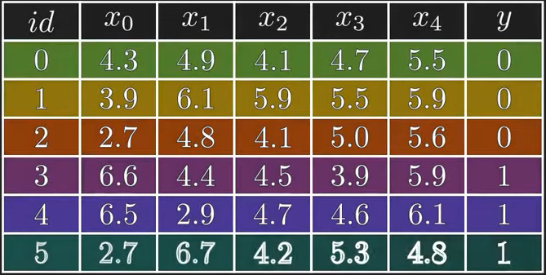
Example: Let’s understand random forest algorithm
To begin let’s take dataset as shown below
Here we are taking a small dataset with six instances and five features. As you can see target variable y takes values
0 & 1 hence it’s a binary classification.
First let us understand why do we need
random forest when we already have
decision tree

Slide 22
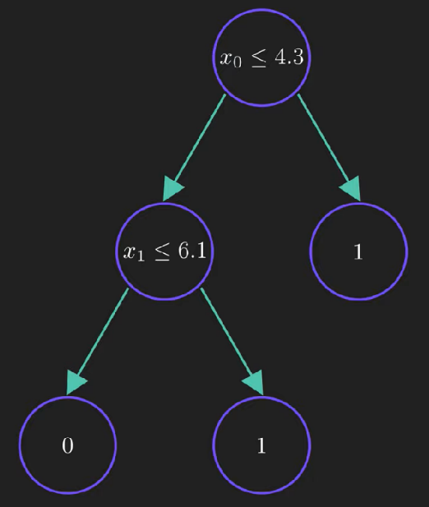
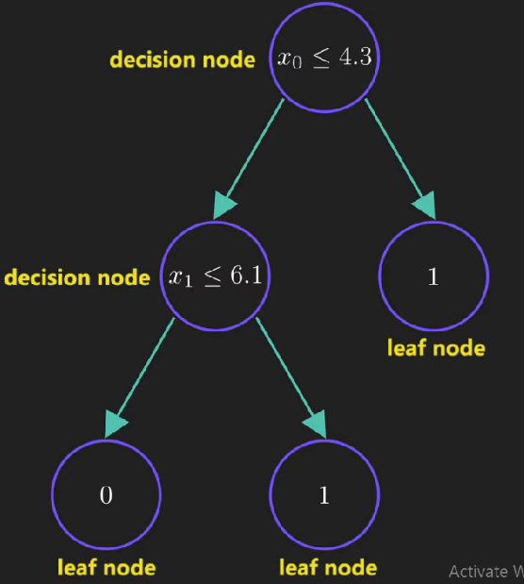

Slide 23
Decision tree splits the dataset recursively using decision nodes unless we are left with pure leaf nodes and its find the best split by maximizing the entropy gain.
If data sample satisfies the condition at the decision node then it moves to the left else it moves to the right child and finally reaches the leaf node where class label is assigned to it.
So, what is the problem with decision tree?
Let’s change out training data slightly. Focus on the row with id=1

Slide 24
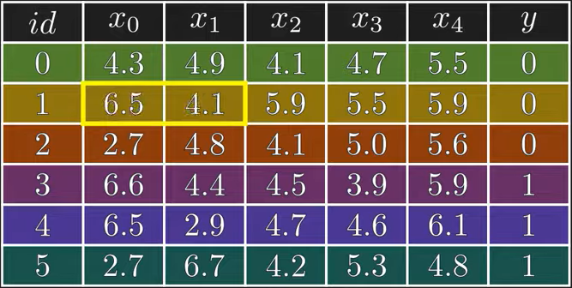
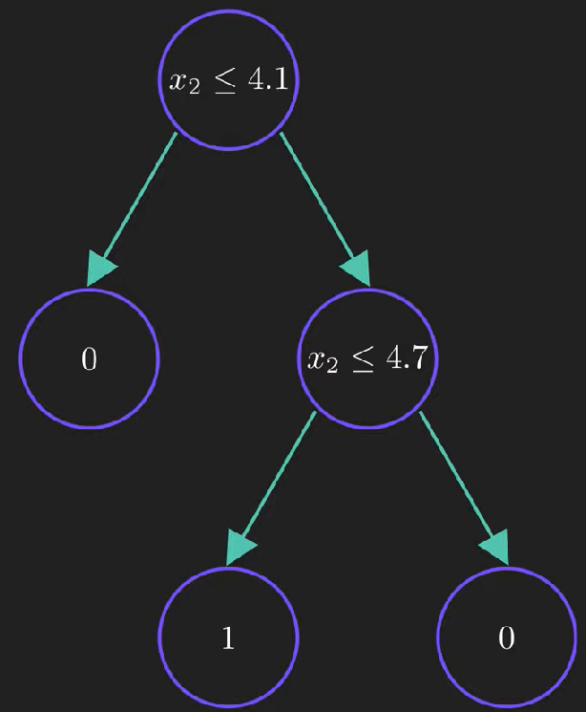
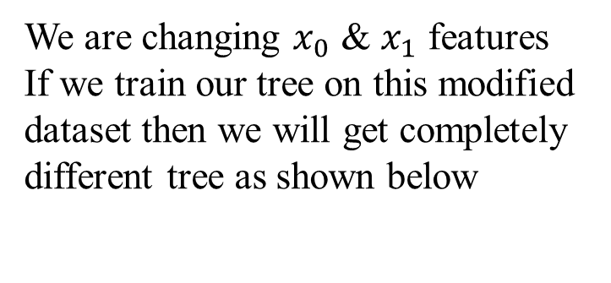
We are changing $x_{0}$ & $x_{1}$ features
If we train our tree on this modified dataset then we will get completely different tree as shown below
This shows us that decision tree are highly sensitive to training data which could result in high variance so our model might fail to generalize. Here comes a random forest algorithm

Slide 25
Random Forest: It is a collection of multiple random decision tree and it’s much less sensitive to the training data. Since we are using multiple trees hence the name forest.
Let’s understand the process of creating a random forest
Step1 : Build new dataset from the original data.
To maintain simplicity we will build only 4(this is w.r.t this example)
We will randomly select rows from original data to build new dataset and every dataset will contain the same number of rows as original one.

