Slide 1
Different types of clustering methods
Mr. Shrikrishna Anand Narvekar
Assistant Professor
Department of Computer Engineering
Agnel Institute of Technology and Design

Slide 2
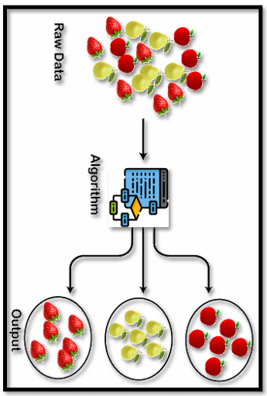
Types of clustering
Partitioning Methods
It is a type of clustering that divides the data into non-hierarchical groups. It is also known as the centroid-based method.
Given a dataset of ‘n’ objects, a partitioning method assembles k partitions of the information, where each partition defines a cluster. ‘k’ < ‘n’. • Each group must include a minimum of one object. • Each object should apply to accurately one group
The general criterion of good partitioning is that objects in the same cluster are “close” or associated with each other, whereas objects of different clusters are “far apart” or very different

Slide 3
K-Means clustering Algorithm
Algorithm K-means: The K-means algorithm for partitioning, where each clusters centre is represented by means value of objects in the cluster.
Input:
K: the number of clusters
D: a data containing n objects
Output: A set of k clusters.
Method:
choose k instances randomly from objects from D as initial cluster centers.
Compute mean of initial clusters and assign the remaining sample to the closet cluster based on Euclidean distance between the instances and centroid of the clusters.
Compute new centroids again considering the newly added samples.
Repeat steps 2-3 till the algorithm becomes stable with no more changes in assignments of instances and clusters.

Slide 4
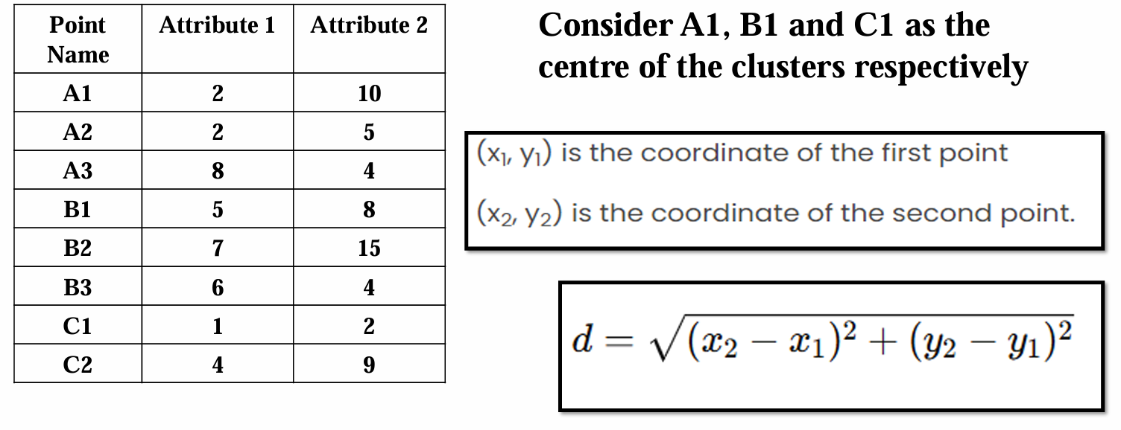
Consider the dataset of 08 objects and perform cluster analysis using K-means algorithm

Slide 5
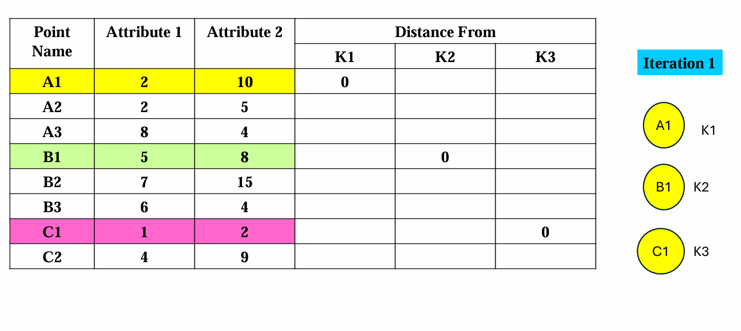

Slide 6
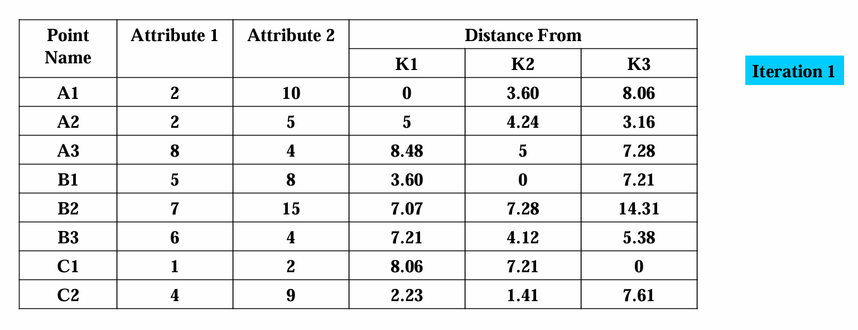

Slide 7
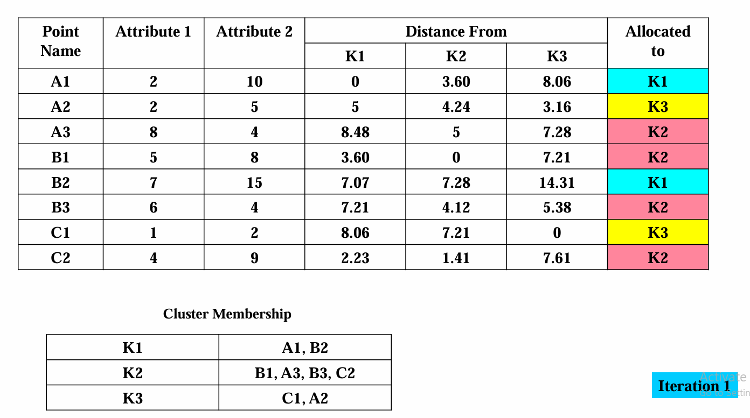

Slide 8
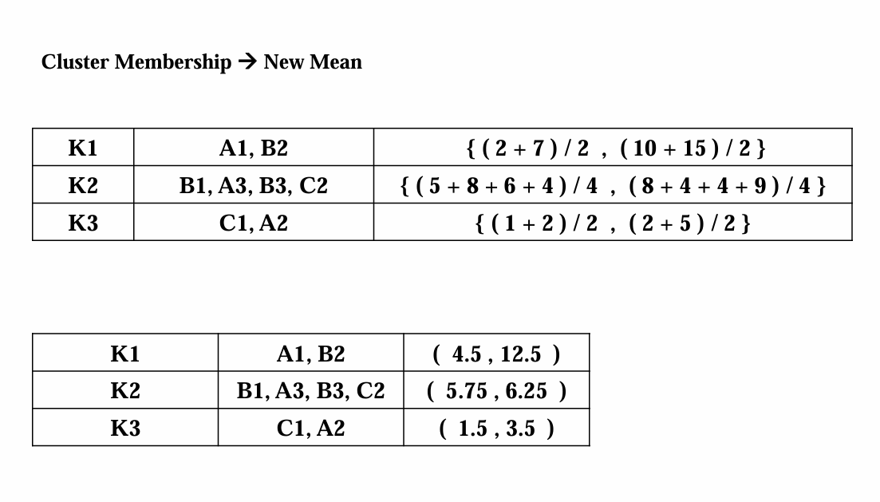

Slide 9
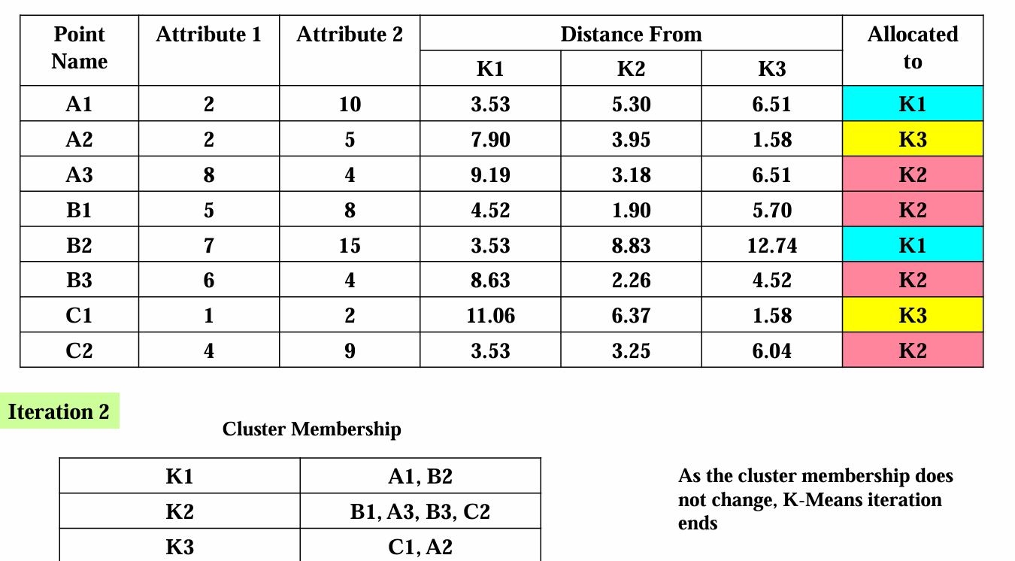

Slide 10
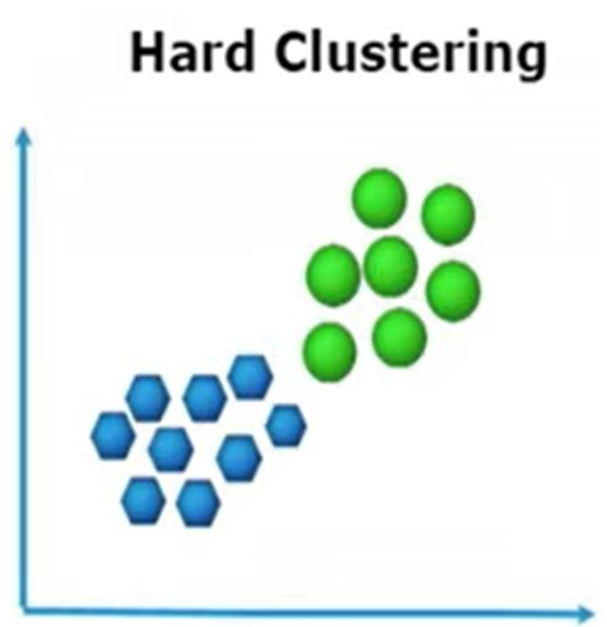
Fuzzy k-means clustering
Hard clustering
Each data point belongs to only one cluster
No sharing allowed
K-means, K-medoids are hard clustering algorithms
A student is either:
“Low performer” OR
“High performer”

Slide 11
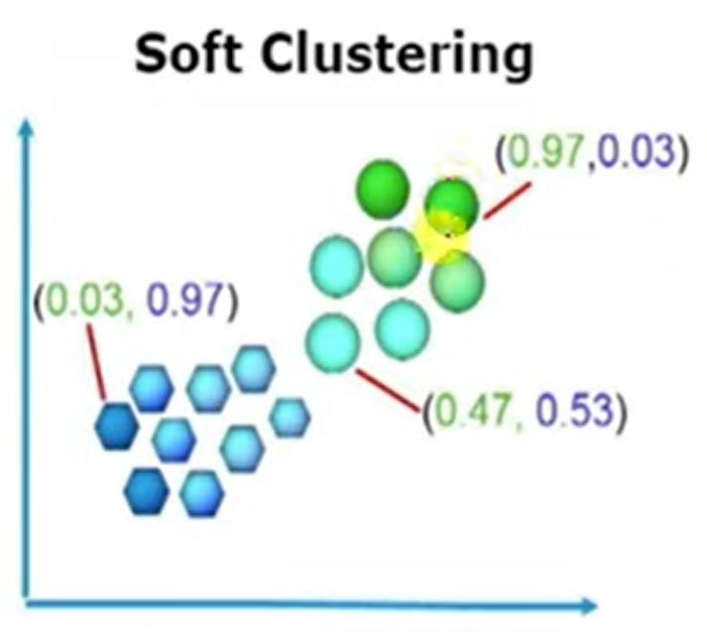
Soft clustering
A data point can belong to multiple clusters.
Each cluster has a membership value (0 to 1)
Ex: Fuzzy k-means

Slide 12
Fuzzy K-means steps
Step 1: Given the data points based on number of clusters required initialize the membership table with random values.
Suppose given data points are {(1,3),(2,5),(6,8),(7,9)}
Let us assume that we need to divide the data into two clusters
Clusters | (1,3) | (2,5) | (4,8) | (7,9)
1 | 0.8 | 0.7 | 0.2 | 0.1
2 | 0.2 | 0.3 | 0.8 | 0.9
Notes:
It means that point (1,3) belongs to cluster 1 with the probability of 0.8 and belongs to cluster 2 with probability of 0.2. If we add the probability of a point belonging to cluster 1 and cluster 2 then it should give value of 1 i.e. 0.8+0.2=1.0

Slide 13
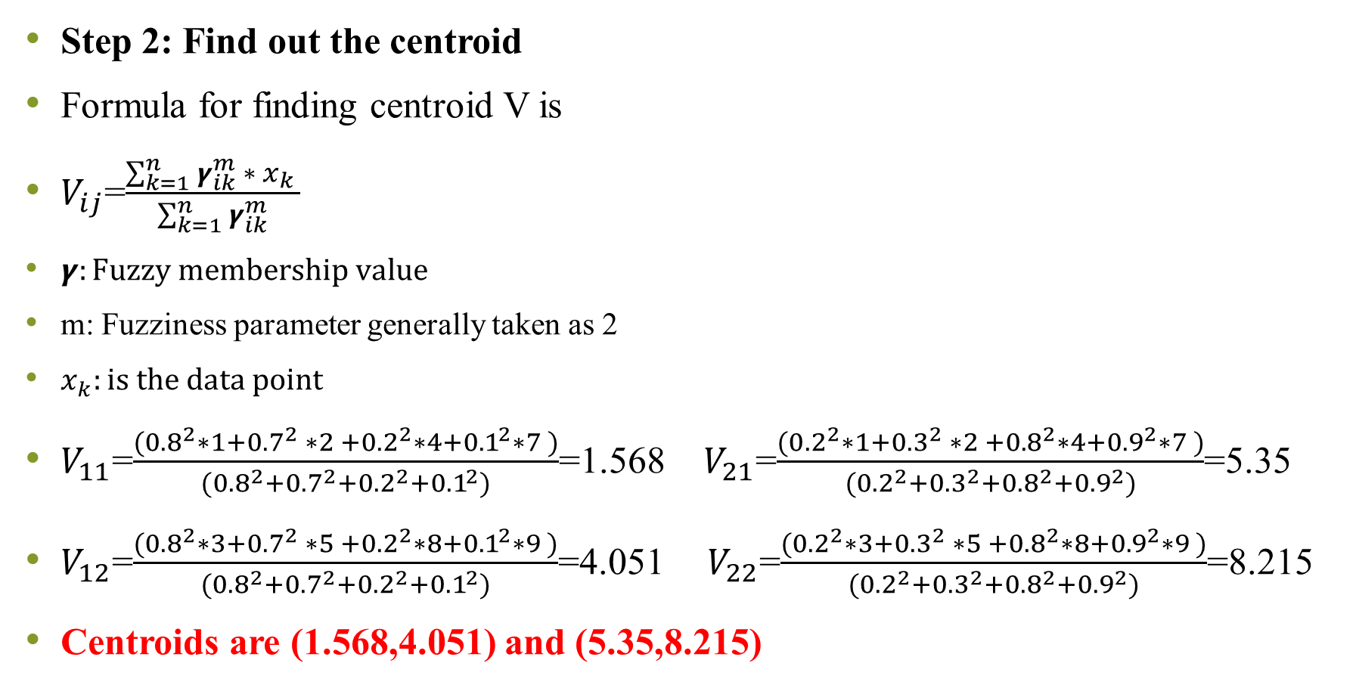
Clusters | (1,3) | (2,5) | (4,8) | (7,9)
1 | 0.8 | 0.7 | 0.2 | 0.1
2 | 0.2 | 0.3 | 0.8 | 0.9
Step 2: Find out the centroid
Formula for finding centroid V is
$V_{ij}$=$\frac{\sum_{k=1}^{n}{γ_{ik}^{m} ∗ x_{k} }}{\sum_{k=1}^{n}{γ_{ik}^{m}}}$
$γ:Fuzzy membership value$
m: Fuzziness parameter generally taken as 2
$x_{k}:is the data point$
$V_{11}$=$\frac{({0.8}^{2}∗1+{0.7}^{2} ∗2 +{0.2}^{2}∗4+{0.1}^{2}∗7 )}{({0.8}^{2}+{0.7}^{2}+{0.2}^{2}+{0.1}^{2})}$=1.568 $V_{21}$=$\frac{({0.2}^{2}∗1+{0.3}^{2} ∗2 +{0.8}^{2}∗4+{0.9}^{2}∗7 )}{({0.2}^{2}+{0.3}^{2}+{0.8}^{2}+{0.9}^{2})}$=5.35
$V_{12}$=$\frac{({0.8}^{2}∗3+{0.7}^{2} ∗5 +{0.2}^{2}∗8+{0.1}^{2}∗9 )}{({0.8}^{2}+{0.7}^{2}+{0.2}^{2}+{0.1}^{2})}$=4.051 ${ V}_{22}$=$\frac{({0.2}^{2}∗3+{0.3}^{2} ∗5 +{0.8}^{2}∗8+{0.9}^{2}∗9 )}{({0.2}^{2}+{0.3}^{2}+{0.8}^{2}+{0.9}^{2})}$=8.215
Centroids are (1.568,4.051) and (5.35,8.215)

Slide 14
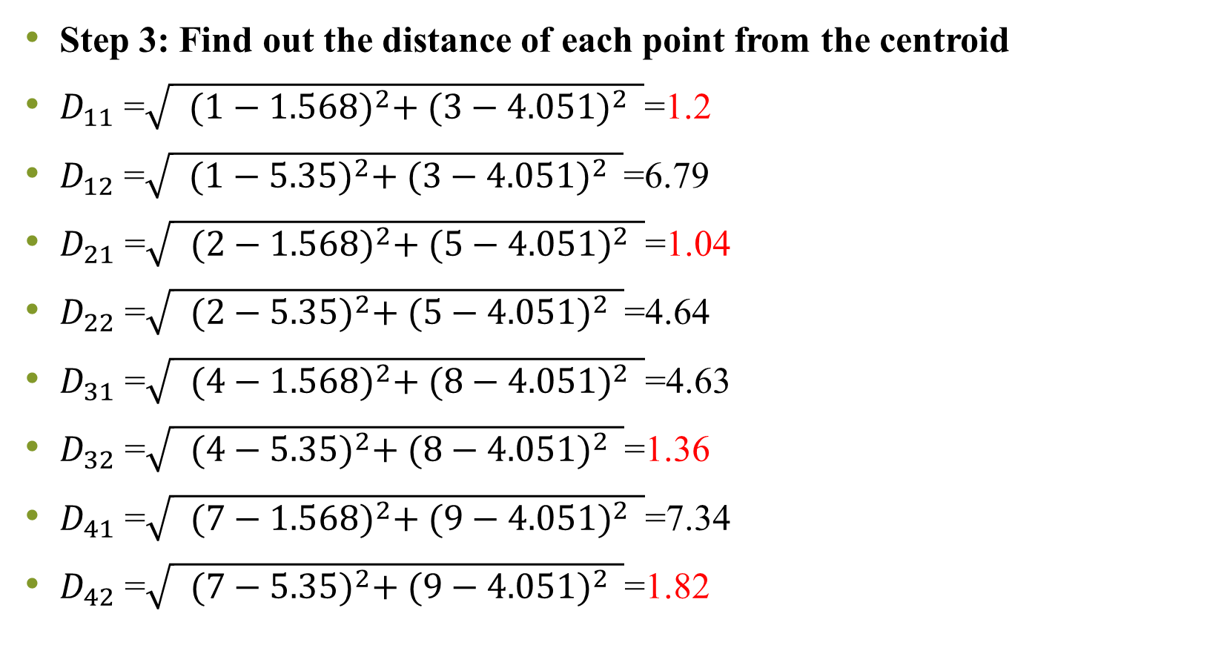
Step 3: Find out the distance of each point from the centroid
$D_{11}$ =$\sqrt{ {(1−1.568)}^{2}+ {(3−4.051)}^{2} }$=1.2
$D_{12}$ =$\sqrt{ {(1−5.35)}^{2}+ {(3−4.051)}^{2} }$=6.79
$D_{21}$ =$\sqrt{ {(2−1.568)}^{2}+ {(5−4.051)}^{2} }$=1.04
$D_{22}$ =$\sqrt{ {(2−5.35)}^{2}+ {(5−4.051)}^{2} }$=4.64
$D_{31}$ =$\sqrt{ {(4−1.568)}^{2}+ {(8−4.051)}^{2} }$=4.63
$D_{32}$ =$\sqrt{ {(4−5.35)}^{2}+ {(8−4.051)}^{2} }$=1.36
$D_{41}$ =$\sqrt{ {(7−1.568)}^{2}+ {(9−4.051)}^{2} }$=7.34
$D_{42}$ =$\sqrt{ {(7−5.35)}^{2}+ {(9−4.051)}^{2} }$=1.82
Centroids are (1.568, 4.051) and (5.35, 8.215)
Clusters | (1,3) | (2,5) | (4,8) | (7,9)
1 | 0.8 | 0.7 | 0.2 | 0.1
2 | 0.2 | 0.3 | 0.8 | 0.9
 | 1 | 1 | 2 | 2

Slide 15
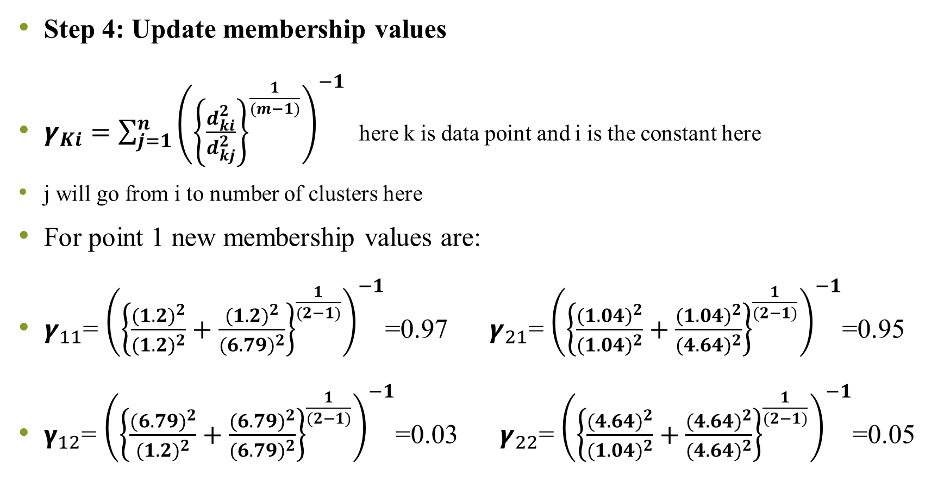
Step 4: Update membership values
$γ_{Ki}=\sum_{j=1}^{n}{{\left({\left\{\frac{d_{ki}^{2}}{d_{kj}^{2}}\right\}}^{\frac{1}{(m−1)}}\right)}^{−1}}$ here k is data point and i is the constant here
j will go from i to number of clusters here
For point 1 new membership values are:
$γ_{11}$= ${\left({\left\{\frac{{(1.2)}^{2}}{{(1.2)}^{2}}+\frac{{(1.2)}^{2}}{{(6.79)}^{2}}\right\}}^{\frac{1}{(2−1)}}\right)}^{−1}$=0.97 $γ_{21}$= ${\left({\left\{\frac{{(1.04)}^{2}}{{(1.04)}^{2}}+\frac{{(1.04)}^{2}}{{(4.64)}^{2}}\right\}}^{\frac{1}{(2−1)}}\right)}^{−1}$=0.95
$γ_{12}$= ${\left({\left\{\frac{{(6.79)}^{2}}{{(1.2)}^{2}}+\frac{{(6.79)}^{2}}{{(6.79)}^{2}}\right\}}^{\frac{1}{(2−1)}}\right)}^{−1}$=0.03 $γ_{22}$= ${\left({\left\{\frac{{(4.64)}^{2}}{{(1.04)}^{2}}+\frac{{(4.64)}^{2}}{{(4.64)}^{2}}\right\}}^{\frac{1}{(2−1)}}\right)}^{−1}$=0.05

Slide 16
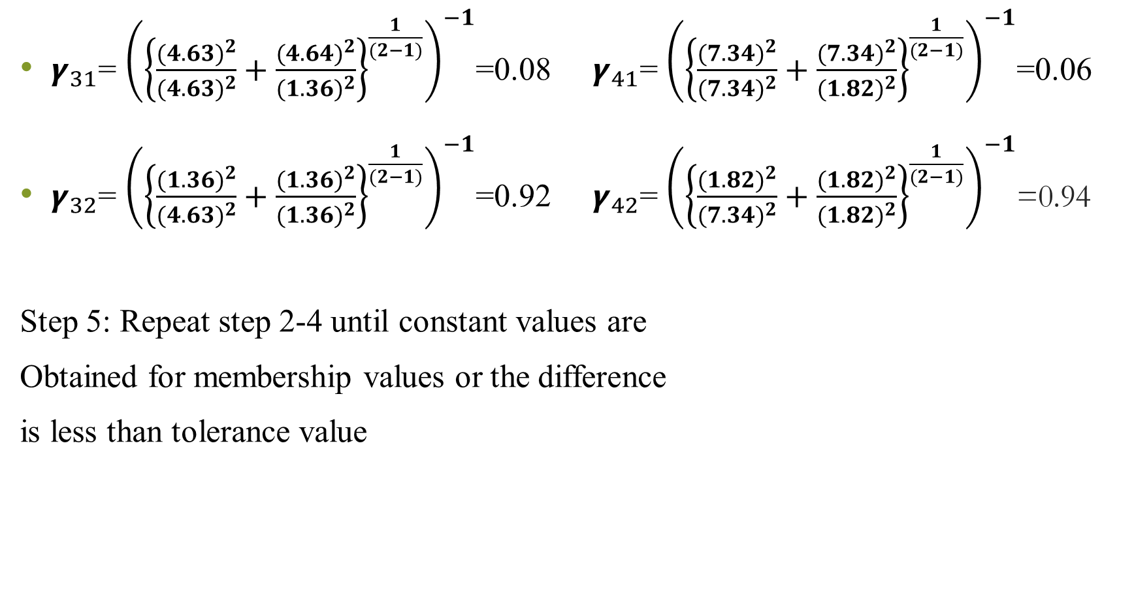
$γ_{31}$= ${\left({\left\{\frac{{(4.63)}^{2}}{{(4.63)}^{2}}+\frac{{(4.64)}^{2}}{{(1.36)}^{2}}\right\}}^{\frac{1}{(2−1)}}\right)}^{−1}$=0.08 $γ_{41}$= ${\left({\left\{\frac{{(7.34)}^{2}}{{(7.34)}^{2}}+\frac{{(7.34)}^{2}}{{(1.82)}^{2}}\right\}}^{\frac{1}{(2−1)}}\right)}^{−1}$=0.06
$γ_{32}$= ${\left({\left\{\frac{{(1.36)}^{2}}{{(4.63)}^{2}}+\frac{{(1.36)}^{2}}{{(1.36)}^{2}}\right\}}^{\frac{1}{(2−1)}}\right)}^{−1}$=0.92 $γ_{42}$= ${\left({\left\{\frac{{(1.82)}^{2}}{{(7.34)}^{2}}+\frac{{(1.82)}^{2}}{{(1.82)}^{2}}\right\}}^{\frac{1}{(2−1)}}\right)}^{−1}$=0.94
Step 5: Repeat step 2-4 until constant values are
Obtained for membership values or the difference
is less than tolerance value
Clusters | (1,3) | (2,5) | (4,8) | (7,9)
1 | 0.97 | 0.95 | 0.08 | 0.06
2 | 0.03 | 0.05 | 0.92 | 0.94
 | 2 | 2 | 1 | 1

Slide 17
Advantages of K-means

