Slide 1
Fisher’s Linear discriminant
Shrikrishna Anand Narvekar
Assistant Professor
Department of Computer Engineering
Agnel Institute of Technology and Design

Slide 2
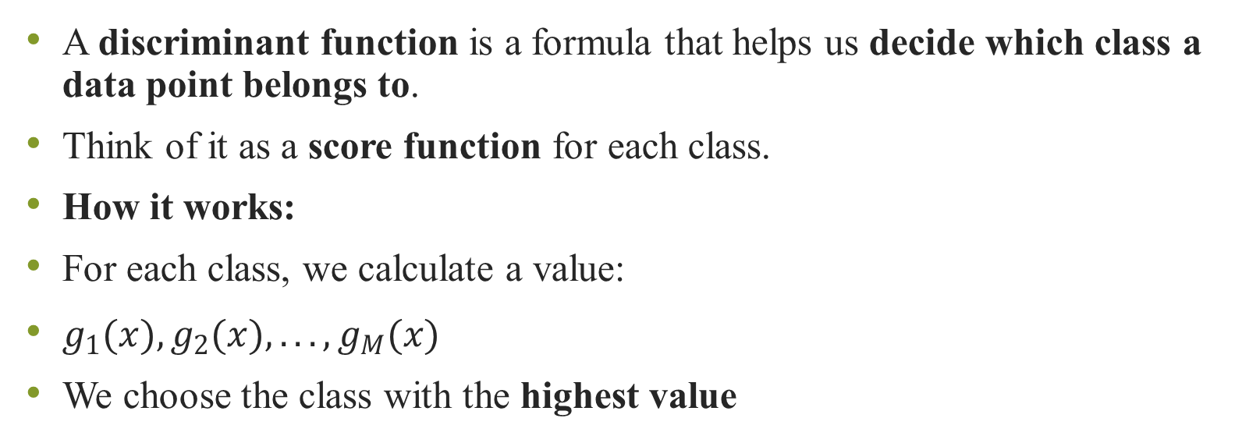
Introduction to Discriminant Functions
A discriminant function is a formula that helps us decide which class a data point belongs to.
Think of it as a score function for each class.
How it works:
For each class, we calculate a value:
$g_{1}(x),g_{2}(x),...,g_{M}(x)$
We choose the class with the highest value

Slide 3
Example:
Suppose you want to classify a fruit:
You calculate:
Apple score → 0.8
Orange score → 0.3
Since 0.8 > 0.3, classify as Apple
Feature | Value
Color | Red
Weight | 150g

Slide 4
Real Life Example
Medical Diagnosis (Multi-Class)
Imagine a doctor using an AI tool to analyse an X-ray. The system needs to decide if the image shows Pneumonia, Bronchitis, or Healthy Lungs.
The system calculates a discriminant function for each possibility based on features like lung capacity, fluid levels, and texture:
g{Pneumonia}(x) = 0.15
g{Bronchitis}(x) = 0.65
g{Healthy}(x) = 0.20
Decision: Since 0.65 is the highest score, the system classifies the scan as Bronchitis.

Slide 5
Spam Filters (Binary Classification)
This is the classic "Class 1 or Class 2" scenario. Your email provider uses a single discriminant function g(x) to analyse an incoming message based on features like "Words in ALL CAPS" or "Number of suspicious links."
The Rule: If g(x) > 0, it’s Spam. If g(x) ≤0, it’s Inbox.
The Calculation: The function might look at an email and produce a score of +2.5.
The Result: Since +2.5 > 0, the email is sent straight to the junk folder.

Slide 6
Credit scoring
When you apply for a credit card, the bank doesn't just look at one number; they use a function that combines your income, debt, and payment history.
If g(Income, Debt, History) > Threshold, you are Approved.
If the result is below the threshold, you are Denied.
The "Discriminant" here is literally the line in the sand that separates "Reliable Borrowers" from "High-Risk Borrowers."

Slide 7
Decision Boundaries
These are lines/curves that separate classes
Example:
Straight line → linear boundary
Curve → nonlinear boundary
Real-life Example:
In a bank system:
Customers are divided into:
Safe
Risky
Boundary separates both groups

Slide 8
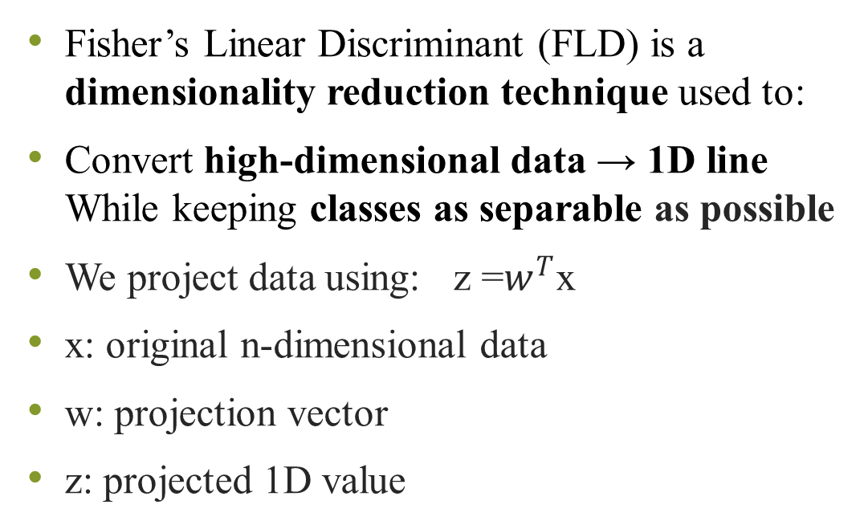
Fisher’s Linear Discriminant
Fisher’s Linear Discriminant (FLD) is a dimensionality reduction technique used to:
Convert high-dimensional data → 1D line While keeping classes as separable as possible
We project data using: z =$w^{T}$x
x: original n-dimensional data
w: projection vector
z: projected 1D value
Goal: Find best direction w such that:
Same class points are close together
Different class points are far apart

Slide 9
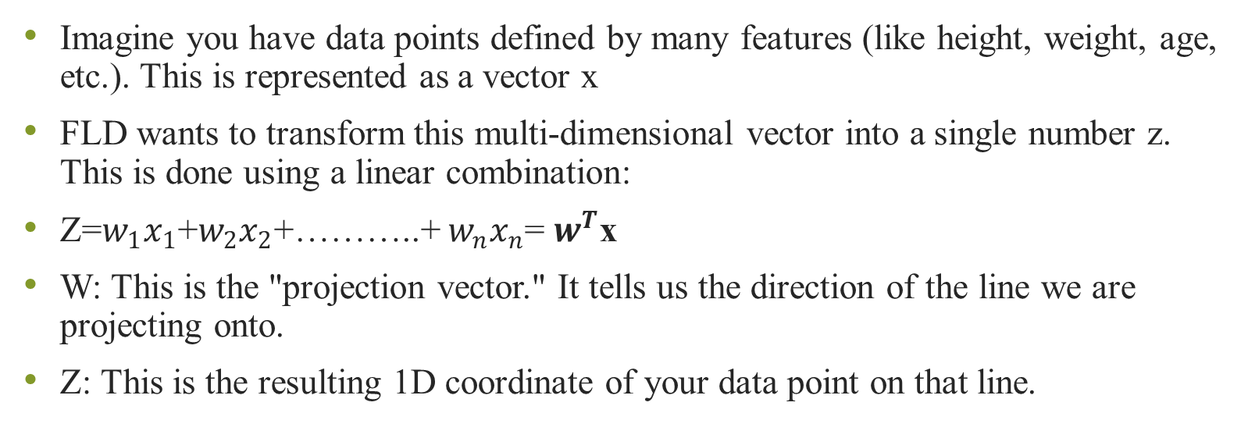
Mapping from many dimensions to One
Imagine you have data points defined by many features (like height, weight, age, etc.). This is represented as a vector x
FLD wants to transform this multi-dimensional vector into a single number z. This is done using a linear combination:
Z=$w_{1}x_{1}$+$w_{2}x_{2}$+………..+ $w_{n}x_{n}$= $w^{T}$x
W: This is the "projection vector." It tells us the direction of the line we are projecting onto.
Z: This is the resulting 1D coordinate of your data point on that line.

Slide 10
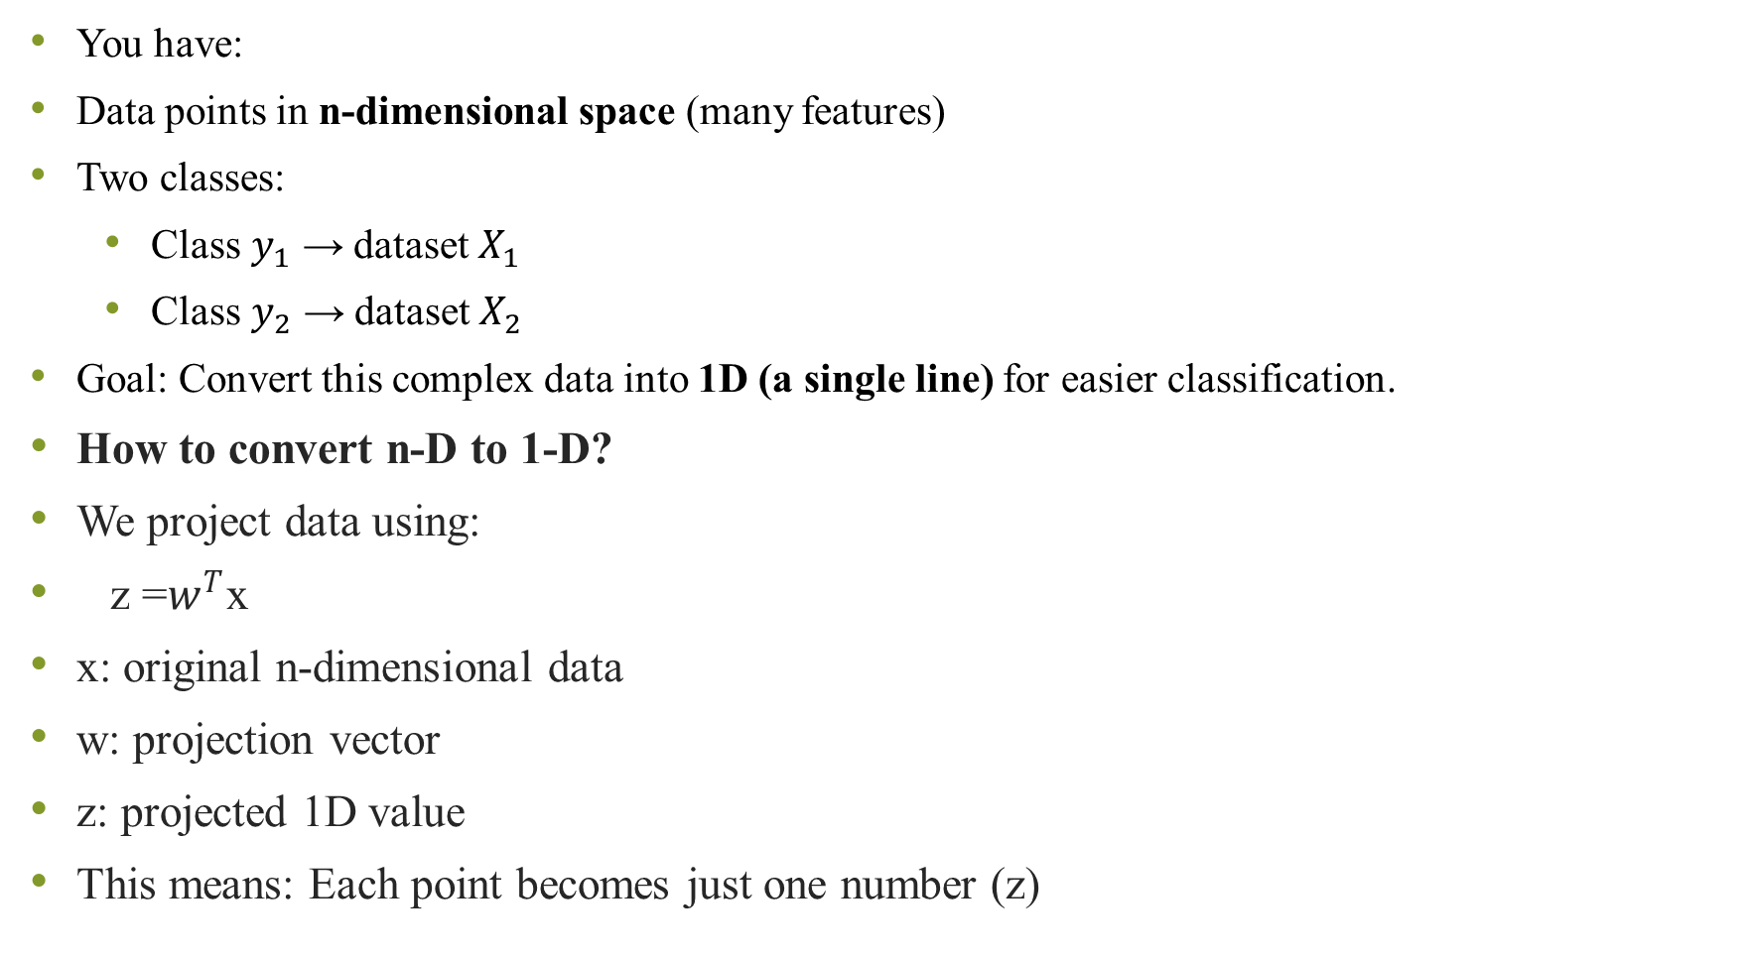
You have:
Data points in n-dimensional space (many features)
Two classes:
Class $y_{1}$​ → dataset $X_{1}$
Class $y_{2}$ → dataset $X_{2}$
Goal: Convert this complex data into 1D (a single line) for easier classification.
How to convert n-D to 1-D?
We project data using:
z =$w^{T}$x
x: original n-dimensional data
w: projection vector
z: projected 1D value
This means: Each point becomes just one number (z)

Slide 11
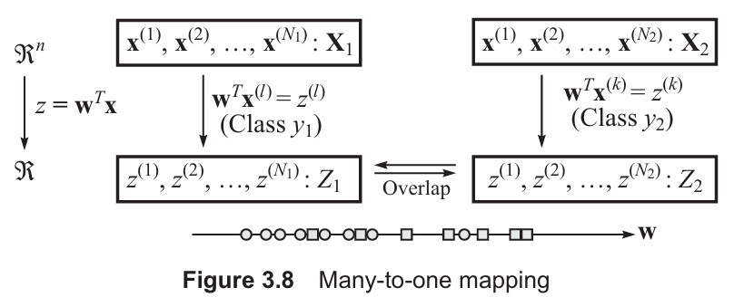
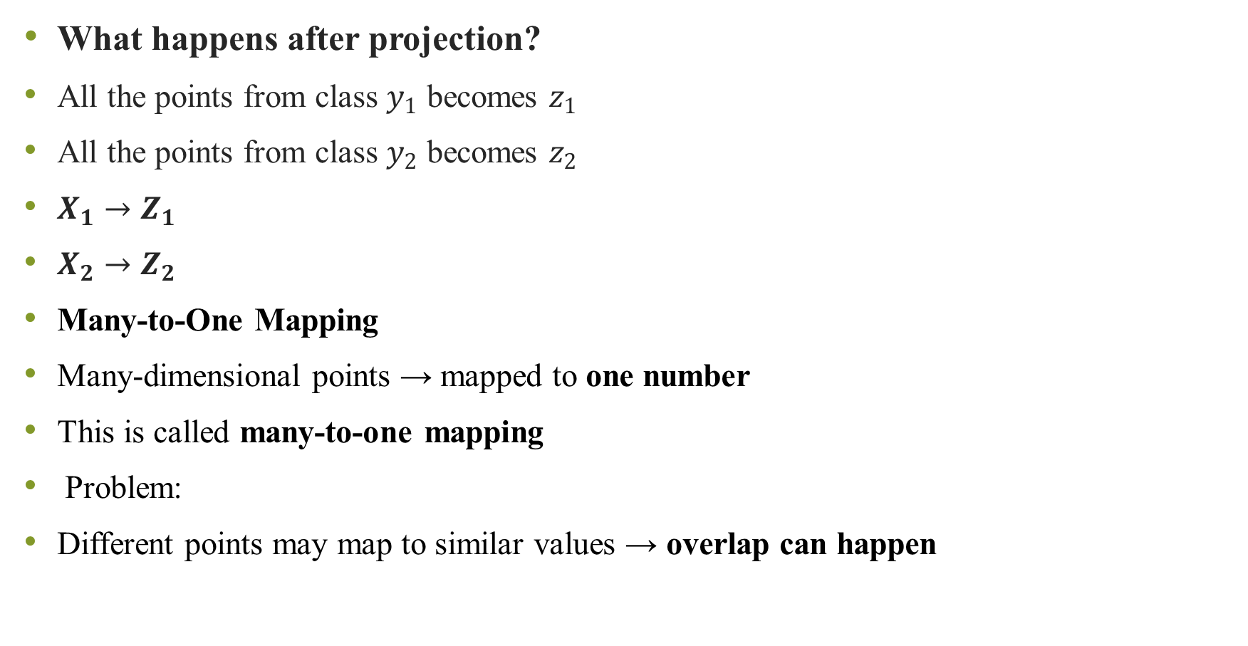
What happens after projection?
All the points from class $y_{1}$ becomes $z_{1}$
All the points from class $y_{2}$ becomes $z_{2}$
$X_{1}→Z_{1}$
$X_{2}→Z_{2}$
Many-to-One Mapping
Many-dimensional points → mapped to one number
This is called many-to-one mapping
Problem:
Different points may map to similar values → overlap can happen

Slide 12
Geometrical Meaning
Imagine a line in space
Each point is projected onto that line
Like casting a shadow of points onto a line
That shadow = z
Role of vector w
w decides direction of the line
Only direction matters, not its size
Why?
Changing magnitude only scales values
It does NOT change separation

Slide 13
Main goal
We want to find the best direction w such that:
✔ Points of same class → close together ✔ Points of different classes → far apart
Imagine:
Red dots (Class 1)
Blue dots (Class 2)
Now draw a line:
Some lines mix colors ❌
Some lines separate them nicely ✅
FLD tries to find that best line

Slide 14
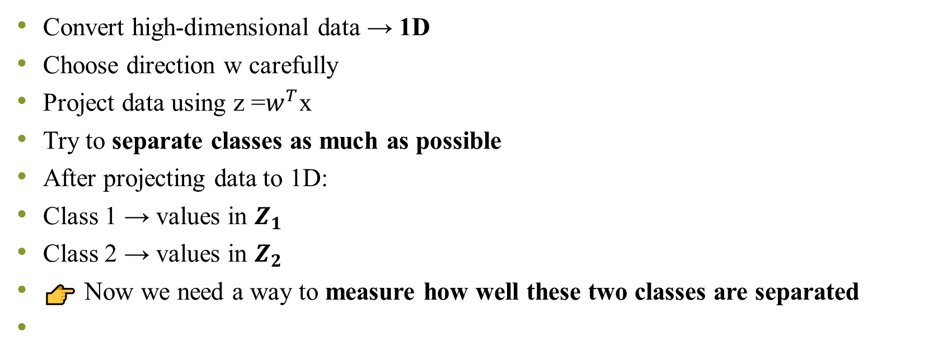
Final Understanding
Convert high-dimensional data → 1D
Choose direction w carefully
Project data using z =$w^{T}$x
Try to separate classes as much as possible
After projecting data to 1D:
Class 1 → values in $Z_{1}$
Class 2 → values in $Z_{2}$
👉 Now we need a way to measure how well these two classes are separated

Slide 15

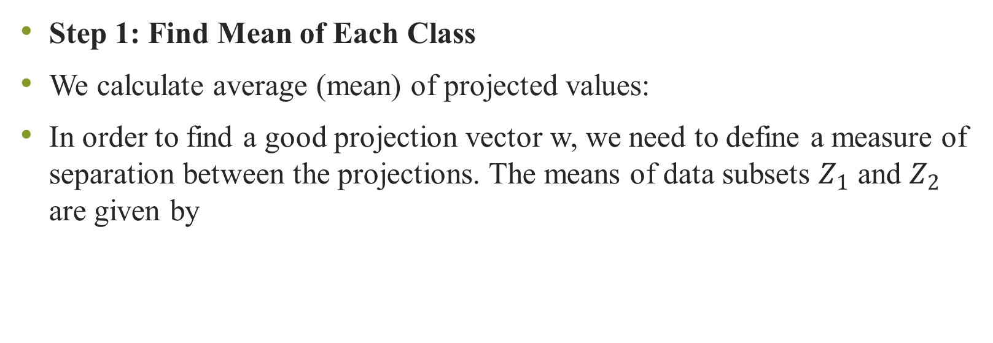
Steps used in FLD
Step 1: Find Mean of Each Class
We calculate average (mean) of projected values:
In order to find a good projection vector w, we need to define a measure of separation between the projections. The means of data subsets $Z_{1}$ and $Z_{2}$ are given by

Slide 16

First Idea (Simple but Not Enough)
We may think:
👉 “If means are far apart, classes are well separated”
Bigger distance = better separation
Problem:
This ignores how spread out the data is!
Why Mean Alone is Not Enough?
Imagine:
Case 1 → tight clusters → good separation ✅
Case 2 → very spread data → overlapping ❌
Even if means are same distance, spread matters

Slide 17
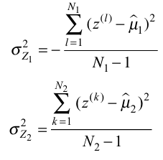
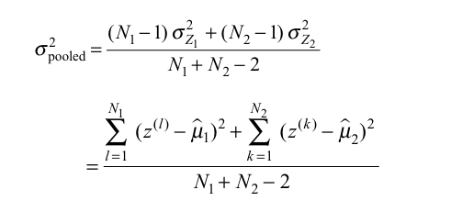
Step 2: Measure Spread (Variance)
For each class:
This tells:
How much data is scattered
Why divide by N−?
Using N → biased result ❌
Using N−1→ correct (unbiased) estimate
Step 3: Combine Both Variances
We calculate pooled variance:
Meaning:
Overall spread of both classes together

Slide 18

Final Measure (MOST IMPORTANT)
Now we combine both ideas:
Good separation happens when:
Means are far apart ↑
Variance is small ↓
✔️ Large value → classes well separated ❌ Small value → overlap

Slide 19
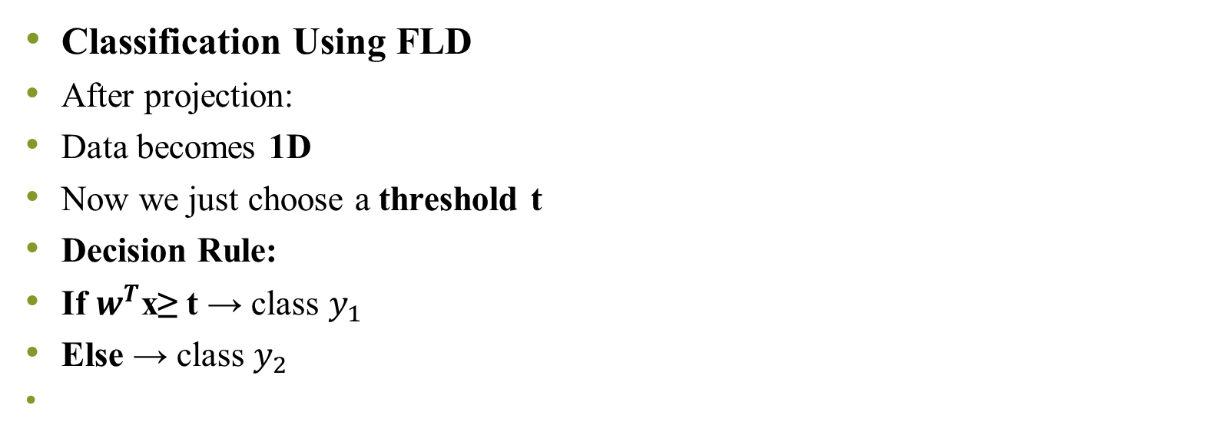
Thresholding
Classification Using FLD
After projection:
Data becomes 1D
Now we just choose a threshold t
Decision Rule:
If $w^{T}$x≥ t → class $y_{1}$
Else → class $y_{2}$

Slide 20
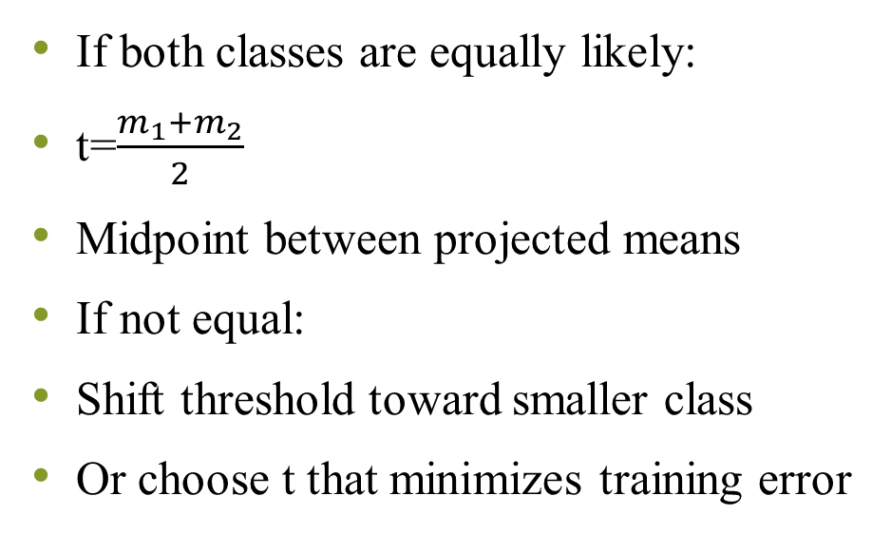
How to Choose Threshold?
If both classes are equally likely:
t=$\frac{m_{1}+m_{2}}{2}$
Midpoint between projected means
If not equal:
Shift threshold toward smaller class
Or choose t that minimizes training error
FLD is trying to:
Stretch distance between classes
Compress spread within classes
👉 Best separation happens when:
Means are far apart
Variance is small

Slide 21
Minimum description length
Among equally good classifier pick the one which required least amount of bit to describe itself.
Description length should be as small as possible given that it has some acceptable level of performance
If classifier is very complex then you need lots of bits to describe it like neural network with lots of weight , support vector machine with lots of support vectors, decision tree with lots of branches.
So, More information you have more detail classifier it is.

Slide 22
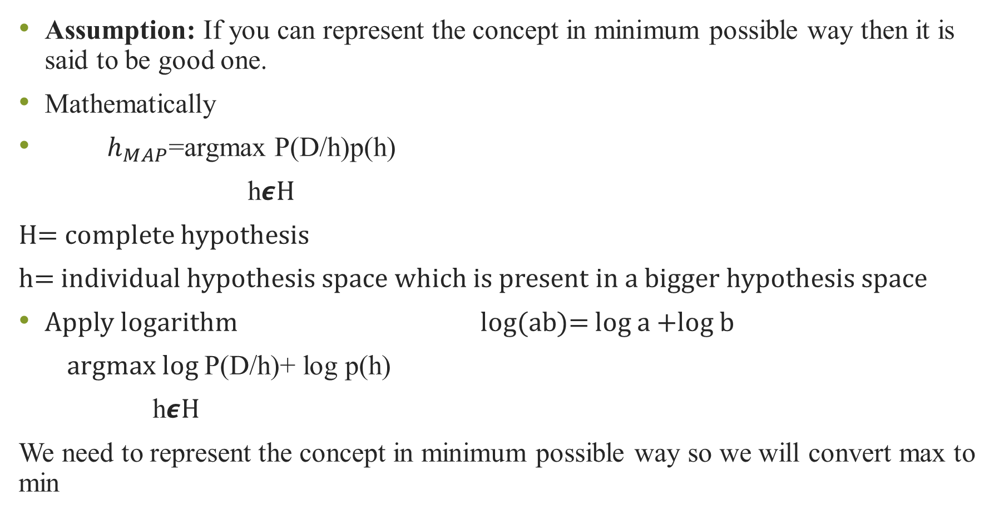
Assumption: If you can represent the concept in minimum possible way then it is said to be good one.
Mathematically
$h_{MAP}$=argmax P(D/h)p(h)
h𝟄H
H= complete hypothesis
h= individual hypothesis space which is present in a bigger hypothesis space
Apply logarithm log(ab)= log a +log b
argmax log P(D/h)+ log p(h)
h𝟄H
We need to represent the concept in minimum possible way so we will convert max to min

Slide 23
argmin –log P(D/h) – log P(h)
h𝟄H
Equation can be interpreted in terms of MDL principle linking minimum description length to Bayesian approach.

