Slide 1
Forms of Learning
Mr. Shrikrishna Anand Narvekar
Assistant Professor
Computer Engineering Department
Agnel Institute of Technology and Design

Slide 2
Content
Four Major forms of learning
Supervised/Directed learning
Classification
Regression
Unsupervised Learning
Clusters

Slide 3
Four Major forms of learning
The field of machine learning generally distinguishes four major forms of learning:
Supervised/Directed Learning
Unsupervised/Undirected Learning
Reinforcement Learning
Learning based on Natural Processes (Evolution, Swarming, Immune Systems)

Slide 4
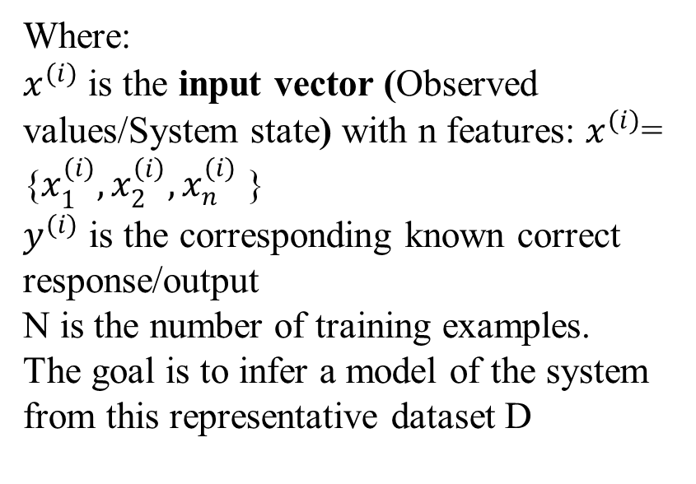
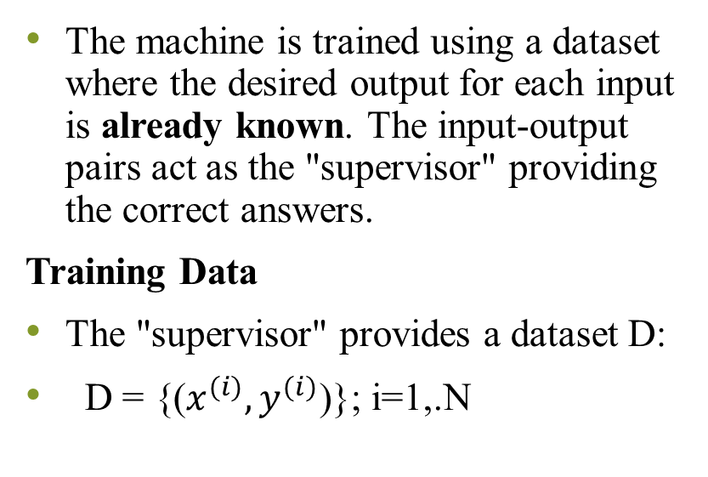
Supervised/ Directed Learning
The machine is trained using a dataset where the desired output for each input is already known. The input-output pairs act as the "supervisor" providing the correct answers.
Training Data
The "supervisor" provides a dataset D:
D = {($x^{(i)}, y^{(i)}$)}; i=1,.N
Where:
$x^{(i)}$ is the input vector (Observed values/System state) with n features: $x^{(i)}$= {$x_{1}^{(i)},x_{2}^{\left(i\right)},x_{n}^{(i)}$ }
$y^{(i)}$ is the corresponding known correct response/output
N is the number of training examples.
The goal is to infer a model of the system from this representative dataset D

Slide 5
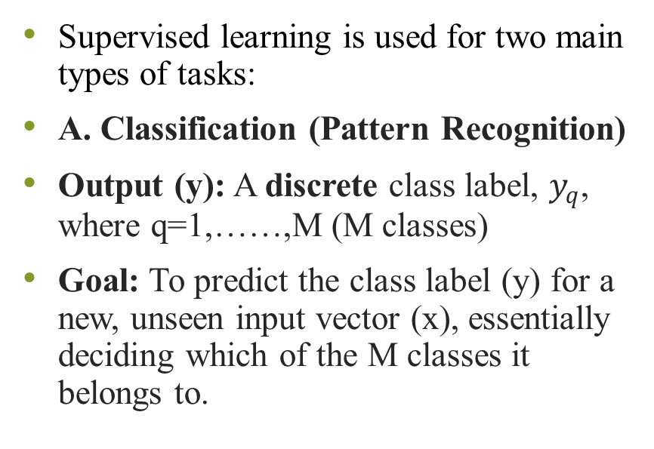
Task in supervised Learning
Supervised learning is used for two main types of tasks:
A. Classification (Pattern Recognition)
Output (y): A discrete class label, $y_{q}$, where q=1,……,M (M classes)
Goal: To predict the class label (y) for a new, unseen input vector (x), essentially deciding which of the M classes it belongs to.
B. Regression (Numeric Prediction)
Output (y): A continuous numeric quantity.
Goal: To fit a continuous function to the input-output data to predict a numeric output value (y) for new unseen input vector (x)

Slide 6
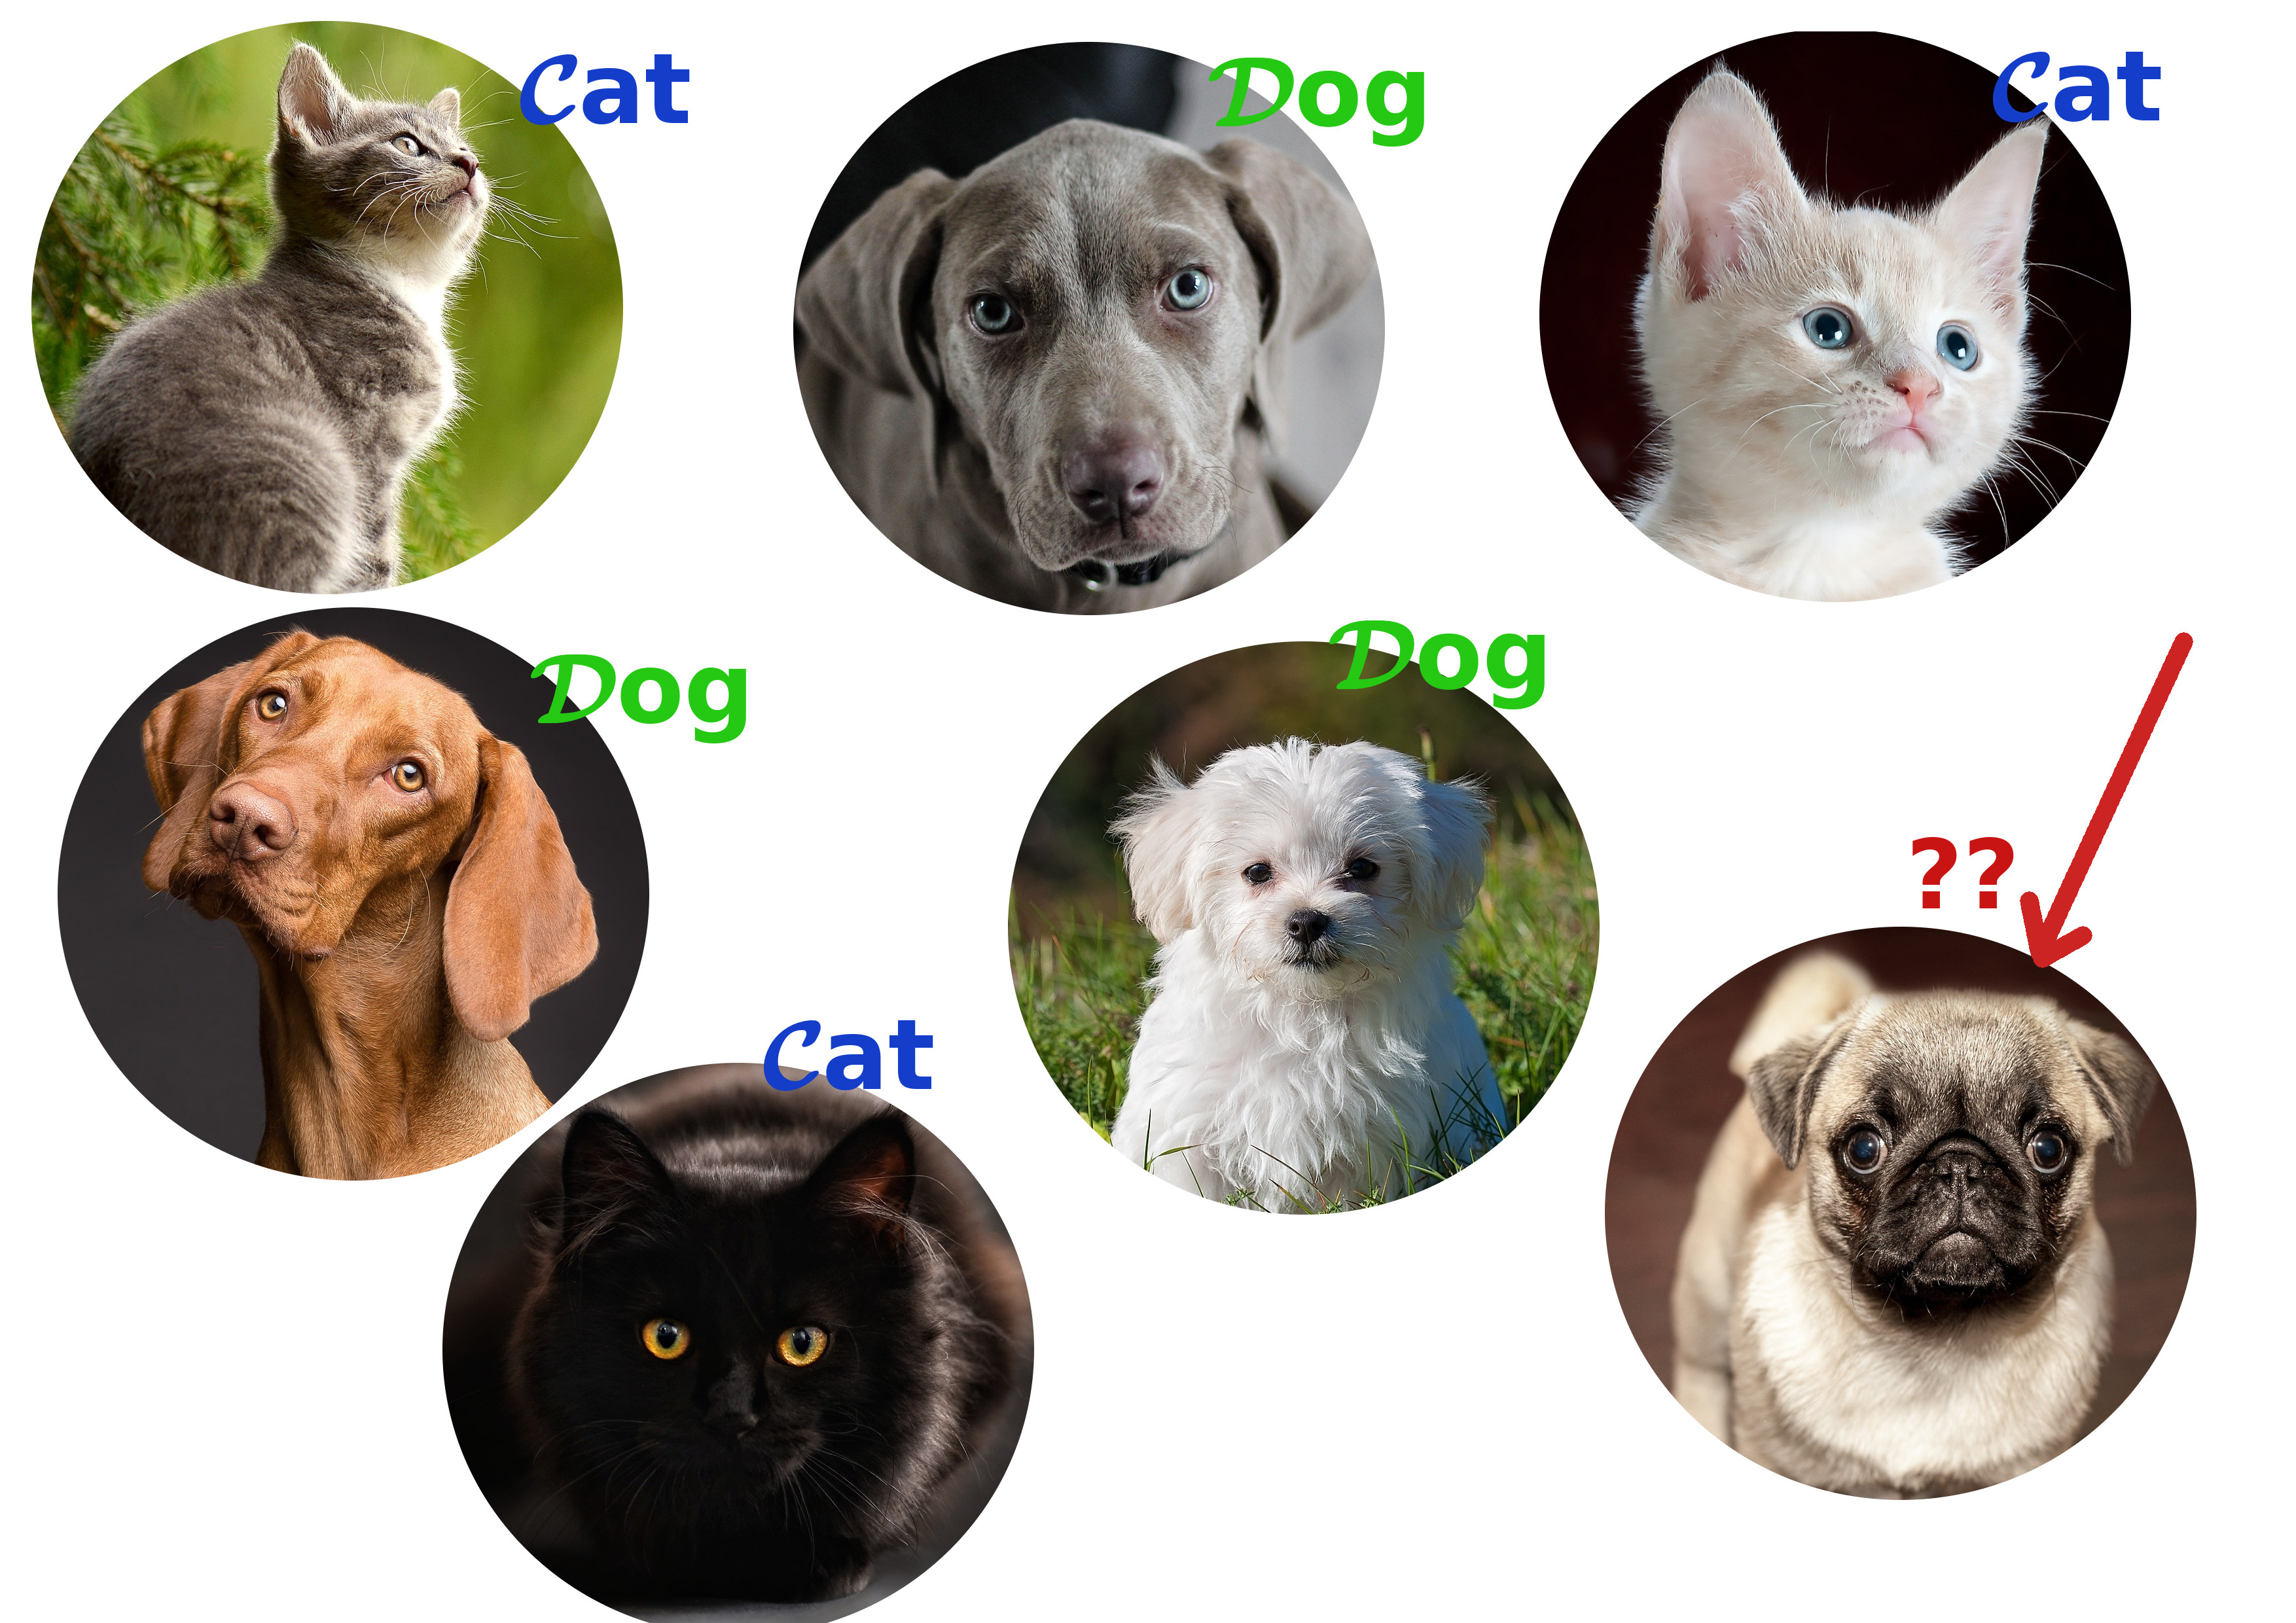
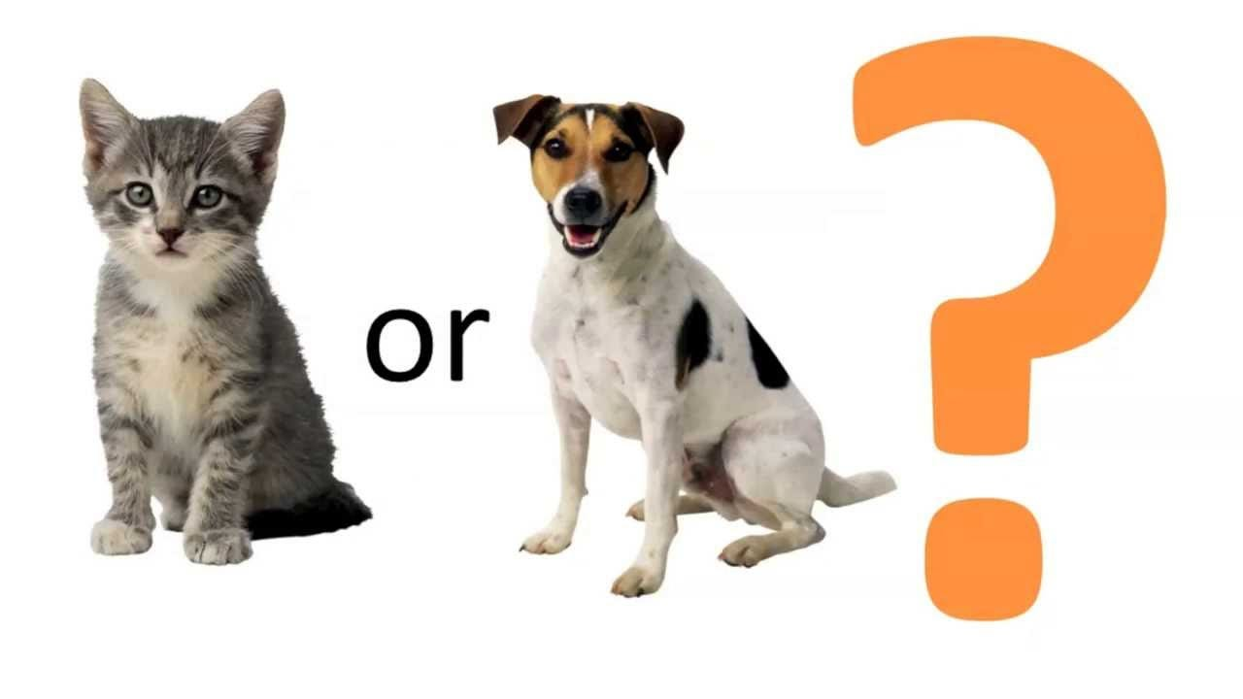
Classification

Slide 7
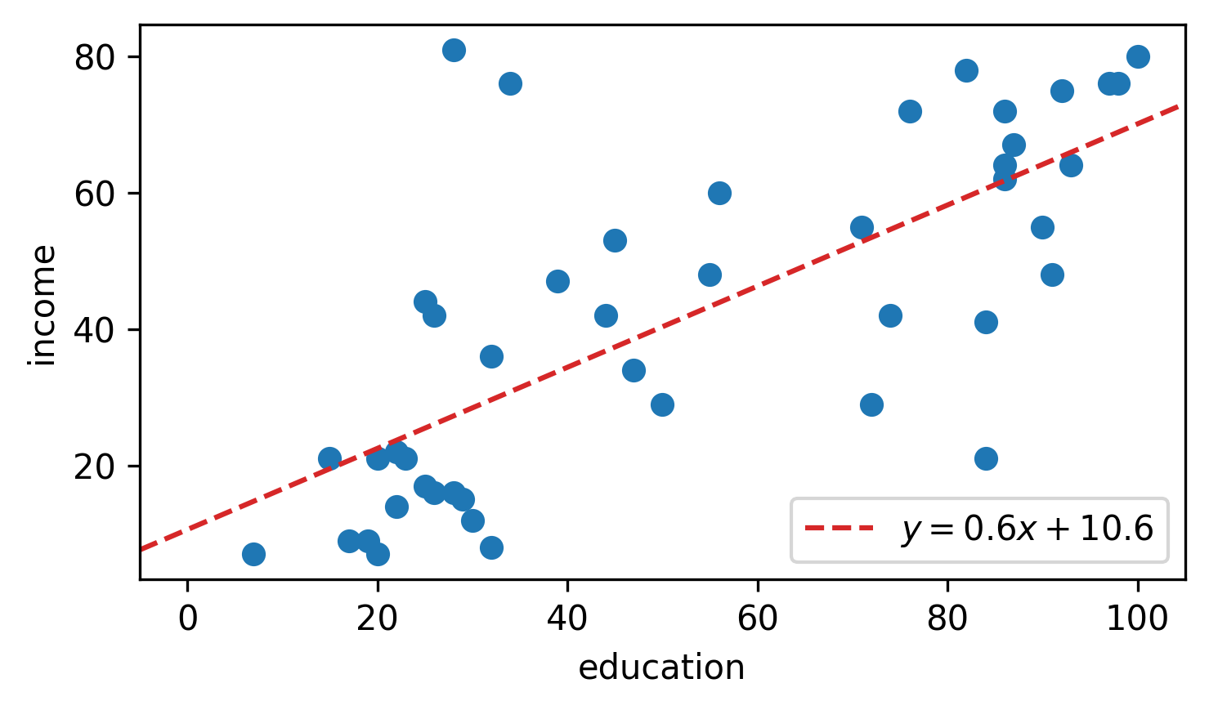
Regression
Simple Linear regression is used to understand relationship between two variables
One dependent(outcome or reponse)
One independent(predictor or explanatory)
Formula Y=mx+c

Slide 8
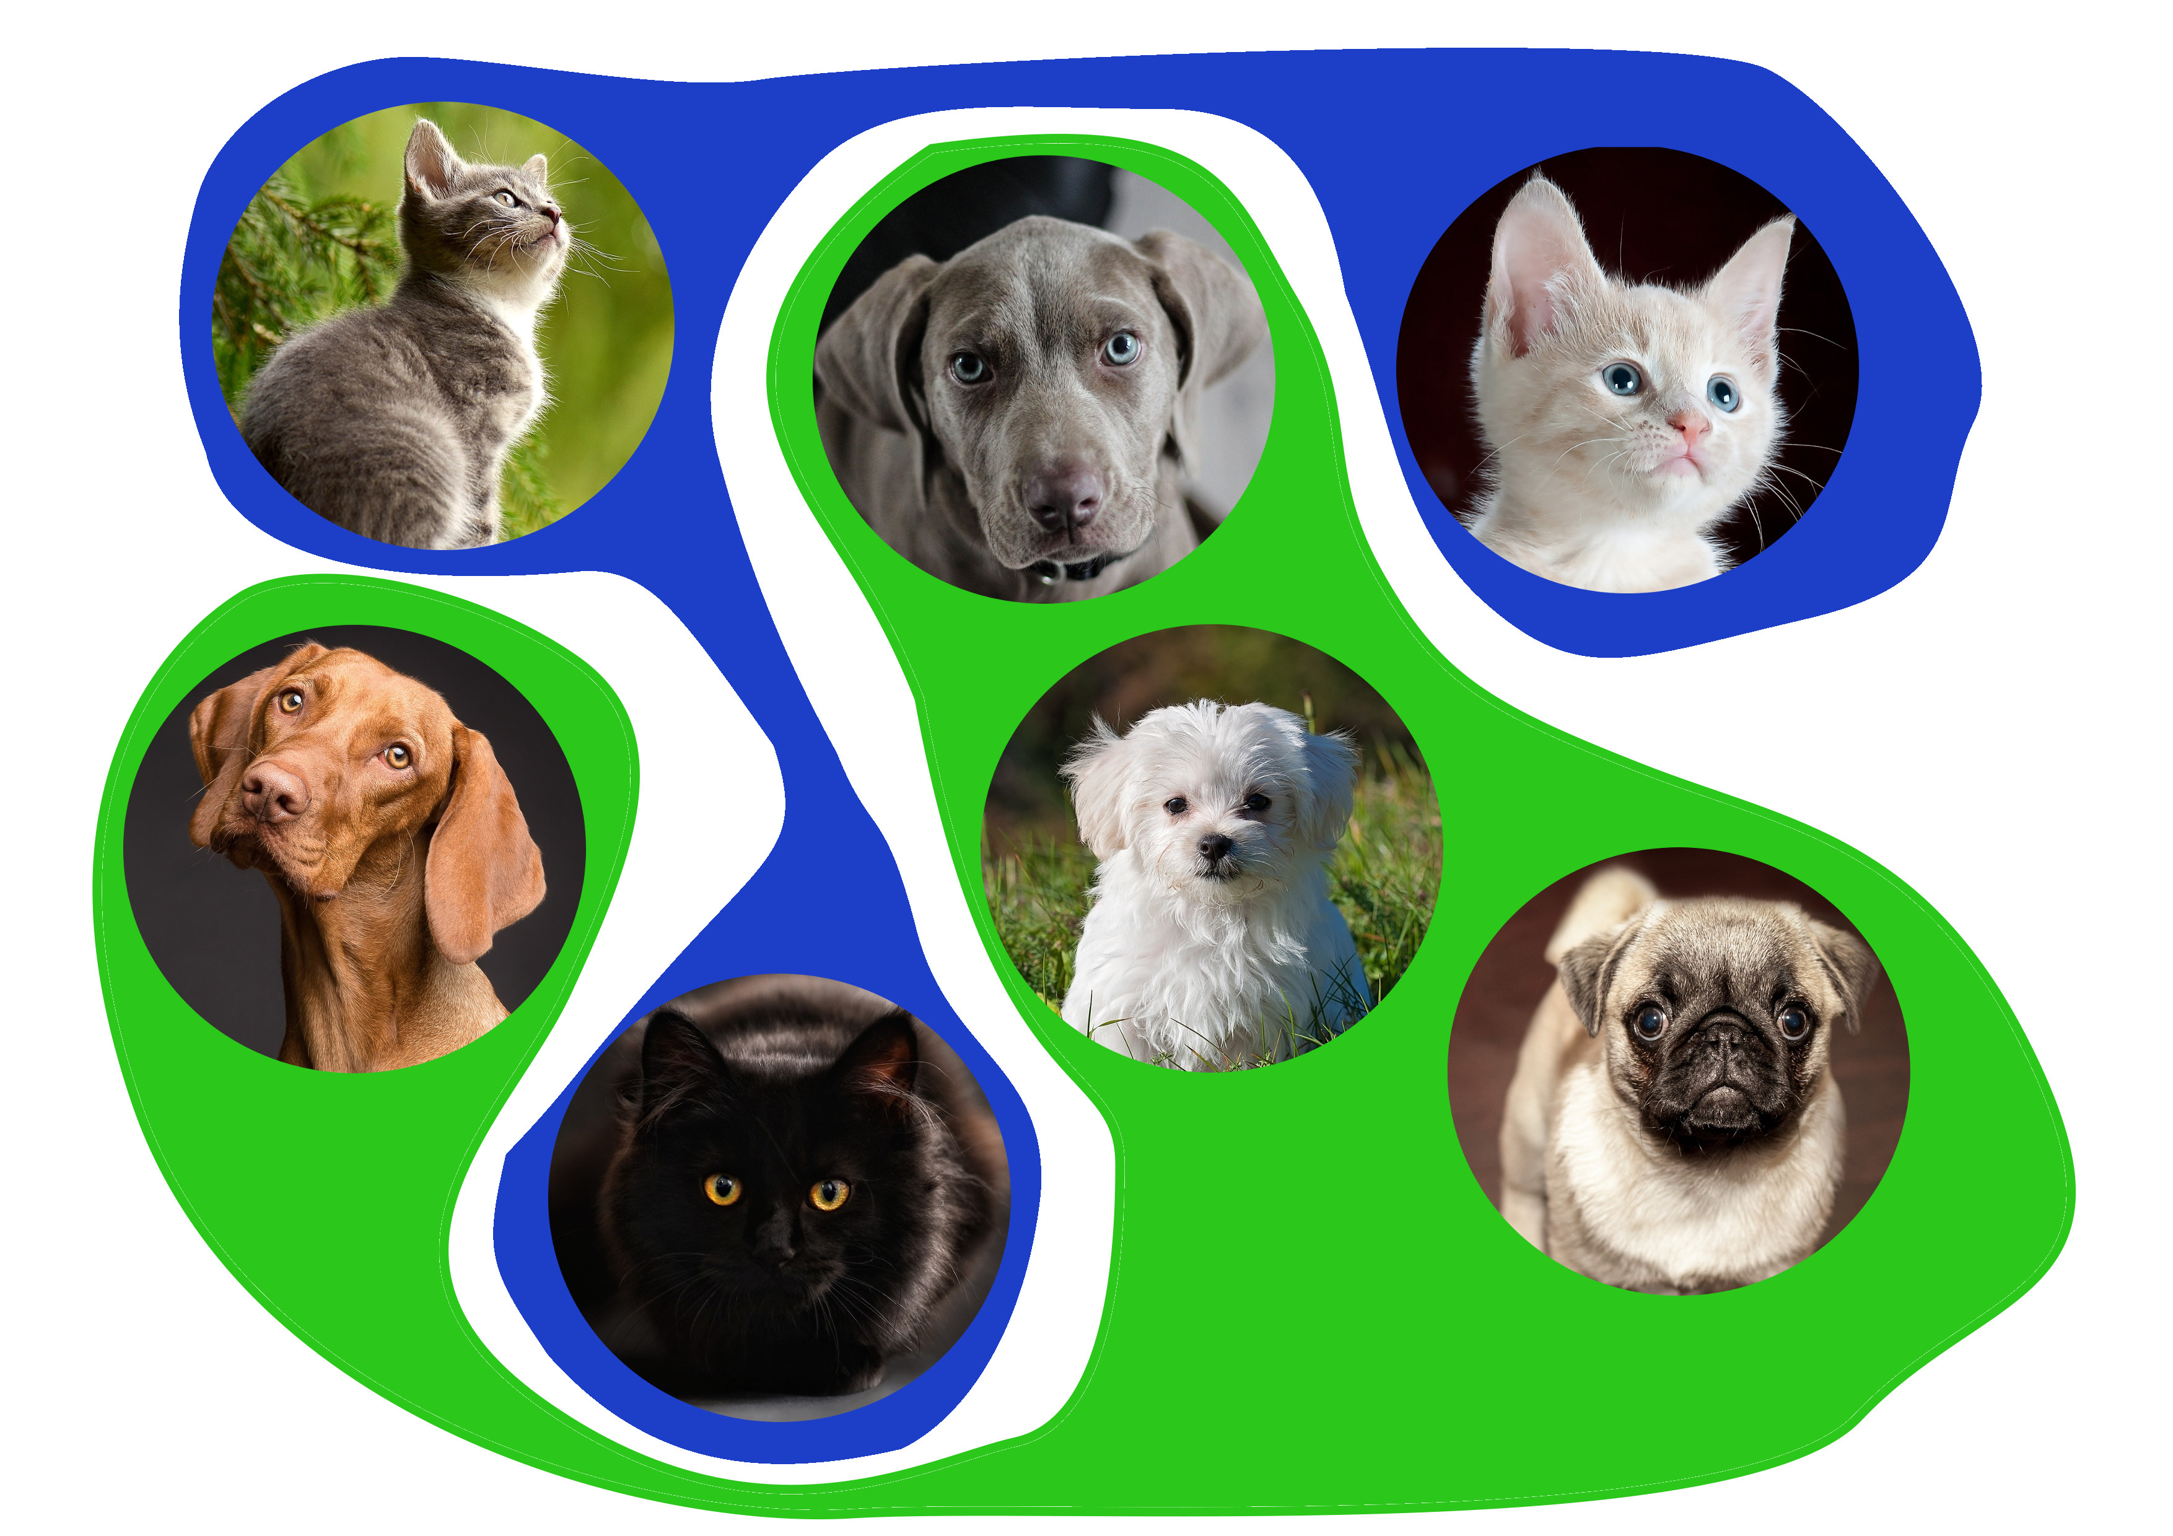

Unsupervised learning
The training data does not include the desired output (y). The goal is to uncover the inherent underlying similarities, patterns, or structure within the input data, $x^{(i)}$

Slide 9
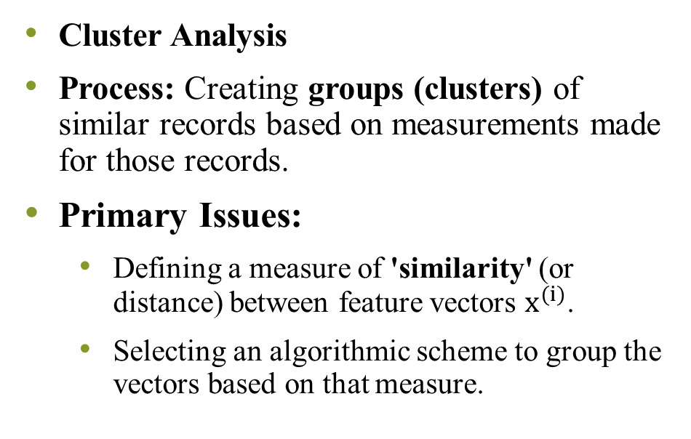
Task in unsupervised learning
Cluster Analysis
Process: Creating groups (clusters) of similar records based on measurements made for those records.
Primary Issues:
Defining a measure of 'similarity' (or distance) between feature vectors $x^{(i)}$.
Selecting an algorithmic scheme to group the vectors based on that measure.
Applications:
Biology: Organizing species into classes/subclasses.
Marketing: Market segmentation (grouping customers by demographics/transaction history).
Finance: Creating balanced portfolios.
Internet Search: Grouping similar user queries.

Slide 10
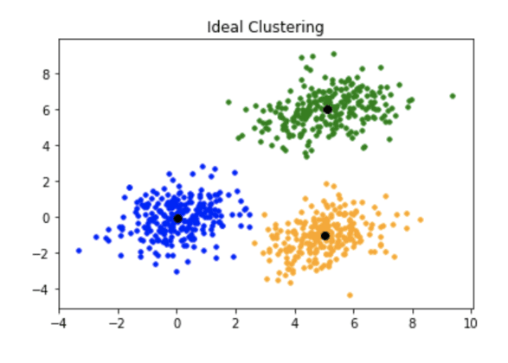
Clusters

Slide 11
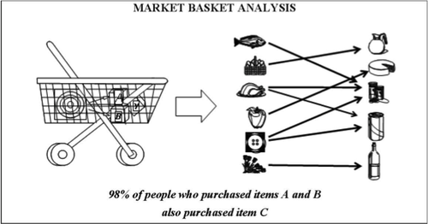
Association Analysis
Process: Discovering patterns or rules in the data where no target variable is specified. The interpretation of the discovered patterns is left to human analysis.
Common Application: Market Basket Analysis (Market co-occurrence).
Studies patterns of products that are frequently bought together.
Example: Online recommender systems (e.g., "Customers who bought X also bought Y").

Slide 12
Reinforcement Learning
Reinforcement learning is founded on the idea of learning through trial-and-error interaction with an environment to maximize a cumulative reward (or minimize a cumulative penalty).
Characteristics
Feedback: In the form of scalar reward(or penalty) after taking action.
No Instruction: The system is not instructed on which action to take. It must find out which actions yield the maximum cumulative reward by trying them.
Cumulative Reward: Actions influence not only the immediate reward but also future states and all subsequent rewards.

Slide 13
Distinguishing attributes of RL
Trial-and-Error Search: The agent explores the environment to see the results of its actions.
Cumulative Reward: The objective is to maximize the total expected reward over time.
RL Vs other forms
vs. Unsupervised: An unsupervised agent cannot learn what to do because it has no information about what constitutes a desirable state or a correct action.
vs. Supervised: In supervised learning, the agent is trained to predict the result of an action; the state-action model is available. In RL, the state-action model is not available.
RL is concerned with optimizing decisions (finding an optimal policy), rather than just making predictions.
Notes:
Applications
Learning to control a mobile robot.
Optimizing operations in factories.
Learning to play complex board games (e.g., Chess, Go).

Slide 14
Learning based on natural process
Category involves machine learning techniques inspired by biological and natural processes, such as:
Evolutionary computation: This approach is inspired by Darwinian evolution (natural selection).
Start with a "population" of random solutions (individuals).
The best solutions are allowed to "reproduce" (combine their successful traits), and "mutations" (small, random changes) are introduced.
Over generations, the population naturally evolves toward better and "fitter" solutions to the problem.
Notes:
How it Works: It's a search and optimization method where the problem-solving technique itself evolves.
Key Examples: Genetic Algorithms (GA), which are the most common computational model derived from this process.

Slide 15
Swarm Intelligence
Inspired by the collective behavior of social animals, like ants or birds, where many simple individuals achieve a complex, intelligent goal together.
A group (Colony or Swarm) of agents, which are unintelligent individually, can collectively display intelligent behaviour through simple interaction rules.
They all rely on a population of individuals that can interact directly or indirectly with each other and the environment.
Primary Examples:
Ant Colony Optimization (ACO): Inspired by how ants find the shortest path to food. Ants leave a chemical trail (pheromone) which guides other ants. This indirect communication leads to the entire colony collectively finding the optimal route.

Slide 16
Artificial Immune system
This approach is inspired by the amazing ability of the human body's immune system to protect itself from disease.
The natural immune system is a master of pattern recognition. It can quickly identify and differentiate between "self" (the body's own cells) and "non-self" (antigens, or foreign invaders like bacteria/viruses).
How it Works in Computing:
AIS algorithms are primarily used for pattern recognition and data clustering.
They mimic the immune system's process of creating different antibodies to match and neutralize foreign antigens.
Crucially, the system exhibits an adaptive nature—it "memorizes" the structure of the recognized threat to ensure a faster response the next time (like a vaccination).

