Slide 1
Heuristic Search in Inductive Learning
Mr. Shrikrishna Anand Narvekar
Assistant Professor
Computer Engineering Department
Agnel Institute of Technology and Design

Slide 2
Content
Bias variance trade off
Search through heuristic space
Techniques in heuristics
Regularization
Early stopping
Pruning
Ensemble learning

Slide 3
Machine learning is not about memorizing the training data; it is about building a statistical model that understands the underlying process.
The goal is generalization—the ability to make accurate predictions on new, unseen data.
Example: If you are training a model to recognize cats, you don't want it to just recognize the specific 100 cats in your photos. You want it to recognize any cat it sees in the future.

Slide 4
Bias-Variance Trade-off
Bias (Underfitting): The model is too simple (e.g., a straight line for a curved relationship). it misses the complexity of the data.
Variance (Overfitting): The model is too complex (e.g., a jagged line that touches every single data point). It mistakes random noise for a real pattern.
Example- High Bias: Studying only one page of a textbook for a final exam. You’ll be too prepared for that page but fail the rest.
High Variance: Memorizing every word of the textbook without understanding the concepts. If the exam questions are phrased slightly differently, you’ll fail.

Slide 5
Search through heuristic space
Word ‘heuristic’ indicates that strategies for the search problem cannot be precisely pre-defined. Trial-and-error is the approach of searching for a ‘good enough’ solution.
Space of probable hypotheses is infinite in theoretical terms. The learning task, therefore, is to explore a widespread space to find the hypothesis that is most consistent with the existing training examples.

Slide 6
Applied machine learning organizes the search as per the following two-step procedure
The search is first focused on a class of the possible hypotheses, chosen for the learning task in hand. Prior knowledge and experience are helpful in this selection. Different classes are appropriate for different kinds of learning tasks.
For each of the classes, the corresponding learning algorithm organizes the search through all possible structures of the learning machine.
Inductive Learning is the process of learning general rules from specific examples. Because there are an infinite number of possible "rules" or "theories" (hypotheses) that could explain a set of data, machine learning uses a two-step search to narrow things down quickly.
Think of this process like trying to find the right tool to fix something in your house.
Notes:
Think of Inductive Learning like a detective trying to solve a case. The detective has a few clues (specific examples) and needs to come up with a motive or a culprit (general rule).
The problem is that there are infinite ways to connect those clues. You need a way to narrow down the search so you don't spend forever investigating impossible theories.
The Example: Predicting "Will I Enjoy This Hike?"
Imagine you have a log of your past hikes:
Hike 1: Sunny, Short, Mountain — Enjoyed
Hike 2: Rainy, Long, Forest — Did Not Enjoy
Hike 3: Sunny, Long, Mountain — Enjoyed
1. The Search Space (The "Infinite" Problem)
Without any constraints, your brain could come up with infinite rules:
"I enjoy hikes only on Tuesdays when it’s 22°C."
"I enjoy hikes if the trail name starts with the letter M."
"I enjoy any hike where I wore my red backpack."
Searching through every possible weird rule is impossible. This is why we need the two-step procedure.

Slide 7
Step 1: Choosing the "Toolbox" (The Hypothesis Class)
Before you start fixing a leak, you don't look at every single object in your house (that would take forever). Based on your experience (prior knowledge), you decide you need a "Plumbing Toolbox" rather than a "Sewing Kit."
In Machine Learning: We don't search through every possible mathematical formula. Instead, we use a heuristic (a smart shortcut) to pick a category of models, such as "Decision Trees" or "Neural Networks," because we know from experience they work well for this type of data.
The Heuristic: "This problem looks like a classification task with tabular data, so I'll start with Decision Trees."
Notes:
2. Step One: Choosing the Hypothesis Class (Focusing the Search)
Before looking at the data, you decide what kind of rules you’re willing to consider. This is where prior knowledge comes in.
The Decision: You decide that "Weather" and "Terrain" are usually what matter for hiking, and you'll use a Decision Tree structure because it's simple and logical.
Why? You’ve "learned how to learn" from experience. You ignore rules about backpack color because you know from experience they are irrelevant.

Slide 8
Step 2: Finding the "Right Tool" (The Specific Structure)
Now that you have your plumbing toolbox open, you have to find the exact wrench that fits the pipe. You don't just pick one at random; you try one, see if it’s too big (overfitting) or too small (underfitting), and then adjust.
In Machine Learning: Once we've picked a "class" (like a Neural Network), the algorithm searches for the specific settings (weights and layers) that fit the data best.
The Heuristic: Since we can’t test every possible version of the network, we use tools like Early Stopping (quitting while we're ahead) or Pruning (cutting off parts of the model that are too specific) to find a "good enough" solution without getting lost in the details.
Notes:
3. Step Two: The Learning Algorithm (Organizing the Search)
Now that you've picked your "shape" (a Decision Tree), the algorithm looks at your 3 hiking examples and organizes the search within that class:
It tests: "Is it the Weather?" (If Sunny, then Enjoyed).
It tests: "Is it the Terrain?" (If Mountain, then Enjoyed).
The Result: The algorithm finds the structure that is most consistent with your examples. It settles on: "If the weather is Sunny, I will enjoy the hike.“

Slide 9
Techniques in heuristics
Heuristics uses following techniques to optimize hypothesis complexity for a given training dataset.
Regularization
Early stopping
Pruning
Ensemble learning

Slide 10
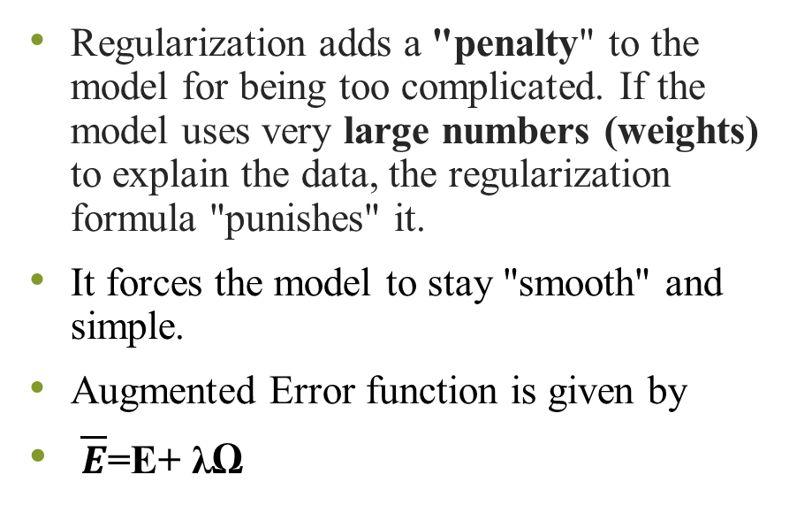
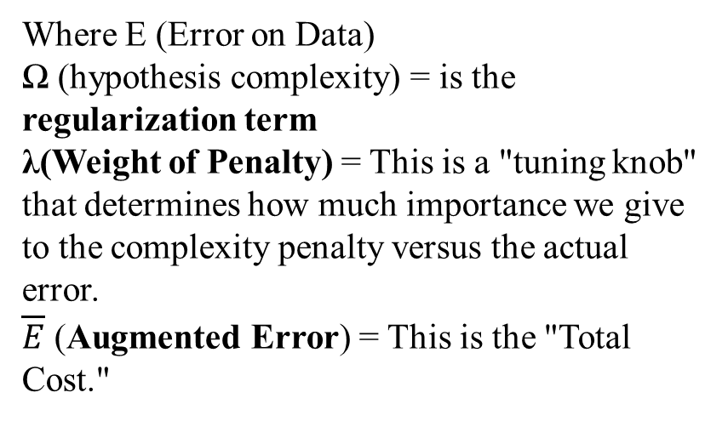
Regularization
Regularization adds a "penalty" to the model for being too complicated. If the model uses very large numbers (weights) to explain the data, the regularization formula "punishes" it.
It forces the model to stay "smooth" and simple.
Augmented Error function is given by
$\overline{E}$=E+ λΩ
Where E (Error on Data)
Ω (hypothesis complexity) = is the regularization term
λ(Weight of Penalty) = This is a "tuning knob" that determines how much importance we give to the complexity penalty versus the actual error.
$\overline{E}$ (Augmented Error) = This is the "Total Cost."
Notes:
Error on data is the standard error or "loss" that the model calculates based on the training set. It measures how poorly the model is performing on the data it is currently seeing. A high E means model is making many mistakes on training examples
(hypothesis complexity) = is the regularization term, which represents the "intricacy" or complexity of the hypothesis (the model). It measures how "wiggly" or complicated the mathematical function is. For example, in neural networks, this is often calculated as the sum of the squares of the weights
If λ is very small, the model ignores complexity and tries to get zero errors on the data (risking high variance/overfitting).
If λ is large, the model ignores the data and focuses only on being simple (risking high bias/underfitting).
$\overline{E}$ (Augmented Error) = This is the "Total Cost." The machine learning algorithm does not just try to minimize the mistakes (E); it tries to minimize the combination of mistakes and complexity.

Slide 11
Early Stopping
When a machine is learning, its error on the training data usually keeps going down the longer it practices. However, after a certain point, it starts memorizing the "noise" (random errors) instead of the actual patterns.
Early Stopping tells the machine to stop training the moment its performance on new data starts to get worse.
Real-Life Example: Think of Baking a Cake.
Notes:
Real-Life Example: Think of Baking a Cake.
If you take it out too early, it’s undercooked (Underfitting).
If you leave it in too long to make sure every single molecule is dry, it burns (Overfitting).
Early Stopping is like checking the cake with a toothpick and taking it out the exact second it’s done, rather than waiting for the timer to hit zero.

Slide 12
Pruning (Gardening approach)
In models like "Decision Trees," the machine often grows a massive, complicated tree to explain every single data point.
Pruning is the process of letting the tree grow fully and then cutting off the "weak" or "useless" branches that don't really help in making general predictions.
Real-Life Example: Imagine a Company Strategy.
A startup might try to sell 50 different products to see what happens. This is the "Full-Grown Tree”.
After a year, they realize that 45 of those products only sold once to a specific person.
Notes:
Real-Life Example: Imagine a Company Strategy.
A startup might try to sell 50 different products to see what happens. This is the "Full-Grown Tree."
After a year, they realize that 45 of those products only sold once to a specific person.
Pruning is when the CEO shuts down those 45 tiny departments to focus only on the 5 core products that everyone actually buys. By "cutting the branches," the company becomes more efficient and better at serving the general public.

Slide 13
Ensemble Learning
Instead of relying on one "expert" hypothesis, ensemble learning combines the predictions of many models to get a more reliable result.
Bagging: Training multiple models independently and averaging them (e.g., Random Forests).
Boosting: Training models sequentially, where each new model tries to fix the mistakes of the previous one (e.g., AdaBoost).
Example: Asking 20 different doctors for a diagnosis and taking the majority opinion (Voting) is much safer than just asking one.

Slide 14
Class Imbalance problem
This occurs when one category of data is much more frequent than the other, making it hard for the machine to "see" the rare cases.
Example: In Credit Card Fraud detection, 99.9% of transactions are legitimate, and 0.1% are fraudulent. A model could get 99.9% accuracy by simply guessing "Legitimate" every time, but it would fail its actual job (finding fraud).
Solutions: Oversampling (duplicating rare cases) or Undersampling (removing common cases).
Notes:
1. Oversampling (The "More is More" Approach)
Instead of just duplicating the rare cases, which can lead to overfitting (the model simply memorizing specific examples), we often use "Synthetic" data generation.
SMOTE (Synthetic Minority Over-sampling Technique): Instead of exact copies, SMOTE looks at the minority points and creates new, "synthetic" examples that lie on the lines between existing ones. It’s like telling the model, "Fraud usually looks like this, but also slightly like this."
Best for: When you have a small dataset and can't afford to lose any information.
2. Undersampling (The "Less is More" Approach)
This involves reducing the majority class to match the minority class.
Random Undersampling: Deleting majority cases at random. The risk here is information loss—you might delete the very data points that define the boundary between "Legitimate" and "Fraud."
NearMiss: An algorithmic approach that selects majority samples based on their distance to minority samples to ensure the "edge cases" are preserved.
Best for: When you have a massive dataset (millions of rows) where the majority class is highly redundant.

Slide 15
Evaluation Metrics
To know if a system is "good," we look at more than just accuracy:
Robustness: Can it handle messy or "noisy" data? ‘Robustness’ means that the machine can perform adequately under all circumstances,
Computational Complexity: How much memory and time does it take? (Crucial for apps on phones).
Interpretability: Can a human understand why the machine made that decision? (Crucial for medical or legal AI).
Scalability: Can it handle millions of rows of data, or does it crash?
Notes:
‘Robustness’ means that the machine can perform adequately under all circumstances, including the cases when information is corrupted by noise, is incomplete, and is interfered with irrelevant data.
Computational Complexity: How much memory and time does it take? (Crucial for apps on phones). Computational complexity of a learning algorithm and learning speed determine the efficiency of a learning system: how fast the systems can arrive at a correct answer, and how much computer memory is required

Slide 16
Estimating generalization Errors
Machine’s performance is determined by how it handles future data, not just the data it already studied.
A model might perform perfectly on its training notes but fail miserably on a real exam.
The Three Datasets
Think of these as the three stages of a student's education:
Training data, validation data and test data
Notes:
Training Data: This is the "Textbook." The model uses this to build its basic structure and learn patterns.
Validation Data: This is a "Practice Quiz." It is used to fine-tune the model's settings (parameters) or choose between different models.
Test Data: This is the "Final Exam." It consists of completely unseen data used only once at the very end to calculate the true error rate.

Slide 17
Training data
Student_ID | Study_Hours | Attendance | Assignments | Result
S1 | 5 | 80 | 7 | 1
S2 | 2 | 60 | 4 | 0
S3 | 6 | 90 | 8 | 1
S4 | 1 | 50 | 3 | 0
S5 | 4 | 75 | 6 | 1
S6 | 3 | 65 | 5 | 0
The model learns patterns like:
More study hours + good attendance → likely pass

Slide 18
Validation data
Used to fine-tune the model and choose the best settings.
Used to check:
Is model overfitting?
Which model works better?
Student_ID | Study_Hours | Attendance | Assignments | Result
S7 | 4 | 70 | 6 | 1
S8 | 2 | 55 | 4 | 0
S9 | 5 | 85 | 7 | 1

Slide 19
Test data
Completely unseen data used only once to measure final accuracy.
This data is never shown to the model during training. It gives the true performance of the model.
Student_ID | Study_Hours | Attendance | Assignments | Result
S10 | 6 | 88 | 8 | 1
S11 | 1 | 45 | 2 | 0
S12 | 3 | 60 | 5 | 0

Slide 20
Simple splitting methods
If you have a limited amount of data, you need clever ways to split it.
In the holdout technique, some amount of data is earmarked for the purpose of testing, while the remainder is employed for training (and a portion of it is kept aside for validation, if needed). Practically speaking, it is common to hold out one-third of the data for testing and use the remainder for training.

Slide 21
Holdout Method
Take your original dataset and divide it into two main parts
Training Set: This is what the machine uses to learn.
Test Set: This is "earmarked" or set aside and used only to check the final accuracy.
Key takeaways from the text:
The 1/3 Rule: It is common practice to use two-thirds of the data for training and hold out one-third for testing.
Time-Series Data: If your data is collected over time, you should use the earlier part for training and the later part for testing. This mimics the real world, where the model is built on the past to predict the future

Slide 22
Stratification
A simple random split can sometimes be "unfair." For example, if you are classifying diseases but the test set accidentally ends up with zero cases of the disease, the test is useless.
Stratification ensures that each class (category) is represented in the same proportion in the training and test sets as it is in the full dataset.
You check if the percentage of each class in the training and test sets is more or less the same as the full dataset.

Slide 23
Full Dataset (Before Split)
Let’s assume we have 10 students.
Student | Study_Hours | Result
S1 | 1 | 0
S2 | 2 | 0
S3 | 2 | 0
S4 | 3 | 0
S5 | 4 | 1
S6 | 5 | 1
S7 | 6 | 1
S8 | 7 | 1
S9 | 8 | 1
S10 | 9 | 1
Class Distribution in Full Dataset
Pass (1) → 6 students → 60%
Fail (0) → 4 students → 40%

Slide 24
Problem: Random Split (Unfair)
Suppose we randomly create:
Training Set (8 students)
Pass= 4
Fail=4
Test Set (2 students)
Pass=100% and Fail =0% Test set has no fail students Model evaluation becomes meaningless
Study_Hours | Result
1 | 0
2 | 0
2 | 0
3 | 0
4 | 1
5 | 1
6 | 1
7 | 1
Study_Hours | Result
8 | 1
9 | 1

Slide 25
Stratified split
Stratification keeps same proportion in all datasets.
We maintain:
60% Pass
40% Fail
Pass=5, Fail=3
Study_Hours | Result
1 | 0
2 | 0
3 | 0
4 | 1
5 | 1
6 | 1
7 | 1
8 | 1

Slide 26
Test Set (2 students)
Pass = 1, Fail =1 50% in both the cases
(close to original proportion)
Study_Hours | Result
2 | 0
9 | 1
Dataset | % Pass | % Fail
Full data | 60% | 40%
Training | ~60% | ~40%
Test | ~60% | ~40%

Slide 27
Random Subsampling
Even with stratification, one single split might result in a biased or "lucky" outcome. To fix this, we use Random Subsampling.
You repeat the holdout method K times, each time using different random samples for the training and test sets.
You calculate the accuracy for each of the K repetitions and then average them to get a more reliable overall estimate

Slide 28
Swapping roles
Another variation involves a 50:50 split where you train on the first half and test on the second, then swap (train on the second and test on the first).
Pros: This helps decrease the effect of an uneven data distribution.
Cons: It is usually not ideal because it is better to have more than 50% of your data dedicated to training the machine

Slide 29
Cross validation
K-Fold Cross-Validation
Divide your data into K equal parts (usually K = 10).
In the first round, use parts 2–10 for training and part 1 for testing.
Repeat this until every part has been the "test set" once.
Average all the errors to get a final score.

Slide 30
Leave-One-Out Cross-Validation (LOOCV)
You train on every single piece of data except for one lone sample, which you use for testing. You repeat this for every single sample in the set.
Pro: Great for getting the most out of tiny datasets.
Con: Very slow and expensive for large datasets.

Slide 31
Bootstrapping
Bootstrap technique is based on the process of sampling with replacement.
The concept of bootstrapping aims to sample the dataset by replacement, so as to form a training set and a test set.
There are many bootstrap techniques. The most popular one is the 0.632 bootstrap, which works as follows:

Slide 32
1. The "Names in a Hat" Analogy
Imagine you have a hat with 10 different names in it. You want to create a "Training Team" of 10 people.
The Process: You reach in, pull out a name, write it down, and put the name back in the hat.
The Result: You repeat this 10 times. Because you put the names back, you might pick "John" three times and never pick "Sarah" at all.
The Split: The names you picked go on the Training Team. The names that were left in the hat (the ones you never picked) become your Test Set.

Slide 33
Where does "63.2%" come from?
The probability that a particular instance will be picked is 1/N; so the probability of not being picked is (1-1/N)
This method is called 0.632 Bootstrap because after drawing samples n times roughly 63.2% of data is drawn at least once and 36.8% of the data is never drawn.
On average, your training set will contain 63.2% of your original unique data points, while the remaining 36.8% are your "unseen" test instances.

Slide 34
The 0.632 Error Formula
If we only measured the error on the test set, it would be too "pessimistic" (it would look worse than it is) because the model only learned from 63.2% of the unique data. To get a more realistic score, we combine the performance from both sets using a weighted average:
Final Error= (0.632× Error on test data) +(0.368 × Error on training data)
Why use this?
Best for Small Data: When you don't have enough data to comfortably set aside a large "Test Set," bootstrapping allows you to use every single piece of data for both training and testing in different iterations.
The Catch: It can be "overly optimistic," meaning it might make the model look slightly better than it actually is.

