Slide 1
K-Nearest Neighbor Classifier(K-NN)
Shrikrishna Anand Narvekar
Assistant Professor
Agnel Institute of Technology and Design

Slide 2
Introduction
Objects which are similar belong to the same class.
So when we want to classify a new data point, we:
Look at the nearest data points in the dataset
Check their class labels
Assign the majority class to the new data point.
This is similar to deciding based on neighbors.

Slide 3
Suppose we want to classify a new fruit. Training data
New fruit:
Weight = 155 Color = Red
We check the nearest neighbors.
Nearest examples → Apples So the new fruit is classified as Apple.
Weight | Color | Fruit
150 | Red | Apple
160 | Red | Apple
130 | Yellow | Mango
140 | Yellow | Mango

Slide 4
K-NN is non-Parametric
k-NN is called non-parametric because:
✔ It does not assume any mathematical model ✔ It does not estimate parameters
Algorithms like linear and logistic regression assumes specific mathematical relationship.
Instead, k-NN simply:
stores all training data and compares new data with it.

Slide 5


Histogram method(old density estimation method)
In histogram data range is divided into bins (intervals)
Probability is estimated using:
Density:
Where
N = total samples
h = width of bin
Small bins → noisy (spiky graph)
Large bins → over smoothing
Marks Range | Number of Students
0–20 | 2
20–40 | 5
40–60 | 10
60–80 | 20

Slide 6
Curse of dimensionality
When dimensions increase:
1D → N points 2D → N² points 3D → N³ points
So for high-dimensional data we need huge datasets.
This is called the Curse of Dimensionality.

Slide 7

k-Nearest Neighbor Density Estimation
Instead of fixing bin width, k-NN does something smarter.
We:
Fix k (number of neighbors)
Find distance to kth nearest neighbor
Use that region to estimate density.
Where
k = number of neighbors
N = total samples
dₖ(x) = distance to kth nearest point

Slide 8
K-NN for classification
Step 2
Compute distance between:
new sample and all training samples
Example distances:
Now comes the most important part.
To classify a new sample x:
Step 1
Choose k
Example:
k = 5
Sample | Distance | Class
1 | 2.1 | A
2 | 1.5 | B
3 | 0.9 | B
4 | 1.2 | A
5 | 1.0 | B

Slide 9
Step 3
Select k nearest neighbors
Example (k=5):
Classes:
B, B, A, A, B
Step 4
Count votes
A → 2 B → 3
Prediction → Class B

Slide 10
Lazy Learners
Lazy learners are a class of machine learning algorithms that defer generalization (i.e., model building) until a query (test instance) needs to be classified or predicted.
Unlike eager learners, which generalize from training data immediately, lazy learners store the training data and delay computation until absolutely necessary.

Slide 11
Advantages of Lazy Learning
• Simple implementation.
• No training time – useful for dynamic/streaming environments.
• Adaptive – naturally supports incremental learning.
• Powerful for non-linear decision boundaries – can approximate very complex class regions
Disadvantages of Lazy Learning
• Slow at prediction time – may scan the entire dataset.
• High memory consumption – stores all training data.
• Lack of interpretability – no clear model or rules to inspect.
• Sensitive to irrelevant/noisy features – treats all attributes equally unless modified

Slide 12
Similarity/Instance based learning
It is a method where we classify a new data point by comparing it with existing data.
Instead of building a model, it stores all training data and uses it when needed.
Also called:
Instance-based learning
Lazy learning
Just In-time learning
Notes:
Example: If a new patient comes, we compare their BMI and Age with previous patients and assign the class (Sugar) based on similar cases.
2. How it Works

Slide 13
Instance-based learning
An instance = one data record (row in dataset)
It contains:
Features (attributes) → e.g., BMI, Age
Class label → e.g., Sugar (0 or 1)
Stores all training data
Does not build a model
Makes decisions only when a new data point comes
Notes:
Important Points:
Called Lazy Learning
Computation happens during testing phase
Uses similarity (distance) to classify

Slide 14
Model-based learning
Builds a model first using training data
Then uses that model to predict new data
Called Eager Learning
Has two phases:
Training phase (model building)
Testing phase (prediction)
Notes:
Examples:
Decision Trees
Neural Networks
SVM

Slide 15
Difference between instance-based learning and Model-based learning
Instance based Learning | Model based learning
Lazy learners | Eager learner
Processing of training instances is only done at testing phase | Processing of training instance is done during training phase
No model is built with training instance before it receives a test instance | Generalizes a model with the training instance before it receives test instance
Predict the class of test instance directly from training data | Predict the class of test instance from the model built
Slow in testing phase | Fast in testing phase

Slide 16
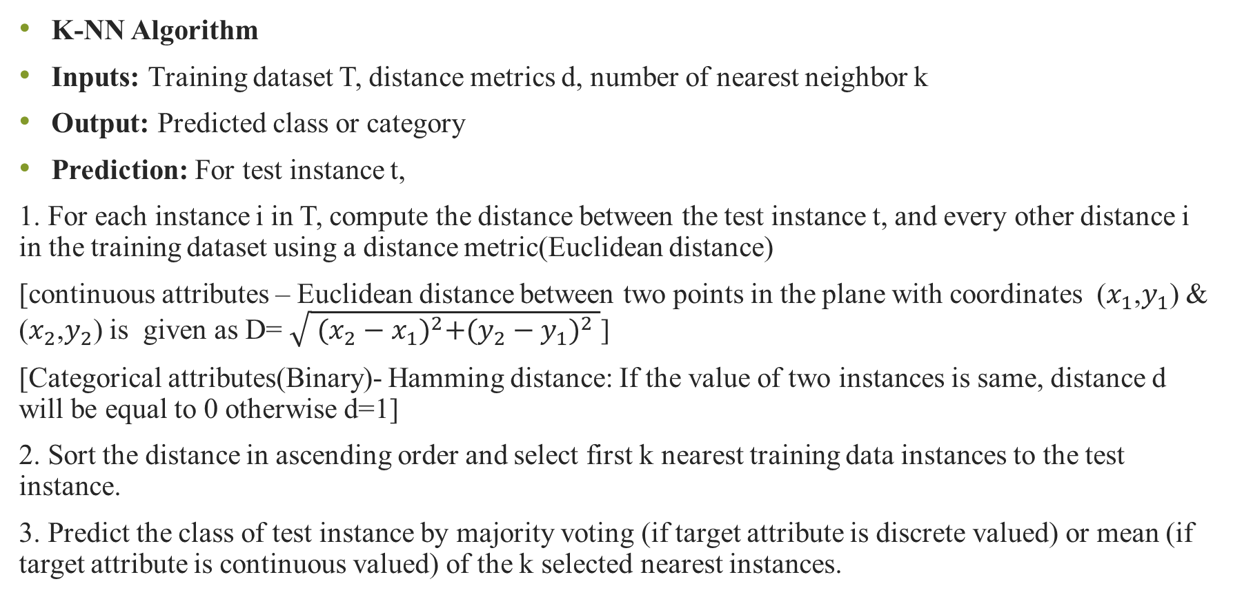
K-NN Algorithm
Inputs: Training dataset T, distance metrics d, number of nearest neighbor k
Output: Predicted class or category
Prediction: For test instance t,
1. For each instance i in T, compute the distance between the test instance t, and every other distance i in the training dataset using a distance metric(Euclidean distance)
[continuous attributes – Euclidean distance between two points in the plane with coordinates ($x_{1}$,$y_{1}$) & ($x_{2}$,$y_{2}$) is given as D= $\sqrt{ {(x_{2}−x_{1})}^{2}+{(y_{2}−y_{1})}^{2} }$]
[Categorical attributes(Binary)- Hamming distance: If the value of two instances is same, distance d will be equal to 0 otherwise d=1]
2. Sort the distance in ascending order and select first k nearest training data instances to the test instance.
3. Predict the class of test instance by majority voting (if target attribute is discrete valued) or mean (if target attribute is continuous valued) of the k selected nearest instances.

Slide 17
Apply KNN algorithm for following dataset Assem K=3
Ex | Height | Weight | Target
1 | 150 | 50 | 1.5
2 | 155 | 55 | 1.2
3 | 160 | 60 | 1.8
4 | 161 | 59 | 2.1
5 | 158 | 65 | 1.7
6 | 157 | 54 | ?

Slide 18
Consider the following dataset with attributes BMI, Age, and Sugar (class label):
Using the K-Nearest Neighbors (KNN) algorithm:
Use K = 3.
Use Euclidean Distance as the distance metric.
Classify the following test tuple:
BMI = 43.6, Age = 40
BMI | Age | Sugar
33.6 | 50 | 1
26.6 | 30 | 0
23.4 | 40 | 0
43.1 | 67 | 0
35.3 | 23 | 1
35.9 | 67 | 1
36.7 | 45 | 1
25.7 | 46 | 0
23.3 | 29 | 0
31.0 | 56 | 1

Slide 19
How it works
Measure similarity (or distance) between data points.
Find the nearest neighbors.
Assign the class based on those neighbors.

Slide 20
Apply K-NN Algorithm to predict the class of test instance. K=4
Height(CM) | Weight(Kg) | Class
167 | 51 | Underweight
182 | 62 | Normal
176 | 69 | Normal
173 | 64 | Normal
172 | 65 | Normal
174 | 56 | Underweight
169 | 58 | Normal
173 | 57 | Normal
170 | 55 | Normal
170 | 57 | ?

Slide 21
