Slide 1
Learning from observations
Mr. Shrikrishna Anand Narvekar
Assistant Professor
Computer Engineering Department
Agnel Institute of Technology and Design

Slide 2
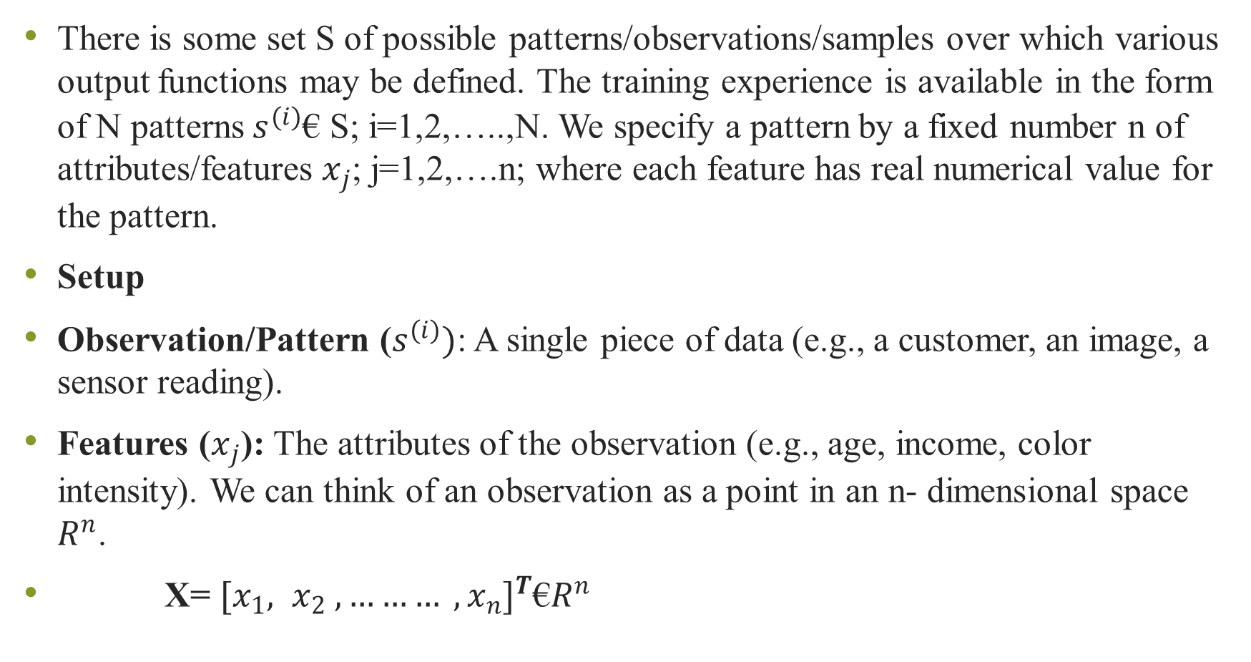
There is some set S of possible patterns/observations/samples over which various output functions may be defined. The training experience is available in the form of N patterns $s^{(i)}$€ S; i=1,2,…..,N. We specify a pattern by a fixed number n of attributes/features $x_{j}$; j=1,2,….n; where each feature has real numerical value for the pattern.
Setup
Observation/Pattern ($s^{(i)})$: A single piece of data (e.g., a customer, an image, a sensor reading).
Features ($x_{j}$): The attributes of the observation (e.g., age, income, color intensity). We can think of an observation as a point in an n- dimensional space $R^{n}$.
X= ${[x_{1}, x_{2} ,……… , x_{n}]}^{T}$€$R^{n}$

Slide 3
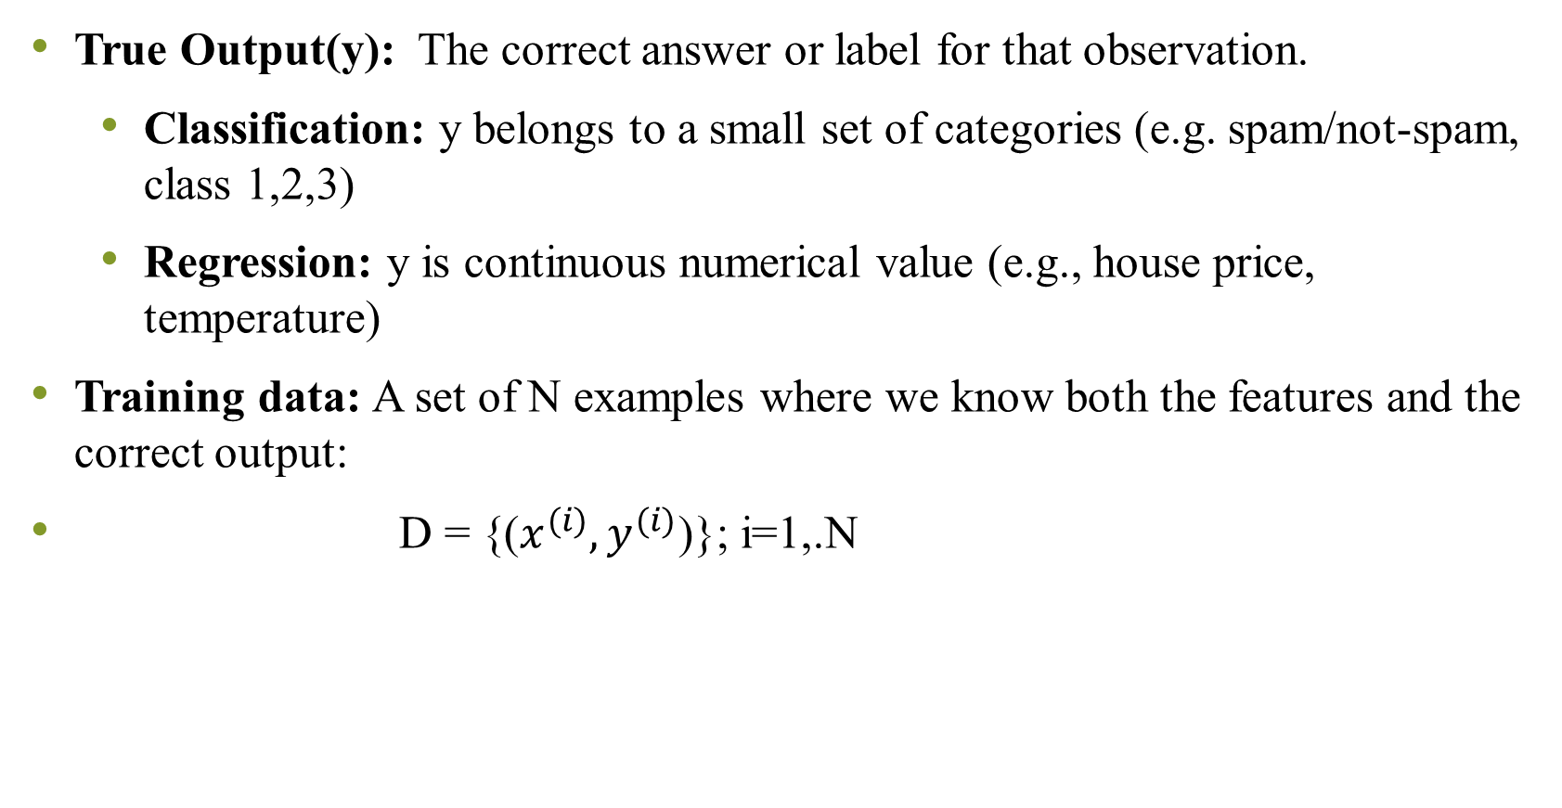
True Output(y): The correct answer or label for that observation.
Classification: y belongs to a small set of categories (e.g. spam/not-spam, class 1,2,3)
Regression: y is continuous numerical value (e.g., house price, temperature)
Training data: A set of N examples where we know both the features and the correct output:
D = {($x^{(i)}, y^{(i)}$)}; i=1,.N

Slide 4
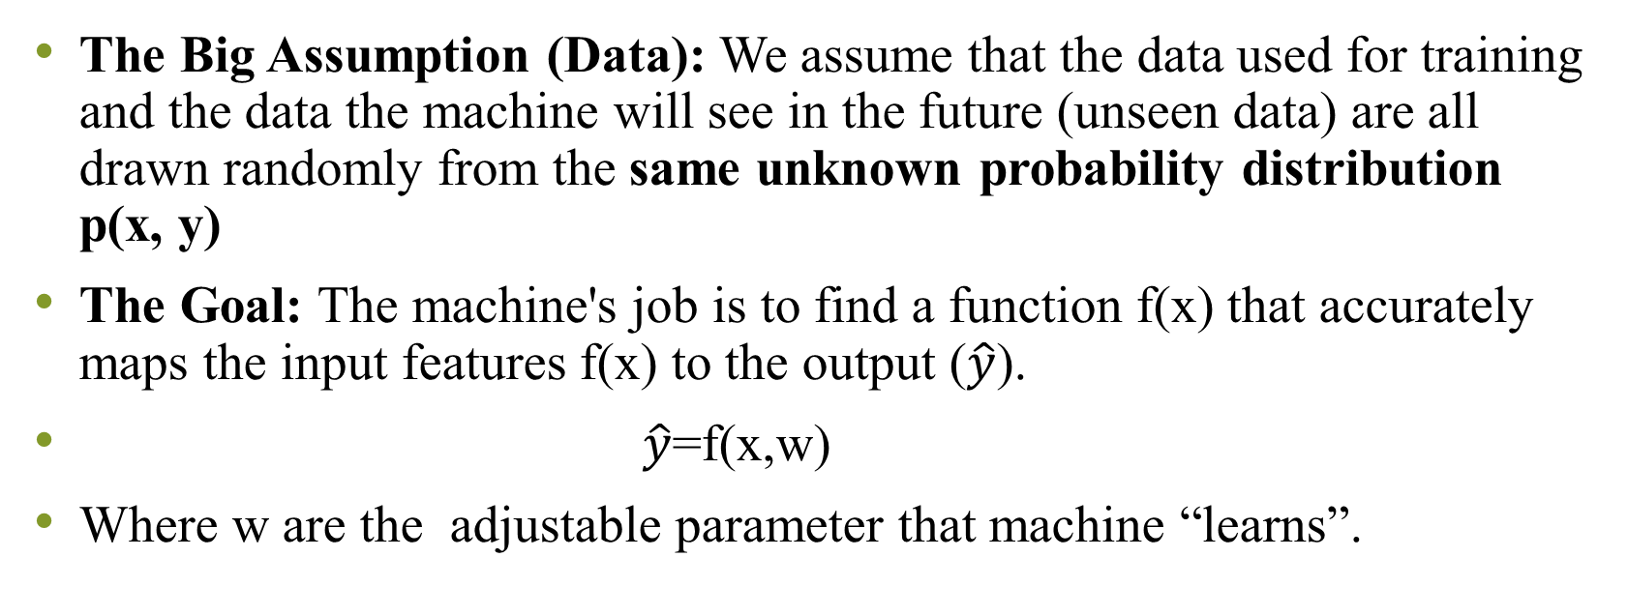
The Key Assumption and Goal
The Big Assumption (Data): We assume that the data used for training and the data the machine will see in the future (unseen data) are all drawn randomly from the same unknown probability distribution p(x, y)
The Goal: The machine's job is to find a function f(x) that accurately maps the input features f(x) to the output ($\hat{y}$).
$\hat{y}$=f(x,w)
Where w are the adjustable parameter that machine “learns”.

Slide 5
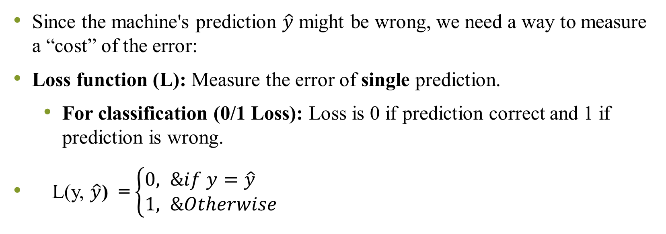
Measuring Performance (Risk and Loss)
Since the machine's prediction $\hat{y}$ might be wrong, we need a way to measure a “cost” of the error:
Loss function (L): Measure the error of single prediction.
For classification (0/1 Loss): Loss is 0 if prediction correct and 1 if prediction is wrong.
L(y, $\hat{y}$) = $\left\{\begin{aligned}0, &if y=\hat{y} \\ 1, &Otherwise \end{aligned}\right.$

Slide 6
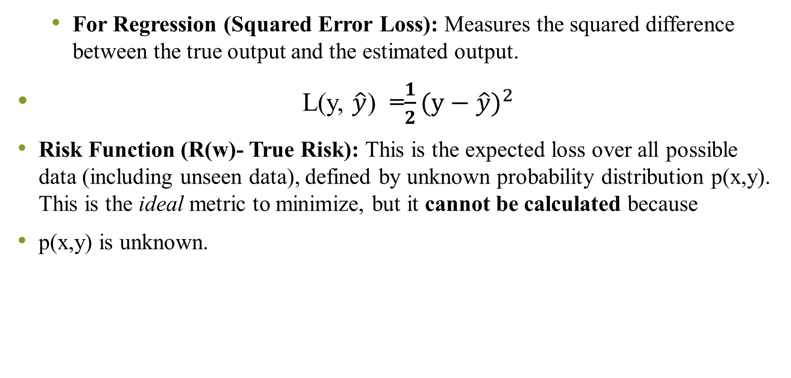
For Regression (Squared Error Loss): Measures the squared difference between the true output and the estimated output.
L(y, $\hat{y}$) =$\frac{1}{2}{(y−\hat{y})}^{2}$
Risk Function (R(w)- True Risk): This is the expected loss over all possible data (including unseen data), defined by unknown probability distribution p(x,y). This is the ideal metric to minimize, but it cannot be calculated because
p(x,y) is unknown.

Slide 7
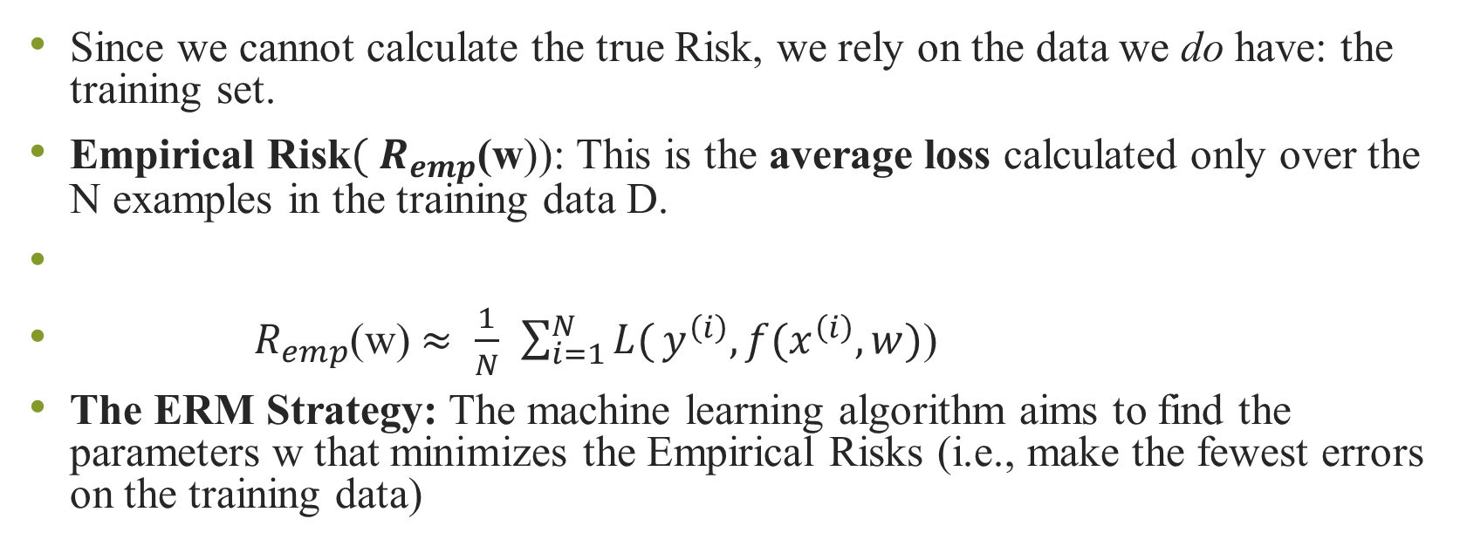
The Practical Solution: Empirical Risk Minimization (ERM)
Since we cannot calculate the true Risk, we rely on the data we do have: the training set.
Empirical Risk$({ R}_{emp}$(w)): This is the average loss calculated only over the N examples in the training data D.
${ R}_{emp}$(w)$≈$ $\frac{1}{N}$ $\sum_{i=1}^{N}{L(}y^{\left(i\right)},f(x^{\left(i\right)},w)$)
The ERM Strategy: The machine learning algorithm aims to find the parameters w that minimizes the Empirical Risks (i.e., make the fewest errors on the training data)

Slide 8
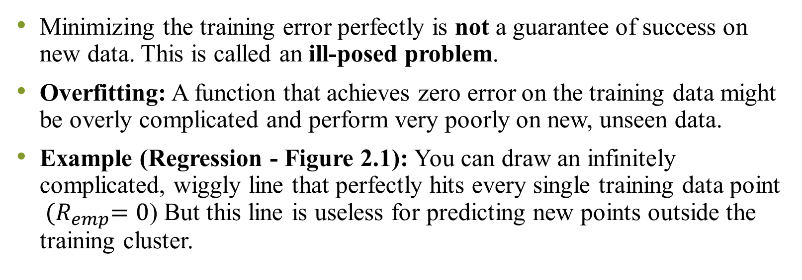
The Problem with ERM: Overfitting
Minimizing the training error perfectly is not a guarantee of success on new data. This is called an ill-posed problem.
Overfitting: A function that achieves zero error on the training data might be overly complicated and perform very poorly on new, unseen data.
Example (Regression - Figure 2.1): You can draw an infinitely complicated, wiggly line that perfectly hits every single training data point ${ (R}_{emp}=0$) But this line is useless for predicting new points outside the training cluster.

Slide 9
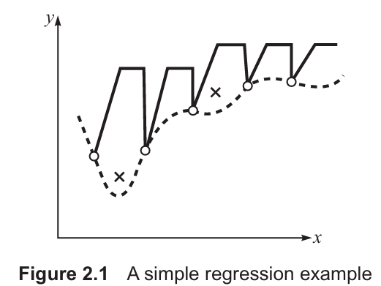
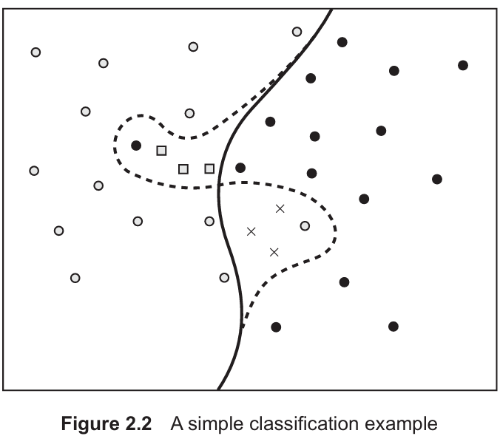
Example (Classification - Figure 2.2): A complex decision boundary that separates every training point correctly might misclassify simple test points that were not in the training set.

Slide 10
The Ultimate Goal: Generalization
Generalization: The ability of the trained machine to accurately predict outputs for novel patterns (data it has never seen before).
Test Dataset: We measure generalization performance by checking the error on a separate test dataset (data not used for training). This error is called the off-training set error.
Inductive Learning: The process of using specific training examples to create a general hypothesis (h(x)) that hopefully approximates the true unknown function f(x) well, allowing it to generalize.

Slide 11
Limitations of the theory
No Free Lunch Theorem: There is no single "best" machine learning algorithm that works best for all possible problems.
Because perfect theoretical solutions are elusive, practitioners often rely on:
Heuristics (Trial-and-Error): Trying different algorithms and configurations.
Occam’s Razor Principle: Favouring the simplest hypothesis (the simplest function f(x)) that adequately explains the data, as this is often less prone to overfitting.

Slide 12
Bias and variance
Imagine you are trying to hit a target (the true function, f(x)) using a dartboard. Every time you train your machine learning model, it's like throwing a dart. Since you get slightly different training data samples each time, your dart hits a slightly different spot.
Bias (The "Wrong Spot" Error)
Simple Term: Underfitting.
You are aiming for the bullseye, but all your darts land consistently in the upper-left quadrant. You are consistently missing the true target because of a fundamental flaw in your aim.

Slide 13
In ML: Bias is the error that arises from the chosen model being too simple or too inflexible to capture the true underlying relationship in the data.
The model is so simple (e.g., a straight line on a curve) that even if you train it on infinite data, the average prediction will still be wrong.
Variance (The "Scattered" Error)
Overfitting.
Analogy: Your darts are scattered all over the board. Sometimes you hit the bullseye perfectly, sometimes you miss widely, but your average aim (the center of the scatter) is correct. Your individual throws are wildly sensitive to tiny differences in how you throw.
In ML: Variance is the error that arises from the model being too complex or too sensitive to the specific training data. If you change the training set slightly, the model's predictions change wildly. The model is learning the noise in the data, not the signal.

Slide 14
Bias variance trade off
Bias refers to the errors due to over simplistic assumptions in the learning algorithms.
Bias always deals with training data.
Data Output
Generally if we have 1000 entries in our data then we divide it into two parts 700= training data , 300= test data
Machine Learning Model

Slide 15
We gave training data to MLM so that it learns the pattern. After it has learned the pattern then we will check what output it gave.
Then we will check output obtained from MLM and actual output of the training data(As the learning is supervised it will have some output). Then we will check if there is any error between actual output and predicted output.
Once model is trained then it is given for test
Let’s consider a linear regression model.
Since training data lies above best fit line which means
There is very high error between actual output and predicted
Output. Which means that you have high bias
Note: If training data gives high error then obviously test
data will also give high error. This model is known as underfit
Notes:
Example: After Students are trained by a faculty on one particular unit of AML then they have to answer IT where paper is set by the same faculty. After looking at the result it was found that many students got less marks this is where we can say that there was high error on training data which is same as high bias.

Slide 16
High bias
When model is too simple, it underfits the data. This means model does not capture important patterns in the data, leading to poor performance on both training and testing data.

Slide 17
Variance
Variance refers to the errors due to model sensitivity to small fluctuations in the training data.
Example: When the model is trained on training data then let’s say error= 20 and when the same model is given test data, error =90. So, the difference =70. This is called high variance

Slide 18
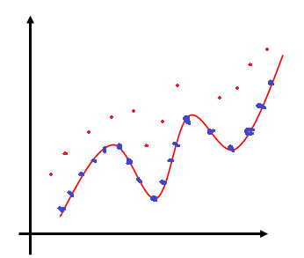
Variance
Model has understood training data so well that all the points of training data lies on the line i.e. Error=0
Same Model Performs poorly on the test data.
Example: Students score good marks in internal test but they could not score good marks in University exams

Slide 19
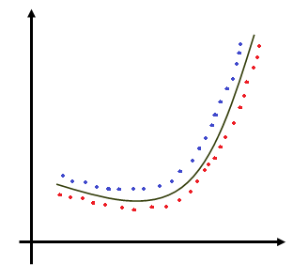
Variance trade off
We don’t want model to either underfit nor overfit instead we want a model which gives low bias and low variance
When bias and variance both are low then we call it a generalized model.
High Variance: When model is too complex to overfit the data. This means model performs well on training data but poorly on unseen test data because it has memorized the training data rather than learning generalized pattern
Low variance: When the model is general enough to perform consistently across both training and testing data.

Slide 20
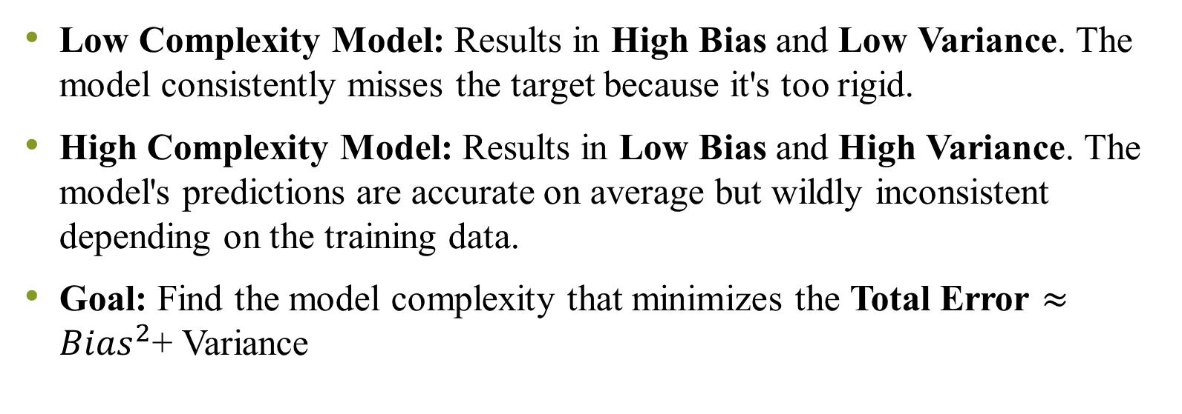
Bias Variance Dilemma
Low Complexity Model: Results in High Bias and Low Variance. The model consistently misses the target because it's too rigid.
High Complexity Model: Results in Low Bias and High Variance. The model's predictions are accurate on average but wildly inconsistent depending on the training data.
Goal: Find the model complexity that minimizes the Total Error $≈{Bias}^{2}$+ Variance

Slide 21
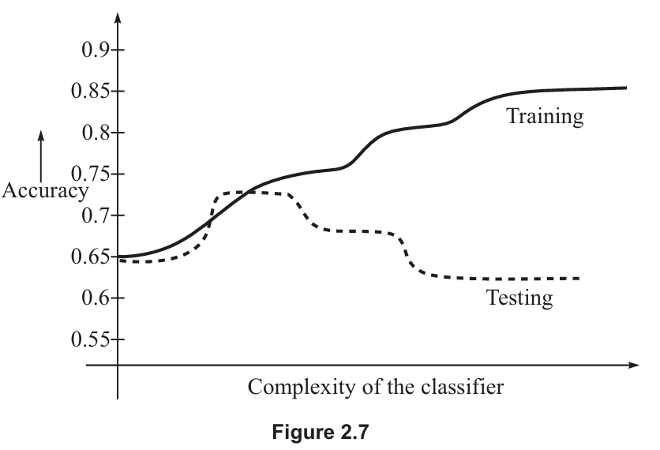
Overfitting and Generalization
Overfitting: Occurs when a model fits the training data (including its noise and coincidental patterns) so well that it performs worse on new, unseen data.
Training Accuracy: Always increases as model complexity increases (the solid line in Fig. 2.7).
Testing/Generalization Accuracy: Increases, but then decreases sharply as complexity increases past the optimal point (the broken line in Fig. 2.7). The goal is to maximize this.

Slide 22
Principles for Overfitting Avoidance
Occam’s Razor Principle
Idea: When faced with two hypotheses (models) that perform equally well on the training data, choose the simpler one.
Reasoning: The simpler model is less likely to have accidentally captured noise or coincidental regularities in the training data, thus offering better generalization on unseen data.

Slide 23
If there are two algorithms and both of them perform equally well on the training set, then according to Occam’s razor principle, the simpler algorithm can be expected to do better on a test set;
‘simpler’ may imply needing lesser parameters, lesser training time, fewer attributes for data representation, and lesser computational complexity.
We usually stop looking for a design when the solution is ‘good enough’, not necessarily the optimal one.

Slide 24
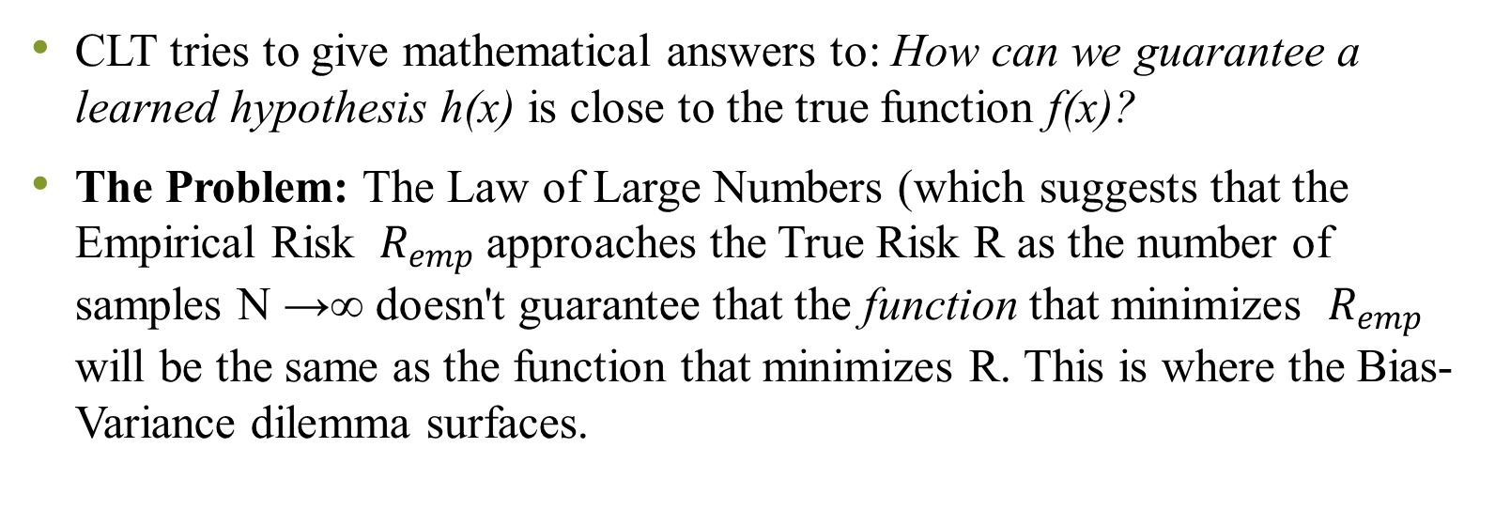
Computational Learning Theory (CLT)
CLT tries to give mathematical answers to: How can we guarantee a learned hypothesis h(x) is close to the true function f(x)?
The Problem: The Law of Large Numbers (which suggests that the Empirical Risk ${ R}_{emp}$approaches the True Risk R as the number of samples N →∞ doesn't guarantee that the function that minimizes ${ R}_{emp}$ will be the same as the function that minimizes R. This is where the Bias-Variance dilemma surfaces.
Notes:
Let’s use a simple example: Predicting if a student will pass an exam based on how many hours they studied.
1. The Problem: The Law of Large Numbers vs. The Reality
Imagine you have a small dataset of 5 students.
Empirical Risk (R_{emp}): This is your "Training Error." If you find a crazy, wiggly mathematical function that perfectly hits every data point in your 5-student sample, your R_{emp} is zero.
True Risk (R): This is the error the model would make on every student in the world.
The Law of Large Numbers says that if you had infinite students, your training error would eventually equal the true error. But you don't have infinite students. CLT warns us that just because you found a function that works perfectly on those 5 specific students (R_{emp} = 0), it doesn't mean it will work for the rest of the world (R).

Slide 25
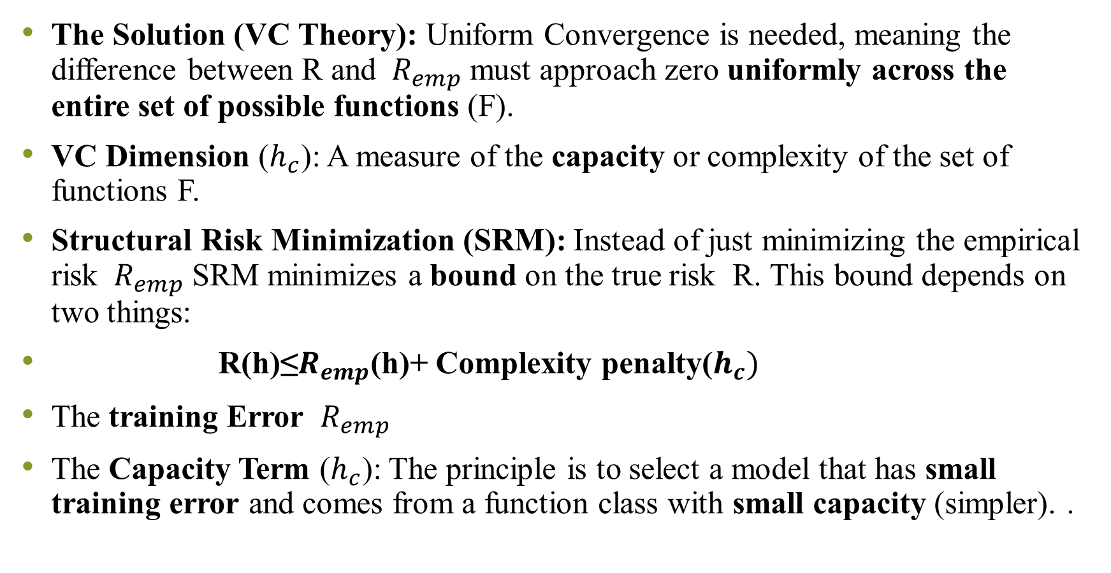
The Solution (VC Theory): Uniform Convergence is needed, meaning the difference between R and ${ R}_{emp}$ must approach zero uniformly across the entire set of possible functions (F).
VC Dimension ($h_{c}$): A measure of the capacity or complexity of the set of functions F.
Structural Risk Minimization (SRM): Instead of just minimizing the empirical risk ${ R}_{emp}$ SRM minimizes a bound on the true risk R. This bound depends on two things:
R(h)≤$R_{emp}$(h)+ Complexity penalty($h_{c})$
The training Error ${ R}_{emp}$
The Capacity Term ($h_{c}$): The principle is to select a model that has small training error and comes from a function class with small capacity (simpler). .
Notes:
Vapnik-Chervonenkis (VC) theory, developed by Vladimir Vapnik and Alexey Chervonenkis
The VC Dimension measures the "flexibility" or "capacity" of your model.
Low Capacity: A simple straight line (Linear Model). It can't fit complex patterns, but it’s hard to "trick" with a few weird data points.
High Capacity: A high-degree polynomial (a very wiggly curve). It can twist and turn to pass through every single point in your sample.
In our study example, a high-capacity model might decide that "Students who study for 4.2 hours and wear blue socks always pass." It fits your small sample perfectly, but it's nonsense.
In our exam example, SRM works like this:
Model A (Simple Line): Has some training error (it misses a few points) but has a very low complexity penalty.
Model B (Complex Curve): Has zero training error but a huge complexity penalty because it's so "wiggly."
SRM chooses Model A. Even though it has a slightly higher training error, the "total bound" (Training Error + Complexity) is lower. This suggests Model A is more likely to perform well on future, unseen students.

Slide 26
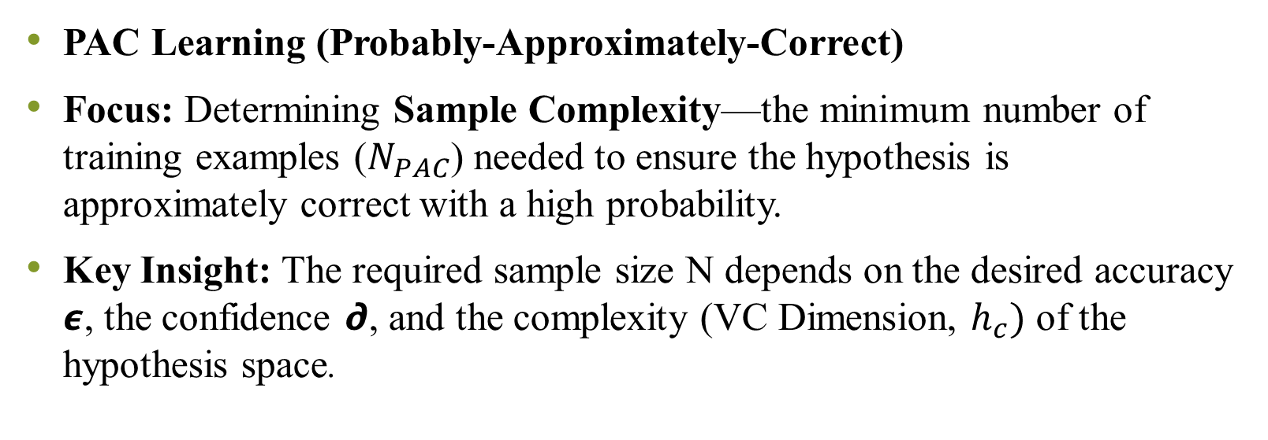
PAC Learning (Probably-Approximately-Correct)
Focus: Determining Sample Complexity—the minimum number of training examples ($N_{PAC}$) needed to ensure the hypothesis is approximately correct with a high probability.
Key Insight: The required sample size N depends on the desired accuracy 𝟄, the confidence 𝟃, and the complexity (VC Dimension, $h_{c})$ of the hypothesis space.
Notes:
If VC Theory is about the quality of the model, PAC Learning is about the quantity of the data.
Think of PAC Learning as a "Success Guarantee" contract. It acknowledges that in machine learning, we can almost never be 100% certain, so we settle for being "Probably Approximately Correct.“
1. The "Approximately" (𝟄- Error)
We accept that the model won't be perfect. 𝟄 is the error margin.
If 𝟄= 0.1, you are saying, "I'm okay if the model is 90% accurate."
The Rule: The smaller the error you want, the more data you need.
2. The "Probably" (𝟃 - Failure Probability)
Even with great data, there is a tiny chance you get a "weird" sample (like flipping a fair coin 10 times and getting heads every time). 𝟃 is the risk of being totally wrong.
If 𝟃= 0.05, you are saying, "I want to be 95% confident that my model is actually good."
The Rule: The higher the confidence you want, the more data you need.
3. The "Complexity" (h- VC Dimension)
This is how complicated your "guess" is.
If I'm just guessing "It's always Heads," that's a simple hypothesis.
If I'm using a complex formula involving wind speed, thumb pressure, and gravity, that’s a high-complexity hypothesis.
The Rule: Complex theories require much more data to "prove" they aren't just coincidences.
You don't need to memorize the formula, just the relationships:
To get more accurate (lower $\epsilon$): You need a lot more data ($1/\epsilon$ grows fast).
To get more confident (lower $\delta$): You need more data (but it grows slowly, via $\log$).
To use a more complex model (higher $h$): You need more data to justify that complexity.

