Slide 1
Metrics for assessing regression accuracy
Mr. Shrikrishna Anand Narvekar
Assistant Professor
Computer Engineering Department
Agnel Institute of Technology and Design

Slide 2
Content
Metrics for assessing regression accuracy
Metrics for assessing classification accuracy

Slide 3
Metrics for assessing regression accuracy
What is residual(Error)
Actual Value (y): The real result (e.g., a house actually sold for $300k)
Predicted Value (h(x)): What your model guessed (e.g., your model guessed $280k).
Error: The difference between them ($20k).

Slide 4
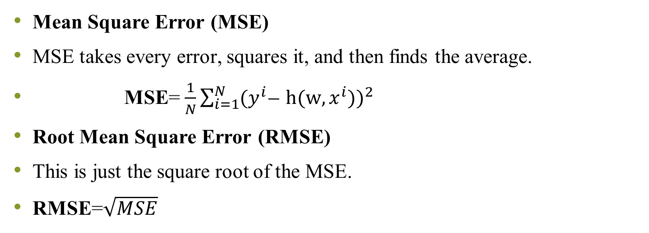
Metrics
Mean Square Error (MSE)
MSE takes every error, squares it, and then finds the average.
MSE= $\frac{1}{N}{\sum_{i=1}^{N}{{(y}^{i }}̶ h(w,x^{i}))}^{2}$
Root Mean Square Error (RMSE)
This is just the square root of the MSE.
RMSE=$\sqrt{MSE}$
Notes:
Why use it? If you are predicting house prices in dollars, MSE gives you "dollars squared," which is hard to imagine. RMSE brings the unit back to "dollars," making it easier to explain to humans.

Slide 5
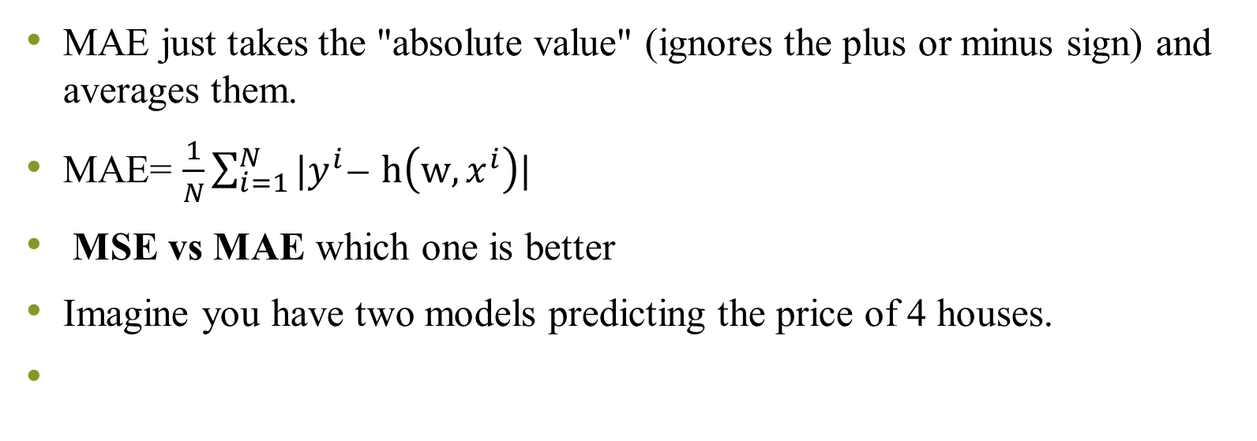
Mean absolute Error
MAE just takes the "absolute value" (ignores the plus or minus sign) and averages them.
MAE= $\frac{1}{N}\sum_{i=1}^{N}{{|y}^{i }}̶ h\left(w,x^{i}\right)|$
MSE vs MAE which one is better
Imagine you have two models predicting the price of 4 houses.

Slide 6
House | Actual | Model A Guess | Model A Error | Model B Guess | Model B Error
1 | $100k | $105k | +5 | $95k | -5
2 | $100k | $95k | -5 | $105k | +5
3 | $100k | $105k | +5 | $95k | -5
4 | $100k | $95k | -5 | $150k | +50

Slide 7
MAE Calculation:
Model A: (5+5+5+5) / 4 = 5
Model B: (5+5+5+50) / 4 = 16.5
MSE Calculation:
Model A: (5^2 + 5^2 + 5^2 + 5^2) / 4 = 25
Model B: (5^2 + 5^2 + 5^2 + 50^2) / 4 = (25 + 25 + 25 + 2500) / 4=643.75
Model B’s MSE exploded because of that one big mistake (50).
Use MSE if you want to strictly punish large errors (e.g., in a medical device where a big error is dangerous).
Use MAE if you want a more "realistic" average and don't want a few weird data points (outliers) to ruin your score.

Slide 8
A model predicts house prices (in ₹ lakhs):
Find: Error for each house price
Calculate MSE,RMSE,MAE
House | Actual Price (y) | Predicted Price (ŷ)
1 | 50 | 48
2 | 60 | 65
3 | 55 | 52
4 | 70 | 75

Slide 9
A real estate company in Mumbai is testing two machine learning models to predict house prices (in ₹ lakhs). The actual selling prices of 4 houses are:
Two models give the following predictions:
Model A: 40, 52, 58, 72
Model B: 40, 50, 60, 120
The company wants to evaluate both models using Mean Square Error (MSE) and Mean Absolute Error (MAE).
Question:
Calculate MSE and MAE for both models.
Which model is better? Justify your answer.
House | Actual Price
1 | 40
2 | 50
3 | 60
4 | 70

Slide 10
Metrics for assessing classification accuracy
In Classification we are teaching a computer to put things into categories—like "Spam" vs. "Not Spam" or "Cancerous" vs. "Healthy.“
Unlike predicting a house price (Regression), where you can be "off by a little bit," classification is binary: you either got the label right, or you didn't.
Why "Accuracy" Can Be Deceptive
The most basic metric is Misclassification Error (how many times the model was wrong). However, the text highlights a huge trap: Imbalanced Data.

Slide 11
Confusion Matrix
True Positive (TP): You predicted "Sick," and they actually are. (Correct)
True Negative (TN): You predicted "Healthy," and they actually are. (Correct)
False Positive (FP): You predicted "Sick," but they are healthy. (False Alarm)
False Negative (FN): You predicted "Healthy," but they are sick. (The "Dangerous Miss")
Notes:
In medicine, a False Negative is usually much worse than a False Positive because a sick person goes untreated.

Slide 12
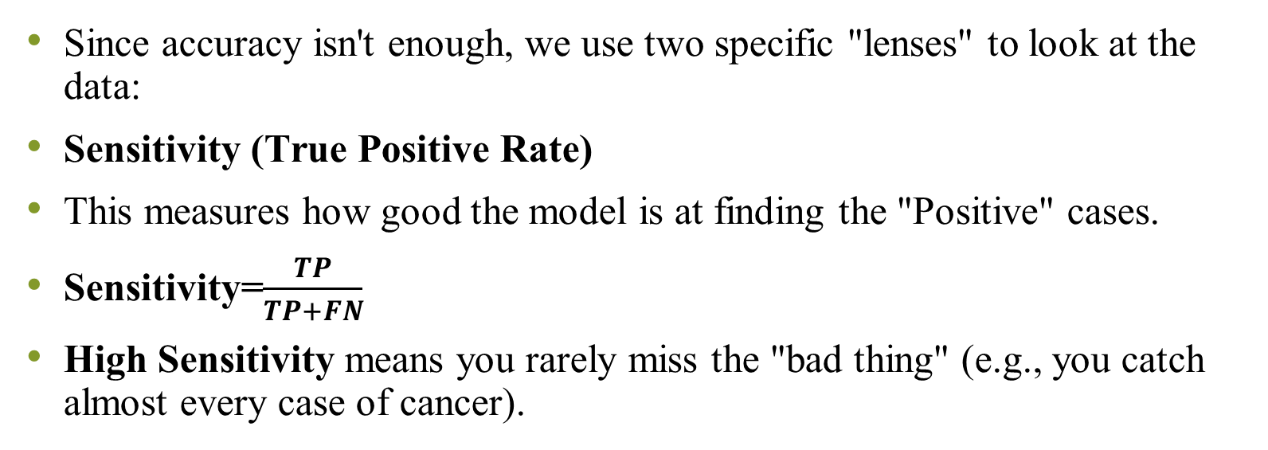
Sensitivity
Since accuracy isn't enough, we use two specific "lenses" to look at the data:
Sensitivity (True Positive Rate)
This measures how good the model is at finding the "Positive" cases.
Sensitivity=$\frac{TP}{TP+FN}$
High Sensitivity means you rarely miss the "bad thing" (e.g., you catch almost every case of cancer).

Slide 13
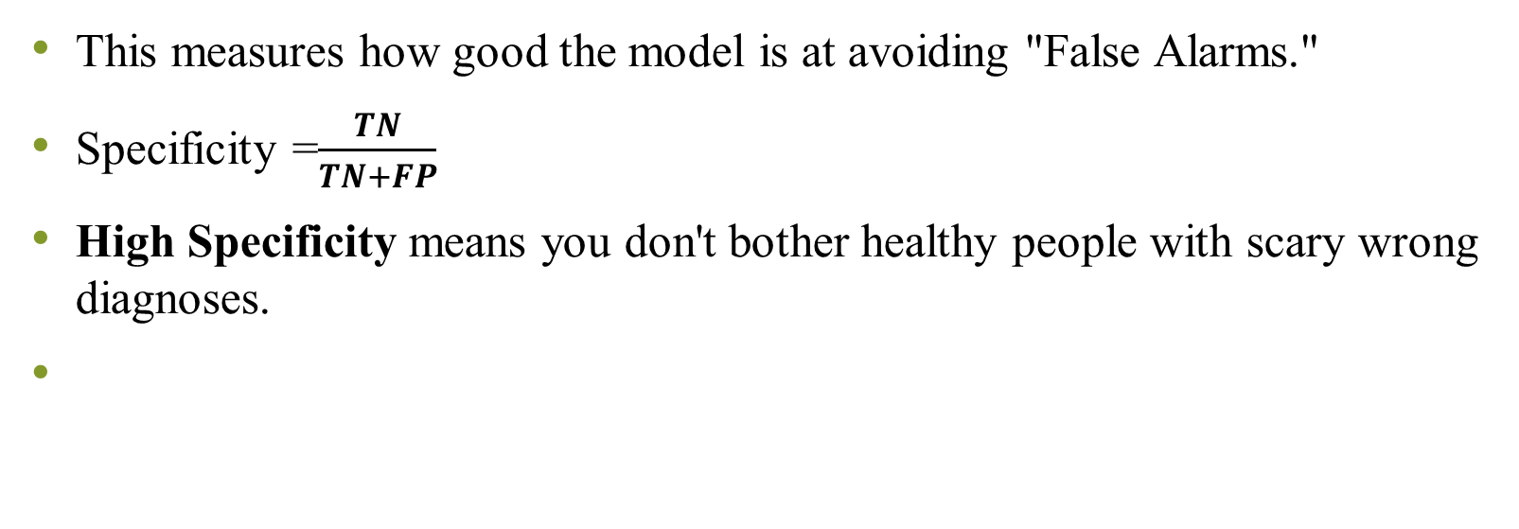
Specificity
This measures how good the model is at avoiding "False Alarms."
Specificity =$\frac{TN}{TN+FP}$
High Specificity means you don't bother healthy people with scary wrong diagnoses.

Slide 14
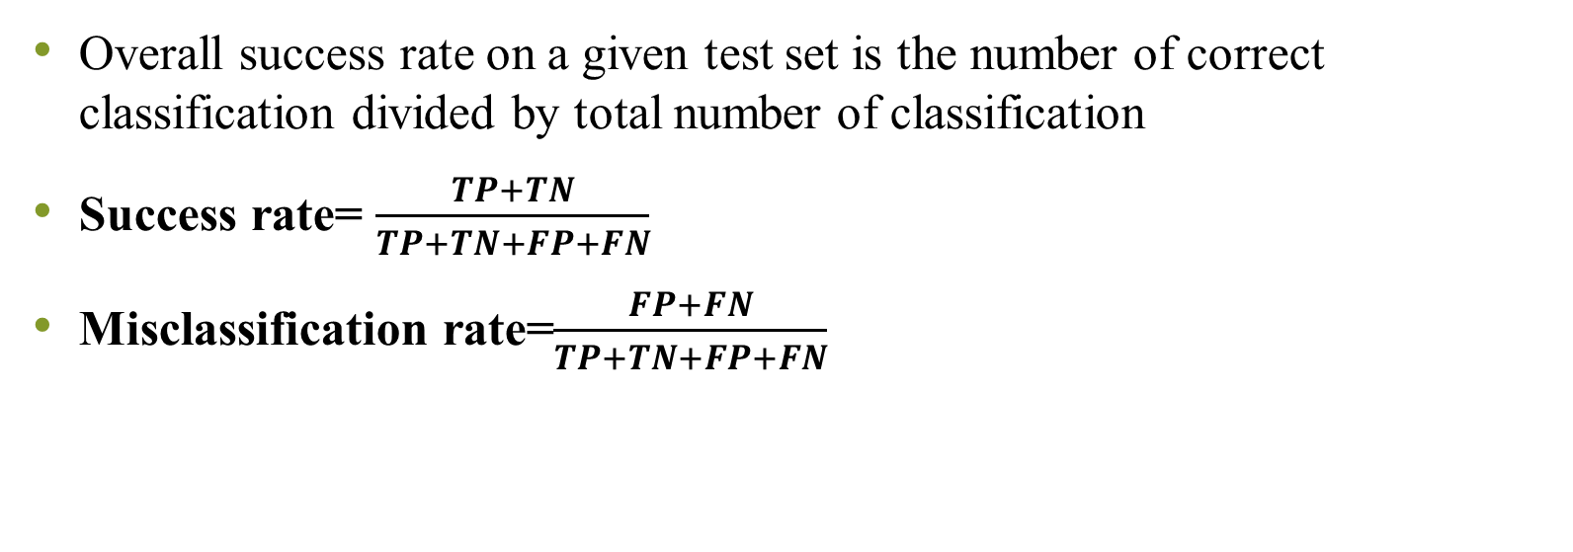
Misclassification error
Overall success rate on a given test set is the number of correct classification divided by total number of classification
Success rate= $\frac{TP+TN}{TP+TN+FP+FN}$
Misclassification rate=$\frac{FP+FN}{TP+TN+FP+FN}$

Slide 15
Numerical
Confusion matrix of a model applied to a set of 200 observations is given in table below
Calculate success rate and misclassification rate
 | Predicted +1 | Predicted -1
Actual +1 | 95 | 7
Actual -1 | 4 | 94

Slide 16
Consider a confusion matrix given below for a binary classifier predicting presence of disease. Classifier made total of 150 predictions. Out of those 150 cases , classifier predicted “Yes”= 100 times and “No” 50 times. Calculate accuracy and misclassification rate
 | Predicted NO | Predicted Yes
Actual No | 45 | 5
Actual Yes | 5 | 95

