Slide 1
Regression Analysis
Mr. Shrikrishna Anand Narvekar
Assitant Professor
Computer Engineering department
Agnel Institute of Technology and Design

Slide 2
Regression
Identify relationship amongst variable based on historical data
Example: Predicting price of house based on several parameters such as size, location , age etc
Independent variable: Size, location ,age
Dependent variable: Price
Use this developed relation to predict future

Slide 3
Regression analysis
Estimating relationship amongst variable
How dependent variable is influenced by independent variable
Eg:Petrol prices increase with increase in demand
Dependent variable: Petrol Prices(Variable you want to predict or explain)
Independent variable: Demand for petrol( Factor that influences petrol prices)

Slide 4
Steps involved on Regression
Understand the variables
Create a dummy data
Perform regression analysis
Interpret the results
Graphical representation

Slide 5
Types of regression techniques
Number of Independent Variables
Shape of the Regression Line
Type of Dependent Variable

Slide 6
Understanding benefits of regression analysis
Indicates the Significant Relationships between Dependent and Independent Variables:
Indicates the Strength of Impact of Multiple Independent Variables on a Dependent Variable:
Helps Compare the Effects of Variables Measured on Different Scales:
Evaluates the Effects of Price Changes and the Number of Promotional Activities
Benefits Market Researchers / Data Analysts / Data Scientists:

Slide 7
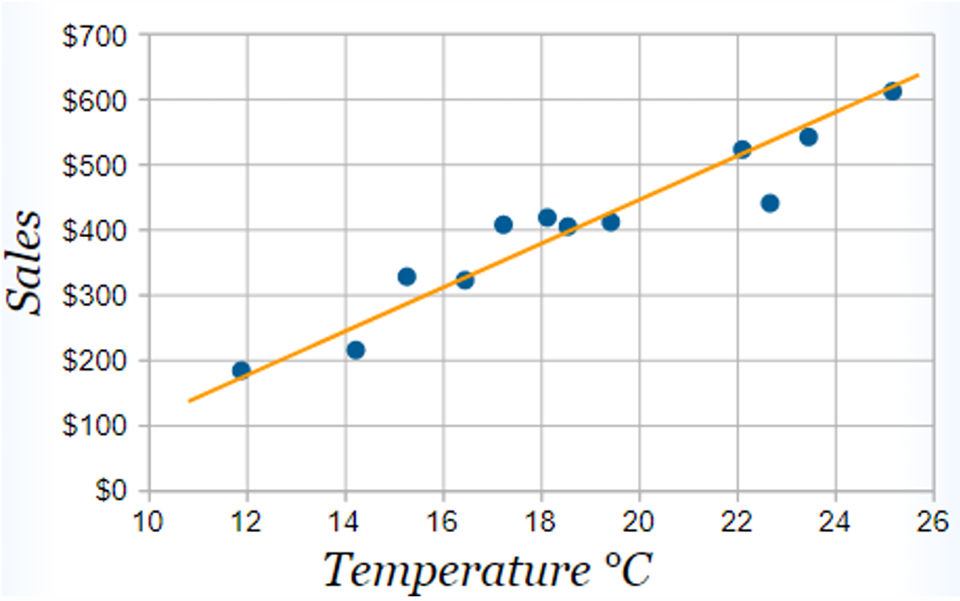
Line of best fit
Imagine you have some points, and want to have a line that best fits them like this
But for better accuracy we will calculate the line using Least Squares Regression

Slide 8
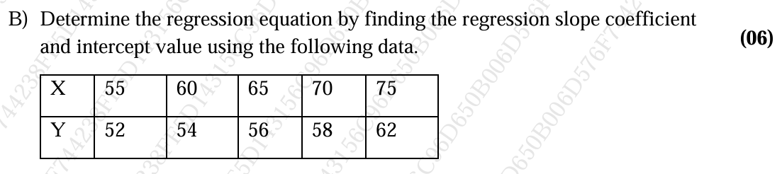
Questions Asked
What is simple linear regression? State how to use simple linear regression with its relevant formula ?
What is multiple linear regression? state how to use multiple linear regression with its formula? explain with the help of house price prediction example

Slide 9
Questions Asked
What is simple linear regression? State how to use simple linear regression with its relevant formula ?
What is multiple linear regression? state how to use multiple linear regression with its formula? explain with the help of house price prediction example

Slide 10
Challenges in linear regression
Overfitting: Overfitting happens when the model includes too many irrelevant details.
Multicollinearity: Two or more predictor variables are highly correlated, making it difficult to estimate their individual effect on the outcome.
Assumption of linearity: Linear regression assumes a straight-line relationship between independent and dependent variables.
Sensitive to outliers: A single extreme value can distort the regression line heavily.
Notes:
1. Overfitting
📌 Concept: The model learns the training data too well (including noise), so it performs poorly on new/unseen data. 📌 Real-life Scenario: Imagine a real estate agency trying to predict house prices.
They collect data with too many irrelevant details (like the color of curtains, number of flower pots, or wallpaper design).
If these features are included, the model may “memorize” them and predict well on the training houses, but on new houses, the predictions fail because curtain color does not really affect house prices.
👉 Lesson: Overfitting happens when the model includes too many irrelevant details.
2. Multicollinearity
📌 Concept: Two or more predictor variables are highly correlated, making it difficult to estimate their individual effect on the outcome. 📌 Real-life Scenario: In predicting a student’s exam score, suppose we use both:
Study time (hours spent reading)
Number of pages read
These two variables are strongly correlated (more hours usually means more pages read). The model struggles to decide: Is the score going up because of hours or because of pages?
👉 Lesson: Multicollinearity makes interpretation of coefficients confusing.
3. Assumption of Linearity
📌 Concept: Linear regression assumes a straight-line relationship between independent and dependent variables. 📌 Real-life Scenario: Consider predicting employee productivity based on working hours.
Up to 8 hours, productivity increases with time.
After 9–10 hours, productivity drops due to fatigue.
If we use linear regression, it assumes productivity always rises with hours worked, which is not true in real life.
👉 Lesson: Not all relationships are linear; sometimes curves (polynomial or non-linear models) are better.
4. Sensitivity to Outliers
📌 Concept: A single extreme value can distort the regression line heavily. 📌 Real-life Scenario: Suppose we are predicting monthly income based on years of experience.
Most employees earn between ₹20,000–₹80,000.
But the CEO (40 years of experience) earns ₹10,00,000.
That one outlier can pull the regression line upward, making the model overestimate incomes for regular employees.
👉 Lesson: Outliers can mislead the regression model’s predictions.

Slide 11
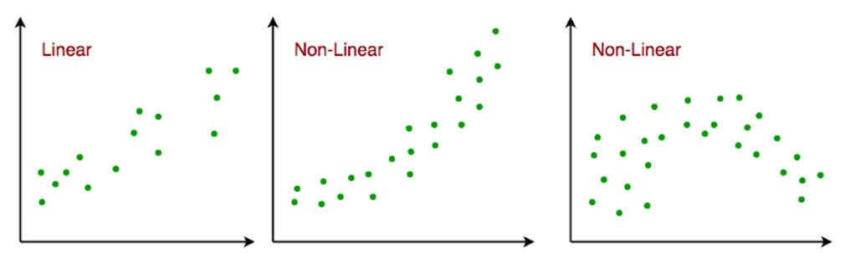
Assumptions of linear regression
Linearity: Linear regression assumes that there is a linear (straight-line) relationship between the independent variable(s) (X) and the dependent variable (Y).
Notes:
1. Linearity: ✅ Real-life example
Suppose you want to predict house price (Y) based on the size of the house in square feet (X).
Generally, as the size increases, the price also increases in a roughly straight-line pattern → this satisfies the linearity assumption.
But, if the relationship is curved (e.g., for very large houses, the price doesn’t increase proportionally due to location constraints), then the linearity assumption is violated.
🔎 How to check linearity?
Scatterplot: Plot X vs Y. If the data points form a straight-line trend, linearity holds.
Residual plots: Residuals (errors) should not show any curve/trend. If they do, the relationship may be non-linear.
⚠️ What if this assumption is violated?
Predictions will be biased or misleading.
Example: Predicting employee productivity from working hours – productivity rises up to 8 hours but then drops due to fatigue → a linear model would wrongly assume more hours always mean higher productivity.

Slide 12
2. Independence of errors: Errors in the prediction should not affect each other.
3. Constant Variance (Homoscedasticity): The spread of residuals (errors) should be the same across all levels of the independent variable(s).
4. Normality of errors: The residual should follow a normal distribution.
5. No multicollinearity: Independent variables should not be highly correlated with each other.
6. No Autocorrelation: Errors should not follow a systematic pattern (especially in time series).
7. Additivity: The effect of independent variables on the dependent variable is additive (the total effect is the sum of individual effects).
Notes:
Independence of Errors
Meaning: The residuals (errors) should be independent of each other.
Real-life Scenario: Suppose you are predicting daily sales of a shop based on advertising spend. If sales today are strongly dependent on yesterday’s sales (like seasonal trends or customer habits), then errors are not independent.
If violated: Model underestimates or overestimates errors → results in misleading confidence intervals.
2. Constant Variance (Homoscedasticity)
Meaning: The spread of residuals (errors) should be the same across all levels of the independent variable(s).
Real-life Scenario: Predicting salary based on years of experience.
If at low experience, salaries vary slightly (tight spread), but at high experience, salaries vary a lot (some earn modestly, some very high), the variance is not constant.
If violated (heteroscedasticity): The model’s predictions are less reliable for certain ranges of X.
3. Normality of Errors
Meaning: The residuals should follow a normal distribution (bell curve).
Real-life Scenario: In predicting students’ marks from study hours, most students should fall near the predicted line, with fewer very high/very low deviations.
If violated: Hypothesis tests (like t-tests, F-tests) become invalid.
4. No Multicollinearity
Meaning: Independent variables should not be highly correlated with each other.
Real-life Scenario: Predicting car price using both engine size and horsepower. Since they are strongly related, the model struggles to decide which one actually influences the price.
If violated: Coefficients become unstable and hard to interpret.
5. No Autocorrelation
Meaning: Errors should not follow a systematic pattern (especially in time series).
Real-life Scenario: Predicting monthly electricity consumption based on temperature. If residuals follow a pattern across months (e.g., higher errors every summer), autocorrelation exists.
If violated: The model fails to capture time-based trends.
6. Additivity
Meaning: The effect of independent variables on the dependent variable is additive (the total effect is the sum of individual effects).
Real-life Scenario: Predicting exam score based on study hours and tuition hours. Linear regression assumes:
Score = effect of study hours + effect of tuition hours.
If the two factors interact (e.g., tuition is more effective only if self-study is also high), additivity is violated.
If violated: Interaction terms or non-linear models are needed.

Slide 13
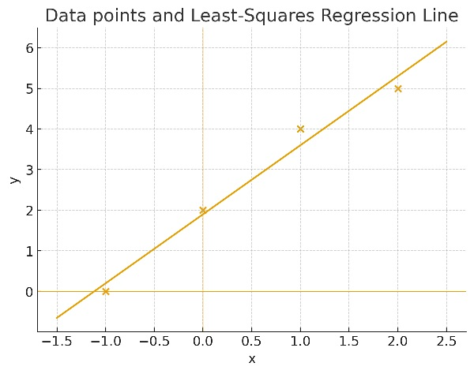
Example
Find the least square regression line for the following set of data {(-1 , 0),(0 , 2),(1 , 4),(2 , 5)}
b) Plot the given points and the regression line in the same rectangular system of axes.

Slide 14
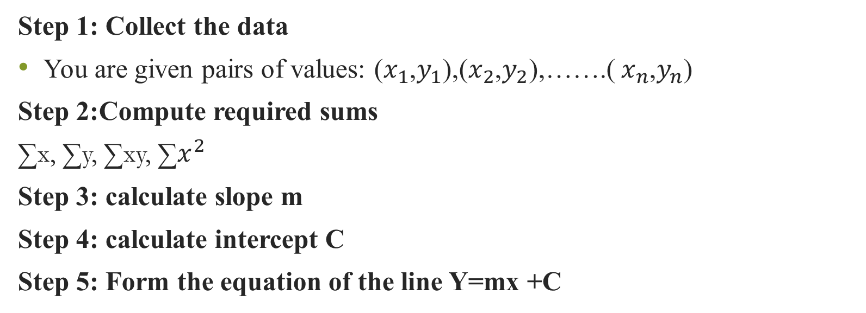
Steps in least square regression
Step 1: Collect the data
You are given pairs of values: ($x_{1}$,$y_{1}$),($x_{2}$,$y_{2}$),…….( $x_{n}$,$y_{n}$)
Step 2:Compute required sums
∑x, ∑y, ∑xy, ∑$x^{2}$
Step 3: calculate slope m
Step 4: calculate intercept C
Step 5: Form the equation of the line Y=mx +C

