Slide 1
Classification Algorithms:SVM
Mr. Shrikrishna Anand Narvekar
Assitant Professor
Computer Engineering department
Agnel Institute of Technology and Design

Slide 2
Introduction
Support Vector Machine or SVM is one of the most popular supervised learning algorithm which is used for classification as well as regression problems.
Primarily it is used for Classification problems in Machine Learning.
Goal: Create best line or decision boundary that can segregate n-dimensional spaces into classes so that we can easily put the new data point into correct category in future.
SVM algorithm can be used for face detection, image classification, text categorization etc

Slide 3
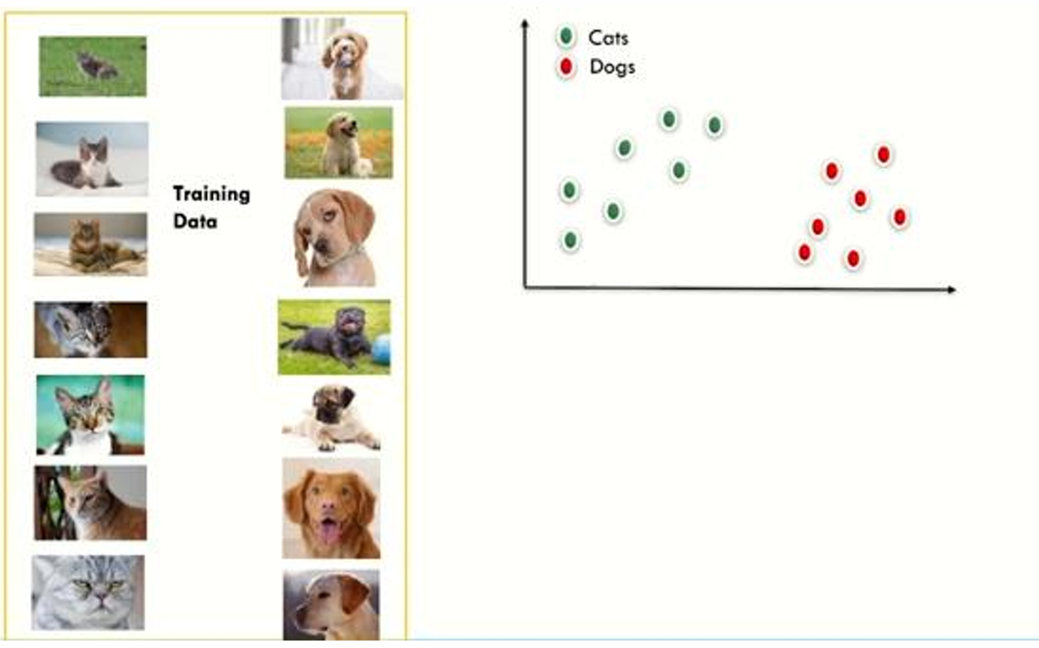
Classification

Slide 4
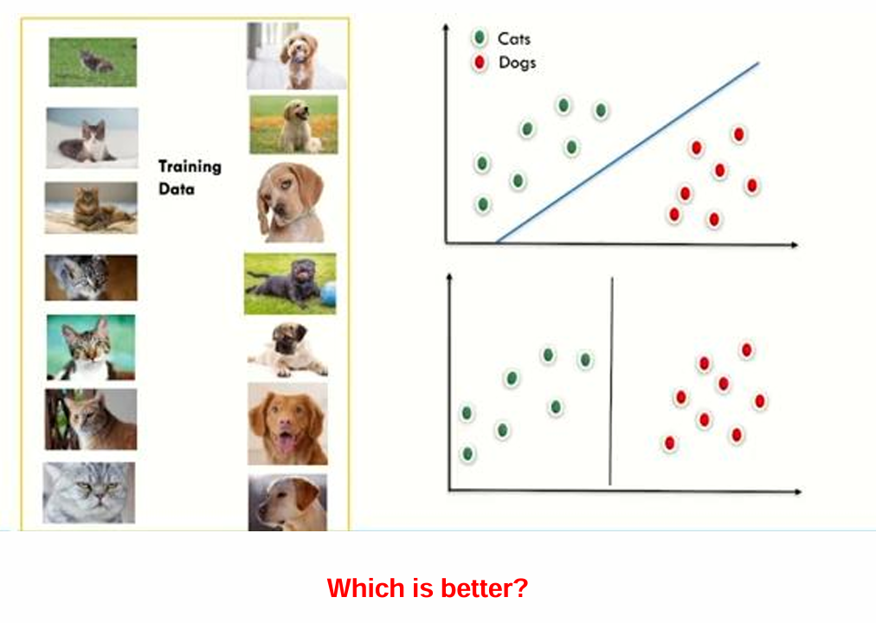
Classification

Slide 5
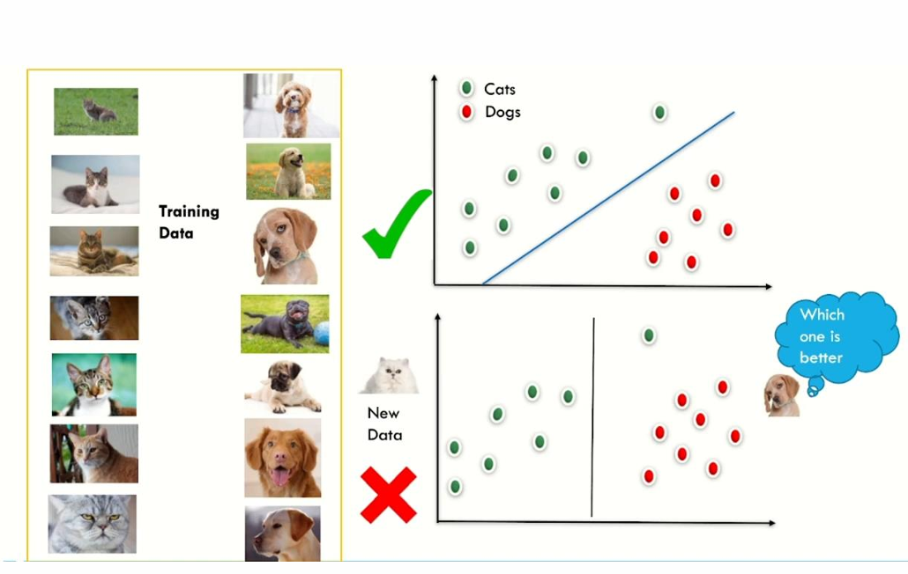

Slide 6
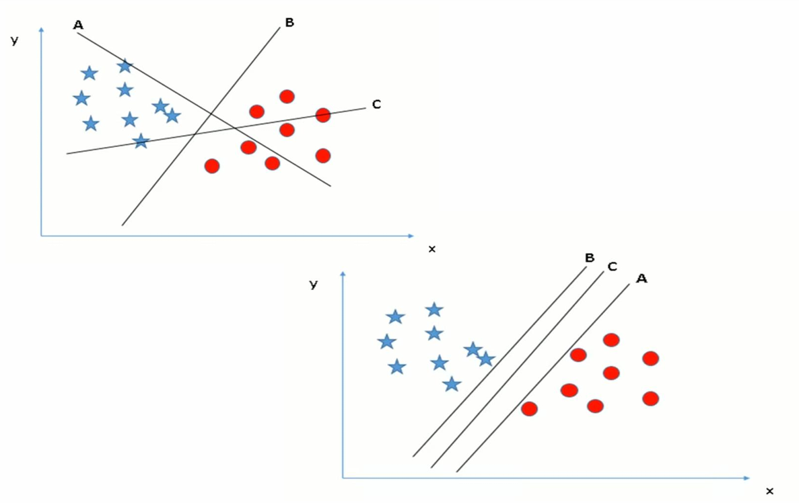
How to choose the partition

Slide 7
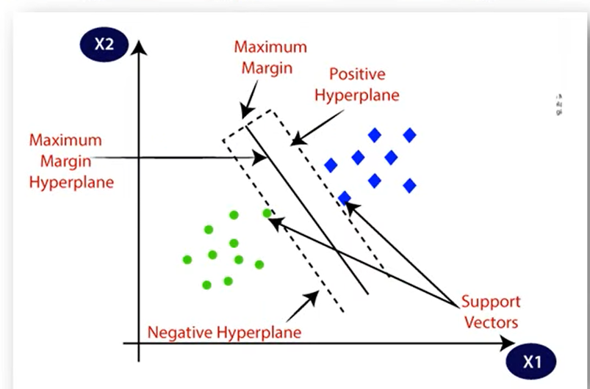
Key concepts of SVM
Hyperplane: It is decision plane or space which is divided between set of objects having different classes.
Support vector: Data points that are closet to the hyperplane is called support vectors
Margin: It is defined as gap between two lines on the closet data points of different classes. It can be calculated as perpendicular distance from the line to the support vectors.
Large margin is considered as good margin and small margin is considered as bad margin.

Slide 8
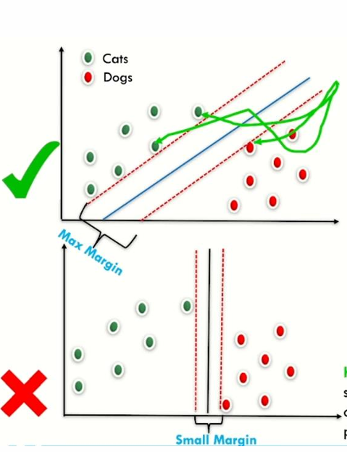
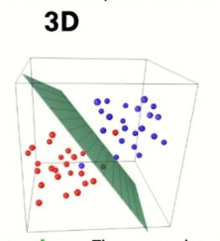
Hyperplanes
A maximum margin linear classifier refers to a linear boundary (like a line in 2D) that maximizes this margin while still correctly classifying the data points.
Hyperplanes:
A hyperplane is the decision boundary that separates different classes in an n-dimensional space.
In the case of 2D data, the hyperplane is simply a line; for 3D data, it would be a plane
Support vectors are the data points that lie closest to the hyperplane. These points are crucial as they determine the position and orientation of the hyperplane
3D hyperplane, where The green plane divides blue and red points in 3D.

Slide 9
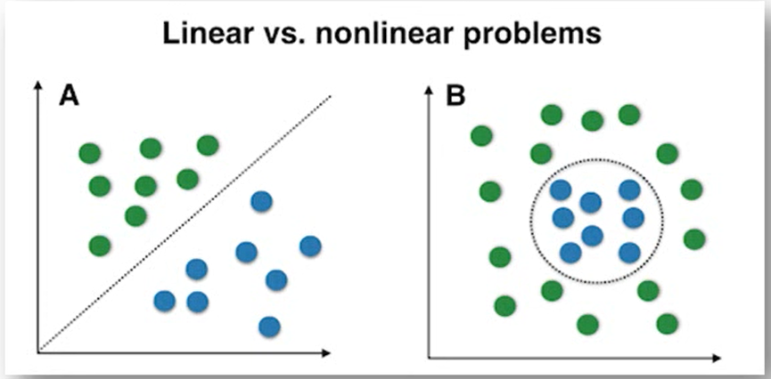
Types of SVM
Linear SVM: It is used for linearly seperable data.
Non-linear SVM: Non-linear SVM is used for non-linearly seperable data, which means if a dataset cannot be classified using straight line,

Slide 10
Algorithm steps
Select two hyperplanes (2D) which separates the data with no points between them (red lines)
Maximize their distance (the margin)
The average line (here the line half way between the two red lines) will be the decision boundary.

Slide 11
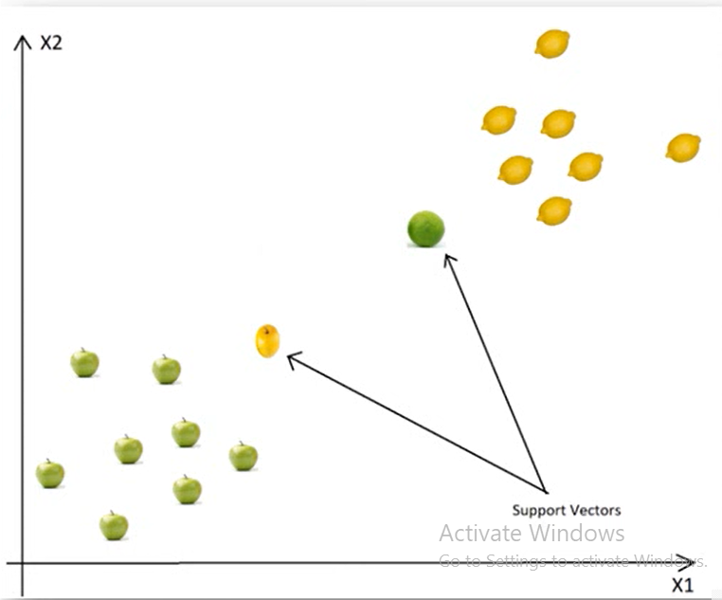
Working of SVM
Scenario 1: Data is linearly separable
There are two classes here apple and lemon
SVM will search for apples that are similar to lemons for example apples which are yellow and have elliptical form
This will be a support vector
The other support vector will be a lemon similar to apple (green and rounded)

Slide 12
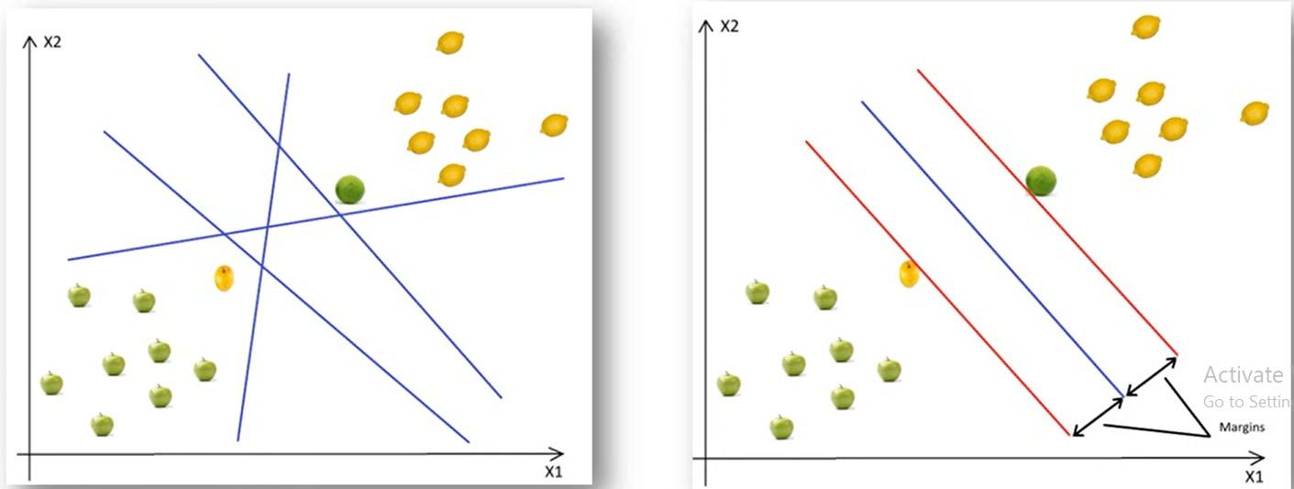
Working of SVM
Based on these support vectors algorithm tries to find the best hyperplane that separates classes.
Finding optimal Hyperplane
To have optimal solution we have to maximize margin in both the ways.
All in all, Support vectors are data
points that defines position and margin of the hyperplane

Slide 13
Soft Margin Formula
It tolerates few dots gets misclassified.
It tries to balance the trade offs between finding the line that maximizes the margin and minimizes the classification.
Two types of misclassifications can happen
The dot is on the correct side of decision boundary but wrong side of the margin
The dot is on wrong side of decision boundary and wrong side of margin.

Slide 14
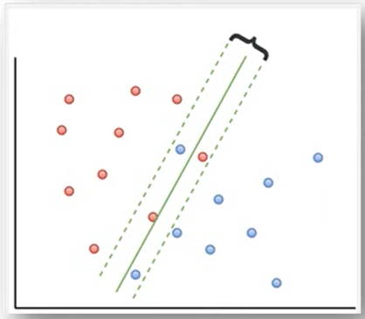

Slide 15
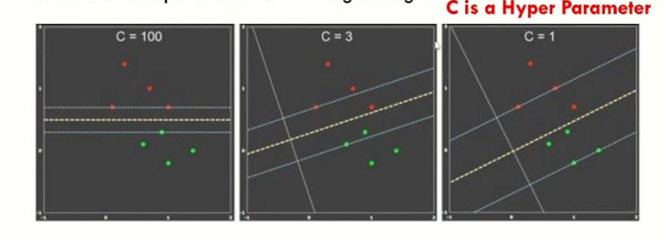
How Misclassification is allowed
C- Parameter tells SVM optimization how much you want to avoid misclassifying each training example.
A large value of C corresponds to a small margin and fewer misclassification errors.
A small value of C results in a larger margin but may allow more misclassification errors.

Slide 16
Errors in SVM
Classification error (A): This error occurs when a data point is misclassified by the SVM model. For example, if a dog is misclassified as a cat or vice versa, that results in a classification error.
Margin error (B): The margin in an SVM refers to the distance between the decision boundary (hyperplane) and the closest data points from each class
Margin errors happen when data points fall within this margin but are not necessarily misclassified. They might still be correctly classified but are too close to the decision boundary
The goal is to minimize both classification errors and margin violations:
Min (C× Classification Error + Margin Error)

Slide 17
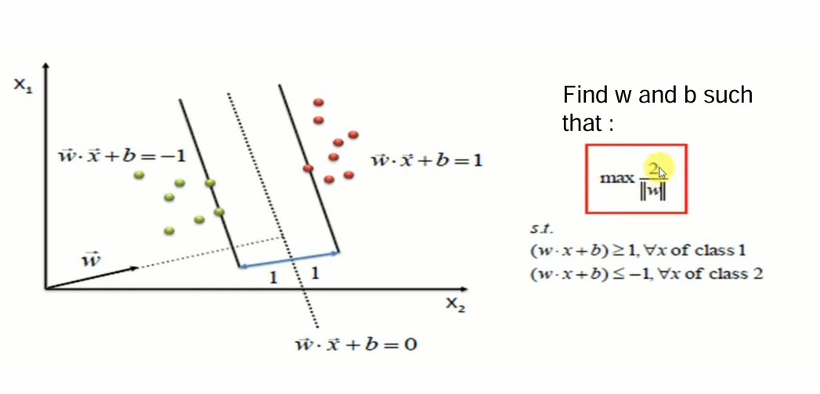
Linear SVM Formula
Where:
w is the normal vector to the hyperplane.
x is the input vector.
b is the bias term (offset of the hyperplane

Slide 18
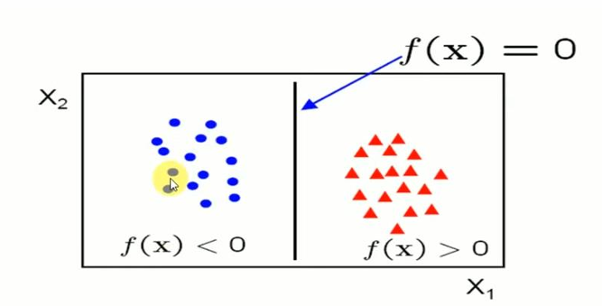

The function f(x) classifies data points:
f(x)>0 means the point is classified as one class.
f(x)<0 means the point is classified as the other class.
The objective is to find w and b that maximally separate the two classes with a large margin

Slide 19
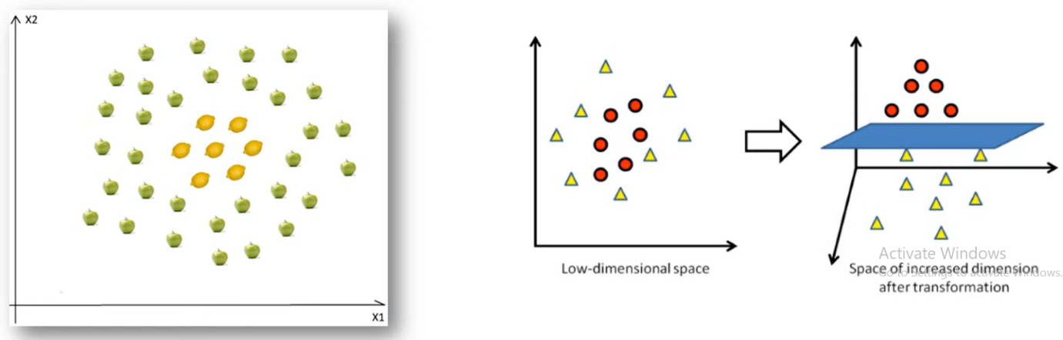
Non-Linear data
Scenario 2: Data is not linearly separable
In this case we cannot find straight lines to separate apples and lemons.
We will use the kernel trick!
The basic idea is that when dataset is inseparable in current dimensions, add another dimension, maybe that is the way data may be separable.

Slide 20
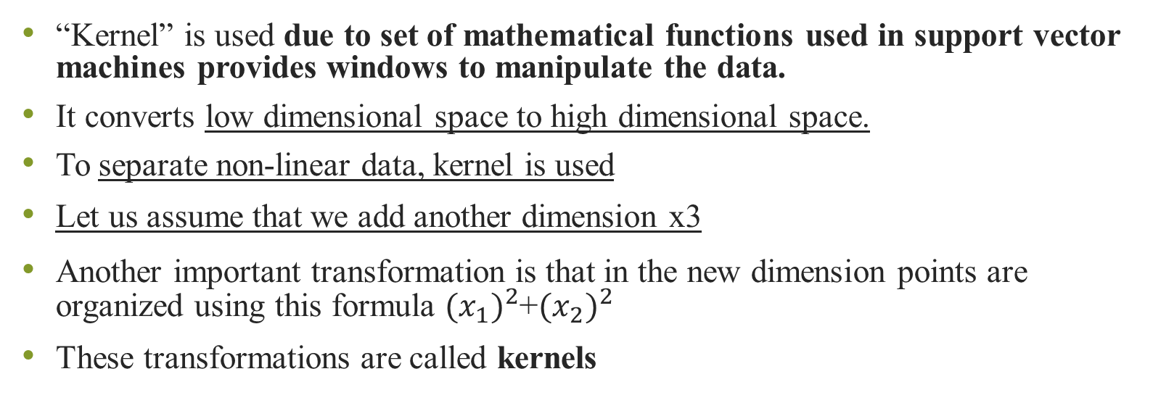
About SVM kernel
“Kernel” is used due to set of mathematical functions used in support vector machines provides windows to manipulate the data.
It converts low dimensional space to high dimensional space.
To separate non-linear data, kernel is used
Let us assume that we add another dimension x3
Another important transformation is that in the new dimension points are organized using this formula ${{(x}_{1})}^{2}$+${{(x}_{2})}^{2}$
These transformations are called kernels

Slide 21
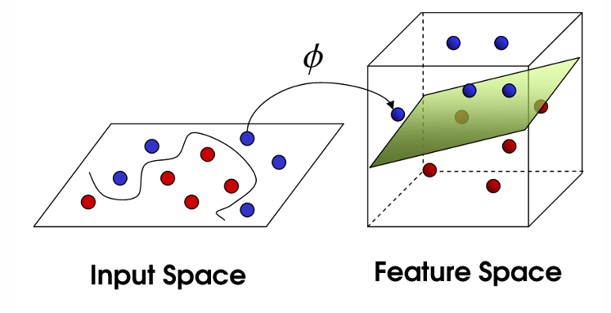

Slide 22
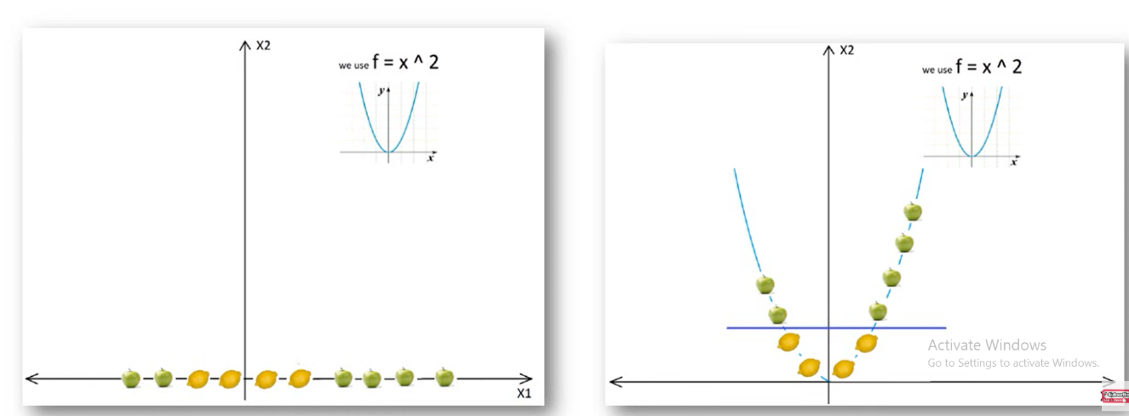
Mapping from 1 D to 2D

Slide 23
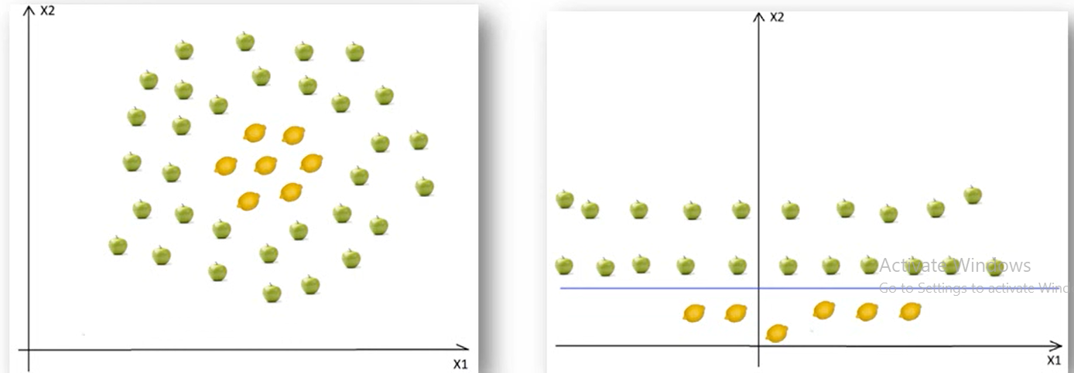
Mapping from 2D to 3D

Slide 24
Text Analysis
It is the automated process of analyzing text to gather insights, patterns and trends
It is widely used in applications like sentiment analysis, spam detection, and document categorization.
When we have vast amount if unstructured data and we want to extract useful information from that time we need text analytics

Slide 25
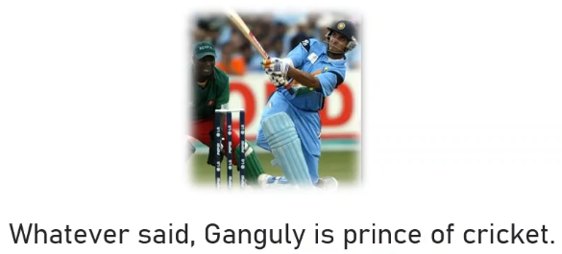
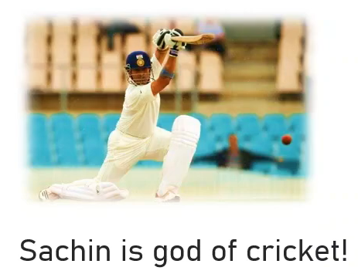
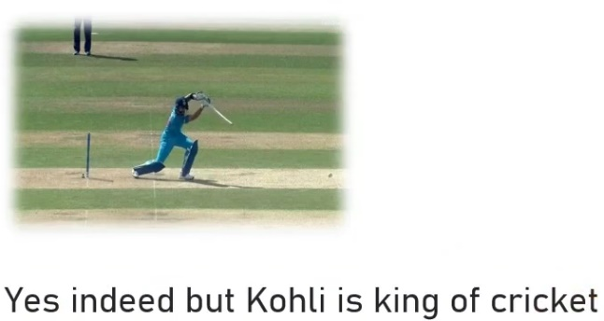
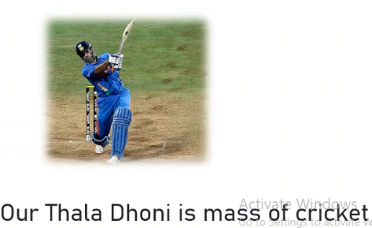
How text gets analyzed
Split the sentence into small elements in the form that they can be treated numerically.

Slide 26
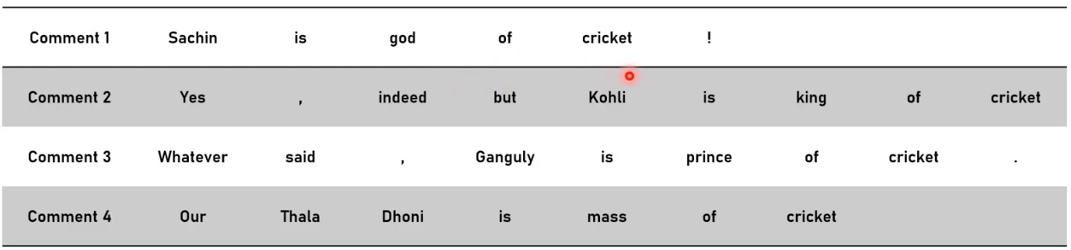
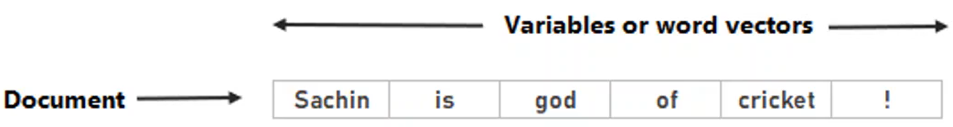
Split Sentence into block of text

Slide 27
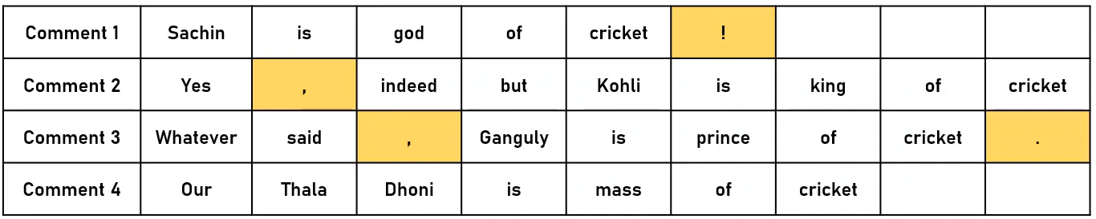
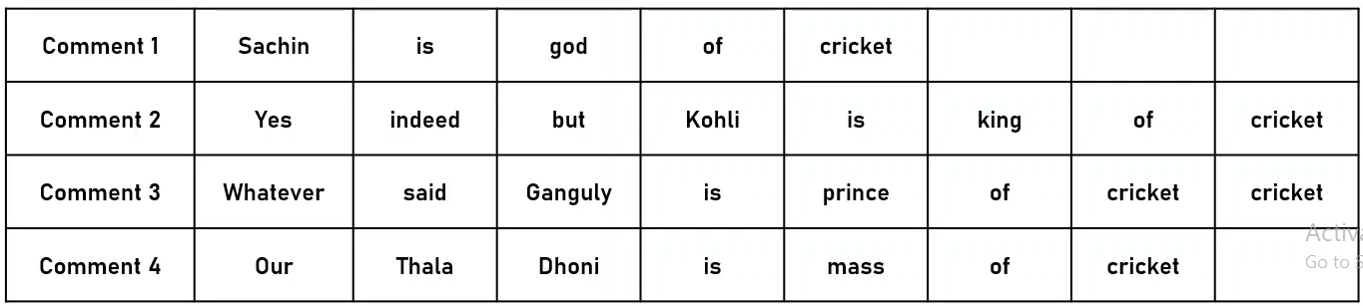
Before cleaning text
The one highlighted in yellow are special characters
The characters such as comma, punctuations, dot are removed first
After cleaning text

Slide 28
To analyze text we introduce something called as term frequency matrix or variable frequency matrix
What we actually do over here is we take all the unique words from the comments and list down it into separate columns.
If it is present in the comment then put it as 1 or else 0.
Let’s highlight two important terms we generally use in text analytics

Slide 29
Token: It is block of words that we see post data cleaning. We already completed process known as tokenization.
Name identity extraction: Process of extracting names from comments is known as Name identity extraction.
We pause on the set of words so that computer can understand that it is name and have a single meaning.

Slide 30
Text Classification
Text classification is the process of assigning predefined categories or labels to a given text document.
Types of text classification:
Binary classification: Classifying text into two categories (e.g. Spam or not Spam)
Multiclass classification: Classifying text into more than two categories(e.g. Classifying news into politics, sports, technology etc.
Multilabel classification: Classifying product reviews into multiple categories like “Home Appliances,” “Electronics,” and “Discounted.”

Slide 31
Steps in text analysis Process
Text analytics process typically consist of several steps aimed at extracting meaningful insights from textual data. Here is brief outline of these steps:
Text Preprocessing
Tokenization: Example: The sentence "Text analysis is fun!" can be tokenized into ["Text", "analysis", "is", "fun", "!"].
Lowercasing: Example: Convert "Text Analysis Is Fun" to "text analysis is fun" to ensure uniformity.
Stopword Removal: Example: From the sentence "Text analysis is fun", remove common words like "is", leaving ["text", "analysis", "fun"].

Slide 32
Steps in text analysis Process
Stemming/Lemmatization: Example:
Stemming: "running" becomes "run", "better" becomes "better".
Lemmatization: "running" becomes "run", "better" becomes "good" (reducing words to their root form based on meaning).
2. Text Representation:
Bag of Words (BoW): Example: For the sentences "I love dogs" and "I love cats", the BoW model builds a frequency table like:
I | love | dogs | Cats
2 | 2 | 1 | 1

Slide 33
Steps in text analysis Process
TF-IDF (Term Frequency-Inverse Document Frequency): Example: For the word "analysis" that appears frequently in one document but rarely in others, TF-IDF will assign it a higher weight compared to common words like "is" or "the".
Word Embedding:
Let’s consider three words: "king", "queen", and "table". In Word2Vec, these words are mapped into a multi-dimensional vector space, where words with similar meanings or used in similar contexts will be close to each other in that space.
"King" might have a vector like: [0.65, 0.33, 0.25, 0.78]
"Queen" might have a vector like: [0.61, 0.35, 0.24, 0.80]
"Table" might have a vector like: [0.12, 0.45, 0.15, 0.34]

Slide 34
Steps in text analysis Process
Even though these vectors are numerical, we can measure the "distance" between them, and words like "king" and "queen" will be closer together in the vector space compared to a word like "table". This distance is calculated using methods like cosine similarity or Euclidean distance.
For example:
The distance between "king" and "queen" would be small, implying they are semantically related (both are royalty).
The distance between "king" and "table" would be larger, as these words are semantically unrelated.

Slide 35
Steps in text analysis Process
Feature Extraction:
Identifying features like word frequency, n-grams (phrases of n words), or parts of speech to form the basis for analysis.
Sentiment Analysis:
Classifying text as positive, negative, or neutral based on the sentiment expressed.
Often involves rule-based, machine learning, or deep learning models.

Slide 36
Steps in text analysis Process
Topic Modeling:
Discovering the underlying themes or topics in a collection of documents (e.g., using Latent Dirichlet Allocation (LDA)).
6. Named Entity Recognition (NER):
Identifying proper nouns or specific entities (e.g., people, organizations, locations) in the text.
7. Text Classification:
Categorizing text into predefined labels or groups (e.g., spam vs. non-spam, product reviews, etc.).
Common approaches include machine learning models like Naive Bayes, Support Vector Machines (SVM), or deep learning models.

Slide 37
Steps in text analysis Process
Text Summarization:
Extracting the most important information or summary of the text while maintaining coherence.
9. Clustering:
Grouping similar texts together based on their content, often using techniques like K-means clustering.
10. Evaluation:
Assessing the performance of models used in text analysis (e.g., precision, recall, F1-score for classification tasks).

Slide 38
Evaluation Metrics for Text classification
Accuracy: Proportion of correctly classified documents.
Precision: Measure of how many selected items are relevant.
Recall: Measure of how many relevant items are selected.
F1-Score: Harmonic mean of precision and recall.
Confusion Matrix: Table showing true positives, true negatives, false positives, and false negatives.

Slide 39
Challenges in Text Analytics
Data Sparsity: The occurrence of many unique words, leading to sparse representations.
Synonymy and Polysemy: Different words having the same meaning (synonymy) or one word having multiple meanings (polysemy).
Context Sensitivity: Meaning of words can change depending on the context (e.g., sarcasm detection).
Class Imbalance: Some categories may have significantly more data than others.

