Slide 1
Spectral clustering
Mr. Shrikrishna Anand Narvekar
Assistant Professor
Department of Computer Engineering
Agnel Institute of Engineering and Management

Slide 2
What is spectral clustering
Spectral Clustering is an unsupervised learning technique used to group data points based on their similarity.
It uses concepts from graph theory and linear algebra to transform data into a space where clustering becomes easier.
Works well for non-linear and complex shapes
Uses concepts from linear algebra (eigenvalues & eigenvectors)
Converts data into a graph structure (nodes and edges)

Slide 3
Types of Spectral Clustering
Unnormalized Spectral Clustering: Uses the similarity values directly to group data points without any adjustment but it may not perform well when the data is uneven.
Normalized Spectral Clustering: Adjusts the similarity values before clustering, which helps in getting better and more balanced clusters in most real-world datasets.
Random Walk Spectral Clustering: Groups data points based on how strongly they are connected to each other in the graph.

Slide 4
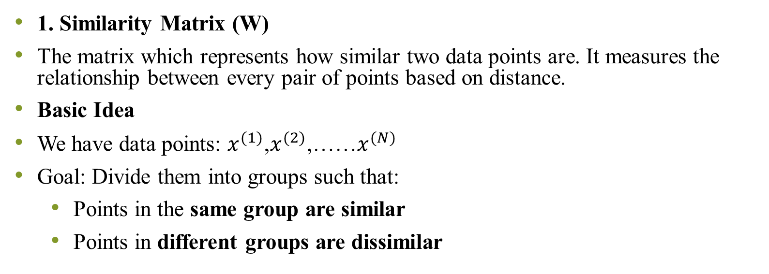
Key concept
1. Similarity Matrix (W)
The matrix which represents how similar two data points are. It measures the relationship between every pair of points based on distance.
Basic Idea
We have data points: $x^{(1)}$,$x^{(2)}$,……$x^{(N)}$
Goal: Divide them into groups such that:
Points in the same group are similar
Points in different groups are dissimilar

Slide 5
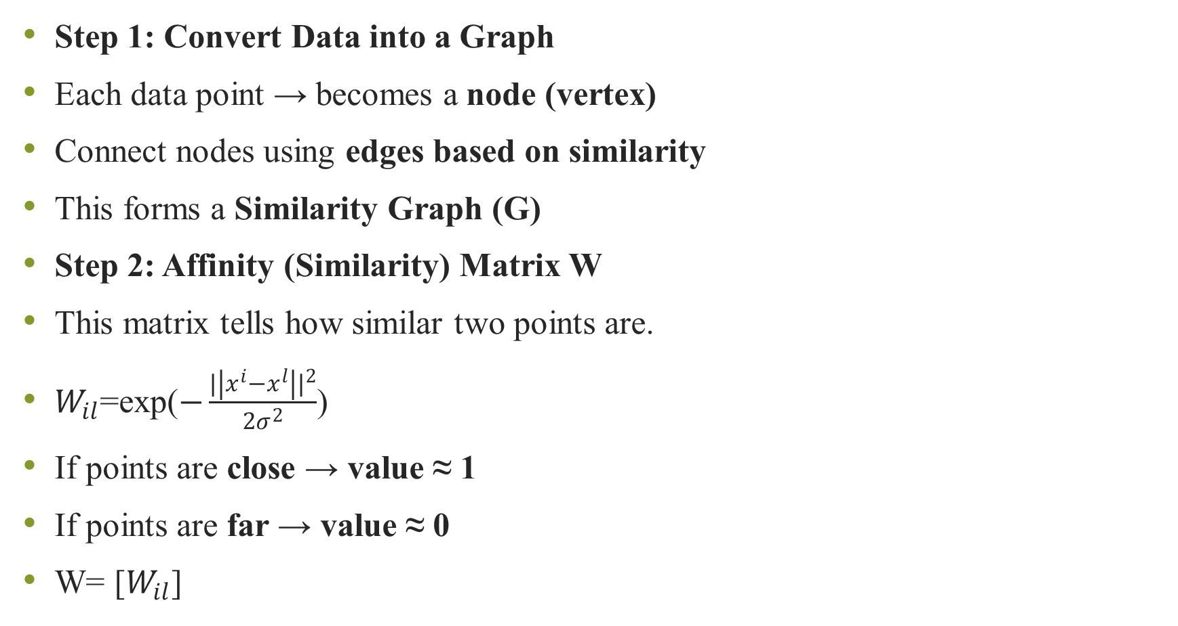
Step 1: Convert Data into a Graph
Each data point → becomes a node (vertex)
Connect nodes using edges based on similarity
This forms a Similarity Graph (G)
Step 2: Affinity (Similarity) Matrix W
This matrix tells how similar two points are.
$W_{il}$=exp($−\frac{{|\left|x^{i}−x^{l}\right||}^{2}}{{2σ}^{2}}$)
If points are close → value ≈ 1
If points are far → value ≈ 0
W= [$W_{il}$]

Slide 6
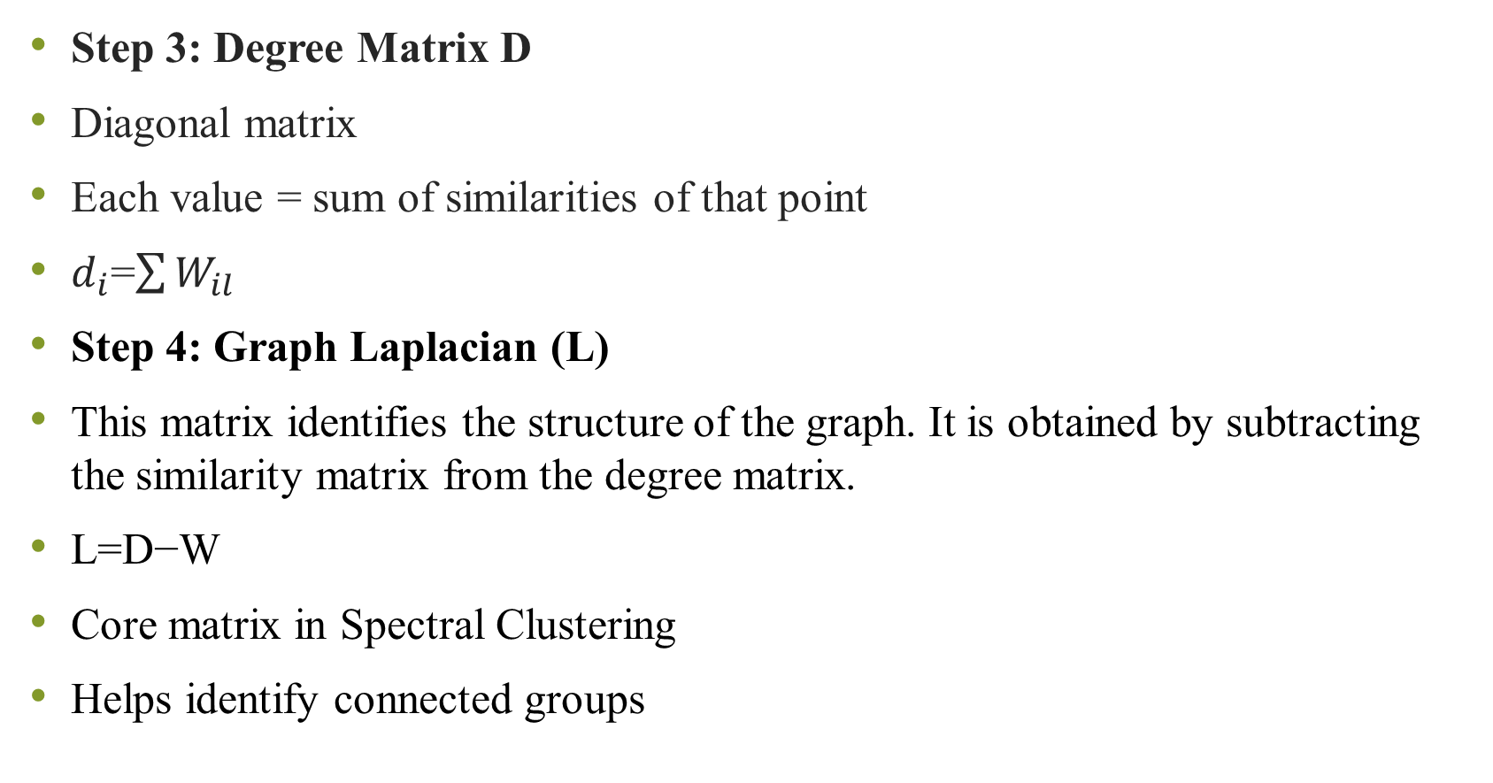
Step 3: Degree Matrix D
Diagonal matrix
Each value = sum of similarities of that point
$d_{i}$=$\sum{W_{il}}$
Step 4: Graph Laplacian (L)
This matrix identifies the structure of the graph. It is obtained by subtracting the similarity matrix from the degree matrix.
L=D−W
Core matrix in Spectral Clustering
Helps identify connected groups

Slide 7
Step 5: Eigenvalues & Eigenvectors
These are mathematical tools used to extract important patterns from the data. They help transform the data into a new space where clusters become clearer.
Used for dimensionality reduction
Makes clusters easier to separate
Here, data is transformed into a new lower-dimensional space where points from same cluster move closer.
Step 6: We apply K - Means algorithm where clusters become easy to detect.

Slide 8
A Simple Example: The Two Moons
This is the classic case where Spectral Clustering shines.
1. The Original Data: Imagine two intertwined crescent moon shapes.
2. Why K-Means Fails: K-Means will try to find two “center points.” It will likely split each moon in half and group the closest halves together, completely failing to identify the two distinct moons.

Slide 9
How Spectral Clustering Succeeds
Step 1 (Graph): It builds a graph where points within the same moon have strong connections, but there are almost no connections between the two moons.
Step 2–3 (Laplacian & Eigenvectors): It computes the eigenvectors. The most important eigenvector (called the Fiedler vector) will assign positive values to all points in one moon and negative values to all points in the other moon.
Step 4 (Embedding): It creates a new 1D representation of the data. All points from the first moon are now clustered around a positive number, and all points from the second moon are clustered around a negative number. They are now perfectly separated.
Step 5 (K-Means): Running K-Means on this new 1D data is trivial. It will find the two clusters perfectly.

Slide 10
